Slide 1
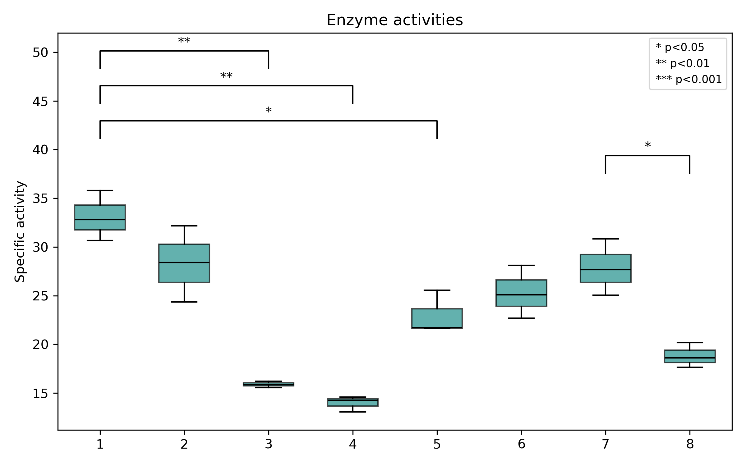
Batch B
fresh
new substrate
Batch B
fresh
old substrate
Batch B
stored on gly
new substrate
Batch B
stored no gly
new substrate
Batch A
fresh
new substrate
Batch A
fresh
new substrate
Batch B
fresh
new substrate
Batch B
fresh
new substrate
pH7
Experiment 1
Experiment 2

