Slide 1
Quick Tips + Stage 3/4 Overview

Slide 2
Stage 2 Feedback
You will receive feedback about Stage 2 early next week.
Part of the feedback will be your Stage 3 Specification.
Lists the features you are being asked to implement.
In most cases, this will just be the other 2/3 of your project.
In other cases we will be cutting the scope of your project.

Slide 3
Stage 3 Maximum Attainable Grade
After Stage 2, your progress as a team will be used to set a maximum attainable grade on the Software Evaluation component of Stage 3 as follows:
No cuts or minor cuts: 100% or 17.5 marks available
Several cuts: 90% or 15.75 marks available
Major/extensive cuts: 80% or 14 marks available
This clause essentially allows your team to pay a small price for simplifying your project.

Slide 4
Stage 3 Maximum Attainable Grade
If your project has cuts, you can still earn 100% marks
Implement the features that were cut, and you can get up to 100%
If you choose not to implement those features – there will be no further penalties. Just focus on getting the remaining features working.

Slide 5
Stage 3
Due Friday March 24th at midnight via GitHub.
Stage 3 is your final software submission.
Additionally:
Minor website updates
Close Issues on GitHub
Update README.md

Slide 6
Acceptance Testing
Details
March 27th to 31st
30 to 45 minute sessions
Schedule and location TBA
Each team will:
Introduce the team and project
Build and run
Demonstrate and test functionality of all user stories/features
Answer questions about the development process, tools, team, etc.

Slide 7
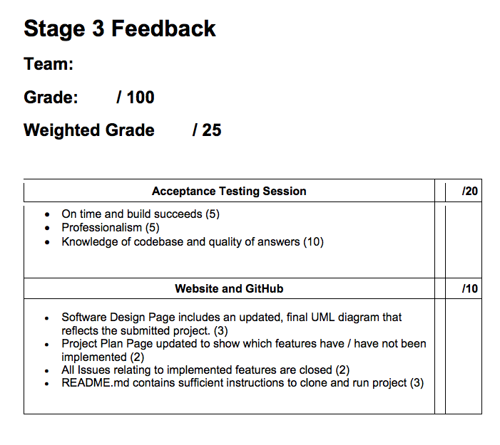
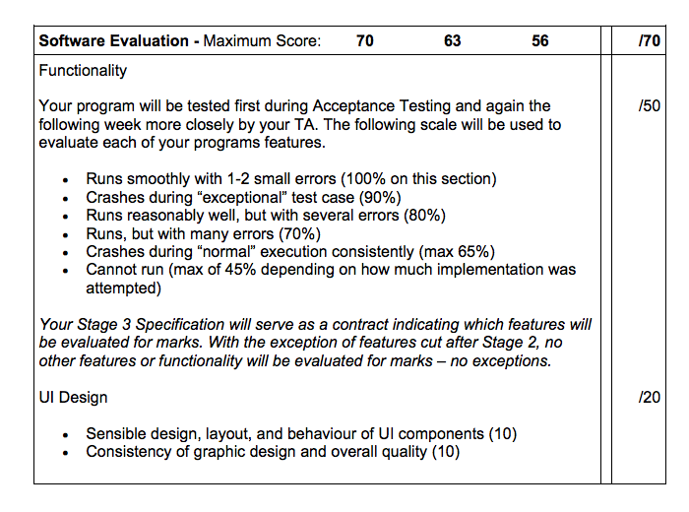

Slide 8
Stage 4
Due Friday April 7th at midnight via GitHub and YouTube.
New website page: Project Retrospective (all point-form, brief)
Workflow
MVC / Design Patterns
Refactor Retrospective
Project Retrospective
Video Demonstration
2 – 4 minute video to showcase your project posted to YouTube
Final updates to README.md
Final touches to developer-friendly instructions about how to install and run your project for the purpose of extension or collaboration

Slide 9
Plan
Lectures will continue as usual for the next 3 weeks.
Software Process Management, Software Testing, Intro to ML (time-dependent)
During the week of March 27th to 31st, no lectures due to Acceptance Testing.
During the week of April 3rd to 7th, no lectures… use the time to finish things up and get ready for exams.

Slide 10
Extras
DB persistence in Grails
environments:
# development:
# dataSource:
# dbCreate: create-drop
# url: jdbc:h2:mem:devDb;MVCC=TRUE;LOCK_TIMEOUT=10000;DB_CLOSE_ON_EXIT=FALSE
# Changing the development dataSource parameters enables persistence with Hibernate
development:
dataSource:
dbCreate: update
url: jdbc:h2:./devDB
basically just change the commented-out code with the new code in /conf/application.yml

Slide 11
Extras
Authentication – Unauthiorized User Access
--- grails: plugin: springsecurity: securityConfigType: 'Annotation' filterChain: chainMap: - pattern: '/api/signup' filters: 'anonymousAuthenticationFilter,restExceptionTranslationFilter' - pattern: '/api/**' filters: 'JOINED_FILTERS,-anonymousAuthenticationFilter,-exceptionTranslationFilter,-authenticationProcessingFilter,
-securityContextPersistenceFilter,-rememberMeAuthenticationFilter' - pattern: '/**' filters: 'anonymousAuthenticationFilter,restExceptionTranslationFilter'
/conf/application.yml

Slide 12
Extras
Authentication – Unauthiorized User Access
grails.plugin.springsecurity.controllerAnnotations.staticRules = [ [pattern: '/assets/**', access: ['permitAll']], [pattern: '/**/js/**', access: ['permitAll']], [pattern: '/**/css/**', access: ['permitAll']], [pattern: '/**/images/**', access: ['permitAll']], [pattern: '/**/favicon.ico', access: ['permitAll']] ]
/conf/application.groovy
Changes in both configuration files (application.yml and application.groovy) are necessary to allow an unauthorized user to access your controllers. For example in this AuthenticationTutorial example, an unauthorized user needs to be able to access the signup features.

