Slide 1

Tornado
Warriors

Slide 2
PHOTO BOOTH CAMERA

Slide 3
Raspberry PI & Ardu camera
OpenCV
Python
Pre-trained classifiers for face, eye and smile detection

Slide 4
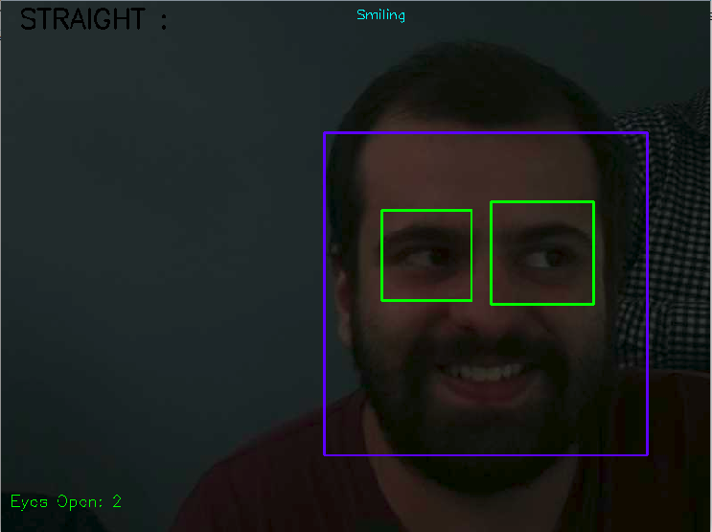
Identify and store the center of each box, assuming that the center of the bounding box is the same as the center of the eye

Slide 5
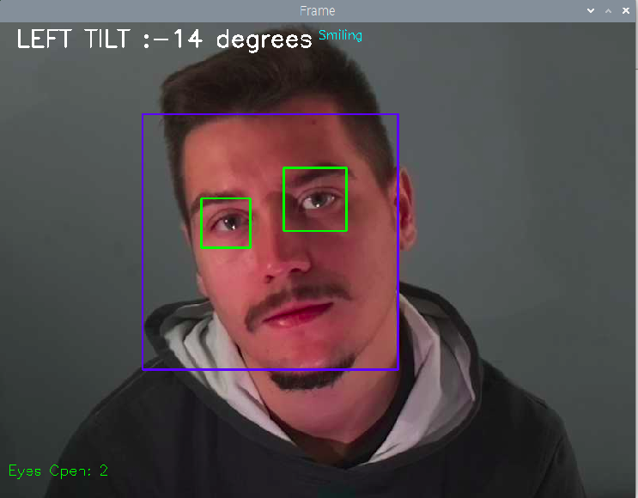
For computing the angle of tilt we assume that the line joining the centers of two eyes is perpendicular to the face
The angle made by the line joining the centers of two eyes with the horizontal is computed. The positive angle indicates the right tilt and the negative angle indicates the left tilt.

Slide 6
