Slide 1
Fetal Health Classification
Sai Meghana Reddy, Chukka (11602012)
Vidhyalakshmivaraprasad Bathina (11610484)
SaiReeshma, Kilaru (11611407)
Pavan, Yarlagadda (11658983)
Group - 30

Slide 2



Introduction
Project overview
Libraries
Methodology

Slide 3
Project Overview
Motivation: Addressing global health concerns of child and maternal mortality by leveraging CTGs for early and accurate fetal health assessment.
Goals and Objectives:
Develop a Machine Learning model for classifying CTG records.
Perform data preprocessing and feature selection for optimal model training.
Evaluate model using metrics like accuracy, precision, recall, F1-score, and ROC-AUC.
Significance: Contributing to the UN's Sustainable Development Goals by reducing child and maternal mortality, especially in low-resource settings.
Features Analyzed: Including Baseline Value, Accelerations, Fetal Movement, Uterine Contractions, Decelerations, Variabilities, and Histogram Parameters.
Deliverables:
A robust Machine Learning model for CTG classification.
A user-friendly interface for healthcare professionals.
Comprehensive documentation and performance metric reports.
Milestones: Covering Data Collection and Preprocessing, Model Development, Testing, Validation, Model Evaluation, and User Interface Development.

Slide 4
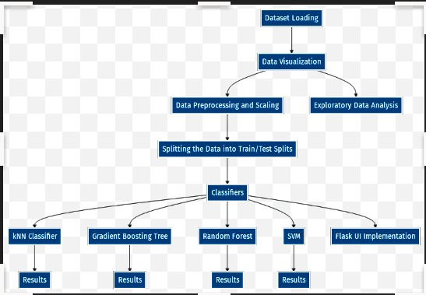
Data workflow:

Slide 5
Libraries
scikit-learn (SVM, Train-Test Split, Metrics): Central for creating the SVM model, splitting the data, and calculating performance metrics like precision, recall, and F1-score.
NumPy: Essential for numerical operations, especially handling arrays and matrix operations required in data processing and model input.
pandas: Useful for data manipulation and analysis, particularly in handling and preprocessing the dataset.
Matplotlib & seaborn: For data visualization, such as plotting ROC curves or visualizing other statistical information.
Flask: The core framework for building the web application. It handles HTTP requests, routing, and rendering templates.
HTML/CSS: Not libraries but essential technologies for creating and styling web pages.

Slide 6
Data Overview
The dataset comprises 2,126 rows and 22 columns, offering a substantial sample size for analysis.
We will concentrate on essential attributes that have a significant impact on fetal health predictions.
These chosen attributes contain critical information for our analysis and prediction model.
By narrowing our focus, we aim to simplify the dataset exploration process.
Our primary objective is to predict "Fetal Health" based on these key attributes.
Understanding these dataset characteristics is crucial for accurate predictions and insights.

Slide 7
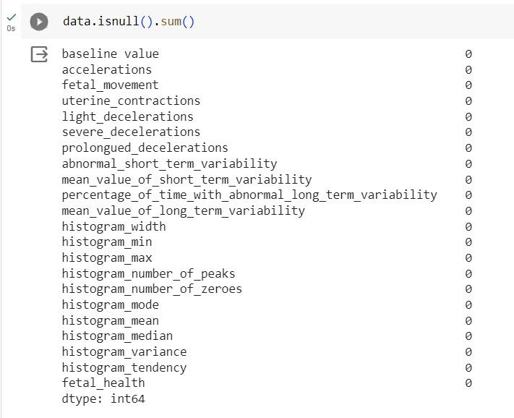
Data Cleaning
Checking Missing values from the data.

Slide 8
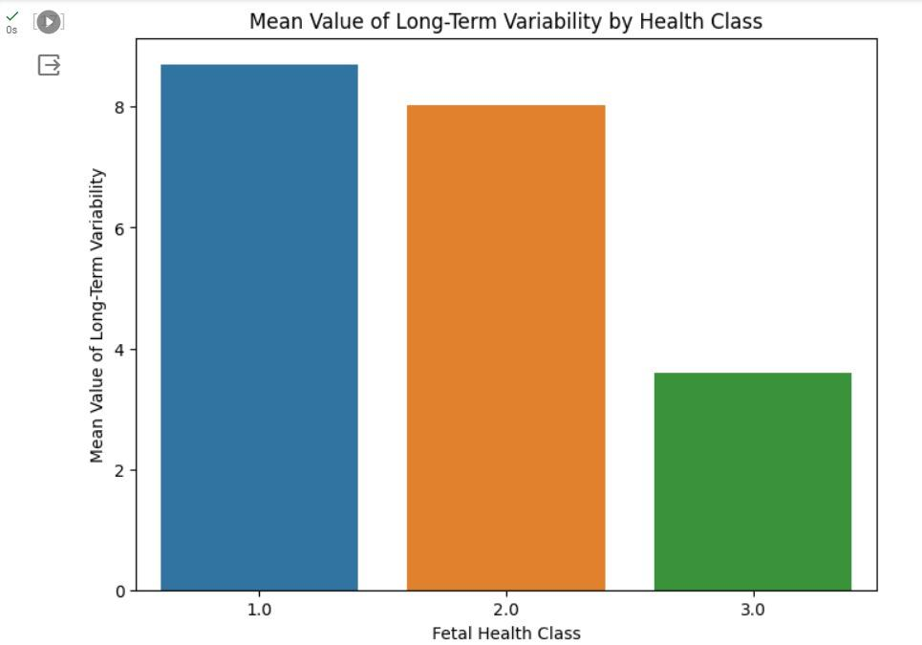
Countplot of Fetal Health Classes
This countplot visualizes the distribution of fetal health classes in the dataset.
It helps us understand the balance or imbalance between different health classes.
Class distribution insights are vital for model training and evaluation.

Slide 9
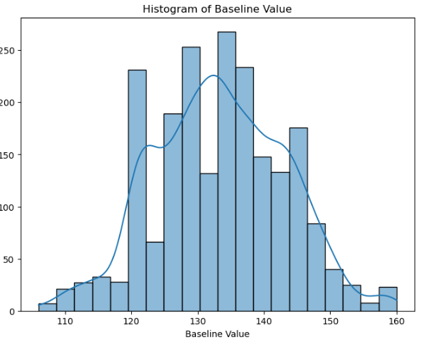
Histogram of Baseline Value
This histogram illustrates the distribution of the "Baseline Value" attribute.
It provides insights into the range and frequency of baseline values in the dataset.
Understanding this feature's distribution is essential for feature engineering.

Slide 10
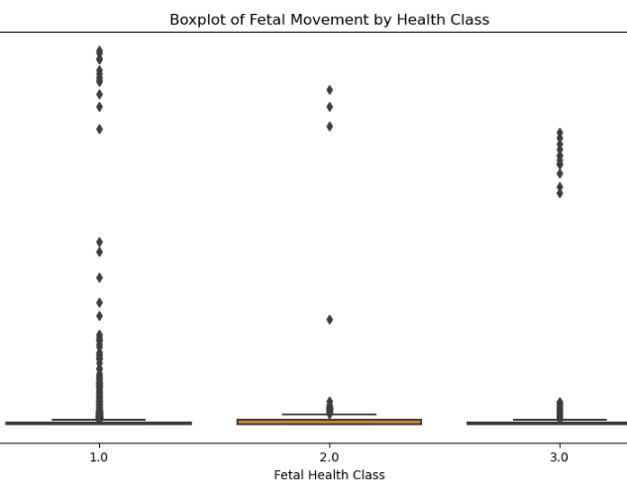
Boxplot of Fetal Movement by Health Class
This boxplot visualizes the distribution of "Fetal Movement" across different fetal health classes.
It helps identify variations in fetal movement for different health conditions.
Understanding this relationship is crucial for predictive modeling.

Slide 11
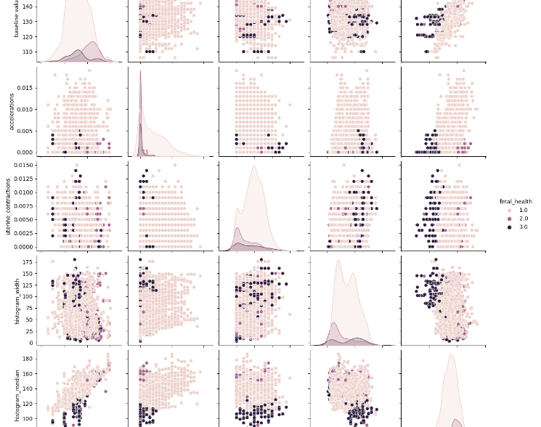
Pairplot of Selected Features
This pairplot explores the relationships between selected features and fetal health classes.
It allows us to visualize feature distributions and their separability for classification.
Understanding feature interactions is essential for feature selection and modeling decisions.

Slide 12
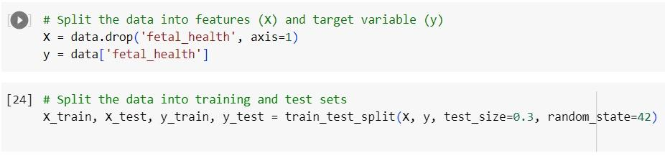
Data Preparation and Model Initialization
The dataset is divided into features (X) and the target variable (y), focusing on 'fetal_health'.
70% of the data is used for training and 30% for testing, ensuring a balanced approach to model training and evaluation.
An SVM classifier with a linear kernel is chosen, ideal for this dataset's complexity and size.
Regularization parameter (C) is set to 1.0, balancing the trade-off between smooth decision boundary and classifying training points correctly.
A fixed random state (42) ensures reproducibility of results across multiple runs.
The model is configured to estimate probabilities, essential for ROC curve analysis.

Slide 13
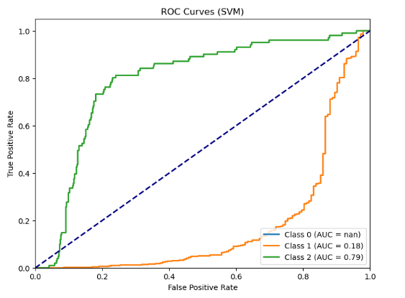
ROC Curve Analysis and Visualization
SVM predicts probabilities for each class, providing a basis for ROC analysis.
ROC curves are calculated for each class, measuring the model's ability to distinguish between classes.
The Area Under the Curve (AUC) is computed for each class, a single measure of model performance.
ROC curves are plotted, visually representing the model's diagnostic ability.
reference line at 0.5 AUC indicates the performance of a random classifier.
An UndefinedMetricWarning indicates potential issues in class representation.

Slide 14
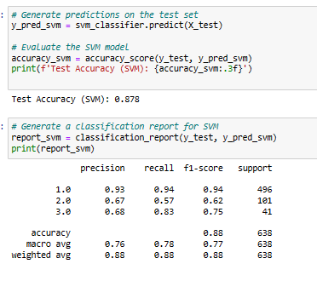
Model Evaluation Metrics
The model achieves an accuracy of 87.8%, indicating high overall performance.
Precision and recall are calculated, providing insights into model's ability to identify positive class samples accurately.
F1-scores balance precision and recall, crucial for unbalanced datasets.
These averages provide insights into the model's performance across all classes.
The model shows varying degrees of effectiveness across different classes.
The classification report summarizes key metrics, giving a holistic view of model performance.

Slide 15
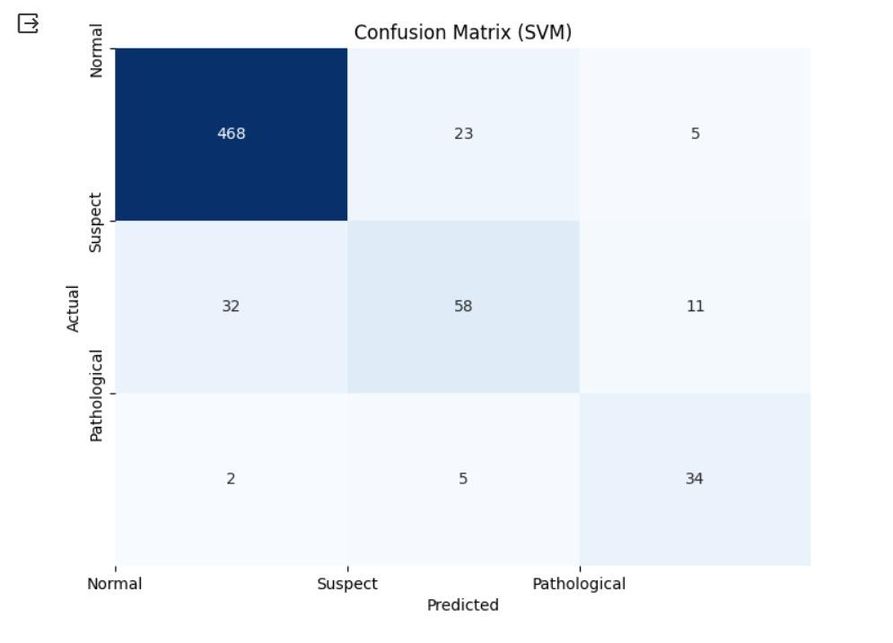
Confusion Matrix and Interpretation
The confusion matrix visually represents the accuracy of predictions versus actual values.
A heatmap is used for easier interpretation of the confusion matrix.
Axis labels ('Predicted' and 'Actual') and class labels ('Normal', 'Suspect', 'Pathological') enhance readability.
Counts of true positives, false positives, true negatives, and false negatives are provided.
The heatmap highlights how often each class is misclassified.
This visual tool helps in identifying the model's strengths and areas for improvement in diagnosing fetal health.

Slide 16
Random Forest
Employed a Random Forest classifier with 100 trees to predict fetal health, achieving an impressive test accuracy of 94.4%.
The classification report highlights precision, recall, and F1-score for each fetal health class, offering insights into model performance. Notably, it excels in predicting 'Normal' fetal health.
Visualized the confusion matrix with a heatmap, providing a clear overview of model predictions versus actual fetal health categories, aiding in identifying potential areas of improvement.
Split the dataset into training and test sets, allocating 70% for training and 30% for testing, maintaining reproducibility with a random state of 42.
Demonstrated the importance of evaluating the model's performance using accuracy and classification metrics to ensure its suitability for the task.
Added the Random Forest model, along with its accuracy, to a collection of models for comparison, aiding stakeholders in selecting the best model for fetal health prediction.

Slide 17
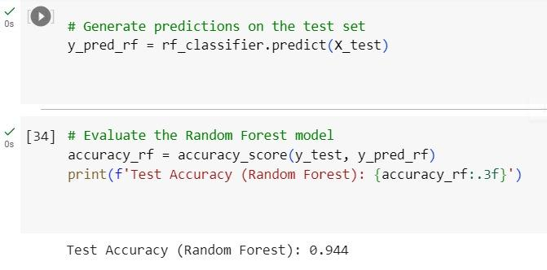
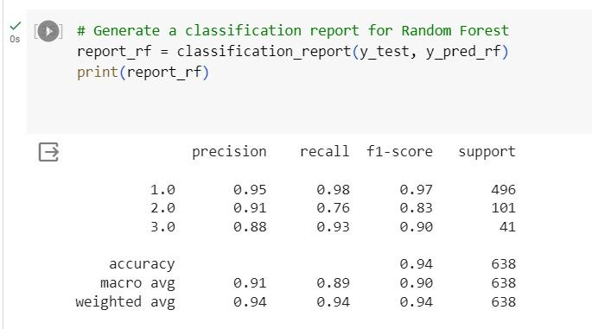
Random Forest- model evaluation metrices

Slide 18
Gradient Boosting
Implemented a Gradient Boosting classifier with 100 estimators for fetal health prediction, achieving a commendable test accuracy of 95.5%.
Presented a detailed classification report containing precision, recall, and F1-score metrics for each fetal health class. The model excels in identifying 'Normal' fetal health cases.
Visualized the confusion matrix with a heatmap, providing a clear overview of model predictions versus actual fetal health categories. This aids in assessing the model's strengths and weaknesses.
Employed a consistent data splitting approach, reserving 70% of the dataset for training and 30% for testing, ensuring replicable results with a random state of 42.
Highlighted the significance of evaluating model performance using accuracy and comprehensive classification metrics, ensuring the model's reliability in predicting fetal health.
Added the Gradient Boosting model to the collection of models for comparison, enabling stakeholders to make informed decisions about the most suitable model for fetal health prediction.

Slide 19
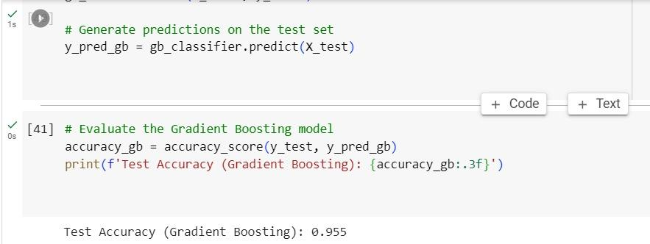
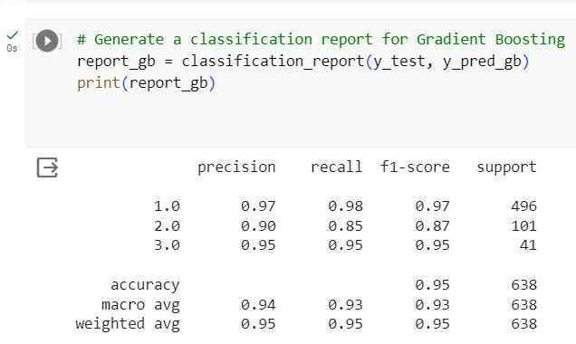
Gradient Boosting- model evaluation metrices

Slide 20
K-Nearest Neighbors (KNN)
Utilized the KNN algorithm to build a classifier for fetal health prediction. The model's default setting, with 5 neighbors, achieved a test accuracy of 87.6%.
Presented a comprehensive classification report containing precision, recall, and F1-score metrics for each fetal health class. The model performs well in identifying 'Normal' fetal health cases but has limitations in classifying 'Suspect' and 'Pathological' cases.
Visualized the confusion matrix with a heatmap, offering a clear representation of model predictions compared to actual fetal health categories. This aids in understanding the model's performance and areas of improvement.
Maintained a consistent data splitting approach, allocating 70% of the dataset for training and 30% for testing, ensuring reproducible results with a fixed random state of 42.
Emphasized the importance of evaluating model performance using accuracy and comprehensive classification metrics to ensure its reliability in predicting fetal health.
Added the KNN model to the collection of models for comparison, enabling stakeholders to make informed decisions about the most suitable model for fetal health prediction.

Slide 21
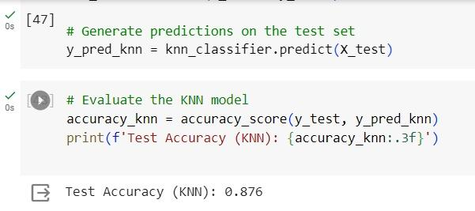
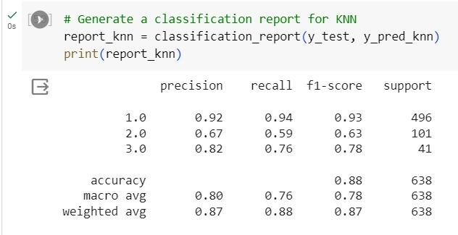
(KNN)- model evaluation metrices

Slide 22






Hyperparameter
Employed GridSearchCV to fine-tune hyperparameters for both the Random Forest and Gradient Boosting classifiers, enhancing their predictive performance.
Conducted a hyperparameter search for the Random Forest classifier, exploring various combinations of parameters such as the number of estimators, maximum depth, minimum samples split, and minimum samples leaf. The best model achieved a test accuracy of 93.9%.
Revealed the optimal Random Forest model with hyperparameters: minimum samples split of 5, 200 estimators, and a random state of 42. This model demonstrated its effectiveness in predicting fetal health with a 93.9% test accuracy.
Conducted hyperparameter tuning for the Gradient Boosting classifier, exploring parameters like the number of estimators, learning rate, and maximum depth. The best Gradient Boosting model achieved a test accuracy of 95.0%.
Unveiled the best-performing Gradient Boosting model with hyperparameters: maximum depth of 4 and a random state of 42. This model excelled in fetal health prediction, boasting a test accuracy of 95.0%.
Demonstrated how hyperparameter tuning can significantly enhance model accuracy, ensuring that the selected models are optimized for the task of fetal health prediction.

Slide 23
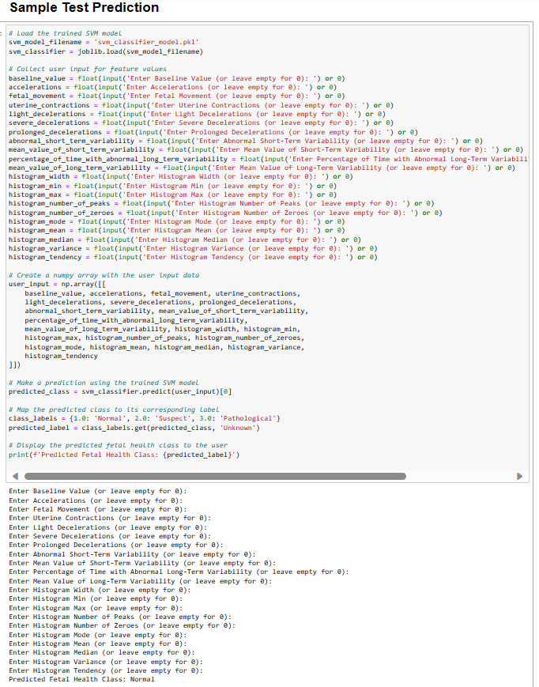
Test Prediction Process
The pre-trained SVM model is loaded, and the user is prompted to enter various fetal health parameters.
User inputs for 21 features, including baseline value, accelerations, fetal movement, and various histogram parameters, are collected.
The input data is transformed into a numpy array, and the SVM model predicts the fetal health class based on this data.
The predicted numeric class is mapped to a corresponding label: 'Normal', 'Suspect', or 'Pathological'.
The system outputs the predicted fetal health class, providing an immediate, user-friendly diagnosis based on the entered data.

Slide 24
Best Model Accuracies
ML Model | Accuracy in percentage
SVM | 87.77
Random Forest | 94.36
Gradient Boosting | 95.45
KNN | 87.62
Hyperparameter tuning accuracies
Model | Accuracy
Random Forest | 93.9
Gradient Boosting | 95.0

Slide 25
UI Implementation
1
2
3
4
5
6
7
8
A Flask web application is created, serving as the interface for the SVM model's fetal health prediction.
Once we run flask code it load a weburl https://127.0.0.1:5000
The pre-trained SVM model is loaded using Joblib, allowing for efficient prediction based on user inputs.
The app's main route ('/') accepts both GET and POST requests, handling user inputs through a web form.
User inputs for 21 fetal health features are collected from the form, converted to floats, and structured as a numpy array.
The SVM model predicts the fetal health class and calculates a prediction score based on the input data.
Depending on the prediction, the app displays the result on 'result.html' or an error message on 'error.html'.
This Flask application provides a user-friendly web interface, making SVM model predictions accessible to non-technical users.

Slide 26
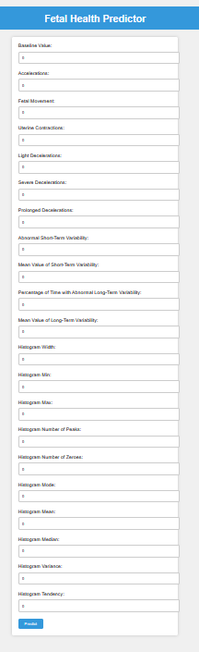
UI for Fetal Health Predictor
The page is titled "Fetal Health Predictor" with a clean and user-friendly design using CSS for styling.
A central form with input fields for various fetal health parameters ensures easy data entry for users.
Each parameter like baseline value, accelerations, fetal movement, etc., has a dedicated, clearly labeled input field.
Input fields are of type 'number' with a default value of '0', allowing for precise data entry.
A submit button styled with CSS provides a clear and accessible way for users to initiate the prediction process.
The use of colors, padding, and borders in the design enhances readability and user engagement with the interface.

Slide 27
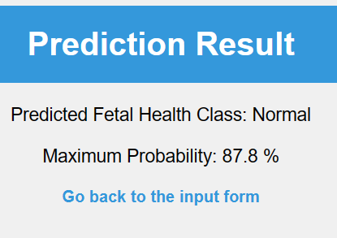
Results and Error UI
The result page, titled "Fetal Health Predictor - Result", displays the prediction with a clean and minimalistic design.
Predicted fetal health class and maximum probability are prominently displayed, providing clear and immediate feedback to the user.
A link to return to the input form enhances user experience, encouraging continuous interaction and exploration of the application.
The error page, simply titled "Error", uses a straightforward design to communicate issues clearly and effectively.
Specific error messages are displayed to the user, aiding in understanding what went wrong during the prediction process.
Both pages maintain a consistent design language with the main form, ensuring a cohesive user experience throughout the application.

Slide 28
Conclusion
After rigorous evaluation, the Gradient Boosting model stands out as the top choice for fetal health prediction, boasting an impressive accuracy of 95.45%. This underscores the importance of selecting the most accurate model to ensure the highest quality healthcare decision support.
The hyperparameter-tuned Random Forest model, with a test accuracy of 93.9%, demonstrates its robustness and consistency in fetal health prediction. This reliability makes it a valuable option for healthcare professionals seeking dependable predictive tools
The Flask UI is designed with the user in mind, featuring intuitive forms for data input and clear presentation of results, enhancing accessibility and usability.
The model effectively handles multiple classes, with notable precision and recall in distinguishing between normal, suspect, and pathological fetal health conditions.
The inclusion of a dedicated error page in the Flask app ensures a smooth user experience, even in cases of input or processing errors.
This combination of web technology and machine learning paves the way for advanced, accessible healthcare solutions, potentially improving prenatal care and outcomes.

Slide 29
Comparison
Compared to other standard projects, our deadly health classification system uses KNN classifiers, Gradient Boosting, Random Forest, and SVC in a novel way. It is specifically engineered to identify and forecast important health hazards, with an emphasis on identifying life-threatening illnesses as opposed to broad health trends.
This method provides vital information for healthcare decision-making and provides a more accurate, perhaps life-saving analysis. This is a huge advancement in predictive healthcare, combining cutting edge technology with a thorough comprehension of human health requirements.

Slide 30
References
Link : Fetal Health Classification Based on Machine Learning | IEEE Conference Publication | IEEE Xplore
Link : Fetal Health Classification Using Supervised Learning Approach | IEEE Conference Publication | IEEE Xplore
Link : [PDF] Ensemble Learning for Fetal Health Classification | Semantic Scholar

Slide 31
Contribution
Team Member | Contribution | Percentages
Vidhyalakshmivaraprasad Bathina | Data Preprocessing, Data Analysis and svm classifier implementation | 25%
Sai Meghana Reddy, Chukka | Exploratory data analysis, visualizations and KNN classifier implementation. | 25%
Sai Reeshma, Kilaru | Random forest classifier and gradient boost classifier implementation, Flask web app implementation. | 25%
Pavan, Yarlagadda | Hyperparameter tunning for random forest and gradient boost classifiers, UI Implementation | 25%

Slide 32
Presentation video link:
https://drive.google.com/file/d/1oi9tV6BW5LqkpoSNcmSkAXNbLwgoAZZU/view?usp=sharing

