Slide 1
MRA TAXPAYER SYSTEM

Slide 2
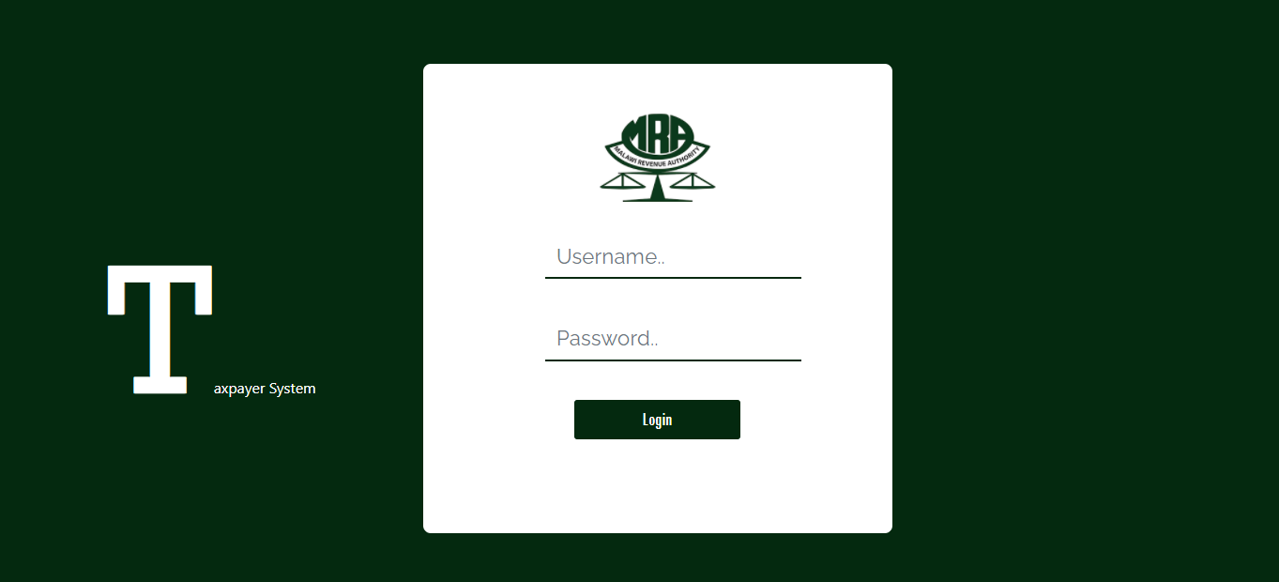
LOGIN
Login page that requires a Username and Password for the officers to log in.
Upon approval of credentials, they are given access to the dashboard.

Slide 3
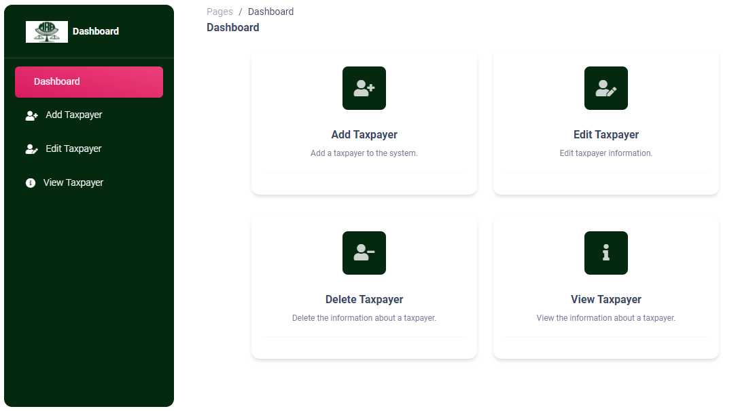
DASHBOARD
The officer dashboard includes four options :
ADD TAXPAYER
EDIT TAXPAYER
DELETE TAXPAYER
VIEW TAXPAYER

Slide 4
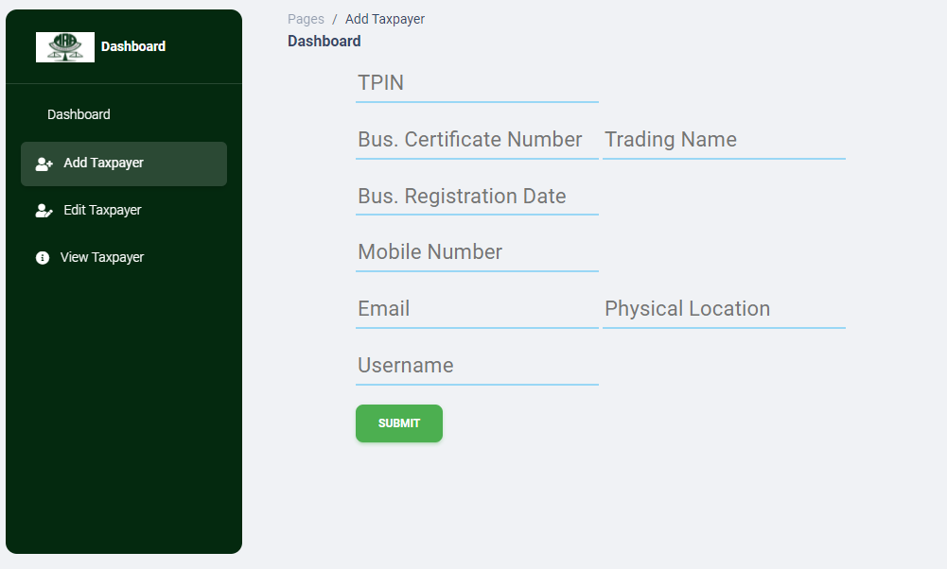
ADD Taxpayer
This is the ADD TAXPAYER menu that requires user information in order to create a new entity in the database with taxpayer information.
Upon clicking ‘Submit’ the data is sent for verification and a response is given.

Slide 5
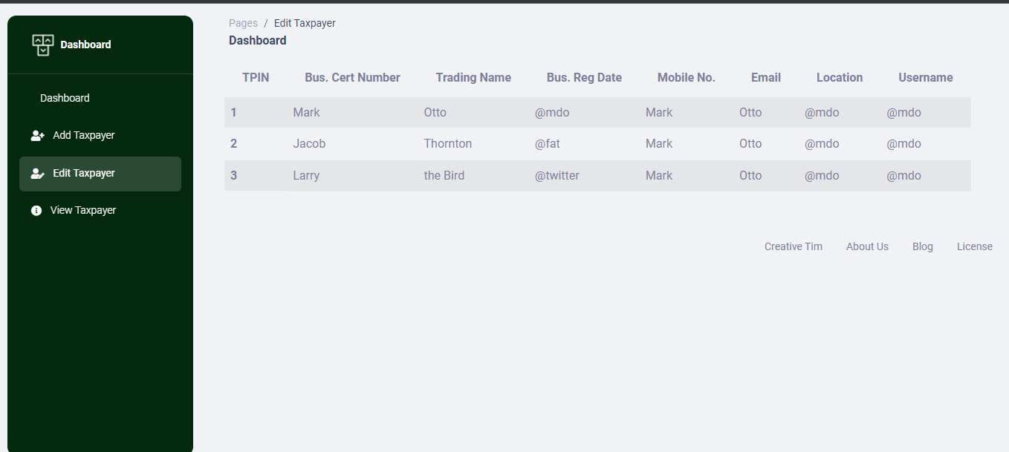
VIEW Taxpayer
The view taxpayer screen allows the officer to view all the data stored in the system.

