Slide 1

AI & MRI
Improving Model Opinion Interpretability:
Similarity Measurement of Input to Average Training Data
(SMI2ATD)
Gonçalo Carvalho
s3450295
Notes:
Hello everyone. My name is Goncalo, I am a 4th year AI student at the RUG who picked a thesis in conjunction with the UMCG. I am going to present what I have been working on for the thesis which is also my internship at the umcg.

Slide 2
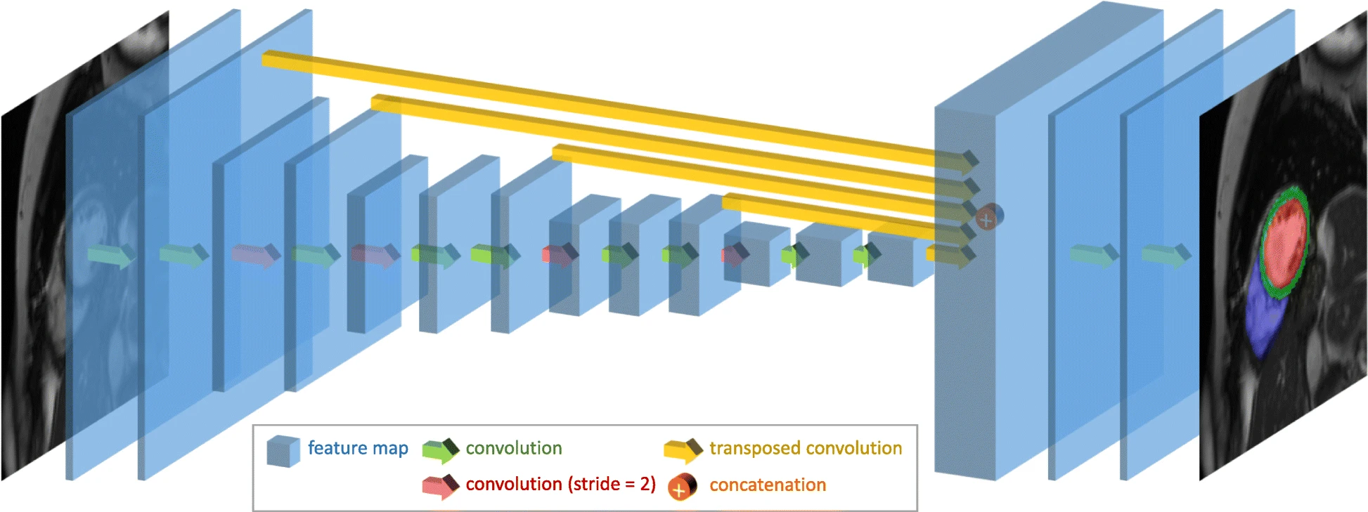

MRI in - semantic segmentation out
The encoder part is inspired by the VGG16 and the decoder part was designed for this medical application
Notes:
What I am doing would probably fall under AI interpretability and generalizability.
This image is a representation of a CNN architecture, the model itself was trained on the Uk Biobank dataset as developed by Bai et al. from the paper and research that I am using as a basis for my thesis - it was developed in a collaboration between 4 Biomedical groups in the UK. I will go over the relevant contents of the data later on.
I am trying to create a training-independent technique to further substantiate the quality of model output - this is basically a measurement like a p-value that conveys how familiar the model is with some input image, I am to retrain Bais pipeline on UMCG data and see if it generalizes to it properly under common measurements. The main focus of my thesis is then to create a training-independent technique that yields a measurement that should elucidate how familiar the model is with a new image by measuring the difference between it and the training dataset used to train the model.

Slide 3
Relevant Problems
It needs a lot Data (labelled by experts at the pixel level);
Different hospitals use different MRI devices;
Input data needs to be evaluated before being sent to the network (garbage in garbage out);
Multiple methods are necessary in the pipeline;
Results are not explainable;
Notes:
Why this useful? 5 reasons at least, the fact that current methods need a lot of data that is labelled by experts, making it expensive and time consuming. Another problem is in training networks that don’t generalize properly cross hospitals due to different MRI devices and protocols. The fact that input data needs to be evaluated before being sent to the network and this often leads to situations where garbage goes in so garbage must come out - we dont understand the output of either model. Multiple methods are necessary to run these pipelines properly (for example, support vector machines are a common choice as a initial evaluator of an images similarity to training set). And the results are just not explainable enough.

Slide 4
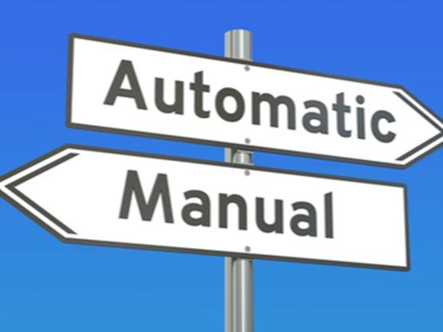
Why is this relevant in Medical Sciences?
Notes:
Automated methods make lots of sense in the medical sciences, since experts are looking for particular features in these MRI images, and these can be learned using AI. There are prospective applications and efforts in the ML research community that could improve and automate diagnosis, but these efforts are often cut short (rightly so) by Medical governing bodies and representatives on the basis of model interpretability and lack of generalizability.

Slide 5
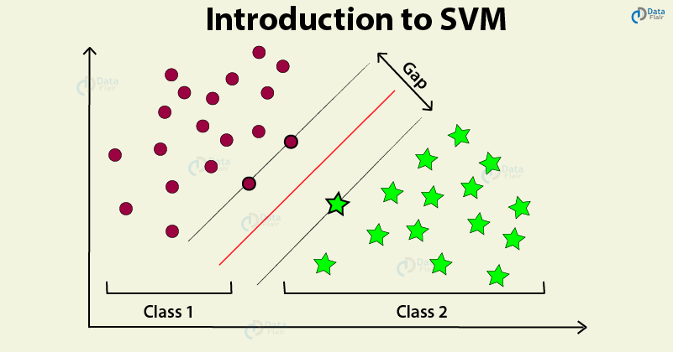
Why is this relevant in Medical Sciences?
Notes:
Another issue related to this is the current common use of models to verify familiarity with data. These are for example SVMs (Support Vector Machines) and other automatic techniques that often answer (yes or no) to the question "is this data similar enough to the training set?" before feeding a novel image to a trained model
These methods need to be retrained on new data every time they are used in different networks - just like the classification model they serve.

Slide 6
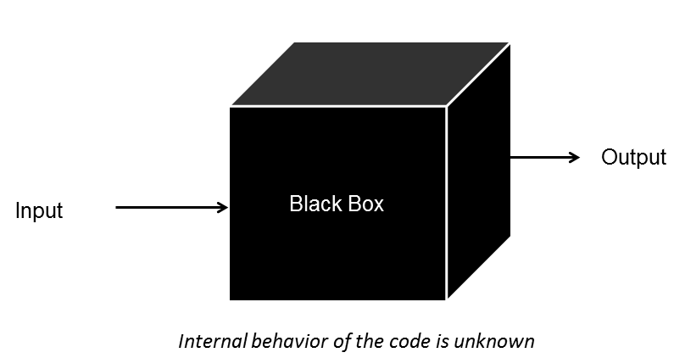
Why is this relevant in Medical Sciences?
Notes:
This binary check is still the outcome of a model that can be considered a black-boxe (blackbox is a term that refers mostly to models that involve complex computations that do not have an obvious causal chain readily understood by humans - so, most neural networks (you can think of the use of probabilities in these models or randomness, for example, which offuscate the reasoning behind classification).

Slide 7
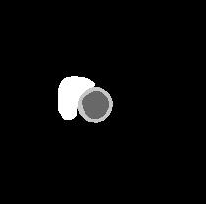
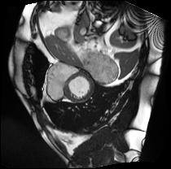
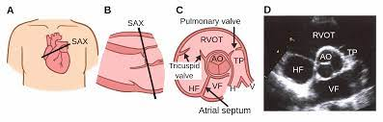
The data
RV
LV
RV
LV
fig 1. Ukbb SAX
segmentation RV & LV
fig 3. cross-sectional view for SAX
fig 2. Ukbb SAX RV & LV
Notes:
I will be using LV SAX images - image 3 shows how the cross-sectional view is acquired by using slices or frames of MRI diagonally or cross-sectionally to the heart.
The images themselves have been labelled by experts and the RV as well as the LV can be seen in the segmentations (both manual and automatically outputed by the model).

Slide 8
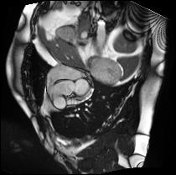
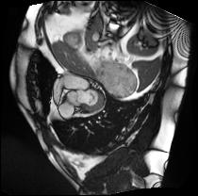
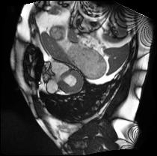
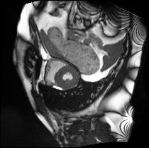
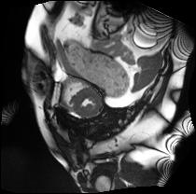
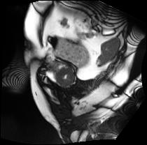
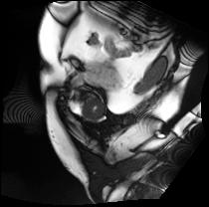
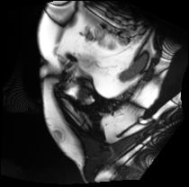
UKBB: End-Systolic (contract -> empties).
Muscle wall
Notes:
More specifically we re interested in the End-systolic cycle, which refers to the volume of blood in the ventricles during Systole, which itself occurs when the ventricles contract and blood flows out from the heart.
Notice how the muscle around the left ventricle is much thicker than in the end diastolic cycle

Slide 9
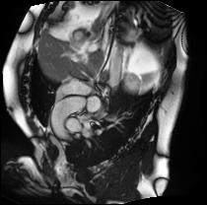
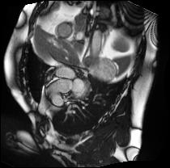
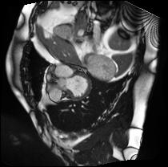
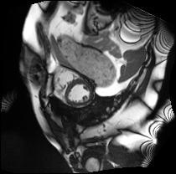
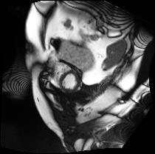
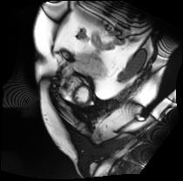
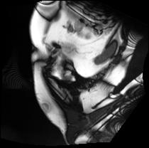
UKBB: End-Diastolic (relax -> fills up)
Muscle wall
Notes:
And the End-Diastolic cycle is when the ventricles relax and the heart fills with blood again

Slide 10
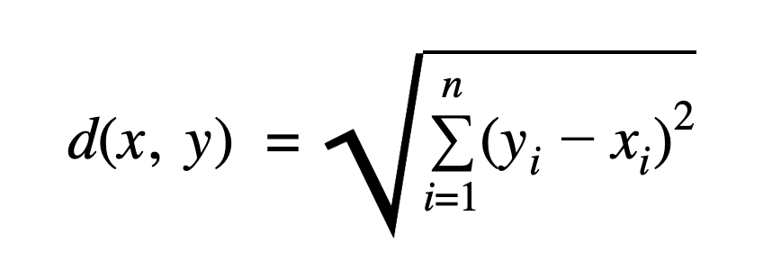
SMI2ATD
Towards improved Explainability
Euclidean distance
‘Is this sample similar enough to the training set?’
The Euclidean distance, or the square root of the sum of squares of the differences between corresponding elements of the vector.
ASSUMPTION: that the images do not differ too much from each other in terms of position (e.g. heart, perspective, position in the 2d plane).
Notes:
SO why the measurement SMI2ATD, why is this the focus of a thesis - because If it works, and as per Occams razor, it’s a simpler alternative to a whole model and it should give an even better indication theoretically speaking than a whole other model since it will solely depend on the main trained model. I ll explain this in the next slides.
IT answers the same question (‘Is this data similar enough to the training set?’ without needing training time - it's training independent - and only consists of arithmetic operations, more specifically the euclidean distance between reduced images..
And it tackles the problem of interpretability through this simplicity - no longer does a model need to be explained or understood since the model is removed and in its place a simpler well known operation : PCA followed by a distance measure, e.g. Euclidean distance is used instead, that is, the distance between two vectors is simply the averaged difference between each point of the vector.

Slide 11
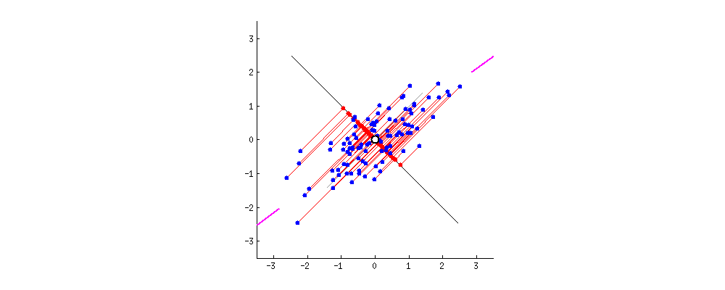
PCA
Dense Bottleneck Layer
(Acts in a similar way as PCA)
Finds the essential variation
Notes:
Most of you will be familiar with Principal component analysis - we can see from the cool looking gif, what is happening. And this is that we are summing the squared difference between points and repeating this until the line with the largest sum of squared distances between projected points and the origin is calculated. I’ll be using a PCA through sklearn in python fitted on 50% UMCG and 50% UKBB data, and this will reduce, hopefully with high fidelity, the images to vectors that can then be used to calculate distance measurements.
The benchmark in this thesis then involves showing that using the bottleneck layers of a trained model yields a better representation than the other more widely used method, the PCA. The bottleneck layer of the model is like a decoder or the first half of an autoencoder, where images get reduced to features or numbers in a vector. These two methods, PCA and bottleneck layer, will be deployed to obtain a feature vector of an input MRI. Then, the similarity measurement will be used on both to compare it to a prototype vector that represents the data set used for training. And since this is about model interpretability I think I should take the bottleneck layer of the trained model and use it as the general decoder to make this prototype vector. This is the same as calculating the centroid of the data using a k-means algorithm, where k=0. The experiment boils down to this then, the technique that generates the vector that is closer to the prototype vector is the best according to this quantitative measure.
What I expect to happen is that images not included in the UKBB dataset should have a large distance from the prototype and vice-versa: images from the UKBB dataset should show a short distance from the prototype. After training the model on UMCG data, the measurement will be deployed again and I expect it to have shortened for UMCG images.

Slide 12
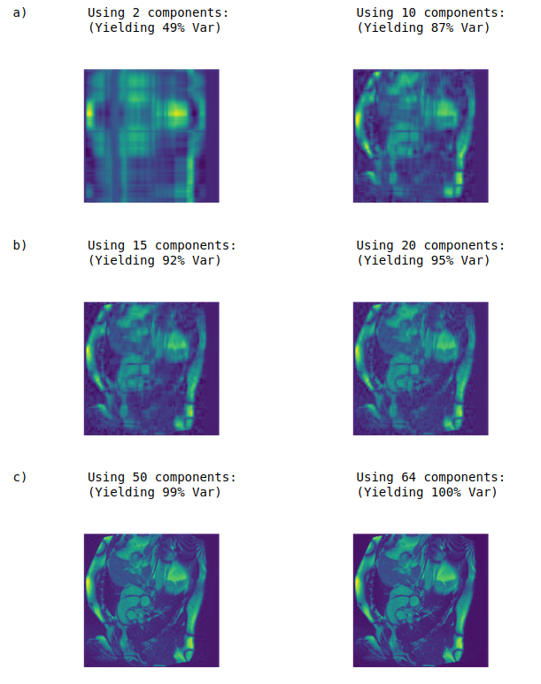
PCA Dimensional reduction
UKBB SAX
256 x 256 = 65536 pixels
Which can be squeezed to just 64 values and still yield a very detailed image
Notes:
The goal in PCA is to extract the important information from the data and to express this information as a set of summary indices called principal components, the definition of which is quite mathematical, I understand them to be the orthogonal lines that best fit the data out of all the points that make up the image - here you have a small visualization analysis that I did using a jupyter notebook. The less components the less information we have so the worst the reconstruction. HEre I think the max components was 100, so the fact that we only actually need half of those to get a pretty accurate image is impressive.
The more units in the bottleneck layer the more precise the representation, the tradeoff being its generalizability.

Slide 13

Transfer learning from UKBB data to UMCG data
Automatic segmentation
NIfTI image composed of dicoms and manual contours
Notes:
Like I said at the start, Bai and his fellow researchers took the VGG16 network trained on imageNet and decided to retrain the model on ukbb images after changing the encoder half of the model.
I will be using Bai’s model and retrain it on SAX LV UMCG data.
To do this I randomly split 100 subjects into two sets: 80 subjects for fine-tuning and 20 subjects for evaluation. Segmentation results will be compared before and after between automatic segmentation and hand-contours using The Dice overlap metrics
STOP NOTE THAT A convolution is a mathematical operation on two functions that produces a third function that expresses how the shape of one is modified by the other.

Slide 14
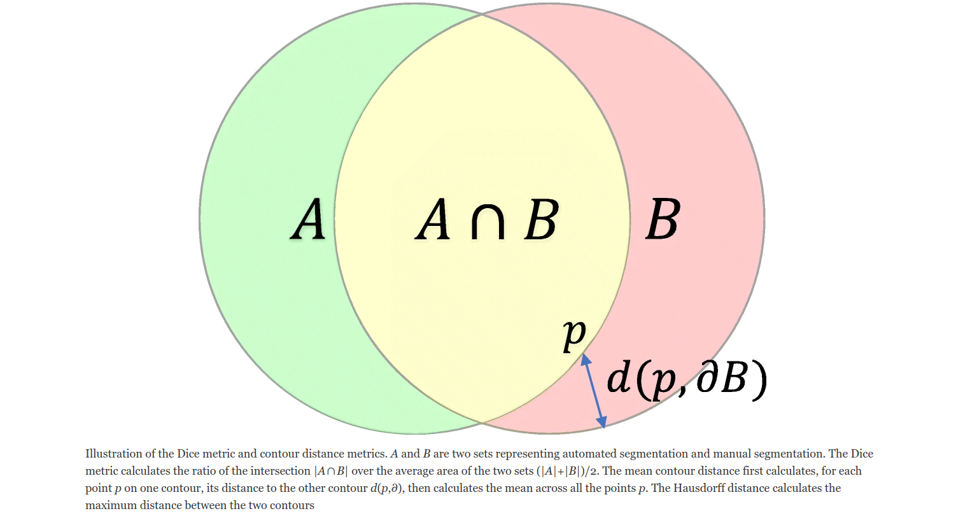
Metric measurements for model accuracy.
DICE
Hausdorff distance
Notes:
I am not sure how familiar you all might be with the methods, but to my understanding they are widely used in medical research involving image contours
The Dice metric is used to calculate the overlap between an automated segmentation A and manual segmentation B, the higher the outputted value the closer the segmentations, so the larger the overlap between automatic and hand segmentations, thus the better the result. It outputs a value between 0 and 1.
The two other metrics are the contour distance and Hausdorff distance.
The contour distance evaluates the mean distance and the Hausdorff calculates the
maximum distance between segmentation contours. Here, the
lower the distance metric, the better the agreement between
segmentations for both metrics.

Slide 15
Objectives 1)
Implement W. Bai, et al. 's pipeline (particularly the short-axis model).
Test the performance of the model on a new dataset generated from a different site with a different machine protocol (UMCG). This should be done using the quantitative assessments also deployed in W. Bai, et al.
Perform transfer learning using UMCG data, more specifically the short-axis model that classifies LV on CMR images. Compare performance with that obtained in B.
Monitor learning using live loss function plotting as enabled by tensorboard.
Notes:
So in sum, the idea is to set Bai s pipeline and the short axis model, test the performance of this model on a umcg dataset using the measurements that I spoke about. Perform transfer learning with live loss plotting using tensorboard on the UMCG SAX LV data and check that classification performance is better.

Slide 16
Objectives 2)
Calculate average vector from training data sample (PCA-prototype-vector or PCAPV) by using PCA to reduce each image and average the resulting vectors element-wise.
Repeat 2)A, Using model bottleneck layer instead of PCA for dimensionality reduction (model-knowledge-prototype-vector or MKPV).
Use PCAPV and MKPV to reduce a UMCG image.
Calculate similarity measure using Euclidean distance between UMCG reduced vectors and…
  PCAPV;
  MKPV.
Check differences between the results from D-a) and D-b).
Train the model on UMCG data and repeat A to E. Training strategy follows from the transfer-learning conducted in W. Bai, et al.: randomly splitting data into 80% subjects for fine-tuning and 20% for evaluation.
Compare the final results between vectors generated before training on UMCG data and after training.
Notes:
Calculate the average vector from training data sample using PCA and Bottleneck, use them to reduce a UMCG image to a vector, calculate Euclidean distance between each and compare differences - hope that bottleneck is better, that is, the difference is smaller than the difference in the PCA. I ll do this for umcg data before training and after training to show that the model became more sure of its answer after.

Slide 17
Possible problem...
Seemingly arbitrary threshold for fidelity in PCA/Bottleneck reduction.
  What is ‘similar’ and what is ‘different’ when it comes to one reduced statistical number (SMI2ATD): when is the similarity good enough?
(Think of P-value thresholding in hypothesis testing)
Possible solution: use the avg distance between images from the training set and the set used for the PCA as ground truth.

Slide 18
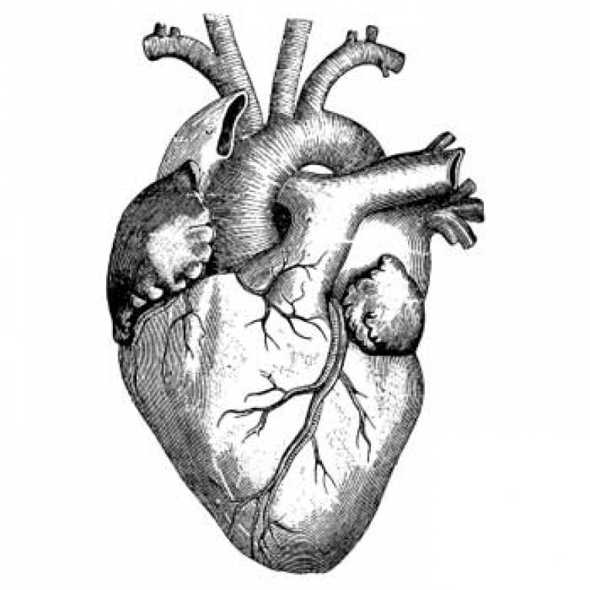
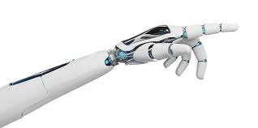
Thank You.

Slide 19
QUESTIONS...

