Slide 1
Presentasi Progres Prosi
Ferdinandus R. 2015730028
Victor C. 2015730022
Bobby S 2015730042
Sutyoso 2015730045
Hendri S. 2014730065
Michael S. V. 2014730077

Slide 2
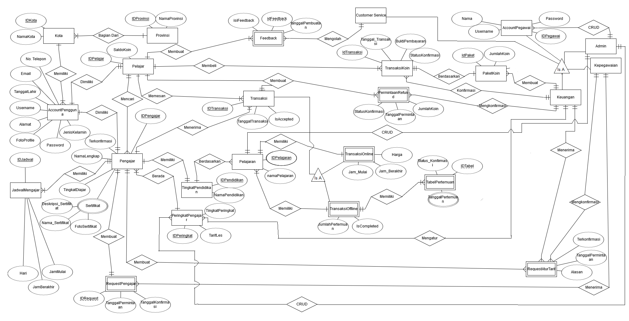
ERD Final

Slide 3
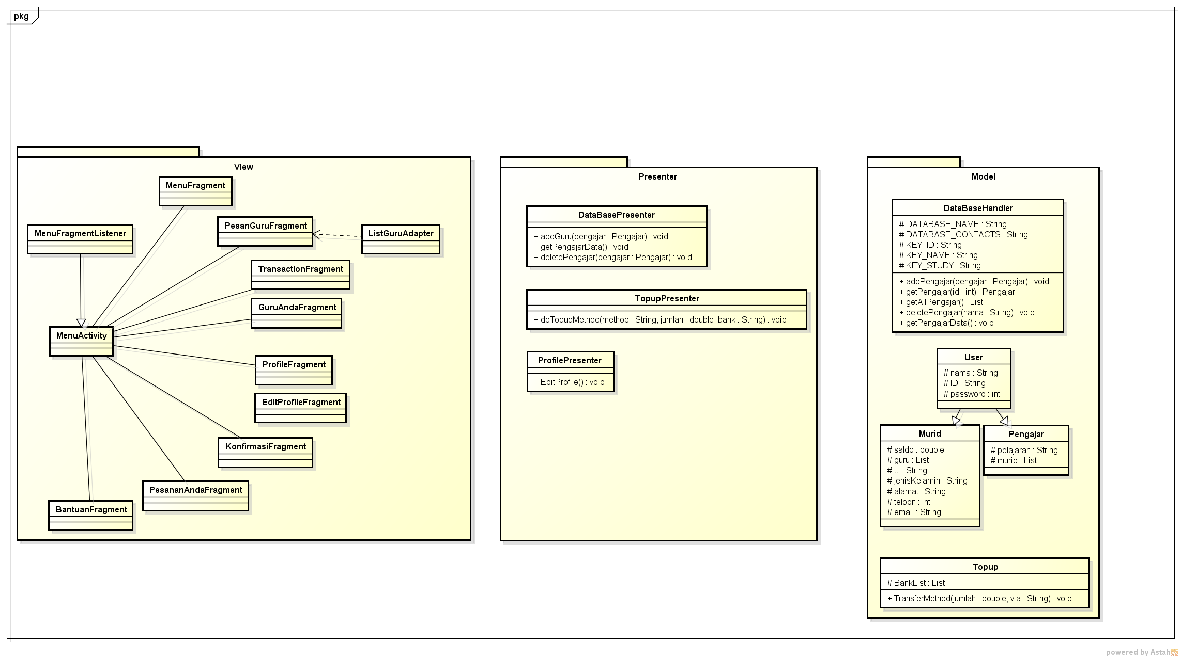
Perbaikan Kelas Android

Slide 4
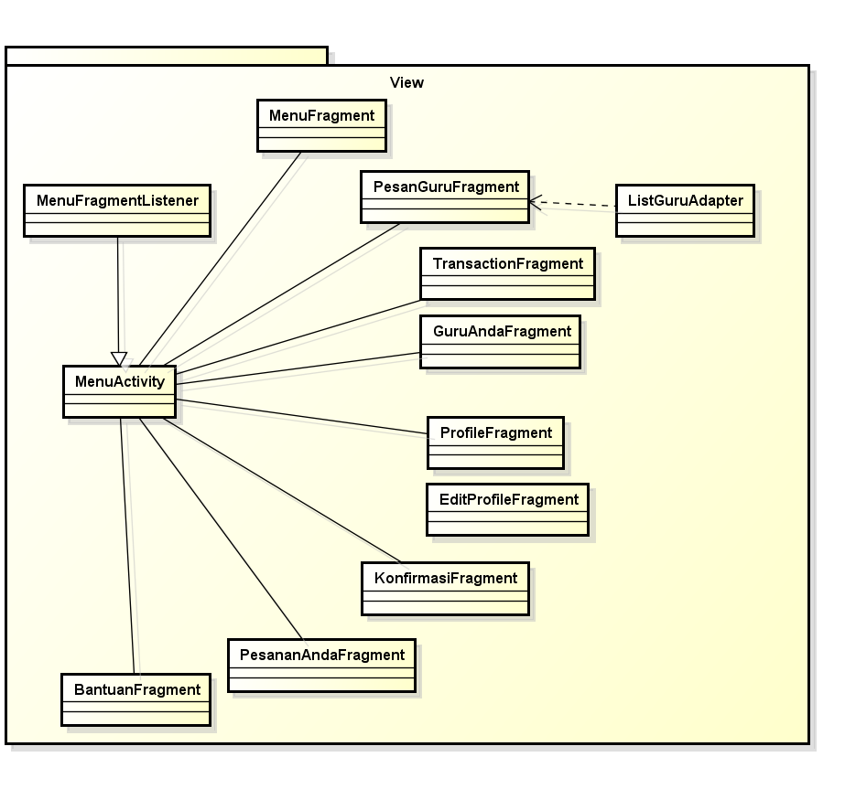

Slide 5
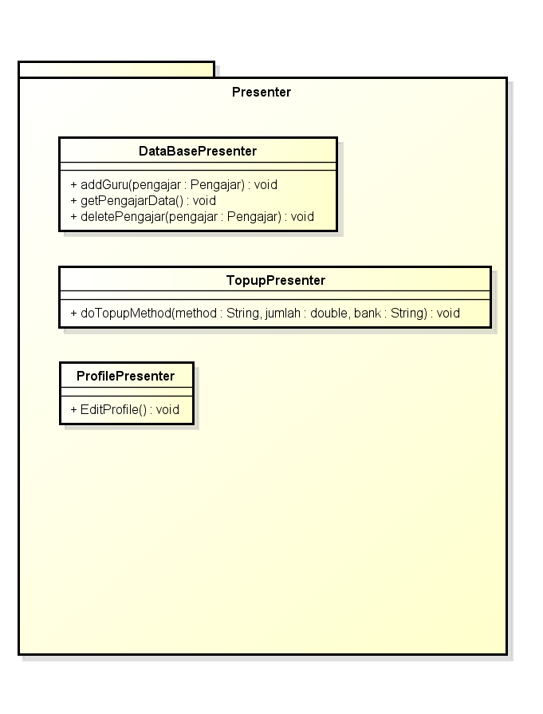

Slide 6
