Slide 1
Pascal Programming
Coding in 70 minutes
Write a program which accept three numbers at command prompt from the user.
The program should output the final speed of the object (v) and distance travelled (s).

Slide 2
Input
These numbers
The initial speed (u) of an object in meters per second (m/s)
The acceleration(a) of the object in meters per second per second (m/s²)
The time(t) which the object travel in seconds

Slide 3

Output
The program should output the final speed of the object (v) and distance travelled (s).
You should use the follow Formulae:
V = at + u

Slide 4
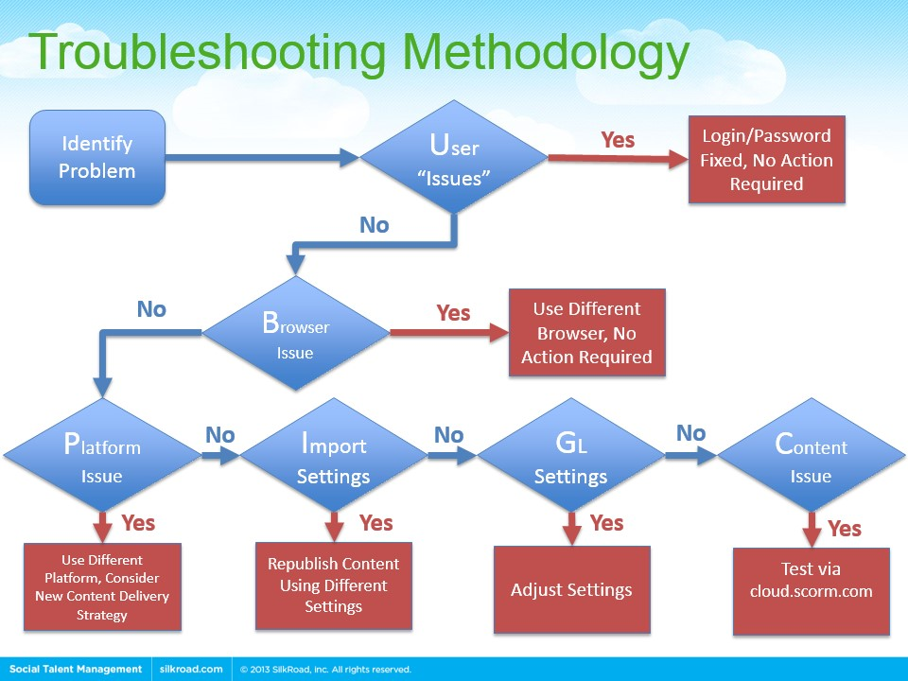
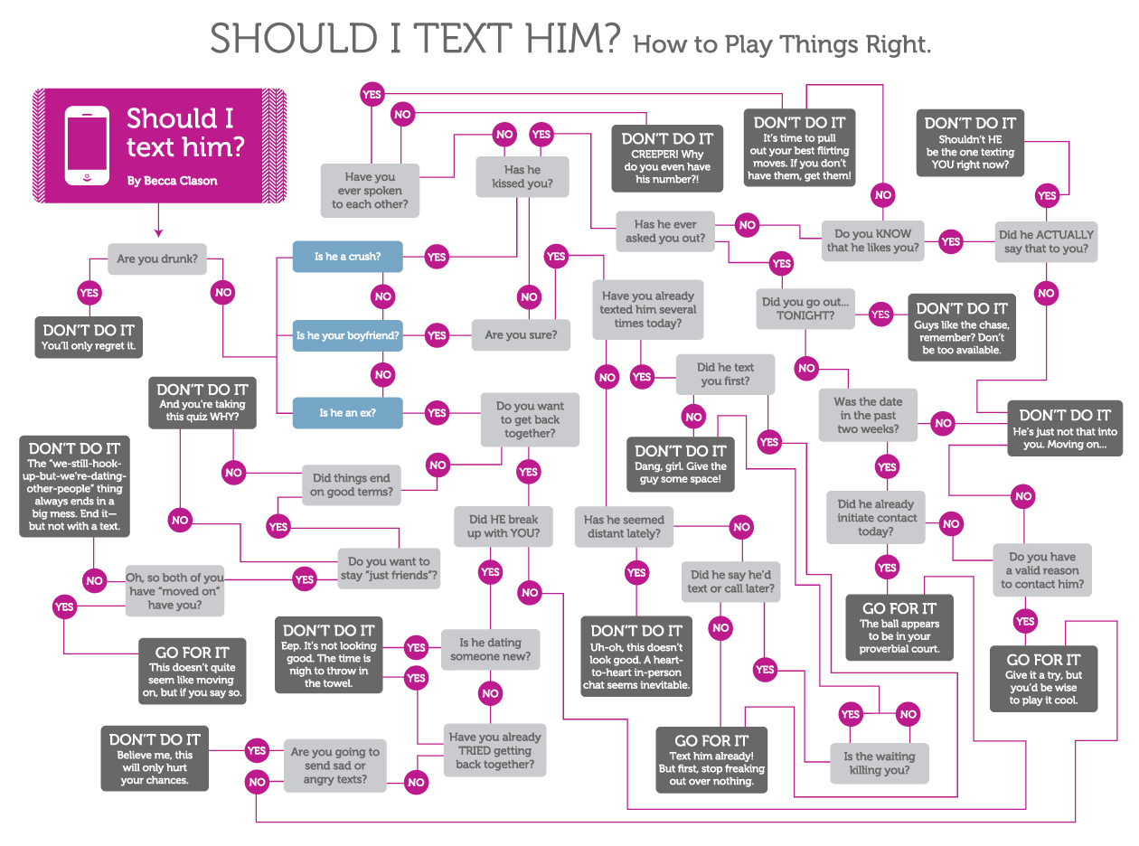
Flow Chart

Slide 5
Design the algorithm v=at
Start
End
Enter integer a
Calculate at
Read a
Enter integer t
Read t

Slide 6
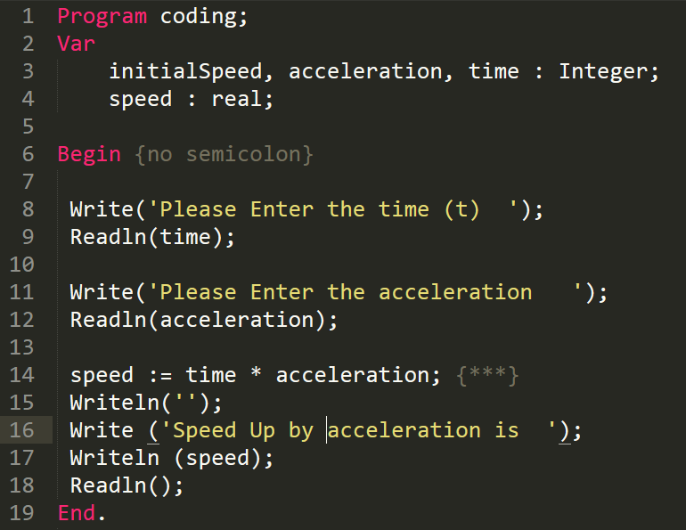
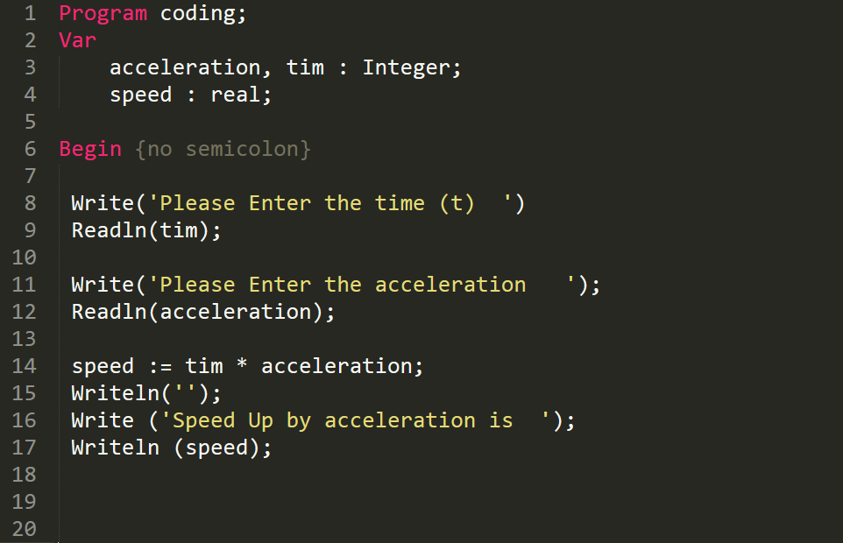
Processing
Error

Slide 7
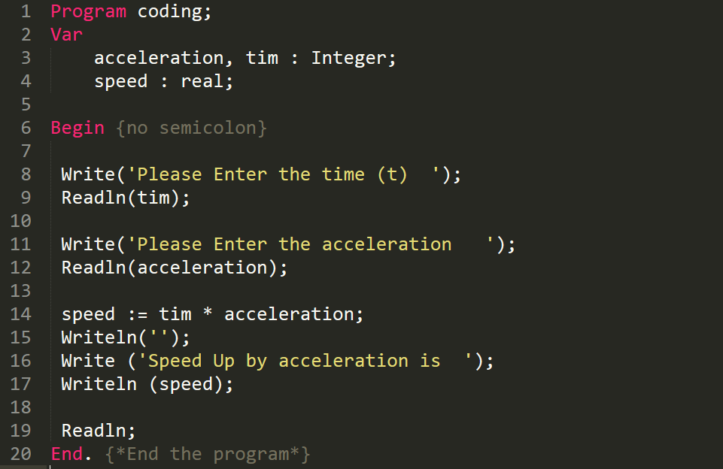
Correct Code

Slide 8
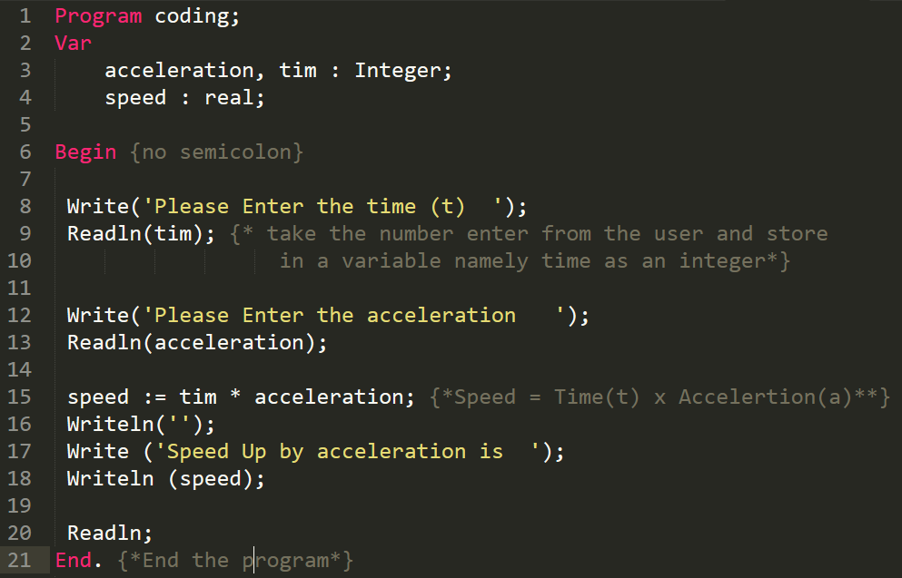
Explain your code

Slide 9
Design the algorithm v=at+u
Start
Read u
Calculate v= at *u
Enter integer a
Enter integer u
End
Read a
Calculate at
Enter integer t
Read t

Slide 10
Design the algorithm s=((u+v)/2) *t

Slide 11
Testing
For example, an object with initial speed 0, acceleration 10, time 1
will have a final speed of 10m/s and have travelled 5 meters

