Slide 1
Reverse Engineering
Mitchell Adair
1/22/2013

Slide 2
About Me
Know Owen from our time at Sandia National Labs
Currently work for Raytheon
Founded UTDallas’s Computer Security Group (CSG) in Spring 2010
Reversing, binary auditing, fuzzing, exploit dev, pen testing…
Python

Slide 3

:P

Slide 4
Goal
At the end of this, you should feel comfortable
Being handed a binary
Examining a binaries sections, imports, strings
Renaming and simplifying the disassembly
Converting from assembly to source, where needed
Understanding process memory layout
Figuring out function arguments and local variables
How many and what types
Using a debugger to fill in the gaps or manipulate program execution

Slide 5
Outline
Static vs Dynamic (overview)
PE and ELF
Assembly
Registers
The Stack
Functions
IDA
Debugging
Note on Bytecode
Conclusion
Try to reverse
Learn something new
Apply the new knowledge

Slide 6
Static vs Dynamic

Slide 7
Static vs Dynamic - Overview
Static
Looking at the code, figure things out
It’s all there, but possibly more complicated
A safer approach
Not running the code!
Dynamic
Examine the process during execution
Can see the values in real time
Registers, memory contents, etc.
Allows manipulation of the process
Should run in a VM!

Slide 8
Static vs Dynamic - Tools
Disassemblers are usually the tool of choice for static
IDA Pro, objdump, etc.
Debuggers are used for dynamic analysis
Windows
WinDBG, Immunity, OllyDBG, IDA
Linux
GDB

Slide 9
Static vs Dynamic - Tools
A good disassembler will have several useful features
Commenting
Renaming variables
Changing function prototypes
Coloring, grouping and renaming nodes (IDA)
…
A good debugger will have several useful features
Set breakpoints
Step into / over
Show loaded modules, SEH chain, etc.
Memory searching
…

Slide 10
Static vs Dyamic
Okay, no more!
We’ll be going into each of these heavily.
That was just a high level overview to understand
The difference between static and dynamic analysis
The general approach taken between the two

Slide 11
PE and ELF

Slide 12
PE and ELF
PE (Portable Executable)
“File format for executables, object code and DLLs, used in 32-bit and 64-bit versions of Windows operating systems” – wikipedia
ELF (Executable and Linkable Format)
“A common standard file format for executables, object code, shared libraries, and core dumps” – wikipedia
Linux, Unix, Apple OS

Slide 13
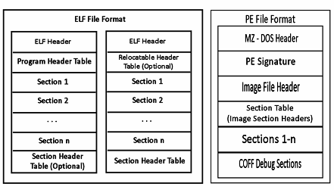
PE and ELF
Image from http://software.intel.com/sites/default/files/m/d/4/1/d/8/keep-memory-002.gif

Slide 14
PE and ELF
We could go very, very deep into file formats… but let’s not
Each format is just a big collection of fields and sections
Fields will have a particular meaning and hold a particular value
Date created, last modified, number of sections, image base, etc.
A section is, generally, a logical collection of code or data
Has permissions (read/write/execute)
Has a name (.text, .bss, etc.)

Slide 15
PE and ELF
Okay, so what? Why is this useful?
Can get an overview of what the binary is doing
Can look at what libraries the binary is loading
Can look at what functions are used in a library
Find vulns
Can parse data sections for strings
Very helpful on CTFs
Can help determine if a binary is packed
Weird section names or sizes, lack of strings, lack of imports
How do we analyze them?
PE : CFF Explorer, IDA, pefile (python library), …
ELF : readelf, objdump, file, …

Slide 16
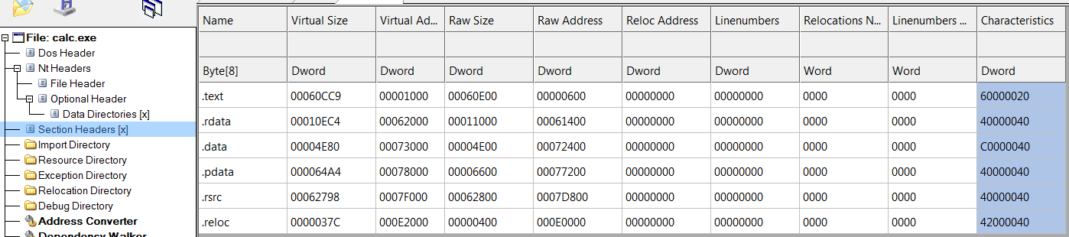
PE – CFF Explorer
This is CFF Explorer looking at calc.exe’s sections headers
Represent permissions

Slide 17
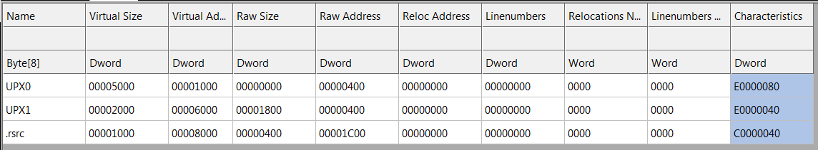
PE – CFF Explorer
This is CFF Explorer looking at a UPX packed executable from a recent CTF
Huge red flag with section names like this

Slide 18
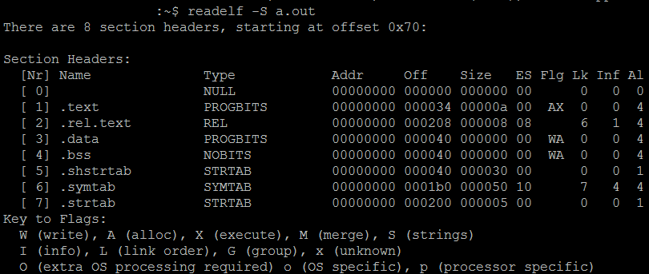
ELF - readelf
This is using readelf to look at section headers

Slide 19
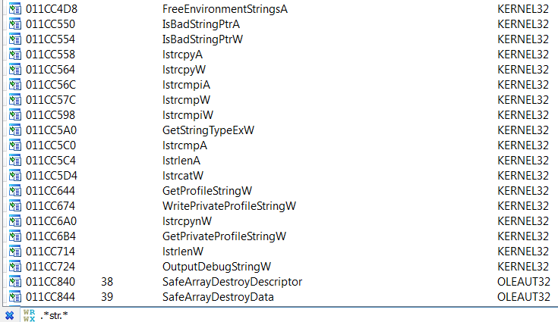
PE and ELF - Imports
This is IDA exemaning what functions are imported
I have filtered using the regular expression .*str.*
Probably worth investigating ;)

Slide 20
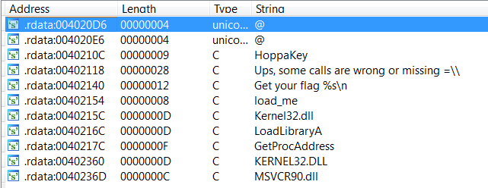
PE and ELF - Strings
This is IDA examining strings it has found for a recent CTF problem
Probably want to start from the “Get your flag %s\n” string and work backwards ;)

Slide 21
PE and ELF – 5 minute exercise
Open number_checker.exe and number_checker_packed.exe
Compare these two!
In CFF Explorer
Look at different fields in the PE format
Look at sections
Just explore
In IDA
Look at strings (shift+f12)
Look at imports (view->open subviews->imports)
Look at sections (shift+f7)

Slide 22
Assembly

Slide 23
Assembly
Two syntax options
ATT
Intel
ATT
instruction source, dest
mov %eax, %edx
“Move eax into edx”
Intel
instruction dest, source
mov edx, eax
“Move into edx, eax”

Slide 24
Assembly
It’s a known fact that Intel’s syntax > ATT’s, so we’ll be using Intels ;)
mov eax, ecx
Move into eax, the contents of ecx
mov eax, [ecx]
Move into eax, the contents of what ecx points to
The brackets, […], mean dereference the value between them
In C, this is like a pointer dereference
eax = *ecx

Slide 25
Assembly
Memory values and immediates can be used as well
mov eax, 5
Move into eax, the value 5
mov edx, [0x12345678]
Move into edx, what 0x12345678 points to

Slide 26
Assembly
A very small handful of instructions will get you a long way
call, mov, cmp, jmp
call 0x12345678
Call the function at 0x12345678
cmp eax, 8
Compare eax to 8
Compare left to right
jmp 0x12345678
Unconditional jump to 0x12345678
jle 0x12345678
Jump to 0x12345678 if eax is less than or equal to 8
jg 0x12345678
Jump to 0x112345678 if eax is greater than 8

Slide 27
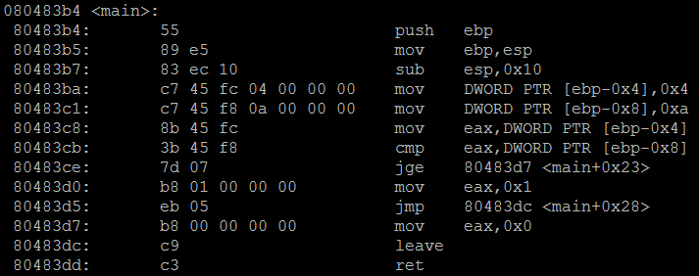
Assembly – Example

Slide 28
Assembly - Example
Let’s focus on the instructions we know
mov, cmp, jmp, call

Slide 29
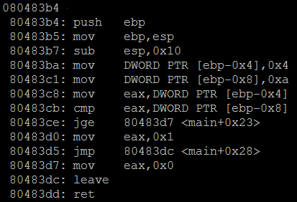
Example 1
[ebp-0x4] = 0x4
[ebp-0x8] = 0xa
eax = [ebp-0x4]
Two values, relative to the pointer contained in ebp have been assigned values
One register has been assigned a value

Slide 30
Example 1
[ebp-0x4] = 0x4
[ebp-0x8] = 0xa
eax = [ebp-0x4]
cmp eax, [ebp-0x8]
eax == [ebp-0x8] ?
4 == 10 ?
jge 0x80483d7
If 4 was >= 10, jmp
Else, continue execution

Slide 31
Example 1
[ebp-0x4] = 0x4
[ebp-0x8] = 0xa
eax = [ebp-0x4]
cmp eax, [ebp-0x8]
eax == [ebp-0x8] ?
4 == 10 ?
jge 0x80483d7
If 4 was >= 10, jmp
Else, continue execution
False, so execution just continues to the next instruction

Slide 32
Example 1
[ebp-0x4] = 0x4
[ebp-0x8] = 0xa
eax = [ebp-0x4]
cmp eax, [ebp-0x8]
jge 0x80483d7
mov eax, 0x1
eax = 1
jmp over the mov eax, 0
leave and return

Slide 33
Example 1
So two memory addresses, relative to the pointer contained in ebp, have values. One has 4, one has 10.
There is a comparison
If operand 1 >= operand 2, take the jump
If not, continue execution
Eax gets assigned the value of 1
The function returns

Slide 34
Example 1
Let’s dig deeper
Everything shown in the disassembly has a purpose
mov DWORD PTR [ebp-0x4], 0x4
What does DWORT PTR mean?
We know the brackets […] mean get the value held at the dereferenced value between them… but DWORD PTR?

Slide 35
Example 1
mov DWORD PTR [ebp-0x4], 0x4
DWORD PTR
DWORD = the size
PTR = dereference the value, accompanied by the brackets
We have a few number of sizes allowed

Slide 36
Example 1 – Types and Sizes
Type | Size (bytes) | Size (bits) | ASM | Example
char | 1 byte | 8 bits | BYTE | char c;
short | 2 bytes | 16 bits | WORD | short s;
int | 4 bytes | 32 bits | DWORD | int i;
long long | 8 bytes | 64 bits | QWORD | long long l;

Slide 37
Example 1
So…
mov DWORD PTR [ebp-0x4], 0x4
The address pointed to by the dereferenced value of [ebp-4] is getting 4 bytes moved into it, with the value of 4.
[ebp-4] is an int
So our source code probably has some int value and hard codes a value of 4 to it

Slide 38
Example 1
mov DWORD PTR [ebp-0x4], 0x4
mov DWORD PTR [ebp-0x8], 0xa
This leaves us with 2 ints being assigned a hard coded value
int x = 4;
int y = 10;
Are these locals, globals, static variables???
We need a little background on process memory layout.

Slide 39
Example 1 – Recap so far
int x = 4;
int y = 10;
We don’t know where these are declared
if (4 >= 10)
jmp to main+0x23
eax = 1
jmp to main+0x28
main+0x23 :
eax = 0
main+0x28:
ret
We don’t take the jmp as already discussed.
It’s starting to look like source code!

Slide 40
Process Memory Layout
Let’s do a quick introduction to process memory layout, then we’ll continue with the first example
We want to know
Why things are relative to esp/ebp?
What are the push/pop instructions doing?
What about the leave/ret instructions?

Slide 41
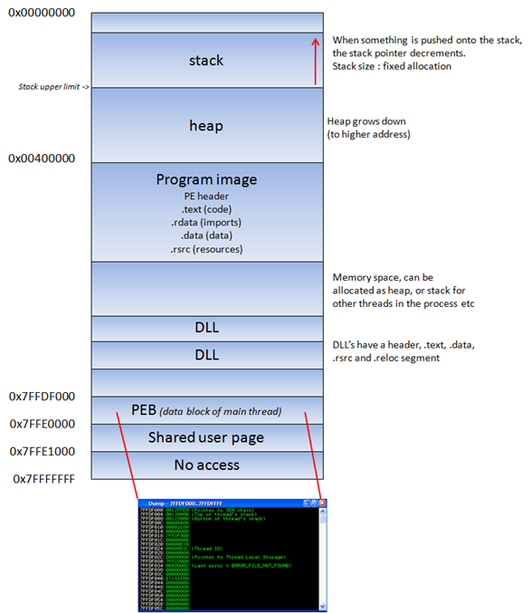
Process Memory Layout - Windows
Image from https://www.corelan.be/wp-content/uploads/2010/08/image_thumb3.png

Slide 42
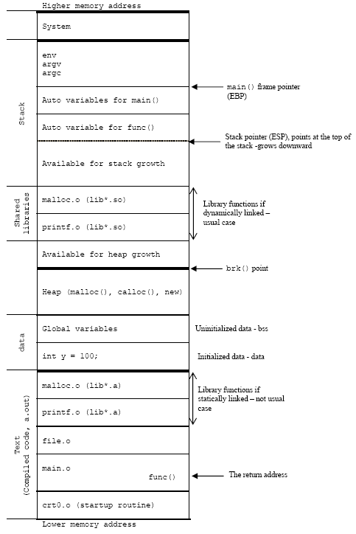
Process Memory Layout - Linux
Image from http://www.tenouk.com/Bufferoverflowc/Bufferoverflow1_files/image022.png

Slide 43
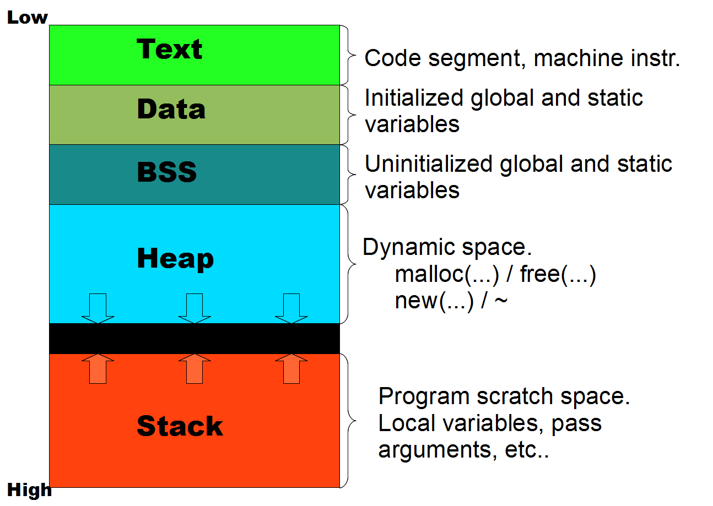
Virtual Memory

Slide 44
Registers

Slide 45
Registers
Register Name | Description
EIP | Next instruction executed *Want to hijack during exploitation
ESP | Stack pointer
EBP | Base pointer
EAX | Accumulation *Holds the return value, usually.
EBX | Base
ECX | Counter
EDX | Data
ESI | Source index
EDI | Destination index

Slide 46
The Stack

Slide 47
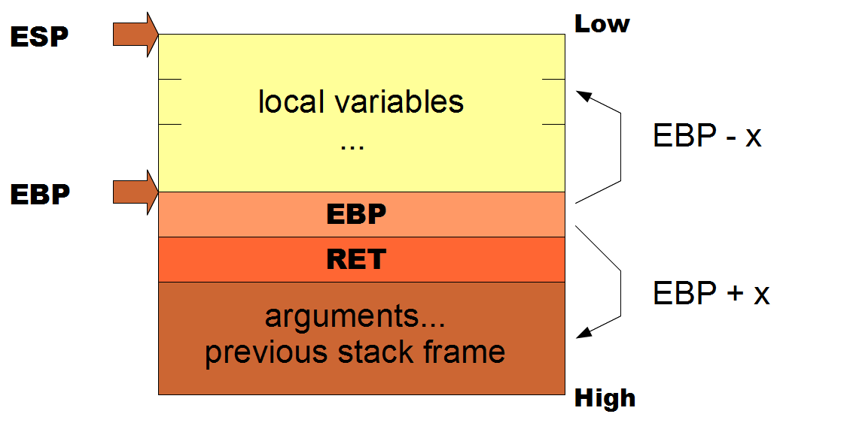
The Stack

Slide 48
Example 1 – Part 2
Okay, we have some background on the registers, the stack, and process layout
Let’s try to figure out what this code’s stack layout would look like
Then, we’ll look back at the code and what we know

Slide 49
Example 1 – Part 2
sub esp, 0x10
There is room for 16 bytes of locals, or 4 ints
[ebp-4] is a local
[ebp-8] is a local
Return value, eax, is either 1 or 0 depending on the comparison

Slide 50
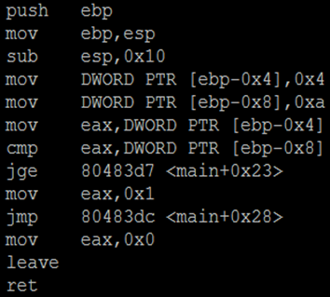
Example 1’s stack
ESP
EBP-16
10
EBP-8
4
EBP-4
args start at EBP+8
EBP
RET
…
No [ebp+x], no arguments to the function

Slide 51
Example 1 – Part 2
int someFunction() {
int x = 4;
int y = 10;
if (4 >= 10)
jmp to main+0x23
eax = 1
jmp to main+0x28
main+0x23 :
eax = 0
main+0x28:
return

Slide 52
A side note about source to asm
‘if’ comparisons get translated opposite from source to assembly
if x > y
Will become
cmp x, y
jle 0x12345678 (jump less than or equal)
If some condition is *not true*, jump over it
If x <= y
Will become
cmp x, y
ja 0x12345678 (jmp above)

Slide 53
Example 1 – Part 2
int someFunction() {
int x = 4;
int y = 10;
if (4 < 10)
Return 1
Return 0
}
Hey, that’s source code!

Slide 54
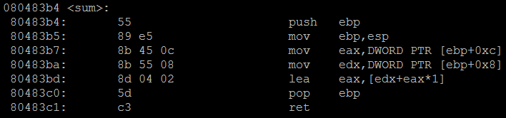
5 Minute Exercise
Produce the source code for the following function
How many local variables, how many arguments, what types?
Hint: lea eax, [edx+eax*1] is the same thing as
eax = edx+eax

Slide 55
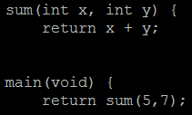
Exercise 2 - Solution
What we just saw was the sum function.
The compiler used lea edx+eax for efficiency
It could have similarly used the add instruction
eax contains the return value
No local variables were used (no [ebp-x]), just arguments ([ebp+x])

Slide 56
Functions

Slide 57
Functions
Looking at the previous exercise introduces a question about how function calls are handled
We know
eax holds the return value
Arguments (from the functions point of view) begin at ebp+8
But how do those arguments get there, and how are they removed?

Slide 58
Functions – Calling Conventions
Two main calling conventions are commonly used
CDECL
Originates from C
Args pushed on the stack, right to left (reverse)
Calling function cleans up
STDCall
Orignates from Microsoft
Args pushed on the stack, right to left (reverse)
Called function cleans up
Must know how many bytes ahead of time

Slide 59
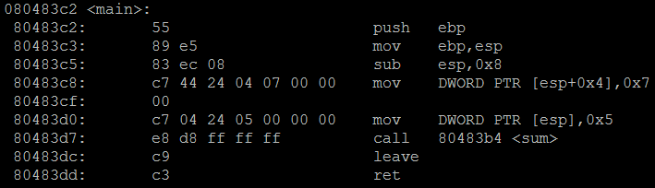
Functions – Exercise 2’s main
GCC tends to use : move [esp+x], arg
Visual studio tents to use : push arg
Regardless, we’re putting args on top of the stack

Slide 60
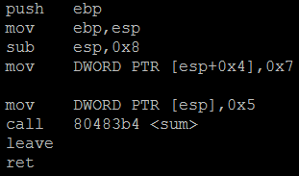
Functions – Exercise 2’s main
EBP + 8
5
ESP
7
EBP
RET
…
Now that the stack is setup, sum is called

Slide 61
Stack Frames
Functions reference local variables and arguments via their stack frame pointers, esp and ebp
So, every function has it’s own prolog and epilog to adjust esp and ebp to contain the correct values

Slide 62
Stack Frames
Prolog – push ebp to save it on the stack, then move ebp to the top of the stack, then make room for locals
Push ebp
mov ebp, esp
sub esp, x
Epilog – move esp back to ebp, pop the top of the stack into ebp, return to the address on top of the stack
add esp, x
pop ebp
ret
Epilog 2 – leave is equivalent to : mov esp, ebp; pop ebp
leave
ret

Slide 63
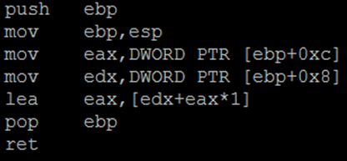
Stack Frames – Exercise 2
ESP
RET
5
7
EBP
RET
…
EBP
The call instruction pushes EIP onto the stack

Slide 64
Stack Frames – Exercise 2
ESP
EBP
RET
5
7
EBP
RET
…
EBP
EBP is saved

Slide 65
Stack Frames – Exercise 2
ESP
EBP
EBP
RET
5
7
EBP
RET
…
EBP has the same value as ESP now

Slide 66
Stack Frames – Exercise 2
ESP
EBP
EBP
RET
5
EAX = 7
7
EBP
RET
…
EAX gets the value of arg 2

Slide 67
Stack Frames – Exercise 2
ESP
EBP
EBP
RET
EDX = 5
5
EAX = 7
7
EBP
RET
…
EDX gets the value of arg 1

Slide 68
Stack Frames – Exercise 2
ESP
EBP
EBP
RET
EDX = 5
5
EAX = 12
7
EBP
RET
…
EAX contains a new value now, not what was in arg2

Slide 69
Stack Frames – Exercise 2
ESP
RET
EDX = 5
5
EAX = 12
7
EBP
RET
…
EBP
In the epilog now, set EBP back to the callers value

Slide 70
Stack Frames – Exercise 2
ESP
EDX = 5
5
EAX = 12
7
EBP
RET
…
EBP
Ret is the same as : pop EIP
Control flow returns to the next instruction in the caller

Slide 71
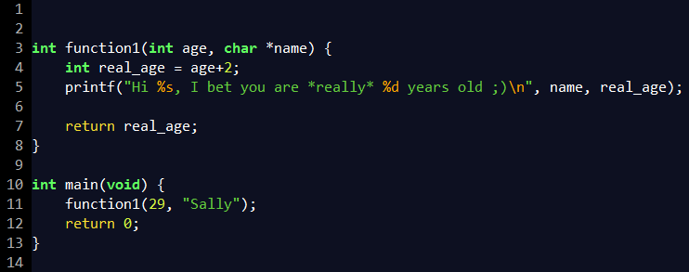
Quick Exercise – 5 minutes
What is the stack going to look like at the printf call?

Slide 72
Solution
ESP
.data section char *
name
real_age
real_age
function1
EBP
EBP
RET
29
Sally
Main
EBP
…
RET

Slide 73
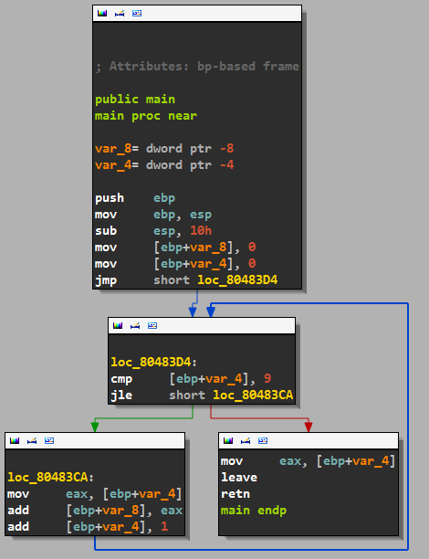
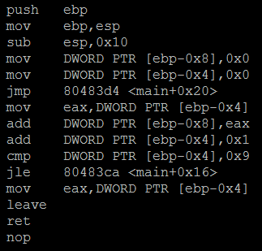
Recognizing Patterns
for(i = 0; i < 10; i++)

Slide 74
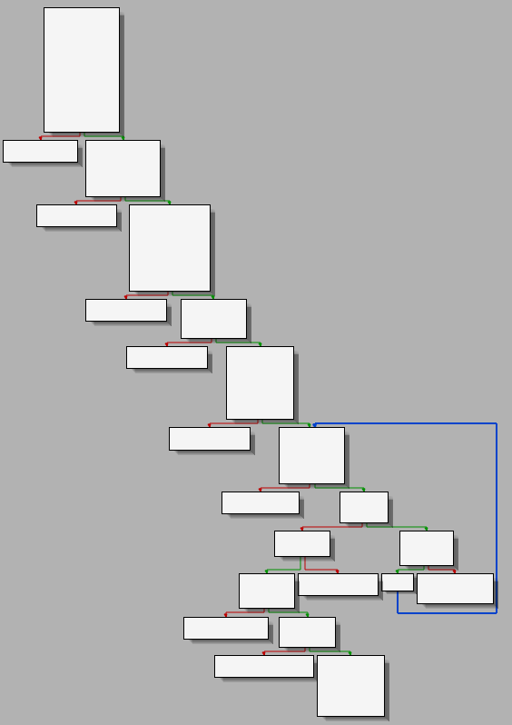
Recognizing Patterns
Without a single instruction, it’s clear what is happening at a high level here
This common “stair step” graph structure is a series of calls/checks that error out on failure

Slide 75
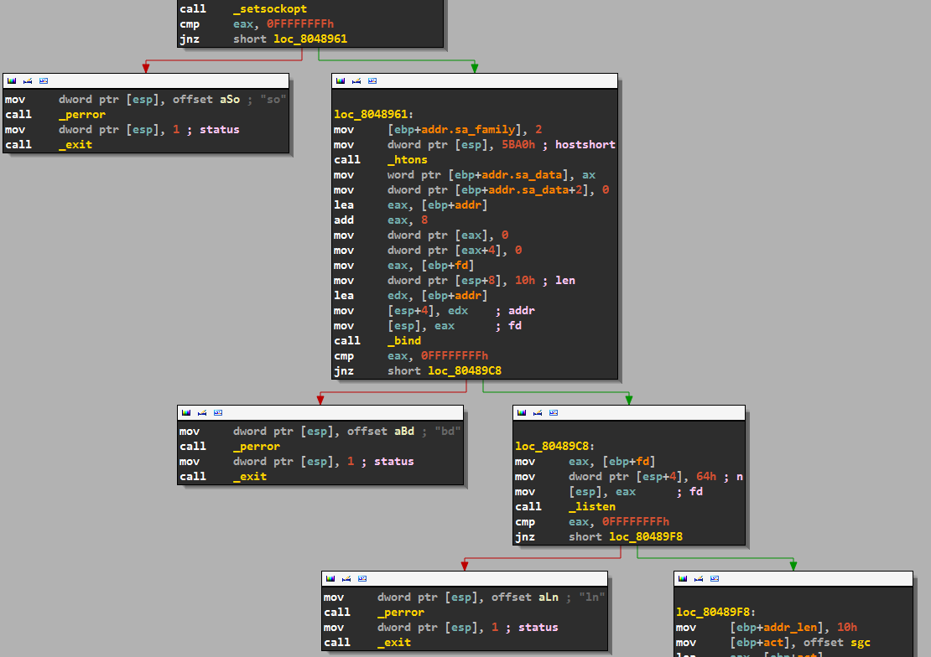

Slide 76
IDA
IDA rocks…
We can do many things, including grouping a set of nodes, color coding them, and renaming them
Knowing that all these checks error out on failure we can simplify the graph

Slide 77
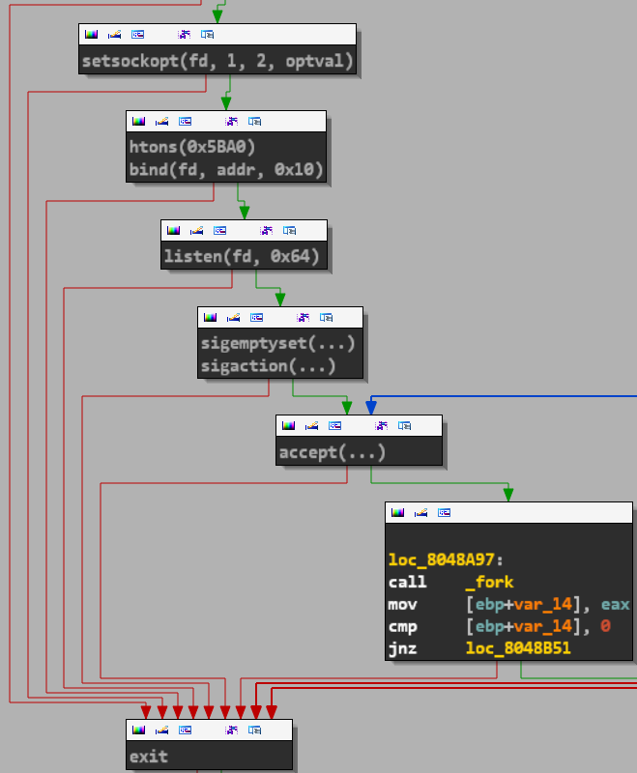
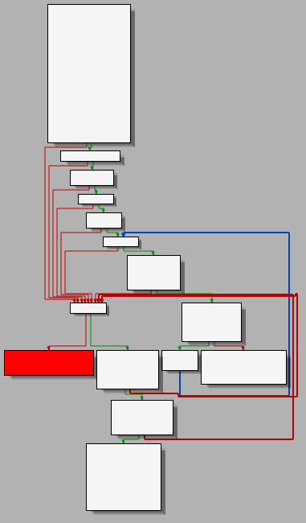
IDA – Simplifying the graph

Slide 78
IDA
I could spend on all day on IDA, too much information to put into slides without making it a pure IDA talk
*Live demo goes here*
How to use IDA
Go over variable renaming, function protocol modification, comments, coloring, grouping, sections, string, imports, etc.

Slide 79
Exercise 3
Can you figure out the correct input to get the key program to print the key?
Use the executable number_checker.exe

Slide 80
Debugging

Slide 81
Debugging
Everything covered so far has been static analysis
Now we’ll cover dynamic analysis through debugging

Slide 82
Debugging
Remember
A good debugger will have several useful features
Set breakpoints
Step into / over
Show loaded modules, SEH chain, etc.
Memory searching
…
WinDBG, OllyDBG, Immunity, IDA, GDB, etc. are good debuggers

Slide 83
Dynamic Analysis – Quick Note
Keep in mind…
You control everything!
If you want to skip over an instruction, or a function call, do it!
If you want to bypass the “authentication” method or make it return true… you can!
You can change register contents and memory values, whatever you want.
You can even patch programs (make changes and save it to a new executable).

Slide 84
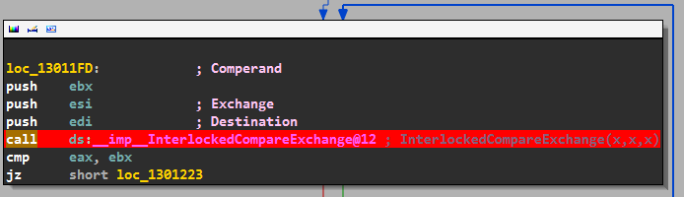
Dynamic Analysis - IDA
F2 will set a breakpoint in IDA, Olly, Immunity

Slide 85
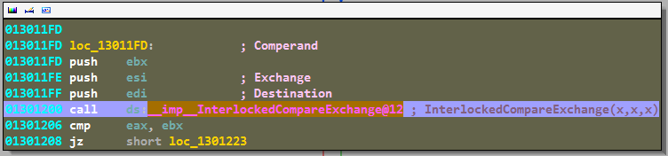
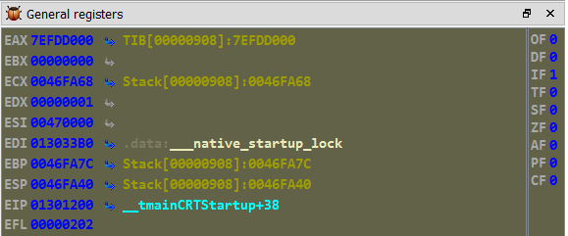
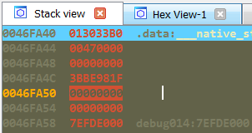
Dynamic Analysis - IDA
The breakpoint has been hit, execution is stopped
The registers
The stack

Slide 86
Dynamic Analysis - IDA
The breakpoint has been hit, execution is stopped
args
The registers
The stack

Slide 87

Dynamic Analysis - IDA
We can now see the function call is
InterlockedCompareExchange(__native_startup_lock, 0x47000, 0)
Looking at the MSDN site for the prototype :

Slide 88
Dynamic Analysis - IDA
Knowing the data types of the parameters, we can trace back up through the program where the values in ebx, esi and edi came from
Then we can rename those values to something useful
Just looking at calls, figuring out their arguments, and tracing back to fill in the data types can really help figure out most of the functions

Slide 89
Exercise 4
We’ll again use the number_checker.exe binary for this exercise
Can you bypass the key check entirely?
In CTFs a lot of times we can see where the key get’s printed, and we’ll try to just jump directly to that function, or make checks return True/False depending on where we want to go.
Usually can get a quick low point problem this way ;)

Slide 90
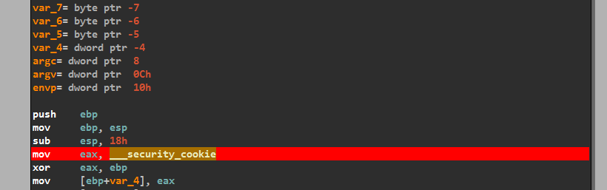
Exercise 4 - Solution
Set a breakpoint at the beginning of the function (f2)

Slide 91
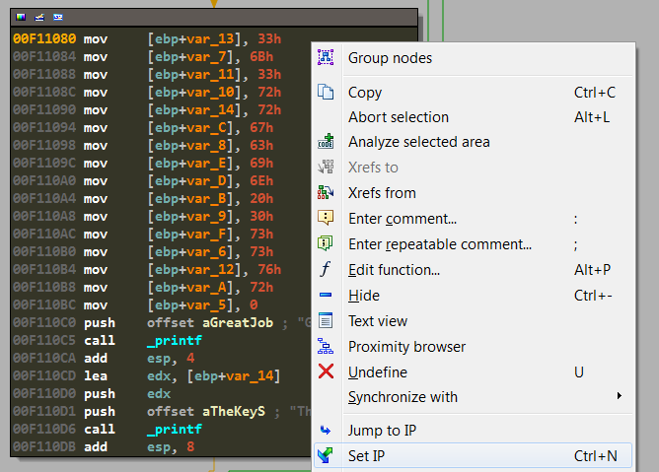
Exercise 4 - Solution
When execution is stopped, find where you want to jump to, and right click -> set ip

Slide 92
Dynamic Analysis - Debuggers
Most of the Windows debuggers are similar
Same windows, same hotkeys, etc.
Except WinDBG, WinDBG is more GDB like
GDB is similar, but is command line
We’ll cover some simple GDB usage

Slide 93
Dynamic Analysis - GDB
Starting GDB and launching the application
With and without arguments
Command | Description
gdb ./my_program | Launch gdb, debug my_program
gdb --args ./my_program arg1 arg2 | Launch gdb, debug my_program, passing two arguments
run | Run the application
run arg1 arg2 | Run the application, pass two args
run $(python –c “print ‘A’*1000”) | Run the application, pass one arg, just like regular shell execution

Slide 94
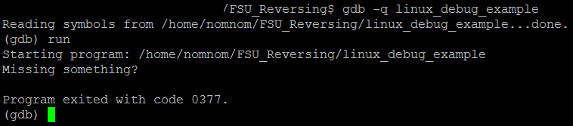
Dynamic Analysis - GDB
1. Launch GDB with the program we want to debug
2. Run it
Hmm… we need more information
(I would just open it in IDA, but we’re trying to learn GDB here!)
1
2

Slide 95
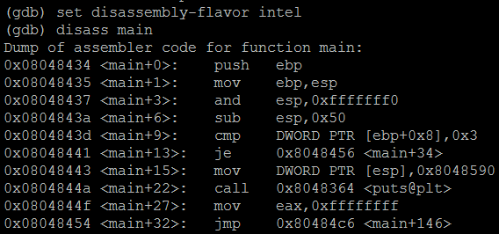
Dynamic Analysis - GDB
Command | Description
set disassembly-flavor intel | Use Intel syntax
disas [function_name] | Disassemple the chosen function

Slide 96
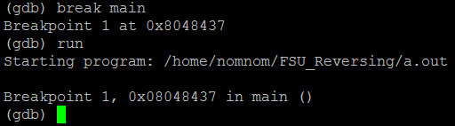
Dynamic Analysis - GDB
Command | Description
break main | Set a breakpoint on the function “main”
break *0x12345678 | Set a breakpoint on the address 0x…
info breakpoints | Show information regarding breakpoints
delete breakpoint 2 | Delete breakpoint 2
delete breakpoints | Delete all breakpoints

Slide 97
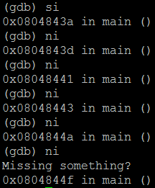
Dynamic Analysis - GDB
Commands | Description
si | Step Instruction. Execute to next instruction, go *into* functions
ni | Next Instruction. Execute to next instruction, go *over* functions
Look at the addresses
We’re manually stepping through the instructions

Slide 98
Dynamic Analysis - GDB
Commands | Description
si | Step Instruction. Execute to next instruction, go *into* functions
ni | Next Instruction. Execute to next instruction, go *over* functions
Look at the addresses
We’re manually stepping through the instructions
This still isn’t helping us though!

Slide 99
Dynamic Analysis - GDB
We can disassemble, set breakpoints, and step through the program… but
We need to
See the contents of registers
See the contents of memory
Modify (if desired)

Slide 100
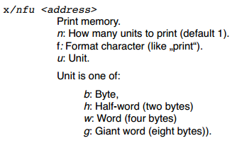
Dynamic Analysis - GDB
Image from http://darkdust.net/files/GDB%20Cheat%20Sheet.pdf

Slide 101
Dynamic Analysis - GDB
x/nfu <address|register>
Command | Description
x/5i $eip | Examine 5 instructions at EIP
x/4xw $esp | Examine 4 hex words at ESP
x/s 0x12345678 | Examine the string at 0x12345678
x/5b $ecx | Examine 5 bytes at ECX
i r | “info register”, show the values of all registers
i r esp ebp ecx | Show the values of registers ESP, EBP, and ECX

Slide 102
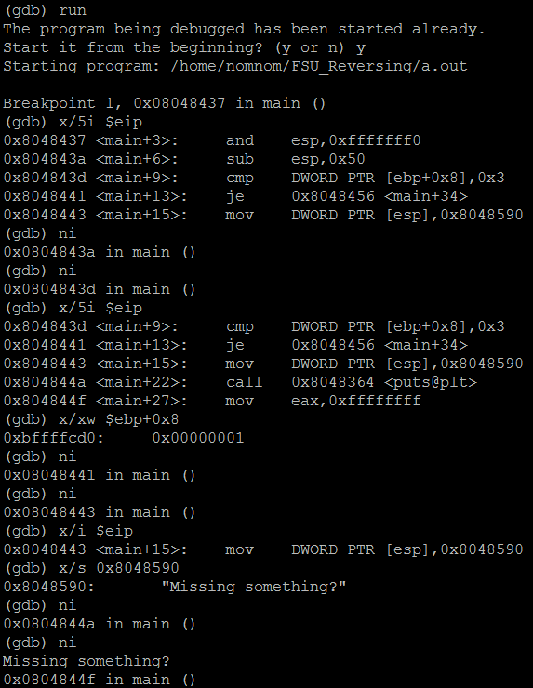

Slide 103
1
Run the program

Slide 104
1
Run the program
Where are we? Check out EIP
2

Slide 105
1
Run the program
Where are we? Check out EIP
Continue until we hit an instruction of interest
2
3

Slide 106
1
Run the program
Where are we? Check out EIP
Continue until we hit an instruction of interest
Let’s see what’s being compared – we can see this jump is not taken
2
3
4

Slide 107
1
Run the program
Where are we? Check out EIP
Continue until we hit an instruction of interest
Let’s see what’s being compared – we can see this jump is not taken
Check out the argument passed to puts
2
3
4
5

Slide 108
1
Run the program
Where are we? Check out EIP
Continue until we hit an instruction of interest
Let’s see what’s being compared – we can see this jump is not taken
Check out the argument passed to puts
2
3
4
5
Aha! We don’t satisfy the compare (1 != 3), and call puts, then exit!

Slide 109
Dynamic Analysis - GDB
Think about the function protocol for main
int main (int argc, char *argv[])
In main, [ebp+8] would reference the first argument, argc
We aren’t passing any arguments, besides argv[0], the program name, hence why [ebp+8] has the value 1

Slide 110

Dynamic Analysis - GDB
Haha, passing the program 2 more arguments (3 total) does in fact satisfy the first cmp instruction
A new code path is taken!

Slide 111
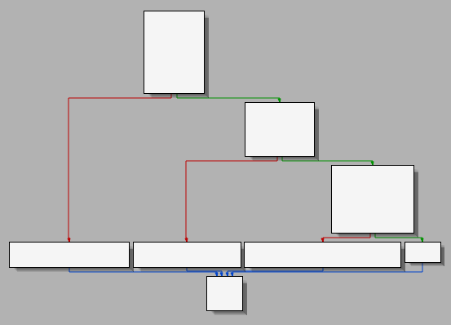
Exercise 5
Try to figure out the correct input that will cause the program to print message, "Congrats, you did it!“
Use IDA and GDB!
Hey, we’ve seen this graph pattern before!

Slide 112
Dynamic Vs. Static
Everyone has their own preferences
But the combination of the two will undoubtedly yield the best results
IDA, WinDBG, Immunity, GDB all have scripting
In fact, they all use Python except WinDBG*
There are awesome scripts that will import results from debuggers into IDA’s view, filling in all the registers/operands for each instruction.

Slide 113
Last Exercise (homework?)
key_checker.exe or
We’ll do a real crackme
Crackme at
http://www.woodmann.com/RCE-CD-SITES/Quantico/mib/crackme2.zip
This might be a little tricky, that’s okay.

Slide 114
One quick note
What about bytecode?
.NET applications, java, python, etc.
Just download a disassembler
You’ll get near complete source code back
It’s really that easy…

Slide 115
Conclusion
Hopefully you feel comfortable
Opening up and examining a binary and looking at it’s sections to get a feel for it
Renaming and simplifying the disassembly
Converting back to source code where needed
Using a debugger to fill in the gaps or manipulate program execution

Slide 116
Conclusion
Fantastic books
Reversing: The secrets of reverse engineering
The IDA Pro book
The Art of Exploitation
Challenges
Crackmes.de
Woodmann.com
Smashthestack.org (plenty of debugging involved ;) )
Links
CSG : csg.utdallas.edu and irc.oftc.net #utdcsg (everyone is welcome)
IDA : hex-rays.com
CFF Explorer : ntcore.com/exsuite.php
Immunity Debugger : immunityinc.com

