Slide 1



Internship
Report in
OneConnect
Ping An International Finance Centre
Shenzhen
China
Jiawei XU
25 June 2019

Slide 2


FOUNDING
FOUNDED, MARCH, 2015
OneConnect company, the world's leading technology service platform covering the whole financial industrial chain, is an associate company of the Ping An Insurance Company of China, Ltd. It was registered and founded in December 2015.
2

Slide 3

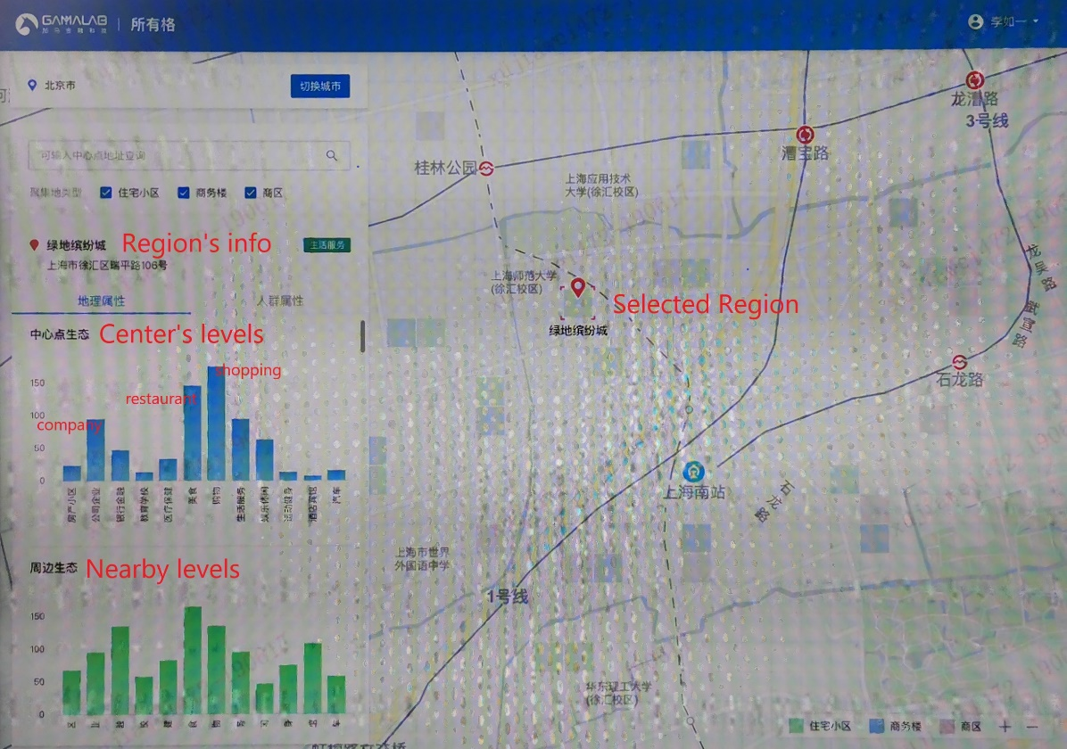
EXISTING PRODUCT
Region-based product “Suo You Ge” (means All the regions in Chinese). This product is based on information about a region in the city. Process the information to get some labels of this region, such as shopping level, restaurant level. Many banks and insurance institutions are interested in these labels.
3

Slide 4
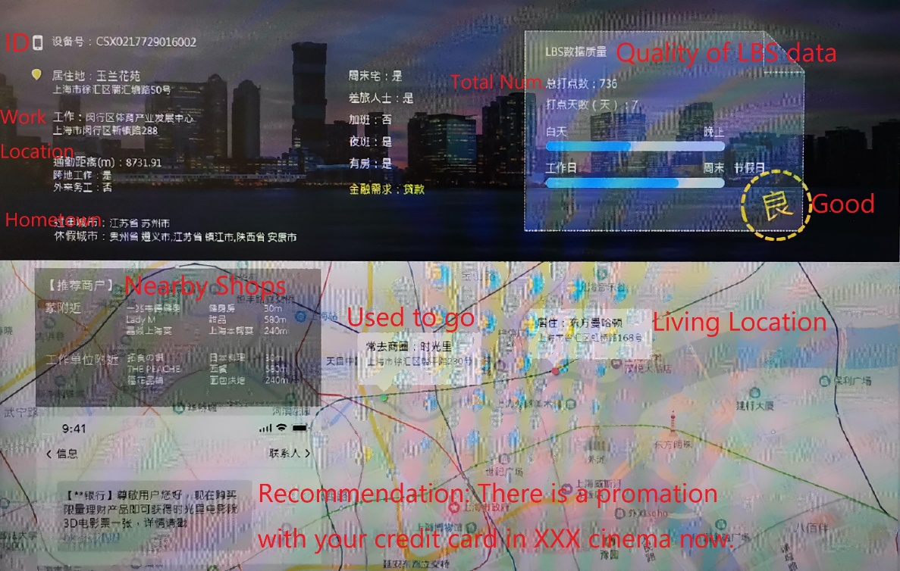
FUTURE PRODUCT
Implement a new product for banks and insurance institutions. This product could provide some useful labels and consumer recommendations. These labels and recommendations are obtained after processed users’ personal location information record.
4

Slide 5
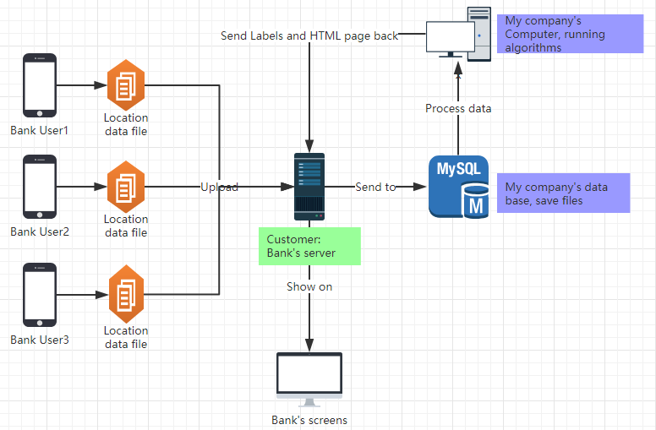
5
The diagrammatic sketch of future Product

Slide 6

Needs
LBS
Information
LBS Information: Location data
Android Application: Container of data and media of transfer
Local Server: Provider connection between phone and process computer
Gaode Map SDK: Map visualization
Android
Application
Local Server
Map
Visualization
6

Slide 7
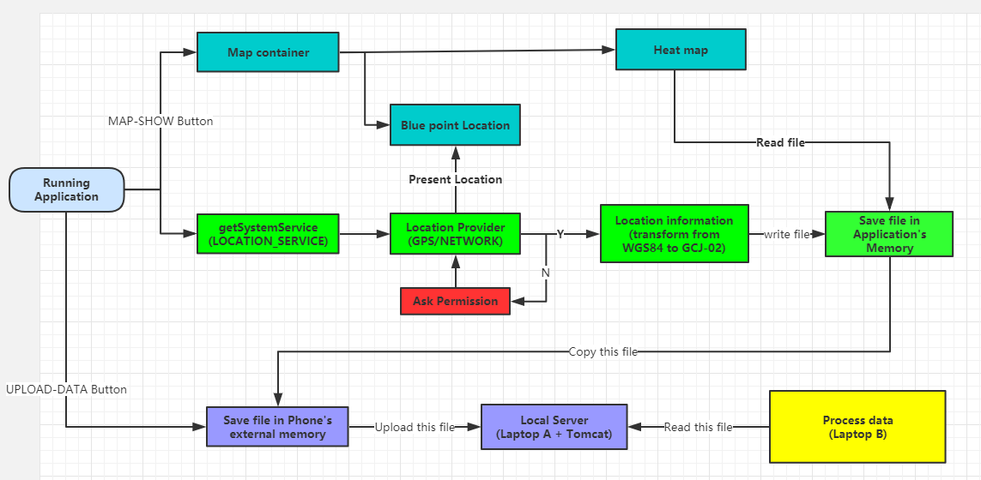
7
The logic diagram of Android application system

Slide 8
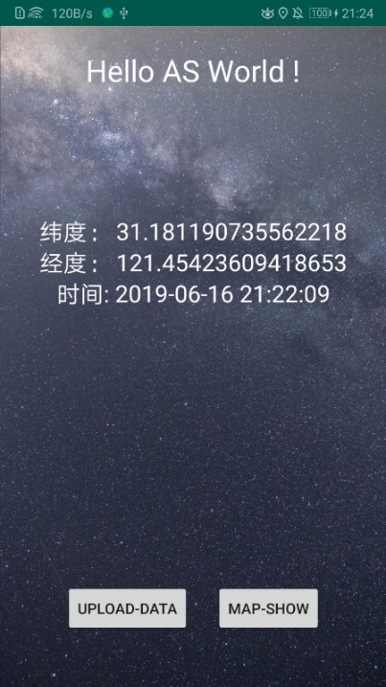
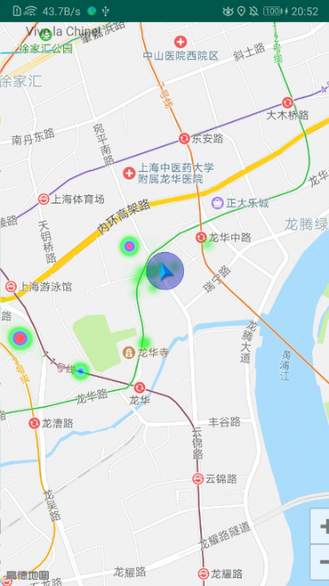
RESULTS
Main page + Map page
Main page: “UPLOAD-DATA”Button for updating and uploading files. “MAP-SHOW” Button for opening map visualization page.
Map page: Map visualization of Heat Map and the Blue Marker.
8

Slide 9
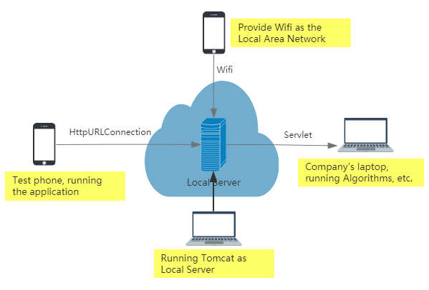
9
The diagrammatic sketch of Project presentation

Slide 10

DEMONSTRATION
APPLICATION
AND SYSTEM

Slide 11
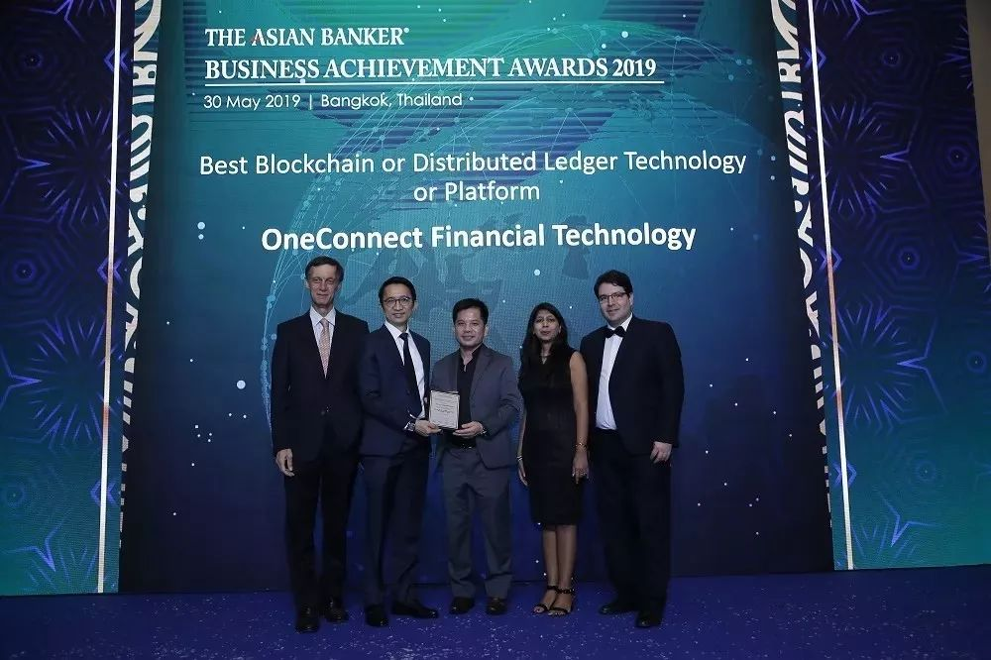
谢谢观赏
MERCI
THANKS

