Slide 1
Know Your Development Environment - Hello Java buddy
2020/12/30 Charlotte

Slide 2
What is the difference J2EE and J2SE? (1/2)
Java SE (J2SE) stands for Java standard edition and is normally for developing applications.
Moving on to this one, Also well-known as Core Java, this is the most basic and standard version of Java. It’s the purest appearance of Java, a basic establishment for all other editions.
It consists of a large range of common purpose API’s (like java.lang, java.util) as well as many particular purpose APIs.
J2SE is used to create applications for Desktop.
In addition, it consists all the basics of Java the language, variables, operators, data types, Arrays, looping, Streams, Strings Java Database Connectivity(JDBC) and much more.

Slide 3
What is the difference J2EE and J2SE? (2/2)
Java EE (J2EE) stands for Java enterprise edition and used for applications which run on servers.
The Enterprise edition of Java has a superior usage of Java, like a growth of web services, networking, server-side scripting and further a variety of web-based applications.
It is a community-driven edition, i.e. there are many of nonstop offerings from industry experts, Java developers, and other open source organizations. Java enterprise versionApart from this, it uses numerous components of J2SE, as well as, holds features like Servlets, Java Message Services and more.
It uses Website designing tools like HTML, CSS, JavaScript, Ajax, Jquery etc, so as to build web pages and web services.

Slide 4
Most popular code
How to start with the IDE tool?
What's the most popular code?
How to run & debug with IDE tool?
What’s Maven, Nexus?

Slide 5
Download & Installation
Download Path
The files of Java course - H:\PASM\PA\Charlotte\Java_courses
Local Repository Files - H:\PASM\PA\Charlotte\mvn_repository
Insatll (Unzip) Software
IntelliJ folder
ideaIC-2020.2.3.win.zip
IntelliJ Plugs-In folder
lombok-plugin-0.33-2020.2.zip
Maven folder
apache-maven-3.6.3-bin.zip
JDK 8
jdk1.8.0_144
Get & Set the CertKey File (cacerts) – in $Download Path\Http-Proxy
Backup the original cacerts file
Copy CertKey to $Your_JDK-Path\security\ folder (eg: C:\WinAP\openjdk-11\lib\security)
Get the setting file of Maven – in $Download Path\Maven-Config
Modify <localRepository>… (in setting.xml file)
Copy setting.xml to $apache-maven-3\conf folder (eg: C:\WinAP\apache-maven-3\conf)

Slide 6
Configuration & Setting - Development Environment
Environment variables setting (FYR - Run_Java-Maven.bat)
Java_Home
SET Java_Home=C:\WinAP\openjdk-11
SET PATH=%Java_Home%/bin;%PATH%
Maven_Home
SET M2_HOME=C:\WinAP\apache-maven-3
SET PATH=%M2_HOME%\bin;%PATH%
Start IntelliJ IDEA
Setup Build Tool - Maven configuration
[Configure/Setting]/[Build/Build Tools/Maven]
Import CA key (ref. file: jdk_cacerts.docx)
Use http proxy for Maven
Setup Plugins
Install Maven Helper from [Marketplace]
Install Lombok from disk (select [install plugin from Disk])
Install Eclipse Formatter from disk (select [install plugin from Disk])

Slide 7
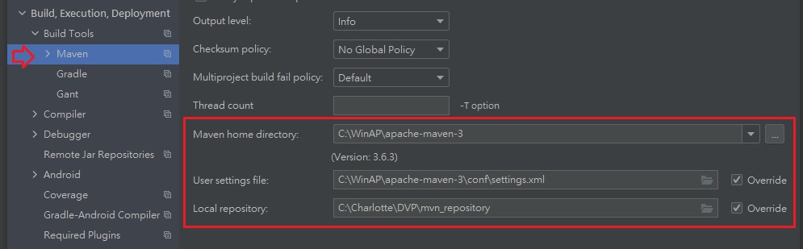
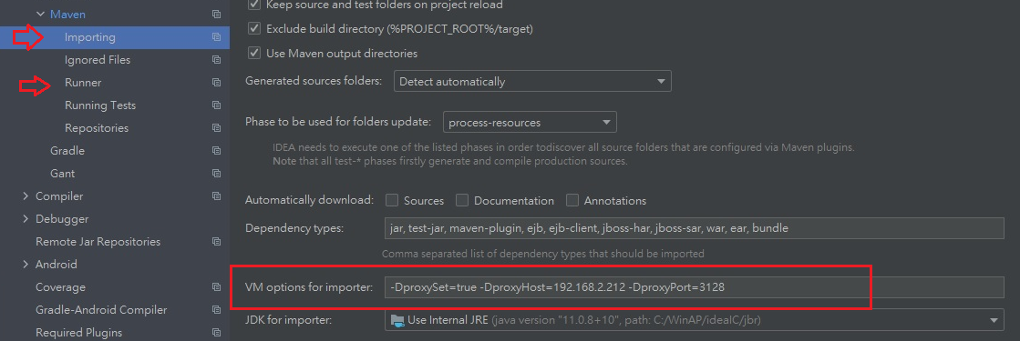
Build Tools – Maven Setting
1
2、3

Slide 8
Create A Spring Boot Project
URL - https://start.spring.io/
Download a zip file
Build project - Run maven (copy command & modify the path of keystore)
clean & package
mvn clean package
Clean & install
mvn clean install
Build with CA key (option)
mvn clean package -Djavax.net.ssl.trustStore=$CertKey_path\MavenKeystore.jks -Djavax.net.ssl.trustAnchors=$CertKey_path\MavenKeystore.jks -Djavax.net.ssl.trustStorePassword=changeit
Open or Import a maven project (Use Intellij IDEA)
Notes:
- Spring-boot run with Argument
> mvn spring-boot:run -Dspring-boot.run.jvmArguments="-Dserver.port=9092"

Slide 9
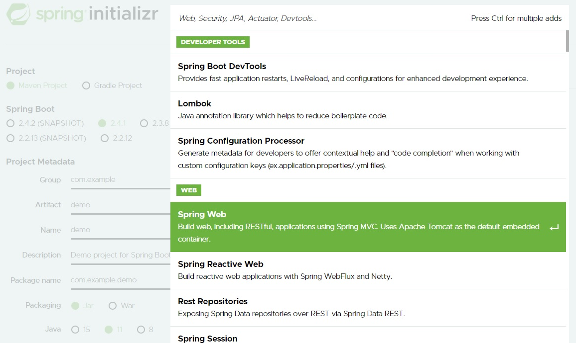

Slide 10
Run & Debug A Spring Boot Project
Run & Debug & Unit Test
Check service port (have trouble to start Spring App)
netstat -ano | findstr 0.0:80
Run by Maven with plug-in
Run > Mvn spring-boot:run –Dspring-boot.run.jvmArguments="-Dserver.port=9092“
OR configure the application.properties file (in $ProjectPath\src\main\resources\application.properties)
Debug
Find out the main program
Right click/[Debug]
public static void main(String[] args) { SpringApplication.run(Testap1Application.class, args); }

Slide 11
Reference
Java 8 vs Java 11 – What are the Key Changes?
10 Best Java Books for Beginners and Advanced Programmers
https://spring.io/quickstart
Debugger Basics in IntelliJ IDEA

