Slide 1
The 3 layers structure of project with Spring Boot.
2021/01/13 Charlotte

Slide 2
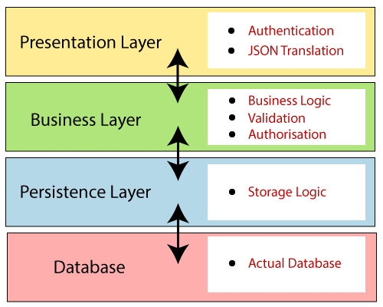
Spring Boot Architecture - Hierarchical Structure

Slide 3
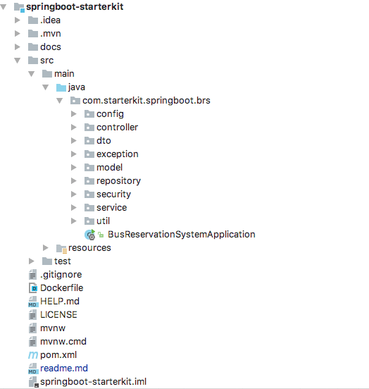
Project Structure and Best Practices
Presentation Layer
Persistence Layer
Business Layer

Slide 4
A 3 layers structure of new project
Spring Initializr
Web, data-jpa, h2 DB, Lombok, Validation, springfox(Swagger3)
Create 3 packages (for each layer)
Repository
Service
Controller
Create unit test (for each layer)

Slide 5
@annotation
@ComponentScan With Arguments
applicationContext.xml配置:
<context:component-scan base-package="com.proc.bean" />
@ComponentScan for Specific Packages
eg: @ComponentScan(basePackages = "com.baeldung.componentscan.springbootapp.animals")
@ComponentScan with Exclusions
eg: @ComponentScan(excludeFilters =
@ComponentScan.Filter(type = FilterType.ASSIGNABLE_TYPE, value = Rose.class))
@Autowired
通過@Autowired自動裝配方式，從IoC容器中去查詢到，並返回給該屬性
那麼使用@Autowired的原理是什麼？ 其實在啟動spring IoC時，容器自動裝載了一個AutowiredAnnotationBeanPostProcessor後置處理器，當容器掃描到@Autowied、@Resource(JSR-250提供的註解)或@Inject(JSR-330提供的註解)時，就會在IoC容器自動查詢需要的bean，並裝配給該物件的屬性
Notes:
* @Autowired
Spring的@Autowired用來依賴注入物件，典型的用法就是掛在類別成員變數上。@Autowired預設會依注入對象的類別型態來選擇容器中相符的物件來注入。
* Spring @Autowired 搭配 @Qualifier 指定注入的Bean
https://matthung0807.blogspot.com/2019/12/spring-autowired-with-qualifier-inject.html

Slide 6
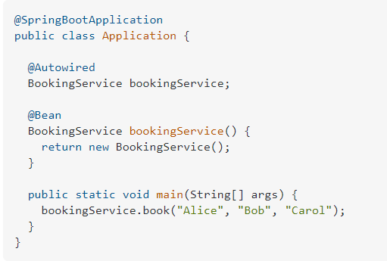
@Bean、@Component、 @Service、 @Repository 和 @Controller註解的區別
@Component: 自動被comonent掃描。 表示被註解的類會自動被component掃描
@Repository: 用於持久層，主要是資料庫儲存庫(DAO層使用)。
@Service: 表示被註解的類是位於業務層的業務component。
@Controller:表明被註解的類是控制component，主要用於展現層 。
@Bean：表示一個方法例項化、配置或者初始化一個Spring IoC容器管理的新物件。
@Bean vs. @Autowired
@Bean tells Spring 'here is an instance of this class, please keep hold of it and give it back to me when I ask'.
@Autowired says ‘please give me an instance of this class, for example, one that I created with an @Bean annotation earlier‘.
【控制反轉與依賴注入】
控制反轉 Inversion of Control - IOC
將控制權交到Spring的手上，讓Spring管理程式中的Bean
依賴注入 Dependency Injection - DI
為實現IOC的手段之一，讓Spring能夠自動創建所需的Bean，並注入到需要這些Bean的地方
Notes:
@Bean、@Component、 @Service、 @Repository 和 @Controller註解的區別
註解後可以被spring框架所掃描並注入到spring容器來進行管理 原文網址：https://kknews.cc/code/ybve63a.html
https://www.itread01.com/content/1543063750.html
@Bean：表示一個方法例項化、配置或者初始化一個Spring IoC容器管理的新物件。 @Component: 自動被comonent掃描。 表示被註解的類會自動被component掃描 @Repository: 用於持久層，主要是資料庫儲存庫。 @Service: 表示被註解的類是位於業務層的業務component。 @Controller:表明被註解的類是控制component，主要用於展現層 。
* @Bean vs. @Autowired
@Bean tells Spring 'here is an instance of this class, please keep hold of it and give it back to me when I ask'.
@Autowired says 'please give me an instance of this class, for example, one that I created with an @Bean annotation earlier'.

Slide 7
Persistence Layer
@Repository
@Repository is a Spring annotation that indicates that the decorated class is a repository. A repository is a mechanism for encapsulating storage, retrieval, and search behavior which emulates a collection of objects.
You need not write an implementation of the repository interface. Spring Data JPA creates an implementation when you run the application.
Derived Query Methods in Spring Data JPA Repositories
By keyword; Spring Data JPA supports find, read, query, count and get.
List<User> findByName(String name) => List<User> queryByName(String name)
the above-derived method will be translated to the following JPQL query:
SELECT u from User u WHERE u.name = ?1
Multiple Parameters
List<User> findByNameOrEmail(String name, String email);
Pagination and Sorting using Spring Data JPA
Notes:
Java Persistence Query language
https://www.tutorialspoint.com/jpa/jpa_jpql.htm
JPQL is Java Persistence Query Language defined in JPA specification. It is used to create queries against entities to store in a relational database. JPQL is developed based on SQL syntax. But it won’t affect the database directly.
JPQL can retrieve information or data using SELECT clause, can do bulk updates using UPDATE clause and DELETE clause. EntityManager.createQuery() API will support for querying language.
Derived Query Methods in Spring Data JPA
https://attacomsian.com/blog/derived-query-methods-spring-data-jpa
Just define the query methods in a repository interface that extends one of the Spring Data's repositories such as CrudRepository. Spring Data JPA will create queries automatically by parsing these method names.

Slide 8
Business Layer
Spring 使用@Autowired注入物件時，如果該類型有多個@Bean實例時，可以搭配@Qualifier控制要注入哪個實例。
若有多個Bean實例但沒用@Qualifier指明注入的對象，例如把上面@Qualifier移除，則Spring程式啟動時會出現錯誤。
使用@Qualifier注入指定Bean的時候，若沒有指明Bean的名稱，則其預設名稱是首字母小寫的類名。
Spring Boot 注入介面 @Autowired interface
使用 spring-boot-starter-actutor (for monitoring)
Add service interface & @Service
Java 為什麼在Service層要使用Interface
在擴充上比較容易
在寫單元測試的時候比較容易
Notes:
* Spring @Autowired 搭配 @Qualifier 指定注入的Bean
https://matthung0807.blogspot.com/2019/12/spring-autowired-with-qualifier-inject.html
* SpringBoot - 監控工具 Actuator
https://kucw.github.io/blog/2020/7/spring-actuator/
* Spring Boot Actuator
https://www.baeldung.com/spring-boot-actuators
* Actuator: Spring Boot Production Monitoring and Management
https://www.vojtechruzicka.com/spring-boot-actuator/
Spring Boot Admin
https://mistech.pixnet.net/blog/post/466588625-spring-boot-admin-%E5%BC%B7%E5%A4%A7%E7%9A%84-spring-boot-%E7%9B%A3%E6%8E%A7%E5%B7%A5%E5%85%B7
codecentric's Spring Boot Admin
https://github.com/codecentric/spring-boot-admin
* Java 為什麼在Service層要使用Interface
https://matthung0807.blogspot.com/2017/12/java-serviceinterface.html
* Spring Boot 注入介面 @Autowired interface
https://www.itread01.com/content/1544909949.html
新增spring-boot-starter-actutor
定義Interface for service

Slide 9
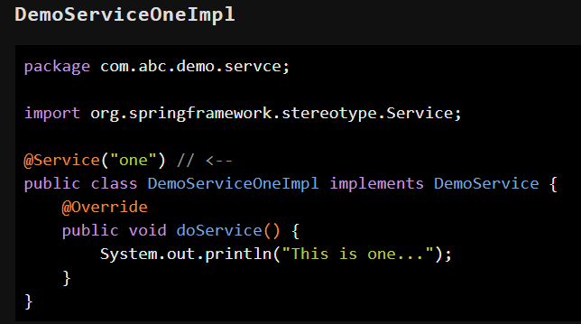
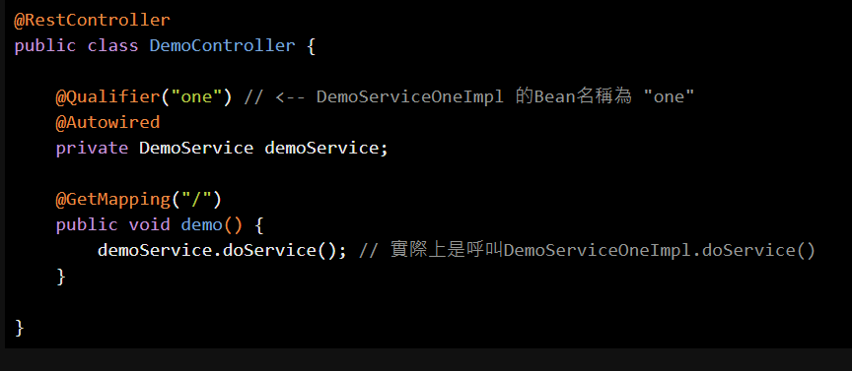
Practice of Interface

Slide 10
Presentation Layer - Controller
@RestController = @Controller+@ResponseBody
從Spring MVC 4.0的多了@RestController，與傳統@Controller的差別其實只是@RestController等於@Controller搭配@ResponseBody
在撰寫RESTful API時，因為通常都是回傳json或xml，所以回傳無須交由View Resolver處理來返回頁面，所以會在Controller的API方法前加上@Responsebody來達成
@GetMapping，@PostMapping，@PutMapping，@DeleteMapping，@PatchMapping等對應RESTful API的HTTP method：GET，POST，PUT，DELETE，PATCH等
Using HTTP Methods for RESTful Services
REST API Best practices
produces=MediaType.APPLICATION_JSON_UTF8_VALUE 等於 Response HeadersContent-Type 的 "application/json;charset=UTF-8"
10 Best Practices for Better RESTful API
Use nouns and not verbs for resources
Use sub resources for relations
Use PLURAL nouns
and more ....
Notes:
Spring MVC @RestController與@Controller的區別
https://matthung0807.blogspot.com/2018/03/spring-mvc-restcontrollercontroller.html
從Spring MVC 4.0的多了@RestController，與傳統@Controller的差別其實只是@RestController等於@Controller搭配@ResponseBody。
在撰寫RESTful API時，因為通常都是回傳json或xml，所以回傳無須交由View Resolver處理來返回頁面，所以會在Controller的API方法前加上@Responsebody來達成而在4.0後可改用@RestController，則該Controller類別中的方法回傳值都將預設為@ResponseBody，所以原本方法前的@ResponseBody就可以拿掉了
* REST API Best practices
Use nouns and not verbs for resources
Use sub resources for relations
Use PLURAL nouns
* 10 Best Practices for Better RESTful API
1. Use nouns but no verbs
2. GET method and query parameters should not alter the state
3. Use plural nouns
4. Use sub-resources for relations
5. Use HTTP headers for serialization formats
6. Use HATEOAS
7. Provide filtering, sorting, field selection and paging for collections
8. Version your API
9. Handle Errors with HTTP status codes
The HTTP standard provides over 70 status codes to describe the return values.
https://developer.mozilla.org/zh-TW/docs/Web/HTTP/Status
10. Allow overriding HTTP method
Some proxies support only POST and GET methods. To support a RESTful API with these limitations, the API needs a way to override the HTTP method.

Slide 11
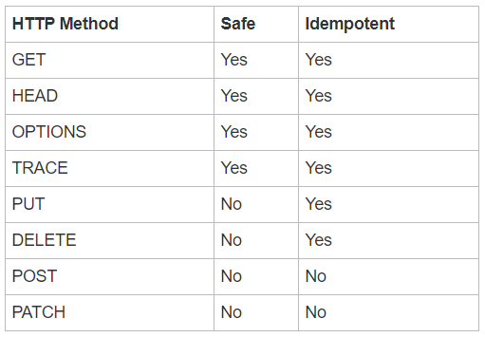
HTTP methods: Idempotency and Safety
Idempotency means that multiple identical requests will have the same outcome. So it does not matter if a request is sent once or multiple times. The following HTTP methods are idempotent: GET, HEAD, OPTIONS, TRACE, PUT and DELETE. All safe HTTP methods are idempotent but PUT and DELETE are idempotent but not safe.
Safe HTTP methods - HTTP methods are considered safe if they do not alter the server state. So safe methods can only be used for read-only operations. The HTTP RFC defines the following methods to be safe: GET, HEAD, OPTIONS and TRACE.
Notes:
* HTTP methods: Idempotency and Safety
https://www.mscharhag.com/api-design/http-idempotent-safe

Slide 12
Version Control – Git repository
Local Git repository
> cd <local simple-webap1 folder>
> git init
> git add HELP.md
> git commit -m "first commit"
Create a remote Git repository in GitHub/GitLab
> cd <local simple-webap1 folder>
> git branch -M <DEV/main>
> git remote add origin <remote Git repository: simple-webap1.git>
> git push -u origin <DEV/main>
使用Intellij IDEA上傳本地專案到遠端Git倉庫
Notes:
* Git 入門指南
https://backlog.com/git-tutorial/tw/stepup/stepup2_2.html

Slide 14
Reference
Spring Boot 2.0 — Project Structure and Best Practices
(Part 1)
(Part 2)
Spring Boot 2.x基礎教程：使用SpringFox 3生成Swagger文件
Introduction to Project Lombok
JUnit 5 tutorial, part 2: Unit testing Spring MVC with JUnit 5
一次搞懂POJO、PO、DTO、VO、BO
Spring中的 @RestController 和 @Controller
Spring Boot @Repository
Accessing Data with JPA
Application properties
Core Technologies of Spring
Spring Boot Apprentice Cookbook
https://medium.com/chikuwa-tech-study/spring-boot-%E7%AC%AC1%E8%AA%B2-%E5%BB%BA%E7%AB%8B%E5%88%9D%E5%A7%8B%E5%B0%88%E6%A1%88-214ff084f787
Notes:
Spring Boot-第13課-配置應用程式設定值
https://medium.com/chikuwa-tech-study/spring-boot-%E7%AC%AC13%E8%AA%B2-%E9%85%8D%E7%BD%AE%E6%87%89%E7%94%A8%E7%A8%8B%E5%BC%8F%E8%A8%AD%E5%AE%9A%E5%80%BC-1e25cf7c8e23
Properties with Spring and Spring Boot
https://www.baeldung.com/properties-with-spring
* Intellij IDEA Remote debug (TODO)
https://www.jetbrains.com/help/idea/tutorial-remote-debug.html#Tutorial__Remote_debug-2-chapter
* Spring Boot Apprentice Cookbook (TODO)
* Complete Guide to Exception Handling in Spring Boot
https://reflectoring.io/spring-boot-exception-handling/
* Spring Boot-第1課-建立初始專案
https://medium.com/chikuwa-tech-study/spring-boot-%E7%AC%AC1%E8%AA%B2-%E5%BB%BA%E7%AB%8B%E5%88%9D%E5%A7%8B%E5%B0%88%E6%A1%88-214ff084f787
* Spring Boot-第2課-設計RESTful API
https://medium.com/chikuwa-tech-study/spring-boot-%E7%AC%AC2%E8%AA%B2-restful-api%E4%BB%8B%E7%B4%B9-955f776da32d
* Spring Boot-第4課-在Controller實作API（二
https://medium.com/chikuwa-tech-study/spring-boot-%E7%AC%AC4%E8%AA%B2-controller%E7%9A%84%E4%BD%BF%E7%94%A8-%E4%BA%8C-b0a38d0af940

