Slide 1

DISCOVER OPENUI5
– THE NEW WEB UI LIBRARY FROM SAP
Frederic Berg, Andreas Kunz / SAP AG
DJ Adams / Bluefin Solutions

Slide 2
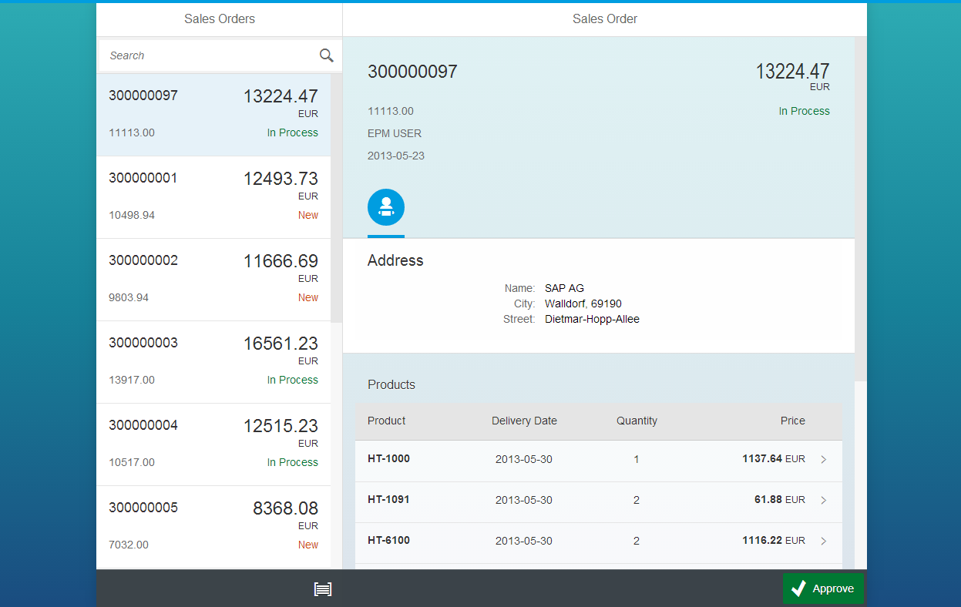
Agenda
Get your hands dirty and code a cross-device application
with OpenUI5
OpenUI5 Overview, Today’s App
(Slides, 10 mins)
Exercise 0 “Getting Started”
(Demo, 10 mins)
Exercise 1 “Resource Model”
(Instructor led hands-on, 10 mins)
Remaining Exercises (2 -> 10)
(All participants hands-on, about 2 hours)

Slide 3
OpenUI5
JavaScript UI library
Huge number of UI controls
MVC, data binding, templating, …
“Enterprise-grade”
Most current browsers and (touch) devices
Responsive design
Is Open Source, uses Open Source
Notes:
[ANDREAS]
Explain that the example app was of course built with UI5 and we actually talk about UI5
JS: runs in browser, completely independent of backend, web dev skillset
Controls: ~180
Features: models: XML, JSON, Odata…. +routing,…
Enterprise Grade: we come to that later
Browsers: mention HTML5 – and that we avoided this buzzword in the slides ;-)
Devices: touch or non-touch, just works everywhere.
Devices/design: across mouse/touch devices with ONE codebase; responsive to fit different screens
OS: Apache license, so free even for commercial usage.
OS: mention jQuery and that we did try not to re-invent the wheel, at least where there was a suitable wheel already

Slide 4
First Look: Hello OSCON World!
Notes:
[ANDREAS]
Explain that the example app was of course built with UI5 and we actually talk about UI5
JS: runs in browser, completely independent of backend, web dev skillset
Controls: ~180
Features: models: XML, JSON, Odata…. +routing,…
Enterprise Grade: we come to that later
Browsers: mention HTML5 – and that we avoided this buzzword in the slides ;-)
Devices: touch or non-touch, just works everywhere.
Devices/design: across mouse/touch devices with ONE codebase; responsive to fit different screens
OS: Apache license, so free even for commercial usage.
OS: mention jQuery and that we did try not to re-invent the wheel, at least where there was a suitable wheel already

Slide 5
OpenUI5 Related Resources
Resource | Link / Description
Homepage | http://openui5.org/
GitHub Page | https://github.com/SAP/openui5/
OpenUI5 SDK | https://openui5.hana.ondemand.com/ Overview, Developer Guide, Controls, API Reference, Demo Apps
Help & Discussions | http://stackoverflow.com/questions/tagged/sapui5 http://scn.sap.com/community/developer-center/front-end/content

Slide 6
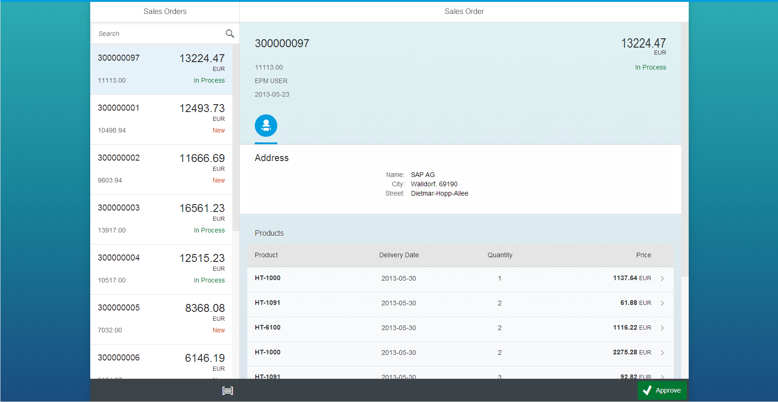
Today’s App: Approve Sales Order
Notes:
Open the application in the browser and explain
General Layout
Main Controls
Navigate and show update of detail area
Navigate to line item details

Slide 7
Model View Controller - MVC
View XML, Java Script, JSON, HTML
Controller
control
marshall events
data binding
Model
JSON, XML or OData
control
Notes:
Explain the general concept of MVC
User Input on View
Handling of all user triggered actions on controller
Model holds data and is connected to view

Slide 8
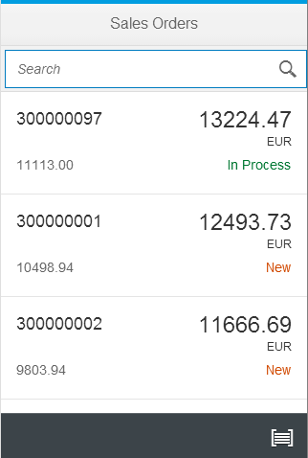
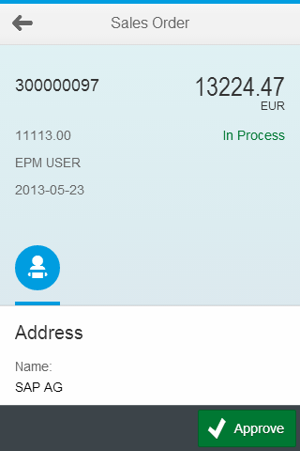
Approve Sales Order App - MVC
App View & Controller
Master View & Controller
Detail View & Controller
Model
Notes:
Explain step-by-step using animation
Master View and Controller (2 files) which create master list
Detail View and Controller (2 files) which create detail screen
App View combines the two into an application incl. Navigation and Data Model

Slide 9
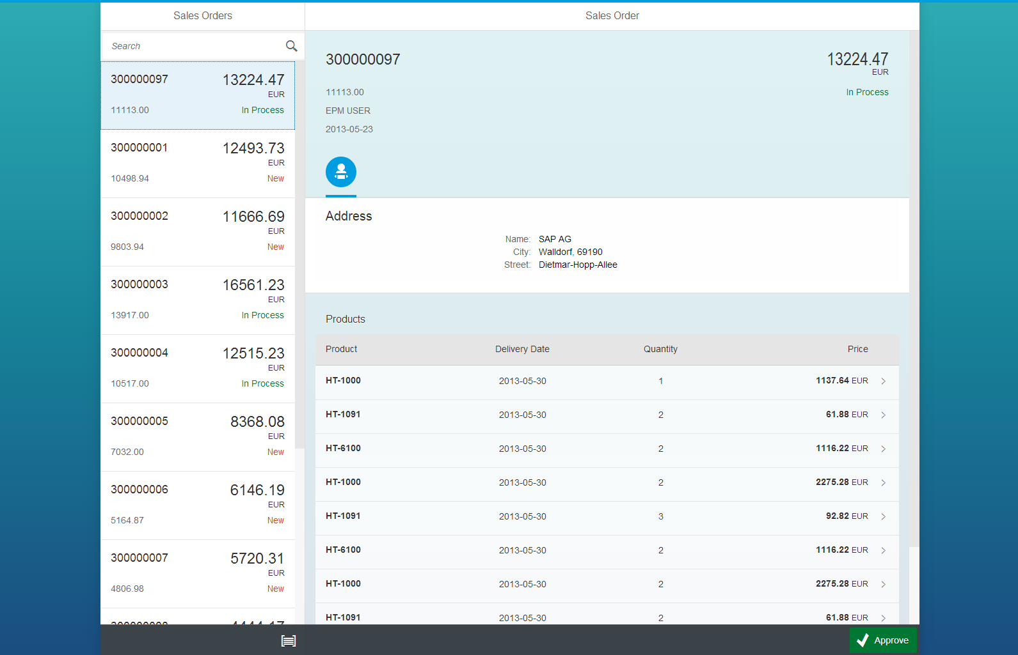
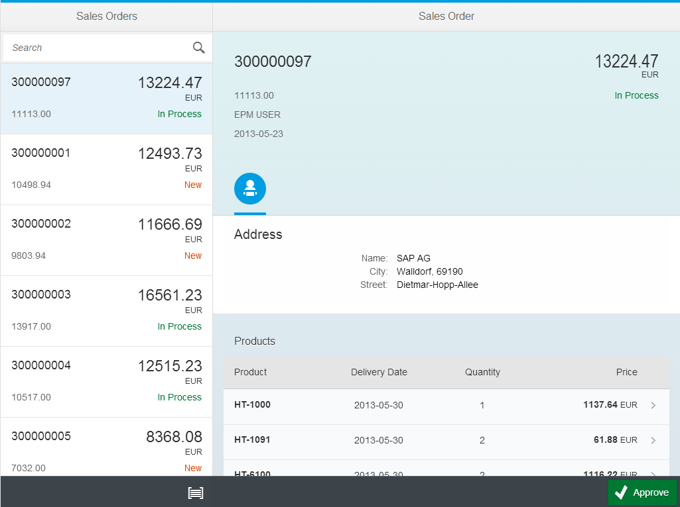
SAP Fiori Application Details – User Interfaces
sap.m.SplitApp
Master Page
Detail Page
sap.m.SplitApp
Master Page
Detail Page
sap.m.App
Master Page
Detail Page
Phone
Tablet
Desktop
Notes:
Explain that this concept holds true for the entire device spectrum.
The only difference (due to responsiveness) comes later in the tutorial when the SplitApp is introduced. Side by Side display of views now possible with automatic adaptation to available screen width.

Slide 10
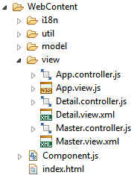
Application Details – Files & Architecture
index.html
trigger
Component.js
App View
App Controller
sap.m.App / sap.m.SplitApp
Navigation
call
Master Controller
Detail Controller
…
Master View
Detail View
…
sap.m.Page
sap.m.Page
Mock Model
i18n Model
call
call
call
util (Formatter.js, Grouper.js)
Notes:
Explain general file structure which will be seen in the hands-on tutorial application:
i18n for internationalization files
Util for general utility functions
Model for sample data
View holds all view/controller combinations
Component.js as main entry point into application
Index.html as start page for browser (one page application)

Slide 11
Exercise Preparation
Developing OpenUI5 Applications
node.js
Any text editor
Current browser (Google Chrome recommended for the exercises)
https://github.com/BluefinSolutions/OpenUI5-OSCON-2014
→ Setup instructions are in SETUP.md

Slide 12

Thank You
Visit our booth (#706 - SAP / OpenUI5)
Related sessions:
  Open Source in Enterprise Software (Sanjay Patil)
    Tomorrow (July 22nd), 10:40 am, E142
  OpenUI5 – The New Responsive Web UI Library (Frederic Berg, Andreas Kunz)
  Tomorrow (July 22nd), 5:00 pm, Portland 252
Links:
  http://openui5.org
  https://openui5.hana.ondemand.com
: @OpenUI5

