Slide 1
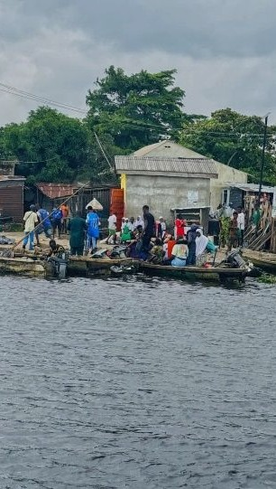

BLUE LAGOS
From Riverine Communities to Better Decisions
134 communities | 502,002 people represented
COMMUNITY • EVIDENCE • ACTION
Blue Lagos Sustainability Initiative
SEPTEMBER 2026
Notes:
MAIN MESSAGE
Blue Lagos connects direct community engagement, practical action and better planning for riverine Lagos.
SAY THIS
Your Excellency, thank you for the opportunity. Blue Lagos works directly with riverine communities to understand their needs and connect those needs to practical action. Today I will briefly show who we are, what we have done, what the field evidence is telling us, and how Lagos State can use this foundation to plan better interventions.
TECHNICAL BACKUP
The 502,002 figure is the sum of current community-reported population values across all 134 records in the verified field register, updated September 2026.

Slide 2
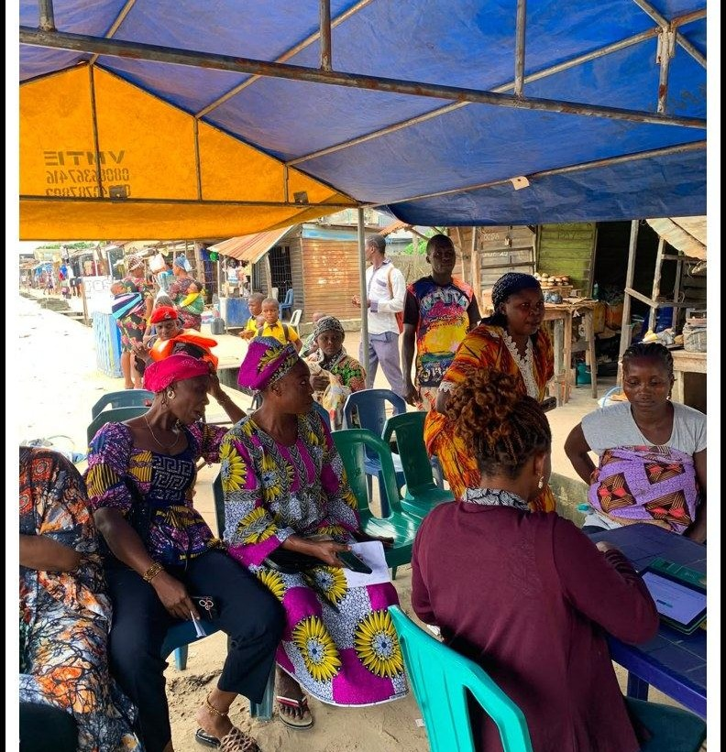
WHO WE ARE
02
Blue Lagos listens, understands and acts.
We work with Lagos' riverine communities to turn local evidence into practical action.
01
LISTEN
Engage directly with communities and local leadership.
02
UNDERSTAND
Collect and map community-level evidence.
03
ACT
Connect needs to interventions and partnerships.
Our focus is the riverine and coastal communities where access, health, infrastructure, livelihoods and environmental pressure differ from inland Lagos.
Blue Lagos field engagement photograph, reproduced from the Community Baseline Report.
BLUE LAGOS | 02
Notes:
MAIN MESSAGE
Blue Lagos is a community-facing initiative built around listening, understanding and practical action.
SAY THIS
Before the numbers, it is important to say who we are. Blue Lagos listens by engaging communities and their local leadership. We understand by collecting and mapping community-level evidence, and we act by connecting that evidence to practical interventions and partners. Our focus is riverine and coastal Lagos, where daily realities are different from inland, road-connected communities.
TECHNICAL BACKUP
The initiative's documented work includes community enumeration, direct field engagement, telemedicine facilitation, civic inclusion support, the Yegunda water intervention and the Community Map.

Slide 3
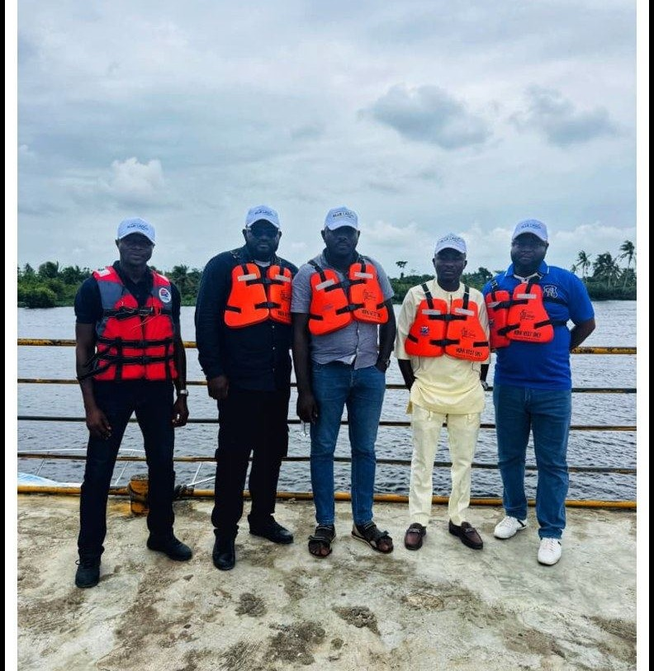
HOW BLUE LAGOS WORKS
03
From community relationships to practical response.
Our role is to stay close enough to communities to understand the need, organize the evidence and help bring the right response together.
01
COMMUNITY PRESENCE
Reach communities directly, including places where the journey depends on water.
02
STRUCTURED EVIDENCE
Turn local knowledge into a register that can be compared community by community.
03
PRACTICAL RESPONSE
Work with communities and partners on health, water, civic inclusion and planning.
Blue Lagos is the bridge from what communities say to what partners and government can act on.
Blue Lagos field team photograph, reproduced from the Community Baseline Report.
BLUE LAGOS | 03
Notes:
MAIN MESSAGE
Blue Lagos combines community presence, structured evidence and practical response.
SAY THIS
Blue Lagos begins with relationships, not software. We reach communities directly, including places where access depends on water. We organize what communities tell us into evidence that can be compared and used, then work with communities, partners and government around practical responses. That bridge between local experience and coordinated action is the role Blue Lagos is building.
TECHNICAL BACKUP
The next slides separate the verified register, field findings, delivered activities and planning analysis so that each claim retains its correct source.

Slide 4
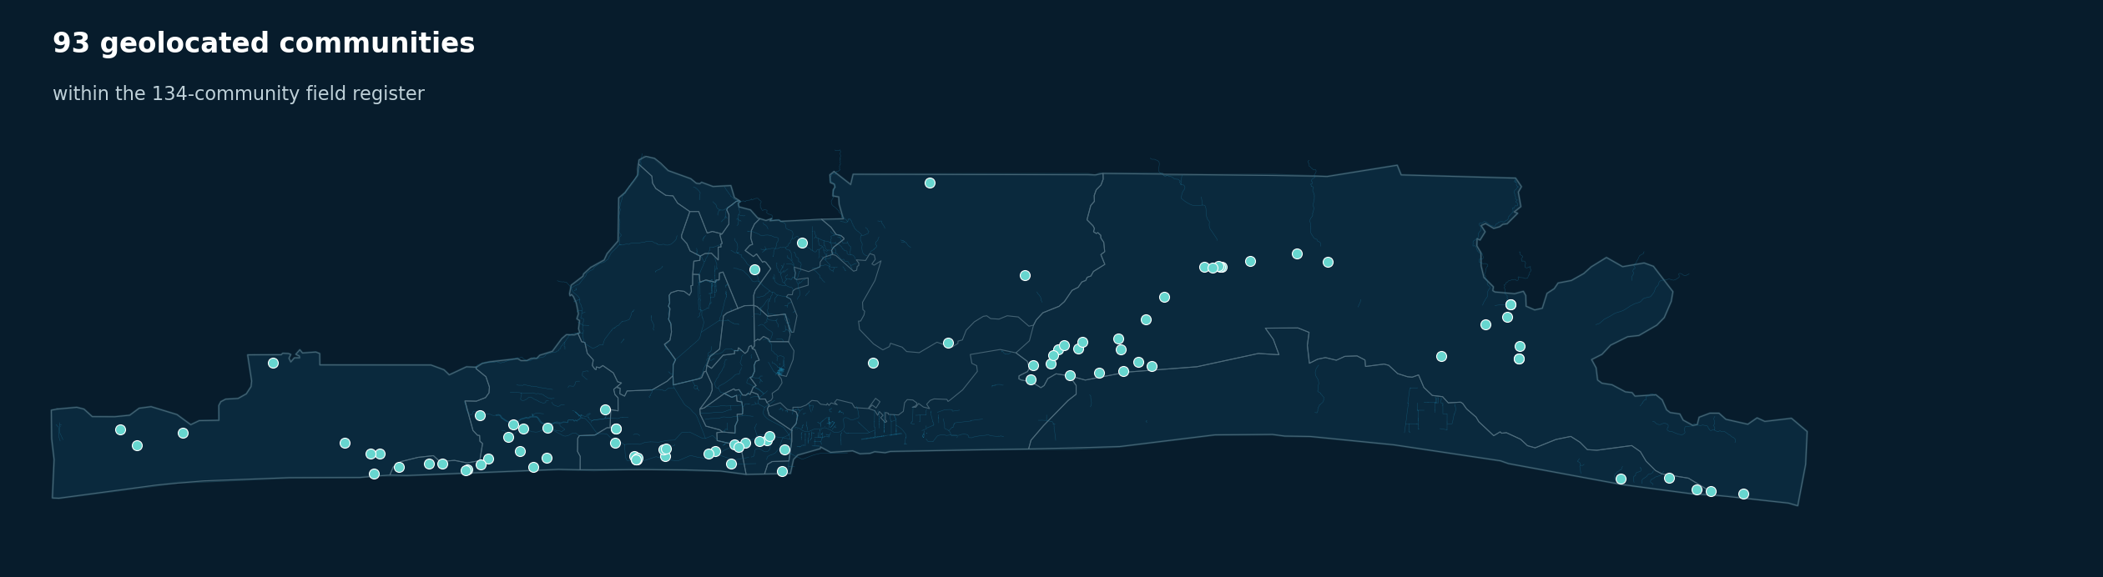
WHAT BLUE LAGOS DID
04
We started by going community by community.
Actual community-level evidence now supports a clearer view of riverine Lagos.
134
502,002
communities enumerated
people represented
18
communities physically visited
Up to 18 across participating LGAs
Population • Health • Water + sanitation • Access • Infrastructure • Livelihoods • Flood + erosion • Community priorities
93 currently geolocated
7 LGAs in the register
Sources: Blue Lagos field register; GRID3 2022 boundaries via geoBoundaries; OSM waterways.
BLUE LAGOS | 04
Notes:
MAIN MESSAGE
Blue Lagos built the evidence base community by community and has physically engaged communities across the participating LGAs.
SAY THIS
We did not start by trying to build a dashboard. We started by identifying the communities themselves. Today our structured register covers 134 riverine communities representing 502,002 people, and our team has physically visited up to 18 communities across the participating LGAs. We collected evidence about population, health, water, access, infrastructure, livelihoods, the environment and community priorities.
TECHNICAL BACKUP
The 134 and 502,002 figures come from the verified September 2026 register. Ninety-three records currently have usable coordinates; the physical-visit figure is the current Blue Lagos programme total supplied for this presentation.

Slide 5
WHAT THE DATA IS TELLING US
05
The communities are different, but the same problems keep appearing.
HEALTH + WATER
ACCESS
ENVIRONMENT
INFRASTRUCTURE
LIVELIHOODS
83.6%
80.6%
22.4%
93.1%
64.9%
No formal first-aid point
Unmotorised boat or no medical evacuation
Reported loss of land or housing to erosion
No school beyond primary inside the community
Fishing is the primary occupation
Different communities carry different combinations, but health, access, environment, infrastructure and livelihoods repeatedly overlap.
Source: Blue Lagos Community Baseline Report, August 2026; shares of 134 surveyed communities.
BLUE LAGOS | 05
Notes:
MAIN MESSAGE
The recurring pattern is overlapping pressure across health, access, environment, infrastructure and livelihoods.
SAY THIS
The communities are not identical, but the same broad problems keep appearing in different combinations. We see gaps in health and water, difficult physical access, environmental pressure, missing infrastructure and livelihoods constrained by geography. Fishing remains the primary occupation in almost two-thirds of the surveyed communities, so access and environmental conditions also affect household income.
TECHNICAL BACKUP
Percentages come from fixed-category field responses in the August 2026 baseline report and raw field register. They are shares of the 134 surveyed communities and do not imply that every community has every problem.

Slide 6
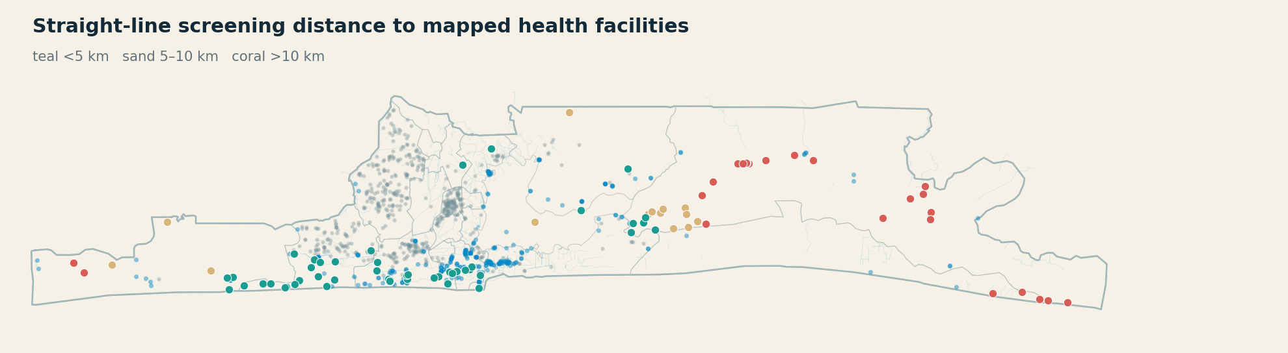
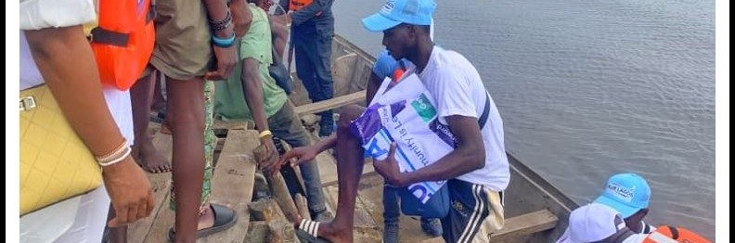
HEALTH, WATER + EMERGENCY ACCESS
06
Healthcare is not only about having a facility nearby.
For many communities, the health journey begins at the landing point.
No formal first-aid point
83.6%
No motorised medical evacuation
80.6%
Open or open-water defecation
81.3%
Well as primary drinking water
61.9%
Planning implication
Health outreach, safe water and emergency movement need to be planned together.
Sources: baseline report; Blue Lagos spatial context; OSM mapped health facilities. Distances are straight-line.
BLUE LAGOS | 06
Notes:
MAIN MESSAGE
Healthcare access combines facility availability, safe water, sanitation and the practical ability to move a patient.
SAY THIS
A clinic is not truly accessible if a patient cannot get safely from the community to the route. The field evidence shows major gaps in first aid, motorised evacuation, sanitation and drinking water. The map adds straight-line screening distance to the nearest mapped health facility, but the real journey can still be harder because it may depend on water transport.
TECHNICAL BACKUP
The percentages are survey response shares. Facility distances use great-circle distance to OSM-mapped health facilities; they are not travel time and do not verify that a mapped facility is operational.

Slide 7
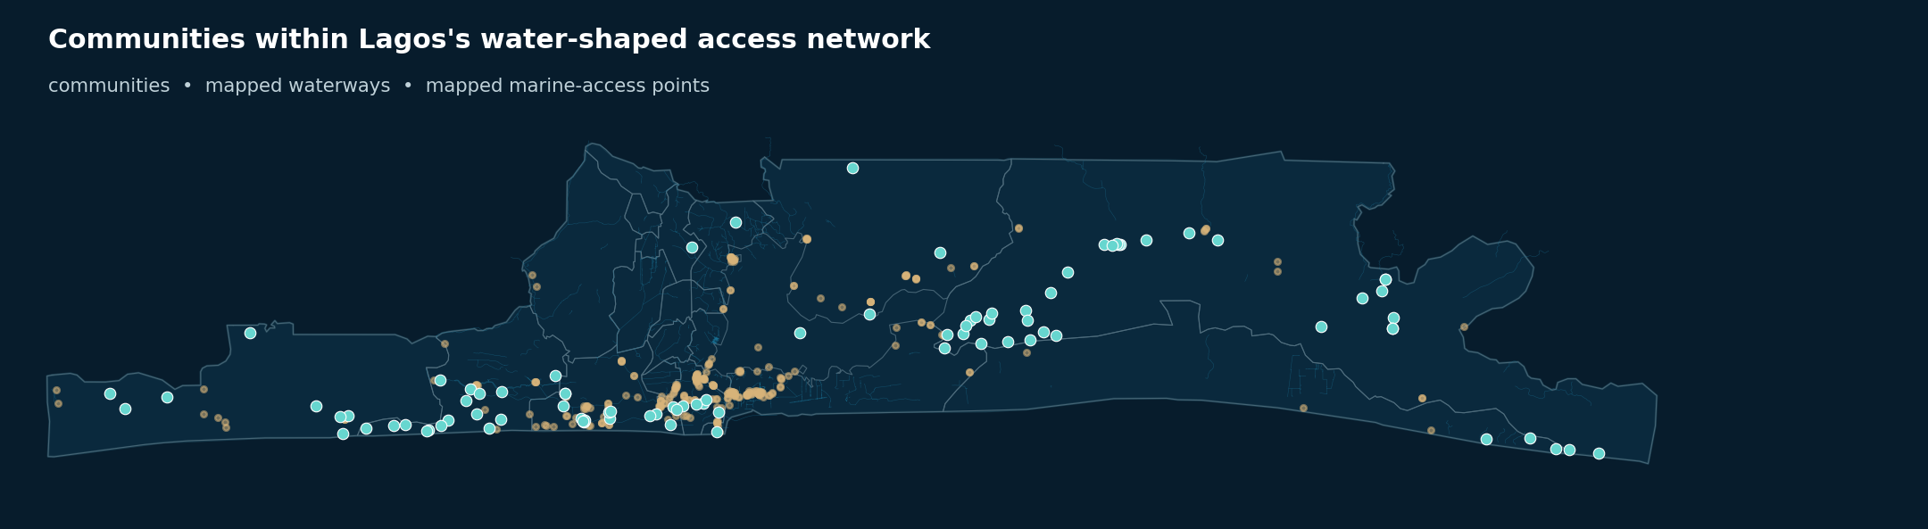
ACCESS AND THE WATER NETWORK
07
Water is part of the transport network.
Communities, waterways and landing points have to be understood together.
WATER-RELIANT ACCESS AFFECTS
Emergency evacuation
Healthcare
Education
Markets and jobs
Government services
Road planning alone cannot explain practical reach.
Sources: field register; OSM mapped waterways and marine-access points. Navigability is not asserted.
BLUE LAGOS | 07
Notes:
MAIN MESSAGE
Waterways and landing points are part of the service-delivery system for riverine communities.
SAY THIS
For many communities, water is part of the transport network. That affects emergency evacuation, healthcare, education, access to markets and jobs, and even how government teams reach residents. Looking only at roads leaves out a major part of how these communities move.
TECHNICAL BACKUP
The map combines geolocated survey communities with OSM-mapped waterways and marine-access points. These are contextual open-mapping features, not an official jetty register or a verified navigable network.

Slide 8
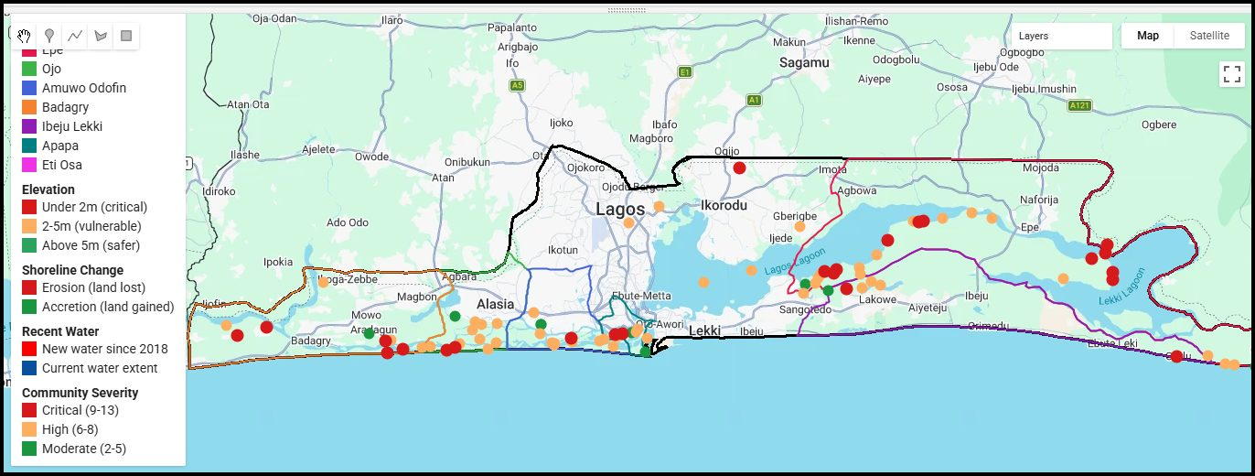
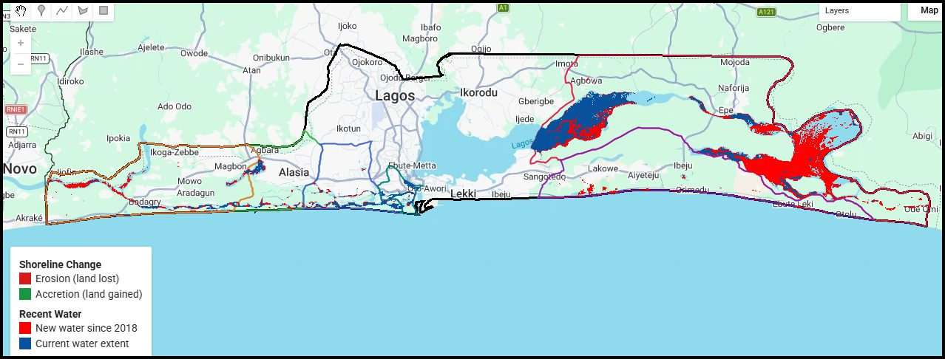
FLOODING, EROSION + ENVIRONMENT
08
Environmental pressure is already part of daily life.
Field experience and historical spatial evidence point to pressure on settlement, housing and livelihoods.
22.4%
of surveyed communities reported losing living space or houses to erosion or water encroachment in the previous five years.
Read the two evidence types separately
Community impacts are field-reported. The maps reproduce historical analysis from the August baseline report.
Figures reproduced from Blue Lagos Community Baseline Report, sections 3.9 and 5.4.
BLUE LAGOS | 08
Notes:
MAIN MESSAGE
Environmental pressure is already experienced as loss of land, housing and livelihood security.
SAY THIS
Communities are not discussing flooding and erosion as distant climate concepts. More than one in five reported losing living space or houses to erosion or water encroachment. These report maps add historical spatial context, while the community impacts remain field evidence.
TECHNICAL BACKUP
The cartography is reproduced from the August 2026 baseline report. It is not presented as a live platform layer or new satellite analysis.

Slide 9
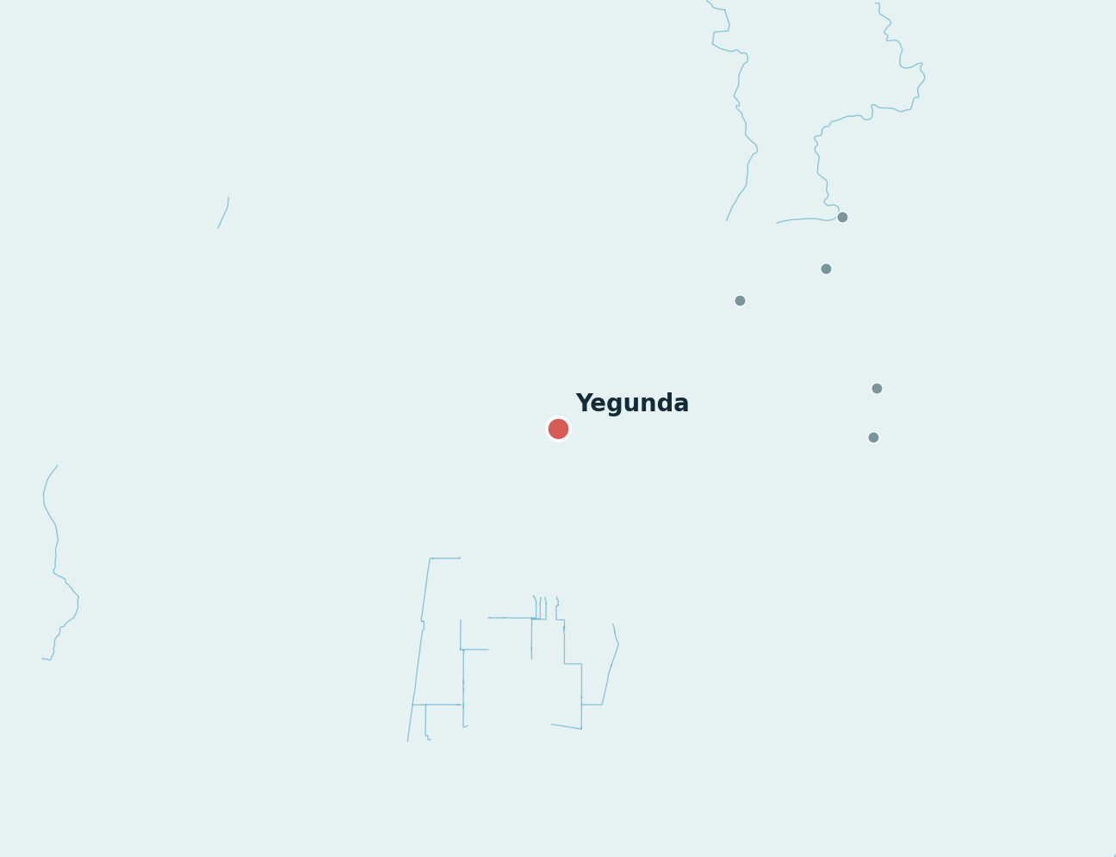
ONE COMMUNITY
09
Every dot on the map has a different story.
Yegunda Community, Epe
312
community-reported population
Road + water
primary visit route
HEALTH
No medical evacuation means recorded; traditional first aid
WATER + SANITATION
Well water; open defecation recorded at baseline
ENVIRONMENT
Flood water reported to stagnate for 1–2 weeks
ACCESS
Wooden landing; no mapped marine access point within 5 km
COMMUNITY REQUEST
Water, health, education, power and a jetty
Baseline conditions show why a practical water intervention matters here.
Sources: Blue Lagos field register and baseline responses; spatial context updated September 2026.
BLUE LAGOS | 09
Notes:
MAIN MESSAGE
The platform can move from the State view to a specific community record without losing context.
SAY THIS
Yegunda is one example. Its baseline combines a road-and-water route, no recorded medical evacuation means, well water, open defecation, prolonged flood stagnation and a wooden landing. Its stated priorities included water, health, education, power and a jetty. The point is not that every community is the same, but that each one can be understood on its own evidence.
TECHNICAL BACKUP
The population is a community-reported estimate and is not a borehole beneficiary count. The marine-access statement is based on OSM-mapped points and straight-line proximity.

Slide 10
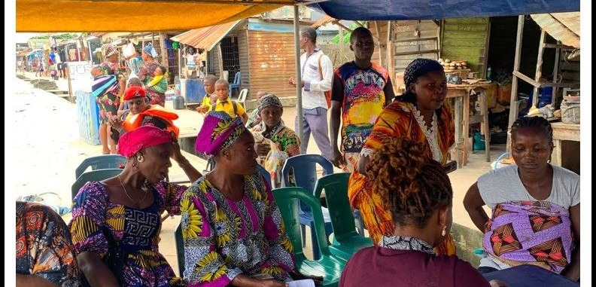
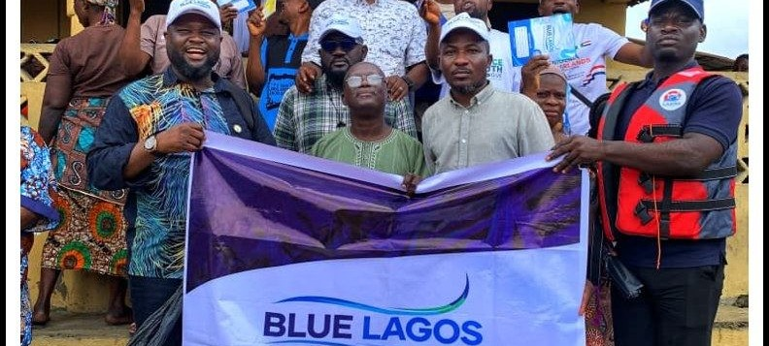
WHAT BLUE LAGOS HAS ALREADY DONE
10
We did not stop at collecting data.
INSERT YEGUNDA SOLAR BOREHOLE FIELD PHOTO
TELEMEDICINE
CLEAN WATER
CIVIC INCLUSION
120
Yegunda Community, Epe
PVC registration support
communities
Telemedicine support facilitated across riverine communities.
Solar-powered borehole donated or facilitated by Blue Lagos.
Facilitated in selected communities to support fuller participation in civic processes.
No beneficiary count claimed
The field register is not just for reporting. It can help direct action.
Source: Blue Lagos programme records. No telemedicine, borehole or PVC beneficiary count is inferred beyond the stated facts.
BLUE LAGOS | 10
Notes:
MAIN MESSAGE
Blue Lagos has already connected field evidence to health, water and civic-inclusion action.
SAY THIS
We did not stop at collecting data. Blue Lagos facilitated telemedicine support across 120 riverine communities. In Yegunda Community, Epe, we donated or facilitated a solar-powered borehole, and we have also supported PVC registration activities in selected riverine communities so residents can participate more fully in civic processes. These actions show how a community register can help direct practical response.
TECHNICAL BACKUP
No PVC-registration or borehole beneficiary count is claimed. The telemedicine figure is the corrected programme total of 120 communities supplied for this presentation.

Slide 11
FROM FIELDWORK TO THE COMMUNITY MAP
11
We needed one place to connect all of this evidence.
Communities
Needs
Access
Environment
Planning
Overview
Community Map
Priorities
Scenarios
LAYER THE EVIDENCE
COMMUNITY
✓
Surveyed communities
Yegunda
✓
LGA boundaries
Epe Road + water access Priority: water, health, education, power, jetty
✓
Waterways
✓
Mapped health facilities
Marine access
Community priorities
Open profile
Editable illustration of the current application interface
Blue Lagos Community Map: current application capabilities shown as an editable presentation mockup.
BLUE LAGOS | 11
Notes:
MAIN MESSAGE
The Blue Lagos Community Map organizes the field evidence without becoming the centre of the story.
SAY THIS
After the fieldwork and interventions, we needed one place to connect the evidence. The Blue Lagos Community Map lets us find communities, open individual profiles, see where needs concentrate, compare health and transport context, view environmental evidence and test possible intervention reach. It is an organizing and planning tool built on the community work, not a replacement for it.
TECHNICAL BACKUP
The interface uses the verified register and reviewed spatial layers. Technical implementation details are deliberately left for questions; open-mapping layers remain clearly sourced and are not described as official registries.

Slide 12
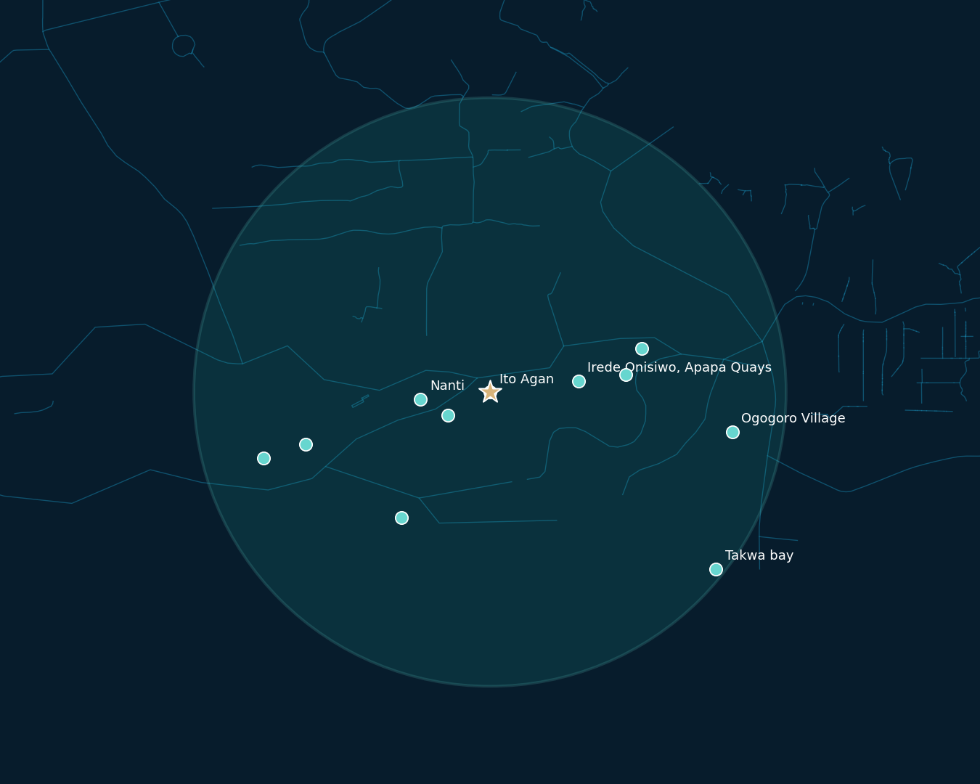
PLANNING SHARED SERVICES
12
Some interventions can serve several communities together.
Nearby communities with similar needs can be screened around one possible intervention location.
ACTUAL REGISTER SCREEN
11
communities within 5 km
75,242
community-reported population in the radius
Candidate point: Ito Agan community location
Planning analysis only. Final sites require land, engineering and government verification.
Method: 5 km straight-line radius using community coordinates and current register population. No routing or site approval implied.
BLUE LAGOS | 12
Notes:
MAIN MESSAGE
Community grouping can help government and partners compare where one intervention may reach several nearby settlements.
SAY THIS
Some interventions do not have to be planned one settlement at a time. This example screens the Ito Agan community location and finds 11 surveyed communities, representing 75,242 people, within a five-kilometre straight-line radius. It helps compare possible shared health, water or emergency-service options before detailed feasibility work begins.
TECHNICAL BACKUP
The calculation uses Haversine straight-line distance and current register population. It excludes land tenure, engineering suitability, capacity, cost, navigability and travel time, so it is not a final site recommendation.

Slide 13
WHAT MORE CAN BE DONE
13
The next step is to connect evidence directly to service planning.
HEALTH
WATER
ACCESS
ENVIRONMENT
LIVELIHOODS
Riverine care Emergency points Telemedicine reach
Safe water points Solar boreholes Sanitation support
Jetties + landings Emergency transport Service connections
Flood + erosion monitoring Shoreline exposure Restoration targeting
Fishing + enterprise Market access Energy + digital services
Target with evidence
Target with evidence
Target with evidence
Target with evidence
Target with evidence
What the evidence can help government, partners and communities target.
Planning opportunities, not Blue Lagos funding commitments or delivery promises.
BLUE LAGOS | 13
Notes:
MAIN MESSAGE
The evidence can help government, partners and communities target practical interventions across five connected areas.
SAY THIS
The next step is to connect evidence directly to service planning. In health, that can mean riverine access, emergency points and telemedicine. In water, safe water points and sanitation. In access, better landings and emergency transport. The same evidence can support environmental monitoring and livelihood access. Blue Lagos is not claiming it will fund all of this; the value is helping the right actors target it.
TECHNICAL BACKUP
These are planning opportunities derived from the recorded needs and platform capabilities, not approved projects, budgets or Blue Lagos delivery commitments.

Slide 14
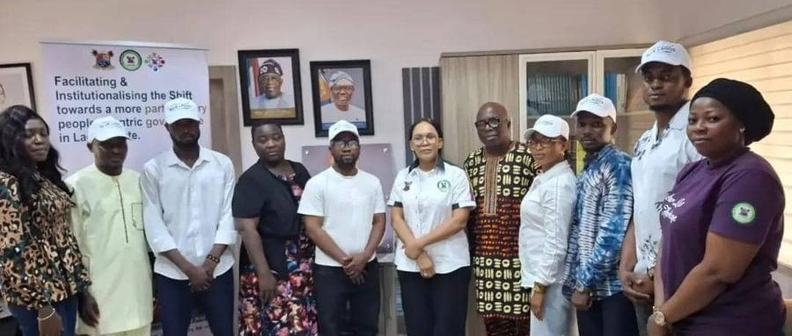
PROPOSED ENGAGEMENT AGENDA
14
KOH Meets Lagos Riverine Communities
A proposed agenda for His Excellency Dr. Kadri Obafemi Hamzat to engage the evidence, communities and next steps.
PROPOSED AGENDA
01
Hear
What riverine communities are experiencing
02
See
The register, maps and community-level evidence
03
Review
Telemedicine, Yegunda water and PVC-support work
COLLABORATION MODEL
04
Select
One priority cluster and practical pilot intervention
Communities + leaders Relevant Lagos State MDAs Health, water + civic partners Private and social-impact partners Research + spatial/data support
05
Convene
Relevant MDAs, partners and community leadership
06
Agree
A clear validation, delivery and follow-up pathway
KOH refers to Dr. Kadri Obafemi Hamzat. This is a proposed engagement agenda, not an organisation or funding programme.
BLUE LAGOS | 14
Notes:
MAIN MESSAGE
KOH Meets Lagos Riverine Communities is a proposed engagement agenda for Dr. Kadri Obafemi Hamzat, not the name of an organisation.
SAY THIS
This proposed agenda creates a practical route from evidence to action. It would allow His Excellency to hear the community realities, see the field register and maps, review the work already facilitated, select one priority pilot, convene the relevant MDAs and partners, and agree a clear follow-up pathway. The intention is a focused engagement that leads to one coordinated next step.
TECHNICAL BACKUP
KOH refers to Dr. Kadri Obafemi Hamzat, Deputy Governor of Lagos State. No separate KOH organisation, funding envelope or programme ownership is claimed.

Slide 15
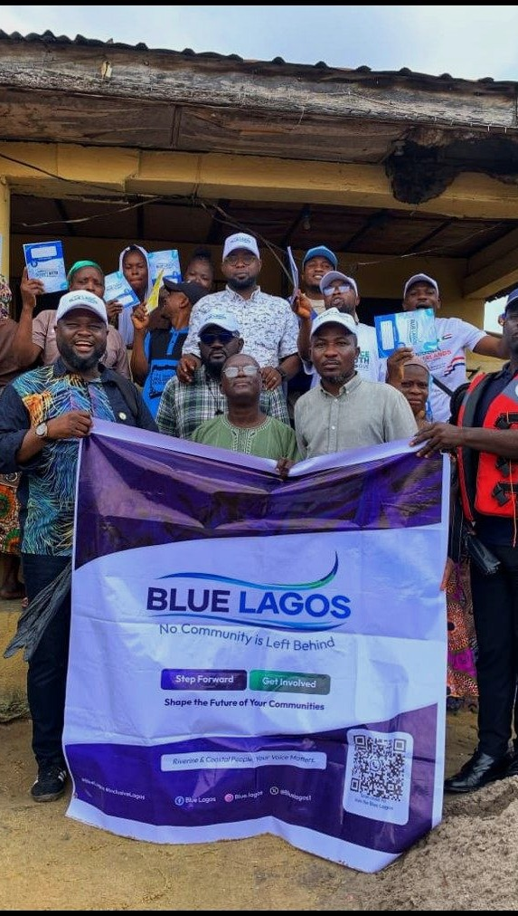
Help us turn this evidence into a repeatable Lagos riverine planning programme.
CONNECT
PILOT
SCALE
Connect Blue Lagos with relevant MDAs and data owners.
Select priority communities for one real intervention.
Update data and monitor interventions across riverine Lagos.
134 communities | 502,002 people | 120 telemedicine communities
The goal is simple: make it easier for riverine communities to be seen, understood and served.
Blue Lagos Sustainability Initiative
Notes:
MAIN MESSAGE
The ask is to connect, pilot and scale a repeatable riverine planning programme.
SAY THIS
Your Excellency, our ask is straightforward. Connect Blue Lagos with the relevant MDAs and data owners. Select priority communities or clusters where this approach can support a real intervention. Then help us build a repeatable framework for updating community data and monitoring delivery across riverine Lagos. The goal is simple: make it easier for riverine communities to be seen, understood and served.
TECHNICAL BACKUP
The closing figures are 134 communities enumerated, 502,002 people represented in the register and telemedicine support facilitated for 120 riverine communities. No funding amount is proposed in this deck.

