Slide 1



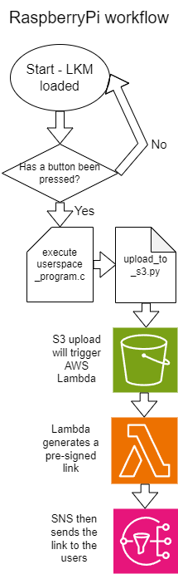
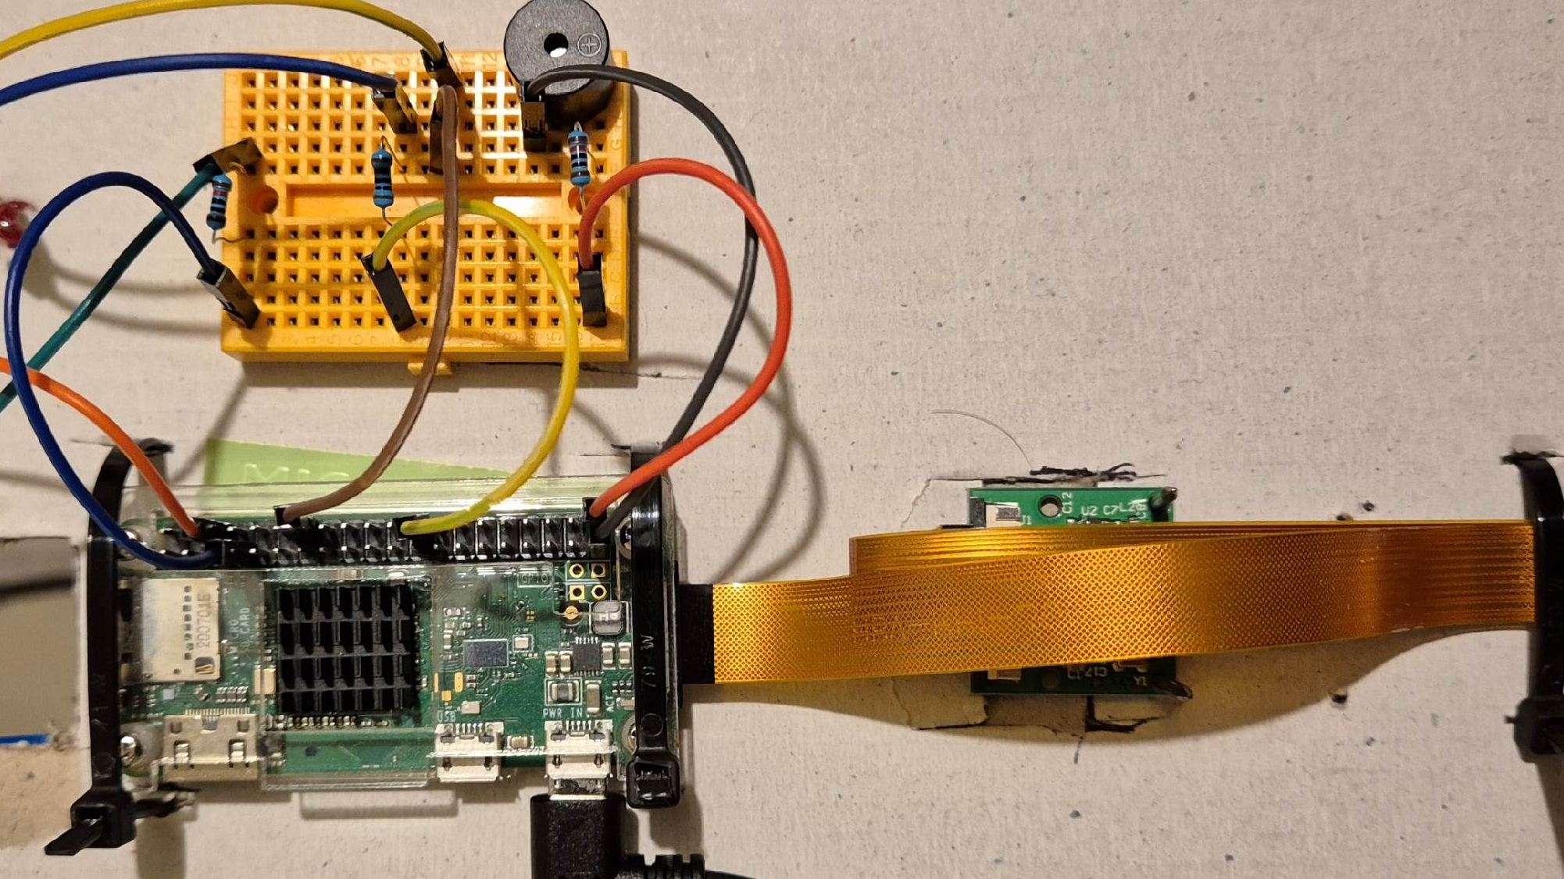

IoT Smart Doorbell Development
Casey V Donaldson (2203162)
CMP408 – IoT and Secure Cloud Development
Introduction
The doorbell uses an LKM to detect a button press before executing a program in user space. Since the program is responsible for controlling the GPIO pins and most hardware the LKM is purely responsible for reducing used resources waiting on a button click, additionally, the LKM can increase security by separating the kernel and user space programs limiting the privileges which the user space program has (Jones and Farrow, 2001).
The user space program was written in C and compiled for the Pi and when the user space program has been called the execution deals with activating the LED and buzzer to improve functionality alerting the homeowner that someone is at the door. The program will then capture an image of the person outside before executing a Python script to upload the image to AWS S3. The program uses the library “WiringPi” to interface with the hardware (Clark, 2018).
The Python script will take the image and use the library “boto3” to upload the image to S3, Python was selected for this as the library “boto3” introduces pre-build functions to upload the image with ease. The above process is visually represented in the workflow diagram to the left.
Amazon Web Services
AWS architecture is used for cloud development. Once an image has been successfully uploaded to S3 the bucket will trigger an event notification. AWS S3 is a simple storage service which gives a cost-effective method for storing the images and allows for scalability. Once an event has occurred AWS Lambda will execute another Python script, this script generates a pre-signed link. This link gives users temporary access to the image to download. The link is distributed by parsing the link to AWS SNS. This service then constructs the email and sends it to every email subscribed, in this scenario that will be the owners of the doorbell.
Security Aspects
An objective of this project was to demonstrate secure cloud development. Below is a summary of the security aspects:
Pre-signed links which give access to the image for 1 hour.
Secure IAM policies which demonstrate the “least privilege principle”
SNS and secure email delivery using encryption.
Updated Pi with default password changed to a secure password.
Project Highlights
The world’s population consistently increases in addition to this so will the volume of houses and doorbell ratio. With this growth so will the increase of threats (Deevey, 1960). This project aims to create a smart doorbell which takes an image of users when a button is clicked. The project will then distribute the image to the owners of the doorbell via email using AWS SNS. The goal is to increase security physically and digitally to improve an individual’s peace of mind.
This project encompasses IoT development using AWS S3, SNS and AWS Lambda, furthermore, the project applies secure development practices by enforcing the “least privilege principle”. Lastly, the project brings relevance to IoT by using real-time interactions using a button, LED, buzzer, camera, cables, resistors and a Raspberry Pi.
Users of this project should be able to click a button which then sounds the buzzer and LED, takes an image and uploads the image to AWS. AWS is responsible for distributing the image using the email protocol and a pre-signed link.
Workflow
The finished project works as expected allowing users of the doorbell to download the image, improving overall security. Below are some highlights of the project.
Data in transit secured using encryption.
Custom IAM Policies.
Learning through failure with the motion sensor.
Future Work
Video over images: The project could use videos which could capture more information on what is happening outside.
AI Event Classification: AWS would allow for ai event classification. This means with the email could indication mention what was detected for example a police officer. This could be implemented using AWS Sagemaker.
Methodology
Raspberry Pi
The main hardware components for the project are a button, LED, buzzer, and camera. Below is a circuit schematic revealing how the circuits are connected.
References
listClark, L. (2018). Programming with the GPIO Pins. Practical Tinker Board, pp.81–129. doi:https://doi.org/10.1007/978-1-4842-3826-4_5.
Deevey, E.S. (1960). The Human Population. Scientific American, [online] 203(3), pp.194–205. Available at: https://www.jstor.org/stable/24940623 [Accessed 5 Jan. 2025].

