Slide 1
Welcome
Project Name: Chat Parser
Group Members:
ID: 2014-2-60-091
Name: Kevin Stephen Biswas
ID: 2014-2-60-108
Name: Sikder Rakinuzzaman

Slide 2
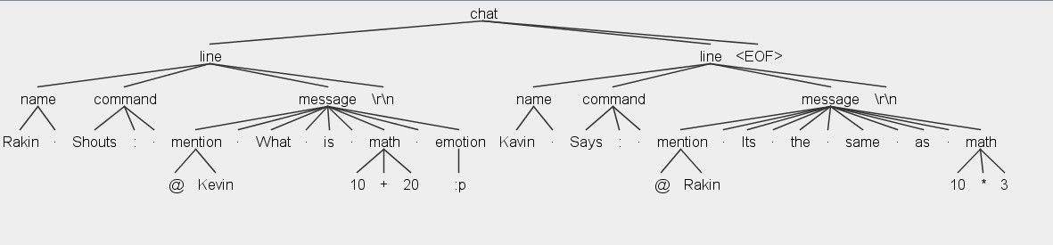

Slide 3
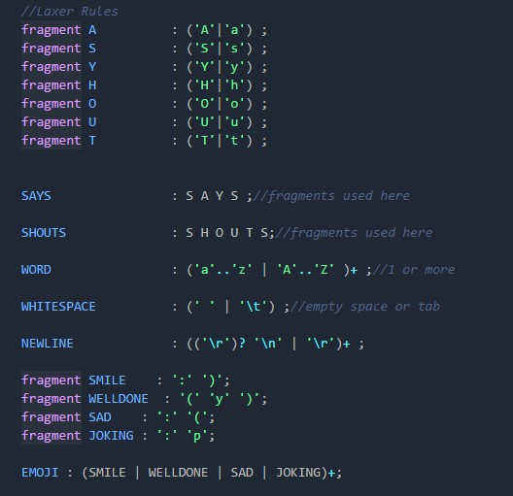

Slide 4
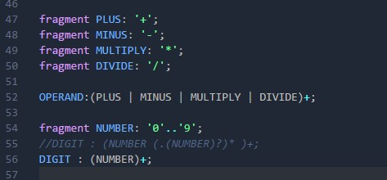

Slide 5
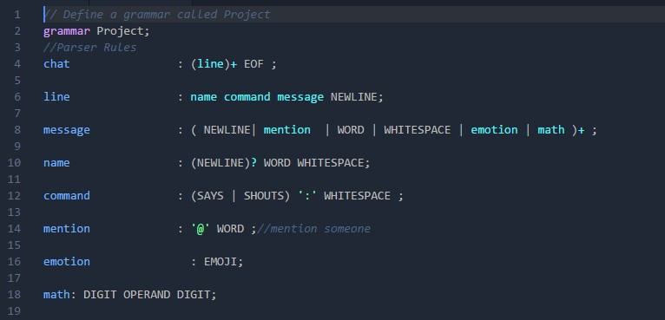

Slide 6
Thank You The End

