Slide 1

EAST WEST UNIVERSITY
SPRING 2018
CSE464
PRESENTED BY :
NUSRAT ZERIN
MAHEDY HASAN
BIRAT SAHA
KAVIN STEPHEN BISWAS

Slide 2

Cricket BATSMAN DATA ANALYSIS

Slide 3
Objectives
Analyze batsman overall performance
Compare a batsman run with other batsman
Find out a relationship with run and strike rate
Evaluate players performances
Predict the batsman performance in next matches

Slide 4
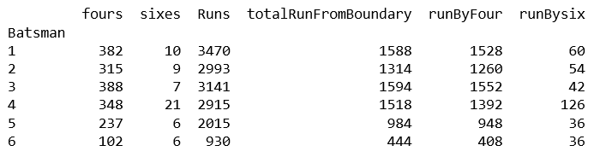
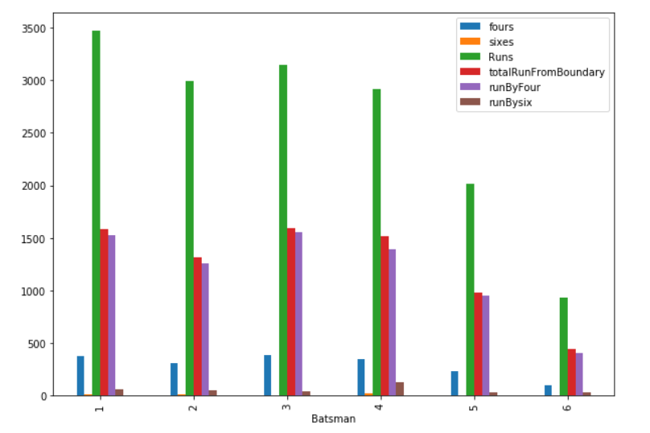
All Batsman Score Figure

Slide 5
Describe Batsman Run Statistics
Batsman | #of Match | Mean | std | min | 25% | 50% | 75% | Max
Batsman1 | 57 | 60.87719 | 56.971 | 0 | 17.00 | 40 | 83 | 239
Batsman2 | 52 | 57.55 | 69.505 | 0 | 9.75 | 28.50 | 78.75 | 243
Batsman3 | 64 | 49.0781 | 48.137 | 0 | 10.50000 | 44.00000 | 71.25 | 254
Batsman4 | 59 | 49.40678 | 48.858 | 0 | 13.00000 | 35.00000 | 72.50000 | 253
Batsman5 | 38 | 53. 0263 | 49. 496 | 1 | 8.2500 | 42.2500 | 85.2500 | 176
Batsman6 | 26 | 35.76923 | 30.362 | 0 | 8.250000 | 32.00000 | 56.75000 | 104

Slide 6
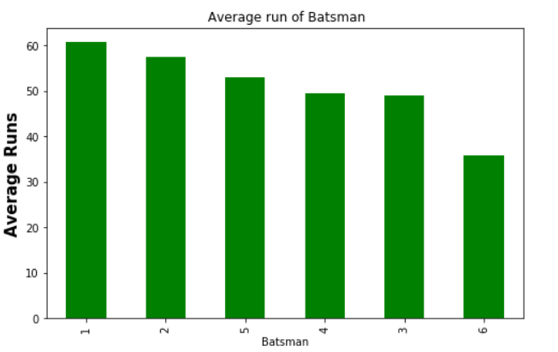
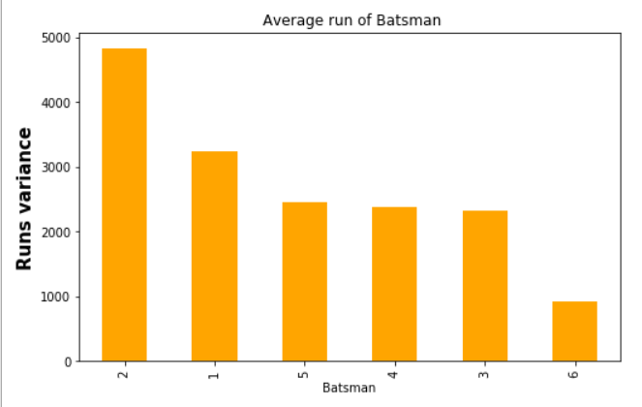
Batsman Run Average & Variance
Batsman | Average | Variance
Batsman 1 | 60.877193 | 3245.716792
Batsman 2 | 57.557692 | 4830.996606
Batsman 3 | 49.078125 | 2317.247768
Batsman 4 | 49.406780 | 2387.107539
Batsman 5 | 53.026316 | 2449.918208
Batsman 6 | 35.76923 | 921.864615

Slide 7
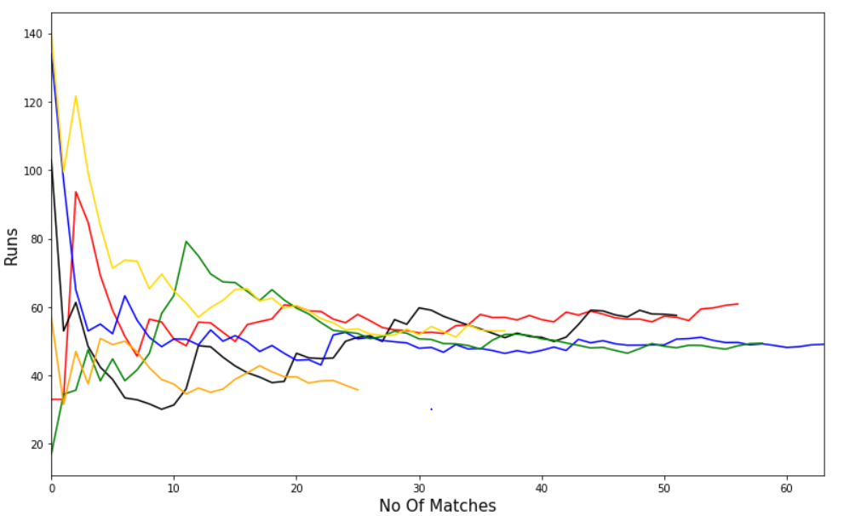
Average of Runs plot in Consecutive Match
batsman1_runs
batsman2_runs
batsman3_runs
batsman4_runs
batsman5_runs
batsman6_runs

Slide 8
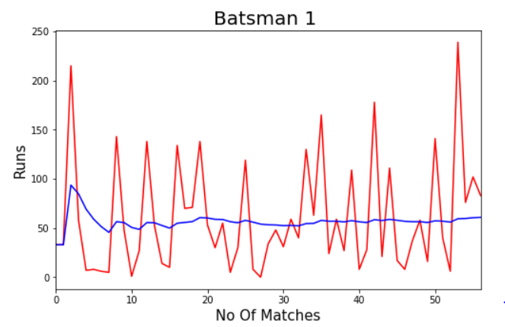
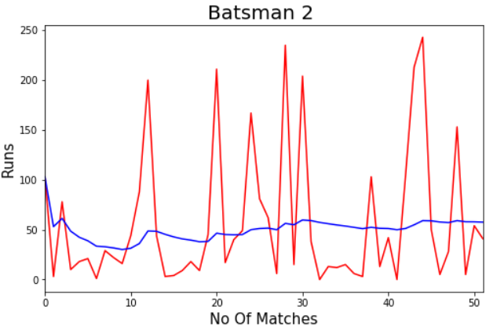
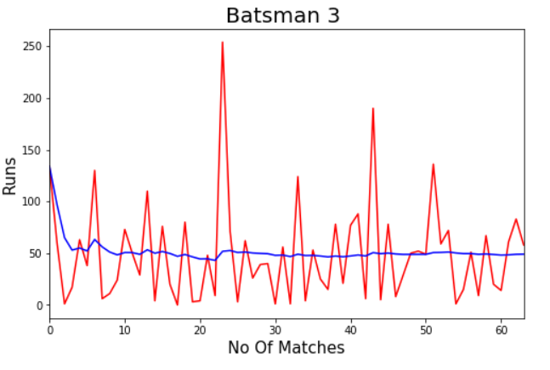
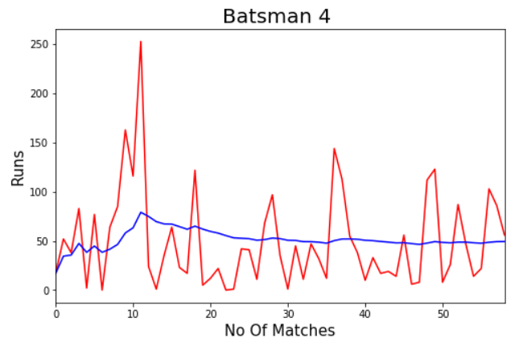
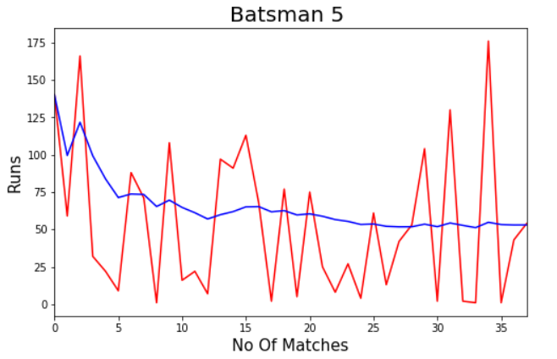
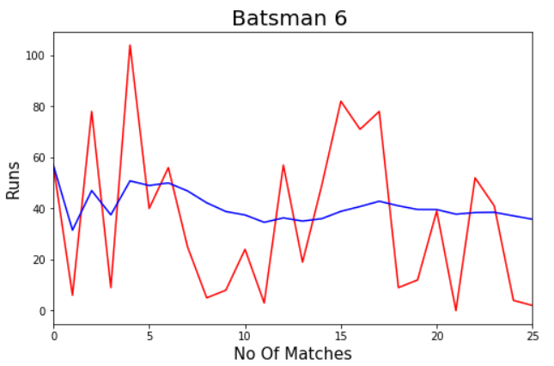
Average vs Runs

Slide 9
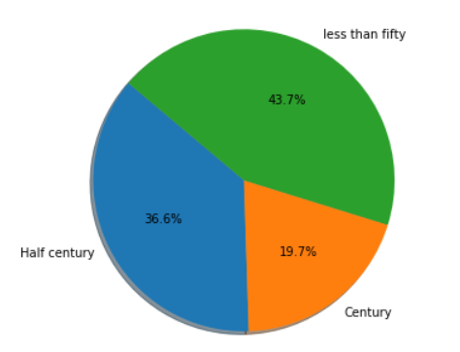
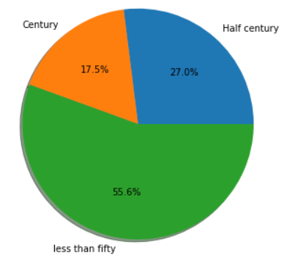
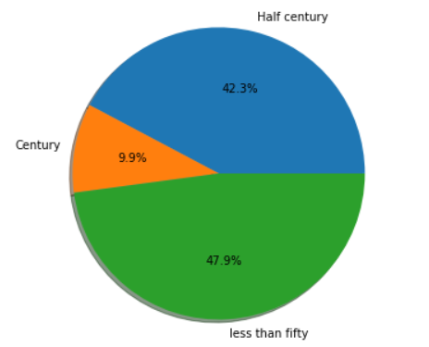
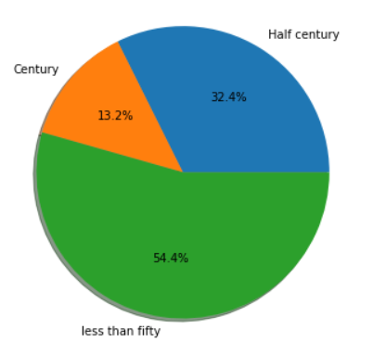
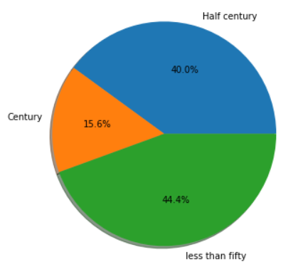
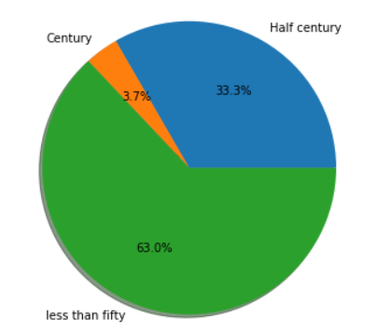
Percentage of score half-century & century
1
2
3
5
6
4

Slide 10
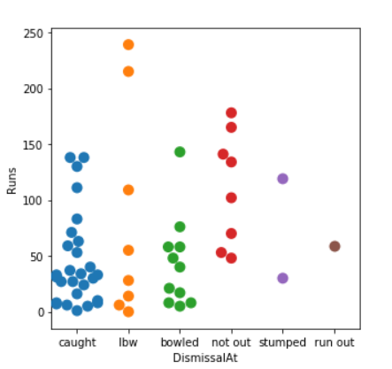
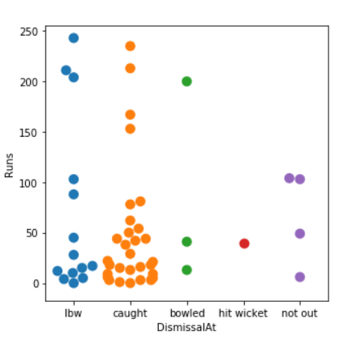
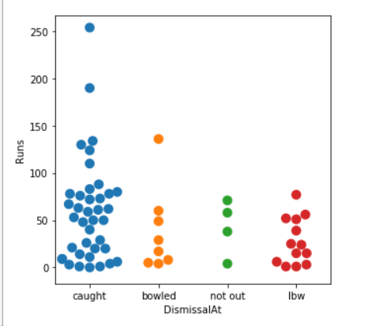
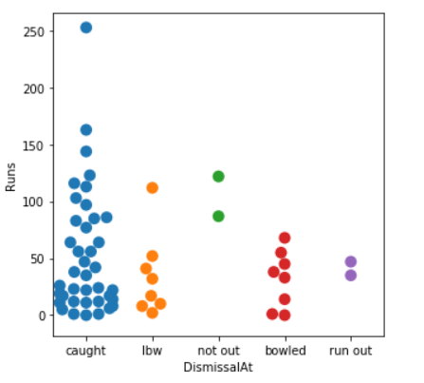
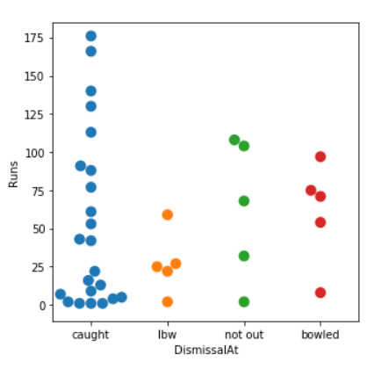
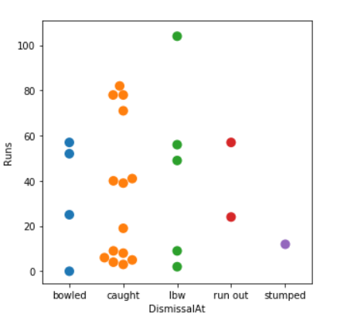
Dismissal Statistics of Batsman (Run VS Out)
1
2
3
4
5
6

Slide 11
Table-8: Total number of matches played in a Position
 | Position 1 | Position 2 | Position 3 | Position 4 | Position 5
Batsman 1 |  |  | 25 | 30
Batsman 2 |  |  | 2 | 46 | 4
Batsman 3 |  | 1 | 22 | 37 | 4*
Batsman 4 | 16 | 42 | 1
Batsman 5 |  |  | 38
Batsman 6 | 25 |  |  |  | 1

Slide 12
Table-9: T-distribution of 3 batsman(with 95% confidence level)
 | Confidence Interval Lower Level | Confidence Interval Upper Level
Batsman1 | 38.28 | 76.84
Batsman2 | 45.79 | 75.97
Batsman5 | 40.99 | 65.06

Slide 13
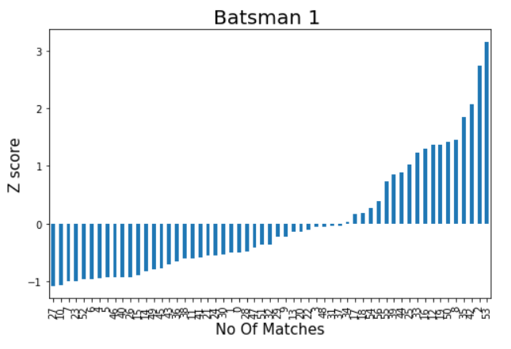
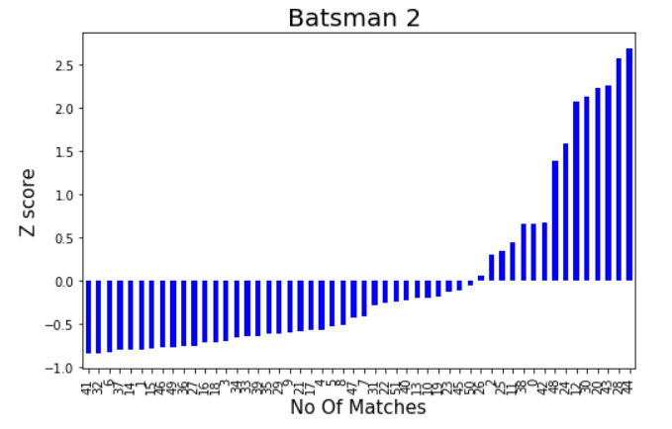
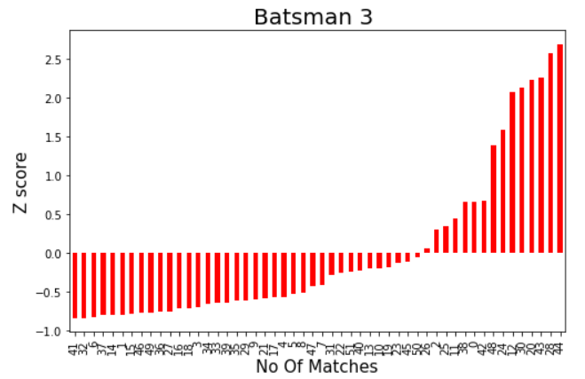
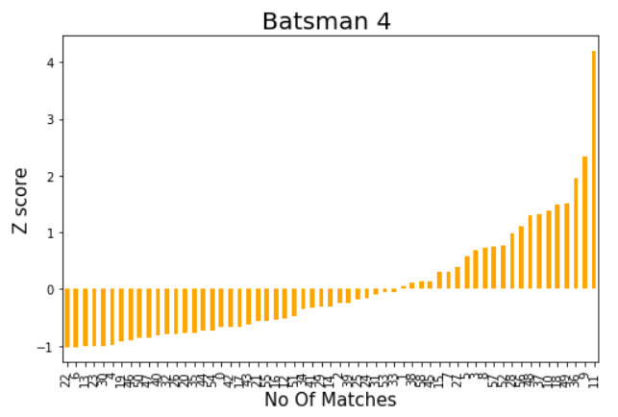
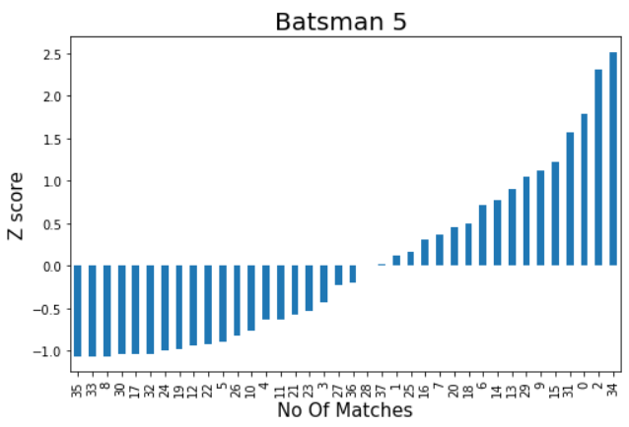
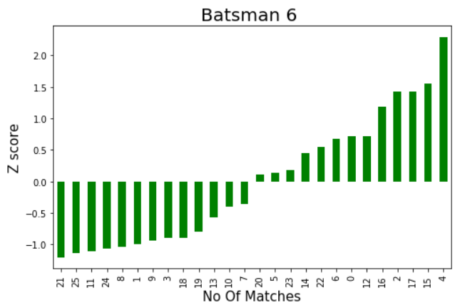
Z-score of Batsman Runs

Slide 14
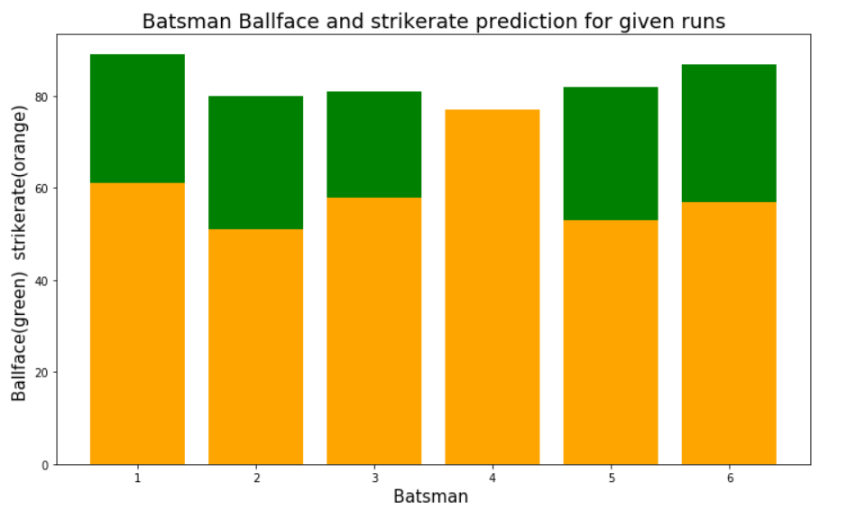
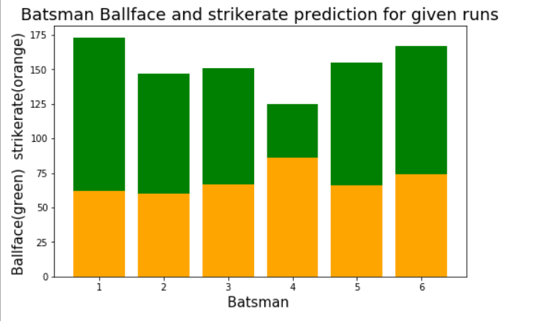
Ball & Strike Rate Prediction of Run Score
(50,100) | Batsman1 | Batsman2 | Batsman3 | Batsman4 | Batsman5 | Batsman6
Ball face | 89,173 | 80,147 | 81,151 | 66,125 | 82,155 | 87,167
Strike Rate | 61, 62 | 51,60 | 58,67 | 77,86 | 53,66 | 57,74
For 50 run score
For 100 run score

Slide 15
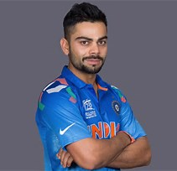
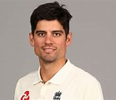
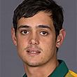
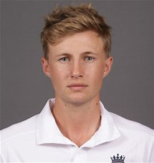

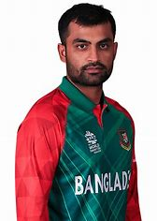
Batsman by his Performance
Virat Kohli(IND)
AN Cook(ENG)
Q De cock(SA)
Joe Root
David Warner(AUS)
Tamim Iqbal(BAN)

Slide 16
References
http://www.cricbuzz.com/
https://www.youtube.com/
http://scikit-learn.org/
http://stats.espncricinfo.com/ci/content/records/227046.html
Source Repository
https://github.com/roy0111/CricketDataAnalysisCSE464/
Any Query
biratewu0111@gmail.com
https://www.facebook.com/birat.111

Slide 17
THANK YOU

