Slide 1
COMPUTERS & GRAPHICS | JOURNAL STUDY
Timestep-Conditioned Adapter Scaling
for Multi-view Diffusion Texture Generation
Control allocation and baked appearance
A controlled evaluation of an existing geometry-residual interface,
from applied scale to UV-textured assets viewed from unseen cameras.
CAD/Graphics 2026 Paper 75 | Revised journal evaluation
Notes:
This demo uses AI-generated narration. This presentation summarizes the V5 journal study of timestep-conditioned adapter scaling for multi-view diffusion texture generation. The focus is what survives comparison with strong controls and evaluation on baked assets.

Slide 2
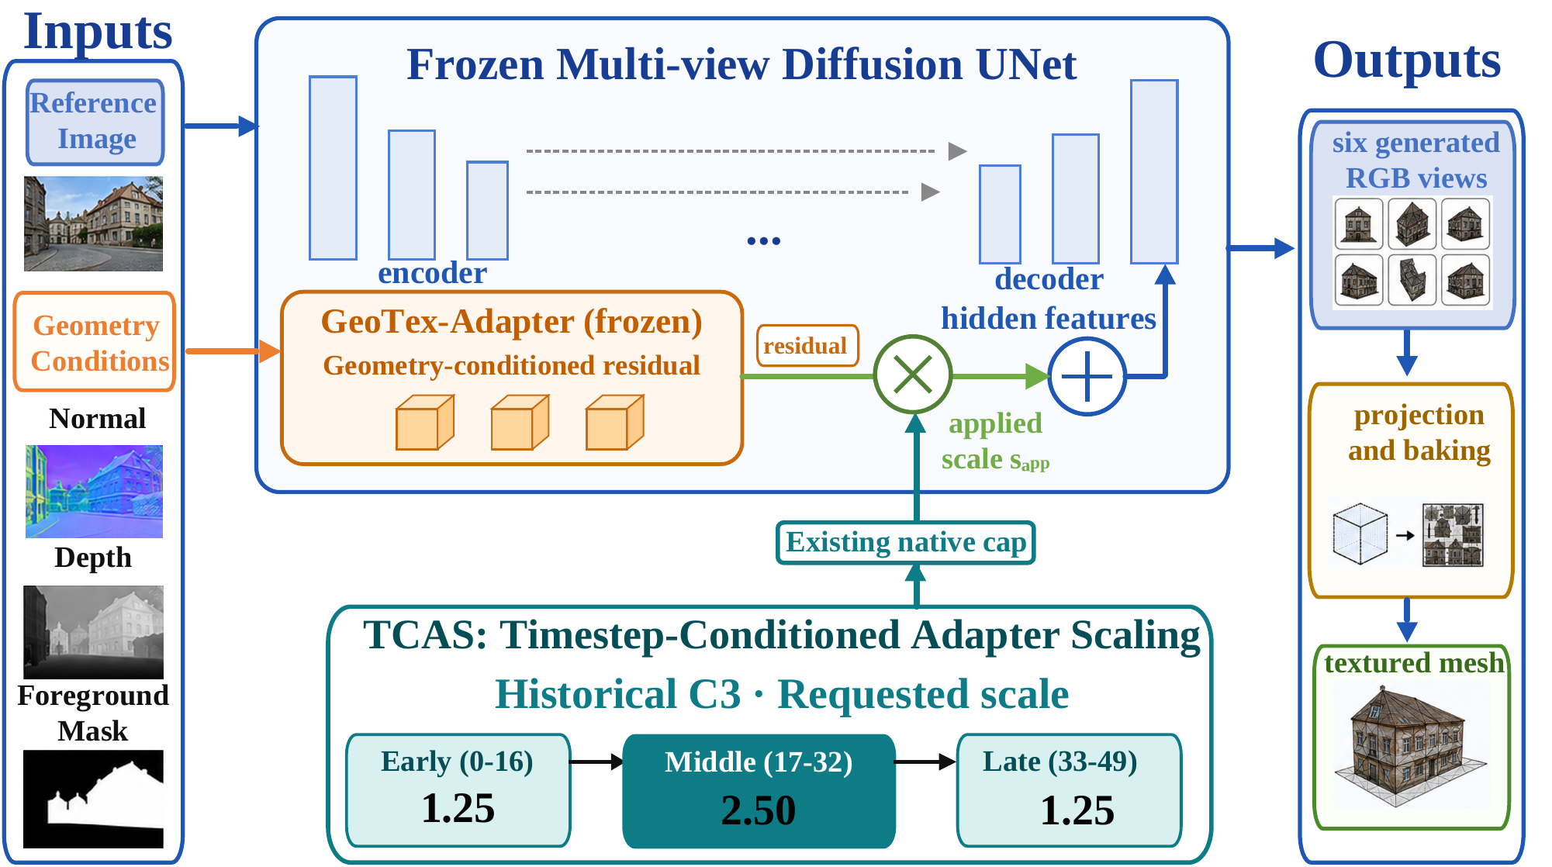
COMPUTERS & GRAPHICS | V5 JOURNAL STUDY
The graphics result is the textured asset, not only the generated view
•
Generated RGB views are intermediate outputs in a 3D texturing pipeline.
•
Projection, UV coverage, hole filling, and resampling affect the final appearance.
•
We evaluate baked meshes from cameras withheld from texture generation and baking.
Study path: executed control → generated views → native-UV bake → unseen-view appearance
V5 journal study | Timestep-conditioned geometry control
02 / 10
Notes:
For graphics, generated RGB views are intermediate. The deliverable is a textured mesh whose appearance should be checked from cameras not used to generate or bake its texture. Projection, UV coverage, and resampling can change the result. This study connects image-space scores to that asset-level outcome.

Slide 3
COMPUTERS & GRAPHICS | V5 JOURNAL STUDY
Follow the executed control, not the schedule label
Historical C3 request across 50 denoising steps
EARLY · 0–16
MIDDLE · 17–32
LATE · 33–49
1.25
2.50
1.25
Fresh C: deep and middle groups retain the requested profile; shallow requests are capped at 0.80 in every window.
THREE DISTINCT QUANTITIES
Requested scale → cap-adjusted applied scale → state-dependent residual correction
Equal scalar sums do not imply equal accumulated residual dose.
V5 journal study | Timestep-conditioned geometry control
03 / 10
Notes:
TCAS changes the requested multiplier on an existing GeoTex adapter residual; it does not add a learned module. The historical C3 profile requests 1.25, 2.50, and 1.25 across early, middle, and late windows. In Fresh C, the shallow group is capped at 0.80 throughout. The realized correction also depends on the evolving hidden state, so a scale label is not a residual-dose measurement.

Slide 4
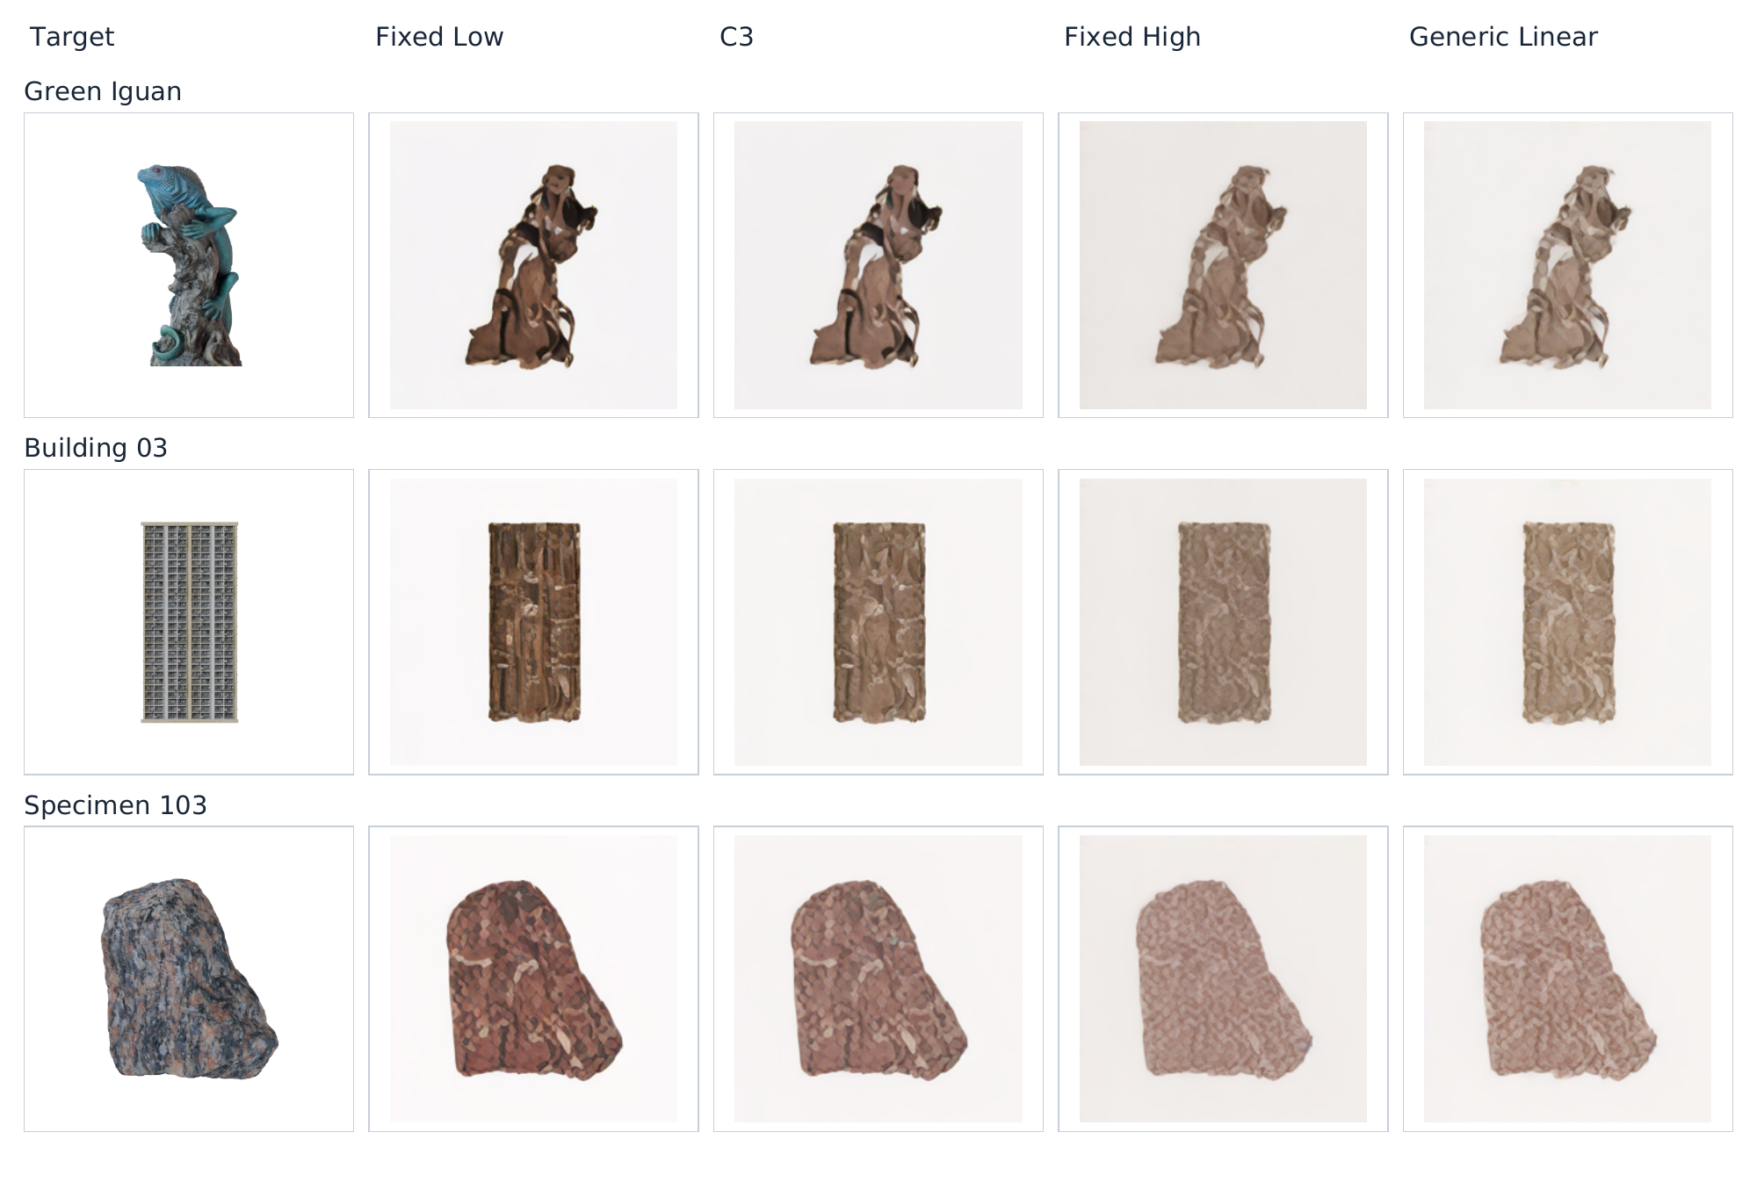
COMPUTERS & GRAPHICS | V5 JOURNAL STUDY
Strong controls revise the interpretation of C3
Fresh C · 300 held-out objects
Same target, five conditions, three display objects
Condition
FG-PSNR ↑
FG-LPIPS ↓
Fixed Low
11.31
0.2051
C3 / Middle
11.83
0.1998
Fixed High
12.58
0.1891
Generic Linear
12.42
0.1862
C3 − Fixed Low: +0.522 dB FG-PSNR, while deep/middle applied sums rise from 62.5 to 82.5.
Fixed High and Generic Linear have better means than C3 on all four image endpoints.
Examples illustrate condition differences; they do not estimate population performance.
V5 journal study | Timestep-conditioned geometry control
04 / 10
Notes:
On 300 held-out objects, C3 improves foreground PSNR over Fixed Low by 0.522 decibels. That comparison also raises the deep and middle applied-scale sums from 62.5 to 82.5. Fixed High and Generic Linear have better means than C3 across all four evaluated image endpoints. This revises the interpretation of the original low-versus-high-versus-low result. The figure shows examples, not an estimate of typical appearance.

Slide 5
COMPUTERS & GRAPHICS | V5 JOURNAL STUDY
Matched applied-scale budgets detect no middle-window advantage
Fresh C · N = 300 · per-group applied-scale sums = 82.5 / 82.5 / 40
−0.15
0
+0.15
Middle-high − mean(Early-high, Late-high) FG-PSNR (dB)
−0.0339 dB 95% interval [−0.1172, +0.0514] p = 0.4324
The specified primary does not support a middle-window advantage; it also does not establish equivalence.
Retrospective early/late pairwise contrasts differ in opposite directions, showing placement sensitivity without a preferred schedule.
V5 journal study | Timestep-conditioned geometry control
05 / 10
Notes:
The specified timing primary compares Middle-high with the object-wise average of Early-high and Late-high at matched per-group applied-scale sums. The mean difference is minus 0.0339 decibels, with a 95 percent interval from minus 0.1172 to plus 0.0514 and a p-value of 0.432. It detects no middle-window advantage and does not establish equivalence. Retrospective pairwise contrasts differ in opposite directions, indicating within-cohort placement sensitivity without selecting a preferred schedule.

Slide 6
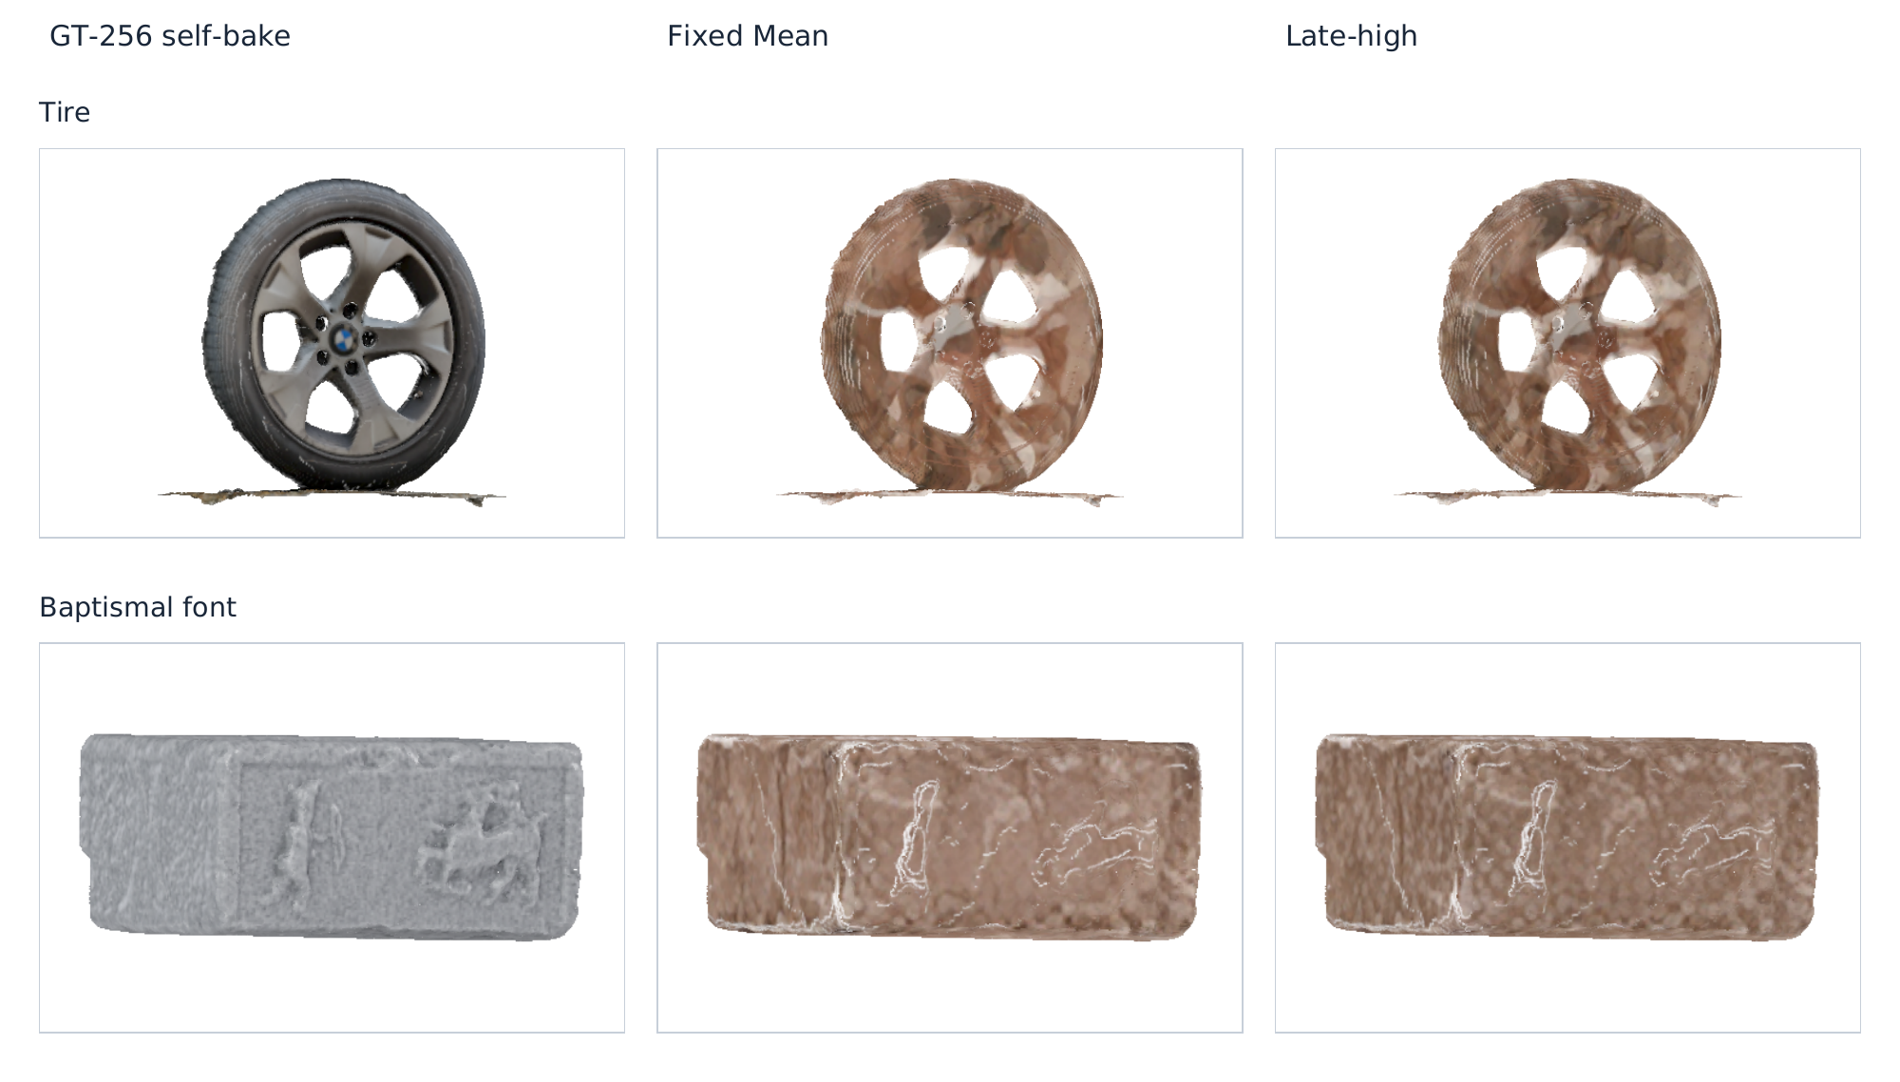
COMPUTERS & GRAPHICS | V5 JOURNAL STUDY
A small baked-view effect does not make C3 the winner
GEOTEX BAKE PILOT · N = 10
Late-high − Fixed Mean
unseen-view FG-LPIPS
−0.00265 [−0.00414, −0.00137]
All ten objects favored Late-high. The change closes 3.7% of the mean reference self-bake gap.
Late-high is distinct from C3. The separate GSO bake (N = 20) did not detect the same benefit: +0.000084 LPIPS, interval [−0.000103, +0.000286].
Compatibility-selected pilot; substantial reference-appearance error remains.
V5 journal study | Timestep-conditioned geometry control
06 / 10
Notes:
In the compatibility-selected GeoTex bake pilot, Late-high—not C3—reduces unseen-view LPIPS relative to Fixed Mean by 0.00265 on ten objects. The change closes about 3.7 percent of the mean reference self-bake gap, while substantial appearance error remains. A separate twenty-object GSO bake study does not detect the same benefit under its distinct protocol.

Slide 7
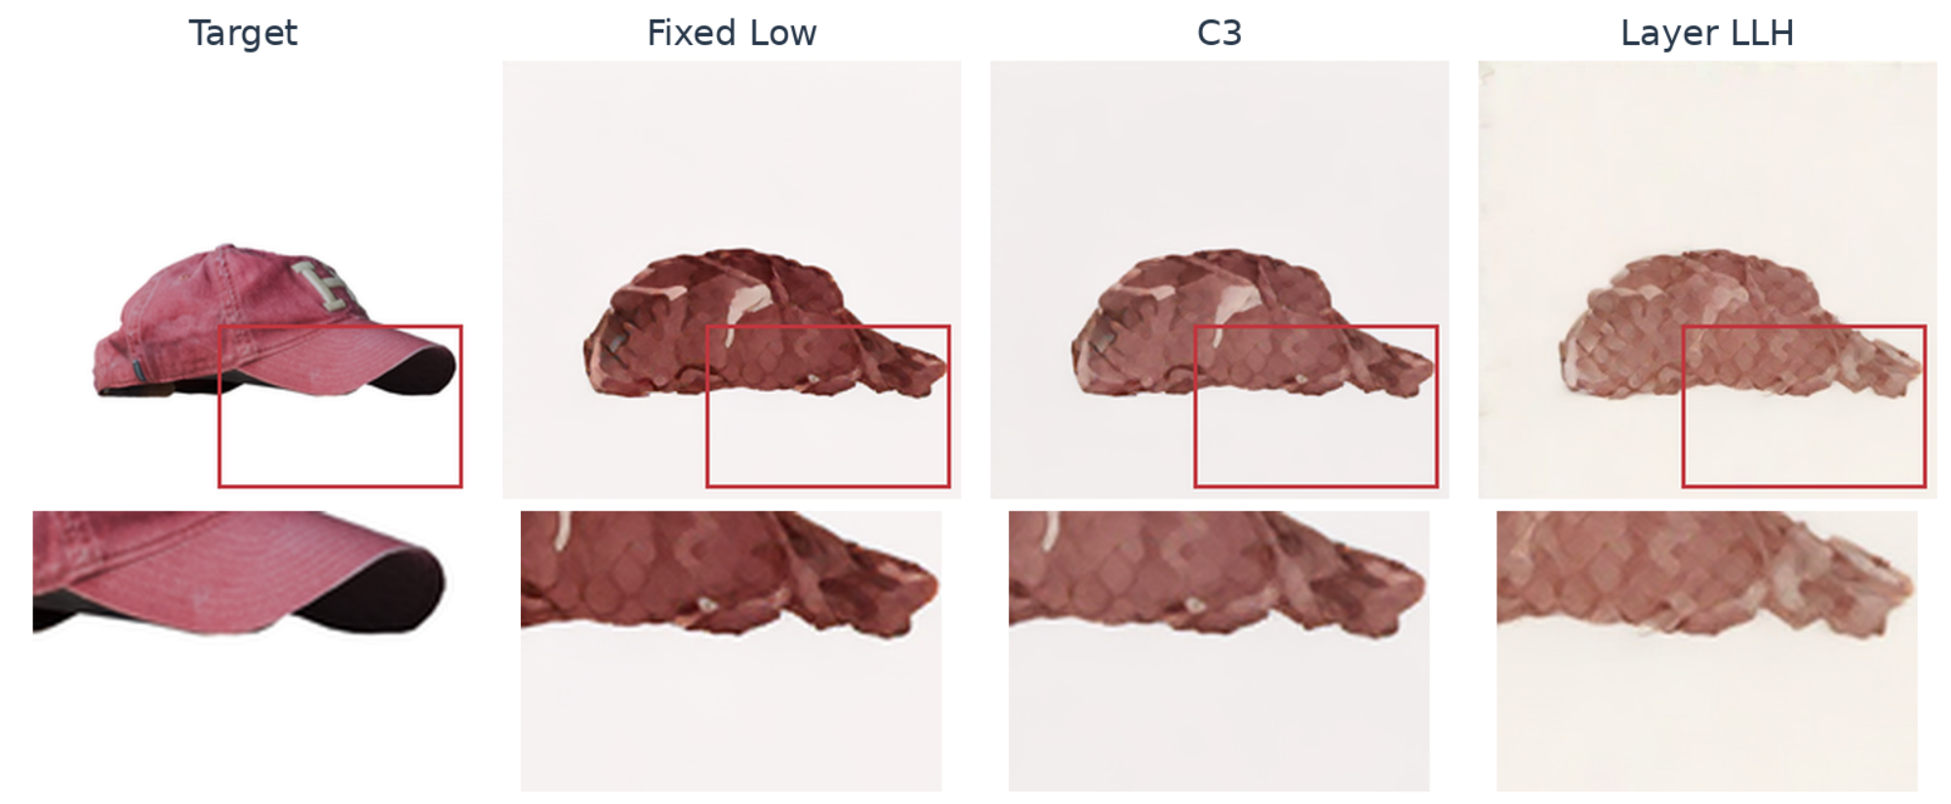
COMPUTERS & GRAPHICS | V5 JOURNAL STUDY
Image-space gains do not imply faithful reference appearance
Reference-color and texture discrepancies remain visible. Unlit base-color renders do not establish PBR or material fidelity.
V5 journal study | Timestep-conditioned geometry control
07 / 10
Notes:
The visual comparison makes the remaining reference-appearance gap concrete. Image-space improvements do not establish faithful color or material reproduction. The bake evaluation uses unlit base color; it does not test a physically based material or lighting pipeline.

Slide 8
COMPUTERS & GRAPHICS | V5 JOURNAL STUDY
Native-interface tests bound transfer across implementations
Study-specific middle-window FG-PSNR primary contrasts · pointwise 95% intervals
GeoTex Fresh C · N=300
-0.034 dB
MV-Adapter50 · N=50
+0.029 dB
GSO100 · N=100
-0.014 dB
−0.14
0
+0.10
All three intervals include zero. The studies use separate cohorts and study-specific contrasts; GSO100 shares the MV-Adapter interface and is not an independent backbone replication.
V5 journal study | Timestep-conditioned geometry control
08 / 10
Notes:
The two MV-Adapter timing primaries also do not detect their specified middle-window contrasts: plus 0.029 decibels on fifty objects and minus 0.014 on the GSO one-hundred-object cohort, with both intervals spanning zero. These are separate cohorts and primary comparisons. GSO one hundred uses the same MV-Adapter interface, so it is not an independent backbone replication.

Slide 9
COMPUTERS & GRAPHICS | V5 JOURNAL STUDY
The contribution is an evidence chain for deployed geometry control
01 IMPLEMENTATION
02 CONTROLLED COMPARISONS
03 ASSET-LEVEL EVALUATION
Separate requested scales, cap-adjusted applied scales, and state-dependent residual corrections.
Compare C3 with strong fixed and linear controls and a matched applied-scale timing test.
Connect image-space results to native-UV bakes from unseen cameras and report transfer boundaries.
The evidence supports reporting the executed interface, applied control, cohort, and asset-level response.
It does not identify a universally preferred schedule or establish faithful material reproduction.
V5 journal study | Timestep-conditioned geometry control
09 / 10
Notes:
The contribution is an evidence chain for an implemented graphics control. We report requested values, cap-adjusted applied values, and state-dependent corrections; compare C3 with competitive fixed and linear controls and a matched scalar budget; then evaluate native UV bakes from unseen cameras and test boundaries across interfaces. The findings support reporting the executed interface and asset response, not a universal schedule recommendation.

Slide 10
CONCLUSION | LIMITED PUBLIC DATA
No universal timing winner.
The baked asset remains the graphics endpoint.
C3 improves over Fixed Low, but stronger controls lead on mean image endpoints. The matched-budget primary detects no middle-window advantage. A small GeoTex bake benefit does not recur in the separate GSO protocol.
ZENODO · VERSION 1.0.1 · LIMITED DERIVED DATA
DOI: 10.5281/zenodo.23383807
Selected object-level metrics and attribution records. Source meshes, textures, model weights, checkpoints, generated-image archives, and participant-level responses are excluded.
Thank you
https://doi.org/10.5281/zenodo.23383807
Notes:
The limited public data release is archived as Zenodo version 1.0.1 at DOI 10.5281 slash zenodo dot 23383807. It contains selected derived metrics and attribution records. It excludes source meshes and textures, generated-image archives, model weights, checkpoints, and participant-level responses. Overall, the evidence does not identify a universally preferred schedule or establish faithful material reproduction. Thank you.

