Slide 1
Adapter Scaling Trade-off and Timestep-Conditioned Scheduling in Multi-view Diffusion Texture Generation
Notes:
In this article, we proposeSelf-Adaptive Feature Fusion Segmentation Network Based on Transfer Learning for Medical Image Segmentation , called SAFFSNet.

Slide 2
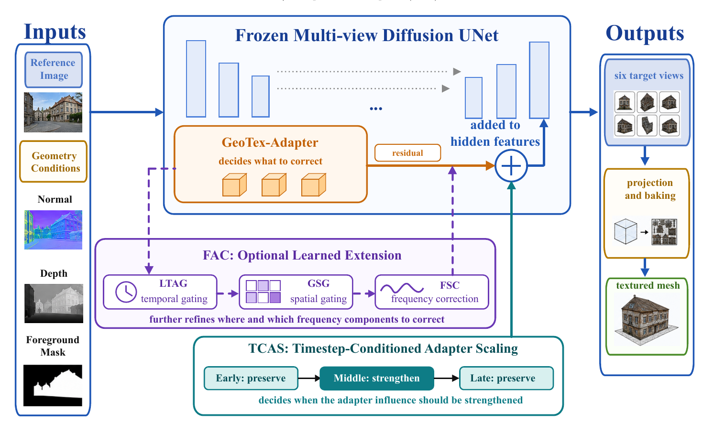
Method overview: Timestep-Conditioned Adapter Scaling
Notes:
Secondly, Multi-Dimensional Hierarchical Feature Fusion module improves the robustness of our framework against noise interference and complex morphological targets, which realizes dynamic alignment and fusion of multi-level features through the synergy of frequency, space, and channel attention mechanisms.

Slide 3
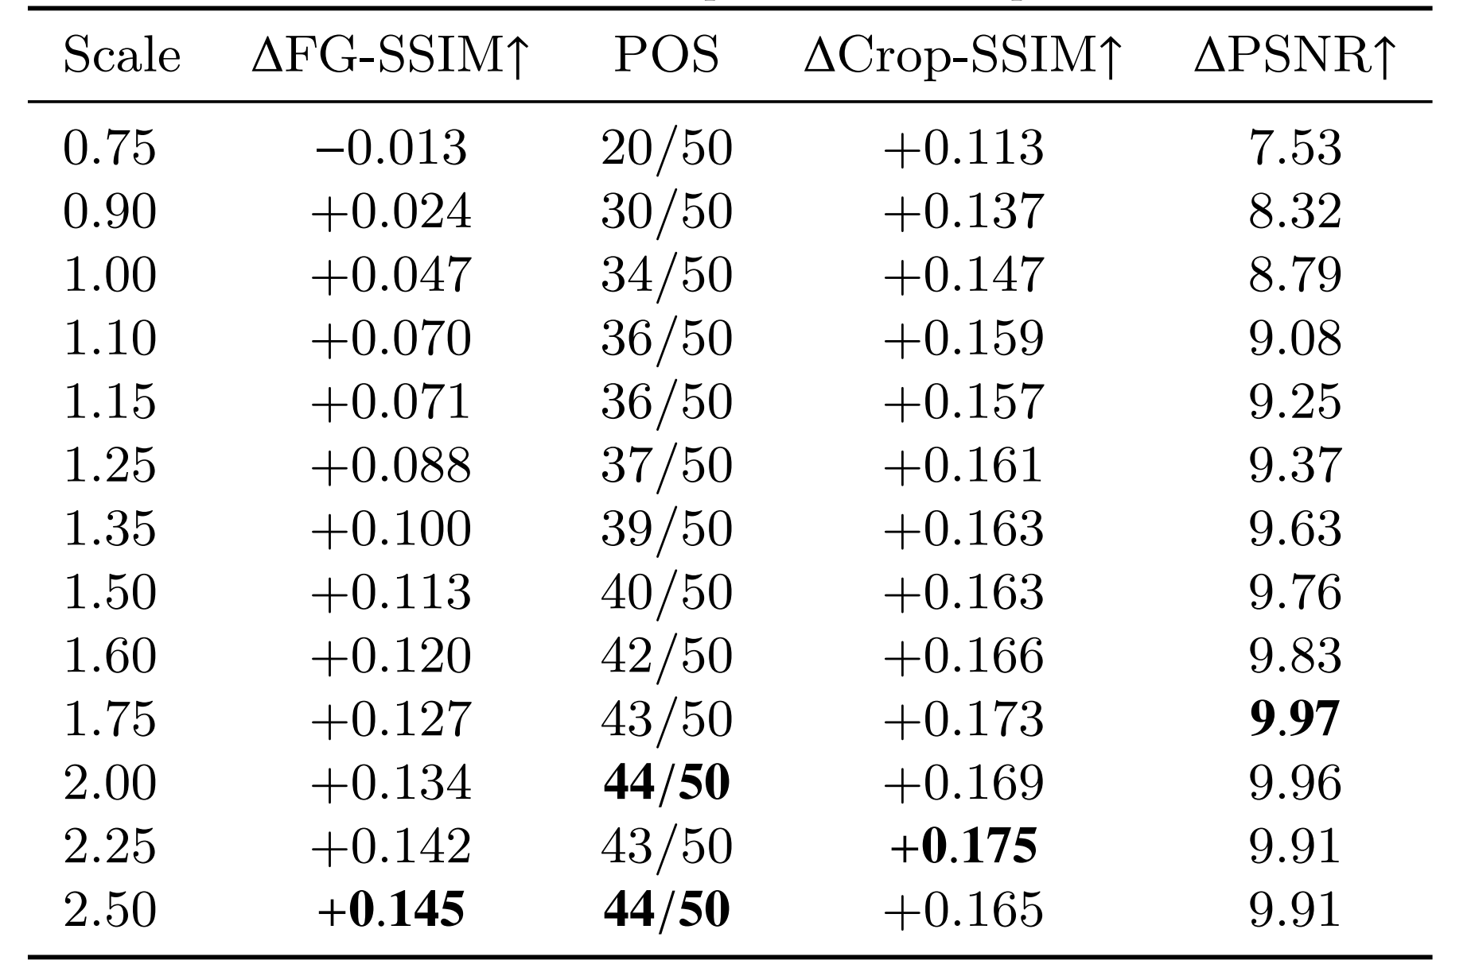
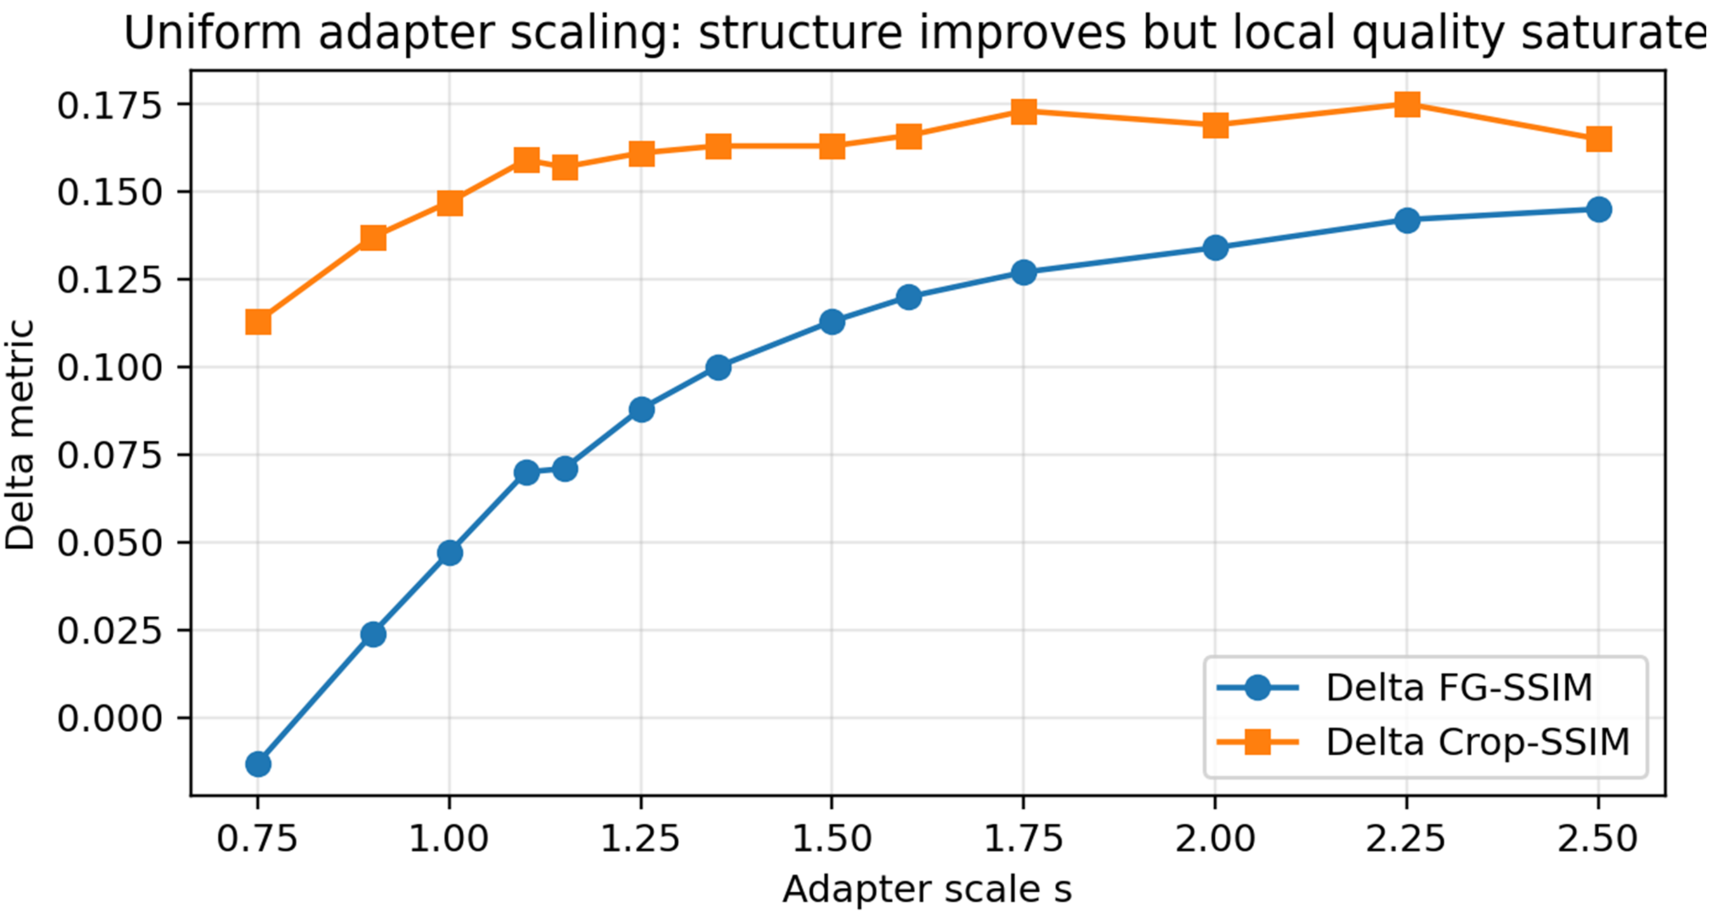
Uniform adapter scaling: structural gain increases with scale
Notes:
The pipeline of our framework consists of three main parts.Firstly, The encoder integrates transfer learning with a lightweight Adapter module to construct a hybrid architecture encoder based on the SAM2 backbone, which not only enhances feature extraction capability but also improves the model's adaptability and generalization across different imaging modalities.

Slide 4
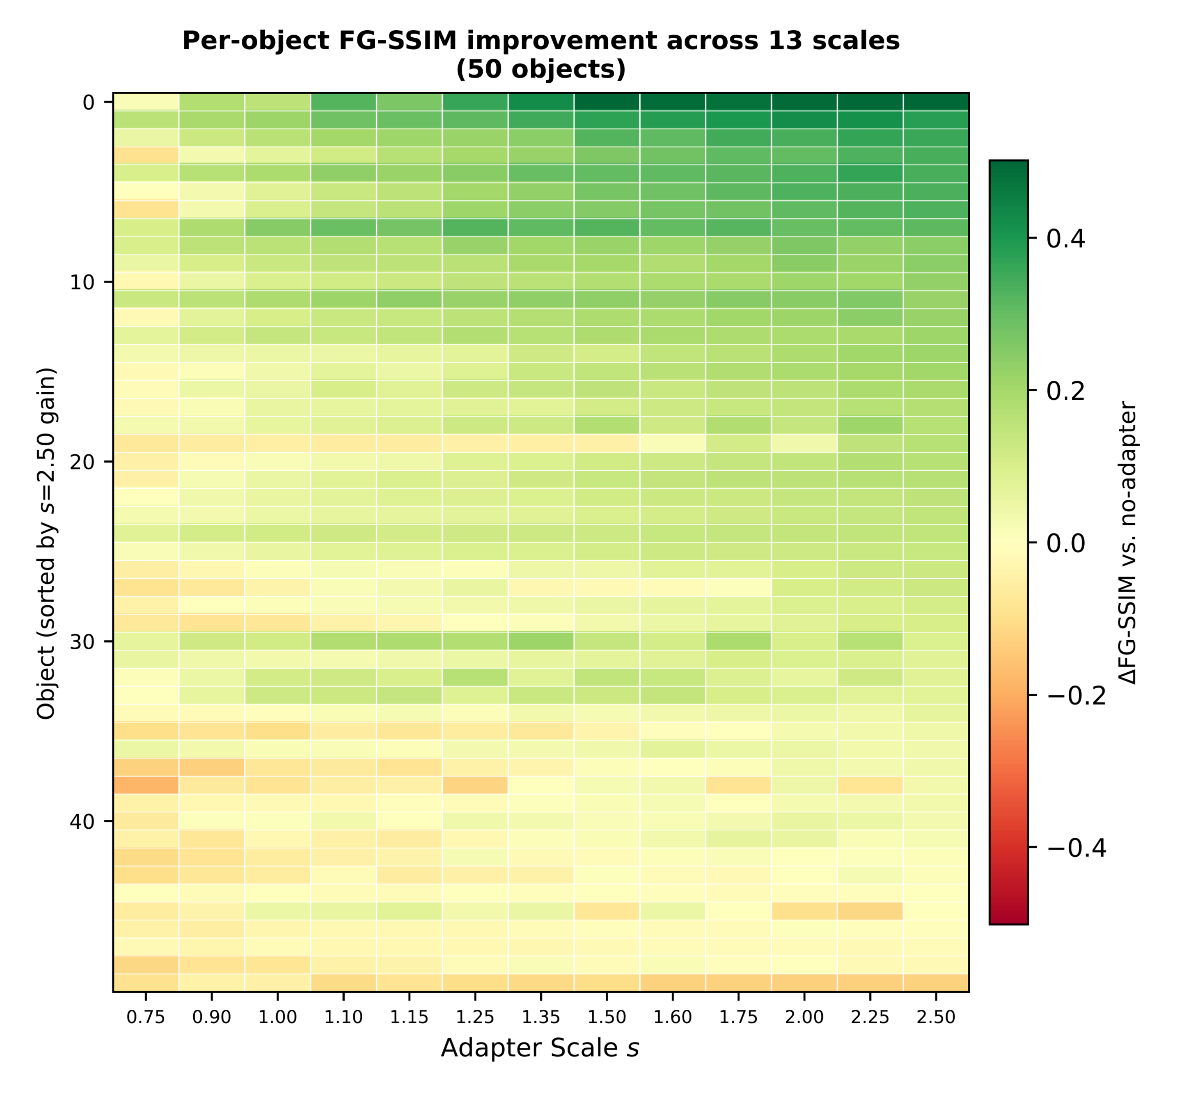
Per-object behavior across 13 adapter scales
Notes:
The pipeline of our framework consists of three main parts.Firstly, The encoder integrates transfer learning with a lightweight Adapter module to construct a hybrid architecture encoder based on the SAM2 backbone, which not only enhances feature extraction capability but also improves the model's adaptability and generalization across different imaging modalities.

Slide 5
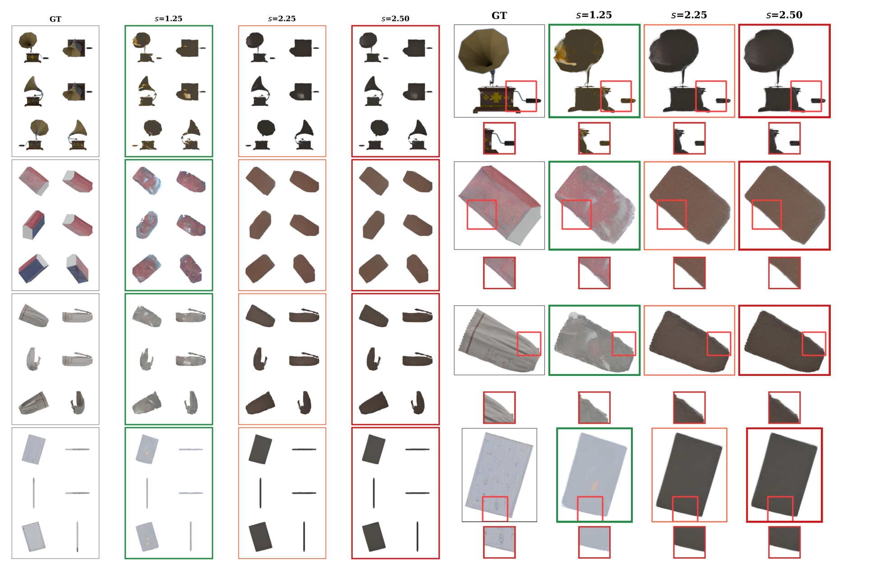
Texture audit: high scale causes texture flattening
Notes:
The pipeline of our framework consists of three main parts.Firstly, The encoder integrates transfer learning with a lightweight Adapter module to construct a hybrid architecture encoder based on the SAM2 backbone, which not only enhances feature extraction capability but also improves the model's adaptability and generalization across different imaging modalities.

Slide 6
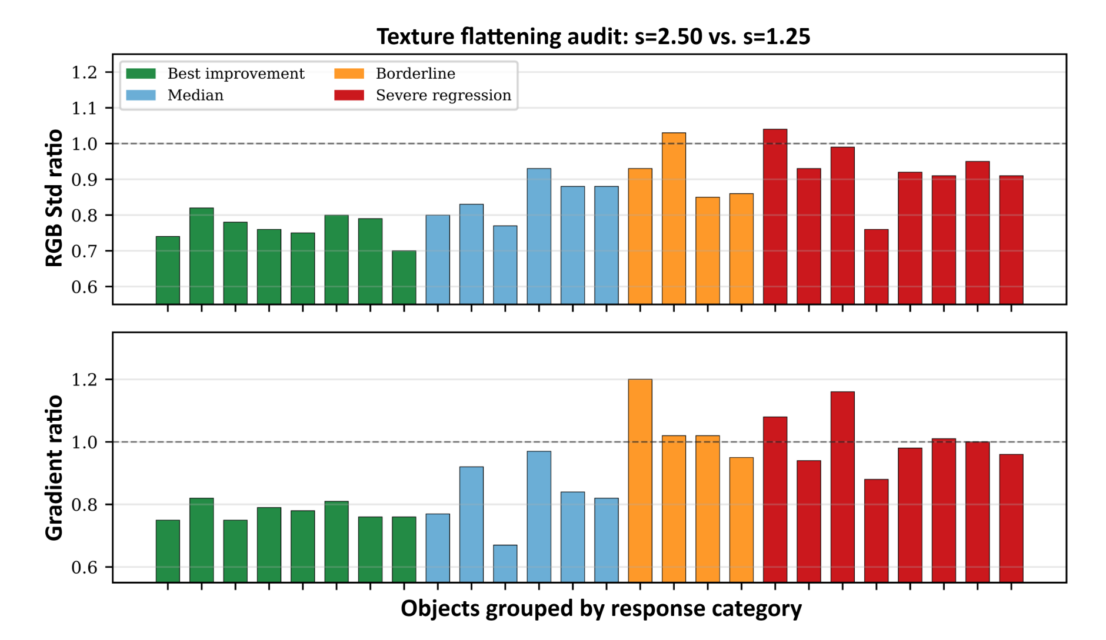
Texture flattening diagnostics
The key evidence is not a single proxy metric: it is the agreement among RGB Std, Gradient Magnitude and local visual audits.
Notes:
The pipeline of our framework consists of three main parts.Firstly, The encoder integrates transfer learning with a lightweight Adapter module to construct a hybrid architecture encoder based on the SAM2 backbone, which not only enhances feature extraction capability but also improves the model's adaptability and generalization across different imaging modalities.

Slide 7
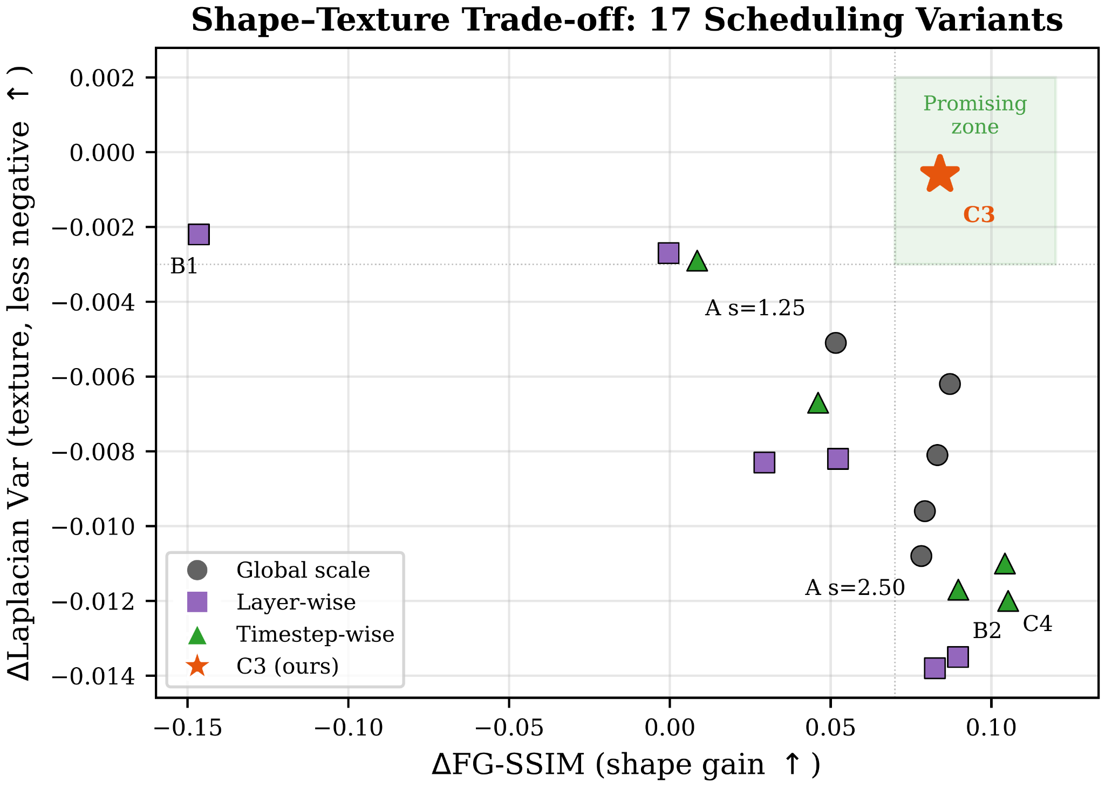
Shape–texture trade-off among 17 scheduling variants
Notes:
The pipeline of our framework consists of three main parts.Firstly, The encoder integrates transfer learning with a lightweight Adapter module to construct a hybrid architecture encoder based on the SAM2 backbone, which not only enhances feature extraction capability but also improves the model's adaptability and generalization across different imaging modalities.

Slide 8
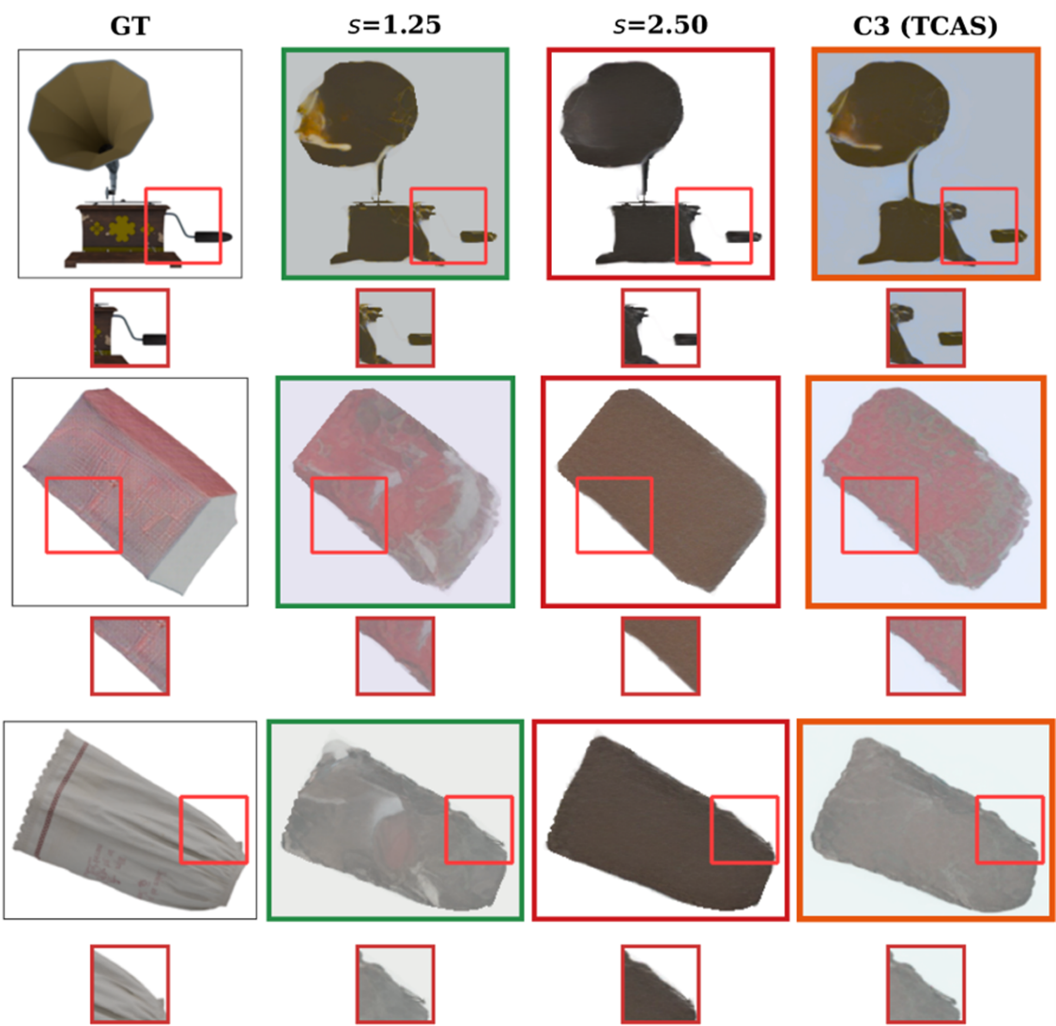
C3 / TCAS qualitative comparison
C3 keeps stronger geometry than s=1.25 and more local texture variation than s=2.50.
Notes:
The pipeline of our framework consists of three main parts.Firstly, The encoder integrates transfer learning with a lightweight Adapter module to construct a hybrid architecture encoder based on the SAM2 backbone, which not only enhances feature extraction capability but also improves the model's adaptability and generalization across different imaging modalities.

Slide 9
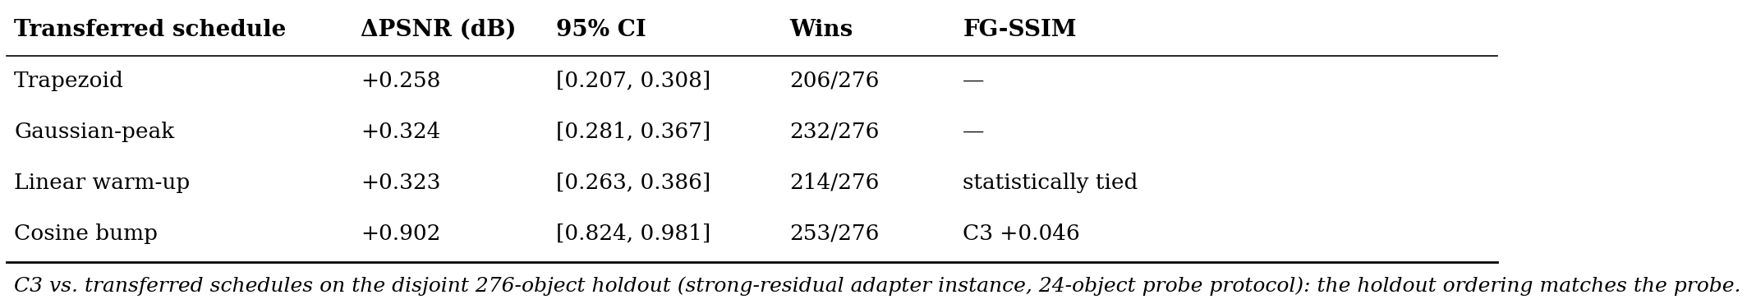
Why generic guidance-style schedules are insufficient
C3 is not a generic monotonic decay or warm-up rule: the high scale is concentrated in the middle denoising stage.
Notes:
Finally, to further improve the accuracy of boundary segmentation, Multi-Level Feature-Guided Aggregation Decoder is designed to achieve more accurate semantic decoding by fusing contour details, shape structure and global semantic information layer by layer, significantly enhancing the clarity and overall consistency of segmented boundaries.

Slide 10
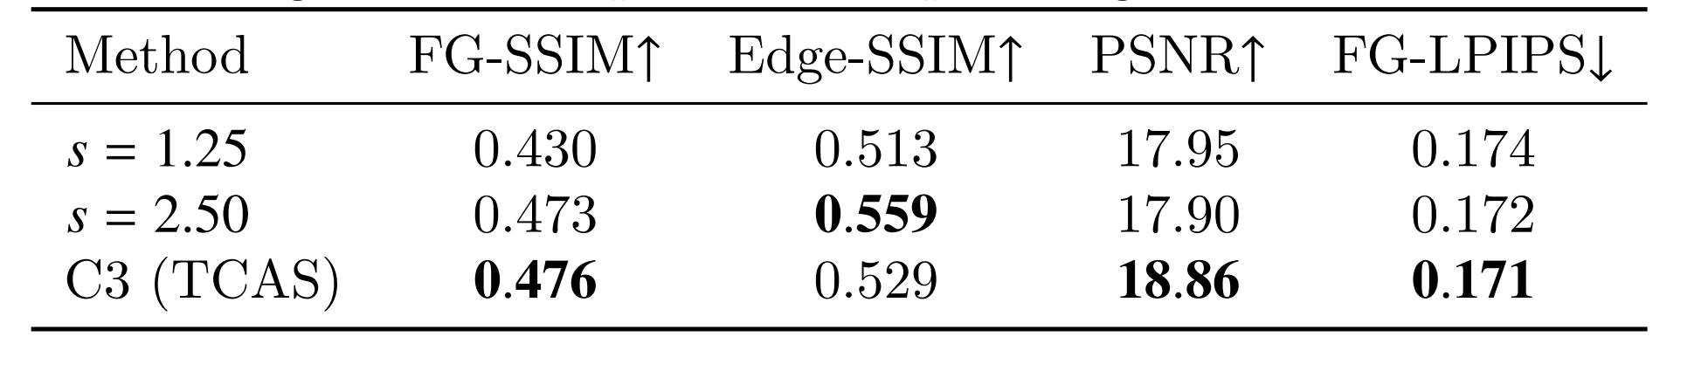
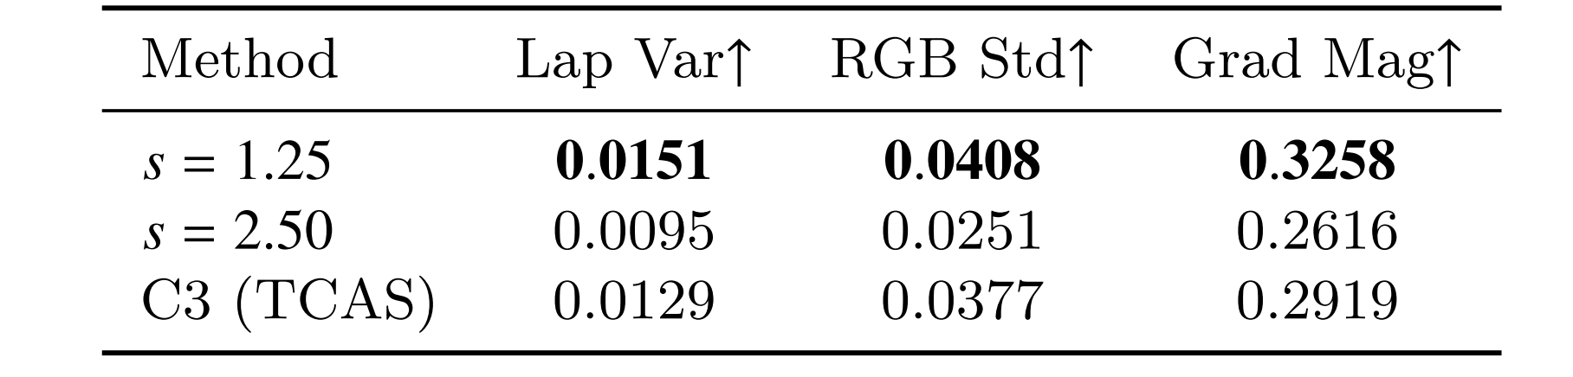
Large-scale validation on 300 objects
C3 is selected on the 24-object probe set and transferred unchanged to the 300-object evaluation pool, with no further search on the evaluation objects.
Notes:
Finally, to further improve the accuracy of boundary segmentation, Multi-Level Feature-Guided Aggregation Decoder is designed to achieve more accurate semantic decoding by fusing contour details, shape structure and global semantic information layer by layer, significantly enhancing the clarity and overall consistency of segmented boundaries.

Slide 11
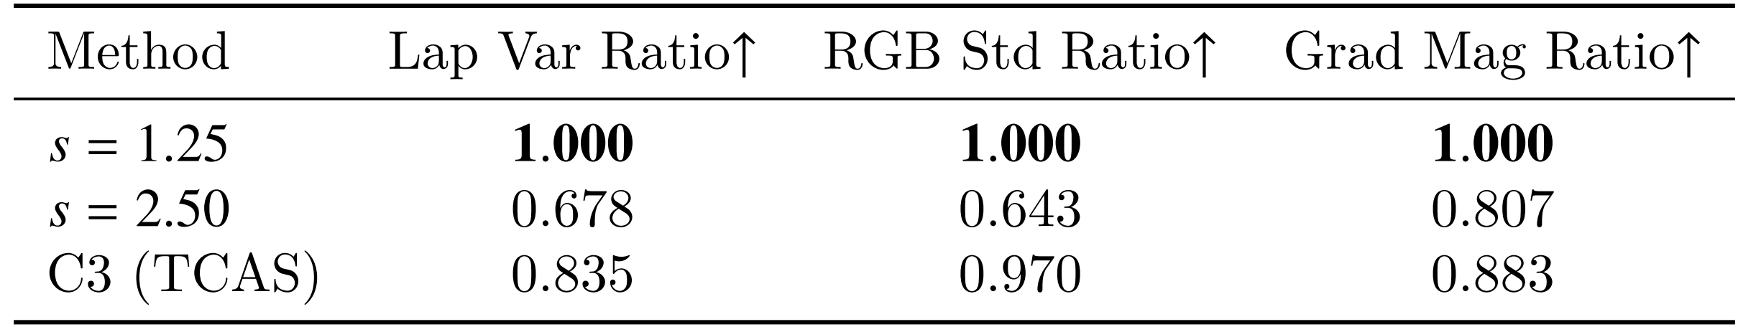
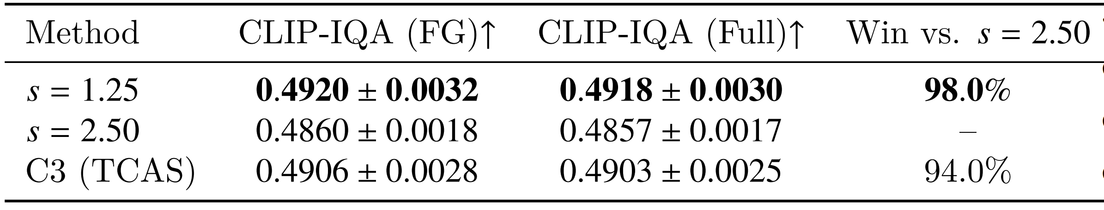
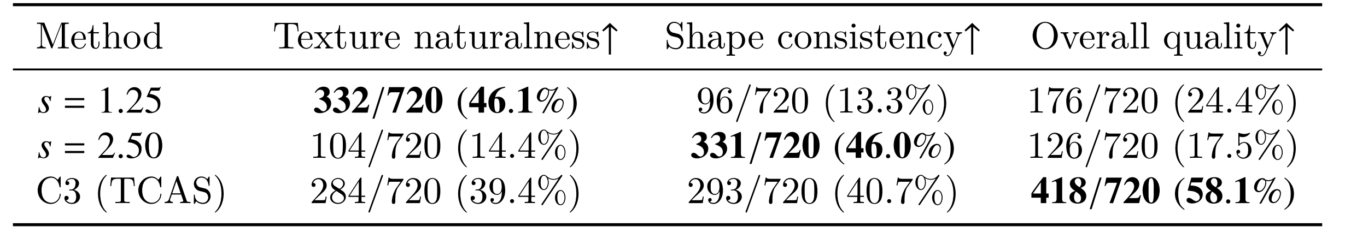
Perceptual validation and user preference
C3 retains more texture variation than s=2.50 and is preferred overall in the blinded study.
Notes:
Moreover, ablation experiments across the TN3K, GlaS, Kvasir-SEG, and ISIC-2016 datasets confirm that the Adapter, MDHFF, and MFGAD modules enhance the performance of our method.

Slide 12
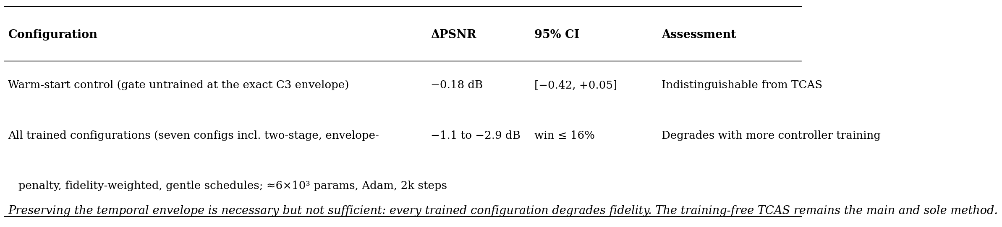
FAC: a controlled re-examination of learned adaptive correction
Notes:
Moreover, ablation experiments across the TN3K, GlaS, Kvasir-SEG, and ISIC-2016 datasets confirm that the Adapter, MDHFF, and MFGAD modules enhance the performance of our method.

Slide 13
Thank you for watching!
Notes:
Thank you for watching!

