Slide 1
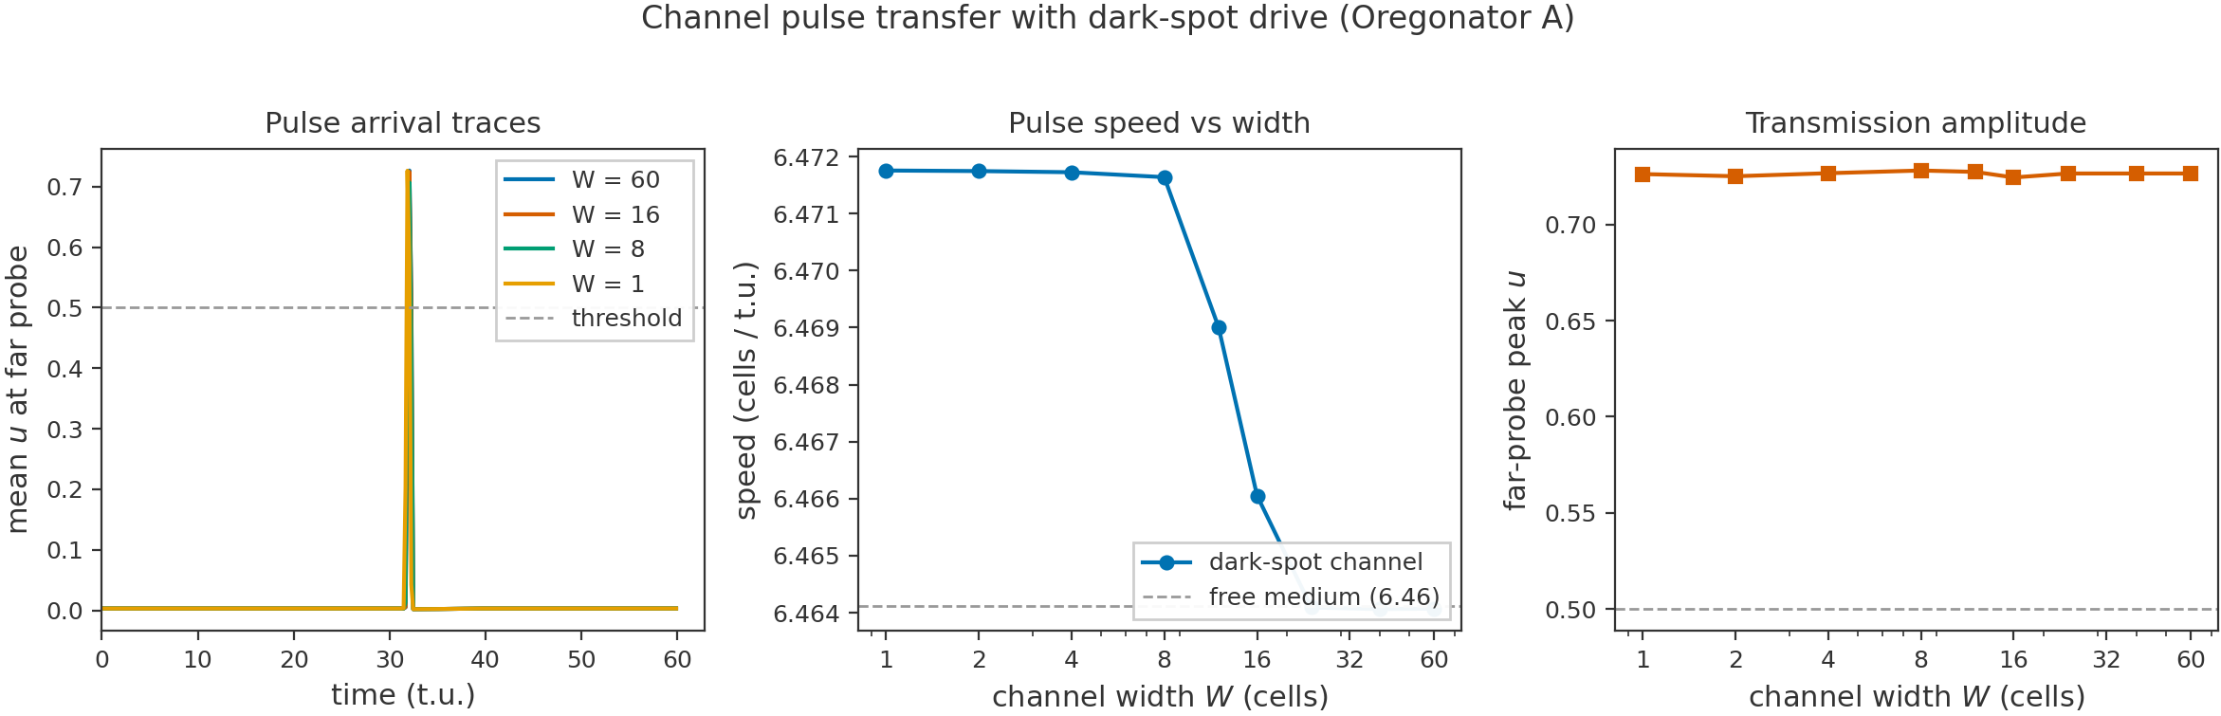
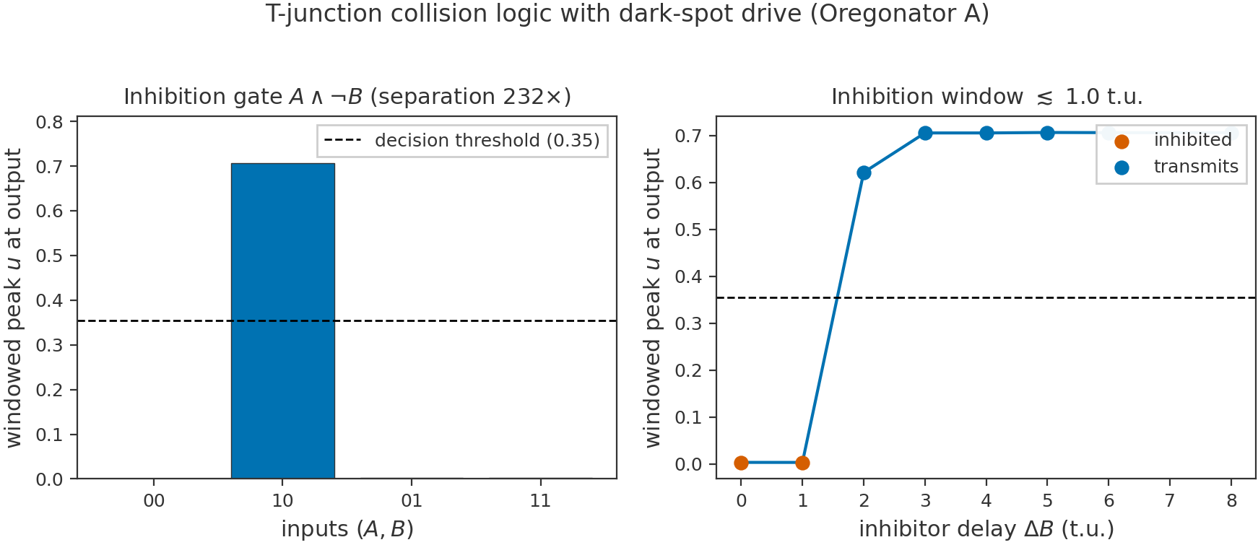
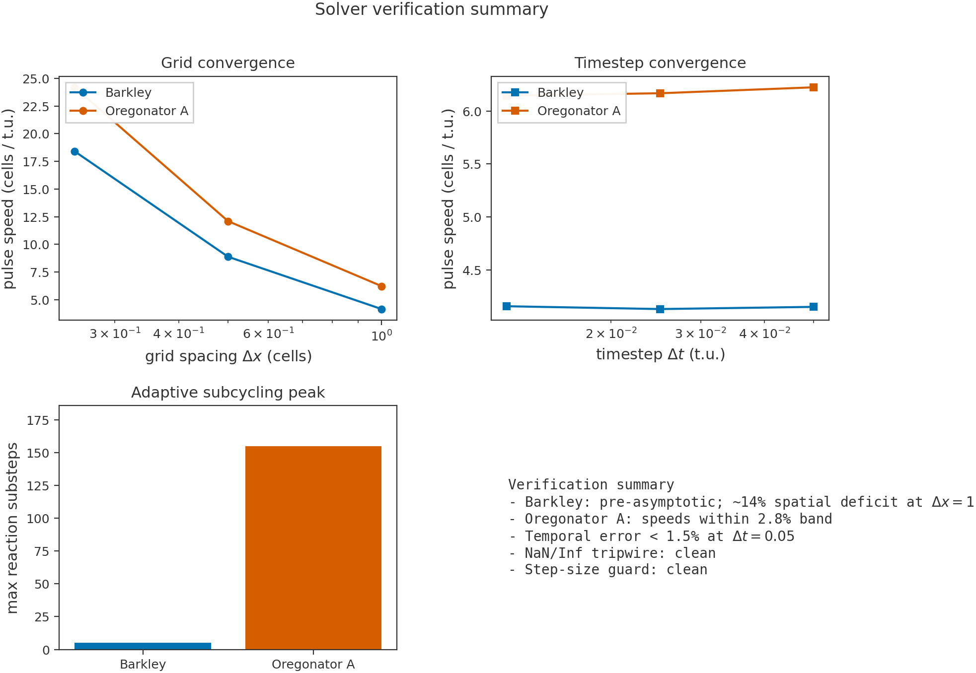
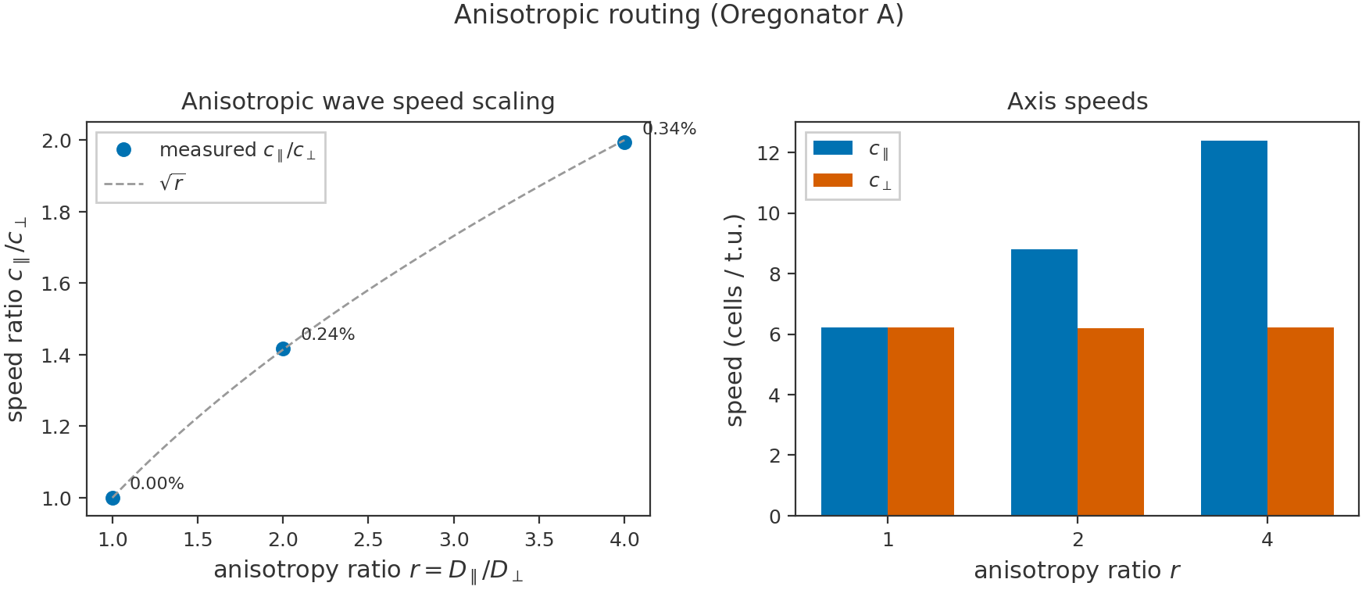
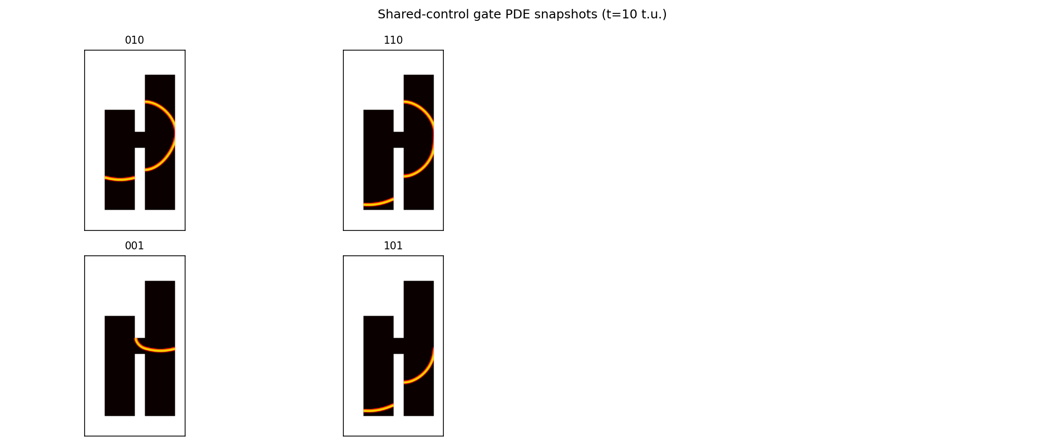
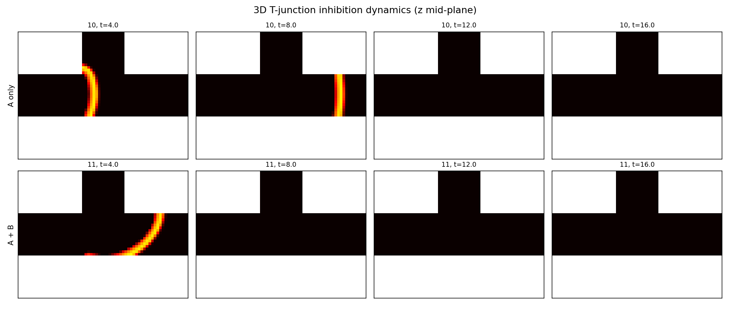
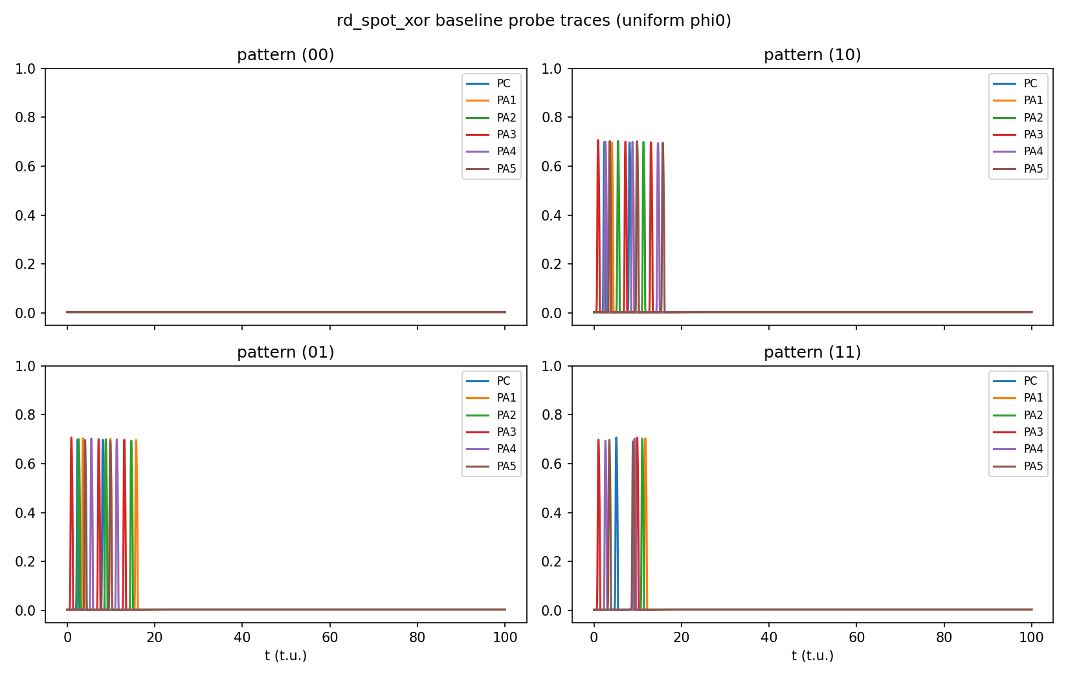


Motivation & Porous Reactor Picture
• Digital neural networks face the von Neumann bottleneck: memory and logic are physically separated.
• A structured BZ reactor can act as a programmable analog computer: chemistry itself performs the computation.
• Wave pulses travel through pore channels; collisions, annihilation and timing implement logic.
• Goal: replace discrete node-by-node simulation with a graph of measured pore-scale operators.
Model & Methods
• Two-variable Oregonator with light suppression φ and anisotropic diffusion tensor D.
• Explicit finite-difference solver: operator splitting + adaptive reaction subcycling.
• Black-box characterisation: measure speed, refractory window and junction truth tables.
• Inputs: calibrated dark-spot flashes (T_FLASH ≈ 3 time units).
Measured Pore-Scale Operators
Graph Simulator
• Event-driven graph built from measured operators.
• Validation: inhibition gate, priority router, shared-control gate.
• Shared channel introduces crosstalk; geometry-aware routing required.
Boundary Experiments
• 3D inhibition gate: 16.8× separation, speed 6.62 cells/t.u.
• Collision XOR leaks when the merging stem stays excitable (free-medium baseline).
• Diode effect: negative result — symmetry dominates over geometry bias.
Conclusions & Future Work
• Pore-network abstraction is viable when junction geometry is carried explicitly.
• Measured operators capture enough physics for fast graph-level prediction.
• Next steps:
– Curated library of junction shapes (T, Y, diode, collision chamber).
– Volumetric 3D illumination and full 3D training.
– Experimental calibration against real photosensitive BZ reactors.
From Measured Pore-Scale Operators to Network-Level Prediction in a Structured Belousov–Zhabotinsky Reactor
Srivijayesh Venugopal · Supervisor: Prof. Weisi Guo · Cranfield University, MSc Computational Fluid Dynamics
Wire: v ≈ 6.46 cells/t.u.
3D inhibition gate
Inhibition: A AND (NOT B), >200×
MMS verification: 2nd-order convergence
Spot XOR leak protocol
Anisotropic routing via sqrt(r) eikonal steering
Graph-to-PDE validation: priority router / shared-control gate

