Slide 1
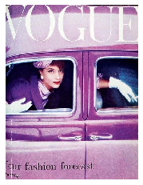


Image Name: 0_#BD8CB5_4b2578e3ee58ba107806ee430ead95.jpg
Source: Pinterest
Board: Vintage-style
[mulberry]
Python scripts:
- Top 10 Colors from ColorPaletteExtractor.py
- Dominant Color based on HEX code provided in
Pinterest json request from webpage in ImageDownloadPinterest.py
Season based on Top 10 Colors + Dominant Color
Pinterest board name
Dark Winter
Vintage-style
New Image Name*: Vintage-style_DarkWinter_0_#BD8CB5_4b2578e3ee58ba107806ee430ead95.jpg
*after processing the image

