Slide 1
ColorPaletteSearchColor
VIAN search color: lavender
Threshold: 0-1%

Slide 2
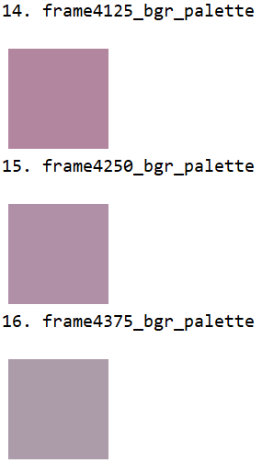
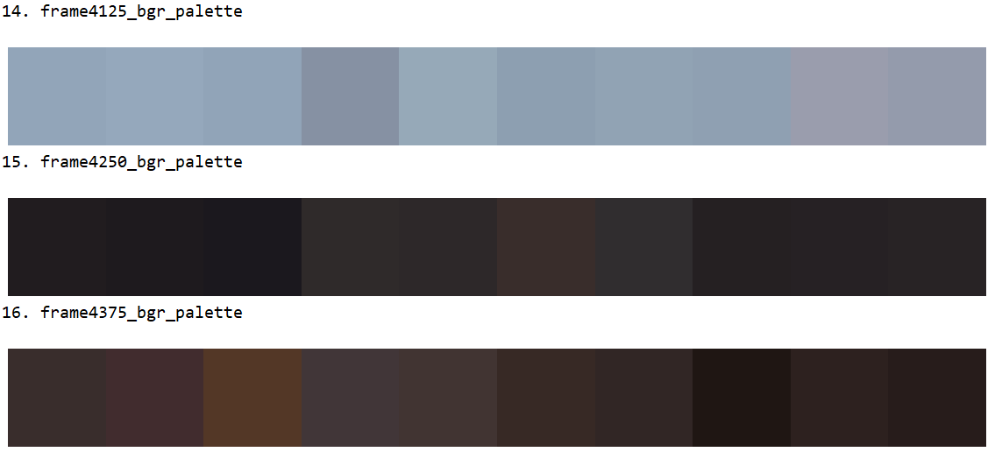
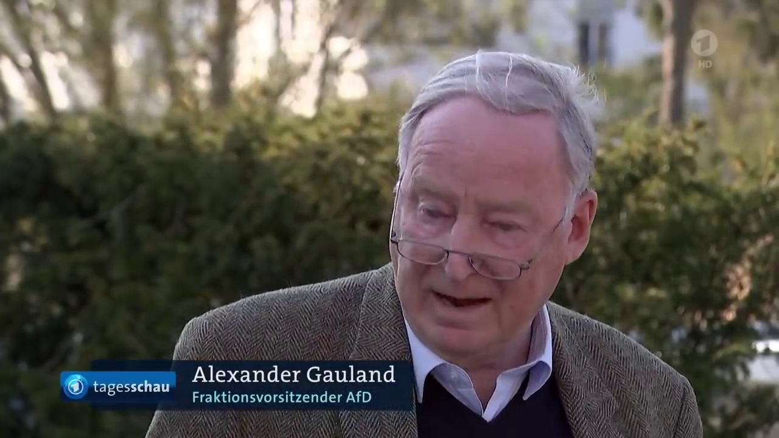
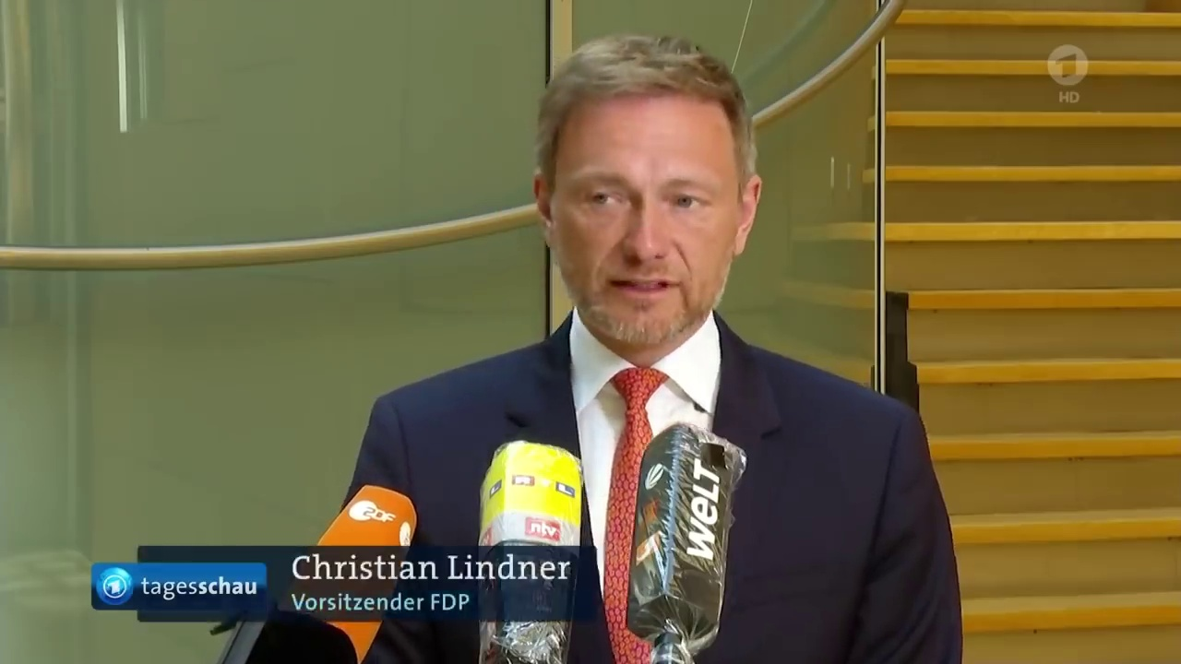
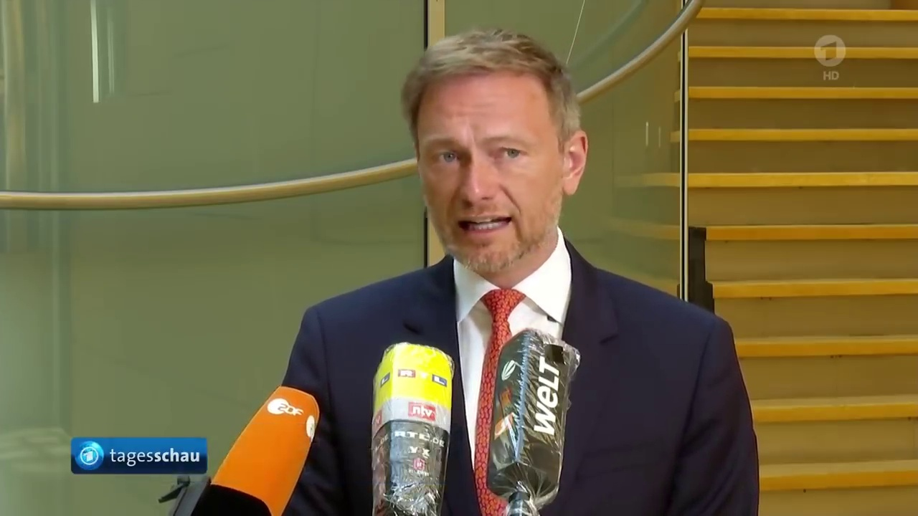
Gold color Color palette Video image

Slide 3
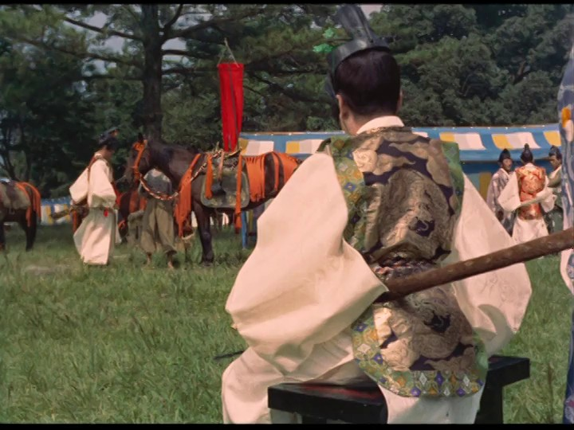
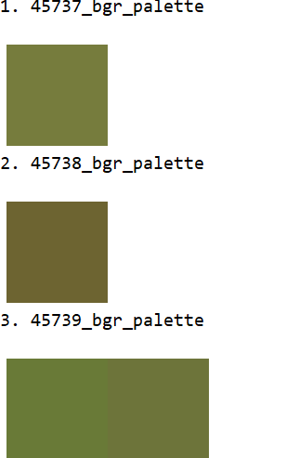
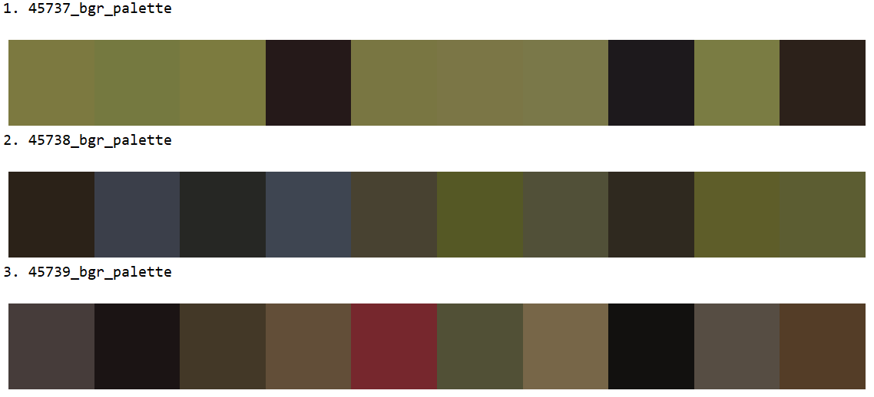
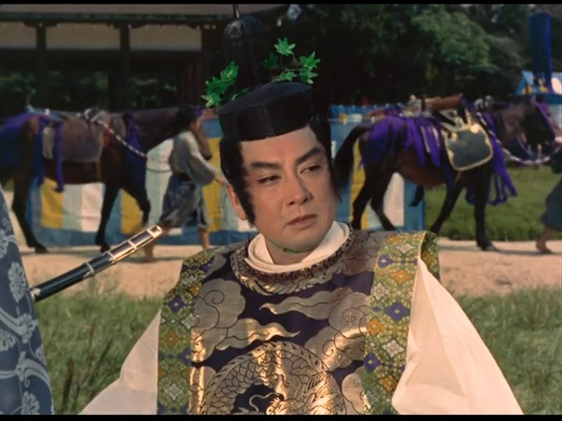
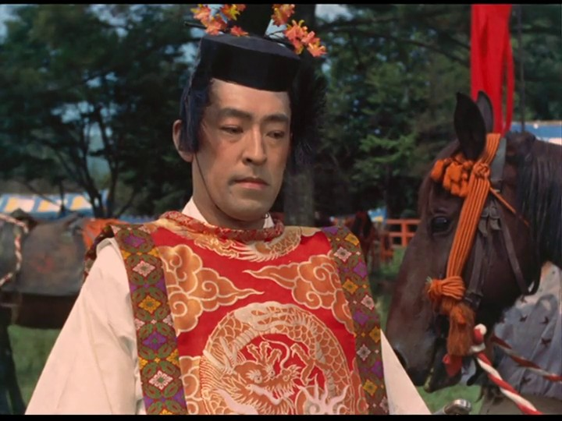
Avocado, threshold = 1
Gold color Color palette Video image

Slide 4
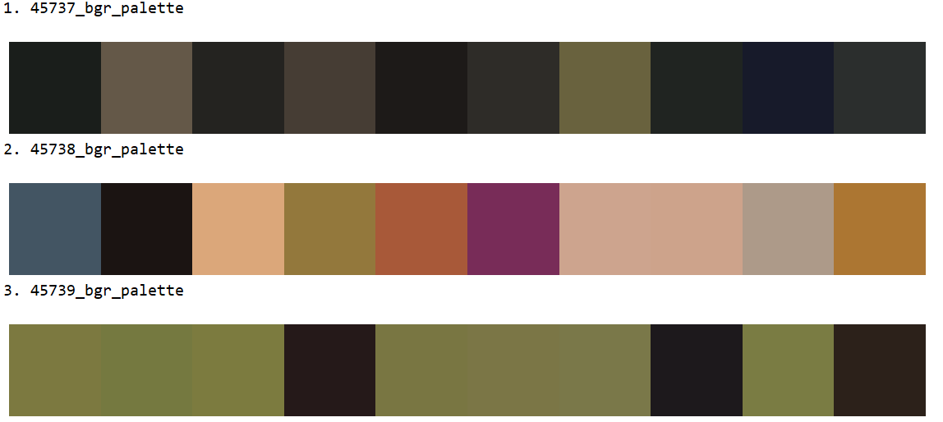
Avocado, threshold = 0
Gold color Color palette Video image

Slide 5
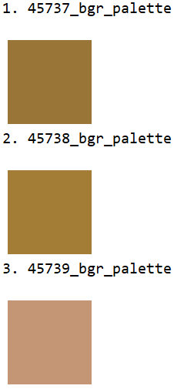
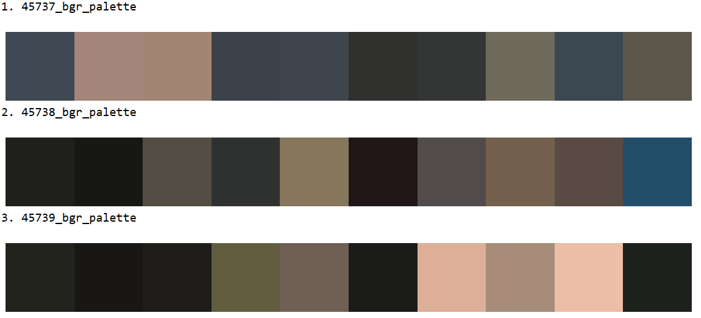
VIAN: Mustard, threshold = 1
Gold color Color palette Video image

Slide 6
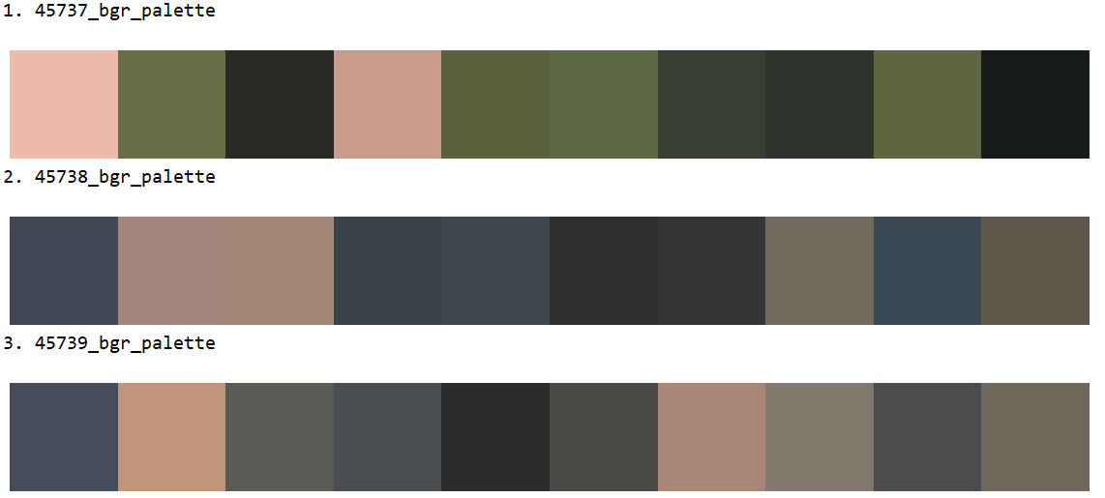
VIAN: Mustard, threshold = 0
Gold color Color palette Video image

Slide 7
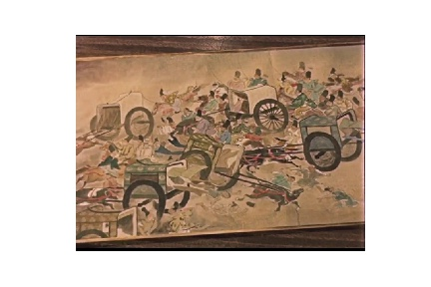
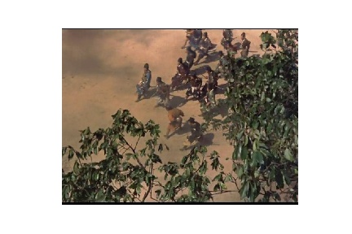
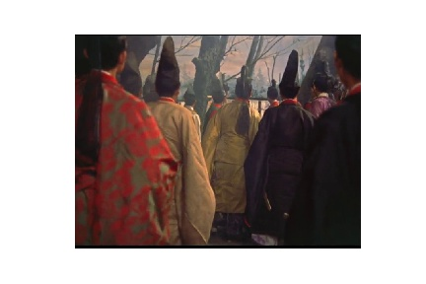
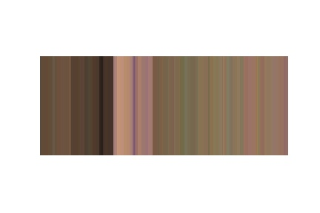
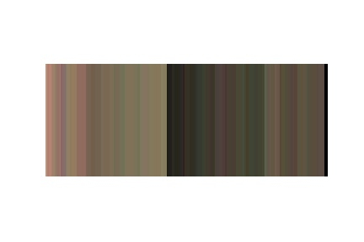
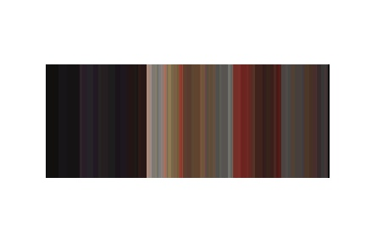

Slide 8
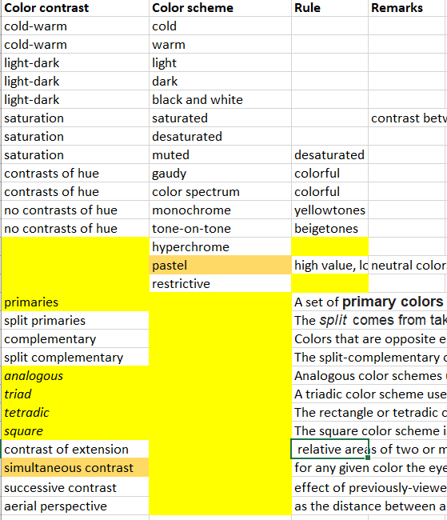
DONE
WHY not
Yellow too?
impossible

Slide 9
Harmony - No Contrast of Extension
Violet:yellow – Proportion: 3:1
Disharmony - Contrast of Extension
Violet:yellow – Proportion: 1:3

Slide 10
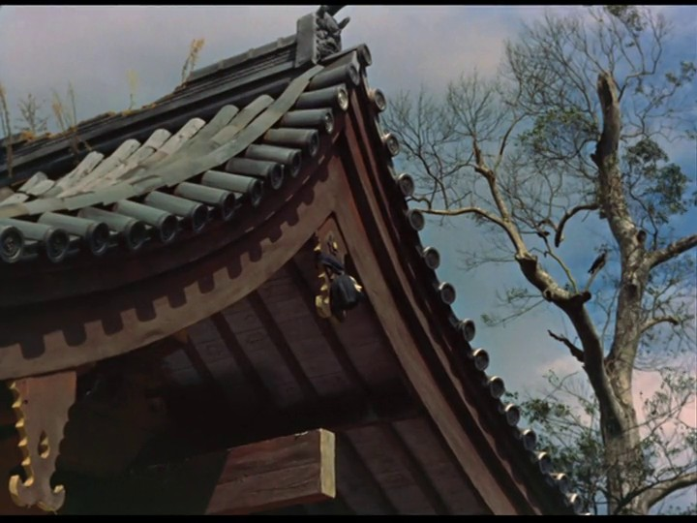
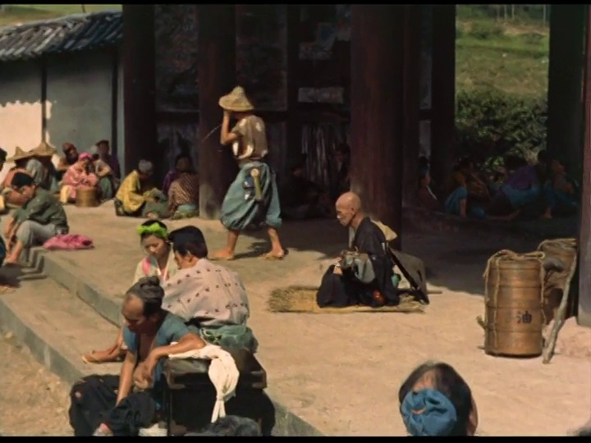
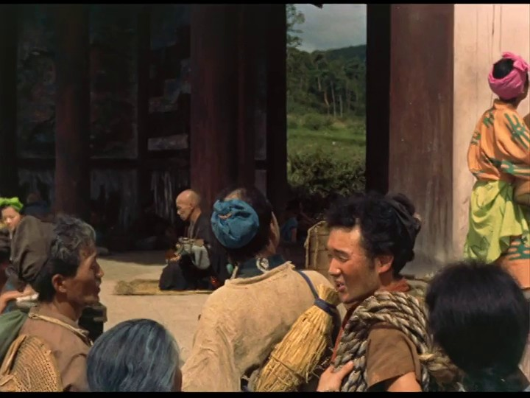
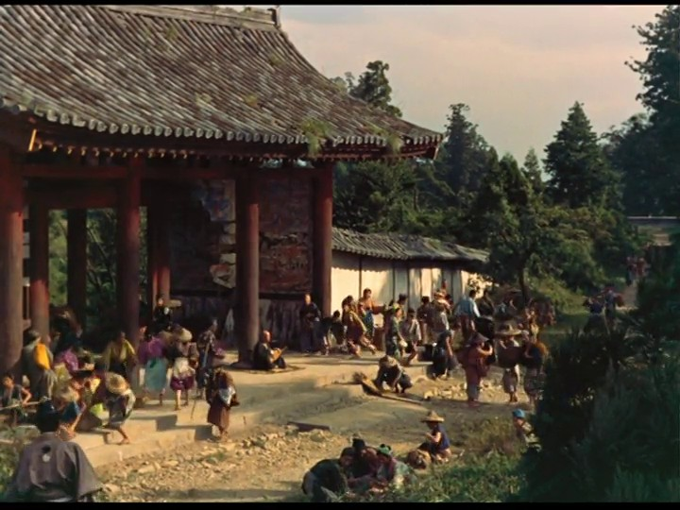
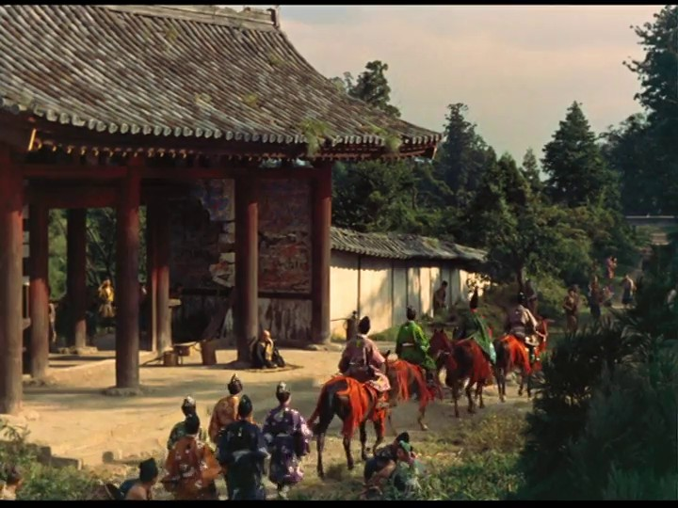
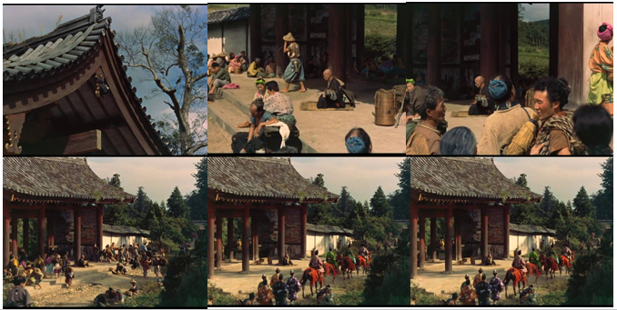

Slide 11
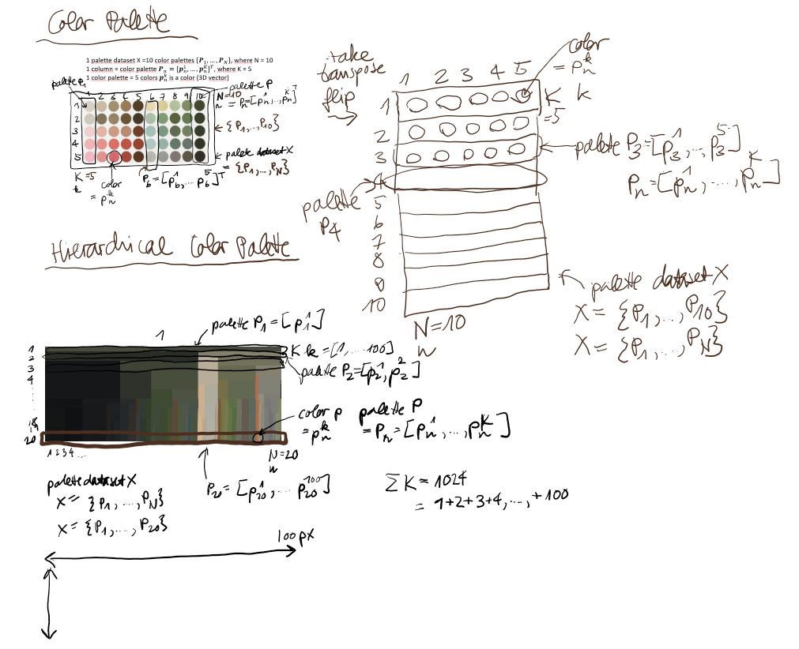

Slide 12
Workflow
There are 720 possible dict colors,
but 255**3 = 16’581’375 possible patch colors.
Dictionary: <dict color> {text, number, image} subspace
Machine learning training: <dict color; color category> subspace-to-space generalization
Color category: dict color {text, number, image}
Color category: basic color {text, number, image}
Color category: contrast color {text, number, image}
Image aka Color Palette: <patch color> {text, number, image} space
Machine learning prediction on Color Palette: <patch color; color category>
Color category: dict color {text, number, image}
Color category: basic color {text, number, image}
Color category: contrast color {text, number, image}
Pairs’ Distance Calculation of Images aka Color Palettes aka Color Histograms: <patch color; patch color> {text, number, image} space
Artistic-to-Scientific Rules Transformation and Application of Color Contrast Rules on Color Palette: <contrast color; color contrast>
Color contrast {text}
Queries
1. «Exact» Search query: <color category>** {text, number, image} → Search result: top-ratio Image aka Color Palette <patch color>
2. «Similar» Search query: <image aka color palette img aka color histogram> {image} → Search result: top-n <image aka color palette img aka color histogram>
3. «Classified» Search query: <color contrast>** {text} → Search result: Image aka Color Palette <patch color>

Slide 13
Queries
Queries
1. «Exact» search query: <color category>** {text, number, image} → Search result: top-ratio plate <patch color>
Color category: space color {number (=HEX, RGB, HSV, CMYK, LAB), image (=icon, patch)}
Color category: dictionary color {text (=color name), number (=HEX, [RGB, HSV, CMYK, LAB]), image (=icon, patch)}
Color category: basic color {text (=color name), number (=HEX, [RGB, HSV, CMYK, LAB]), image (=icon, patch)}
Plate: movie frame {image (=JPG, PNG)}
Plate: color palette {image (=JPG, PNG)}
2. «Similar» search query: <plate> {image} → Search result: top-n plate <plate>
Plate: movie frame {image (=JPG, PNG)}
Plate: color palette {image (=JPG, PNG)}
Plate: histogram {image (=JPG, PNG)}
3. «Classified» search query: <color contrast>** {text} → Search result: plate <patch color>
Color contrast {text (=contrast name)}
Plate: movie frame {image (=JPG, PNG)}
Plate: color palette {image (=JPG, PNG)}

Slide 14
Classification
Color classification
Color palette classification
Patch color
color category
Patch color
color category
Color contrast
Dict color: aliceblue
Basic color: blue
Dict color: aliceblue
contrast color: blue
Dict color: aliceblue
Dict color: aliceblue
Dict color: grass
contrast color: green
contrast of hue
Non-dict color: aliceblue2
Dict color: aliceblue
Non-Dict color: vermillion2
contrast color: red
Color Palette X’’
Color Palette X
Color Palette X’
Color Palette X
Color Palette X’
Search basic color «blue» or dict color «alice blue»
Search color contrast «contrast of hue»

Slide 15
basic color
dict color
Non-dict color

