Slide 1
Color Spaces

Slide 2
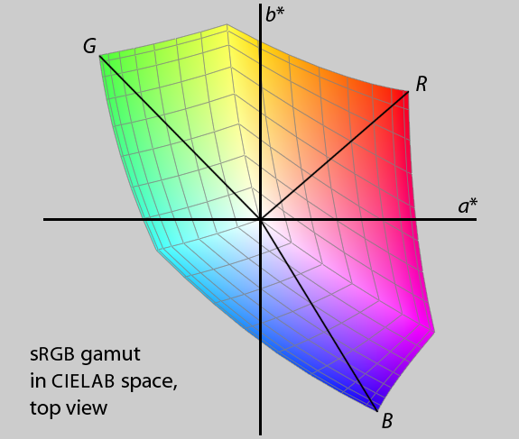

Slide 3
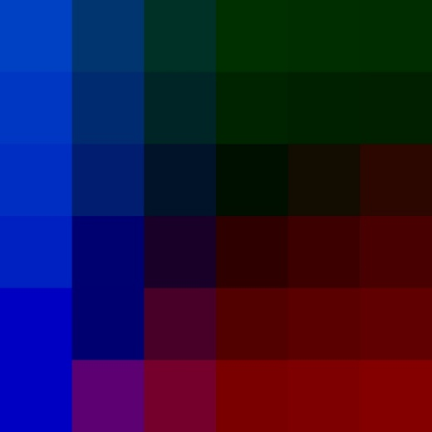
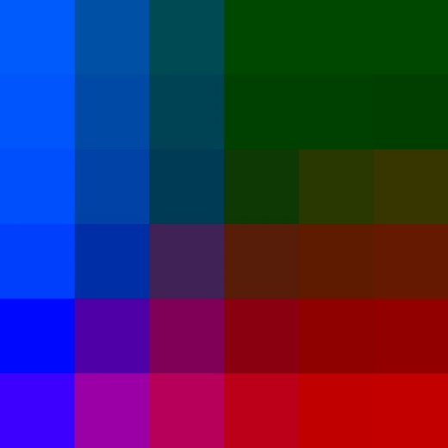
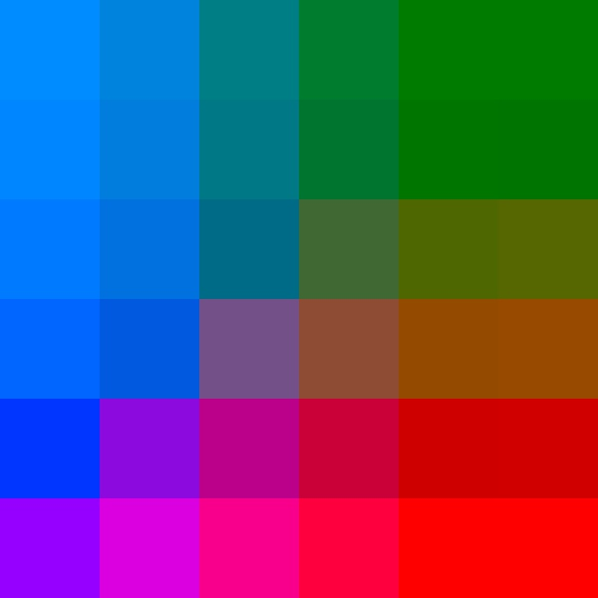
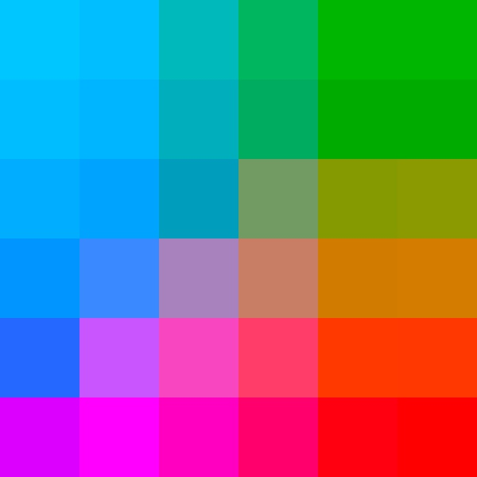
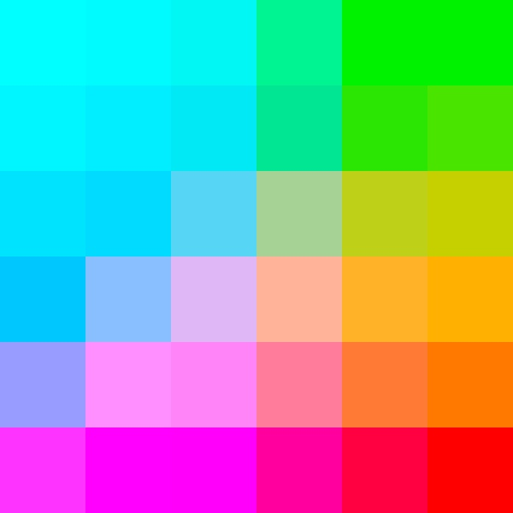
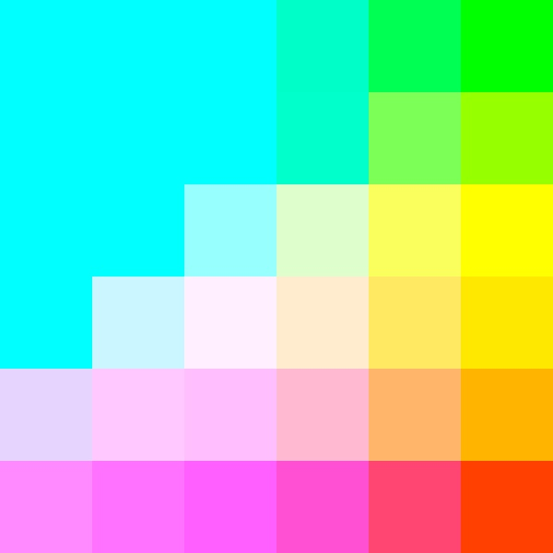

Slide 6
 | Color Name Designations |  |  | Numeral and/or Letter Color Designations
Level of Granularity | Level 1 (coarse) | Level 2 | Level 3 | Level 4 | Level 5 | Level 6 (fine)
Number of Segments of Color Solid | 3 | 12 | 500 | 256x256x256 = 16’777’216 | >3 trillion | infinite
Type of Color Designation | Primary colors: color space channels | Basic colors: hue names | Color names: dictionary colors, palette colors | Grid-sampling of color system | Interpolation of grid-point values, HSV space | Cielab space, XYZ space
Example | Blue | Green | Avocado green | RGB(22,122, 108) | HSV(27.17, 0.86, 0.72) | Lab(99.3411, -24.1, 22.33)
Color Systems | RGB: red, green, blue CMYK: cyan, magenta, yellow Primary: red yellow, blue | Boynton Itten | EPFL Color Thesaurus XKCD Color Survey | RGB cube | HSV cylinder | Cielab horseshoe

Slide 7
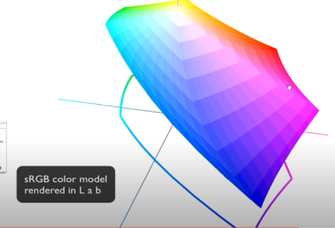
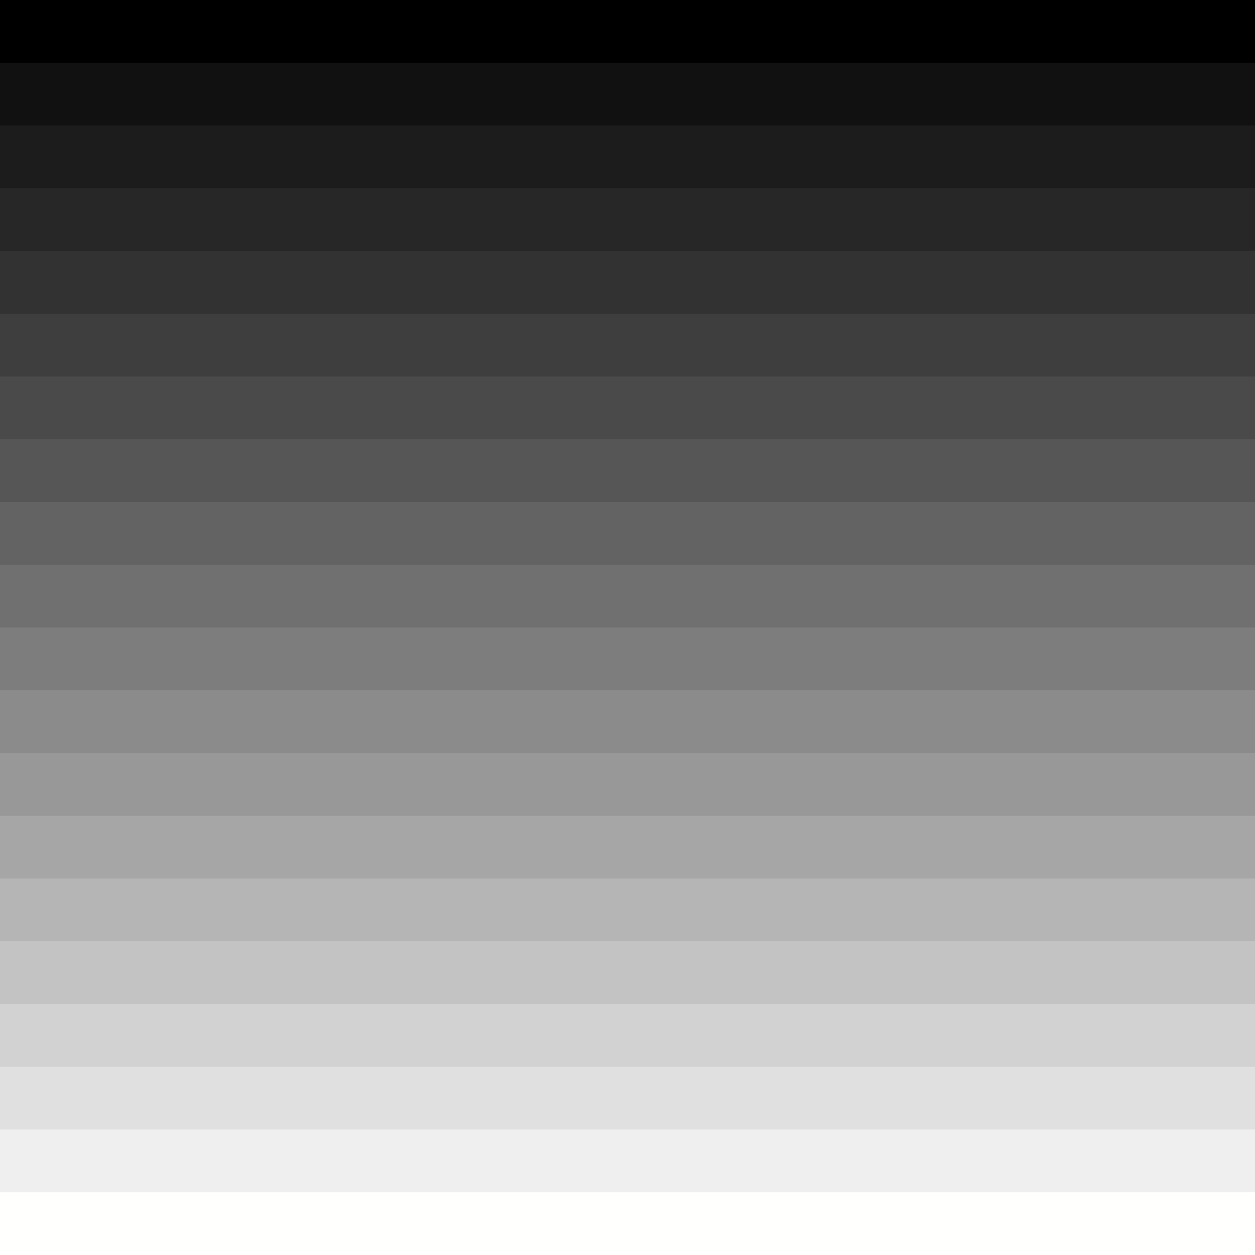
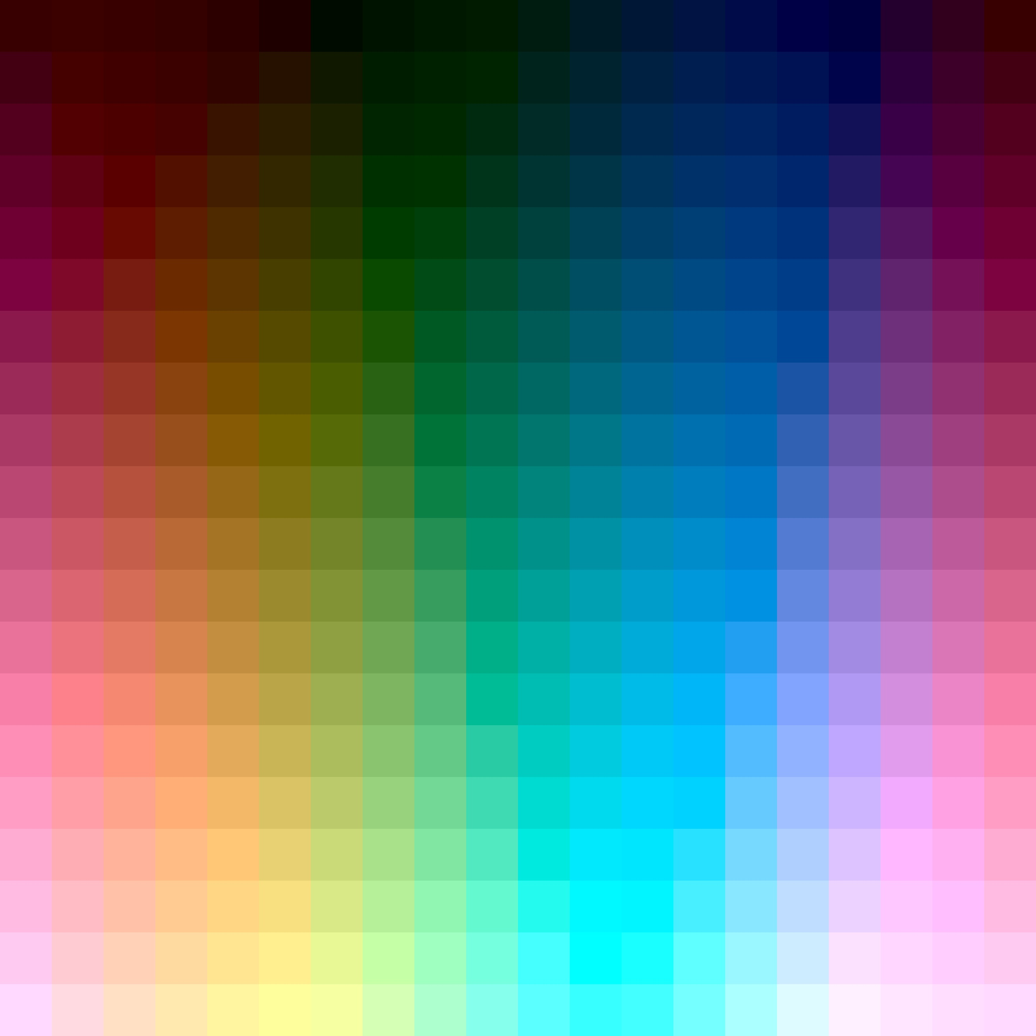
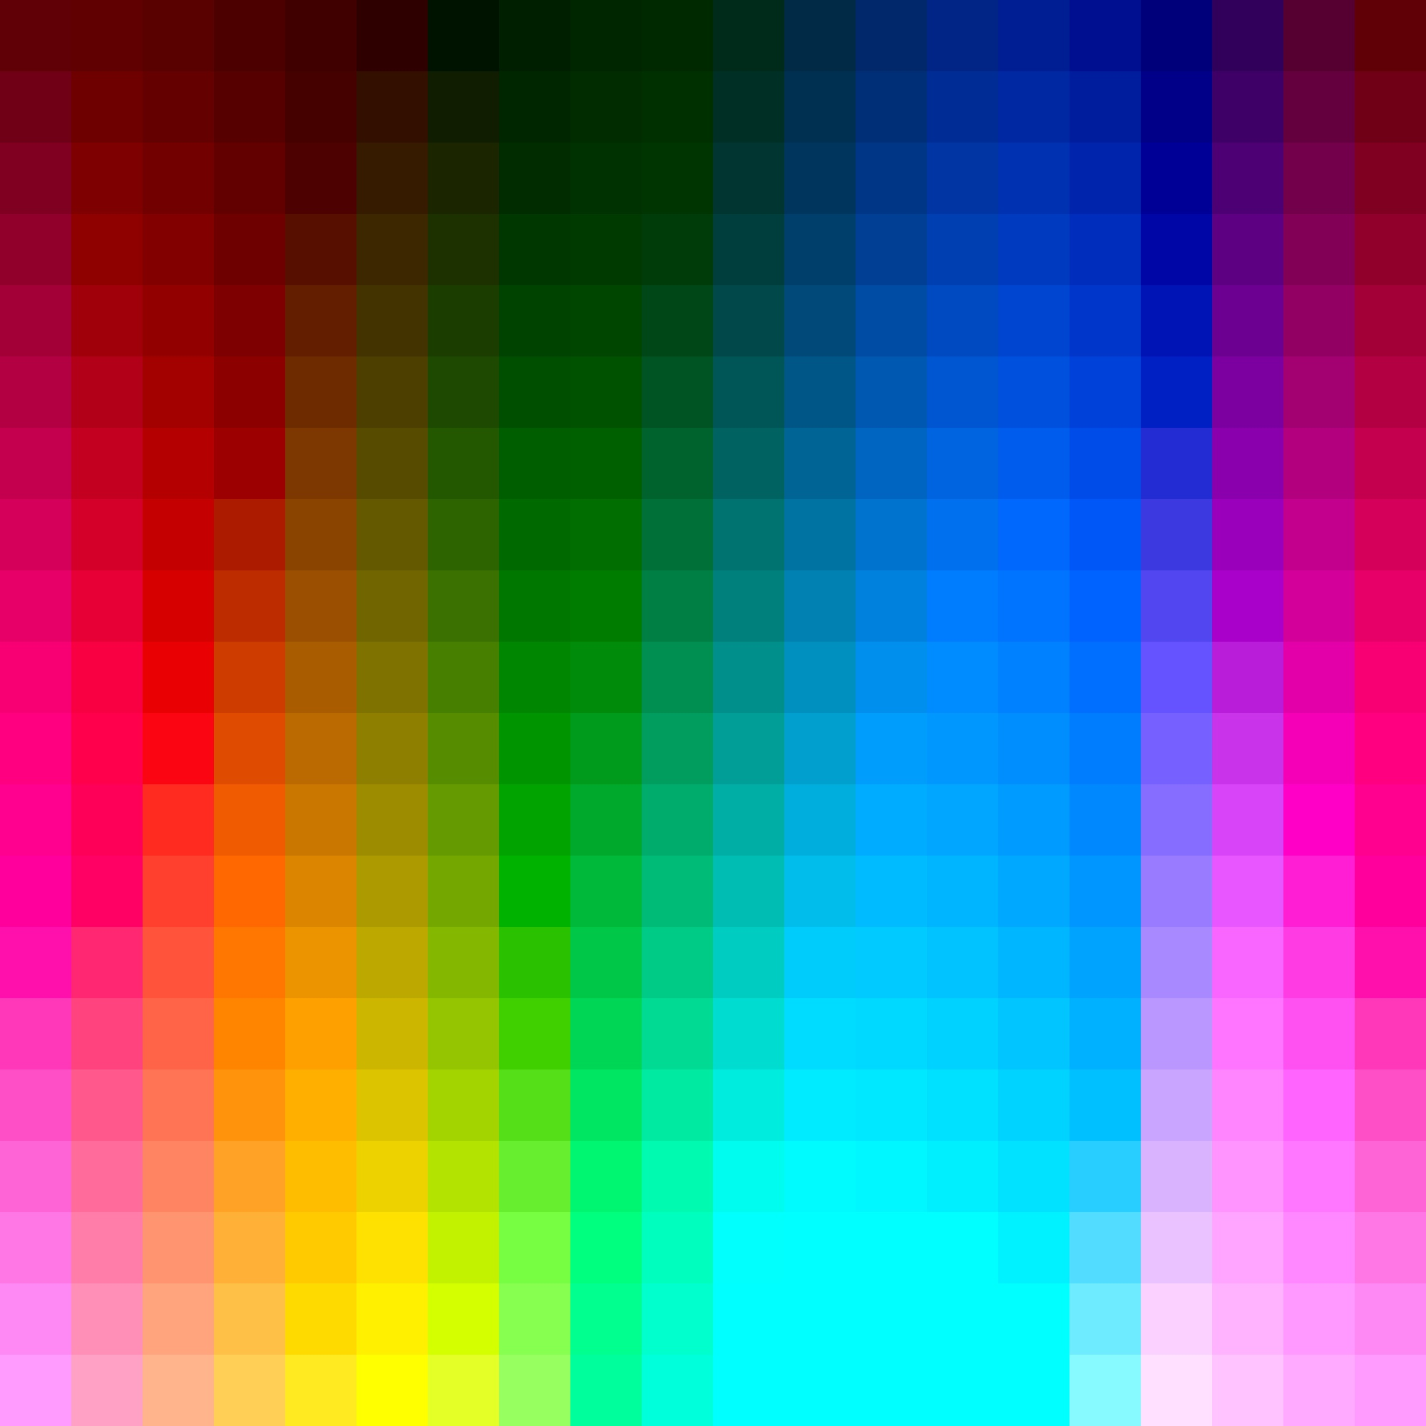
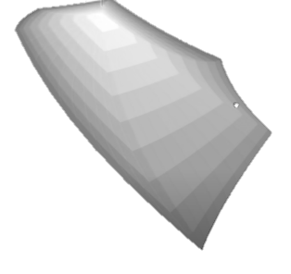
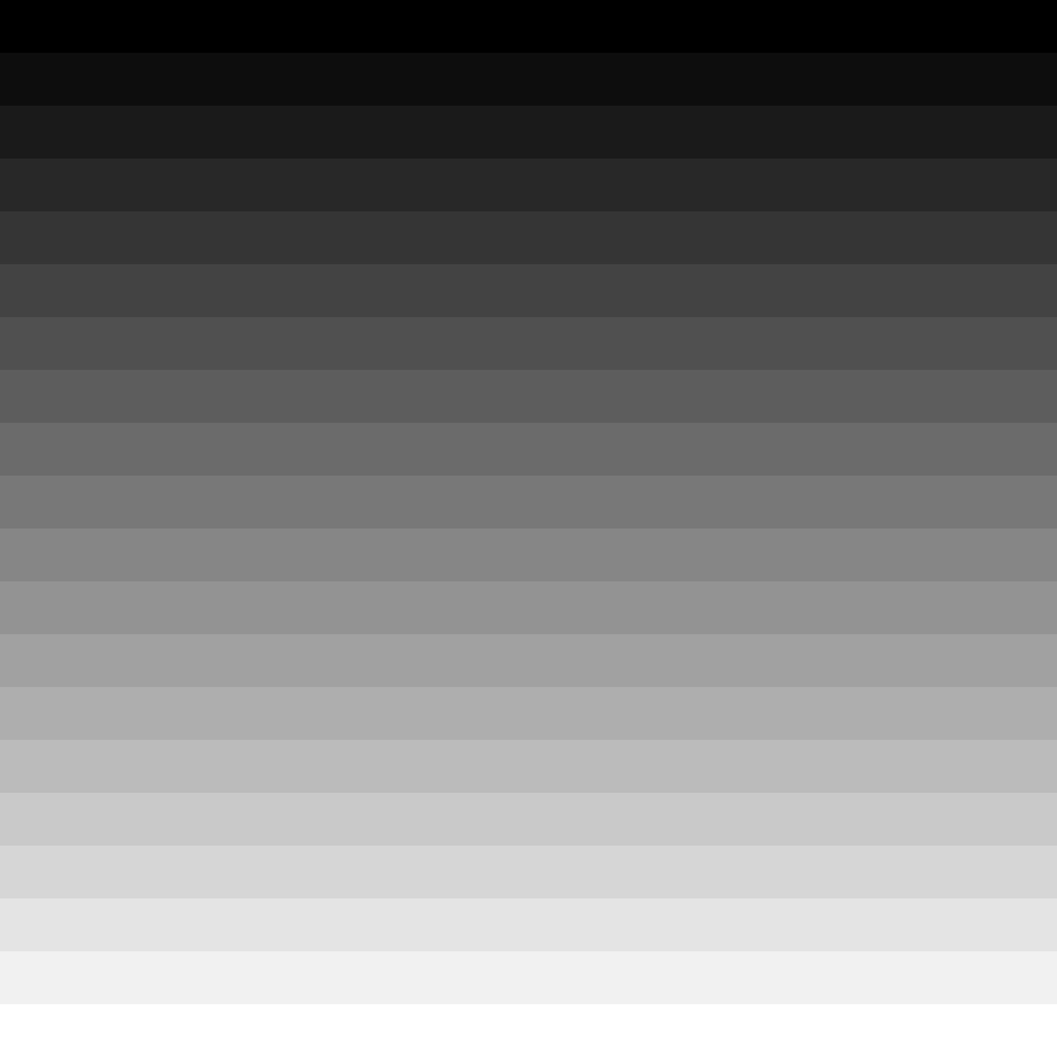
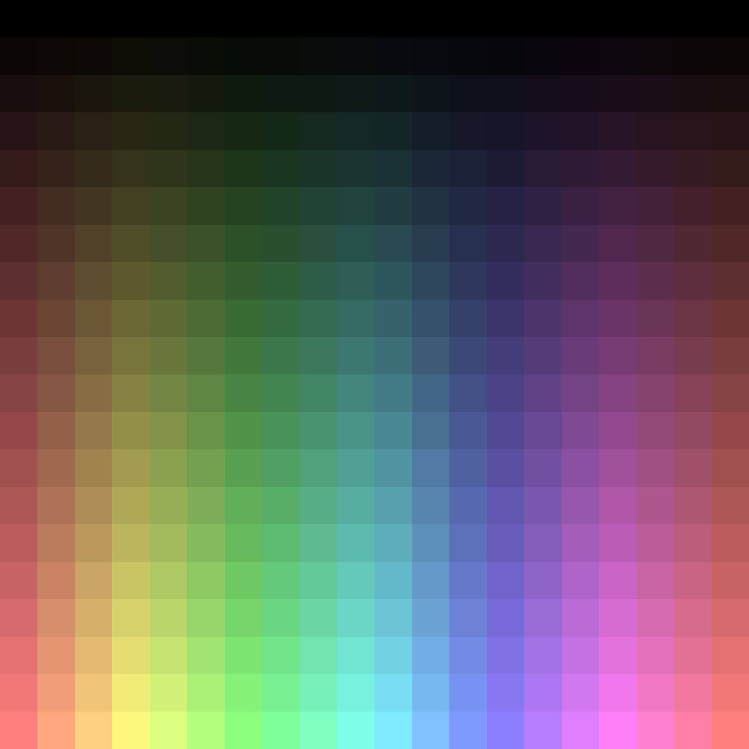
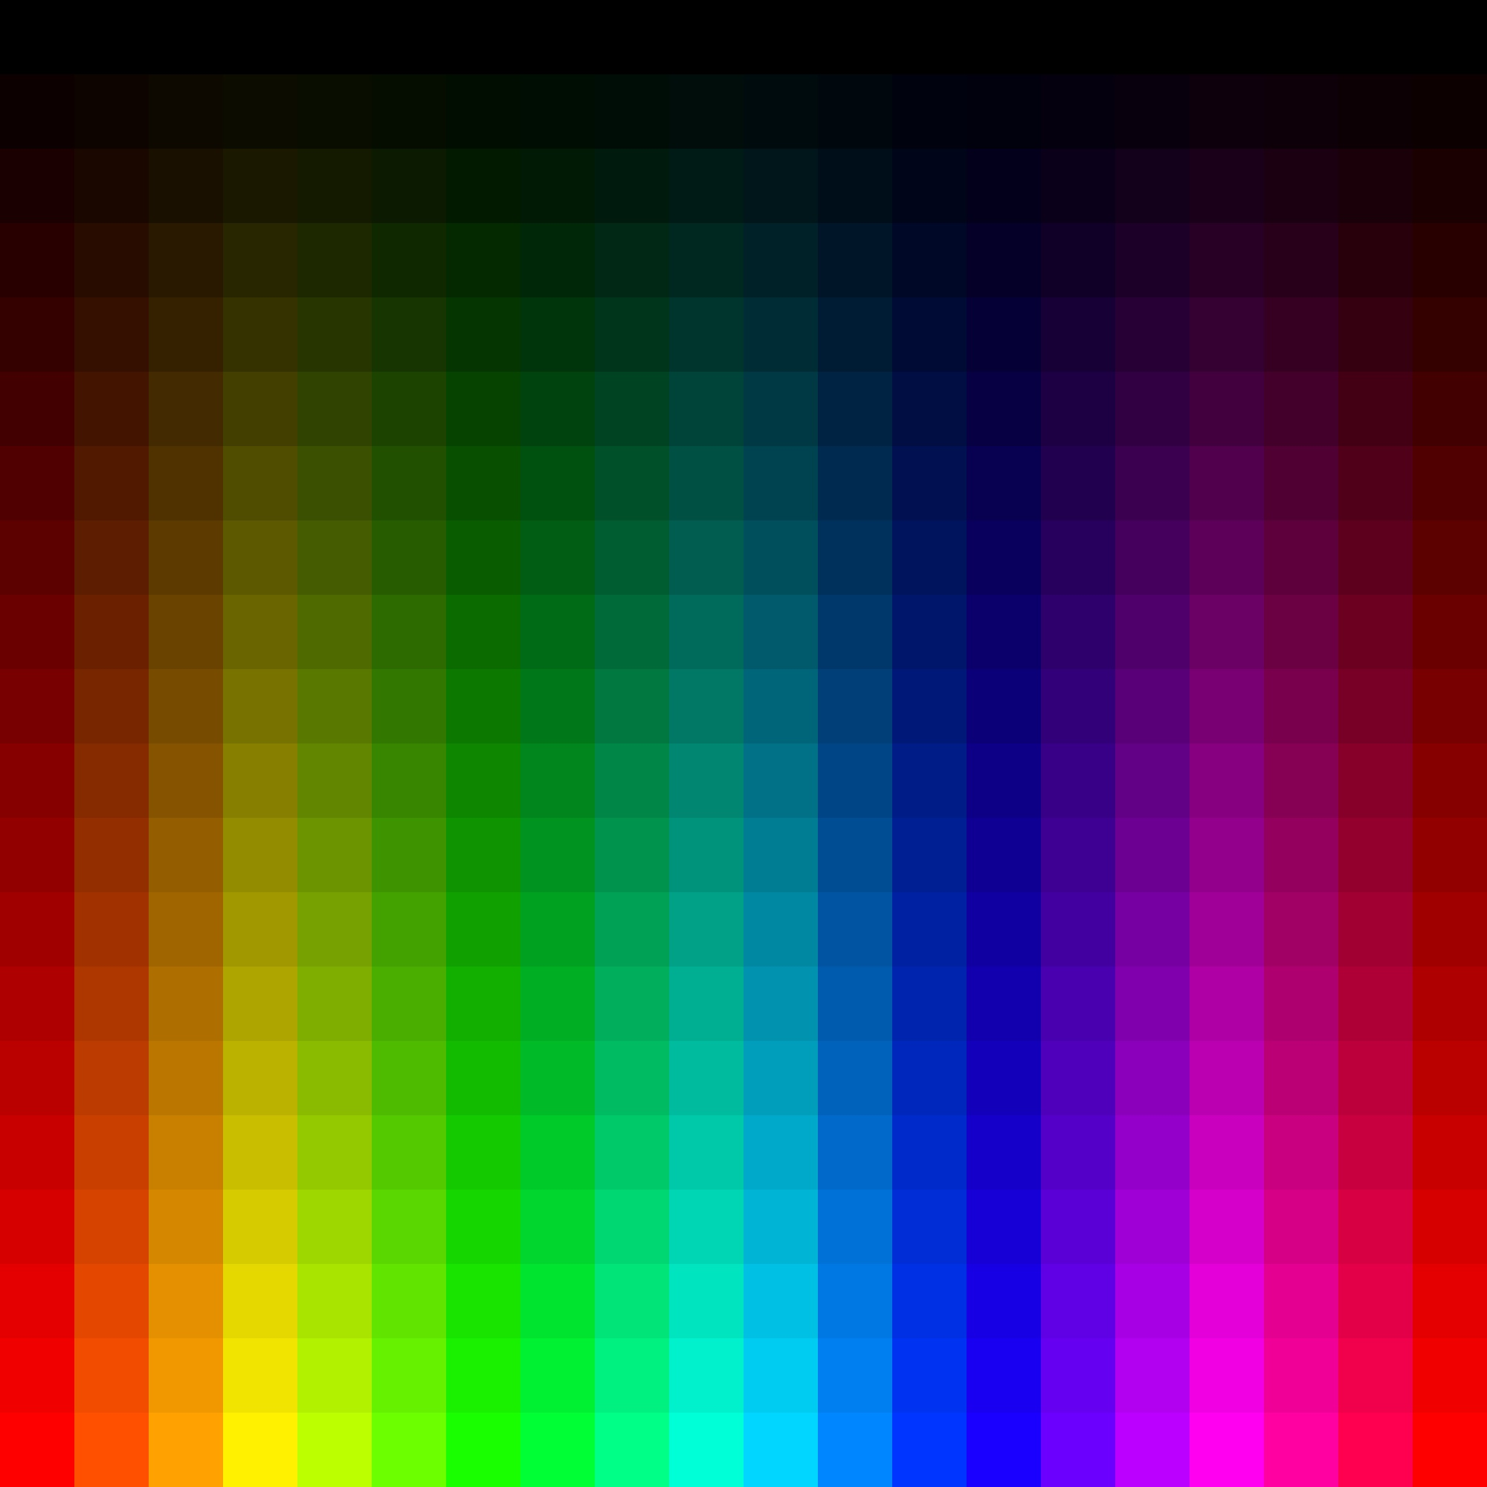
LCH (LAB)
HSV (RGB)
0%
50%
100%
Color Solid
Saturation

Slide 8
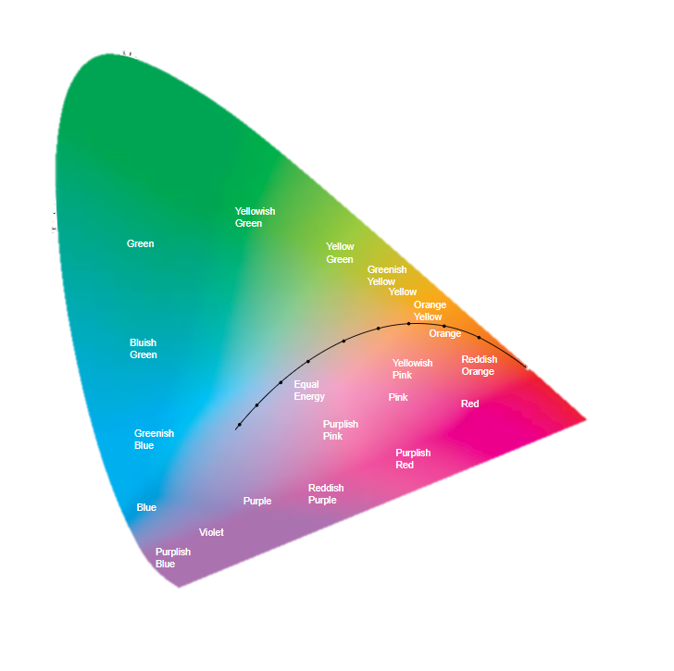

LAB
RGB
CMYK

Slide 9
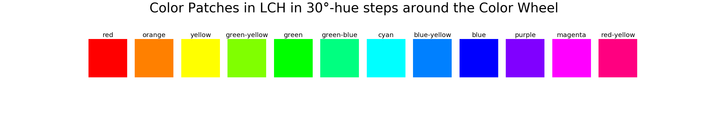
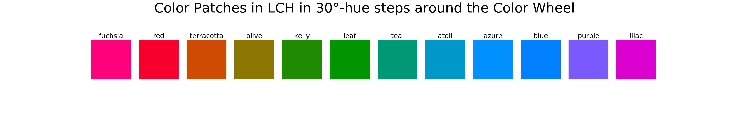
(a)
(b)

Slide 10
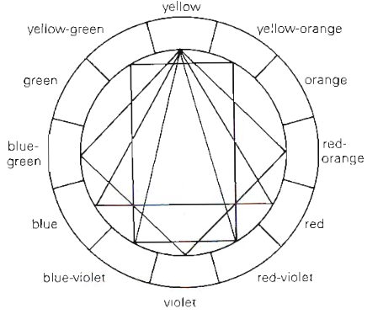
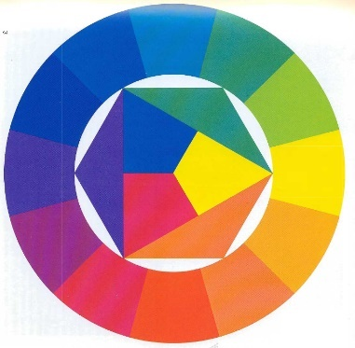
(a)
(b)

Slide 11
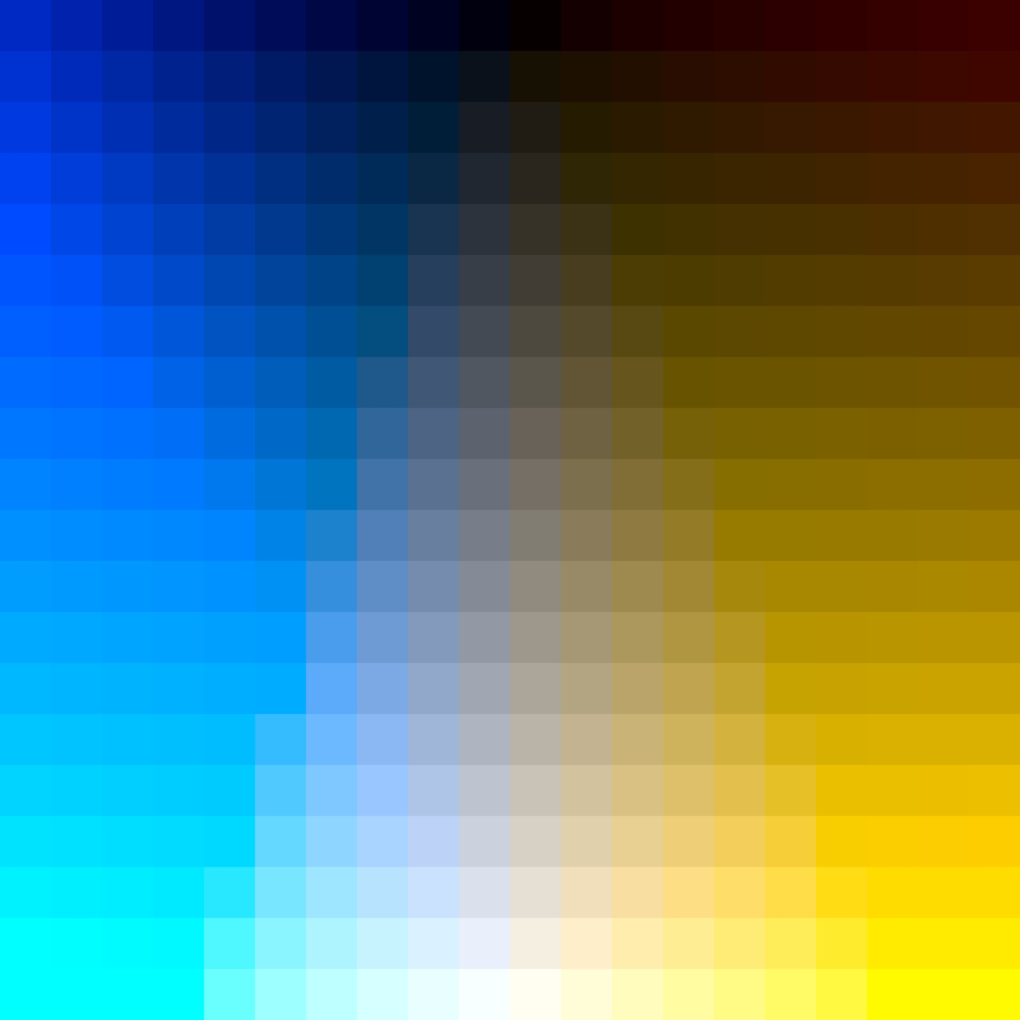
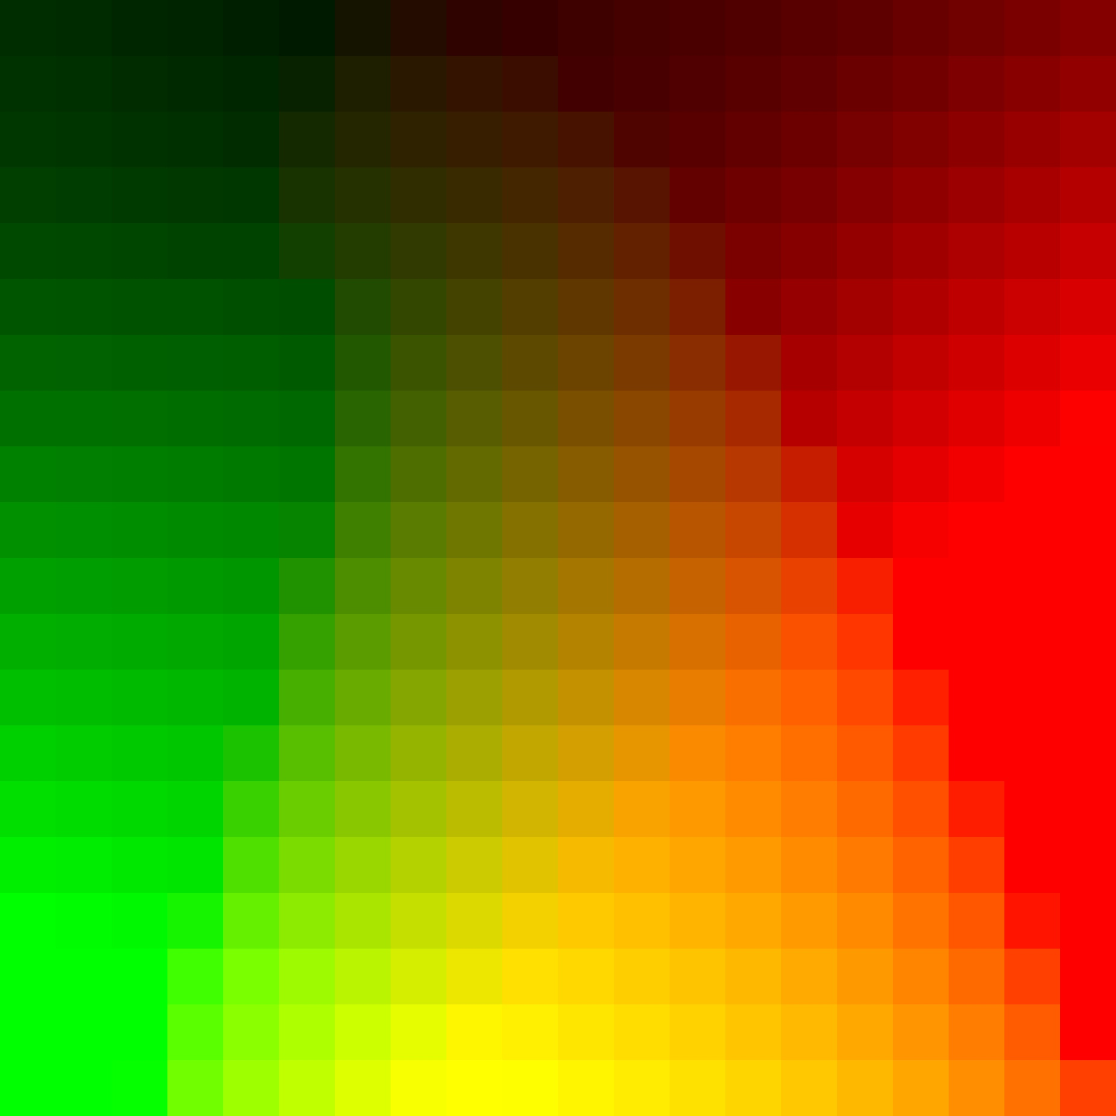
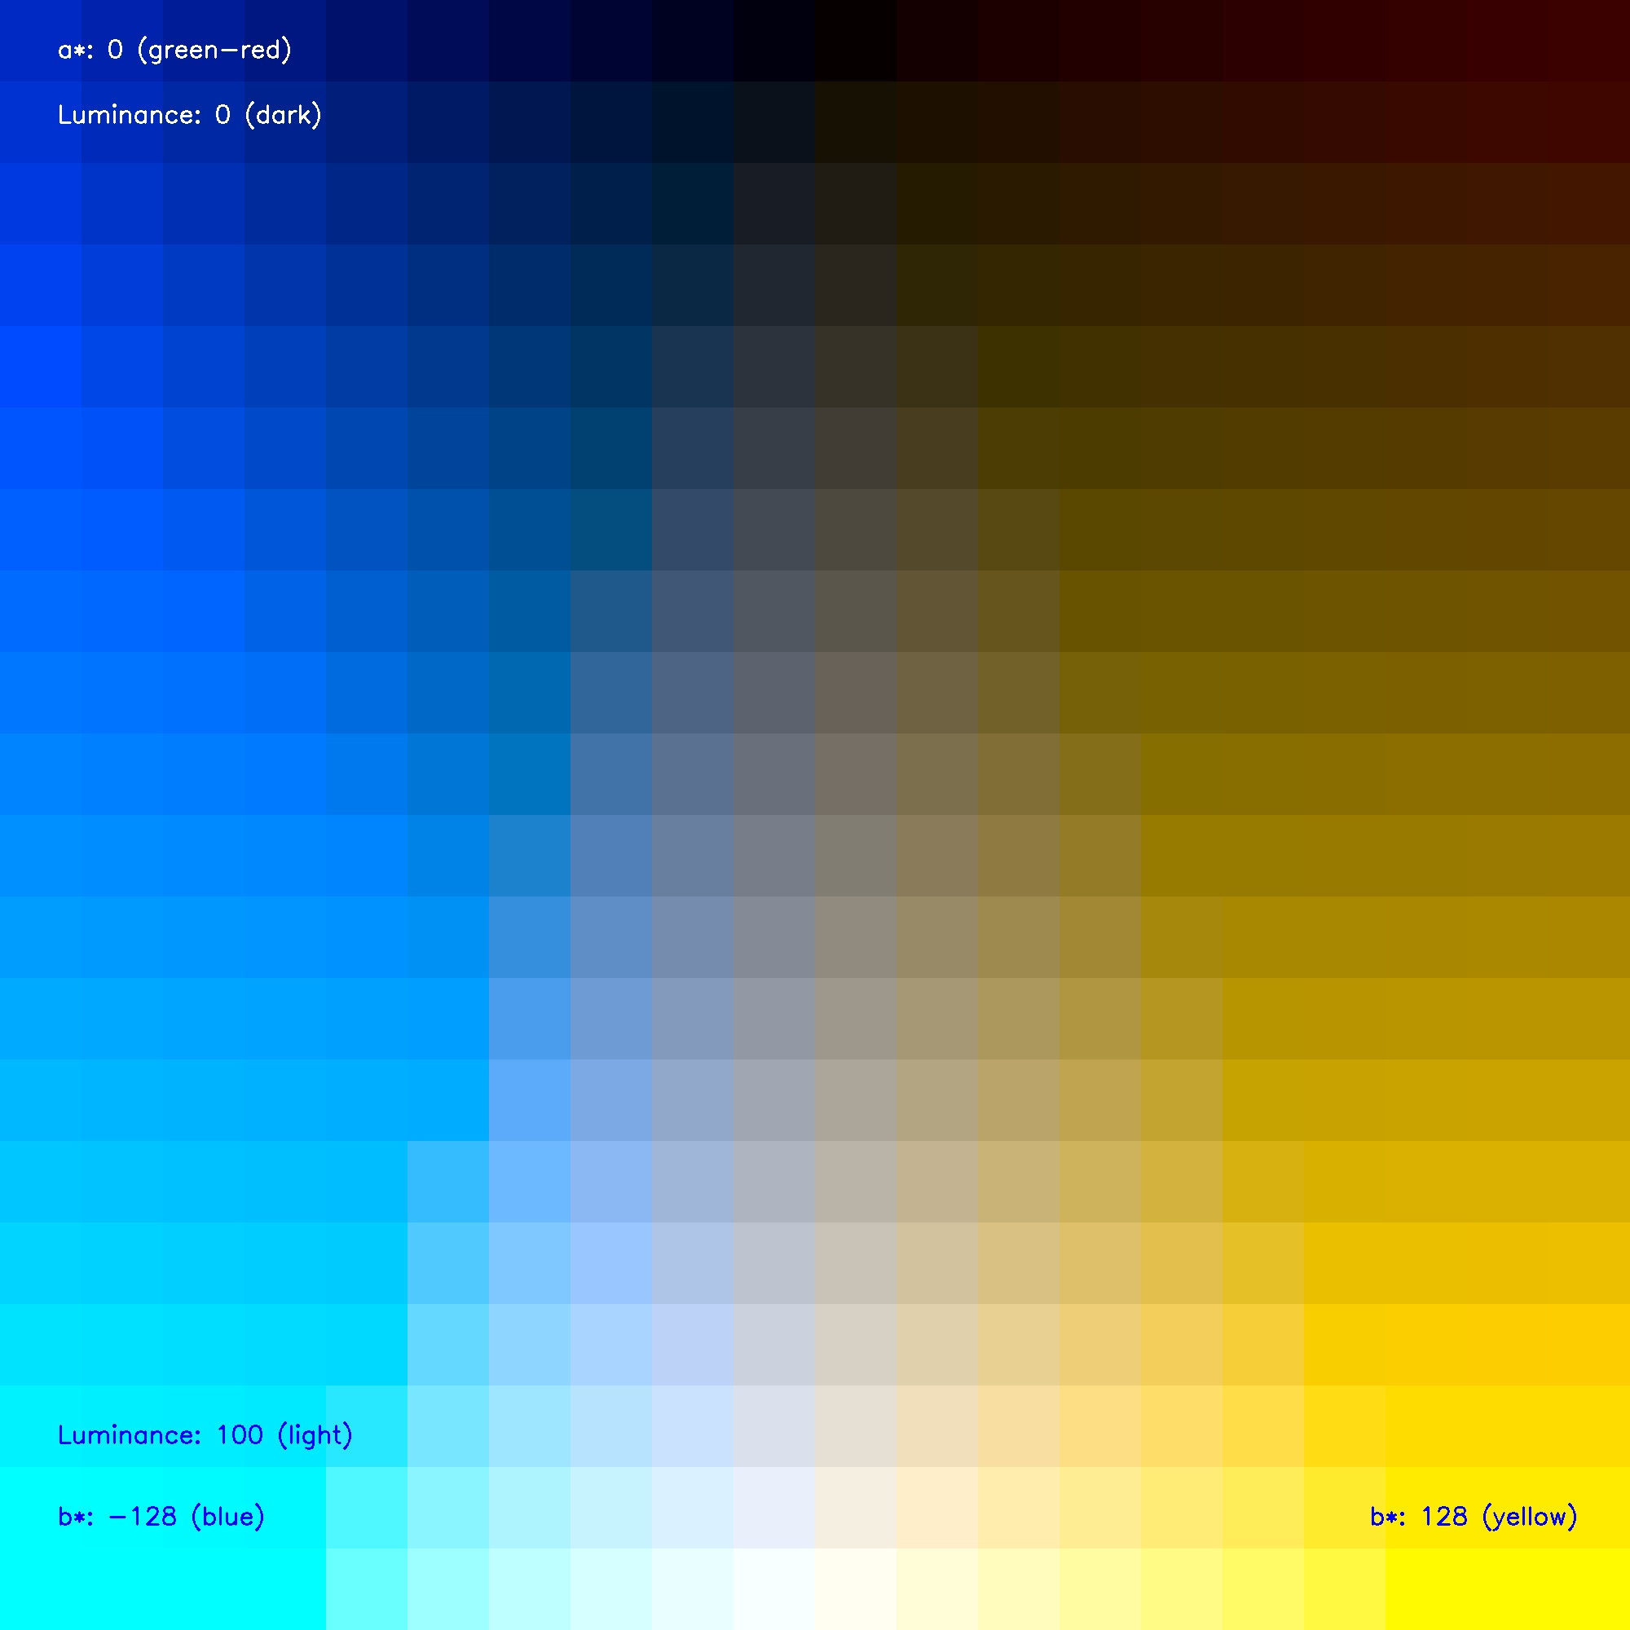
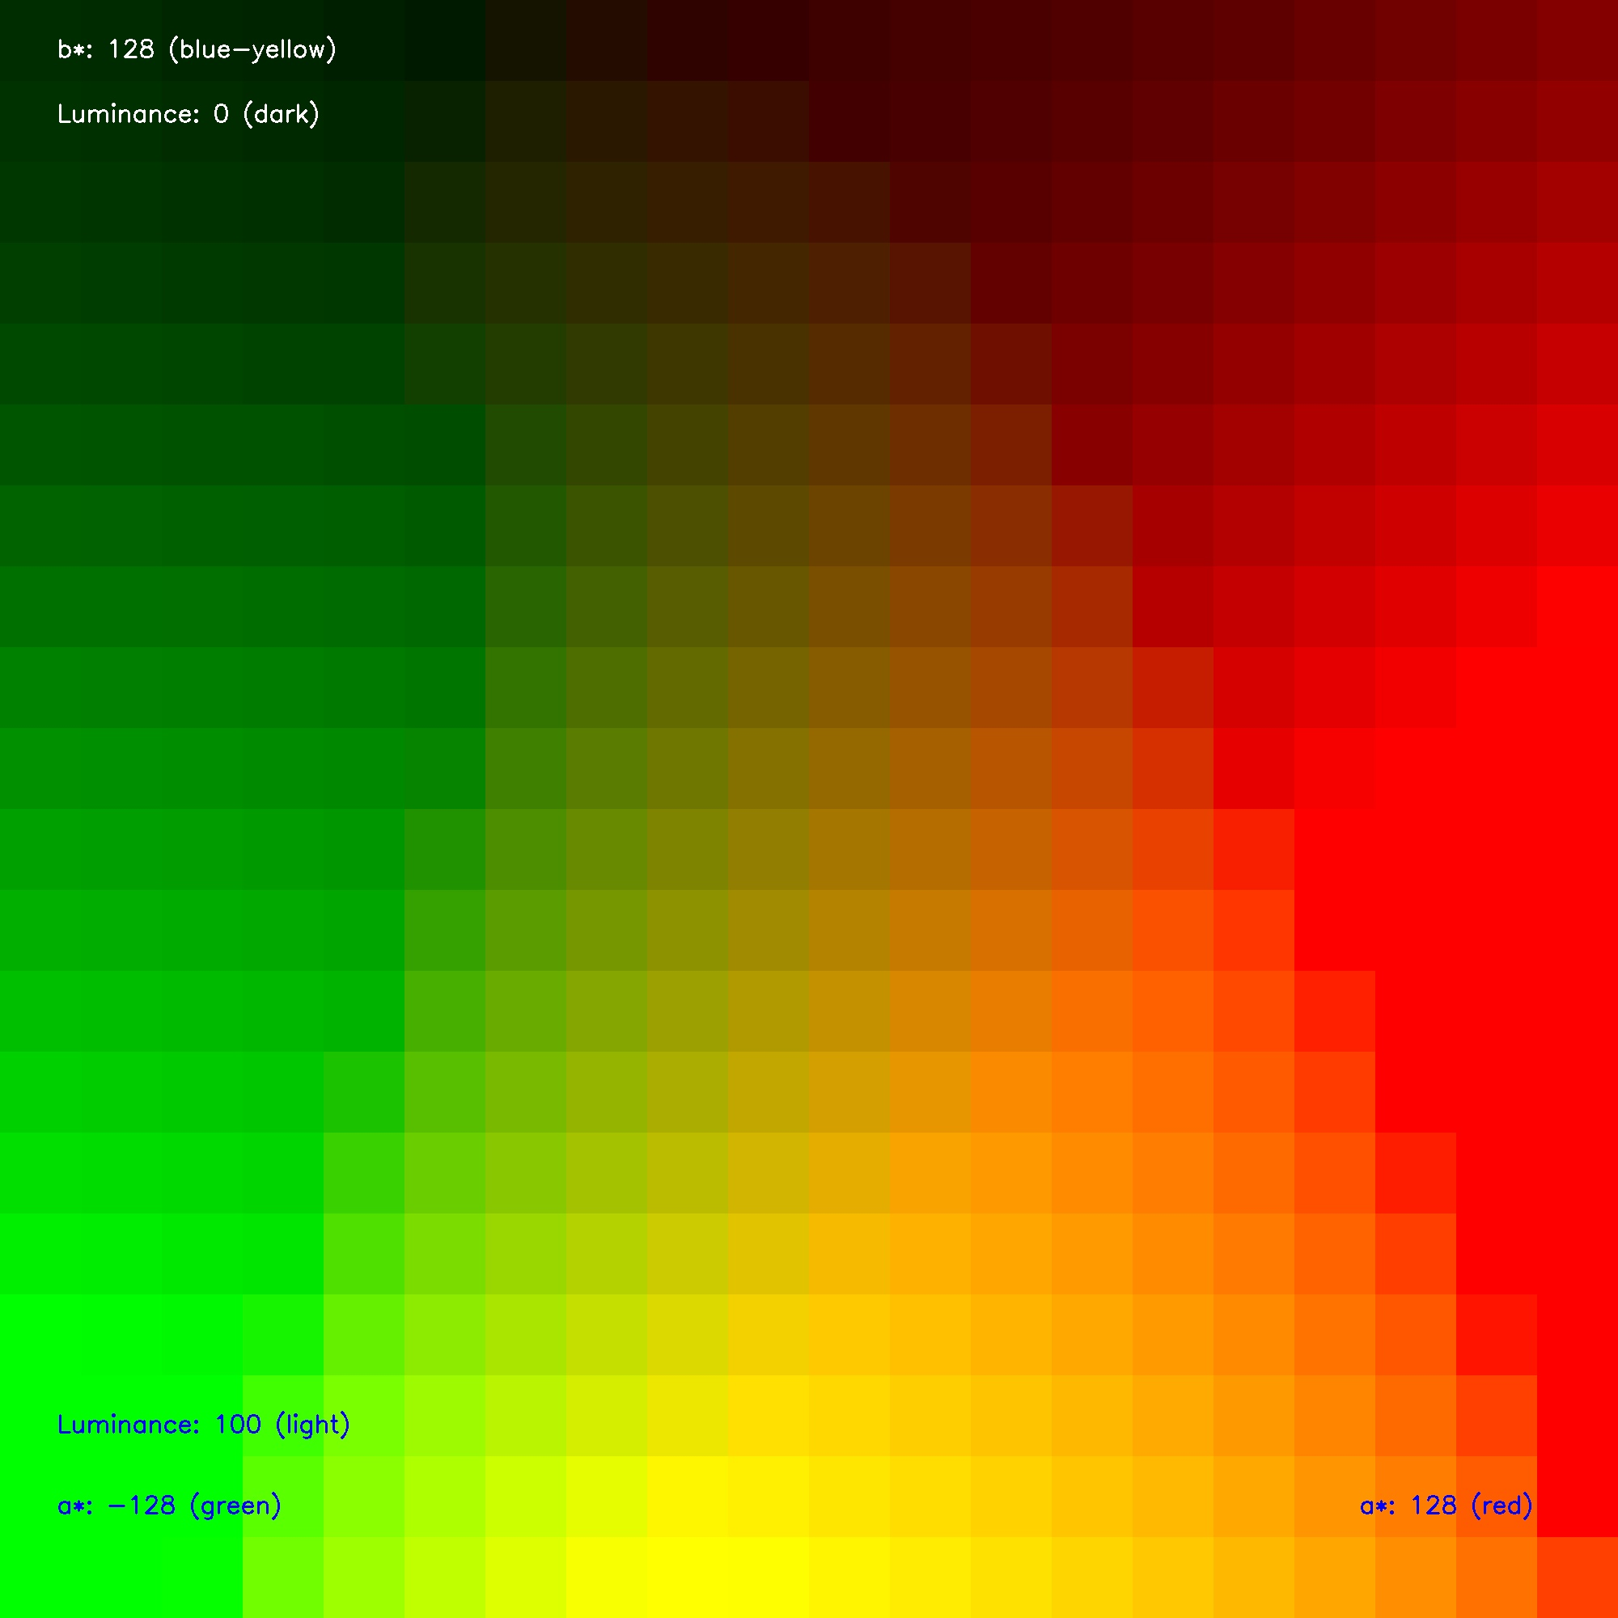
(a)
(b)
black
brown
brown
blue
green
green
Luminance
red
gray
orange
yellow
white
yellow
b*
a*

Slide 12

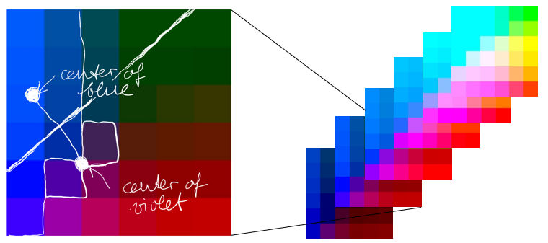
center of
blue
center of
violet

