Slide 1
Machine Learning Diagrams

Slide 2
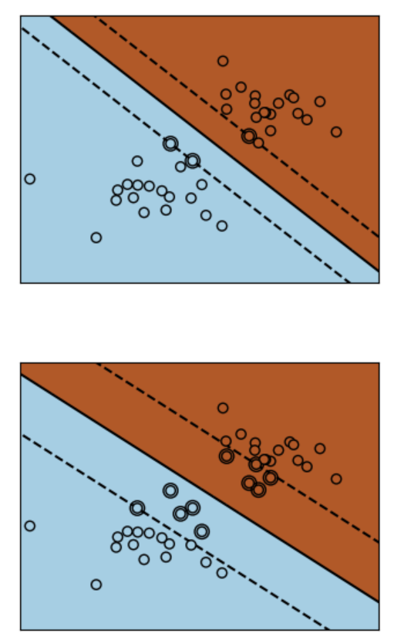
Support Vector Classifier 1
Support Vector Classifier 2
Support Vector 1
Support Vector 1
Hyperplane
Hyperplane
Support Vector 2
Support Vector 2
Hard Margin
High C
Soft Margin
Low C

Slide 3
One-vs-Rest (OvR)
One-vs-Rest (OvR)
red
red
blue
blue
green
green
yellow
yellow

Slide 4
One-vs-One (OvO)
One-vs-One (OvO)
red
red
blue
blue
green
green
yellow
yellow

Slide 5
