Slide 2
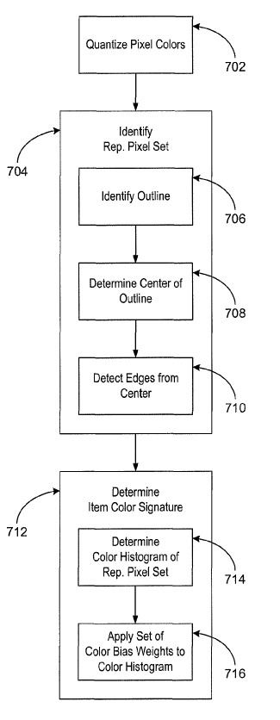
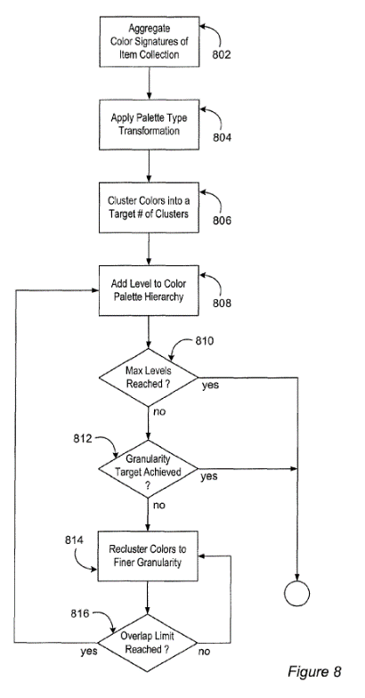
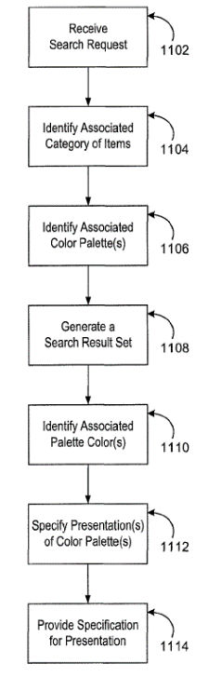
Determine Color Space
Extract Representative Palette Color Set for Video Frame
Map Basic Colors or Dictionary Colors to Palette Colors
Query Color Palette by Basic Color or Dictionary Color

Slide 3
Determine Set of Video Frames
Extract Representative Color Palettes for Video Frames
Keep Highest Representative Level in the Color Palettes Hierarchy
Transform Color Palettes to Color Histograms
Micro
Compute Pairwise Distances of Color Histograms
Query Top-N Most Similar Video Frames from a Pool of Video Frames and an Input Video Frame
Macro

Slide 4
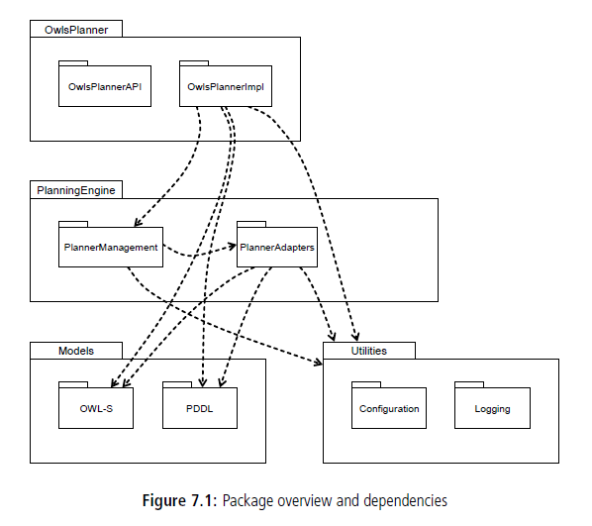
Utilities
ColorConversion*.py
Visualization*.py
Dictionary
Category
ColorNameDict*.py
ColorClassCenter*.py
Models
Retrieval
ColorMLPrediction*.py
ColorPalette[s]*.py

Slide 5
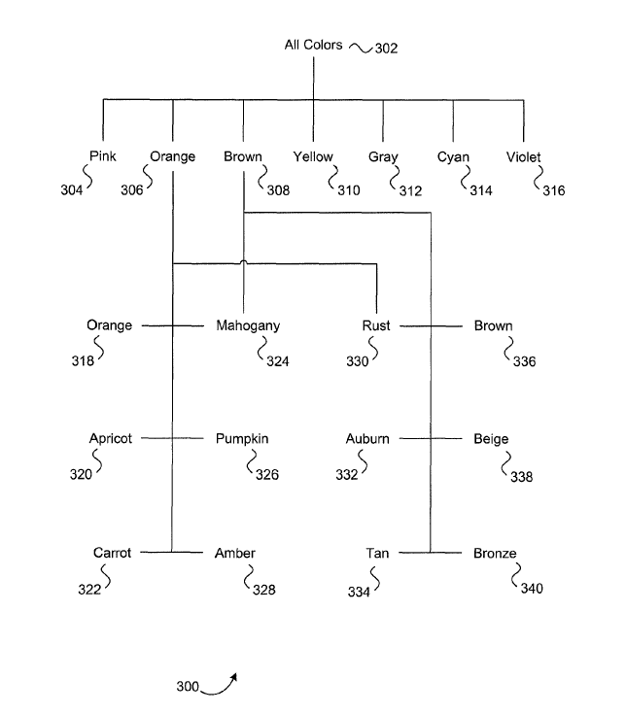
All Colors
15’000’000
Space Colors
5-15
red
orange
yellow
green
blue
violet
Basic Colors
10’000
brown
rust
amber
apricot
beige
bronze
Dictionary Colors

