Slide 2
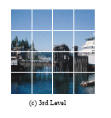

Slide 3
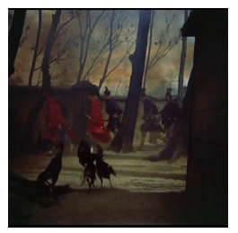

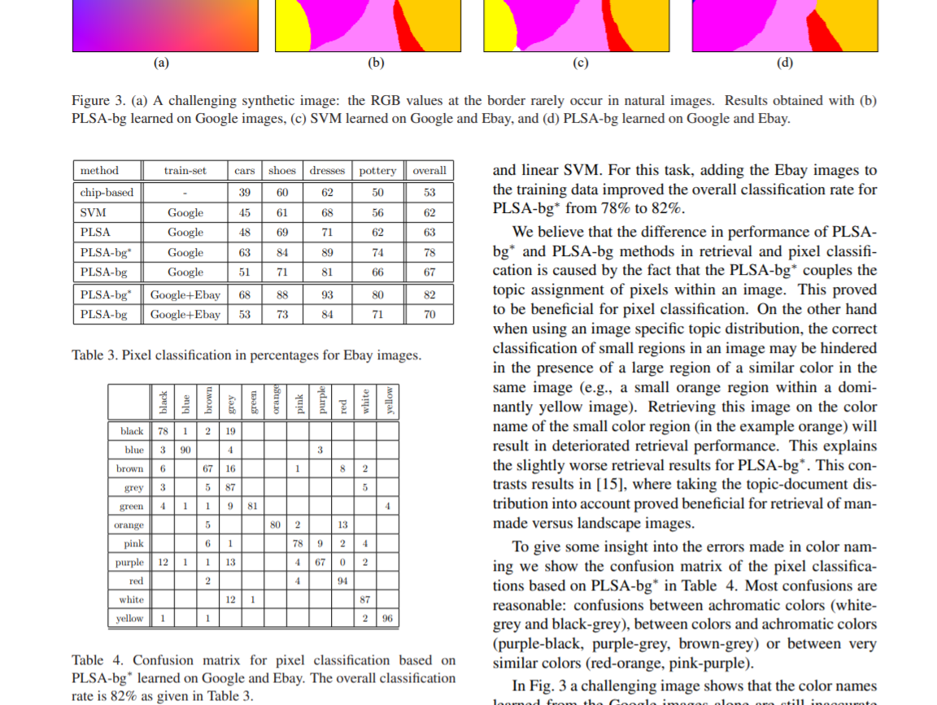
Contrast of hue
Light-dark contrast
Cold-warm contrast
45465

Slide 4
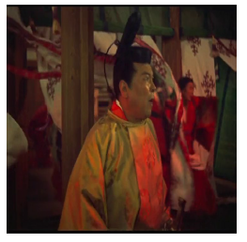

Complementary contrast
Contrast of saturation
Contrast of extension
45455

