Slide 2
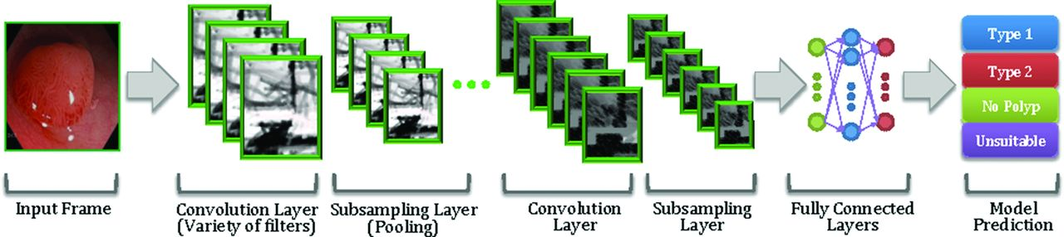
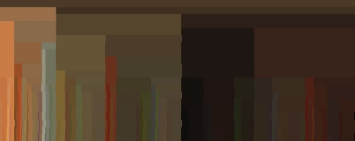
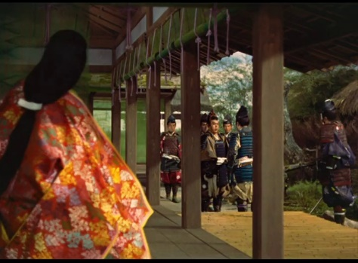
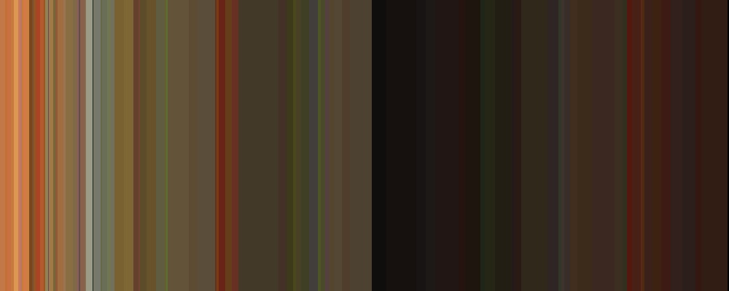
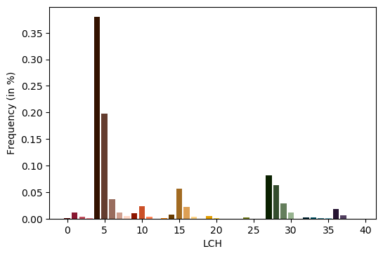
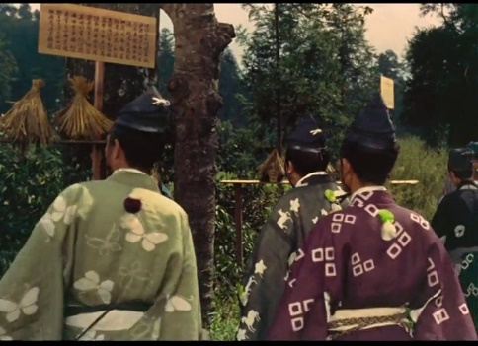
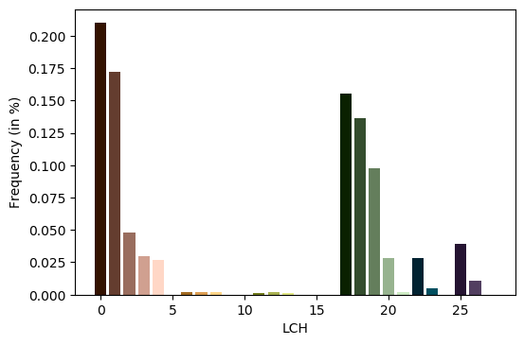
Dictionary Colors
Basic Colors
apricot
orange
army green
green
amber
brown
almost black
black
amethyst
purple
Color Indexing
Color Contrasts
Hue
Light-dark
Cold-warm
Complemen-tary
Saturation
Extension
Hue: red, orange, yellow, green, blue, violet
Lumens: dark, light
Tone: saturated, desaturated
Input Video Frame
Color Distribution
Representation
Color / Contrast
Identification
'beige',
'black',
'blue',
'brown',
'copper',
'green',
'mustard',
'orange',
'pink',
'purple',
'red'
{'almost black',
'amber',
'amethyst',
'apricot',
'aqua',
'army green',
'avocado green',
'azure',
'baby green',
'baby pink',
'baby poop'}
Frame: 45533
Frame: 45609

Slide 3
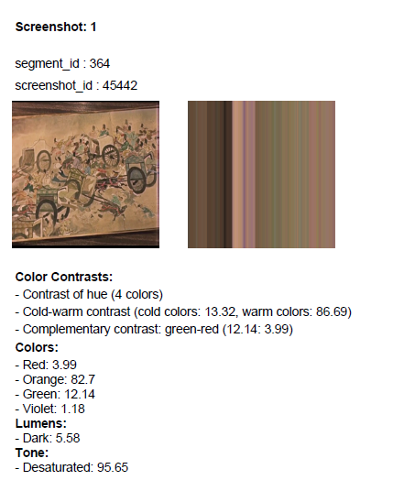
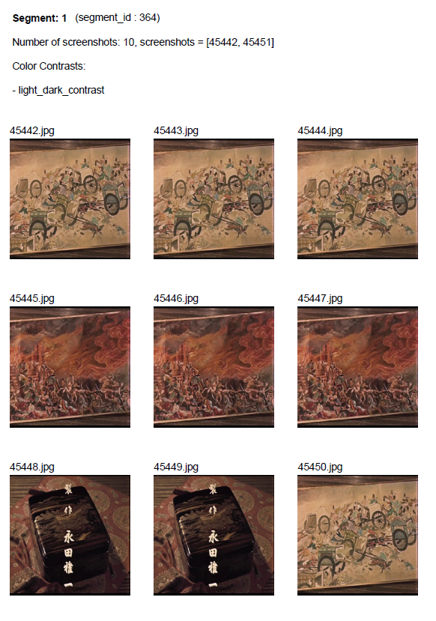
(a)
(b)

