Slide 1
baseline
Strengthening Water Democracy

Slide 2
We believe in strengthening Water Democracy by creating actionable knowledge from local data , empower citizen from data they trust and strengthen large data sets for better decisions.
baseline

Slide 3
The Concern
There is lack of information in public domain to measure accountability and impact of various projects in water domain.
Decisions about water usage are governed by Two factors
a) Fear
b) Ignorance
There is lack of awareness among population ( Urban and Rural ) about their endogenous water resource.
These are the societal concerns which leads to Social and Environmental Problem
baseline

Slide 4
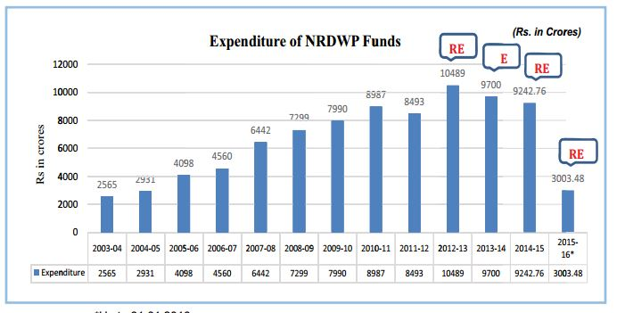
The Problem
Water Governance
- Lack of Accountability and mechanism to measure impact of various Government and Non Governmental Projects on Water Resources, Drinking Water Supply , Water Quality etc.
baseline

Slide 5
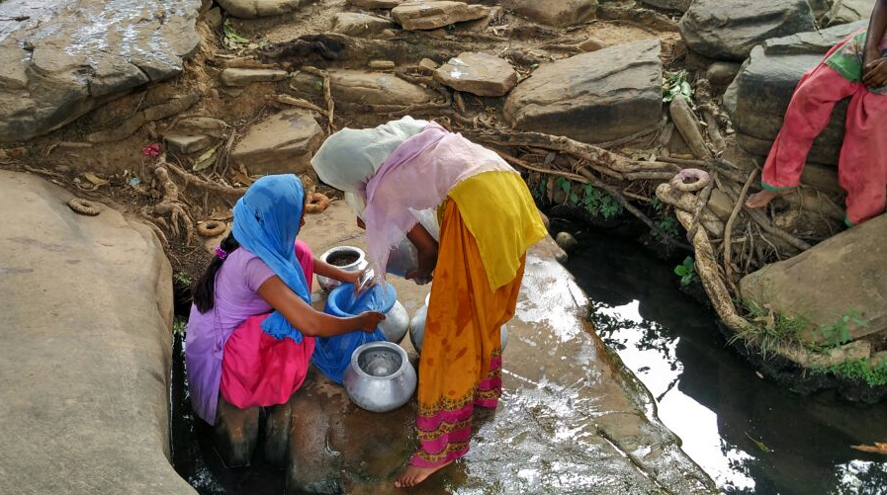
The Problem
Household Practices.
- Lack of informed decisions regarding safe drinking water practices.
- High Expenditure on health care and expensive water filters.
baseline

Slide 6
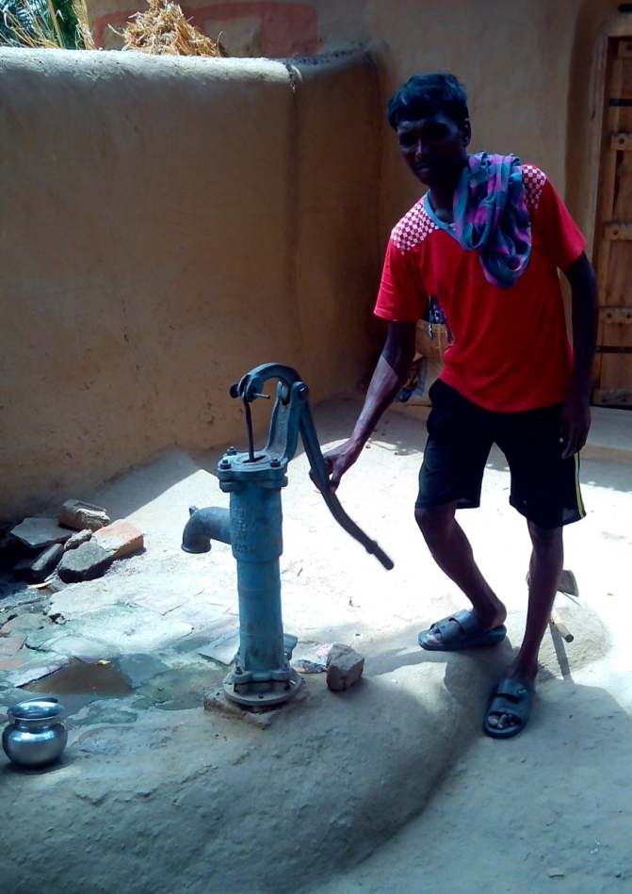
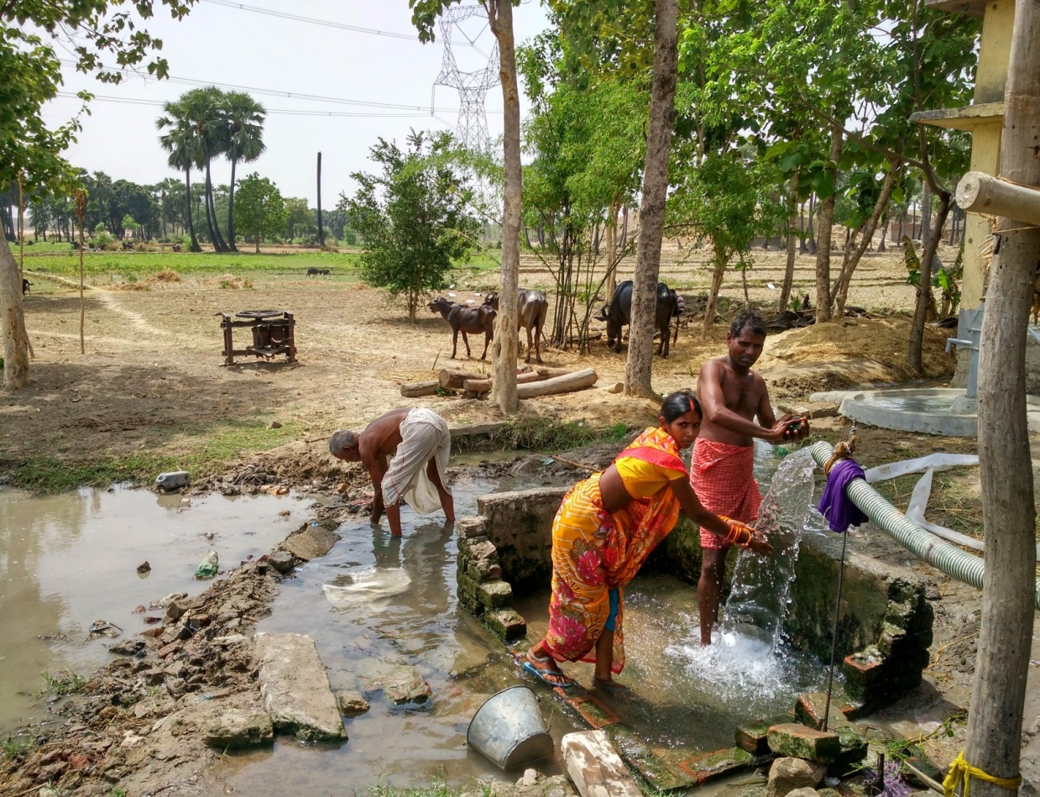
The Problem
Agriculture
- High dependency on exogenous water resources.
- High risks due to uncertain climatic vulnerabilities.
baseline

Slide 7
The Problem
Water Conflicts
baseline

Slide 8
The Solution
Baseline
- Citizen based Monitoring and information system to collect and disseminate information of local water resources , actionable knowledge from data they trust.
Strengthen Water Governance by transforming decision making process through local data sets.
Convergence of citizens and governance.
baseline

Slide 9
The Proposed Solution
Citizen based monitoring and information system to provide actionable knowledge to empower citizen.
Soil Moisture Sensors
Server / Cloud
Large data base
GSM
ZIGBEE
BLUETOOTH
IOT
Weather Station
Baseline Device
Satellite/IOT
Water Quality
Community based communication centre
Ground Water
baseline

Slide 10
The Proposed Solution
Water Governance by transforming decision making process through local data sets.
Micro Data
National Policies/
Program
Actionable
Knowledge
Citizen
State Level Polices/ Programs
National Policies
Strengthening watershed programs
State Policies / Programs
Meso Data
Impacting
national policies
Macro Data
Macro data
Citizens
baseline

Slide 11
The Model and Expected Output
Current Geographical Area – Maharashtra
State | Maharashtra
Population | 111.2 Million (Census 2011)
No. of Gram panchayats | 28,813 (Census 2011)
No. of River Basins | 5 ( Source : MWRD)
No. of Water Quality Monitoring Station | 250 ( Source : MPCB)
No. of Automatic weather station | 35 (Source: IMD)
Customers/ Beneficiaries
Our customers are Gram Panchayats located in Maharashtra facing issues in water resource management.
NGO’s / INGO’s working at grassroots level on watershed development, WASH and Provision of Safe drinking water.
- Civil Society Organizations, Research Organizations and Government bodies.
Potential Outcomes
Reducing Vulnerabilities, Mitigating Risks in building resilience in agriculture and households water consumption.
Measuring quantitative impact on their water resources.
Better granular data for policy research , development program and policy advocacy.
baseline

Slide 12
The model and Expected Output
Approach
Collection and cleaning of Historic data sets in Maharashtra.
Installation of IMIS stations, Water information centers.
Collection of information on Water Quality, Weather ( Especially Rainfall), Soil Moisture and Ground Water.
Capacity building of local contact person.
Dissemination of information from public source ( IMD, Agriculture universities) through information centers. ( 2-3 years)
Analysis of local data and converting into actionable knowledge.
Delivering actionable knowledge to communities.
Using large data sets for research , development and advocacy.
baseline

Slide 13
The model and Expected Output
Scale and Journey
Year | Scale
2017 | Prototype development and Pilot and final prototyping (100 G.P in Maharashtra )
2018 | Scale up 3000 G.P. in Maharashtra
2019 | Scale up : 10,000 G.P. in Maharashtra Scale Deep – Small and Big data Analysis Convergence with Government institutions.
2020 | Scale up to different states of India
2030 | Strengthening Governance for Sustainable Development Goal’s
Revenue Streams
Research Grants and funding from donor agencies.
Installation of These monitoring stations.
Sale of big data / analysis of data.
Premium service for specific data.
baseline

Slide 14
Team
Amit Tandon - Founder
Architect and Water Policy and Governance professional with multidisciplinay experience in field of research , ecological architecture , child rights , water and sanitation.
Alisha Contractor - Consultant
Founder of Astrin Engineering , she holds honours degree in Aerospace & Space System Engineering from University of Glasgow. She is specialised in Remote Sensing and image Processing. She has experience in hardware and software development along with developing software aid for precision agriculture.
baseline

