Slide 1


Slide 2
Our esteemed customers can be attended to from the comfort of their homes or visit our premises in various towns across Kenya i.e Nairobi, Mombasa, Nakuru, Eldoret, Kisumu, Kapsabet, Kitale, Nyeri and Voi. Feel free to contact us.

Slide 3
RANKING
Blue Beauty Parlor is a well known beauty and hairdressing company in Kenya. It is among the top beauty parlors ranking third in the country.

Slide 4
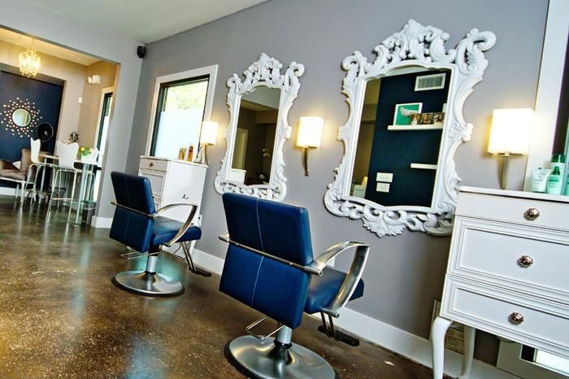

Slide 5
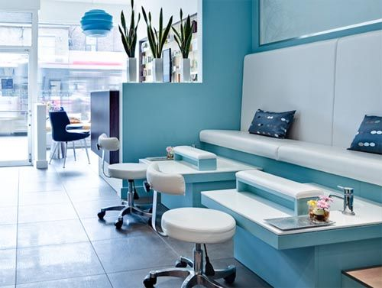

Slide 6
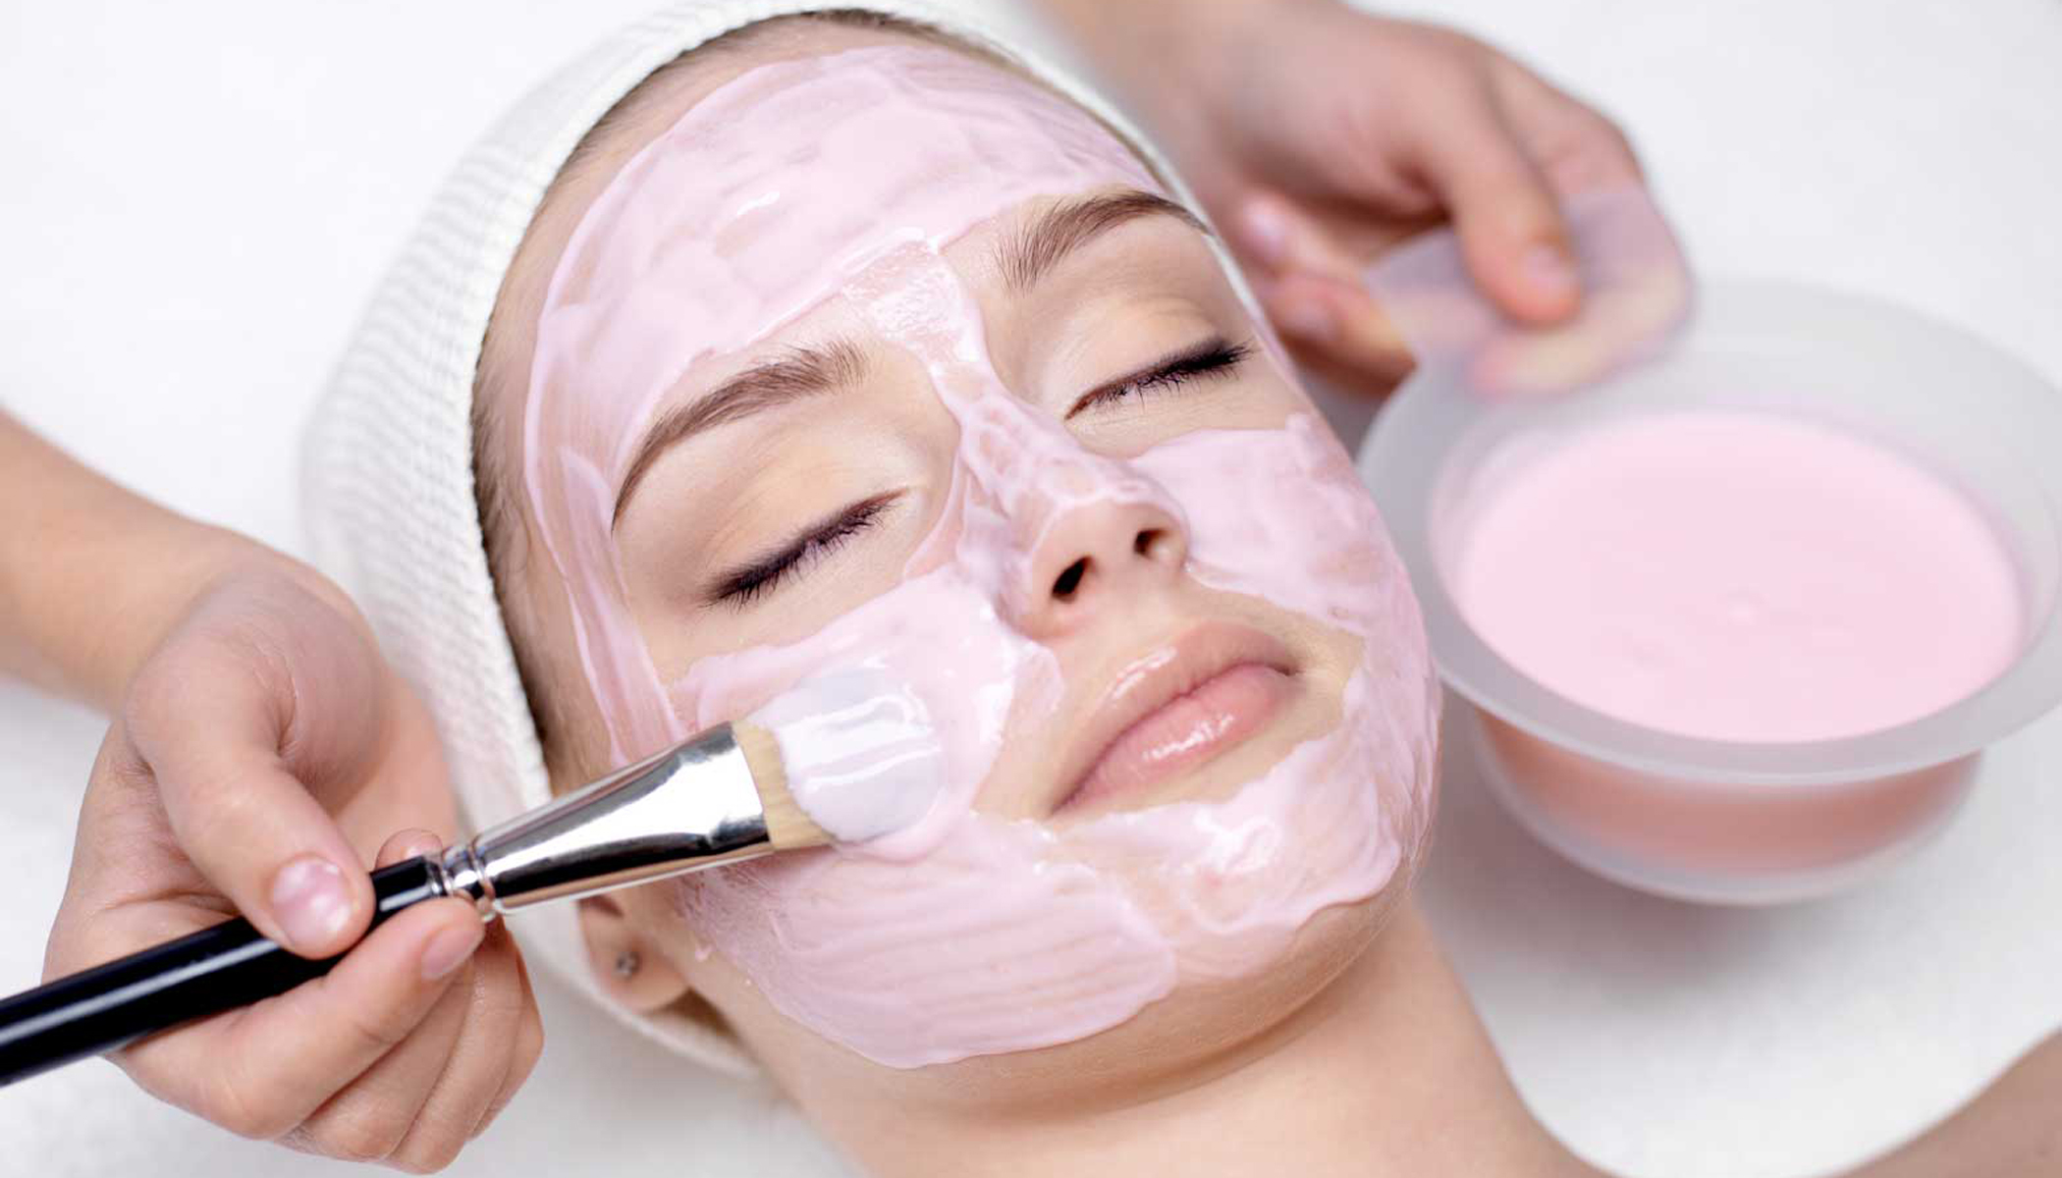

Slide 7
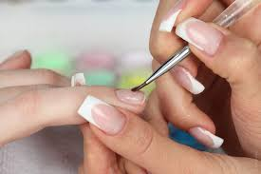

Slide 8
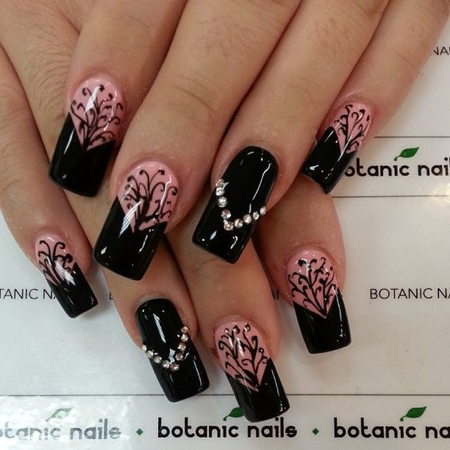

Slide 9
