Slide 1
OUTRUN
By P.S.W.S
Group 4
Ian Corkill
Max Evans
Harvey Palmer

Slide 2
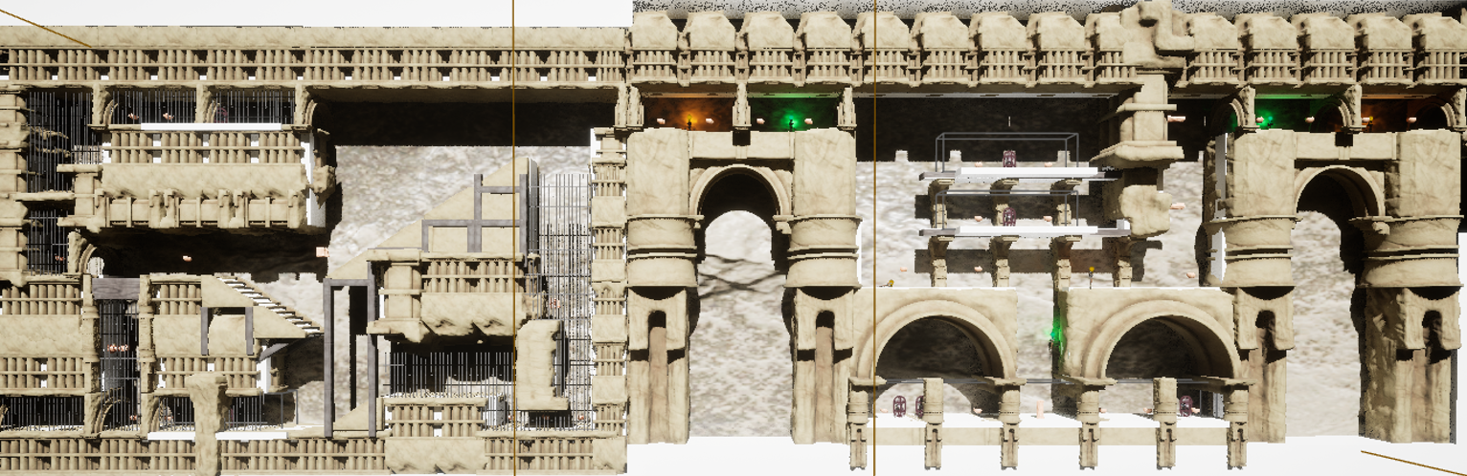
The Game
To show you Outrun, we would like to let the game speak for itself
.
LEVELS
Core Idea
Changes in Development
The problem with over specialisation in Unreal
The Move to Static Streaming
Designing for Multiplayer
The problems of Multiplayer
Optimisation

Slide 3


Player Movement
Player has a few different options to traverse the level, all implemented using the enhanced input system in C++:
2D side scroller left and right movement
A double jump
Player is able to dash forward on the ground and in the air. This reduces the height of the player hitbox and can also be done in mid air, which feels smooth and player gravity is set to 0 only during the dash, so the player does not drop down.
Crouching to reduce visibility and hitbox size
Player is able to wall jump. If the player hits a wall in the air, they will cling to the wall and their velocity will be reduced. They can then decide where they want to jump to next
Player mid dash
Player clinging to wall

Slide 4
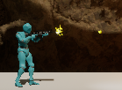
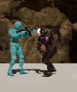
Shooting and Enemies
Players have the ability to shoot projectiles to defend themselves from enemies.
These projectiles are stored in an object pool, where rather than allocating and deallocating memory by creating and destroying bullets, they are all created on the game start, are just moved out of and back into the object pool when needed.
Players have three different firing modes, Rifle, Machine Gun and Shotgun, all having varying bullet damages.
Levels include enemies made with a behaviour tree, they will run at the player to attack them and have varying detection ranges based on if they can see the player and if the player is crouched
Player firing projectile
Player being attacked by an enemy

Slide 5
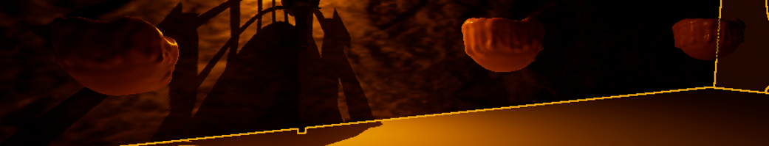
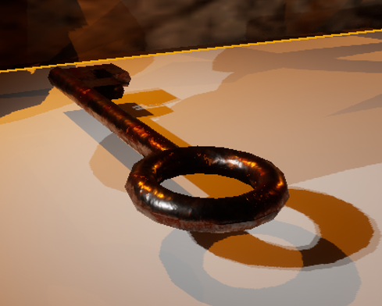
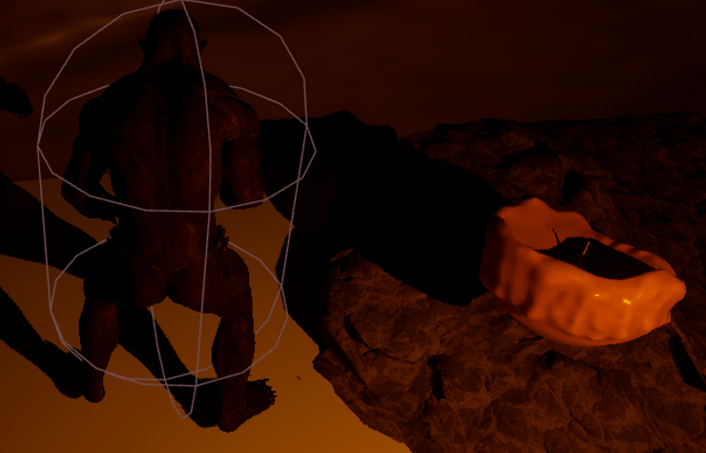
Interactables: Health, Score, Hazards, Checkpoints
Players can collect items throughout the level which will either increase their score or provide them with additional health in between checkpoints
Using OnOverlapBegin functions, when an instance of the main character overlaps with one of the collectables, it will hide it in the scene so that the player can no longer interact with it
For the hazards, these use the OnHit function to determine if a collision happens between an instance of the main character and the hazard actor, reducing player health. The reduction in health has been set so that this does not occur continuously when the collision happens and that there is a delay in the damage being sustained
A screenshot of the score collectables
Screenshot of a checkpoint actor (key)

Slide 6
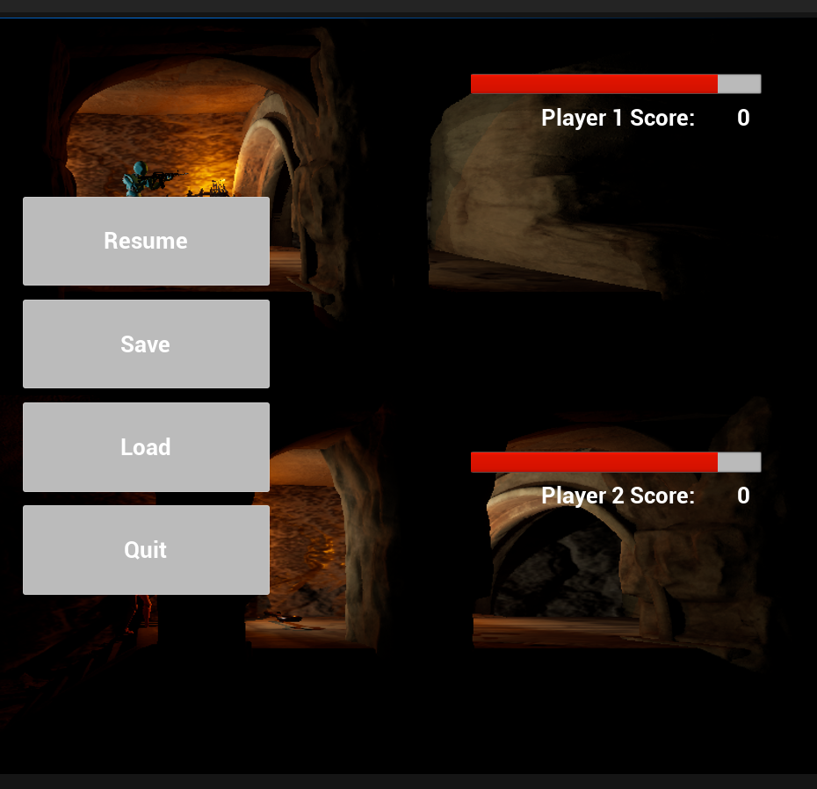
Saving, Loading and UI
Saving and loading uses the SaveLoad class to iterate through the actors in the scene that need to be saved (collectables, players, hazards and enemies) through separate for loops and are saved to a game slot. Loading the game loads from this slot, using a predetermined name and user slot to locate the data
The UI uses a combination of C++ and blueprints to call the custom save and load functions. We did this as the data did not seem to locate when a button was bound to the UI during gameplay, but worked without issue when the binding occurred during blueprints
During gameplay, a progress bar and textbox are bound via C++ script. The widget blueprint, used to set up the UI, is attached to the player in the inspector and updated based on the main character interacting with collectables (score updates score, hazards reduce health bar). Two individual widgets are setup so that both characters only affect their own UI

Slide 7
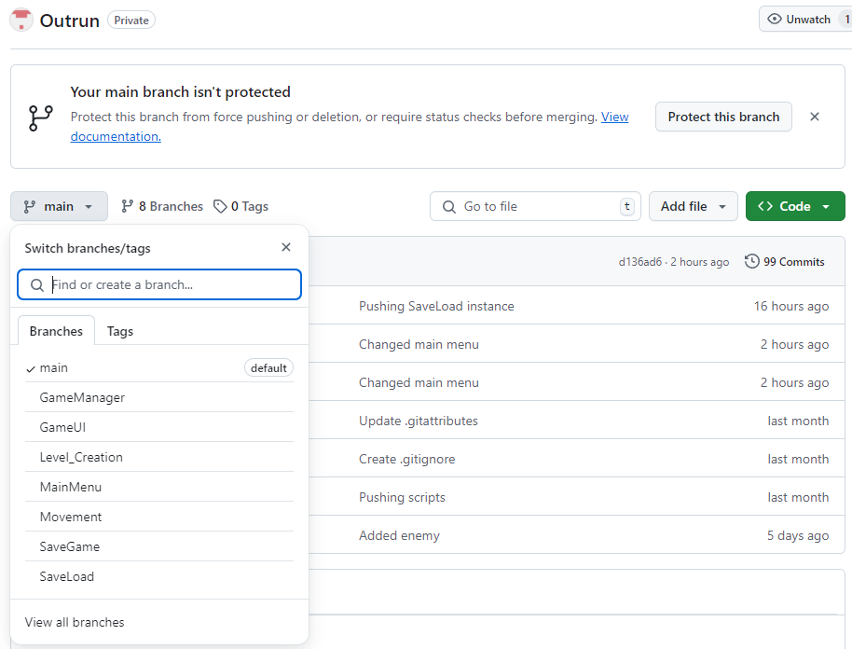
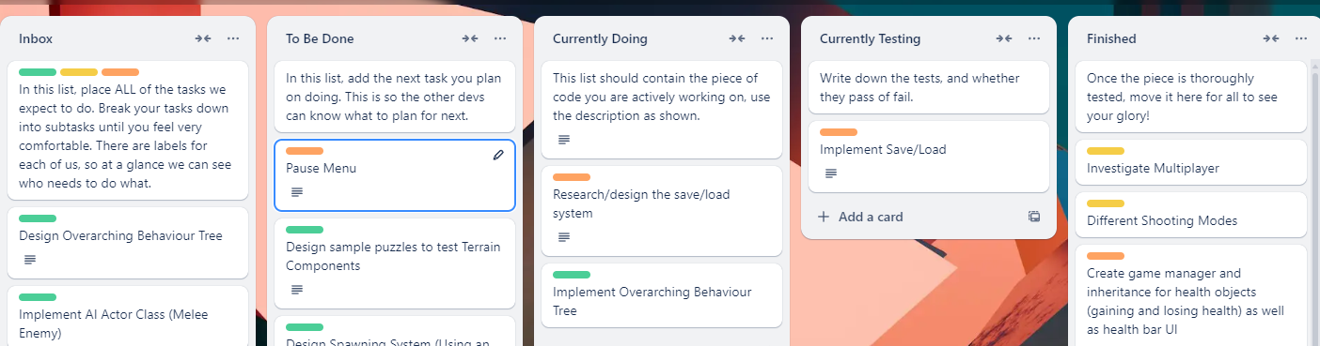
Management, Testing, and Reflection
MANAGEMENT
We used two methods of management.
First, we had individual roles chosen from the start.
Max: Management, Level Design, Testing Harvey: Player and Enemy Ian: UI, Interactables, and Saving
To allocate tasks, we had a Trello Board, and meetings every Friday
TESTING
Once a component was ready to be integrated, it was passed to Testing.
We tested the integration, the performance difference, and aggressively tested edge cases.
REFLECTION
What went well?
What went poorly?
How would we fix that?

Slide 8
References:
Hasshu, N. (30/09/2024) Advanced Game Engine Application. Available at: Week 4 - First Person Shooter (Accessed on: 30/09/2024 - 18/11/2024)
Ulibarri, S.S., (2020) Unreal Engine C++ the Ultimate Developer’s Handbook. 1st Edition. Great Britain: Amazon.

