Slide 1



AI – Tank War
Presentation Slides
Tank Sinatra
Ian Corkill – P2681678
Natalia Wozniakowska – P2672445
Zefan Stone – P2662029
Dan Lubek – P2673198

Slide 2
Job Roles and Meetings
Date: | Topic:
06/03/2023 | Discussion on how to develop FSM
13/03/2023 | Further discussion on FSM
24/03/2023 | Catch up meeting
28/03/2023 | Bringing new ideas and working together as a group
03/04/2023 | Working together
06/04/2023 | Working together
 | Easter Break
10/04/2023 | Working together main focus on FSM
12/04/2023 | Working together main focus on RBS
13/04/2023 | Working together FSM And RBS
14/04/2023 | Working together FSM,RBS, BT
16/04/2023 | Working together FSM,RBS, BT
17/04/2023 | Working together FSM,RBS, BT
18/04/2023 | Working together FSM,RBS, BT
20/04/2023 | Working together BT
Ian Corkill – Finite State Machine - Developer
Dan Lubek – Behvioural Tree – Product Owner
Natalia Wozniakowska – Ruled Base System - Developer
Zefan Stone – Documentation/Presentation/General Help – Scrum Master

Slide 3
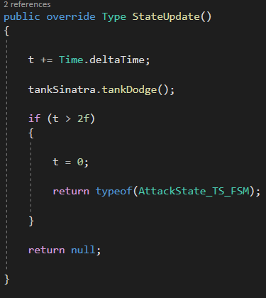
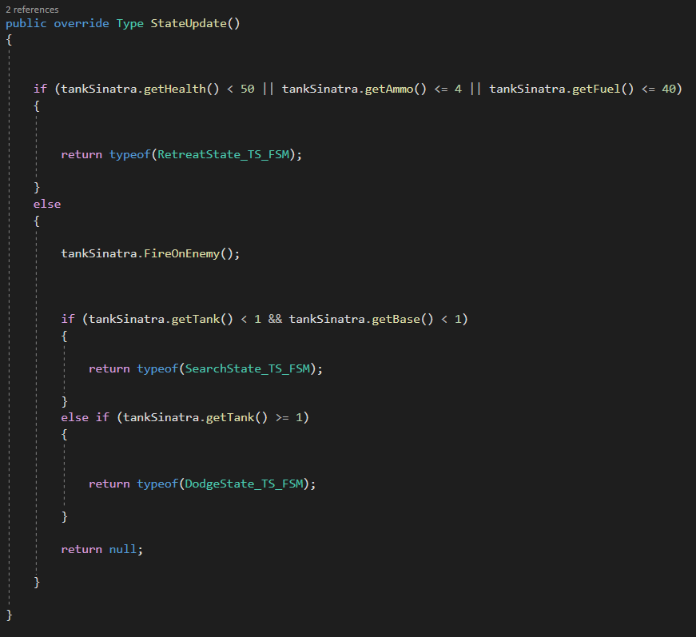
Finite State Machine
States :
Attack State
Search State
Chase State
Retreat State
Ambush State
Dodge State
Our main two scripts are the State Machine and Base State.
Base State contains the main three functions that the individual states will use to actually do things. These are StateEnter, StateUpdate and StateExit. StateEnter will be used when the tank enters the specified state, StateUpdate will be called every frame whilst the tank is in that state, and StateExit is called just before the tank leaves the state.
State Machine will implement all of the functions that are already given within AITank, and the state machine will then take this information and decide how to use it independently within each state, and when to switch between states.

Slide 4
Rule Based System
Uses a different variety of rules to determine which rule should be chosen depending if the value is true or false.
If Health == true && Ammo == true
The ruled-based system is set to work in an offensive manner, meaning it will continue to chase or attack enemies even if health, fuel, or ammo are low.
Tank Sinatra tank will prioritize collecting consumables before changing into an attack state.
**Loop through all rules**
CHASE STATE, SEARCH STATE, ATTACK STATE, RETREAT STATE
Change into the corresponding state

Slide 5
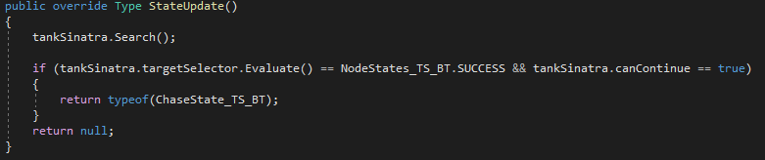
Behavioural Trees
Example of what a behavioural tree could look like for this project >
Start
The behavioural tree uses sequences to determine the resources the tank needs for certain states and actions as well the order in which the resources should be prioritised.
It also uses a selector to determine whether its attacking an enemy base or the enemy tank itself
The implementation of the behavioural tree focuses on a more defensive strategy and so it makes choices that prioritise self preservation, such as focusing on locating consumables over enemies all the time or changing its speed to reduce its fuel consumption
Has tank got low health?
Are any bases located?
No
Locate and Attack Enemies
Has tank got low ammo?
Yes
Yes
No
Retreat and look for health
Are any enemy tanks located?
Yes
Continue fighting
Attack Enemies
Yes
No
No
Retreat and look for ammo
Continue fighting
Attack Bases
Top: Example of sequence and selector
Bottom: Example of selector in use in the SearchState

Slide 6
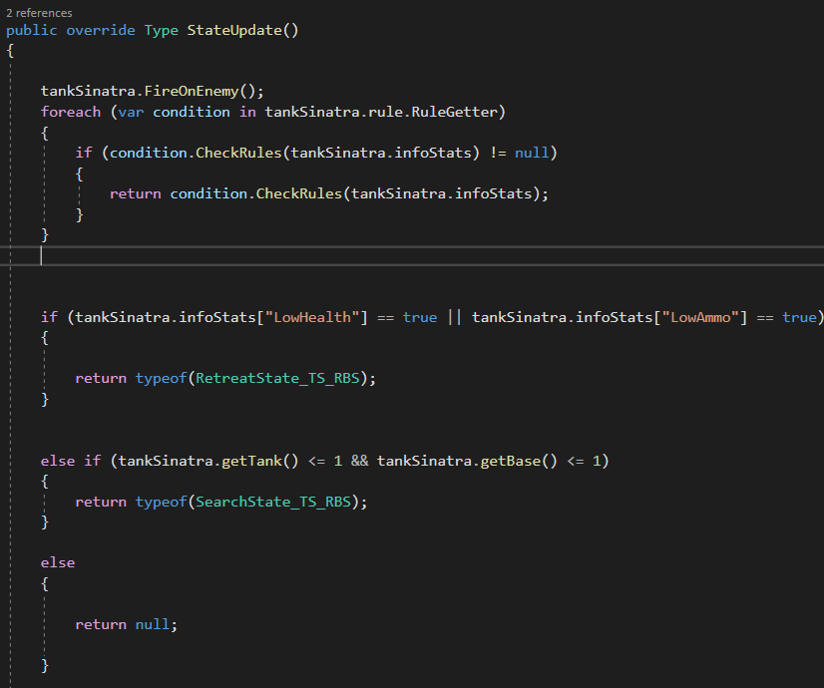
Combining the AI Techniques
We combined all three of these techniques in a few different ways. The rule based system utilises the different states and the rules affect which state the tank is in, this is rule based system combining with finite state machine. The behavioural trees are combined with the finite state machine too as it has an effect on which state the tank is in and which state it needs to go into.
Screenshot taken from Rule Based Systems, to show the implementation of both RBS and FSM

Slide 7
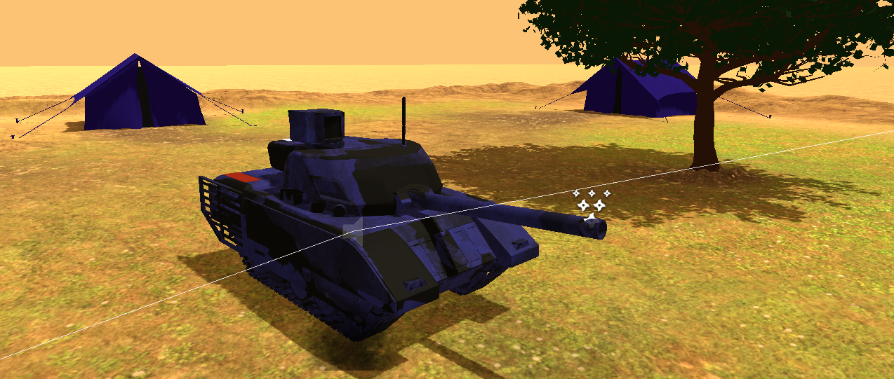
Tournament!
We’re going to use our Rule Based Systems version:
SmartTank_TS_RBS
StateMachine_TS

Slide 8
Any Questions?
?

