Slide 1
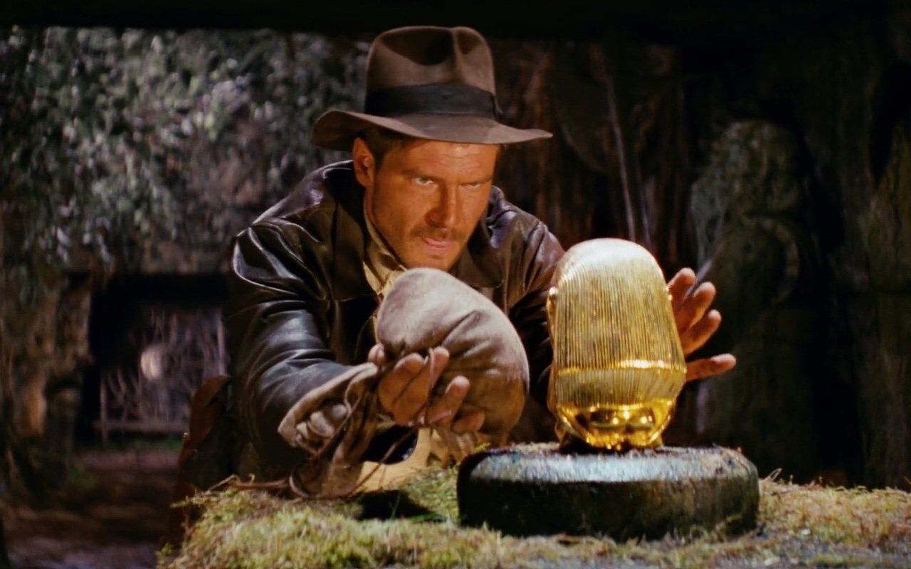
Game Engine
Milestone One Showcase

Slide 2

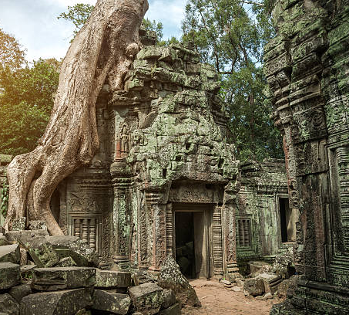
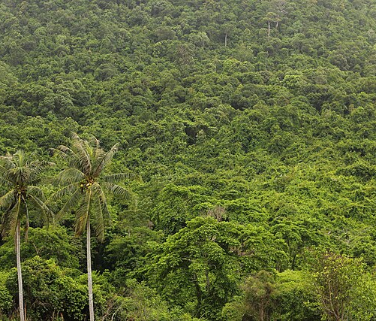
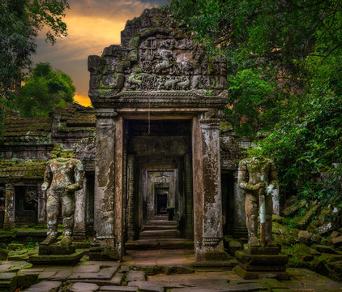

Theme
Jungle Adventure

Slide 3
Scene Will Feature:
FPS Camera
5 Models, Trees, Temple, Water, Crocodiles, A “Relic”
Terrain using heightmap from file, used for floors and rock walls
Navigable level using Keyboard & Mouse
UV Textures on models
Skydome of sunny weather, jungle theme
Text UI displays fps, player location
Billboarded Clouds
Lighting/Shadows
Reflections
Particles for water
Volumetric Fog

Slide 4
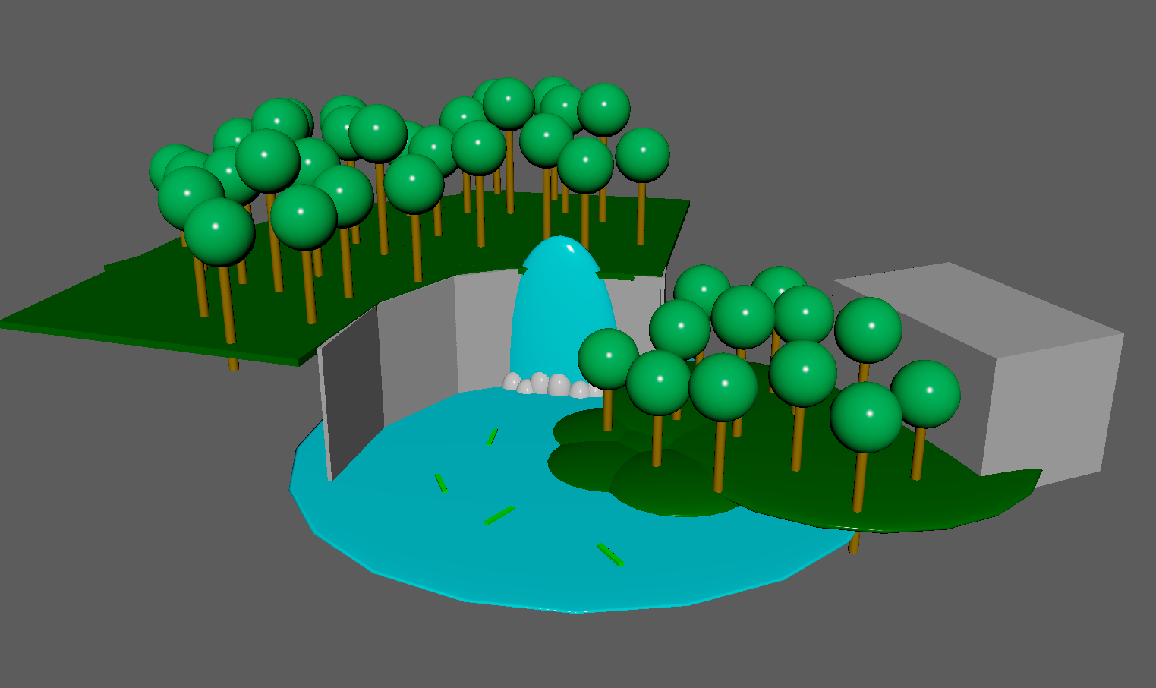
Scene Layout

Slide 5
Check Github For Performance

