Slide 1
Introduction to Moonstone
BluLab Medical Language Research Group
University of Utah
3/19/2018

Slide 2
Download / Install / Run Moonstone
Download MoonstoneDemo.zip from BluLab GitHub site.
De-archive.
Open Terminal or Shell, type:
“java –jar *.jar”
Moonstone GUI appears (next slide).
Manually adjust window size per comfort
(Current GUI not elegant by any means…)

Slide 3
Moonstone Control Tool (MCT)

Slide 4
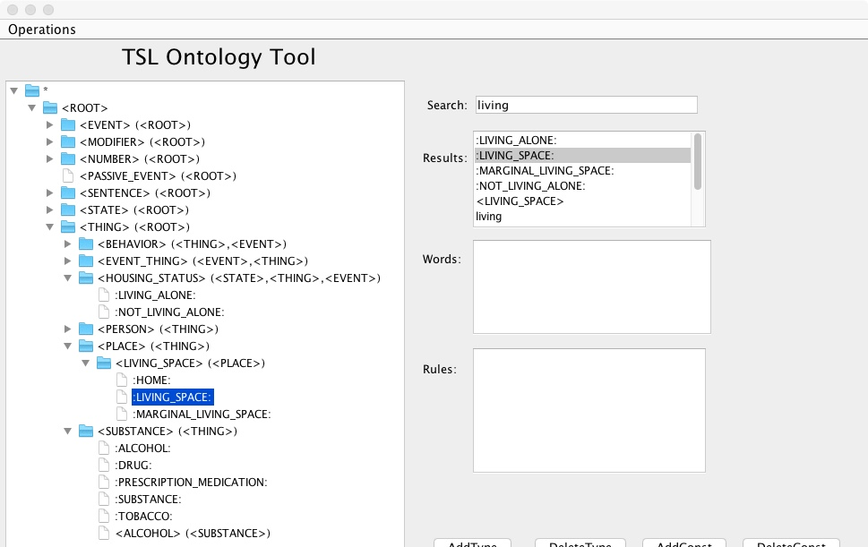
Moonstone Ontology Tool

Slide 5
Note: Pathnames in tsl.properties file
The file tsl.properties in the top of the distribution directory contains parameters used by Moonstone. While this file need not be edited for this demo, it will need to be edited for more compliex applications such as using Moonstone to annotate a corpus of files and compare the results against a reference standard. The parameters may include file pathnames, particularly the following parameters:
WorkbenchKnowtatorSchemaFile (location of Ehost project schema file)
TextInputDirectory (directory containing corpus of texts to be processed)
ResultsOutputDirectory (directory to which Ehost format Moonstone xml files are stored).
AnnotationInputDirectoryFirstAnnotator (directory containing reference standard Ehost files)
AnnotationInputDirectorySecondAnnotator(directory containing comparison standard Ehost files – usually the same path as ResultsOutputDirectory)
Pathnames can be either absolute (e.g. starting with “/” on Linx/Mac computers or “C:\\” on windows), or they can be relative to the top directory containing the Moonstone distribution, in which case they will start with the name of a directory or file in that top directory.
Note: The initial distribution uses pathnames in Mac/Linux format. To change to Windows, change all instances of “/” to “\\” (escaped backslash) in the path name. If using an absolute pathname, be sure the pathname is correct for your machine and begins with a file system identifier such as “C:”.

Slide 6
GUI Functionality
Main functions:
Front-end for all Moonstone-related functions
Parse sentences, documents or corpora
Interactive view of parse results
View grammar rule definitions
Most useful menu functions:
Knowledge->View Ontology Tool (view ontology tool)
Rules->Reload rules from file (load grammar)
Interpretation-> Get Interpreted Pattern Analysis Annotations (parse text typed/pasted into upper window)
Rules->View Selected Rule in Text Editor (displays selected rule in text editor app for editing)
EBL->Create BagOfConcepts Rule from Top Annotation Only (auto-generates new rule containing user-selected concept)

Slide 7
Relevant files / directories in MoonstoneDemo directory
TSL.properties:
Contains all startup parameters
resources/DemoOntology
Contains types, constants used for this demo (related to living alone)
GrammarRules/DemoGrammar
Files containing semantic grammar rules.

Slide 8
TSL Ontology File
Location: resources/DemoOntology (Portion shown below)
Deftype introduces type constants and their parent types.
Defstringconstant introduces object constants belonging to types, e.g. “:LIVING_ALONE:” is a constant of type “<HOUSING_STATUS>”

Slide 9
Grammar Rules
Demo grammar rules located in: GrammarRules/DemoGrammar/SentenceGrammar/LivingAloneRules,
e.g.,

Slide 10
Grammar rule pattern token syntax
Semantic type, e.g “<PERSON>”
Concept constant, e.g. ":PATIENT:”
Pattern position variables, e.g. ?0 refers to sub phrase matching first pattern element, ?1 to sub phrase matching second element, etc.
Word string, e.g. “significant other”

Slide 11
Rule properties (partial list)
Ruleid (required)
Pattern (required: disjunctive lists of pattern tokens)
E.g. (pattern (":PATIENT:") (":LIVING_ALONE:”))
One element from each sublist must be matched for the rule to fire.
Stype (optional: semantic type)
E.g. (stype “<PERSON>”)
Concept (optional)
E.g. (concept “<PERSON>”)
Ordered / Justaposed (optional)
E.g. (ordered true), (juxtaposed true)
Whether matched elements need to be ordered left-to-right or juxtaposed. Default is to permit pattern elements to appear in any order in the text.

Slide 12
Rule Properties, cont’d
Properties (optional)
E.g. (properties (directionality negated))
Relations (optional)
E.g. (relations (lives-with ?0 ?1))
Tests (optional): Boolean Java functions for testing new annotations, e.g.
“(neg ?0) -1st sub-phrase must have property “directionality=negated”.
“(notneg ?1)”- 2nd sub-phrase must not have negation property.
RemoveProperties instruction (optional): Ensures that a property (e.g. negation) does not get inherited by parent annotation, e.g.
“(removeproperties directionality)”

Slide 13
Examples of word-level grammar rules

Slide 14
Higher rules for combining smaller patterns into larger ones, e.g.
Note: In second rule, “(tests (neg ?0))” validates that the annotation with concept
“:LIVING_ALONE:” is negated, i.e. has property “(directionality negated)”.
Then “(removeproperties directionality)” ensures that negation property does
not get attached to new annotation, since “:NOT_LIVING_ALONE:” implies
negation.

Slide 15
Tutorial examples to try out
“He lives alone”
“He does not live alone”
“Patient not living alone”
“Living not patient alone”
should fail – order enforced in rule
“He lives with his son”
In absence of rule, Moonstone generates composite concepts, including ":PATIENT::LIVE_AT::FAMILY:"
NOTE: Middle window displays multiple parse trees. Click on open/close
icon to expand tree. Click on parse tree element to display grammar rule
in lower window.

Slide 16
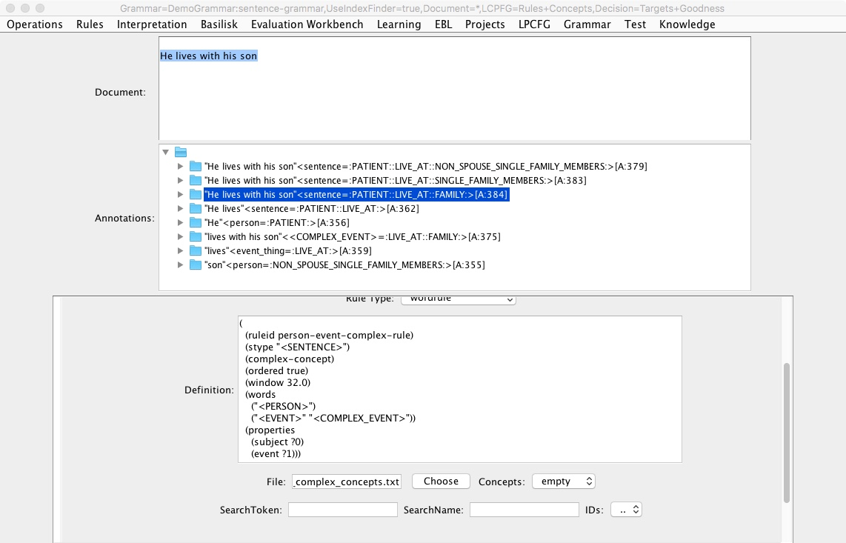
Need rule to infer LivingAlone if patient lives with family

Slide 17
How to add/edit rules:
Use text editor to edit rules files, in this case Moonstone/GrammarRules/DemoGrammar/SentenceGrammar/LivingAloneRules
For convenience, after selecting a node in the middle window, select menu item “Rules->View Selected Rule in Text Editor” to display rule in text editor app.
Be careful with parentheses and quotation marks!
Some editors, like TextWrangler, check parenthesis matching.
Select Rules->Reload rules from file
Type “he lives with his son” into GUI’s Document window
Select “Interpretation->Get interpreted pattern analysis annotations” to see results
Mouse-click node in parsetree to see rule definition
Hover mouse over node to see more detailed information about annotation in tooltip box.

Slide 18
Exercise: Add new rule to LivingAloneRules file
;; e.g. “he lives with his son”, “significant other currently staying with him”, etc.
((ruleid living-with-family-means-not-living-alone-rule)
(concept ":NOT_LIVING_ALONE:")
(pattern (":FAMILY:" ":FRIEND:")
(":LIVE_AT:")
(":PATIENT:"))
(tests (notneg ?1))
(relations (live-with ?0 ?2)))

Slide 19
Results

Slide 20
Simpler way to create rules
Use mouse to select best composite concept, e.g.
":FAMILY::LIVE_AT::PATIENT:”
Select menu item “EBL->Create Bag of Concepts Rule from Top Annotation Only”
Select “:NOT_LIVING_ALONE:” from popup menu.
New grammar rule is automatically created in folder “GrammarRules/DemoGrammar/sentence-grammar/EBL/EBLRules (see next slide)

Slide 21
Auto-generated rule
(
(ruleid "BOC-:NOT_LIVING_ALONE:-1-2018/03/19 14:22:19")
(specialized)
(example-snippet "son and grandson live with him")
(ordered true)
(concept ":NOT_LIVING_ALONE:")
(stype "<HOUSING_STATUS>")
(bagofconcepts true)
(words
(":FAMILY::LIVE_AT::PATIENT:"))
(tests
("notneg" ?0)))

Slide 22
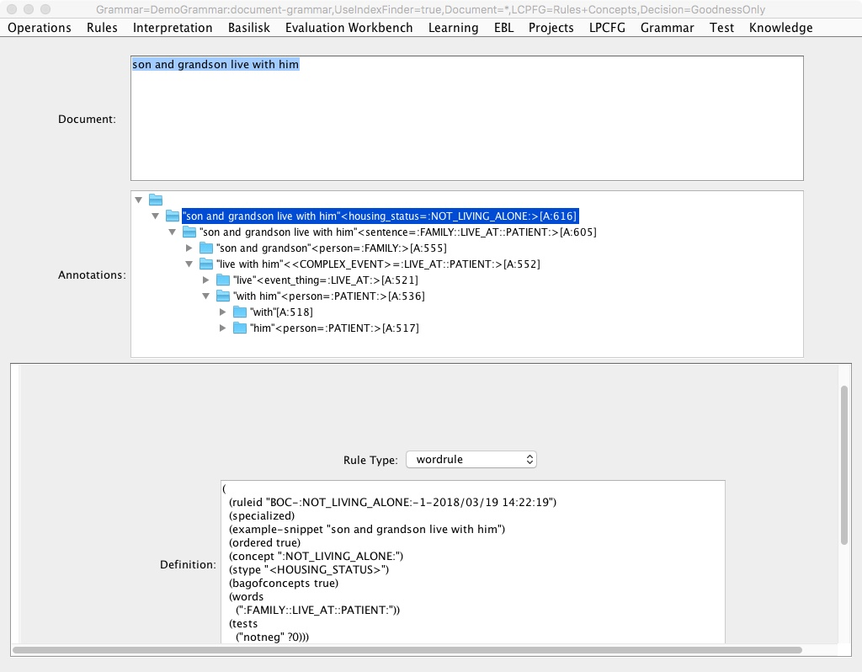
Auto-generated rule result

Slide 23
What if Moonstone can’t connect words?
Moonstone is a grammatical parser; if can’t connect, phrases remain unconnected.
Abstract grammar rules often apply; produce composite concept e.g. ":PATIENT::LIVE_AT::FAMILY:”
Only solution is to create new rules, by hand or via rule generation function.

Slide 24
Example abstract rule
((ruleid person-event-complex-rule)
(stype "<SENTENCE>")
(complex-concept) ;; instruction to create composite
(ordered true)
(window 32)
(words ("<PERSON>") ("<EVENT>”)) ;; abstract pattern
(properties (subject ?0) (event ?1)))

Slide 25
End of Tutorial

