Slide 1
Generische Prozesskette (deutsch)
Consumer Unit
Provisioning Carriers
Palletizing
Provisioning Primary Package
Product Filling
Closing Primary Package
Labelling
Production
Trade Unit
Logistics Unit
Repacking
Labelling
Palletizing
Load Securing
Labelling
Transfer
Provisioning Secondary Package
Provisioning Carriers

Slide 2
Modular Logistics System (MLS)
Logistics Orchestration Layer (LOL)
Logistics Area (LA)
Logistics Line (LL)
Logistics Equipment Assembly (LEA)
Logistics Equipment Assembly (LEA)
Logistics Equipment Assembly (LEA)
Logistics Equipment Assembly (LEA)
Logistics Equipment Assembly (LEA)
Logistics Line (LL)
Logistics Equipment Assembly (LEA)
Logistics Equipment Assembly (LEA)
Logistics Equipment Assembly (LEA)
Logistics Equipment Assembly (LEA)
Fixed Coupling
Loose Coupling

Slide 3
Logistics Area (LA)
AGV
Layer
Palletizer
(PAL)
Push
Stretch Hood Machine 1
(SH1)
Pull
Outbound Node
Pallet Supply
(PAS)
Stretch Hood Machine 2
(SH2)
Inbound Node
In/Outbound Node
Foil Supply
(FOS)
Processing Node
Order Node

Slide 4
Modular Logistics System (MLS)
Logistics Orchestration Layer (LOL)
Logistics Area (LA)
Logistics Line (LL)
Order-oriented LEA
Logistics Equipment Assembly (LEA)
Logistics Equipment Assembly (LEA)
Logistics Equipment Assembly (LEA)
Demand-oriented LEA
Logistics Equipment Assembly (LEA)
Logistics Equipment Assembly (LEA)
Logistics Line (LL)
Logistics Equipment Assembly (LEA)
Logistics Equipment Assembly (LEA)
Logistics Equipment Assembly (LEA)
Logistics Equipment Assembly (LEA)
Fixed Coupling
Loose Coupling
Packaging order from LOL

Slide 5
LEA
LEA Operator Screen
LEA Service
Service
Parameters
Report Values
Process Values

Slide 6
RESUMING
PAUSED
PAUSING
IDLE
(Initial State)
STARTING
(Ramping up the LEA)
EXECUTE
(Cyclic Processing)
COMPLETING
(Emptying the LEA)
RESETTING
(Setting up initial state)
UNHOLDING
HELD
HOLDING
STOPPED
STOPPING
ABORTED
ABORTING
COMPLETED
(LEA emptied)

Slide 7
RESUMING
(Parameterization of SES)
PAUSED
(Waiting for a trigger)
PAUSING
(Finish processing)
IDLE
(Initial State)
STARTING
(Ramping up the LEA)
EXECUTE
(Processing of an LO)
COMPLETING
(Emptying the LEA)
RESETTING
(Setting up initial state)
UNHOLDING
HELD
HOLDING
STOPPED
STOPPING
ABORTED
ABORTING
COMPLETED
(LEA emptied)

Slide 8
ArrayServParam
(Configuration parameter)
ArrayServParam
(Configuration parameter)
Logistics Equipment Assembly
ProductDataSet
(Array Data Block)
PackagingDataSet
(Array Data Block)
LEA-specific structure
ProductId | Logistics-ObjectStatus | PackagingId | Param1 | …
1 | 1 | 2 | x | …
1 | 4 | 3 | y | …
2 | 2 | 2 | z | …
… | … | … | … | …
PackagingId | Param1 | …
1 | x | …
2 | y | …
3 | z | …
… | … | …
Reference

Slide 9
Parameter | Data Type
OSLevel | BYTE
ApplyEn | BOOL
ApplyExt | BOOL
ApplyOp | BOOL
ApplyInt | BOOL
Sync | BOOL
StateChannel | BOOL
StateOffAut | BOOL
StateOpAut | BOOL
StateAutAut | BOOL
StateOffOp | BOOL
StateOpOp | BOOL
StateAutOp | BOOL
StateOpAct | BOOL
StateAutAct | BOOL
StateOffAct | BOOL
SrcChannel | BOOL
SrcExtAut | BOOL
SrcIntAut | BOOL
SrcIntOp | BOOL
SrcExtOp | BOOL
SrcIntAct | BOOL
SrcExtAct | BOOL
Parameter | Data Type
OSLevel | BYTE
ApplyEn | BOOL
ApplyExt | BOOL
ApplyOp | BOOL
ApplyInt | BOOL
Sync | BOOL
StateChannel | BOOL
StateOffAut | BOOL
StateOpAut | BOOL
StateAutAut | BOOL
StateOffOp | BOOL
StateOpOp | BOOL
StateAutOp | BOOL
StateOpAct | BOOL
StateAutAct | BOOL
StateOffAct | BOOL
SrcChannel | BOOL
SrcExtAut | BOOL
SrcIntAut | BOOL
SrcIntOp | BOOL
SrcExtOp | BOOL
SrcIntAct | BOOL
SrcExtAct | BOOL
true
Sync = TRUE

Slide 10
FFS
CONV
PAL
(2) Procedural Relation
2
FFS Service
CONV Service
PAL Service
STARTING
EXECUTE
(1) Parameterizing Relation
BagQuantity := 50
1
BagQuantity = 50
3
(3) Interlocking
Relation
ClearanceIn := TRUE
ClearanceOut := TRUE

Slide 11
LOL / Operator
«choreography»
Logistics Line
«participant»
LEA1
«participant»
LEA2
«participant»
LEA3
«automation service»
LEAService1
«automation service»
LEAService2
«automation service»
LEAService3
LEA-external relation

Slide 12
LEA
Configurable Logic
Configurable Communication
(Active Reading)
Input List
Logic List
Output List
Configurable Communication
(Active Writing)
LEA Service
Configurable Communication
(Active Reading)
State Machine
Configurable Communication
(Active Writing)
Service Parameters
Process Values
Configurable Communication
(Active Reading)
Configurable Communication
(Active Writing)
Report Values

Slide 13
Configurable Logic
Input List
Output List
LEA.Execute
LEA.Start
fixed
LEA.ProcedureCur
LEA.ProcedureSel
…
…
configurable
ConfigInput1
ConfigOutput1
…
…
WritableInput1
writable
…

Slide 14
LEA
LEA Service
Service-Control
Service Parameters
Report Values
Process Values

Slide 15
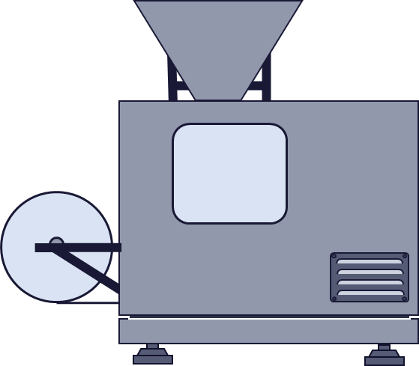
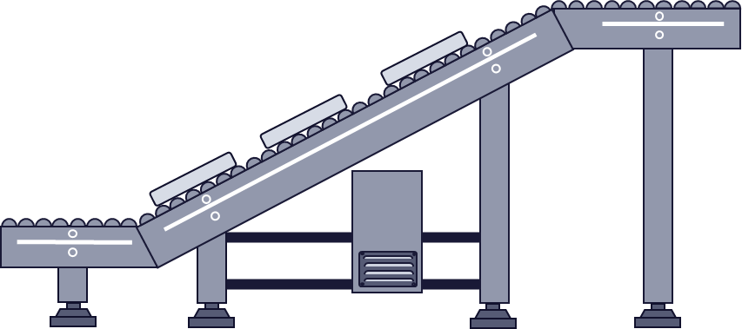
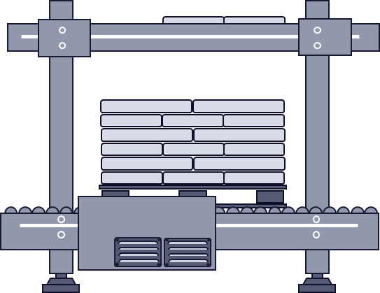
Choreographed Logistics Line
LineService with Line Interface
ServiceControl3
Param1.1
Param1.3
RV2.2
PVOut3.2
LEA 1 (e.g., FFS)
LEA 2 (e.g., CONV)
LEA 3 (e.g., PAL)
LEA Service 1
LEA Service 2
LEA Service 3
Service-Control1
Param1.1
Service-Control2
Prozess2.1
Service-Control3
Param3.1
Param1.2
RV2.1
PVIn3.1
Param1.3
RV2.2
PVOut3.2
RV1.1
Elements of the Line Interface
Lead Service
Param… Parameter
Choreography-internal connected interface element
RV… Report Value
Follower Service
PV… Process Value

Slide 16
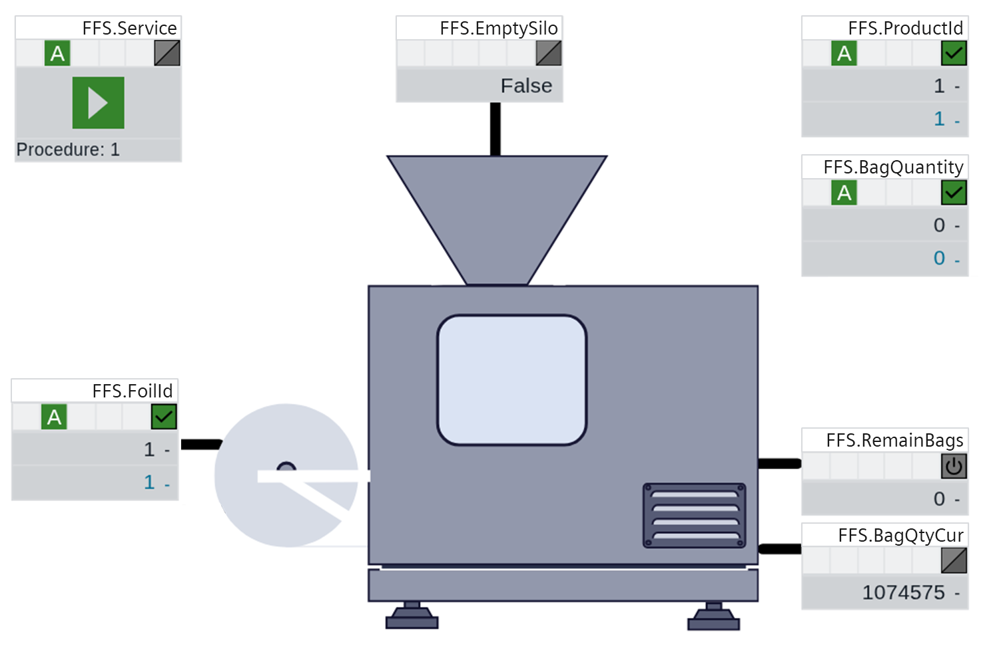
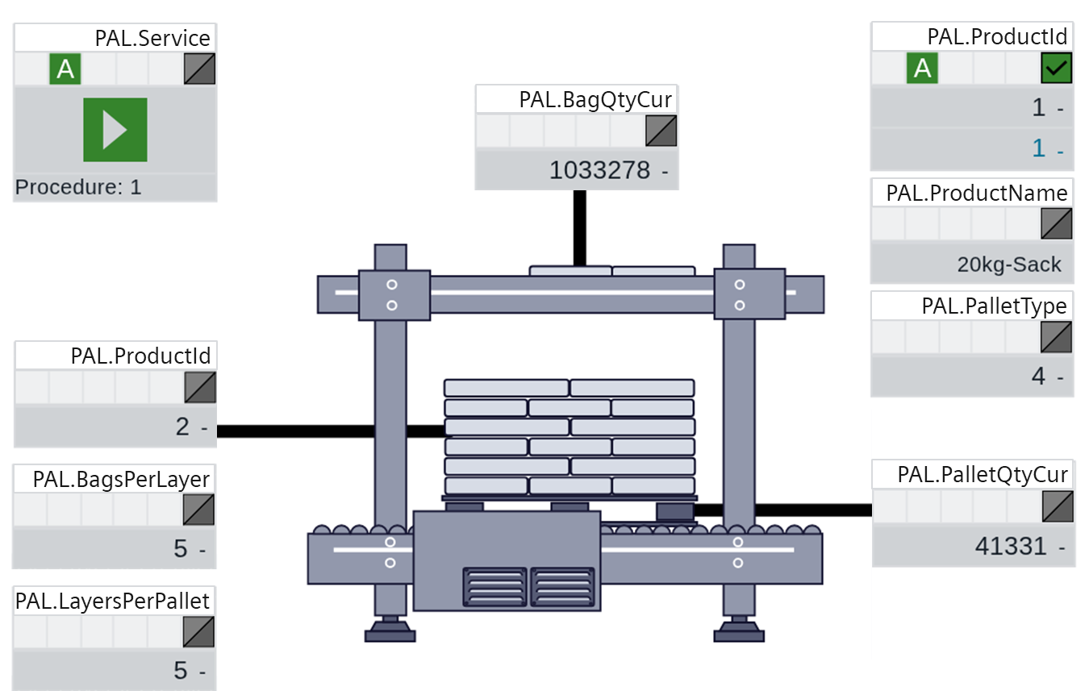
FFS HMI
CONV HMI
PAL HMI

Slide 17
FFS-Bedienbild (FFS_HMI)
CONV-Bedienbild (CONV_HMI)
FFS HMI
Elements used from a LEA HMI
Line-specific HMI elements
Logistics Line HMI

Slide 18
Logistics Line HMI
FFS HMI
CONV HMI
PAL HMI

Slide 19
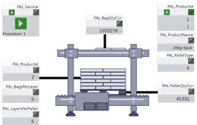
HMIs Logistics Line
HMIs Logistics Line
FFS HMI
HMIs FFS
CONV HMI
HMIs CONV
PAL HMI
HMIs PAL
Variant 3
Variant 4

Slide 20
Composed MTP
Semantic Models
(Aspects of the Composed MTP)
References
Attachments
LEA1MTP
LEA MTPs
LEA2MTP

Slide 21
Composed MTP
LEA1 MTP
Manifest
Manifest
Aspect1
AspectA
Attachments
AspectA
Aspect1
LinkedObject/
ID-Link/
ExternalElement
ID-Link
InternalElement (HasExternalMtpContext)
CustomSymbol
ExternalElement
InternalElement
Attachments
according to [MTP Specification Part 1]
ReferenceLEA1MTP
ReferenceLEA2MTP

Slide 22
Composed MTP
ModuleTypePackage
LogisticsLine (ComposedModuleTypePackage)
Services
Manifest
ProcessValues
Pictures
Semantic Models
Attachments
Services
Aspect Models
ProcessValues
Pictures
Attachments
LEA1MTP
LEA MTPs
LEA2MTP
Choreography Configuration

Slide 23
Logistics Orchestration Layer (LOL)
Parameter Management
Material Flow Management
Transport Management (TM)
LEA Manage- ment
Order Management
TN Proxy
TN Proxy
Transport Service (ID: 1)
OPC UA
Server
AGV System Adapter
Logistics Area
Configuration
Decentralized Orchestration
AGV System
Query of routing information
Fleet Manager
Parameterization of default routes acc. Section 3.3
Logistics Equipment Assembly (LEA)
Logistics Equipment Assembly (LEA)
AGV
AGV
TN Block
TN Block
OPC UA Client
OPC UA Client
Statics Connection (configured during engineering)
Legend
InOutbound Node
Order Node
Dynamic Connection (configured during runtime)
Not covered in the context of this artifact

Slide 24
Logistics Orchestration Layer (LOL)
Transport Management (TM)
ProxyId:1
Order Management
TN Proxy
1
Status (e.g., Transport)
2
Transport Service (ID: 1)
TN Proxy
3
4
Proxy-Id:2
AGV System Adapter
TN Proxy
TN Proxy
ProxyId:4
ProxyId:3
Logistics Area
Palletizer
(PAL)
Stretch Hood Machine (SH)
Fleet Manager
Push
AGV
Labeller
(LABEL)
Order Node
In/Outbound Node
Inbound Node
Processing Node

Slide 25

Transport Management (TM)
standardized
standardized
extendable
Logistics Equipment Assembly (LEA)
AGV System
Logistics Equipment Assembly (LEA)
AGV System
Logistics Equipment Assembly (LEA)
Fleet Manager
Logistics Equipment Assembly (LEA)
Fleet Manager
AGV
AGV
AGV
AGV
Direct Interaction
Interaction via Transport Management

Slide 26
Transport Management (TM)
Transport Management (TM)
AGV1 Service
Transport Service (ID: 1)
AGV2 Service
Transport Service (ID: 2)
Logistics Equipment Assembly (LEA)
AGV System
Logistics Equipment Assembly (LEA)
AGV System
Logistics Equipment Assembly (LEA)
Fleet Manager
Logistics Equipment Assembly (LEA)
Fleet Manager
AGV 1
AGV 2
AGV
AGV
One service per AGV
One service per transport order

Slide 27
SAIL Functions
Transport Coordination
Transport-Management (TM)
Transport Order
Ressource Utilization
AGV
System
Fleet Manager
Mission Management
Direction Control
Information Collection
AGV
Facility Control

Slide 28
Order Management
Transport Management (TM)
Transport Management (TM)
Transport Management (TM)
Transport Service (ID: 1)
Transport Service (ID: 1)
Transport Service (ID: 1)
Transport Service (ID: 2)
Transport Service (ID: 2)
Transport Service (ID: 2)
Logistics Equipment Assembly (LEA)
AGV System
Logistics Equipment Assembly (LEA)
AGV System
Logistics Equipment Assembly (LEA)
AGV System
Logistics Equipment Assembly (LEA)
Fleet Manager
Logistics Equipment Assembly (LEA)
Fleet Manager
Logistics Equipment Assembly (LEA)
Fleet Manager
AGV
AGV
AGV
AGV
AGV
AGV
Central Orchestration
Decentral Orchestration
Choreography

Slide 29
Logistics Equipment Assembly (LEA)
Transport Management
Transport Management
Logistics Equipment Assembly (LEA)
Transport Service
Logical View
Technical View

Slide 30
Transport Management (TM)
Transport Management (TM)
Transport Management (TM)
TM Endpoint
Transport ID
Transport Service (ID: 1)
Configuration of Transport Service Connection
Transport Service (ID: 1)
Config. of Proxy Connection
Transport Proxy
Transport Service (ID: 1)
Transportdienst (ID: 2)
Transport Service (ID: 2)
Transport Service (ID: 2)
Browsing
Logistics Equipment Assembly (LEA)
AGV System
Logistics Equipment Assembly (LEA)
AGV System
Logistics Equipment Assembly (LEA)
AGV System
Logistics Equipment Assembly (LEA)
Fleet Manager
Logistics Equipment Assembly (LEA)
Fleet Manager
Logistics Equipment Assembly (LEA)
Fleet Manager
AGV
AGV
AGV
AGV
AGV
AGV
Browsing of Transport Services via LEAs
Configurative connection of Transport Services via TM
Configurative connection of Proxies via TM

Slide 31
Transport Management
observe
Transport Management
Transport Service (ID: 1)
Transport Service (ID: 1)
Transport Services (ID: 2)
Transport Services (ID: 2)
Logistics Equipment Assembly (LEA)
AGV System
Logistics Equipment Assembly (LEA)
AGV System
Logistics Equipment Assembly (LEA)
Fleet Manager
Logistics Equipment Assembly (LEA)
Fleet Manager
AGV
AGV
AGV
AGV
Creation by the LEA
(using OPC UA methods)
Creation by the TM

Slide 32
Material Flow Management
Transport Management
Parameter Management
Transport Management
Transport Service (ID: 1)
Transport Service (ID: 1)
Parameterization acc. to Section 3.3
Material Flow Management
Transport Service (ID: 2)
Transport Service (ID: 2)
Logistics Equipment Assembly (LEA)
AGV System
Logistics Equipment Assembly (LEA)
AGV System
Logistics Equipment Assembly (LEA)
Fleet Manager
Logistics Equipment Assembly (LEA)
Fleet Manager
AGV
AGV
AGV
AGV
Determination of transport nodes by the TM
Determination of transport nodes by the LEAs

Slide 33
Transfer- FromLea-Succeeded
Transfer- ToLea-Succeeded
Push-Requested
Rerouting
Rerouting
Undefined
Transport
Transport-AwaitReq
Transfer- FromLea
Transport
Transport-AwaitReq
Transfer- ToLea
Pull-Requested
Transport-Declined
Transport-Awaited
Processing-Succeeded
Transport-Declined
Transport-Awaited
Initiated by the LEA
Transport-Arrived
Processing
Transport-Arrived
Initiated by AGV system / TM
Creating transport services
Signalling transport demands
Transport and approaching a LEA
Takeover or Processing of LOs
Transport and approaching a LEA
Handover of LOs

Slide 34
IDLE
STARTING
(Transition of Transportstatus)
EXECUTE
Undefined
Push-Requested
Transport-AwaitReq
Transfer- FromLea
Transfer- ToLea
Pull-Requested
Transport-Awaited
Transfer- FromLea-Succeeded
Transfer- ToLea-Succeeded
COMPLETED
COMPLETING
Transfer- ToLea-Succeeded
Transfer- ToLea-Succeeded
Transport
Transport-Declined
Transport-Arrived
Processing
Processing-Succeeded
Rerouting
Initiated by the LEA
Initiated by AGV system / TM

Slide 35

Transport Management (TM)
Order Management
Transport Services (ID: 1)
ProcedureCur
NextNode.VExt
TN Proxy
Read
Read/ Write
Palletizer
(PAL)
InOutbound Node
OPC UA connection configured during LEA commissioning
OPC UA read and write operations
Assignment configured at runtime
TM-internal signal exchange

Slide 36
Start-Up (Scenario 1)
Exception Handling (Scenario 3)
Unhold (Scenario 4)
Reset (Scenario 5)

Slide 38
1)
MTP LEA1
MTP LEA2
Model Definitions
Choreography-Participant
ChoreographyParticipant
InputList
InputList
OutputList
MTP modelling
(this work)
FixedInput-Element
Manager-Link
Configurable-InputElement
RefId
FixedOutput-Element
Index
RefID
ManagerIndex
Index
Interface Definitions
UnionElement
OpcUaClient-
ServerManager
Choreography-
ParticipantManager
Ua-Reader
In-put
Out-put
LEA1
LEA2
OPC UA- Server
OPC UA Server
OPC UA- Server
OPC UA Client
Input List
Input List
Output List
LEA1.Execute
(UnionType)
Node-ID
…
LEA.Start (UnionType)
PLC implementation
(according to [Stu26])
Ua-Reader
…
LEA Service
Configurable-Input (UnionType)
LEA Service
…
1) For the sake of clarity, the ChoreographyParticipantManager and the OpcUaClientServerManager are not shown here.

Slide 39
MTP LEA1
1)
MTP LEA2
ChoreographyParticipant
ChoreographyParticipant
InputList
OutputList
InputList
FixedInput-Element
RefId
Configurable-OutputElement
ManagerLink
WritableInput-Element
ManagerLink
MTP modelling
(this work)
Manager-Index
Index
Index
ManagerIndex
RefID
Choreography-
ParticipantManager
OpcUaClient-
ServerManager
Writable-UnionElement
OpcUaClient-
ServerManager
In-put
Out-put
Ua-Writer
Value-Field
LEA1
LEA2
OPC UA- Server
OPC UA- Server
OPC UA- Client
OPC UA- Server
Input List
Output List
Input List
LEA1.Execute
(UnionType)
…
Node-ID
…
PLC implementation
(according to [Stu26])
Ua-Writer
UaValue-Field
…
LEA Service
ConfigurableOut-put (UnionType)
WritableInput (UnionType)
2)
1) For the sake of clarity, the ChoreographyParticipantManager is not shown here.
2) Forwarding to the corresponding fixed output (LEA2.Start) in the output list; see Figure 6.12

Slide 40
Flexible Transport System
Transport Management
MTP-Transportdienst (ID:1)
MTP Transport Service (ID: transA)
Order Node
ID: 1
Stretch Hood Machine (SH)
Palletizer
(PAL)
InOutbound- Node
Inbound-
Node
ID: 2
ID: 4
Push
Processing Node
ID: 3
Labeller (LABEL)

Slide 41

Logistics Orchestration Layer (LOL)
Choreography Configurator
Line HMI
Implementation in the course of this work
Labeller (LABEL)
Filler (FILL)
Capper (CAP)
Choreography
LABEL Service
FILL Service
LEAD Service
CAP Service
Native Software
Native Software
Native Software
Existing software
Material flow defined by fixed Coupling
Information exchang within choreography

Slide 42
Logistics Orchestration Layer (LOL)
Packaging Order Management
HMI Functionality
Transport Management
Material Flow Management
Logistics Area
Fleet Manager
AGV
Layer Palletizer
(PAL)
Push
Stretch Hood Machine 1
(SH1)
Pull
Pallet Supply
(PAS)
Stretch Hood Machine 2 (SH2)
Outbound Node
Foil Supply
(FOS)
Processing Node
Inbound Node
Order Node
In/Outbound Node

Slide 43
LEA
MTP Service
Transportknoten-Baustein
Packaging Functionality
Transport Node Block
(TN Block)
Native Software

Slide 44
Modular Logistics System (MLS)
Logistics Orchestration Layer (LOL)
Logistics Area (LA)
Logistics Line (LL)
Storage
Form Fill Seal Machine
(FFS)
Conveyor 1 (CONV1)
Layer Palletizer
(PAL)
Paletten-Vereinzeler
(LEA)
Labeller (LABEL)
Stretch Hood Machine 1
(SH1)
Paletten-Vereinzeler
(LEA)
Pallet Supply
(PAS1)
Foil Supply
(FOS)
Logistics Line (LL)
Octabin Filling
(OFill)
Conveyor 2 (CONV2)
Ocatbin
Sealing
(OSeal)
Octabin Assembly Unit
(OAU)
Fixed Coupling
Loose Coupling
Packaging order from LOL

Slide 45
A
Reducing effort
In general, MTP can reduce the amount of engineering and coordination effort required by automating the integration of intelligent equipment.
B
Prerequisites
Prerequisites are …
… interface definitions for all necessary automation interfaces.
… semantic model definitions for all information relevant to integration.
… tools for generating, importing, and interpreting MTP files.
… a uniform communication technology used by the integrated equipment.
C
Basic Assumption of Validation
If these prerequisites are also met for production-related logistics, MTP can also reduce the engineering and coordination effort in this field.
D
Assessment of the Prerequisites
Assessment of the prerequisites for production-related logistics:
regarding (1) and (2): This can be demonstrated based on the three evaluation examples. ✓
regarding (3): This is merely a development need, not a research need. ✓
regarding (4): OPC UA was used consistently in all three evaluation examples. ✓
E
The MTP concept allows engineering efforts to be reduced also in the context of production-related logistics.
Conclusion

Slide 46
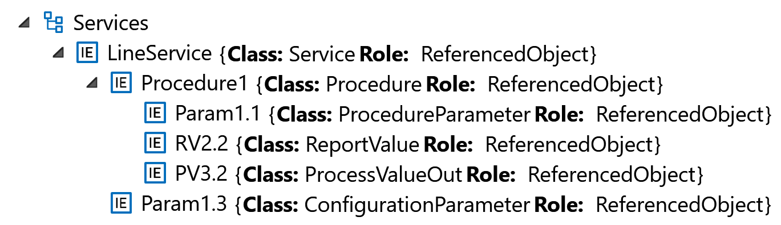
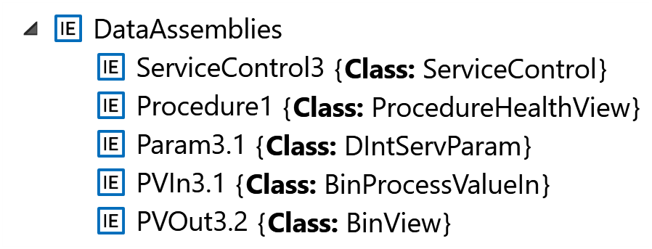
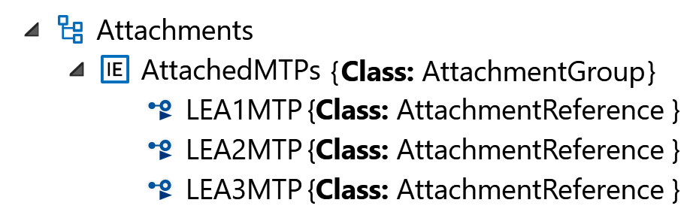
LinkedObjects (RefID)
MTP of LEA 3 in the attachment
ID-Link
(ContextID)
[…]
[…]
AttachmentReference (refUri, DocumentType)

Slide 47
OrderNodeLea3
Logistics Line
LEA 1
(z. B. OFill)
LEA 2
(z. B. CONV)
LEA 3
(z. B. OSeal)
InNodeLea1
OutNodeLea3

