Slide 1
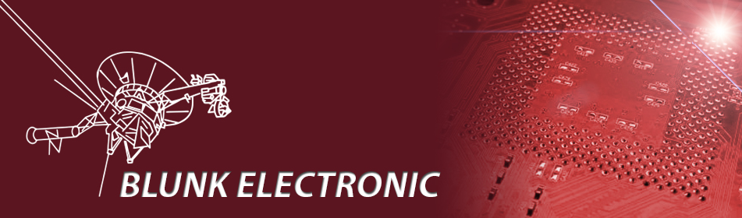
Basics on
IEEE1149.x / JTAG /
Boundary Scan
Boundary Scan Basics www.blunk-electronic.de Page <number>/15

Slide 2
Introduction
Blunk electronic
Owned by Dipl. Ing. Mario Blunk
Location: Buchfinkenweg 3
99097 Erfurt
Germany
Phone +49 176 2904 5855 / +49 361 6022 5184
Email info@blunk-electronic.de
Internet www.blunk-electronic.de
Boundary Scan Basics www.blunk-electronic.de Page <number>/15

Slide 3
Our Services
CAE Support and Prototyping
Low Volume PCB assembly
Boundary Scan Test Development
Consulting for Design for Test (DFT)
Boundary Scan Basics www.blunk-electronic.de Page <number>/15

Slide 4
Boundary Scan ...
is a technique to test ICs, boards and systems.
allows access to buried nets and pins.
gives fault diagnostics down to pin level.
allows in System Programming (ISP).
reduces UUT access to 5 wires.
requires the UUT powered up.
bases on silicon embedded test points.
is standardized by IEEE 1149.x.
Boundary Scan Basics www.blunk-electronic.de Page <number>/15

Slide 5
Why Boundary Scan ?
COST SAVING DUE TO:
early design verification in design stage
prototype test and bring up
applicable on board and system level
repair process simplified
less mechanical equipment
rapid automated test generation
Read more at http://www.blunk-electronic.de/bsm/how_to_test.pdf
Boundary Scan Basics www.blunk-electronic.de Page <number>/15

Slide 6
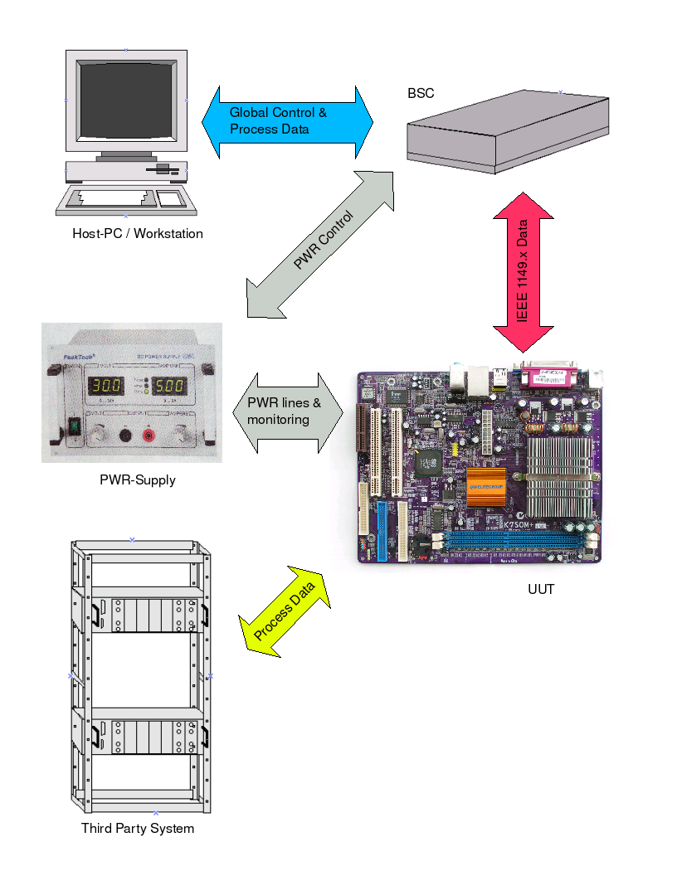
System Overview
Boundary Scan Basics www.blunk-electronic.de Page <number>/15

Slide 7
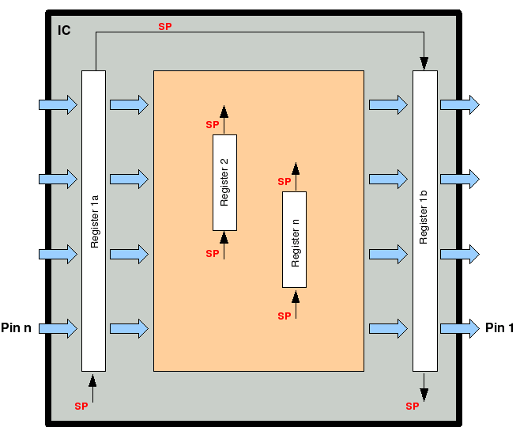
IC inside
Boundary Scan Basics www.blunk-electronic.de Page <number>/15

Slide 8
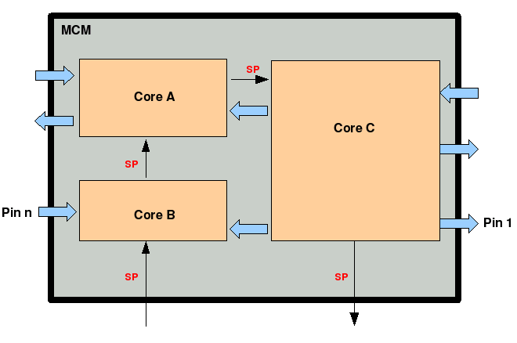
System On Chip inside
Boundary Scan Basics www.blunk-electronic.de Page <number>/15

Slide 9
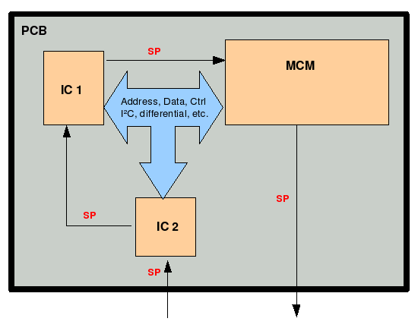
PCB Level #1
Boundary Scan Basics www.blunk-electronic.de Page <number>/15

Slide 10
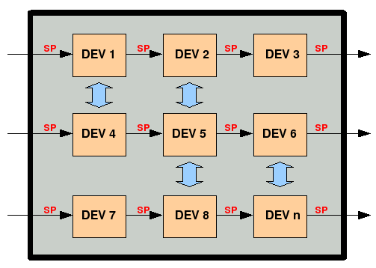
PCB Level #2
Boundary Scan Basics www.blunk-electronic.de Page <number>/15

Slide 11
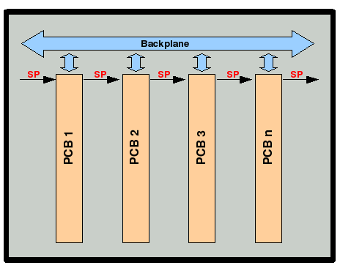
System Level
Boundary Scan Basics www.blunk-electronic.de Page <number>/15

Slide 12
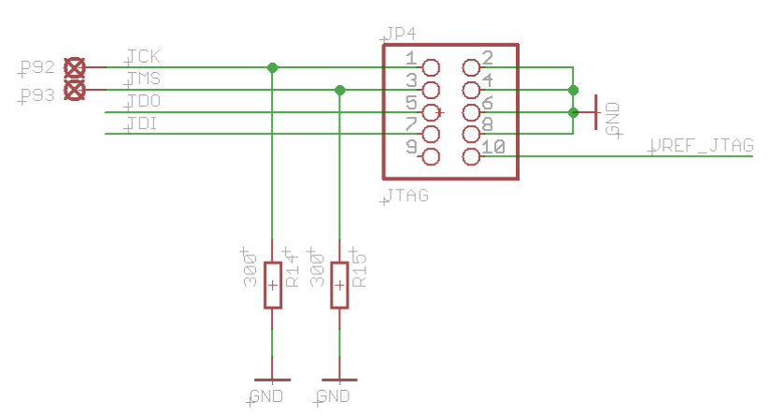
Wiring #1
Boundary Scan Basics www.blunk-electronic.de Page <number>/15

Slide 13
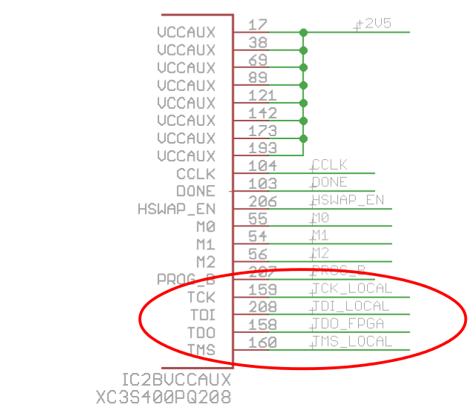
Wiring #2
Boundary Scan Basics www.blunk-electronic.de Page <number>/15

Slide 14
Links
PCB Houses in Germany:
www.q-print.de (Prototypes)
www.jlp.de (Mass Production)
Distributors and EMS in Germany:
www.technikron.de
Boundary Scan Basics www.blunk-electronic.de Page <number>/15

Slide 15
Thanks for your attention !
Boundary Scan Basics www.blunk-electronic.de Page <number>/15

