Slide 1
Level Design and Gameplay Through Procedural Generation
Phillip Law - 1422892

Slide 2
The Aims of the Project
To research various applications of PCG in video games
To investigate and evaluate various methods of implementation
To create a computer game prototype that utilised PCG

Slide 3
What is Procedural Content Generation?
PCG is The process of creating content using algorithms and rulesets
PCG Uses:
Traditional
Level Generation
Item Generation and Placement
Foliage Generation
Potential
Dynamic Difficulty
Infinite Content

Slide 4
The Literature Review – Advantages/Disadvantages
Advantages
Efficiency and Cost Saving
Potentially infinite content
Dynamically adapt to the player
Disadvantages
Efficiency and Cost Saving
Generic Content/Lack of Control

Slide 5
The Literature Review – Guidelines
Don’t overuse randomness
Know the metrics
Create subsets

Slide 6


The Design - Concept

Slide 7
The Design – The System Goals
Generate the level within an acceptable timeframe
Generate a new layout each time for the player
There should be a start and end point
Every room generated should be accessible
The map should encourage exploration

Slide 8
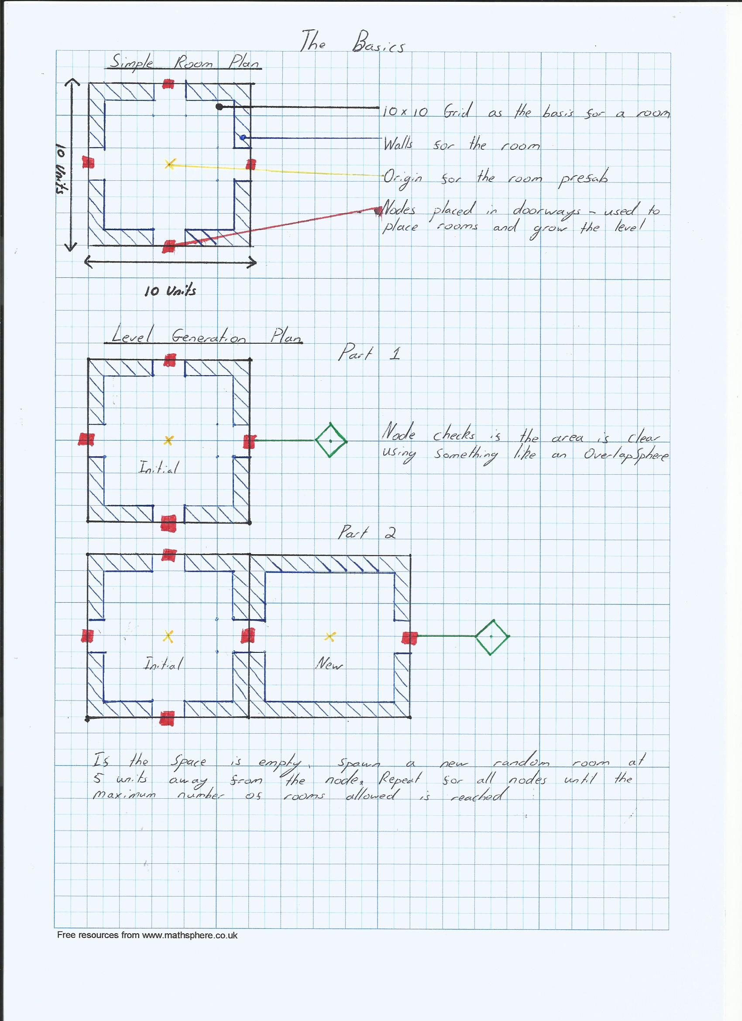
The Design – Setting the Metrics

Slide 9
The Design – Level Generation

Slide 10
Vital Components
Level Manager
Lists
OverlapSpheres

Slide 11
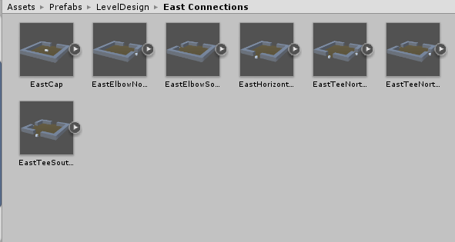
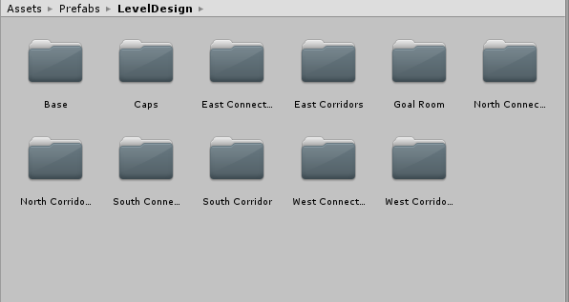
The Implementation – Creating Prefabs

Slide 12
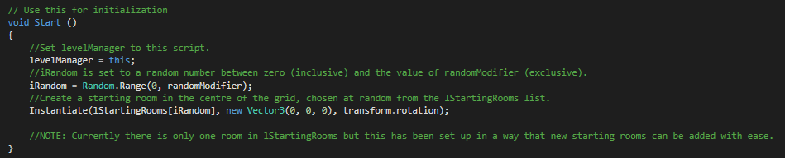
The Implementation – Generating the Map
Spawning the first room

Slide 13
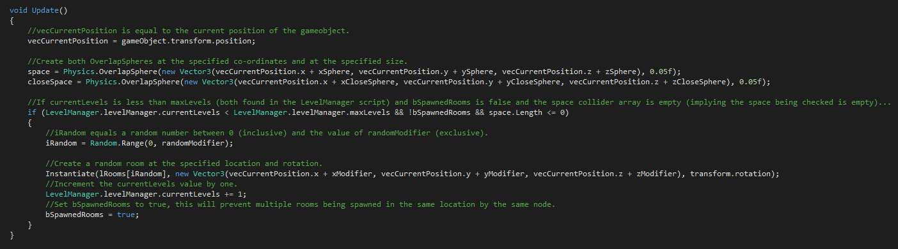
The Implementation – Generating the Map
Generating the remaining rooms:

Slide 14
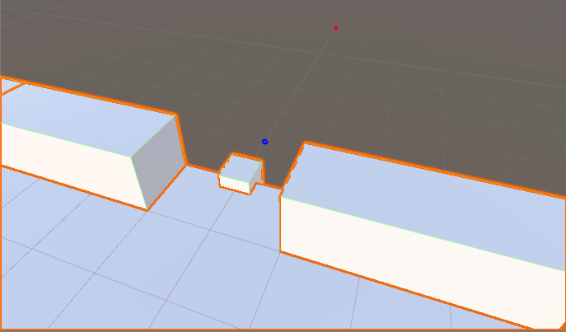
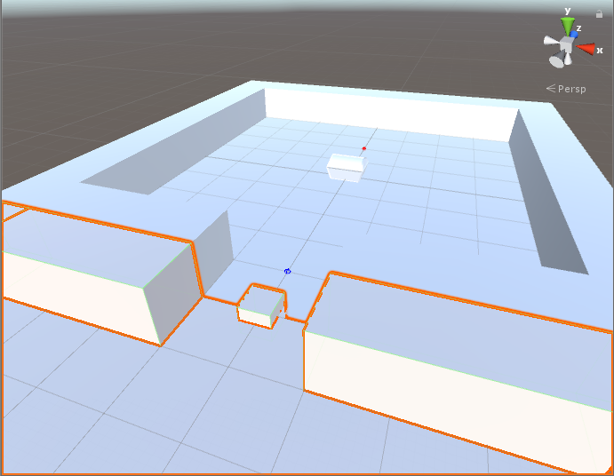
The Implementation – Capping the Map

Slide 15
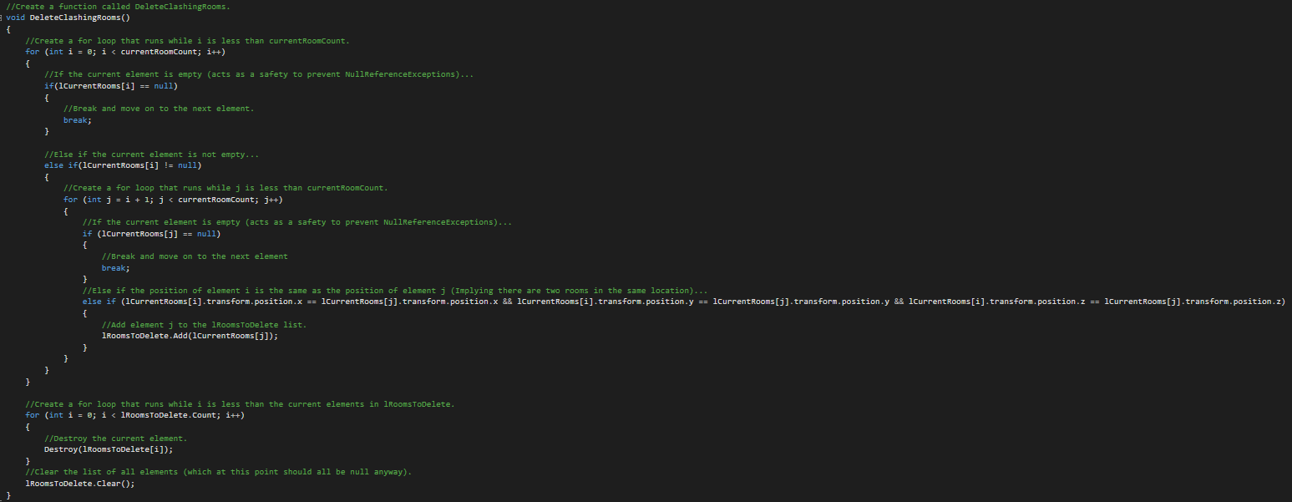
The Implementation – Deleting Clashing Rooms

Slide 16
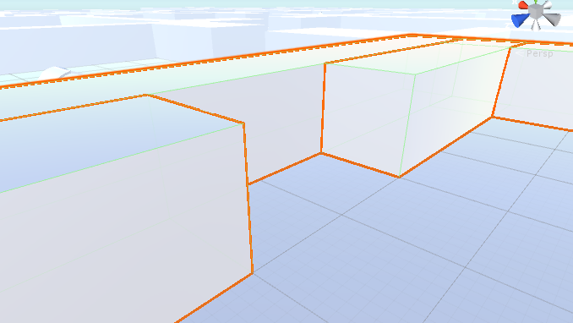
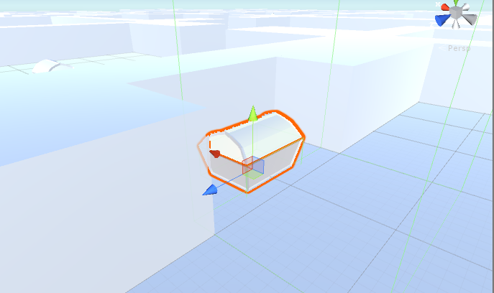
The Implementation – Adding Chests

Slide 17
Testing
Testing Log
A document maintained throughout the development process
Kept track of bugs and attempts to fix them
User Testing
Two playtest sessions with the same participants
Asked to play the latest build of the game
Asked to provide feedback through a questionnaire

Slide 18
Conclusions
Implementation
Limitations
Scope of the Project
User Testing
Lessons
Planning is always vital
PCG
The tool is only as effective as those who wield it
Has a lot of potential within the industry

Slide 19
The Implementation
Demonstration

