Slide 1
出芽酵母单核苷酸突变特征
生信 2001 张子栋 梁国相

Slide 2
分工
张子栋
代码实现
项目展示
实验报告
梁国相
思路与模型建立
代码校对
R 语言绘图

Slide 3
1. 基因序列和非基因序列突变率的差异
实验思路
使用 Java 通过 MyBatis 操作数据完成数据处理和统计量计算
通过 R 绘图

Slide 4
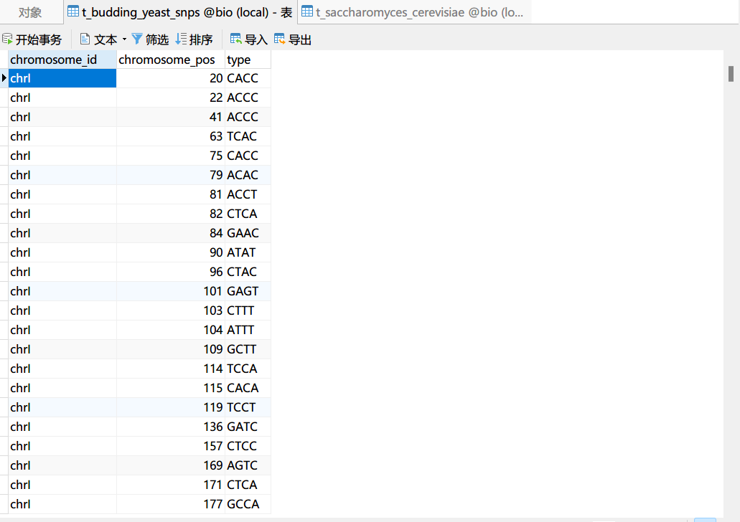
数据预处理
数据导入
通过 Navicat 导入向导导入数据
其中，saccharomyces_cerevisiae_R64-1-1_20110208.gff 文件仅提取第 1，3，4，5 列为有效信息

Slide 5
数据预处理
/** * @author ZidongZh * @date 2022/3/3 */ public class Mutation { private String chromosomeId; private Integer chromosomePos; private String type; /** * constructor * * @param chromosomeId 染色体号 * @param chromosomePos 染色体位置 * @param type 变异类型 */ public Mutation( String chromosomeId, Integer chromosomePos, String type) { this.chromosomeId = chromosomeId; this.chromosomePos = chromosomePos; this.type = type; }
创建实体类
实体类 Information 用于存储序列信息
实体类 Mutation 用于存储变异信息
/** * @author ZidongZh * @date 2022/3/3 */ public class Information { private String chromosomeId; private String type; private Integer startPos; private Integer endPos;

Slide 6
数据预处理
处理重叠基因序列
/** * 合并重叠基因区间 * * @param information 原始数据 */ void connect(List<Information> information) { int i = 0; int j = 1; Information previous = null; Information next = null; while (j + 1 < information.size()) { previous = information.get(i); next = information.get(j); if (previous.getEndPos() >= next.getStartPos() && previous.getEndPos() <= next.getEndPos()) { previous.setEndPos(next.getEndPos()); information.remove(j); information.set(i, previous); } else { i++; j++; } } }

Slide 7
数据预处理
获取非基因序列
/** * @param genes 基因信息 * @return 非基因序列 */ List<Information> getNonGenes(List<Information> genes, List<Information> chromosomes) { int pos = 0; List<Information> nonGenes = new ArrayList<>(); Information nonGeneHead = new Information(chromosomes.get(0).getChromosomeId(), "nonGene", 1, genes.get(0).getStartPos() - 1); nonGenes.add(nonGeneHead); for (int i = 0; i < chromosomes.size(); i++) { for (int j = 0; j < genes.size(); j++) { if (genes.get(j).getChromosomeId().equals(chromosomes.get(i).getChromosomeId()) && genes.get(j + 1).getChromosomeId().equals(chromosomes.get(i).getChromosomeId())) { Information nonGene = new Information(genes.get(j).getChromosomeId(), "nonGene", genes.get(j).getEndPos() + 1, genes.get(j + 1).getStartPos() - 1); nonGenes.add(nonGene); pos = j + 2; } } if (null != genes.get(pos)) { Information nonGeneHead1 = new Information(genes.get(pos).getChromosomeId(), "nonGene", 1, genes.get(pos).getStartPos() - 1); nonGenes.add(nonGeneHead1); } } return nonGenes; }

Slide 8
数据预处理
获取非基因序列
/** * @param genes 基因信息 * @return 非基因序列 */ List<Information> getNonGenes(List<Information> genes, List<Information> chromosomes) { int pos = 0; List<Information> nonGenes = new ArrayList<>(); Information nonGeneHead = new Information(chromosomes.get(0).getChromosomeId(), "nonGene", 1, genes.get(0).getStartPos() - 1); nonGenes.add(nonGeneHead); for (int i = 0; i < chromosomes.size(); i++) { for (int j = 0; j < genes.size(); j++) { if (genes.get(j).getChromosomeId().equals(chromosomes.get(i).getChromosomeId()) && genes.get(j + 1).getChromosomeId().equals(chromosomes.get(i).getChromosomeId())) { Information nonGene = new Information(genes.get(j).getChromosomeId(), "nonGene", genes.get(j).getEndPos() + 1, genes.get(j + 1).getStartPos() - 1); nonGenes.add(nonGene); pos = j + 2; } } if (null != genes.get(pos)) { Information nonGeneHead1 = new Information(genes.get(pos).getChromosomeId(), "nonGene", 1, genes.get(pos).getStartPos() - 1); nonGenes.add(nonGeneHead1); } } return nonGenes; }

Slide 9
数据处理
计算统计数
在 Information 类中添加属性 mutationNum 和 mutationRate
/** * @author ZidongZh * @date 2022/3/3 */ public class Information { private String chromosomeId; private String type; private Integer startPos; private Integer endPos; private Integer mutationNum; private Double mutationRate;

Slide 10
数据处理
计算统计数
计算变异率
//计算变异数与变异率
for (int i = 0; i < allMutation.size(); i++) {
for (int j = 0; j < genes.size(); j++) {
if (allMutation.get(i).getChromosomeId().equals(genes.get(j).getChromosomeId()) && allMutation.get(i).getChromosomePos() >= genes.get(j).getStartPos() &&
allMutation.get(i).getChromosomePos() <= genes.get(j).getEndPos()) {
genes.get(j).setMutationNum(genes.get(j).getMutationNum() + 1);
genes.get(j).setMutationRate((double) genes.get(j).getMutationNum() / (double) (genes.get(j).getEndPos() - genes.get(j).getStartPos() + 1));
}
}
for (int j = 0; j < nonGenes.size(); j++) {
if (allMutation.get(i).getChromosomeId().equals(nonGenes.get(j).getChromosomeId()) && allMutation.get(i).getChromosomePos() >= nonGenes.get(j).getStartPos() &&
allMutation.get(i).getChromosomePos() <= nonGenes.get(j).getEndPos()) {
nonGenes.get(j).setMutationNum(nonGenes.get(j).getMutationNum() + 1);
nonGenes.get(j).setMutationRate((double) nonGenes.get(j).getMutationNum() / (double) (nonGenes.get(j).getEndPos() - nonGenes.get(j).getStartPos() + 1));
}
}
}

Slide 11
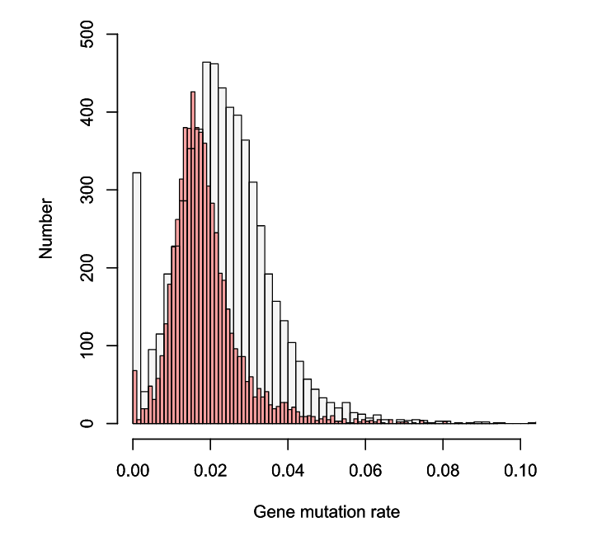
数据可视化
使用 R hist() 函数
> geneMutationRate = read.table(file.choose(), header = F, sep = ",")
> geneMutationRate = as.matrix(geneMutationRate)
> nonGeneMutationRate = read.table(file.choose(), header = F, sep = ",")
> nonGeneMutationRate = as.matrix(nonGeneMutationRate)
> hist(geneMutationRate, xlab="Gene mutation rate",ylab="Number",col=rgb(255, 0, 0, 90, maxColorValue=255), breaks = 100, xlim = c(0.0,0.1), ylim = c(0,500), main = NULL)
> par(new = T)
> hist(nonGeneMutationRate, xlab="Gene mutation rate",ylab="Number",col=rgb(2, 0, 0, 10, maxColorValue=255), breaks = 100, xlim = c(0.0,0.1), ylim = c(0,500), main = NULL)

Slide 12
假设检验
主要算法：
//t检验 double t = 0.0; t = (geneMutRateMean - nonGeneMutRateMean) / (sqrt((((genes.size() - 1) * geneVariance) + ((nonGenes.size() - 1) * nonGeneVariance)) / (genes.size() + nonGenes.size() - 2)) * sqrt((1 / (double) genes.size()) + (1 / (double) nonGenes.size()))); System.out.println("t = " + t); //u 检验 double u = 0.0; u = (geneMutRateMean - nonGeneMutRateMean) / (sqrt((geneVariance / genes.size()) + (nonGeneVariance / nonGenes.size()))); System.out.println("u = " + u);
输出结果：
geneMutRateMean = 0.018604969719609406
geneVariance = 8.597880264141603E-5
nonGeneMutRateMean = 0.023312667924136225
nonGeneVariance = 1.7675824048238737E-4
t = -22.612916116843113
u = -22.610982585720944

Slide 13
使用 R 内置 t.test()验证结果
> t.test(geneMutationRate,nonGeneMutationRate)
Welch Two Sample t-test
data: geneMutationRate and nonGeneMutationRate
t = -22.611, df = 10825, p-value < 2.2e-16
alternative hypothesis: true difference in means is not equal to 0
95 percent confidence interval:
-0.005115816 -0.004299580
sample estimates:
mean of x mean of y
0.01860497 0.02331267
结果与 Java 基本一致

Slide 14
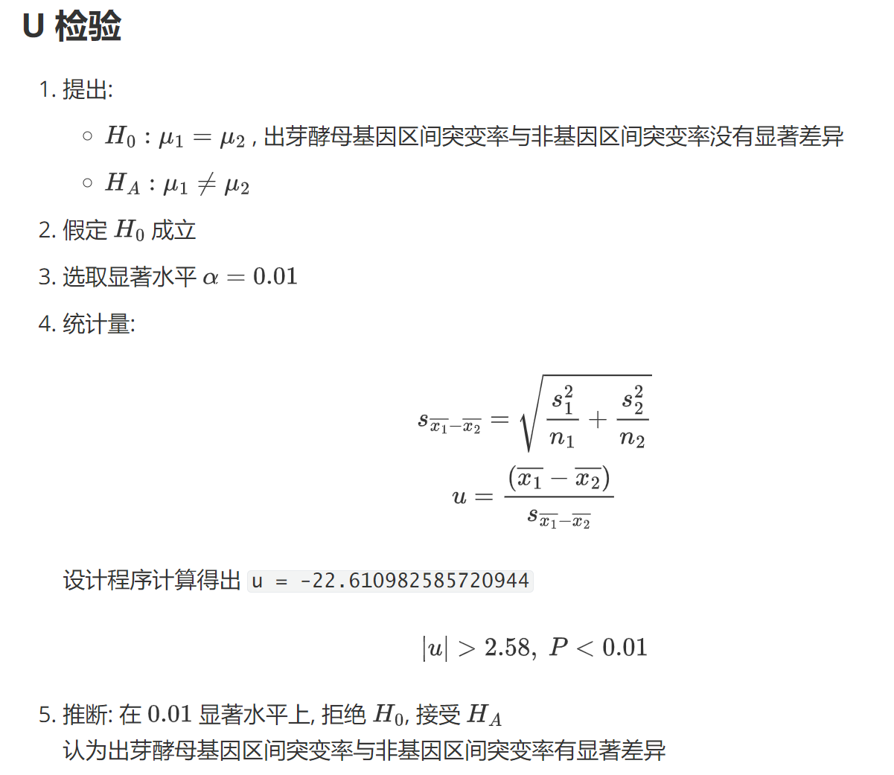

Slide 15
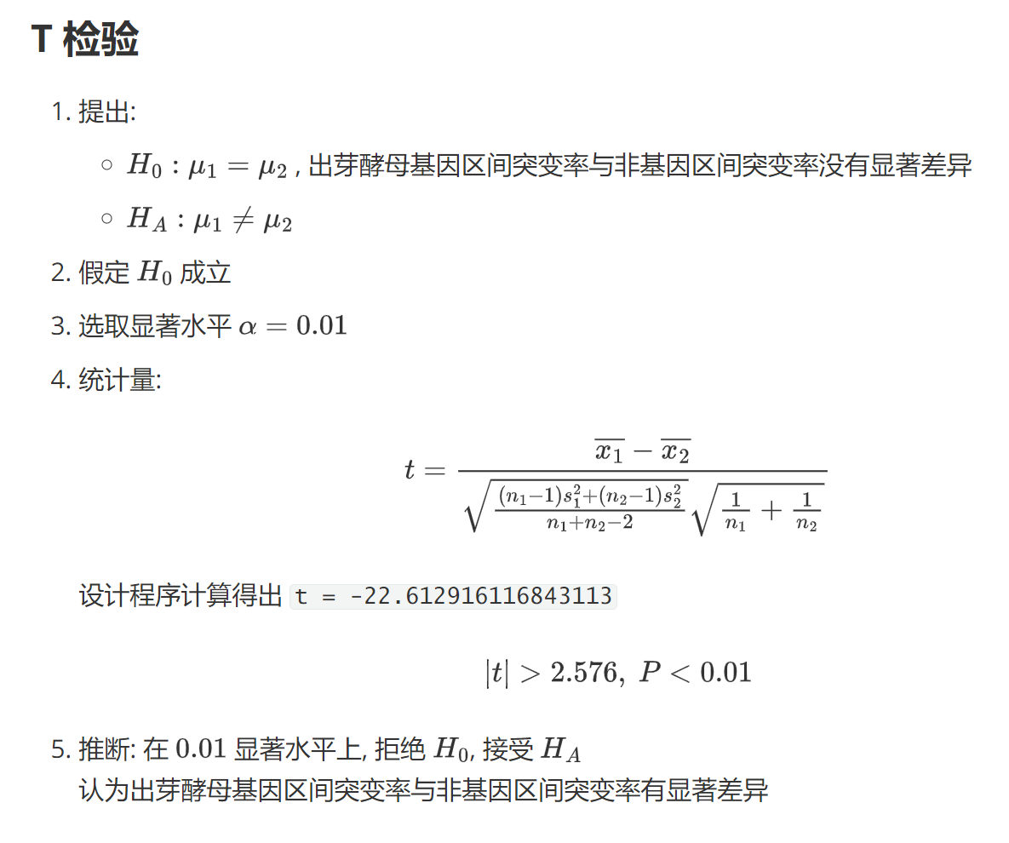

Slide 16
2.突变方向的差异性
修改实体类
public class Information { private String chromosomeId; private String type; private Integer startPos; private Integer endPos; private Integer mutationNum; private Double mutationRate; private Integer AGNum; private Integer ACNum; private Integer ATNum; private Integer GANum; private Integer GCNum; private Integer GTNum; private Integer CANum; private Integer CGNum; private Integer CTNum; private Integer TANum; private Integer TGNum; private Integer TCNum;

Slide 17
算法设计
获取基因突变方向及突变数
void classify(Information gene, Mutation mutation) { if (mutation.getChromosomeId().equals(gene.getChromosomeId()) && mutation.getChromosomePos() >= gene.getStartPos() && mutation.getChromosomePos() <= gene.getEndPos()) { if (mutation.getType().startsWith("AT")) { gene.setATNum(gene.getATNum() + 1); } else if (mutation.getType().startsWith("AG")) { gene.setAGNum(gene.getAGNum() + 1); } else if (mutation.getType().startsWith("AC")) { gene.setACNum(gene.getACNum() + 1); } else if (mutation.getType().startsWith("TA")) { gene.setTANum(gene.getTANum() + 1); } else if (mutation.getType().startsWith("TG")) { gene.setTGNum(gene.getTGNum() + 1); } else if (mutation.getType().startsWith("TC")) { gene.setTCNum(gene.getTCNum() + 1); } else if (mutation.getType().startsWith("GA")) { gene.setGANum(gene.getGANum() + 1); } else if (mutation.getType().startsWith("GT")) { gene.setGTNum(gene.getGTNum() + 1); } else if (mutation.getType().startsWith("GC")) { gene.setGCNum(gene.getGCNum() + 1); } else if (mutation.getType().startsWith("CA")) { gene.setCANum(gene.getCANum() + 1); } else if (mutation.getType().startsWith("CT")) { gene.setCTNum(gene.getCTNum() + 1); } else if (mutation.getType().startsWith("CG")) { gene.setCGNum(gene.getCGNum() + 1); } } }

Slide 18
算法设计
/** * t检验 * * @param genes 基因序列数据 * @param nonGenes 非基因序列数据 * @param flag 需要计算的突变类型 “AG” 表示由 A 突变为 G * @return */ double tTest(List<Information> genes, List<Information> nonGenes, String flag) { List<Double> geneRate = rate(genes, flag); List<Double> nonGeneRate = rate(nonGenes, flag); double geneMutRateMean = 0.0; double nonGeneMutRateMean = 0.0; double geneSum = 0.0; double nonGeneSum = 0.0; double geneVariance = 0.0; double nonGeneVariance = 0.0; double t = 0.0; geneMutRateMean = mean(geneRate); nonGeneMutRateMean = mean(nonGeneRate); geneSum = (double) genes.size(); nonGeneSum = (double) nonGenes.size(); geneVariance = variance(geneRate, geneMutRateMean); nonGeneVariance = variance(nonGeneRate, nonGeneMutRateMean); t = (geneMutRateMean - nonGeneMutRateMean) / (sqrt((((geneSum - 1) * geneVariance) + ((nonGeneSum - 1) * nonGeneVariance)) / (geneSum + nonGeneSum - 2)) * sqrt((1 / geneSum) + (1 / nonGeneSum))); System.out.println("gene mean is " + geneMutRateMean); System.out.println("non gene mean is " + nonGeneMutRateMean); return t; }
t 检验算法

Slide 19
算法设计
u 检验算法
/** * u检验 * * @param genes 基因序列数据 * @param nonGenes 非基因序列数据 * @param flag 需要计算的突变类型 “AG” 表示由 A 突变为 G * @return */ double uTest(List<Information> genes, List<Information> nonGenes, String flag) { List<Double> geneRate = rate(genes, flag); List<Double> nonGeneRate = rate(nonGenes, flag); double geneMutRateMean = 0.0; double nonGeneMutRateMean = 0.0; double geneSum = 0.0; double nonGeneSum = 0.0; double geneVariance = 0.0; double nonGeneVariance = 0.0; double u = 0.0; geneMutRateMean = mean(geneRate); nonGeneMutRateMean = mean(nonGeneRate); geneSum = (double) genes.size(); nonGeneSum = (double) nonGenes.size(); geneVariance = variance(geneRate, geneMutRateMean); nonGeneVariance = variance(nonGeneRate, nonGeneMutRateMean); u = (geneMutRateMean - nonGeneMutRateMean) / (sqrt((geneVariance / geneSum) + (nonGeneVariance / nonGeneSum))); return u; }

Slide 20
辅助算法
/** * 由原始数据计算突变率 * * @param information 输入的序列 * @param flag 需要计算的突变类型 “AG” 表示由 A 突变为 G * @return 返回突变率集合 */ List<Double> rate(List<Information> information, String flag) { int num = 0; int length = 0; List<Double> rates = new ArrayList<>(); for (int i = 0; i < information.size(); i++) { length = information.get(i).getEndPos() - information.get(i).getStartPos() + 1; if ("AT".equals(flag)) { num = information.get(i).getATNum(); } else if ("AG".equals(flag)) { num = information.get(i).getAGNum(); } else if ("AC".equals(flag)) { num = information.get(i).getACNum(); } else if ("TA".equals(flag)) { num = information.get(i).getTANum(); } else if ("TG".equals(flag)) { num = information.get(i).getTGNum(); } else if ("TC".equals(flag)) { num = information.get(i).getTCNum(); } else if ("GA".equals(flag)) { num = information.get(i).getGANum(); } else if ("GT".equals(flag)) { num = information.get(i).getGTNum(); } else if ("GC".equals(flag)) { num = information.get(i).getGCNum(); } else if ("CA".equals(flag)) { num = information.get(i).getACNum(); } else if ("CT".equals(flag)) { num = information.get(i).getCTNum(); } else if ("CG".equals(flag)) { num = information.get(i).getCGNum(); } rates.add((double) num / (double) length); } return rates; }
以下方法在 t/u 检验方法中被调用
计算突变率
通过此方法可以获取突变率集合

Slide 21
辅助算法
计算突变率均值
/** * 计算突变率均值 * * @param rates 突变率集合 * @return 返回均值 */ double mean(List<Double> rates) { double sum = 0.0; for (int i = 0; i < rates.size(); i++) { //Double是引用数据类型 此处 if 语句用于防止自动装箱时产生误差 if (rates.get(i) > 0.0) { sum += rates.get(i); } } return sum / rates.size(); }

Slide 22
辅助算法
计算方差
/** * 计算方差 * * @param rates 突变率集合 * @param mean 突变率均值 * @return 返回方差 */ double variance(List<Double> rates, double mean) { double sum = 0.0; for (int i = 0; i < rates.size(); i++) { //Double是引用数据类型 此处 if 语句用于防止自动装箱时产生误差 if (rates.get(i) > 0.0) { sum += pow((rates.get(i) - mean), (double) 2); } } return sum / (rates.size() - 1); }

Slide 23
假设检验
主程序
@Test public void mutationTest() throws IOException { InputStream inputStream = Resources.getResourceAsStream("mybatis-config.xml"); SqlSessionFactoryBuilder sqlSessionFactoryBuilder = new SqlSessionFactoryBuilder(); SqlSessionFactory sqlSessionFactory = sqlSessionFactoryBuilder.build(inputStream); SqlSession sqlSession = sqlSessionFactory.openSession(); InformationMapper informationMapper = sqlSession.getMapper(InformationMapper.class); MutationMapper mutationMapper = sqlSession.getMapper(MutationMapper.class); List<Information> genes = informationMapper.getGenes(); List<Information> nonGenes = informationMapper.getNonGenes();

Slide 24
假设检验
System.out.println("------------------------------------"); System.out.println("AC: t is " + tTest(genes, nonGenes, "AC")); System.out.println("------------------------------------"); System.out.println("AT: t is " + tTest(genes, nonGenes, "AT")); System.out.println("------------------------------------"); System.out.println("GA: t is " + tTest(genes, nonGenes, "GA")); System.out.println("------------------------------------"); System.out.println("GC: t is " + tTest(genes, nonGenes, "GC")); System.out.println("------------------------------------"); System.out.println("GT: t is " + tTest(genes, nonGenes, "GT")); System.out.println("------------------------------------"); System.out.println("CA: t is " + tTest(genes, nonGenes, "CA")); System.out.println("------------------------------------"); System.out.println("CG: t is " + tTest(genes, nonGenes, "CG")); System.out.println("------------------------------------"); System.out.println("CT: t is " + tTest(genes, nonGenes, "CT")); System.out.println("------------------------------------"); System.out.println("TA: t is " + tTest(genes, nonGenes, "TA")); System.out.println(); System.out.println(); System.out.println("------------------------------------"); System.out.println("AC: u is " + uTest(genes, nonGenes, "AC")); System.out.println("-----------------------------------"); System.out.println("AT: u is " + uTest(genes, nonGenes, "AT")); System.out.println("-----------------------------------"); System.out.println("GA: u is " + uTest(genes, nonGenes, "GA")); System.out.println("-----------------------------------"); System.out.println("GC: u is " + uTest(genes, nonGenes, "GC")); System.out.println("-----------------------------------"); System.out.println("GT: u is " + uTest(genes, nonGenes, "GT")); System.out.println("-----------------------------------"); System.out.println("CA: u is " + uTest(genes, nonGenes, "CA")); System.out.println("-----------------------------------"); System.out.println("CG: u is " + uTest(genes, nonGenes, "CG")); System.out.println("----------------------------------"); System.out.println("CT: u is " + uTest(genes, nonGenes, "CT")); System.out.println("-----------------------------------"); System.out.println("TA: u is " + uTest(genes, nonGenes, "TA")); }
主程序
续

Slide 25
输出结果
t test:
u test:
------------------------------------
AC: t is -12.737652036387919
------------------------------------
AT: t is -21.419035715474898
------------------------------------
GA: t is -2.4649230471397994
------------------------------------
GC: t is -8.191668558555735
------------------------------------
GT: t is -13.803584880399859
------------------------------------
CA: t is -12.737652036387919
------------------------------------
CG: t is -5.413376607132111
------------------------------------
CT: t is -5.337783238152486
------------------------------------
TA: t is -19.556575936619616
------------------------------------
AC: u is -12.737652036387919
-----------------------------------
AT: u is -21.419035715474898
-----------------------------------
GA: u is -2.4649230471397994
-----------------------------------
GC: u is -8.191668558555735
-----------------------------------
GT: u is -13.80358488039986
-----------------------------------
CA: u is -12.737652036387919
-----------------------------------
CG: u is -5.413376607132111
----------------------------------
CT: u is -5.337783238152486
-----------------------------------
TA: u is -19.556575936619616

Slide 26
生物学意义
根据假设检验结果:
基因序列和非基因序列突变率存在显著差异
不同突变方向在基因序列和非基因序列之间存在显著差异
不同突变方向之间部分存在显著差异

Slide 27
源代码
GitHub: Bluuur/BiostaticsProject1: 生物统计学课程项目1 (github.com)
同步至 Gitee: BiostaticsProject1: 生物统计学课程项目1 (gitee.com)
实验报告
GitHub: MarkdownNotes/Biostatics at main · Bluuur/MarkdownNotes (github.com)
同步至 Gitee: Biostatics · blur/MarkdownNotes - 码云 - 开源中国 (gitee.com)

