Slide 1
Data Glacier Data Report
blaisepke@gmail.com

Slide 2
Problem Statement
XYZ is a private firm in US. Due to remarkable growth in the Cab Industry in last few years and multiple key players in the market, it is planning for an investment in Cab industry and as per their Go-to-Market(G2M) strategy they want to understand the market before taking final decision.

Slide 3
DATA INTAKE
With an initial look at the data we have 7 columns and 359,392 records.
The 7 columns are:
Transaction ID: This is a unique identification for every transaction by a taxi.
Date of Travel: The date of travel is meant to indicate the date of the transaction/ trip
Company: This column specifies the cab company that the transaction belongs to, there are two columns the Pink and Yellow Cab company
City: This column gives information of the location of the transaction
KM Travelled: This captures the number of KM the trip covered
Price Charged: This is the total price that was due by the cutomer who took the taxi
Cost of Trip: The cost of the trip is the amount the tip cost the cab company.

Slide 4
ASSUMPTIONS
Assuming the start date of collecting the data is 1-1-2016 and the end was 30-12-2018.
The outliers are to kept as they help understand cab trips/transactions
There are no other cab companies in the mentioned states
The difference between the cost of the trip and the price charged is the profit; a negative profit is considered a loss
In the day_week 0 is Monday through to 6 which is Sunday
Each user uses only a single account (User ID)

Slide 5
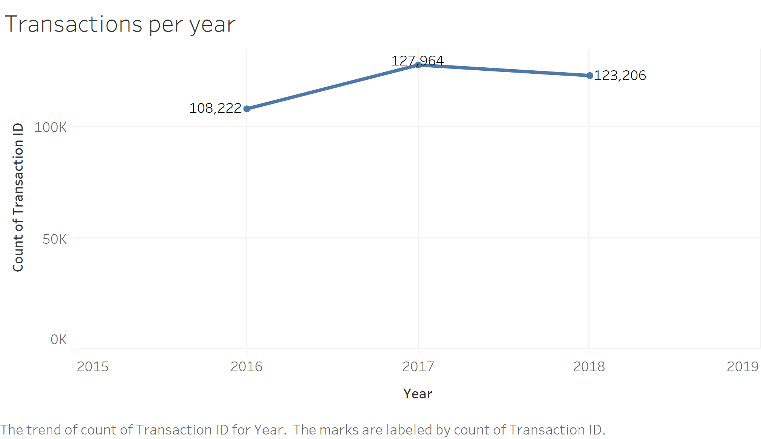
The cab industry saw an increase in number of rides from the year 2016 to 2017. This however, slightly dropped in the year 2018.

Slide 6
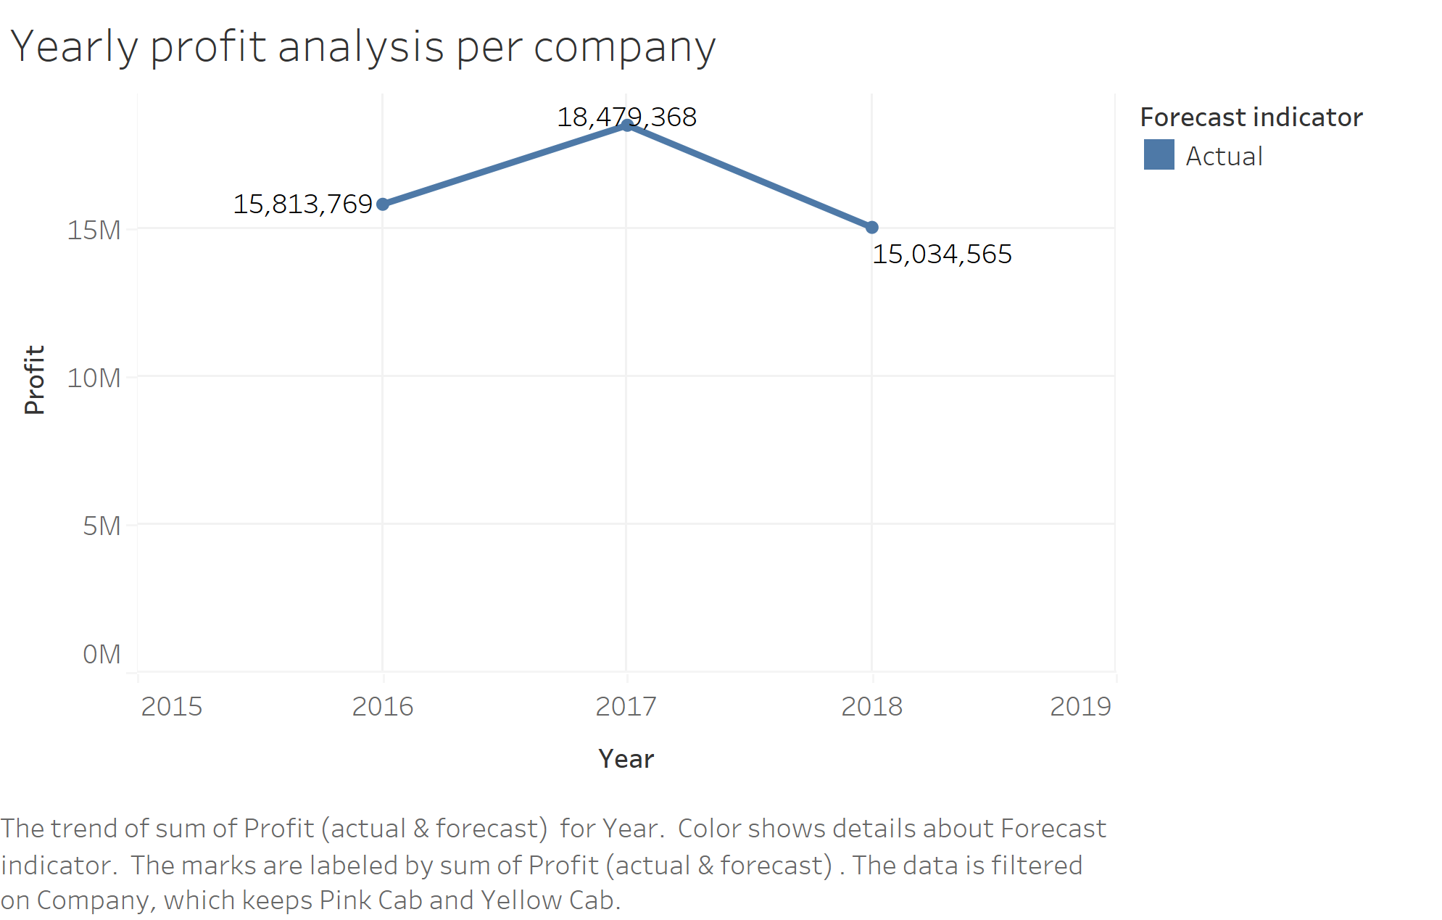
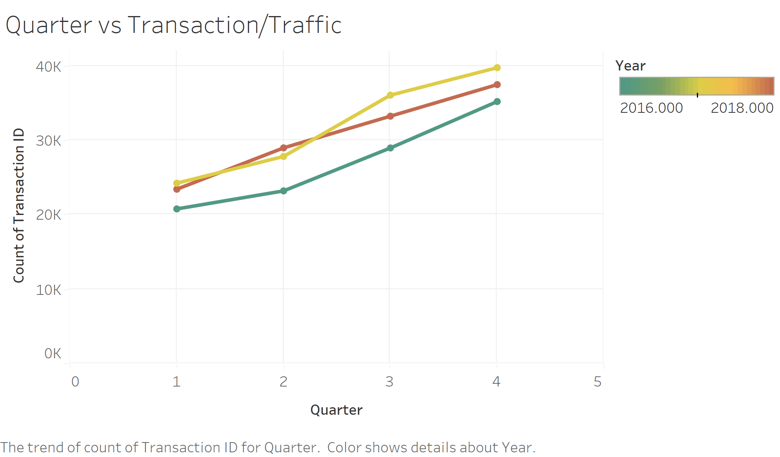
CAB Industry Analysis
The year 2018 saw the lowest profit gain in the cab industry in the past three years with 2017 being the most profitable with a margin of over $2 million from 2018.
This could probably be to the rise of cab applications such as uber in the year 2018. Which had a huge impact on other cab companies
The cab industry experience a gradual increase in users as the quarters progress. The fourth quarter sees the highest usage of the cabs in every year

Slide 7
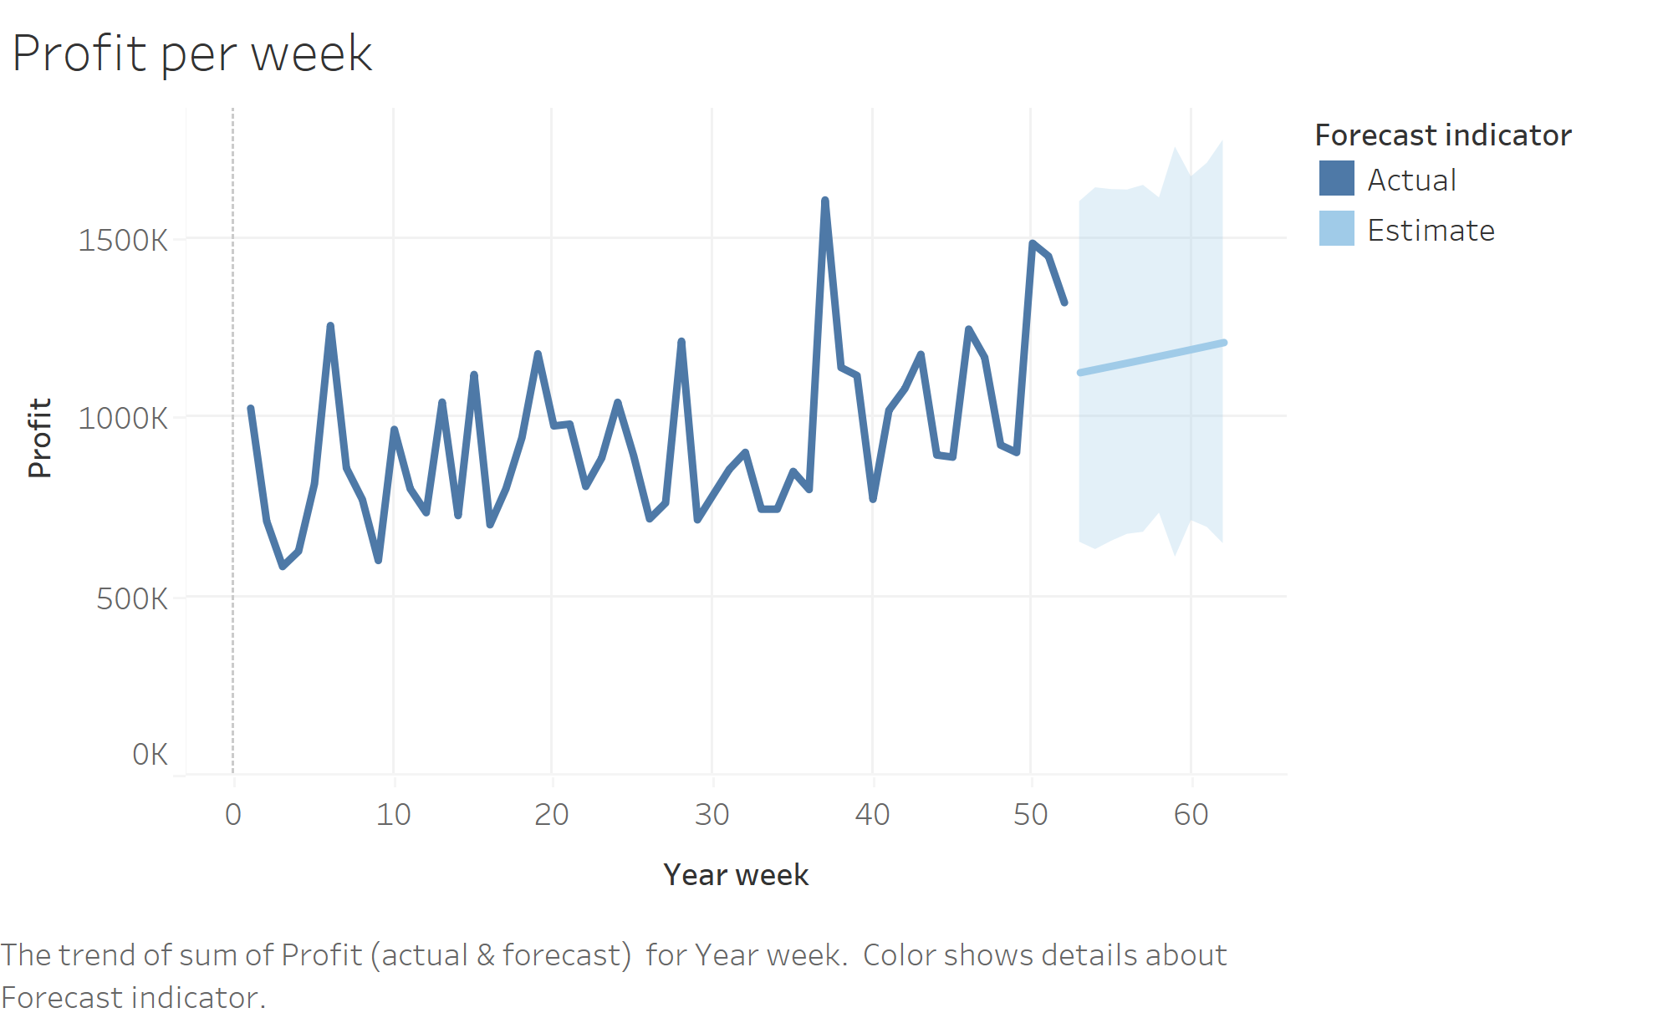
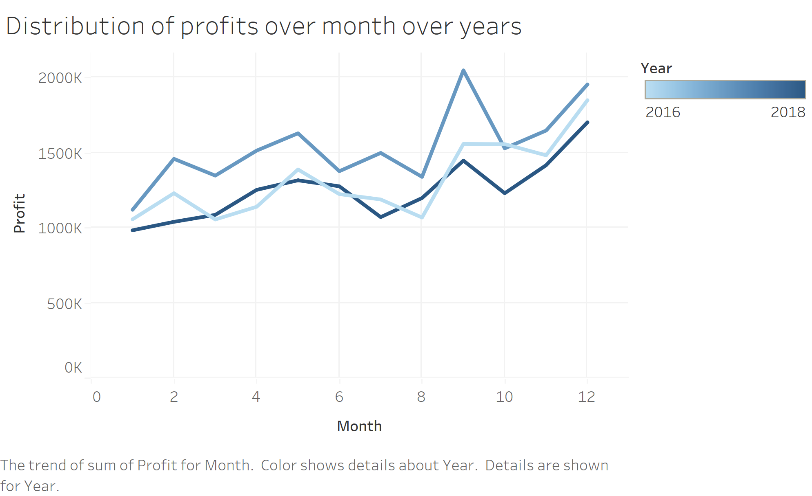
CAB Industry Analysis
The industry sees peak profit in week 37 of the year.
Week 37 is early September in the years. This can be due to it being the last few weeks of summer and lots of travelling happens then
With the same analysis we do see that September is the most profitable month, accredited to the summer holidays which generate profit for the cab company

Slide 8
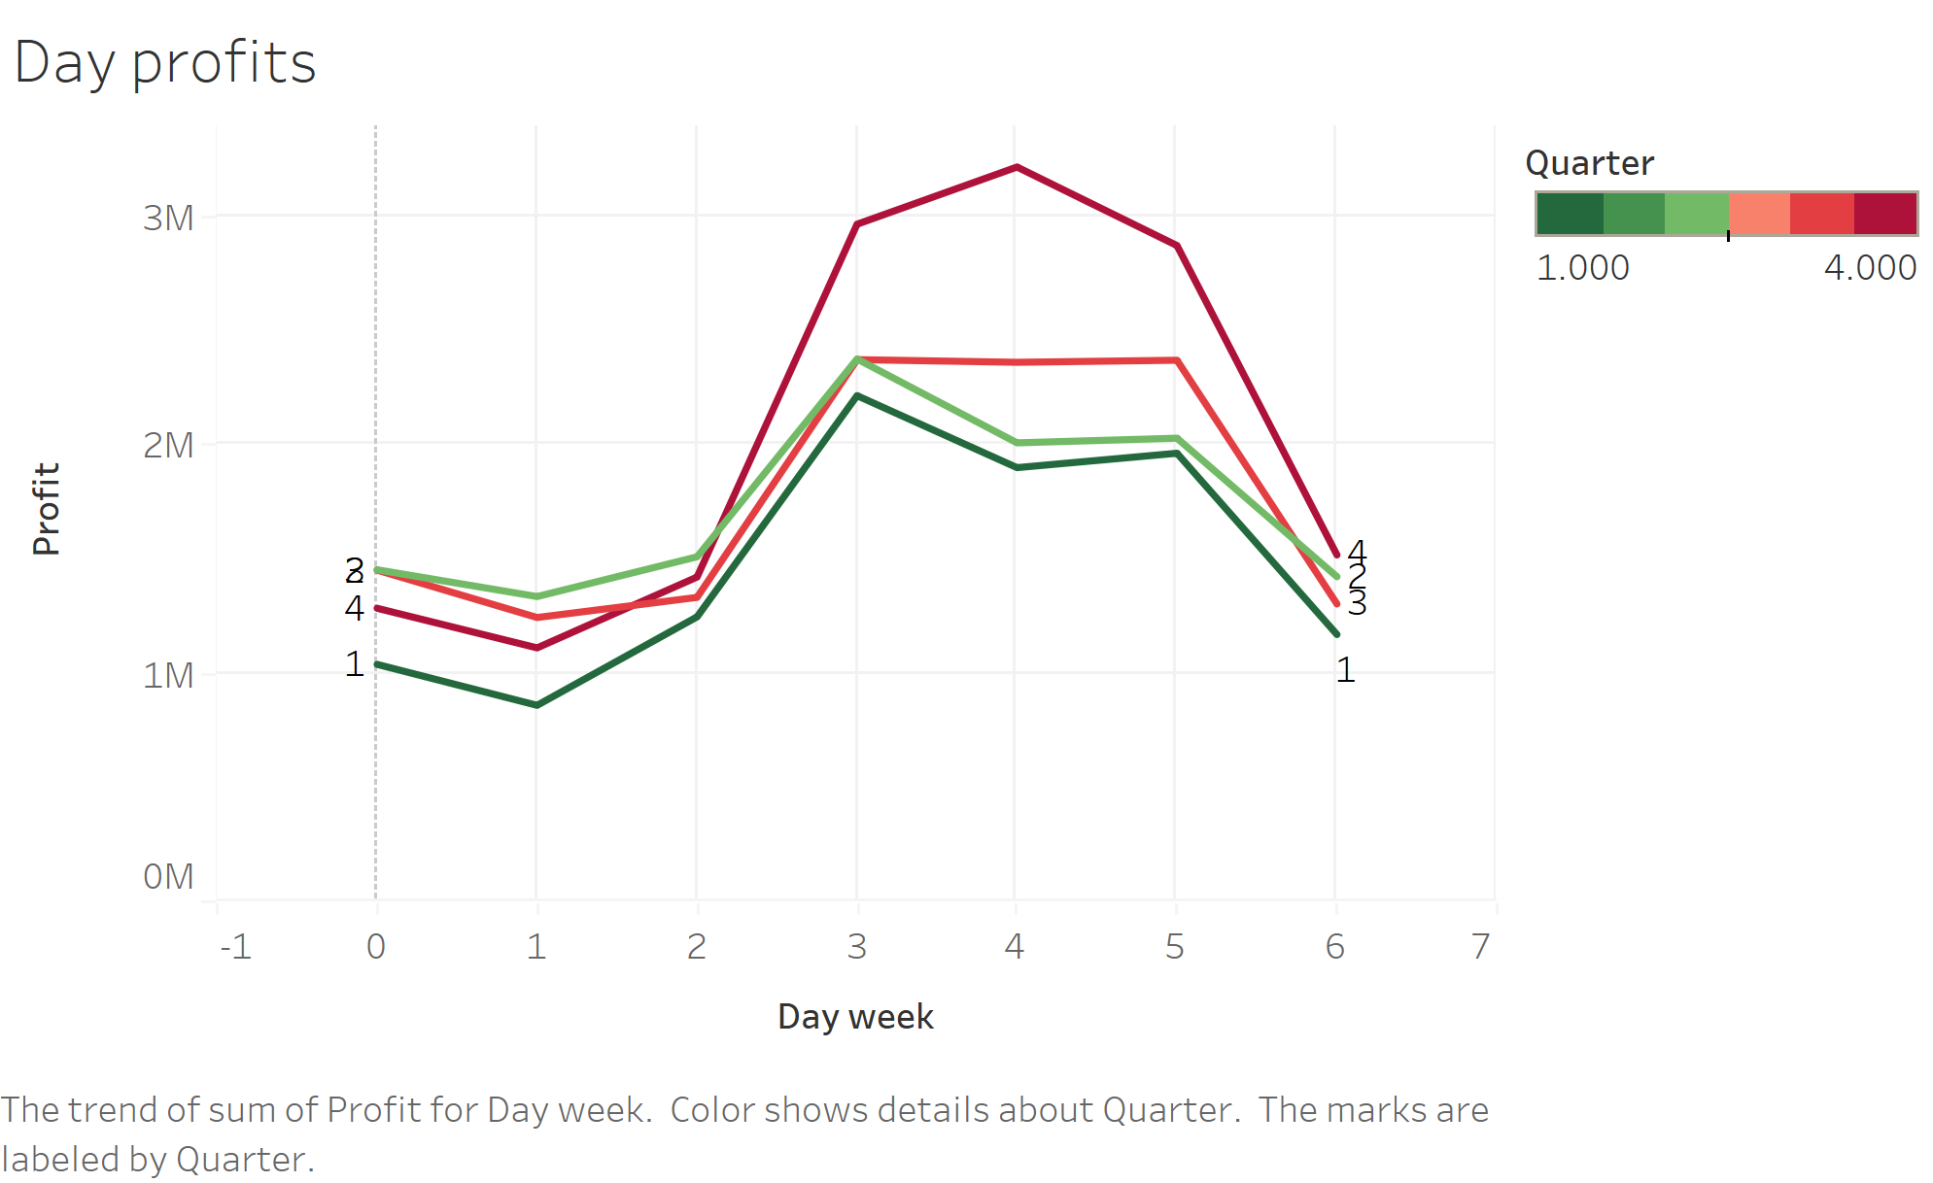
CAB Data Anlaysis
The cab industry generates most profit mid week with spikes witnessed in the fourth quarter of the year.

Slide 9
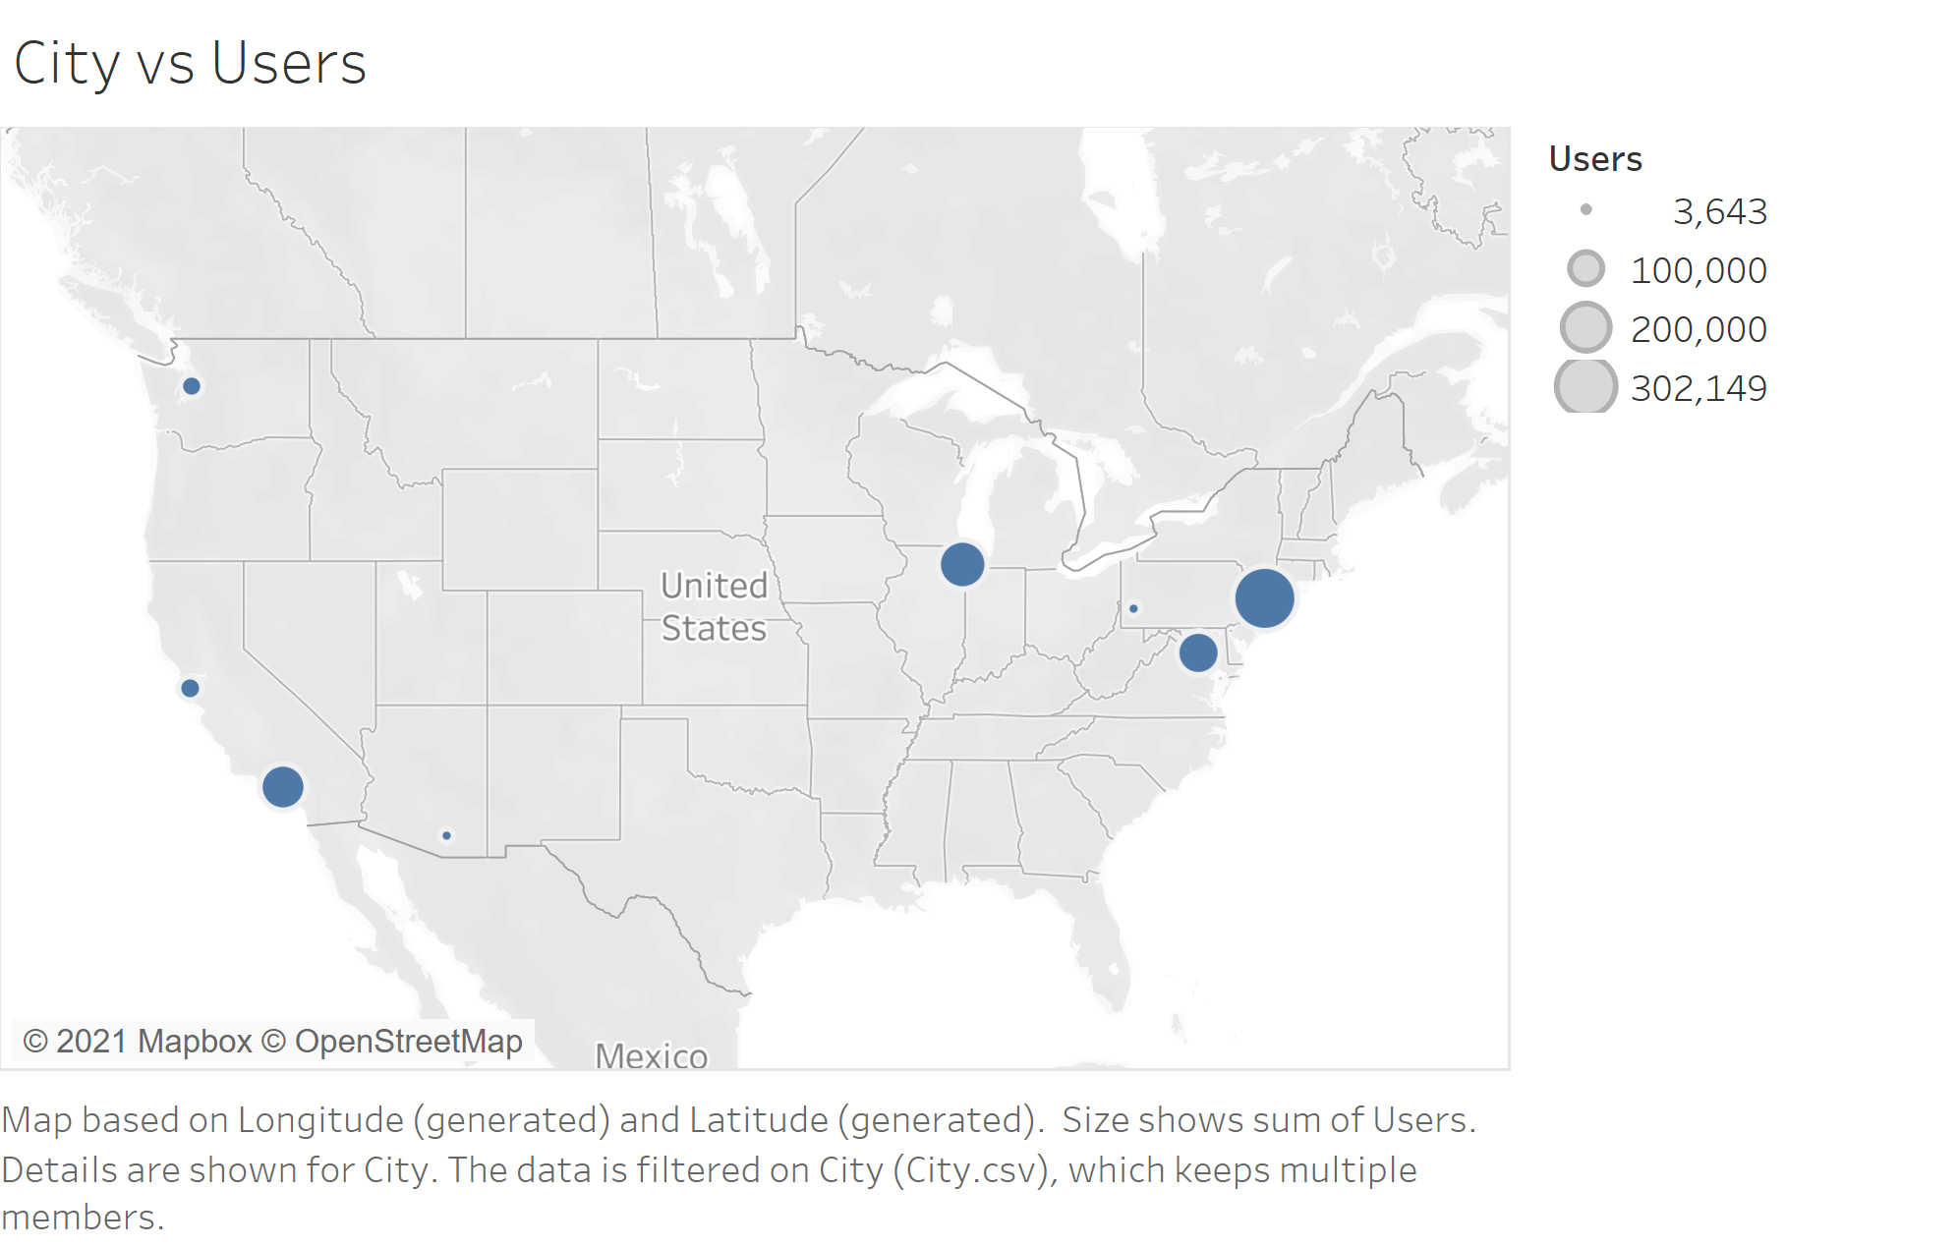
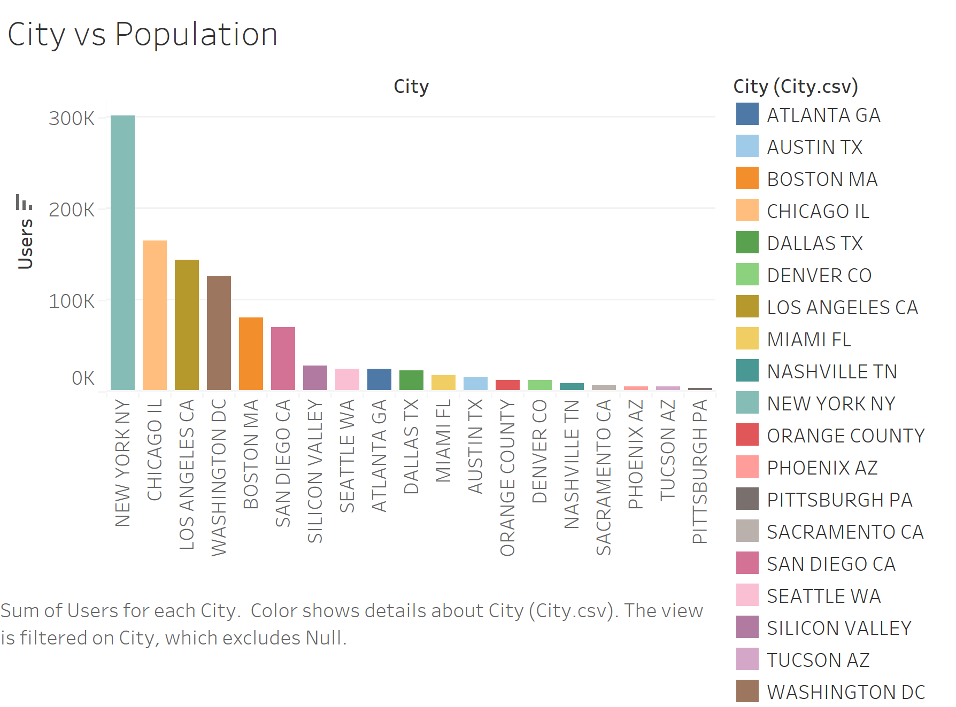
User Analysis

Slide 10
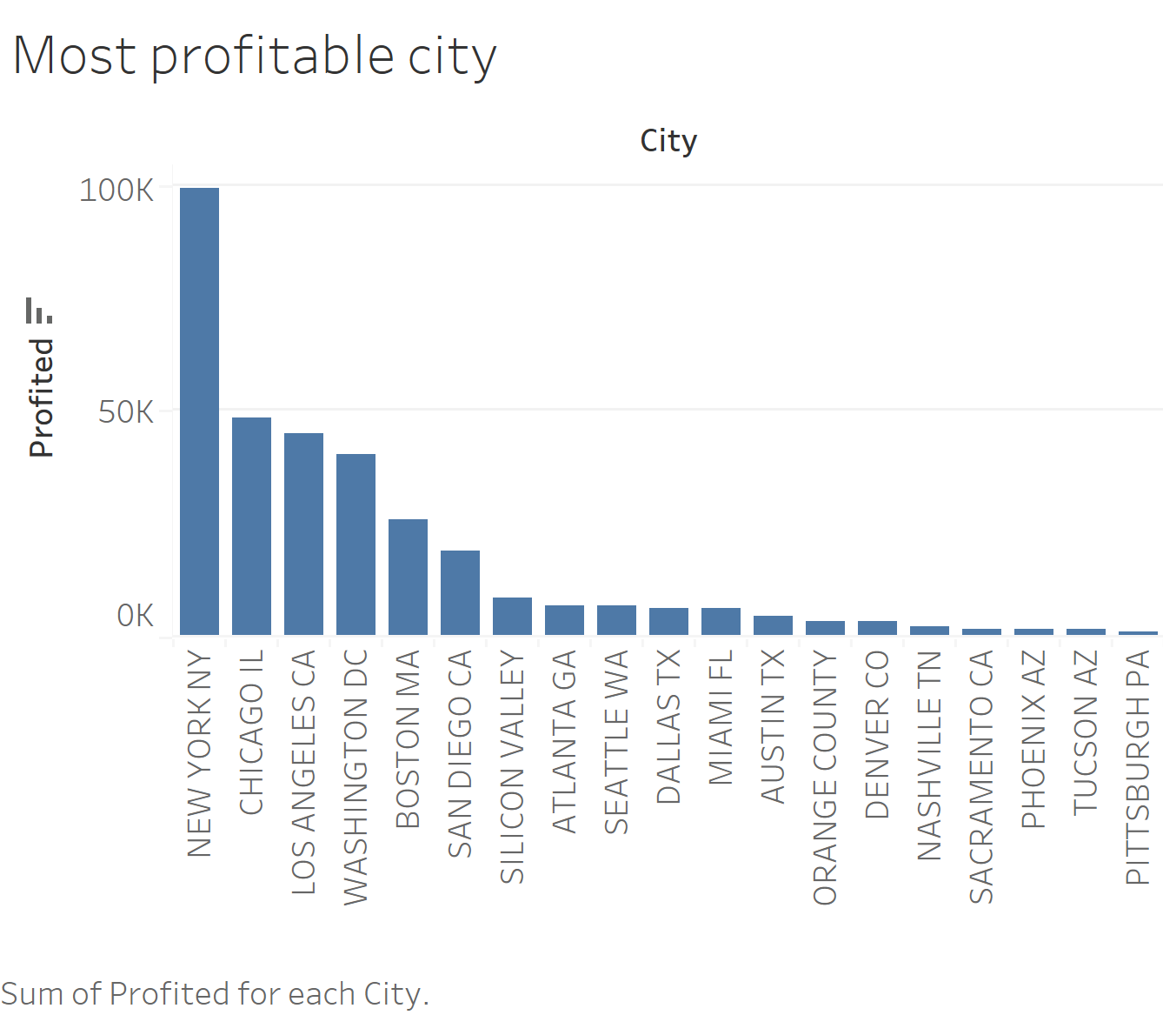
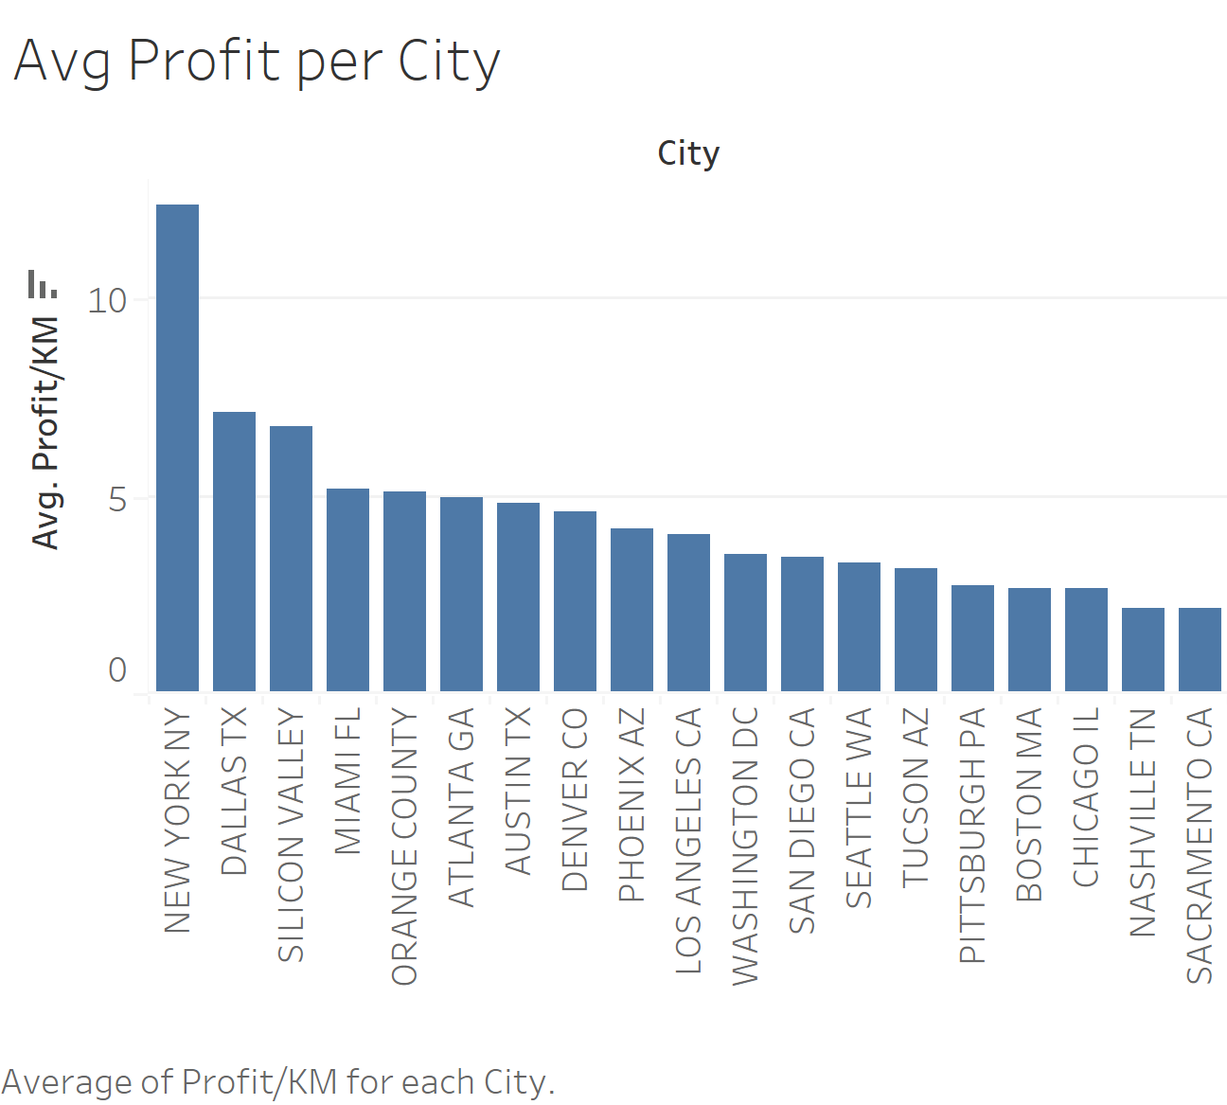
New York city tops the list with it being the most profitable city with the cab companies, silicon valley is also an area of interest that brings great revenue to the cab companies

Slide 11
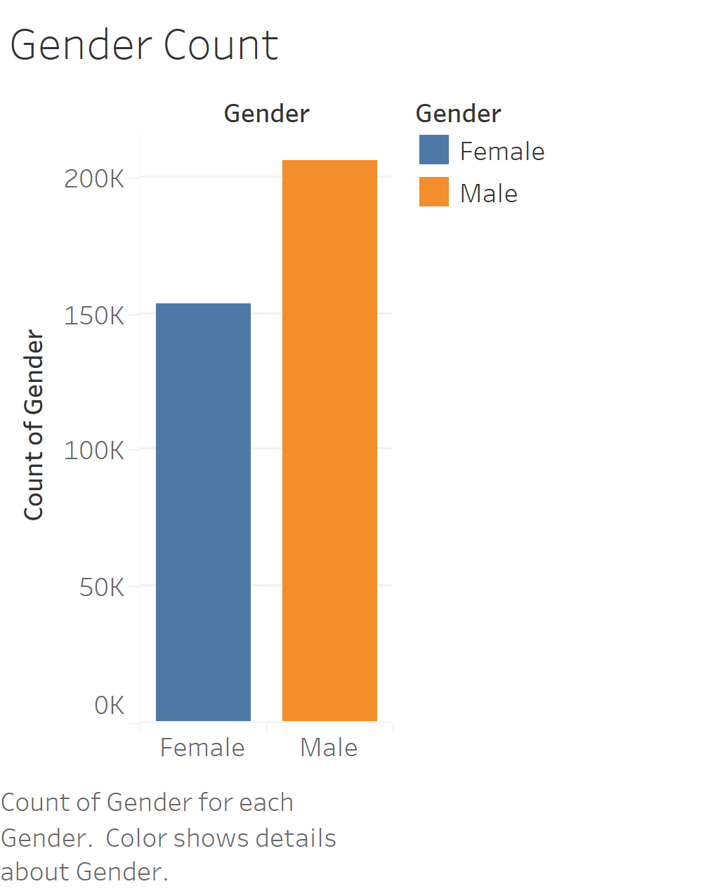
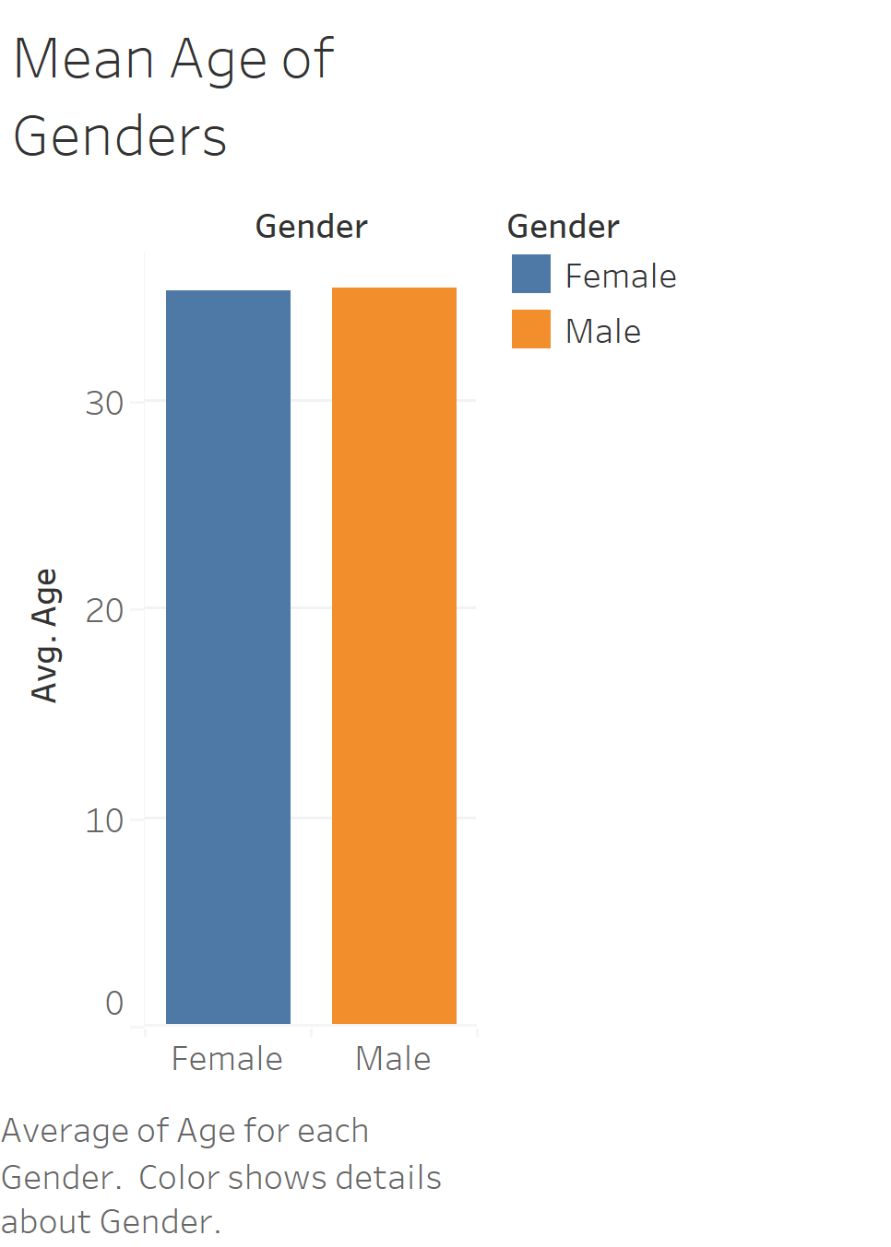
Cab Industry Analysis
The industry saw more males use cab services than females in the past three years with a deficit of roughly 50,000 more men using the service than women.

Slide 12
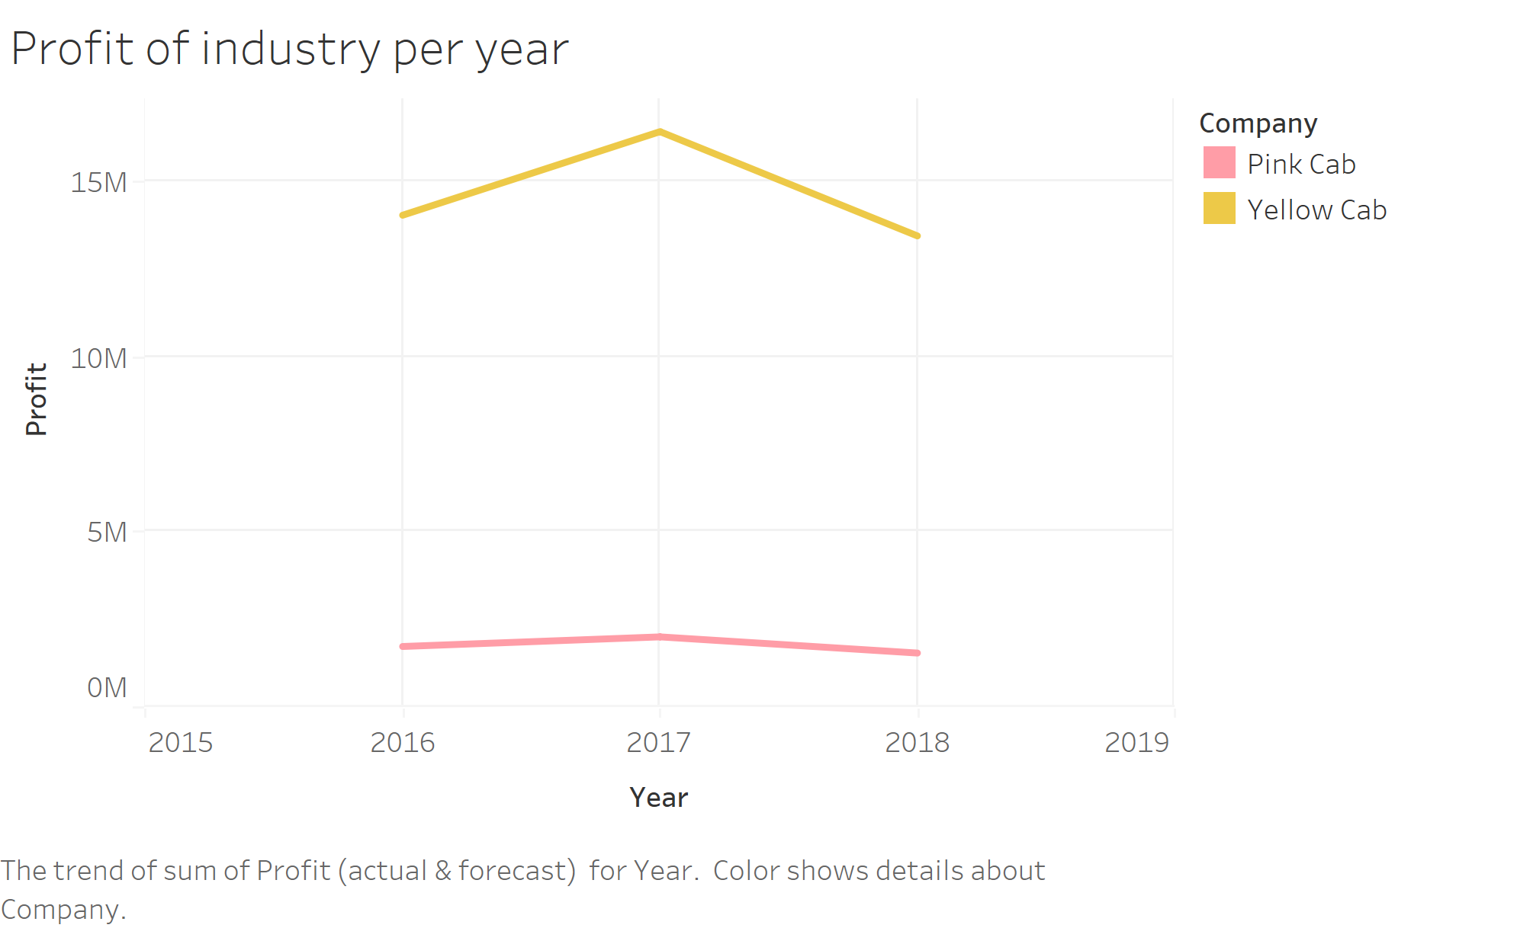
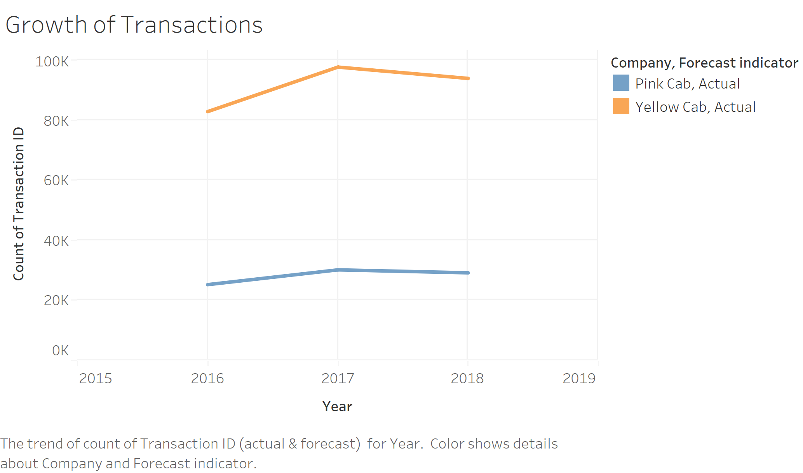
Company Analysis
The pink cab company has had a rather steady two years with having steady profit changes.
The yellow cab company was however heavily impacted in the year 2017-2018 and had a major drop in profit
Just like the industry the two cab companies experienced similar effect on the number of transactions/trips they had over the past three years.

Slide 13
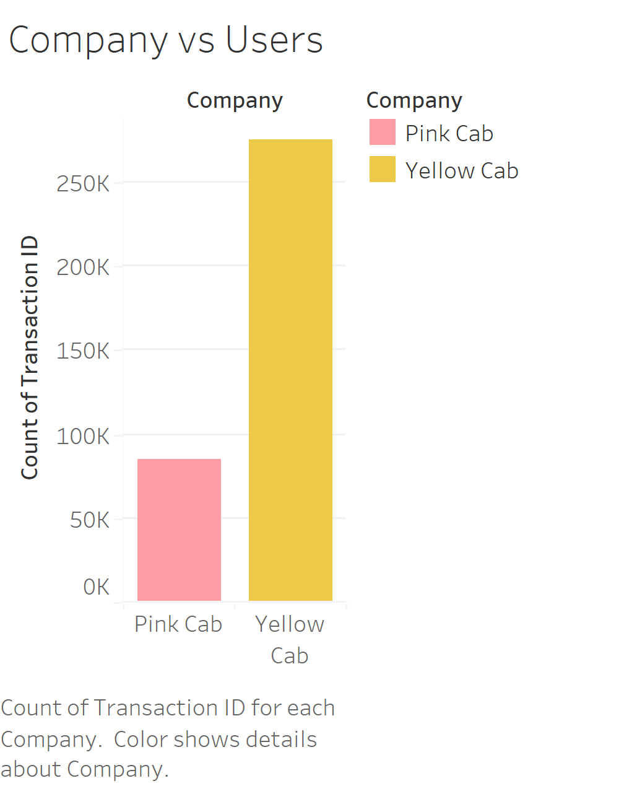
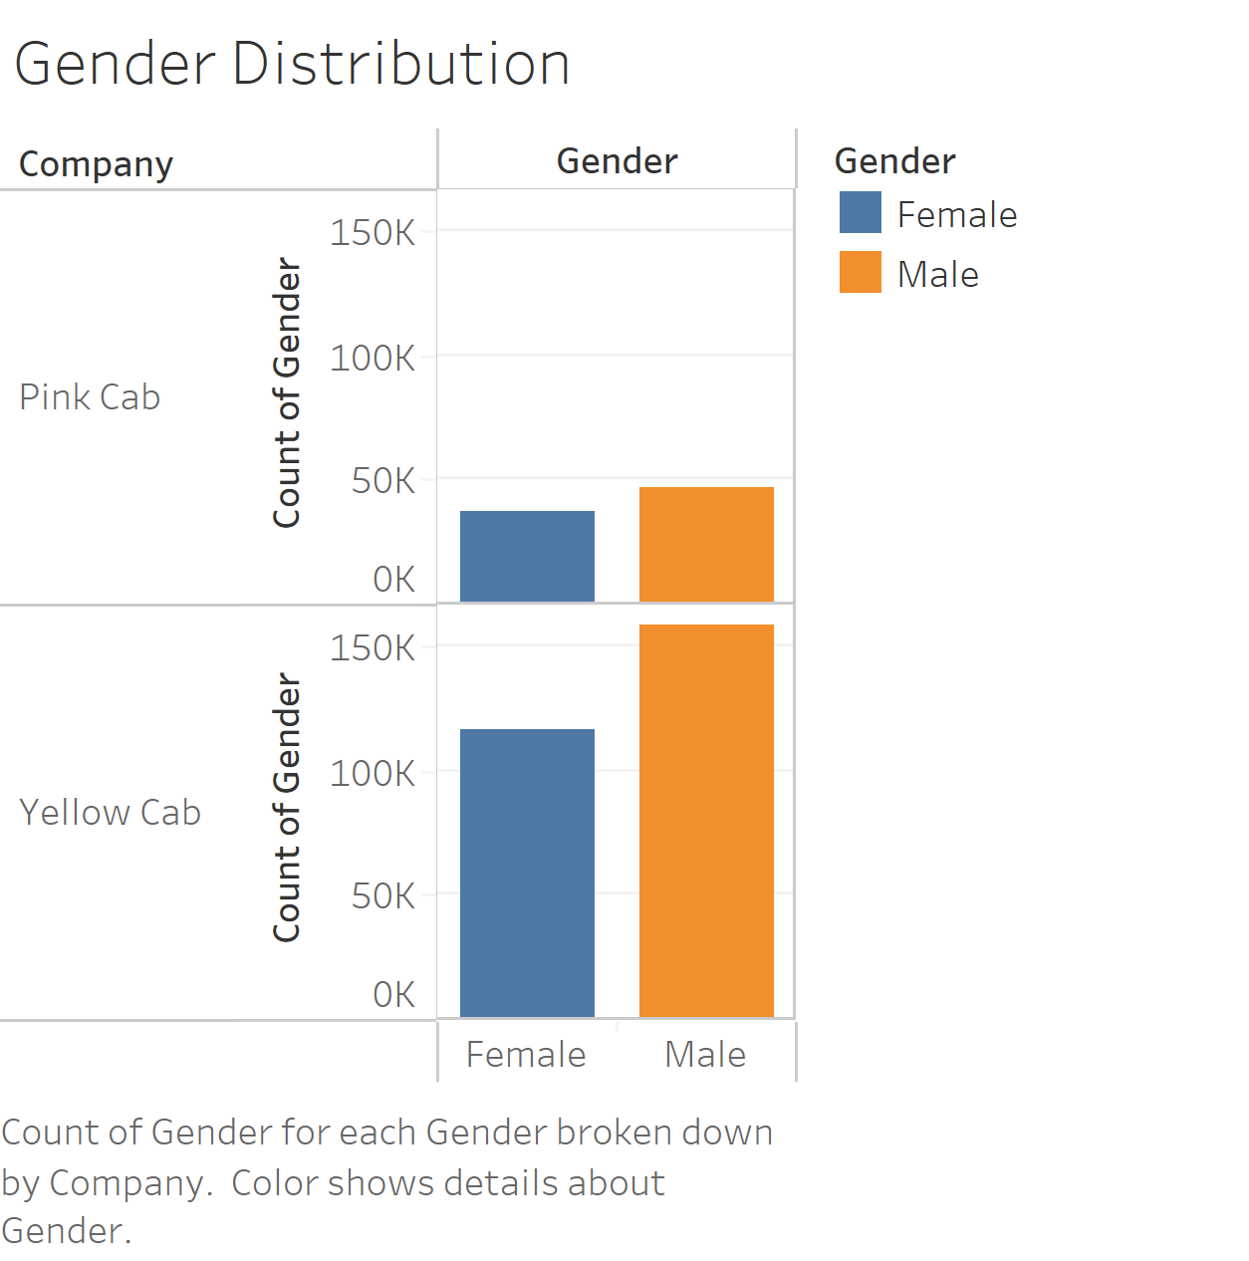
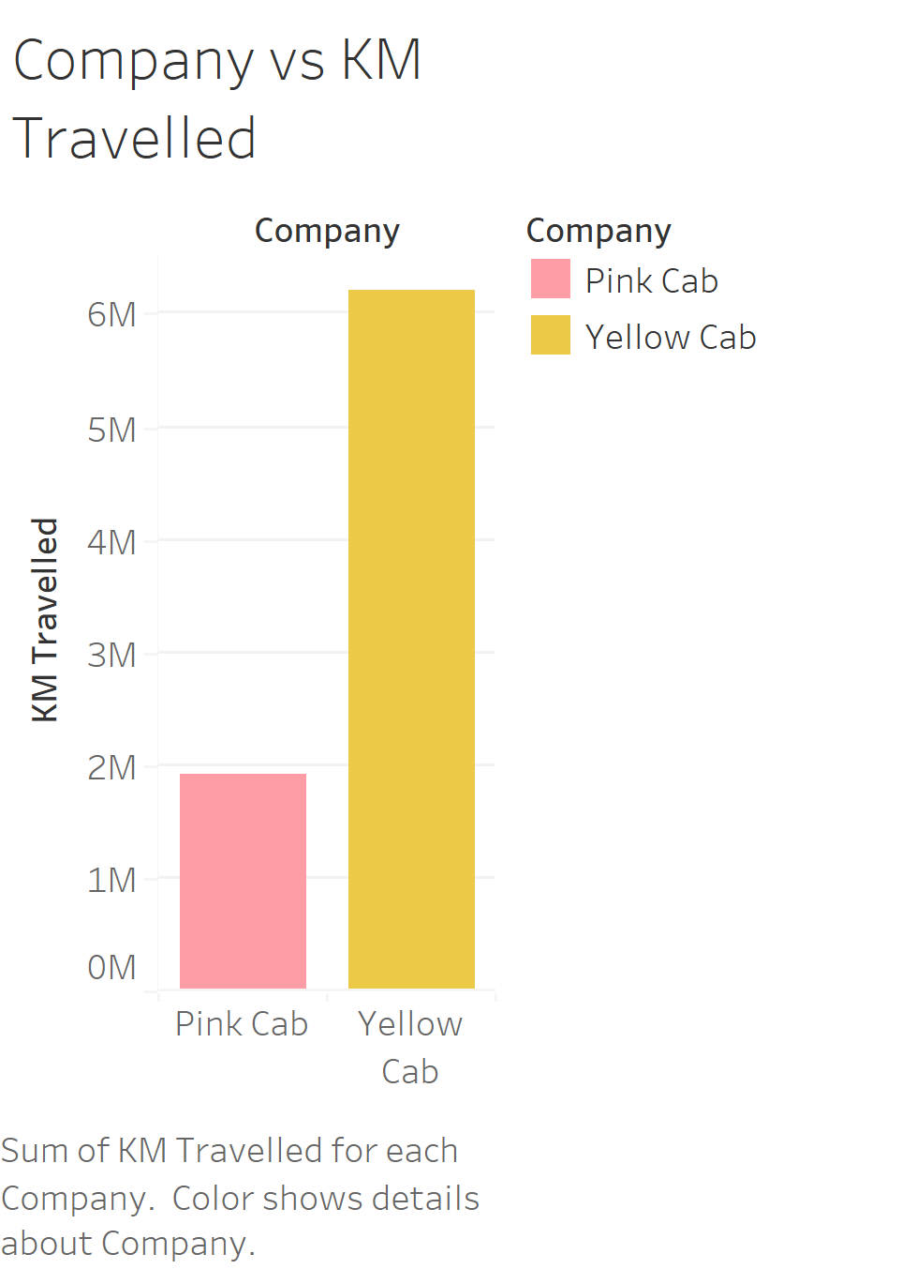
This shows the number of active users per company.
The yellow company had a significantly more userbase as compared to the pink company

Slide 14
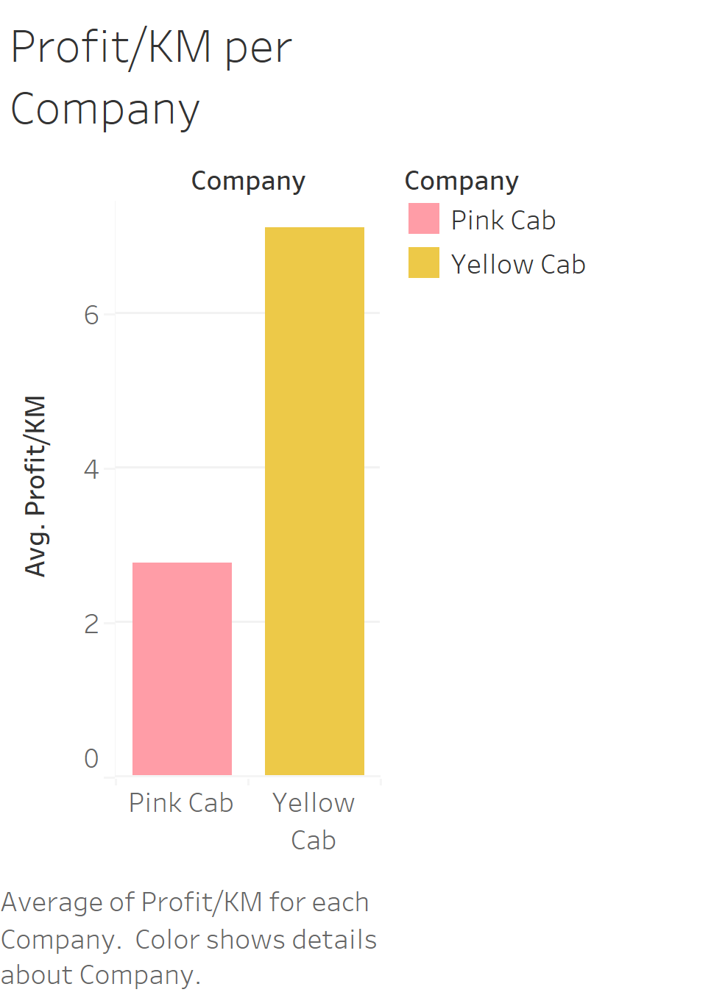
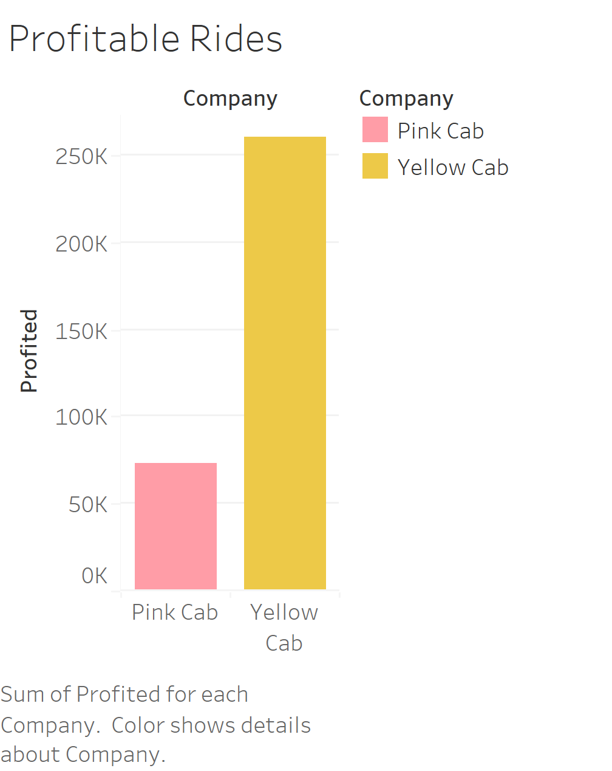
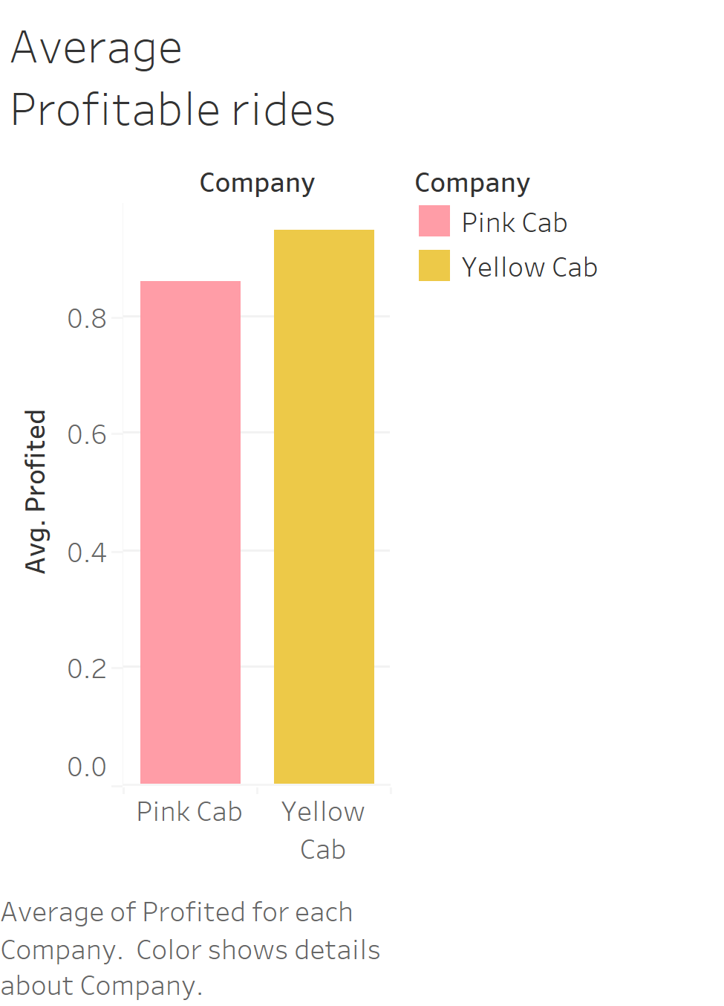
This is calculated by calculating how many rides on average result in a profit for the company.
The yellow cab company appears to have dominated the industry in various sectors including profit/km , average profitable rides and number of profitable rides when compared to the pink yellow cab company

Slide 15
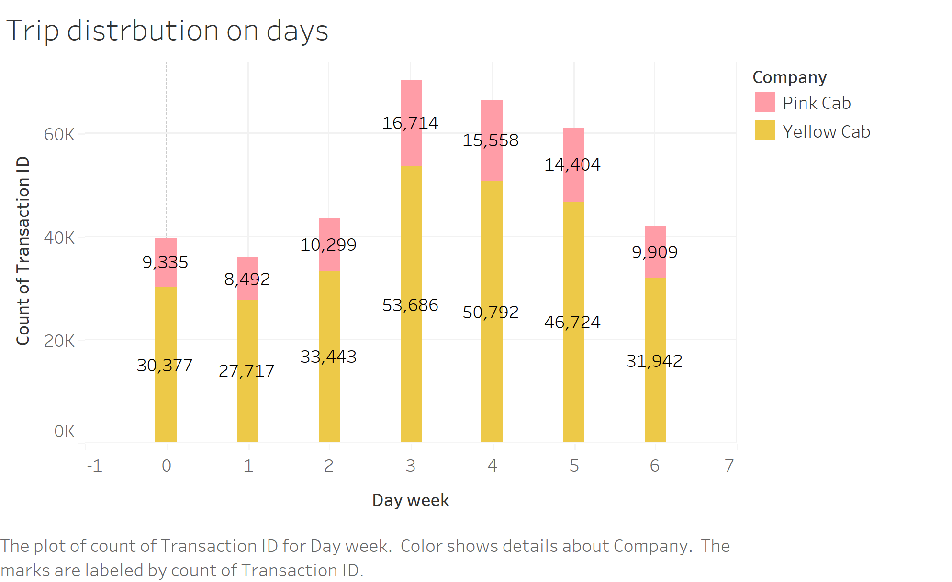
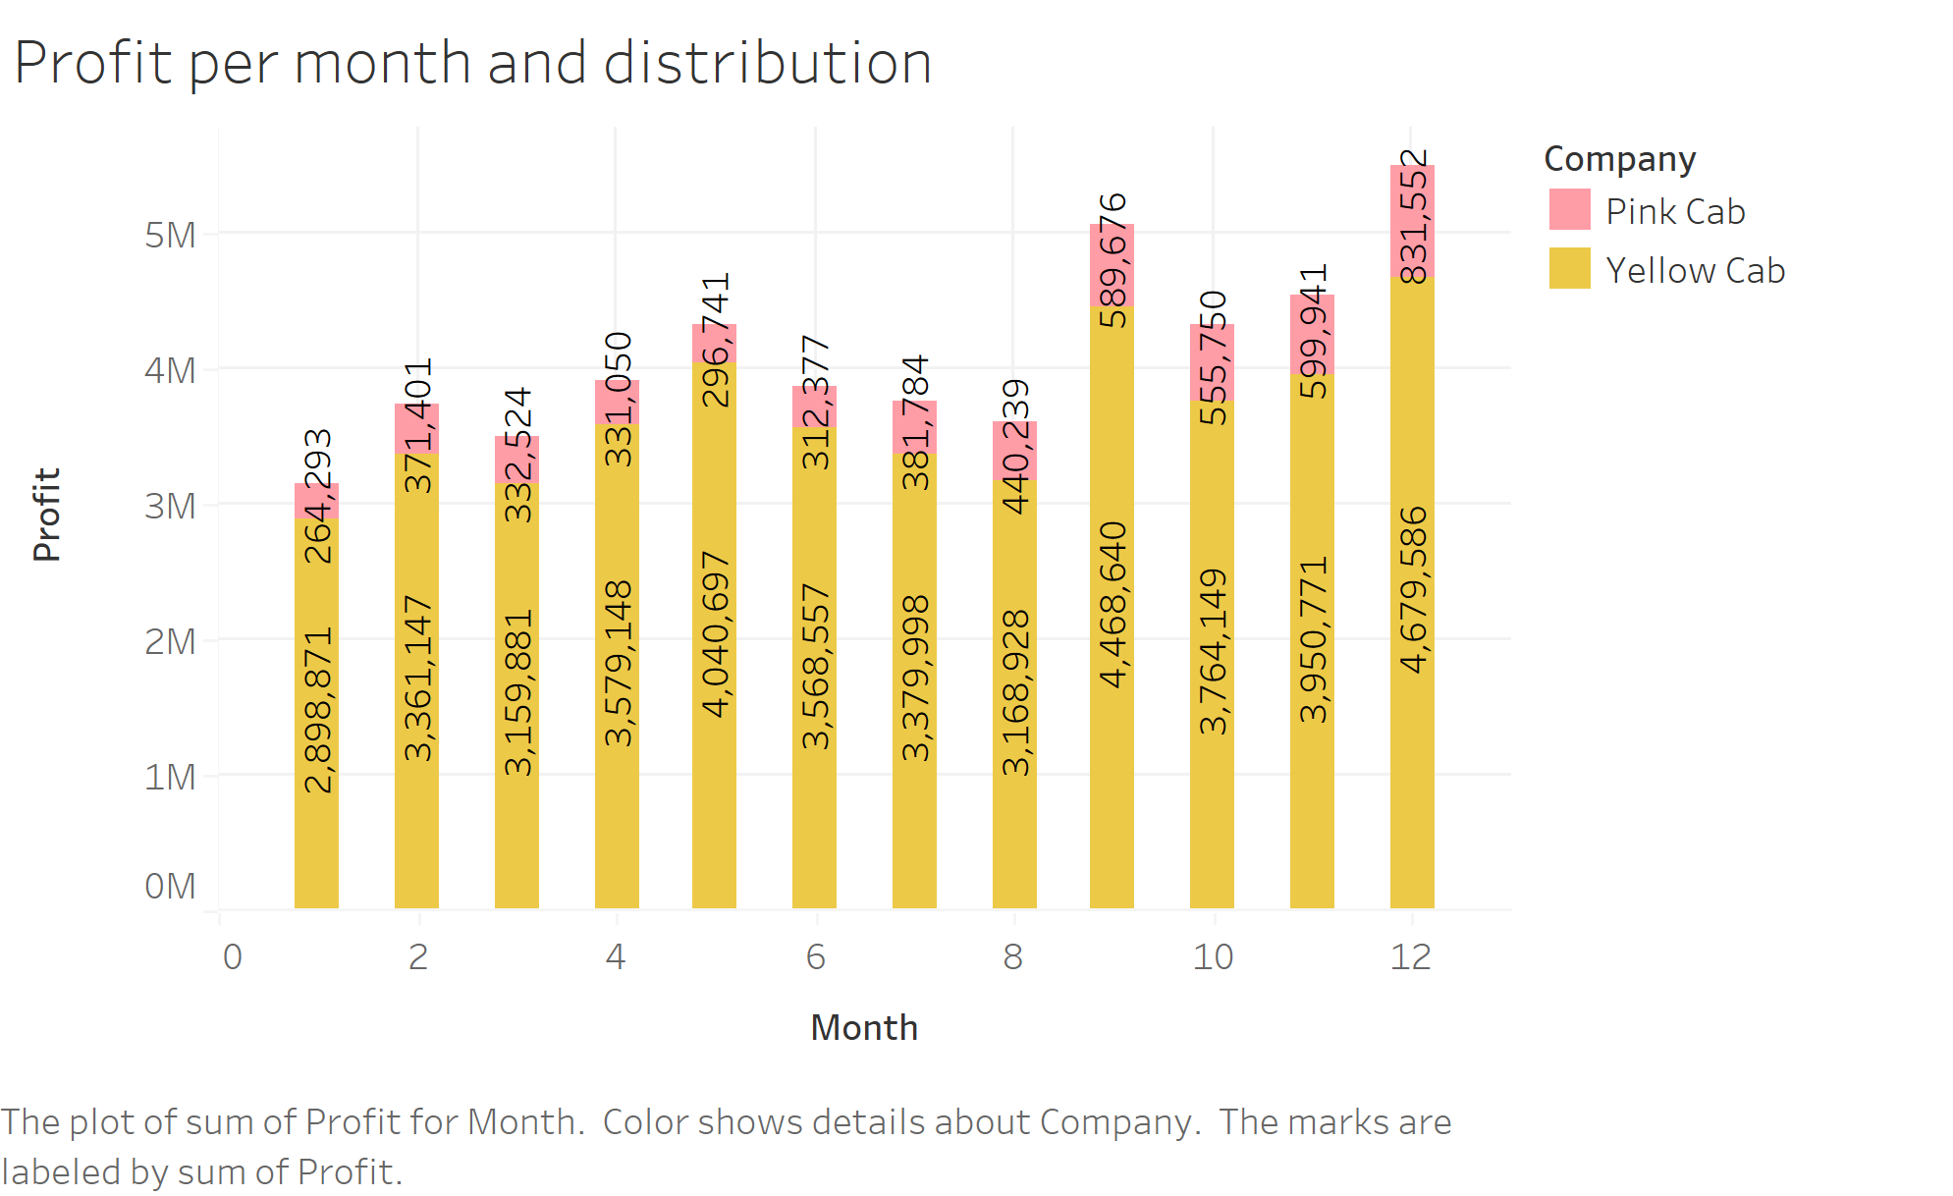
The yellow company yet again edges the pink cab company with profits acquired per month distribution

Slide 16
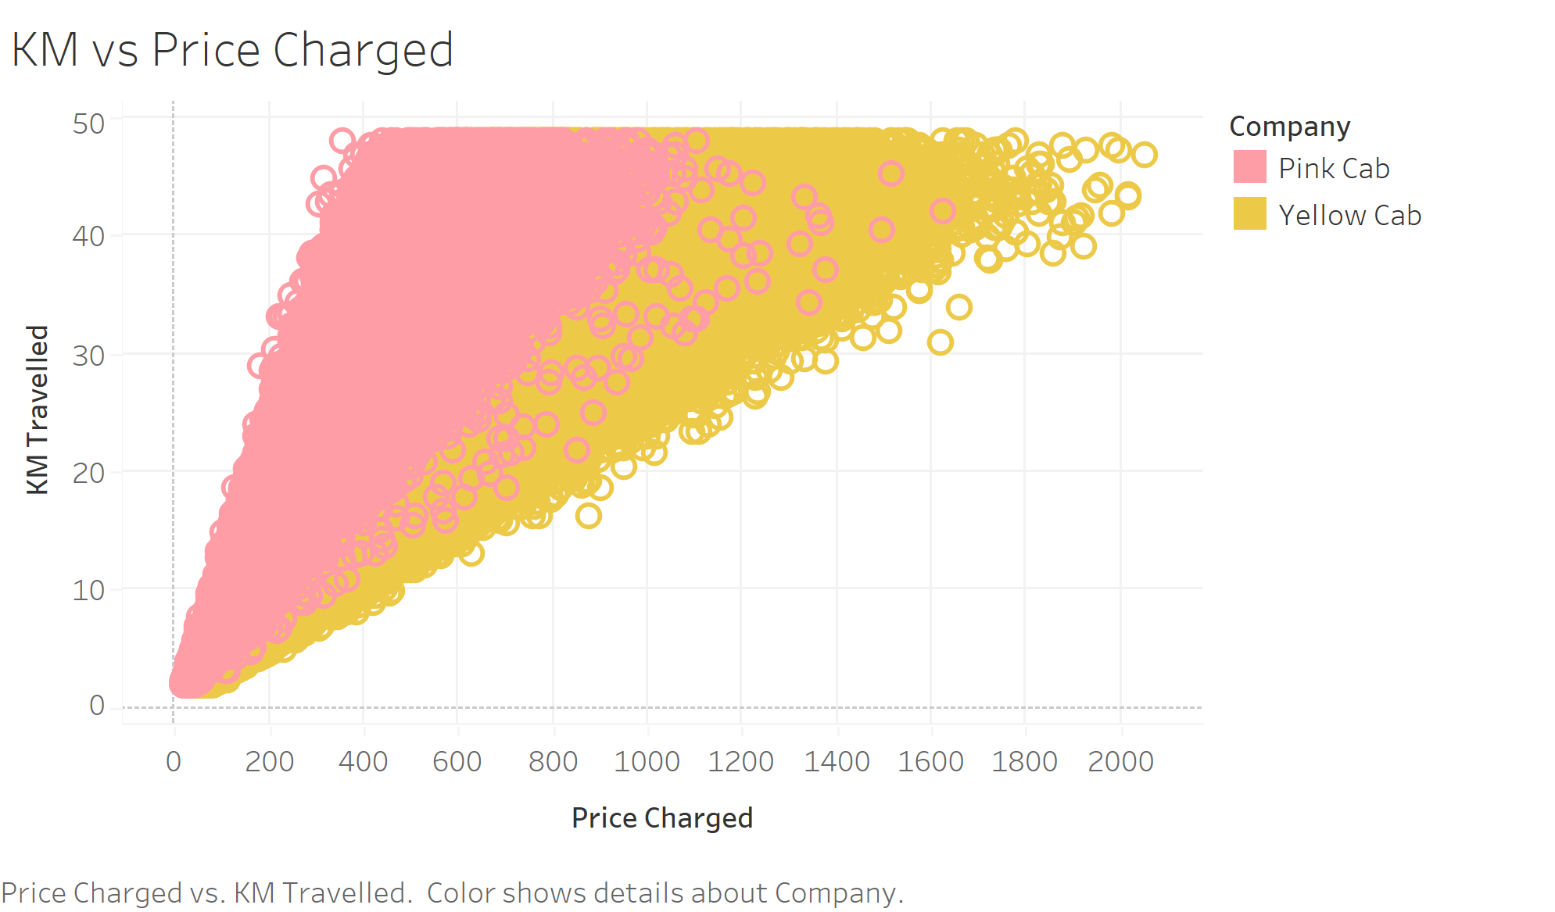
The yellow cab company charges more per kilometer than the pink cab company. This also translates to more profit per kilometer.

Slide 17
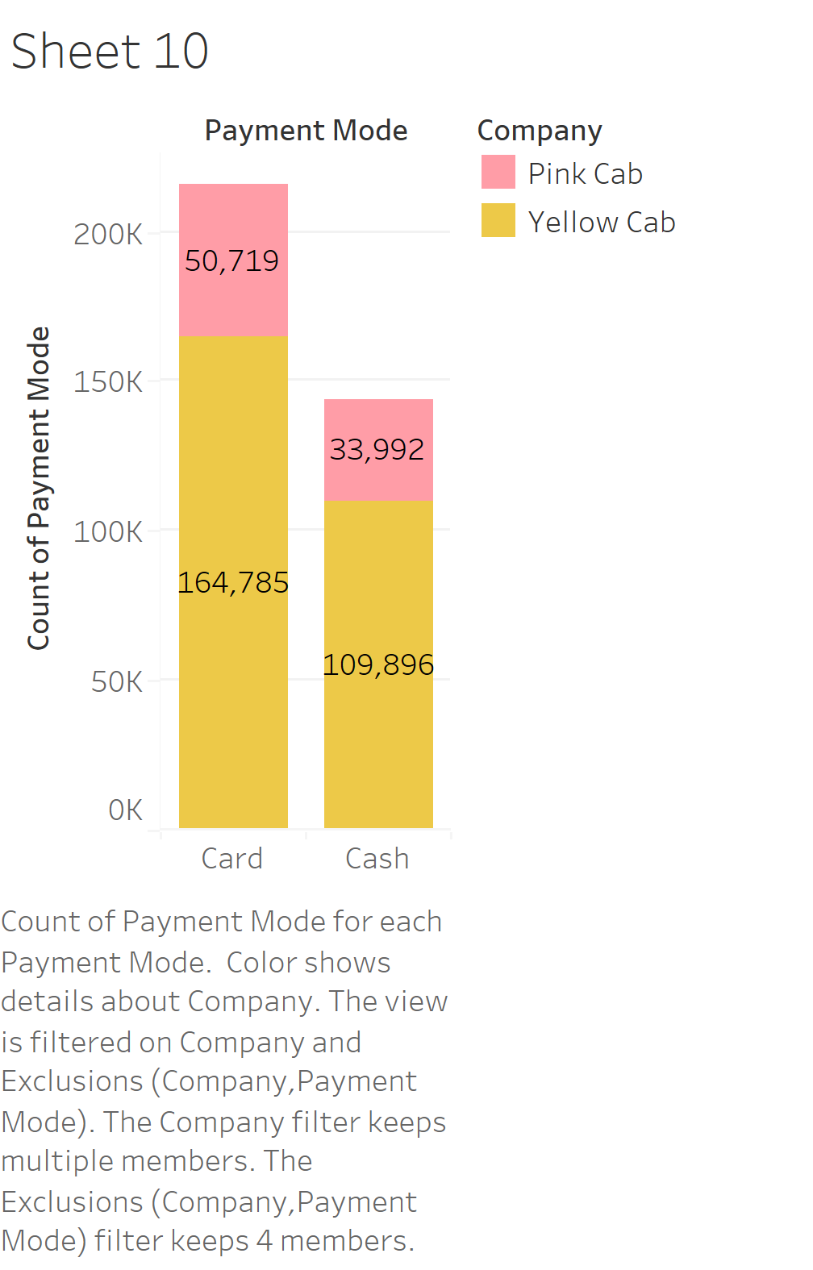
Payment Options
Users of the cab services used two payment options with card being the preferred option between the two.
The chart also shows the distribution of payment methods per company

Slide 18
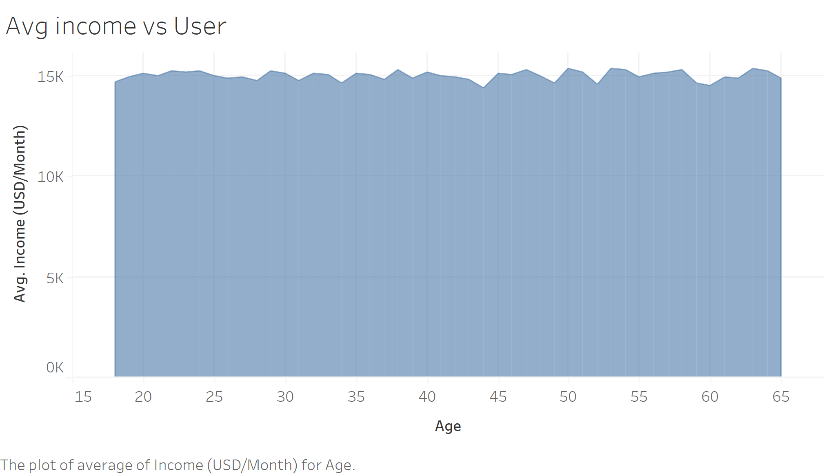
AVERGAE INCOME IN USERS
Users of different age groups earn similar income on average

Slide 19
RECOMMENDATIONS
Which company is more profitable
The yellow Cab Company is more profitable and hence the better option if Profitability is used as a KPI for investment
If they are targeting a certain city
If the company is aiming at a certain city for them to expand / invest .. The yellow cab company is the best option as it has a higher reach in most of the major cities in the industry
Target higher income areas so as to get more revenue
If they are targeting higher income areas they should invest in the yellow cab company
Customer Churn
Yellow Cab has a lower churn(Has a larger loyalty base when compared to the pink company and hence should invest in yellow cab if this is used as a KPI
Targeting a particular quarter
If they intend to invest during a specific quarter to get higher returns the company should invest in the Yellow cab company during the last two quarters/ second half of the year

