Slide 1

PLM
PRESENTATION
Gabriel EL HACHEM
Loévan LE QUERNEC
Jade FALCK

Slide 2

COMPANY OVERVIEW
Company specializing in the production of innovative and eco-friendly energy drinks.

Slide 3

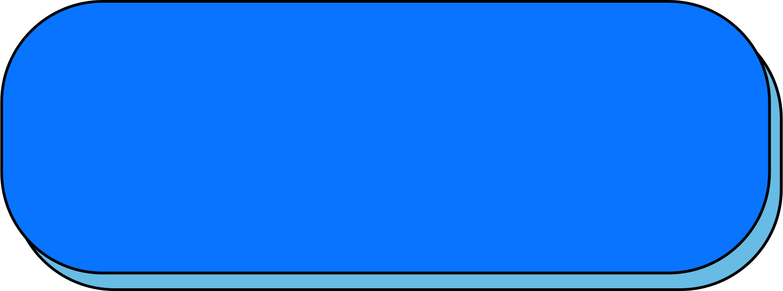
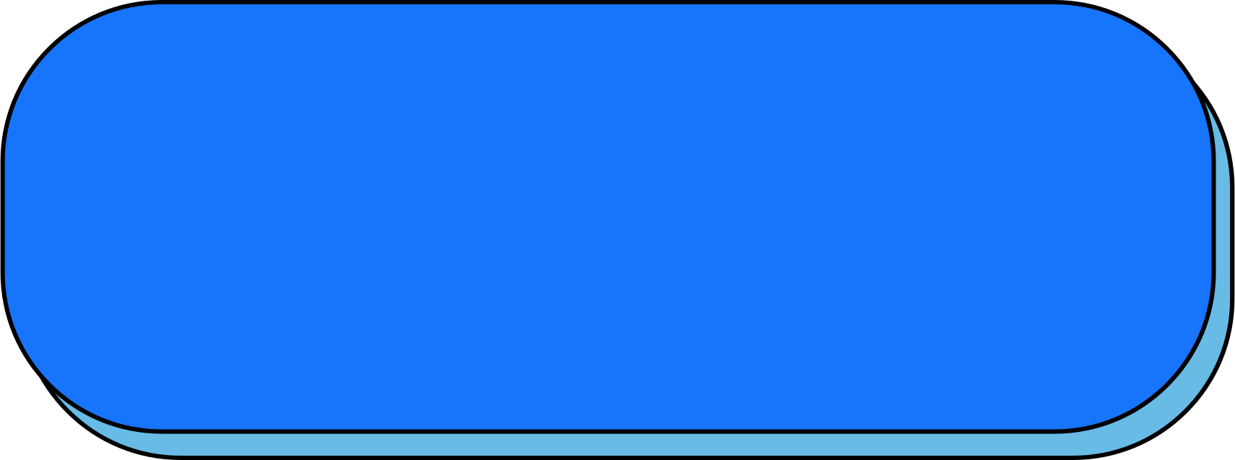

OUR VISION & MISSIONS
"Revolutionizing the energy drink market with healthy, sustainable products tailored to the needs of each consumer."
QUALITY
OPERATIONAL EFFICIENCY
SUSTAINABLE PROCESSES

Slide 4

INNOVATION
QUALITY
DURABILITY
OUR VALUES
COLLABORATION
CUSTOMER SATISFACTION
TRANSPARENCY

Slide 5
2. DEVELOPPED PRODUCTS

Slide 6




3 ENERGIZING DRINKS
CAFFEINE
THEINE
VITAMINS

Slide 7
3. ORGANIZATION AND STRUCTURING OF THE COMPANY

Slide 8





ORGANIZATION
ADMINISTRATION
ACCESS, IDEA, ...
SUPPLIER MANAGER
ADD, DELETE, MANAGE
CUSTOMER SUPPORT
REVIEWS, COMPLAINTS
ORDER MANAGER
ADJUST, PLANNING

Slide 9
4. TECHNICAL SOLUTIONS

Slide 10
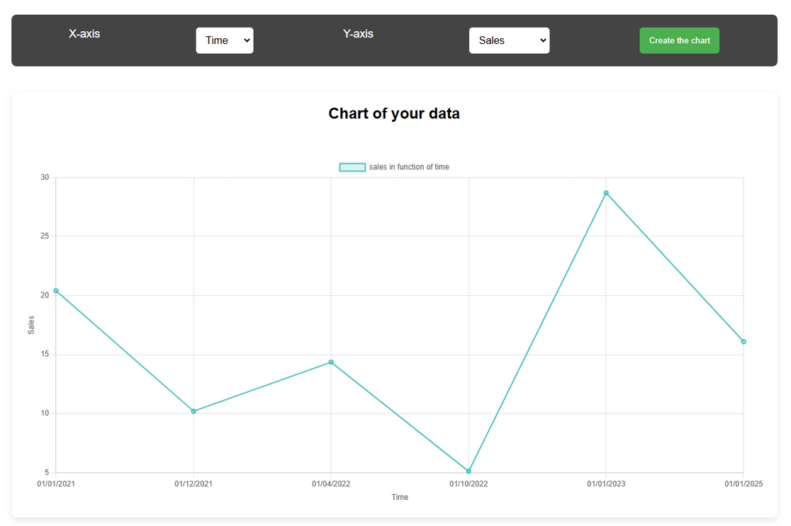
DASHBOARD
CAFEINE
THEINE
VITAMINES

Slide 11
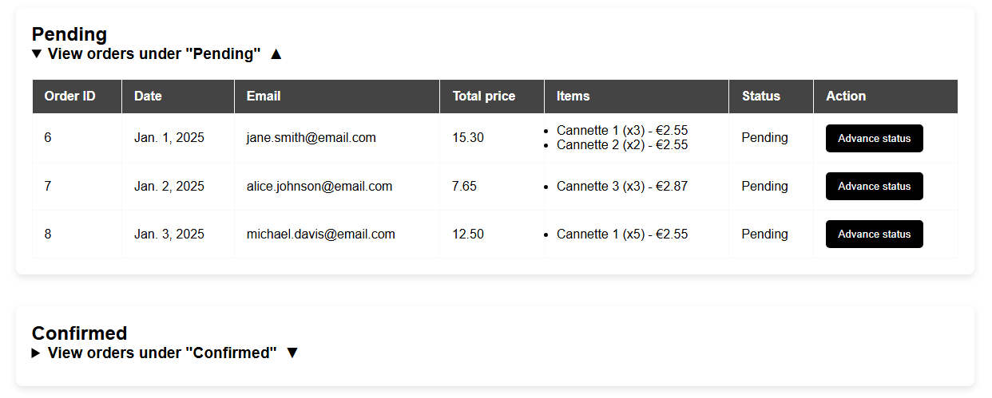
SALES
CAFEINE
THEINE
VITAMINES

Slide 12
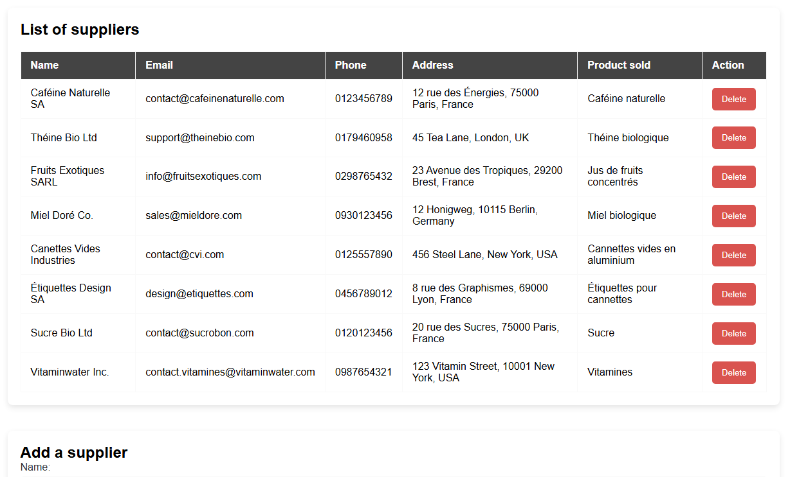
SUPPLIERS
CAFEINE
THEINE
VITAMINES

Slide 13
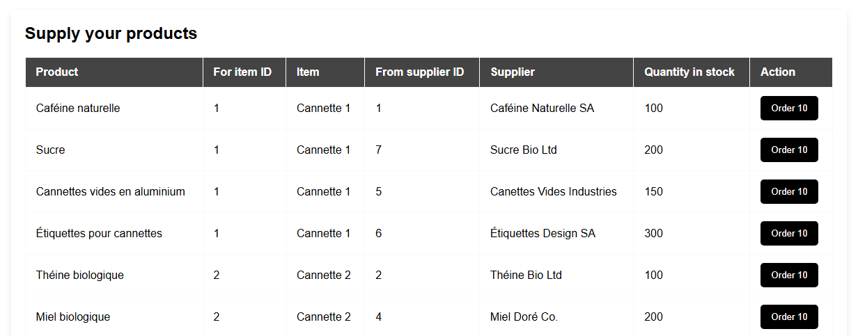
MANUFACTURE
CAFEINE
THEINE
VITAMINES

Slide 14
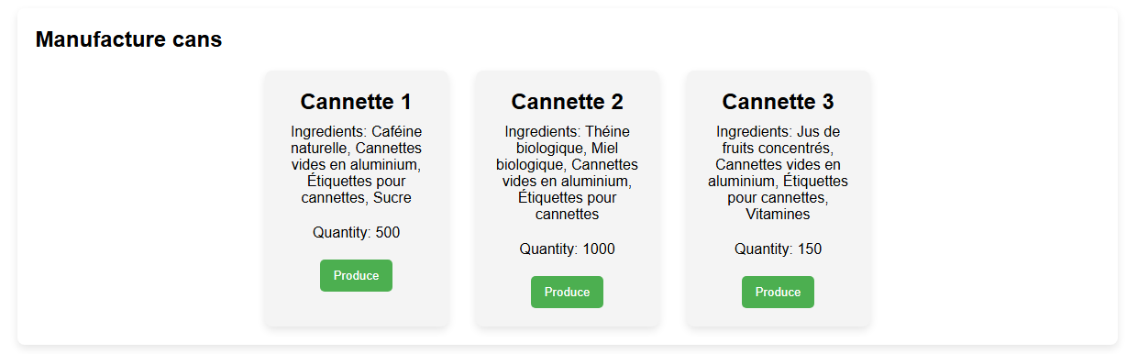
MANUFACTURE
CAFEINE
THEINE
VITAMINES

Slide 15
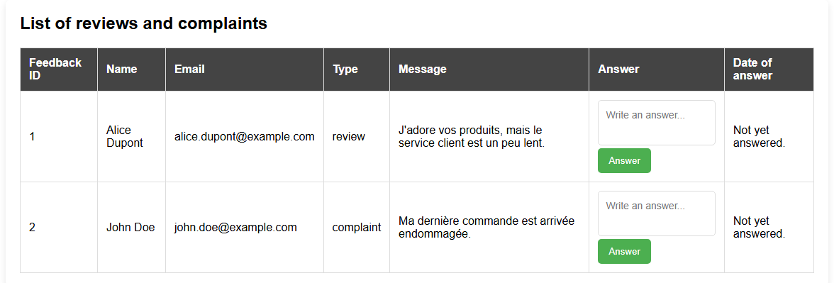
FEEDBACKS
CAFEINE
THEINE
VITAMINES

Slide 16
5. DEMO

Slide 17
6. ARTICLE PRESENTATION

Slide 18
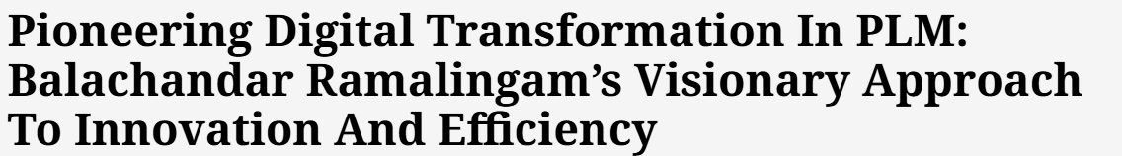
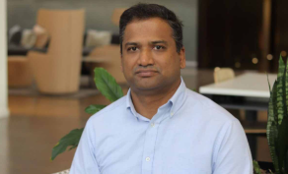
ARTICLE ON PLM INNOVATION
Article link

Slide 19
THANKS FOR LISTENING

