Slide 1
Sales Performance Dashboard – Detailed Explanation
A complete breakdown of KPIs, filters, charts, and insights

Slide 2
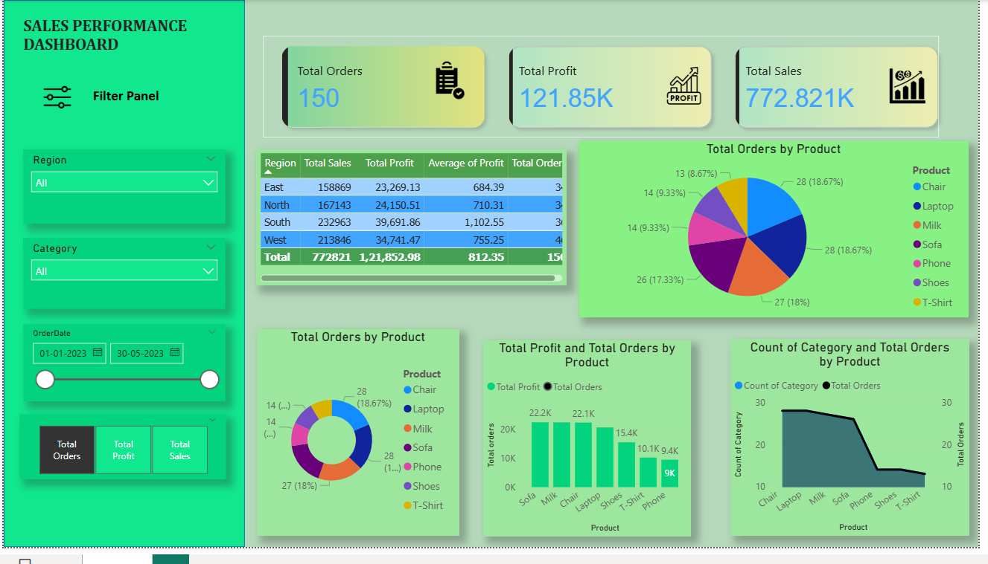
Dashboard Snapshot

Slide 3
Filter Panel – Detailed Breakdown
Region Filter:
  Choose East, West, North, or South regions for localized performance insights.
  Category Filter:
  Filter by product groupings for product-specific dashboards.
  Order Date Filter:
  Allows dynamic analysis over time ranges to compare trends.
  KPI Toggle Buttons:
  Helps visually switch between Total Orders, Total Profit, and Total Sales KPIs.

Slide 4
Key Performance Indicators (KPIs)
Total Orders (150):
  Indicates the total number of customer orders processed.
  Total Profit (121.85K):
  Represents gross profit earned from all sales within selected filters.
  Total Sales (772.821K):
  Shows revenue generated across all products and regions.
  KPIs help assess overall business health instantly.

Slide 5
Region-Wise Sales Summary – Detailed Insight
East Region:
  Strong performance with high total sales and significant profit contribution.
  North Region:
  Consistent sales with stable profit margin.
  South Region:
  Shows highest numbers in profit and sales among all regions.
  West Region:
  Balanced performance with strong sales and average profit values.
  Summary Table helps compare regional strengths and weaknesses.

Slide 6
Total Orders by Product – What It Reveals
Top Products:
  Chair, Laptop, Sofa show the highest share of customer orders.
  Moderate Performing Products:
  Shoes, Phones indicate medium order frequency.
  Lower Range Products:
  Milk and T-shirt categories show lower demand.
  Pie chart helps identify demand patterns for inventory planning.

Slide 7
Total Profit and Total Orders by Product – Analysis
Products with high sales + high profit (e.g., Sofa, Milk):
  Indicate strong profitability & customer demand.
  Products with high orders but lower profit (e.g., Chair):
  Useful for evaluating margin improvement areas.
  Products with low orders and low profit:
  Signal low-performing categories needing review.

Slide 8
Category Count & Total Orders – Trend Explanation
Category Count:
  Shows availability or variety within each product category.
  Order Trend Line:
  Reveals how customer preference aligns with available categories.
  Useful for product assortment optimization.

Slide 9
Key Insights & Business Recommendations
Top-performing regions should receive increased stocking and marketing investment.
  Low-performing products may require redesign, bundling, or promotional offers.
  High-profit items should be prioritized in campaigns.
  Date filters reveal seasonal trends—useful for forecasting demand.
  Overall dashboard helps guide strategic sales and operational decisions.

