Slide 1

Welcome to Metis Live Online!

Slide 2


The Immersive Course Model

Slide 3


Training
Repetition
Culture & Community

Slide 4
1. Training

Slide 5
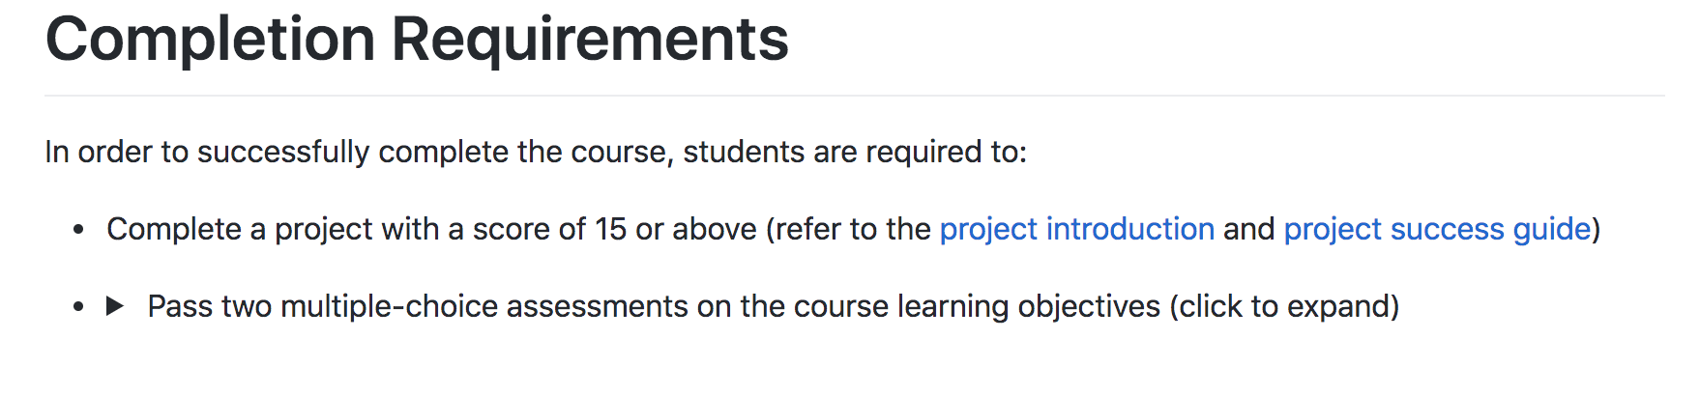
Summary
Metis immersive courses are built around measurable learning objectives which are put into practice by real-world data projects and frequently assessed throughout the course.

Slide 6
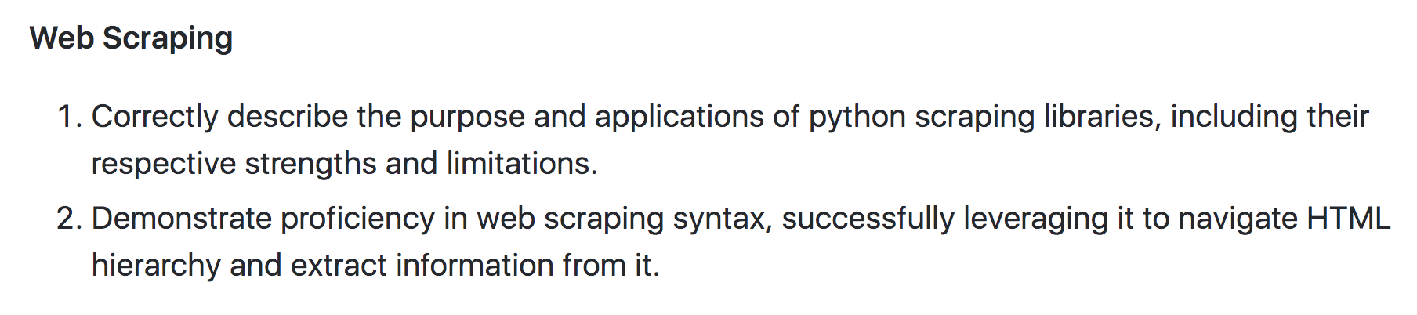
Measurable Learning Objectives

Slide 7
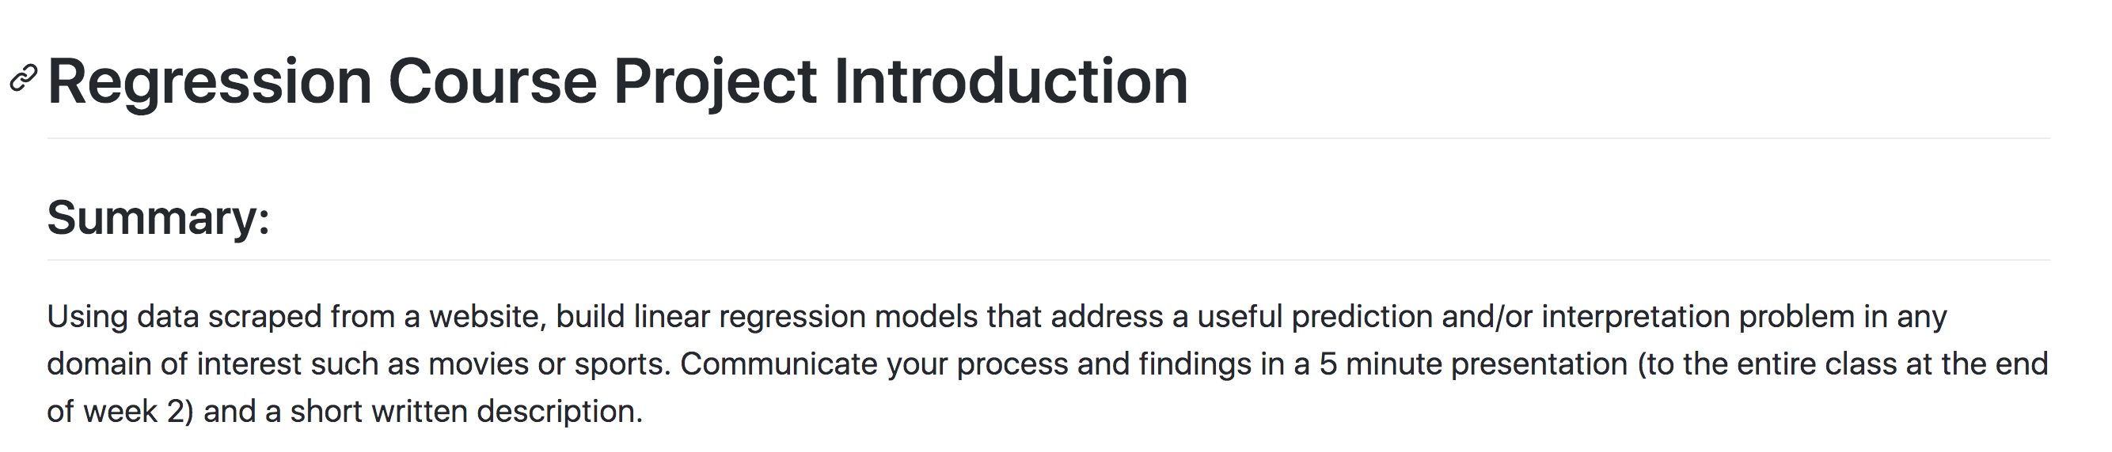
Put into Practice by Projects
Design
Data
Algorithms
Tools
Communication
Regression Problem
Scraped, Tabular
Regression Models
Scraping Tools
Presentation

Slide 8
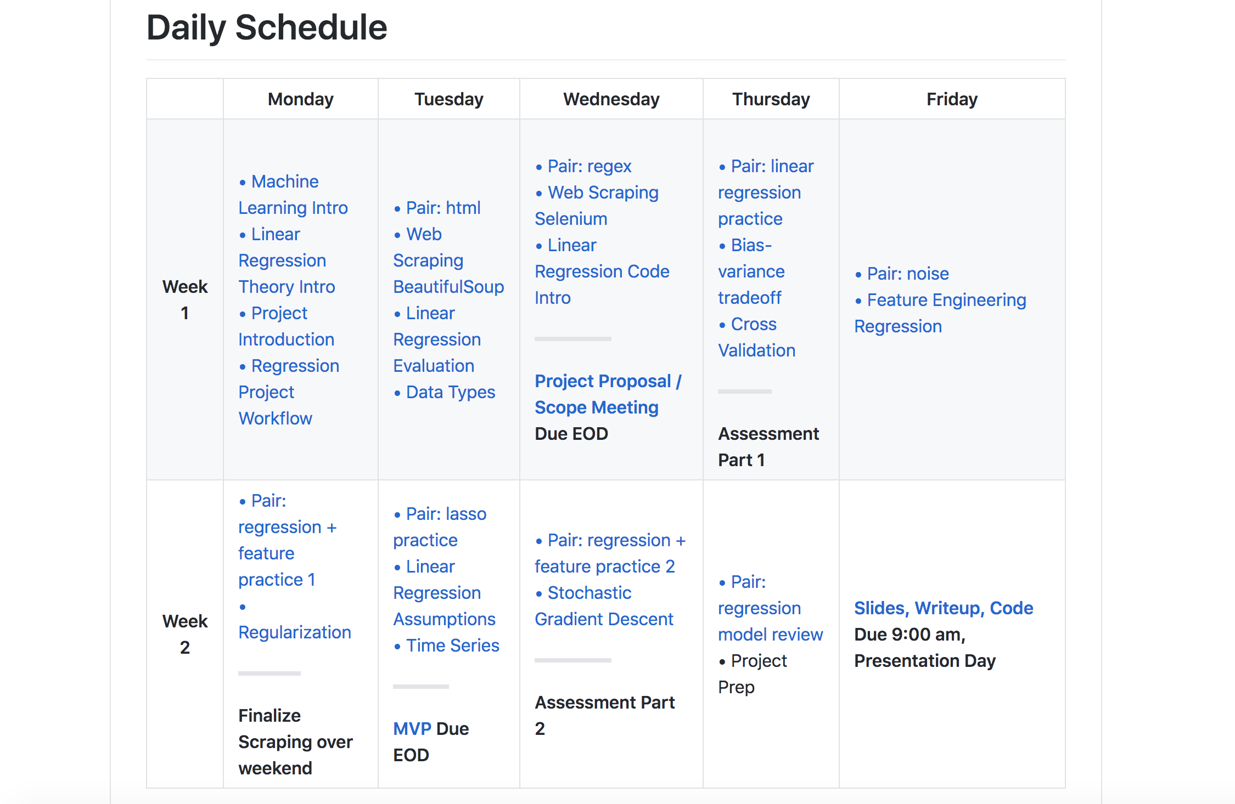
And Frequently Assessed

Slide 9
2. Repetition

Slide 10
Repetition: Review-Oriented Schedule
Focus on practicing techniques
Focus on reinforcing new concepts

Slide 11
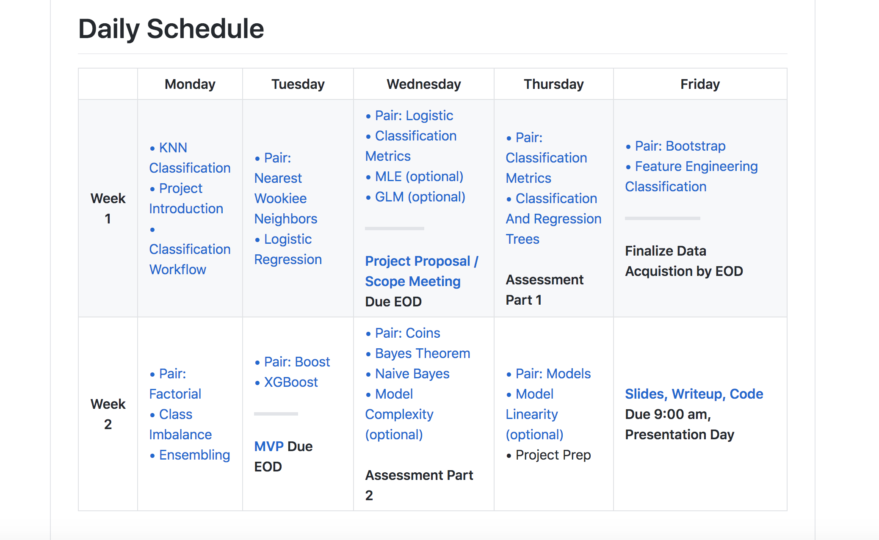
Repetition: Consistency Across Courses
Metis immersive courses are consistent in structure and requirements

Slide 12
3. Culture, Community, & Resources

Slide 13
During a Metis course, you will have…
Focused Time
Peer & Community Support
Experienced Instructors
Industry Leading Curriculum

Slide 14
Instructor and Peer Collaboration
Daily live instruction
Daily pair programming exercise with peers
Daily instructor support for 1-1 help

Slide 15
Culture: Inclusivity
Metis is committed to promoting an inclusive learning environment
1. Diversity of backgrounds
2. Community of respect
3. All voices heard

Slide 16
Culture: Overcoming Obstacles
You must overcome two things:
1. Imposter Syndrome
2. Perfectionism

Slide 17
Culture: Imposter Syndrome

Slide 18
Culture: Imposter Syndrome
You must overcome two things:
1. Imposter Syndrome
Collaboration
Communication
2. Perfectionism
Notes:
Can overcome by working with others, on pair problems or projects – realize everyone else is on the same page and you may be able to bring your own expertise in to teach your peers something.
Constantly communicate with the instructors. It’s okay if you don’t know something. We’re here to make sure you understand the material and get a job at the end.

Slide 19
Culture: Perfectionism
You must overcome two things:
1. Imposter Syndrome
Collaboration
Communication
2. Perfectionism
Unfairly short deadlines
Jumping into the unfamiliar

Slide 20
Community: Becoming a Data Professional
Mixture of individual and collaborative work
Instructors, Program Manager
Career Advisor support and hiring partners (for those doing a Bootcamp track)
Metis alumni network

Slide 21

“The classroom instruction, project work, and resources offered through the career counseling and continued alumni support is invaluable. I was exhausted every day, but I woke up looking forward to every day.”
– Metis Alumni
“”

