Slide 1

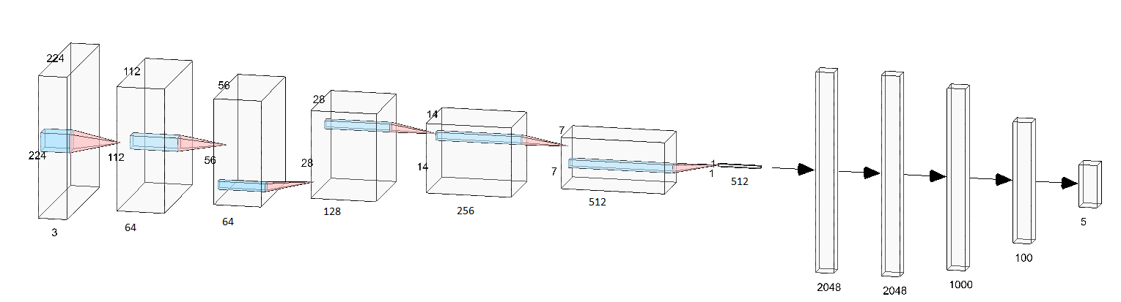
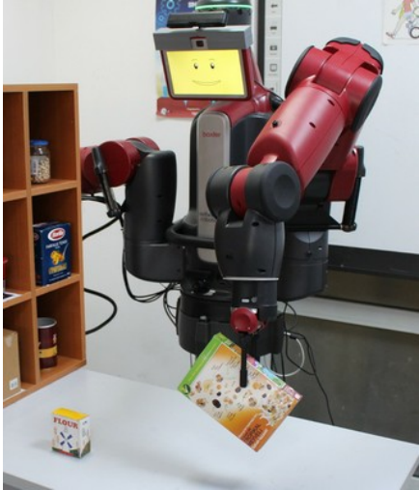
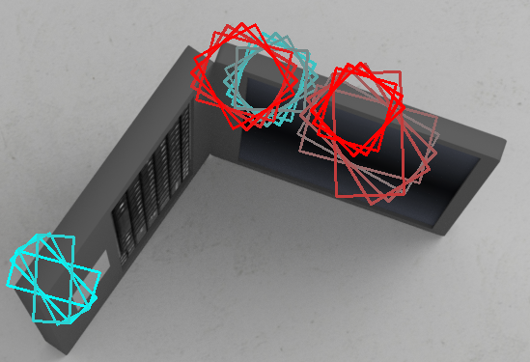
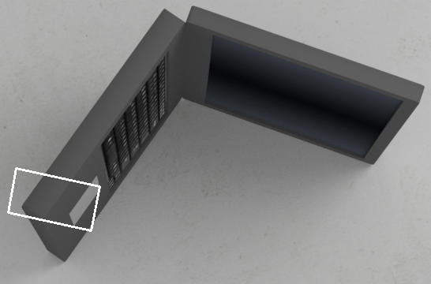
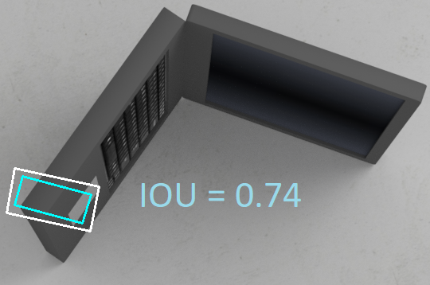
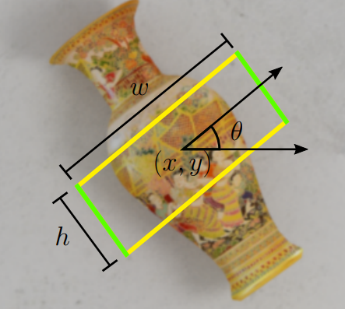
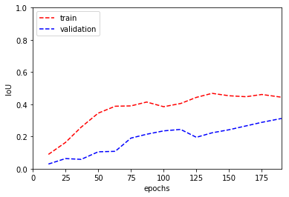
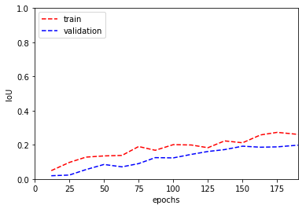
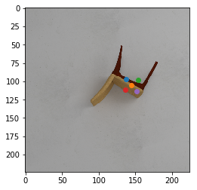
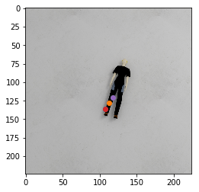
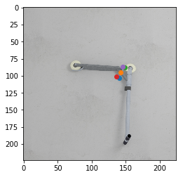
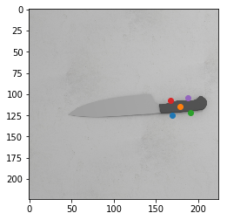
Implementing Deep Learning Methods
For Novel Object Grasping
Burak Mete, Abdullah Cihan Ak, Sanem Sarıel
Istanbul Technical University, Artificial Intelligence and Robotics Laboratory
Project Summary/Motivation
METHODS
Main focus is to build an autonomous system that can create successful grasp positioning from robots visual sensory.
Our modal should:
1- Generate successful grasps for
novel objects
2- Enhance the current methods
in the literature
ResNet34[2] is chosen as the feature extractor model. The final layers are manipulated to create regression parameters as x, y, h, w, θ; the center coordinates, height, width and the orientation respectively. The loss function we introduce is IoU loss, which is widely used for measuring the accuracy for grasping task along with object detection tasks. However, since the operation is non-differentiable, this operation is not used in neural network systems. We are proposing a new way to differentiate this operation to come up with a better learning model for the grasping task. Along with making the operation differentiable, we are also selecting the label to calculate the error via IoU loss.
All Ground Truth Values Network Output Selected Label via IoU
IoU is actually the ratio of intersection area and the union area between the prediction and the ground truth. In order to make that set operation differentiable, we are treating this problem as an image transformation problem, by creating a custom mesh for the output and the ground truth, apply affine transform with the parameters taking from the 5 parameters from the output and the ground truth. After the transformation, we get a transformed binary mask which refers to the grasping region. By adding those masks and passing it over a ReLu, we get the union area. Subtracting 1 from the added mask and passing it over a ReLu, gives the intersection area. Thus, 1-{In}/{Un} gives the error, meaning that how close is the prediction to the actual result. The closest candidate is selected via applying the IoU operation for all possible annotations and select the one that gives the highest result.
Problem Definition
Still, most of the robotic grasping systems, relies on the object detection while the robot tries to grasp the object from its center. However, this approach fails for most of the time in real life objects. Thus researchers tried to build neural networks to solve the issue in the past. While they give inputs as 2D/3D image data, they tried to implement models that give different types of outputs. Therefore, robot would acquire the grasping parameters from its visual perception.
Exemplary grasping rectangle output with 5 parameters
(centroid coordinates, height, width and orientation)
There are three main issues to be enhanced in the state of art of this problem.
1- Using hand-labelled training data: While training the model, most of the current methods use datasets which are gathered in real life objects and annotated positively or negatively by a human. This has drawbacks since it is very time consuming and makes the model biased to the human comprehension.
We overcame this problem by using a synthetic dataset[1], which is gathered and annotated in a physics simulation environment. The dataset includes more than 10000 objects, 50000 images and nearly 60 annotations for each image
2- The optimizing technique: In the state of art literature for the grasping task, Mean Squared Error (MSE) is mostly used for loss calculation for the model. However, most of the methods creates outputs such as the centroid of the grasping rectangle along with its height, width and the orientation. Since MSE calculates the L2 norm of the difference between ground truth value and the output, taking the L2 norm distance of orientations should not be the most optimal way to measure the difference. Thus we are proposing a new loss function for the grasp prediction task, which is Intersection over Union (IoU) loss.
3- Multi labelled Training Data- Most of the time, objects have more than one valid grasp positions. Thus, while training the model, the correct annotation should be chosen to calculate meaningful errors. Some current models choose approaches like taking the geometric average of all ground truth values while calculating the loss, which has various drawbacks in overall. We are also trying to overcome this issue.
RESULTS
Accuracy for the model trained with IoU Accuracy for the model trained with MSE
As it can be inferred from the results, the model that is trained with the loss function that we proposed, gives slighlty better training and validation accuracies for our dataset.
Some exemplary outputs from the model.
Orange point: Centroid of the grasping region
Red/Purple/Blue/Green points: grasping region corners

