Slide 1
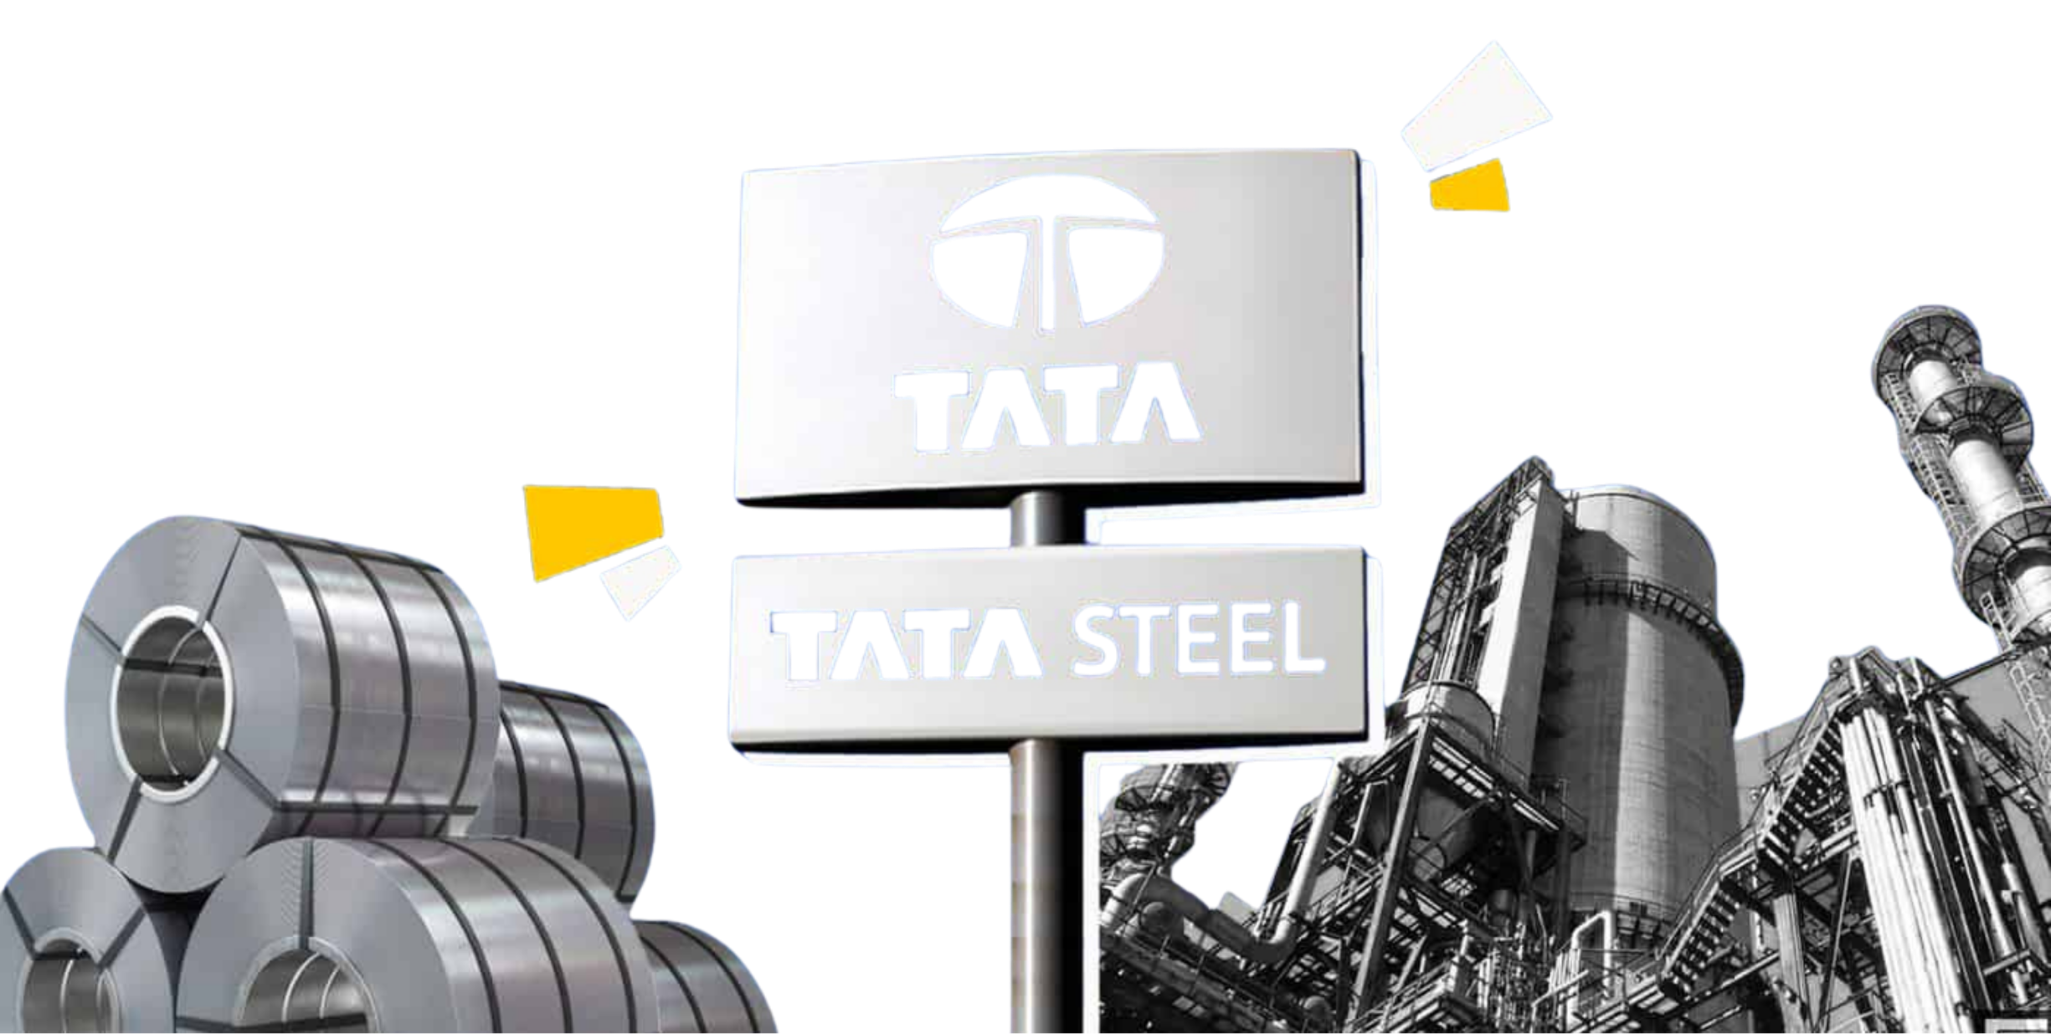
SPA · SALES PLANNING & ADMINISTRATION
Prepared by Bharat Mimani
HRC Price Intelligence
Faculty Guide Nikhil Rastogi
Company Mentor Pawan Kumar Mishra
hrcpipeline-tata-bharat.streamlit.app
Analysis of Global Steel Price Dynamics and Inter-Nation Interdependence along with
Investigation of Key Variables Influencing International Steel Market Price Movements

Slide 2














INDUSTRY
HRC & SUPPLY CHAIN
COMPANY & RIVALS
PRICING
THE PROBLEM
DASHBOARD
RECOMMENDATIONS
Steel Industry in India
Historically a long-product market, but as the economy matures, flat products (autos, appliances, engineering) are gaining share.
#2
100 kg
6–7%
World's 2nd largest steel
producer (~151 MT crude, FY25)
Per-capita use vs 221 kg
world avg
Demand CAGR; 150 → 230 MT
by FY31 (projected)
FLAT PRODUCTS
LONG PRODUCTS
Rising finished-steel demand (MT)
53–55% of demand
45–47% of demand
80–88 MT consumed in India
68–75 MT consumed in India
Key products
Key products
HRC, CRC, galvanised
Plates, sheets, slabs, tubes
TMT bars, rebars, wire rods
Structurals, beams & sections
End-use sectors
End-use sectors
FY26 demand by sector (164 MT)
43% Building & construction
Auto
Appliances
Mfg
Heavy eng
Construction
Infra
Railways
Power
25% Infrastructure
22% Engineering & packaging
TSL volume
TSL volume
9% Automotive
FY27 ABP 19.3 MT → FY31 proj. 20.3 MT
FY27 ABP 5.74 MT → FY31 proj. 11.85 MT
1% Defence
Source: Ministry of Steel / JPC, World Steel Association, IBEF, Tata Steel ABP. Sector split per India finished-steel consumption.

Slide 3








INDUSTRY
HRC & SUPPLY CHAIN
COMPANY & RIVALS
PRICING
THE PROBLEM
DASHBOARD
RECOMMENDATIONS
HRC & the Steelmaking Supply Chain
From iron ore, coking coal and fluxes to hot-rolled coil — HRC is the flat-product, and its cost is set upstream.
RAW MATERIALS
Iron ore · coking coal · fluxes
IRON MAKING
Sinter · coke · blast furnace → hot metal
STEEL MAKING
BOF / steel melting shop → cast slabs
HOT ROLLING & DISPATCH
Hot strip mill → HR coil → customer
Process flow — Tata Steel Kalinganagar (TSK)
What HRC costs to make
Iron ore & fines (Domestic)
Raw
Material
Stockyard
Hot metal
Slabs
The selling price of HRC is anchored to its two big raw-material inputs:
Coking coal (Domestic / ~85% imported)
1.6 × Iron Ore + 0.9 × Coking Coal
Blast
Furnace
Steel
Melting
Hot Strip
Mill
Fluxes (lime) (Domestic / imported)
HR Coil
≈ 76% of the HRC selling price is raw material, so it’s cost leads the price story.
Inbound raw materials are planned, sourced (own mines, domestic suppliers, imports via ports) and converted stage-by-stage; HRC is the direct-dispatch flat output of the hot strip mill.
Dispatch & distribution footprint
4
27
24
Road · Rake · Coastal
1,500+
Mother mills
(HSM · TSCR · TSK · TSM)
Flat-product
service centres (SPCs)
Stockyards across
the network
Multi-modal
outbound logistics
Customers served
across segments
Source: Tata Steel supply-chain & logistics overview (TSK). Cost identity per Tata BPM steelmaking-spread formula.

Slide 4


INDUSTRY
HRC & SUPPLY CHAIN
COMPANY & RIVALS
PRICING
THE PROBLEM
DASHBOARD
RECOMMENDATIONS
Tata Steel in HRC — and the Competitive Field
Among India's big-4 integrated flat producers; competing on cost, value-added mix and an integrated raw-material base.
26.1 MT
23.5 MT
20+ MT
₹58.7k/t
Tata Steel India crude
capacity (post-KPO II)
Best-ever FY26 India crude
production (+8% YoY)
FY26 domestic deliveries —
crossed 20 MT first time
Domestic HRC spot price
(May 2026 reference)
India crude-steel capacity by producer (MTPA)
How the big-4 flat producers compare
Producer
India cap.
Flat focus
Edge
Tata Steel
26.1 MT
High
Captive ore + VA mix
JSW Steel
34.2 MT
High
Largest scale, Vijayanagar
SAIL
~20.6 MT
Medium
PSU, plates & rails
Tata Steel's structural edge
AM/NS India
~9.6 MT
High
Auto-grade, Hazira
Captive iron ore & coal
  Integrated mines in Jharkhand & Odisha cushion raw-material cost
Value-added flat mix
  Auto AHSS, branded retail, tubes, tinplate — richer than commodity slab
Scale runway to 40 MTPA
  Kalinganagar ramp-up + Ludhiana EAF, Jamshedpur Combi Mill
Why pricing is hard here
HRC is a near-commodity: four scaled producers, trade-parity pricing vs landed Chinese imports, and thin differentiation mean realisations are set as much by global cost and import parity signals as by domestic demand.
Source: Tata Steel FY26 business update & Annual Report; company filings (JSW, SAIL, AM/NS); Nomura/Kotak HRC price notes (May 2026). Capacities approximate, India operations.

Slide 5


INDUSTRY
HRC & SUPPLY CHAIN
COMPANY & RIVALS
PRICING
THE PROBLEM
DASHBOARD
RECOMMENDATIONS
How HRC Is Priced
Domestic HRC is a managed monthly price built off global cost, import parity and the steelmaking spread — not set in isolation.
Trade-parity anchor
The steelmaking spread
Contract vs spot
Differentials & discounts
Domestic HRC tracks landed Chinese FOB + freight + duty. Imports set the ceiling.
HRC − (1.6×iron ore + 0.9×coking coal). The margin the business actually earns — the core of pricing defensibility.
OEM contracts (quarterly/half-yearly, volume) vs distributor/spot (monthly, price-led). SPA manages the spread between them.
Regional freight differentials, grade premia, mill discounts and seasonal patterns layer on the base price list.
The spread is the margin
SPREAD = HRC − ( 1.6 × Iron Ore + 0.9 × Coking Coal )
Source: HRC pricing mechanics (trade parity, contract/spot, differentials) per India market practice; Tata BPM steelmaking-spread formula & FY figures.

Slide 6




INDUSTRY
HRC & SUPPLY CHAIN
COMPANY & RIVALS
PRICING
THE PROBLEM
DASHBOARD
RECOMMENDATIONS
The Problem We Set Out to Solve
Pricing decisions are made with the right intent but incomplete evidence — reactive, lagging, and hard to defend after the fact.
Reactive, not anticipatory
No early-warning signals
Hard to defend
Prices react after iron ore, coking coal and Chinese HRC have already moved. By the time the cost shows up in realisations, the window to act has passed.
No systematic read on which drivers lead HRC, by how many months, or where the margin sits versus history. Decisions lean on instinct, not a watch-list.
When realisations miss plan, there's no quantified attribution of what moved the price. So the post-mortem is narrative, not evidence.
THE GAP
TODAY Price moves → we react → explain later, from memory
NEEDED Leading indicators → act early → decision backed by some evidence
The solution: an HRC price-intelligence dashboard that turns 10 years of evidence into a monthly early-warning watch-list for SPA.
Problem framing per SPA pricing-administration scope and Tata Steel commercial decision context.

Slide 7
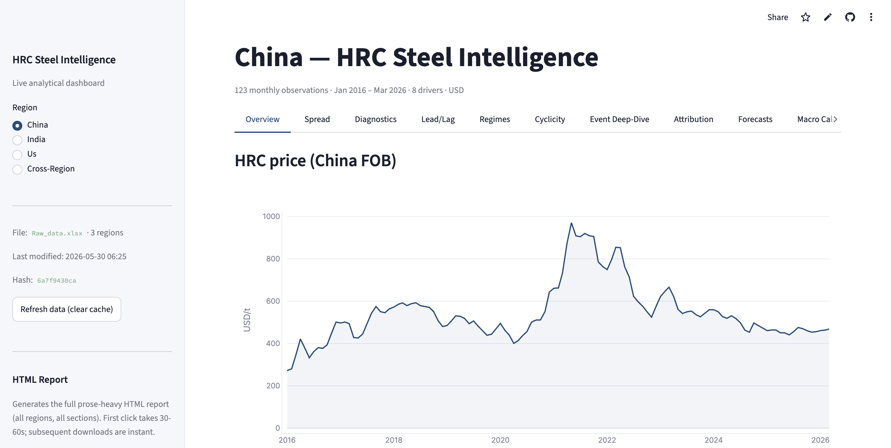
INDUSTRY
HRC & SUPPLY CHAIN
COMPANY & RIVALS
PRICING
THE PROBLEM
DASHBOARD
RECOMMENDATIONS
The Solution: A Live HRC Price-Intelligence Dashboard
Evidence base — three regions, a decade
124
88
125
CHINA
INDIA
US
Jan'16–Apr'26 · USD/t · 8 drivers
Jan'19–Apr'26
Jan'16–May'26 · price reference
Live dashboard — hrcpipeline-tata-bharat.streamlit.app
Source: HRC pipeline (Bmimani007/HRC_Pipeline), deployed on Streamlit Cloud. Coverage as of latest monthly refresh.

Slide 8
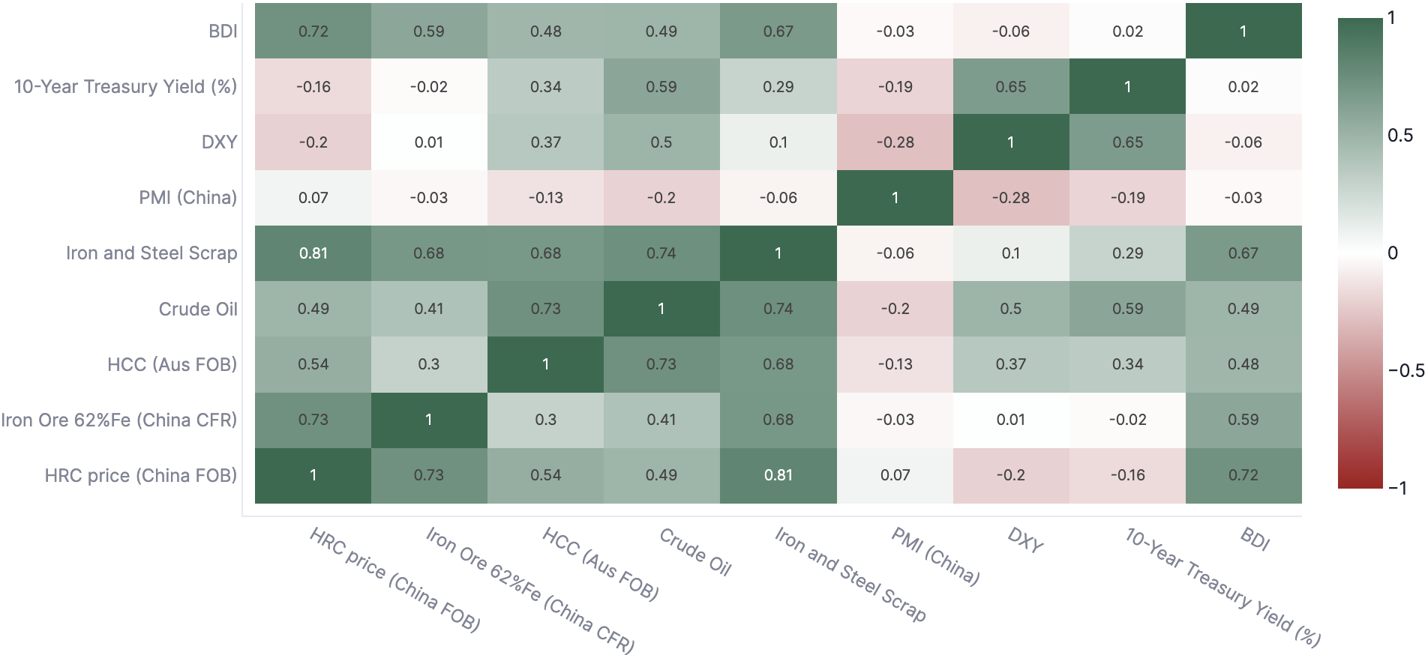



INDUSTRY
HRC & SUPPLY CHAIN
COMPANY & RIVALS
PRICING
THE PROBLEM
DASHBOARD
RECOMMENDATIONS
What Moves the HRC Price — Raw Materials Dominate
Cost leads the story; demand and macro come second. The correlation matrix isolates which inputs co-move most with HRC.
Driver ↔ HRC correlation matrix
The drivers that matter most
Iron Ore (62%Fe, China CFR) · Primary cost input
Coking coal (HCC, Aus FOB) · Second-biggest cost
Crude oil · Energy & freight proxy
Steel scrap · Marginal-cost signal
BDI · US bond yield · Demand & macro context
What this means for pricing
Because raw materials drive ~76% of the HRC price, the watch-list starts with iron ore and coking coal. When inputs move, the price will follow — so input costs are the first thing SPA should monitor for the Pricing Committee.
Source: HRC dashboard — correlation tab (China module). Correlations on driver/HRC series.

Slide 9
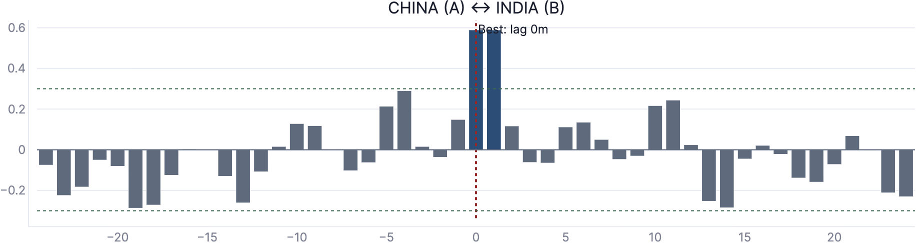
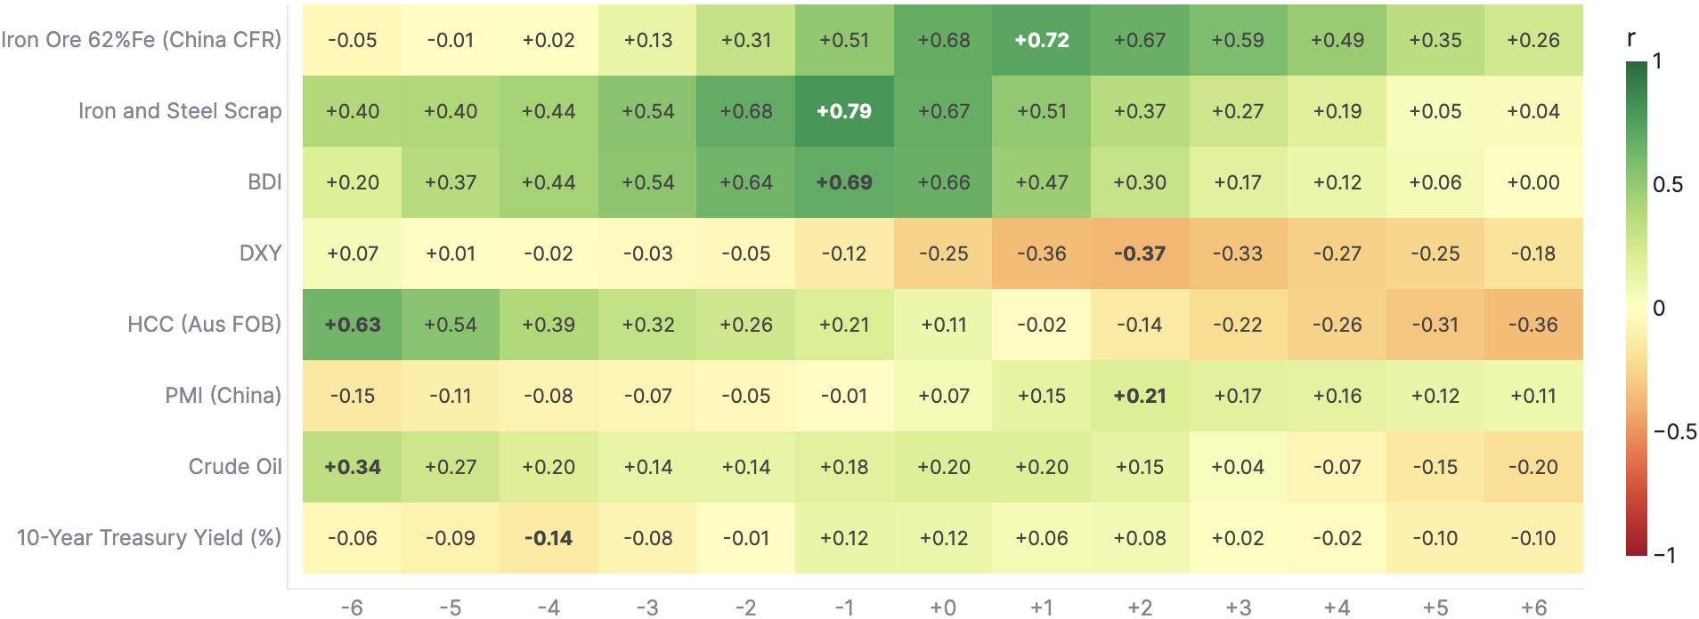
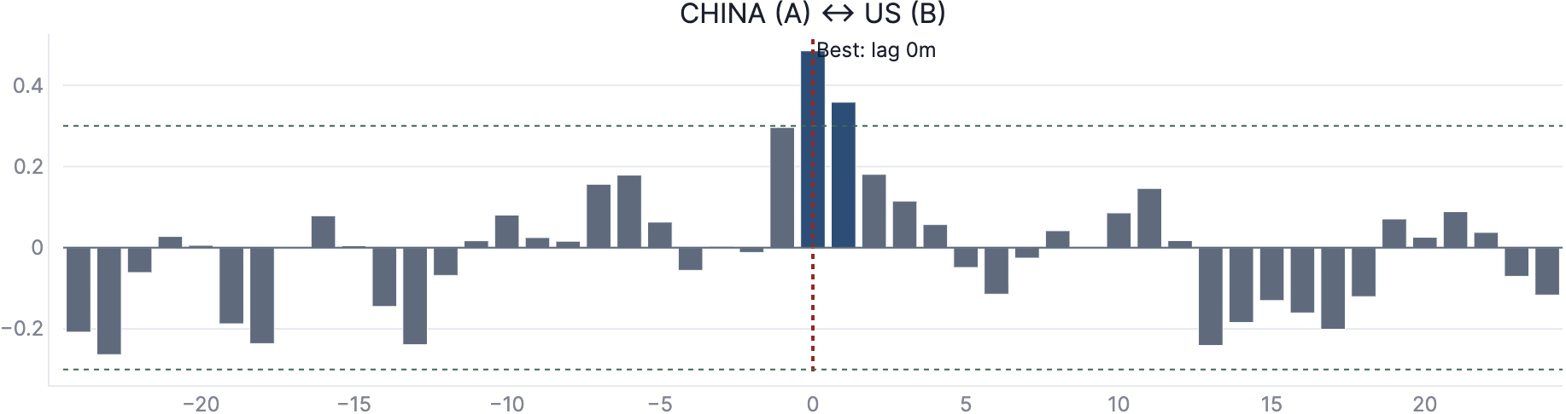
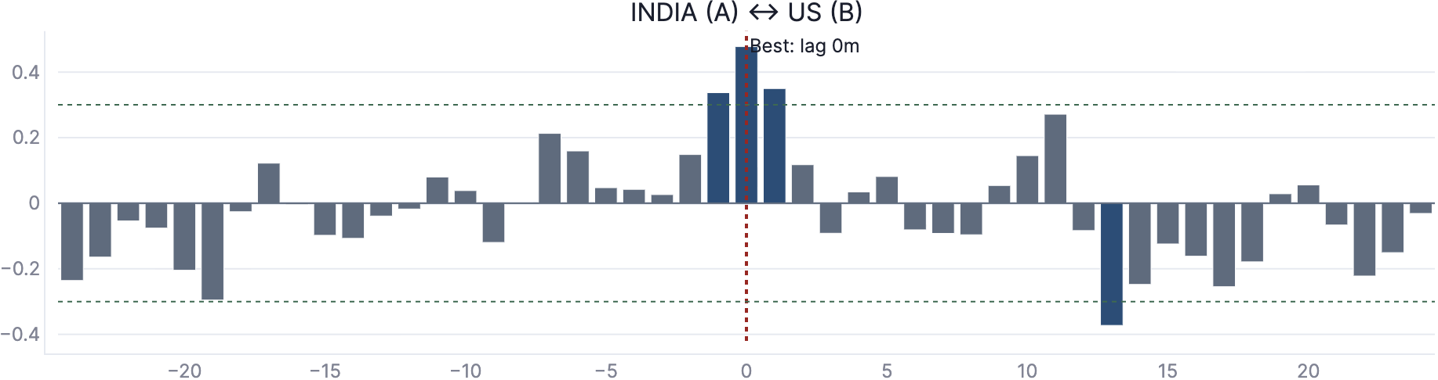

INDUSTRY
HRC & SUPPLY CHAIN
COMPANY & RIVALS
PRICING
THE PROBLEM
DASHBOARD
RECOMMENDATIONS
Timing — Some Drivers Move First, and China Leads India
Lead-lag is computed on STL residuals (trend & seasonality removed) to isolate true short-run transmission. Lead time = warning time.
Lead-lag: driver co-movement with HRC (−6…+6 m)
China ↔ India · corr 0.59
China ↔ US · corr 0.48
India ↔ US · corr 0.48
Leading is not causing.
The headline linkage
Positive lag = the driver moves first and HRC follows (a leading indicator). We say “tends to lead” and “historically precedes” — never “predicts.”
CHINA
moves first
INDIA
follows
corr ≈ 0.59
+1 m
Source: HRC dashboard — lead-lag & cross-region tabs. CCF on STL residuals; pairwise correlations on returns (currency-neutral), 86–123 month overlaps.

Slide 10
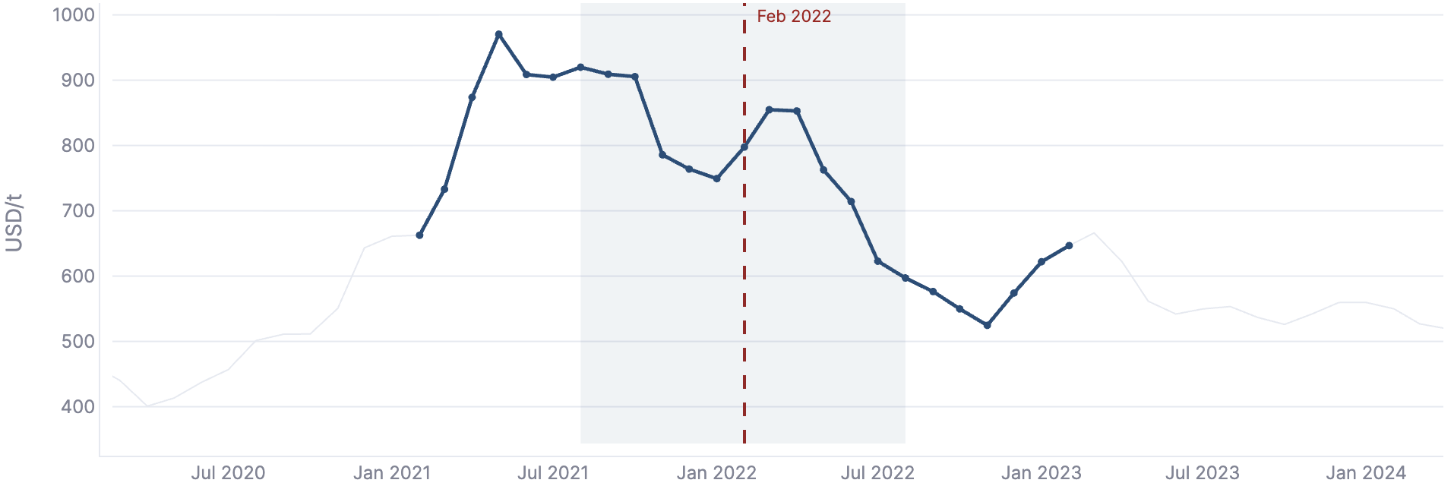
INDUSTRY
HRC & SUPPLY CHAIN
COMPANY & RIVALS
PRICING
THE PROBLEM
DASHBOARD
RECOMMENDATIONS
Event Deep-Dive — Watching the Engine Work (Ukraine, Feb 2022)
Purely backward-looking: what moved, why, and how it transmitted into India — a validation that the framework explains real history.
HRC around the shock — Feb 2022 marked
The India channel — hit from both sides
~85%
of India's coking coal is imported — Coal spike fed straight into mill costs
+₹5,000/t
domestic HRC & TMT price rises — Indian mills raised prices, early Mar 2022
SUPPLY SHOCK — lifted prices, briefly
Russia: major energy, coal & pig-iron supplier. Ukraine output −68% (Azovstal, Ilyich halted). Inputs spiked → brief HRC lift.
May 2022
steel export duty imposed — Redirected supply inward; weighed on Indian HRC into mid-2022
DEMAND FORCE — won out, medium term
Energy costs fed inflation → central banks hiked; China property slowdown rolled on. Demand won → HRC followed costs back down.
A global event, transmitted directly into our own costs
Source: HRC dashboard — event deep-dive tab; sourced, dated market context (coking coal, export duty). Backward-looking analysis only.

Slide 11
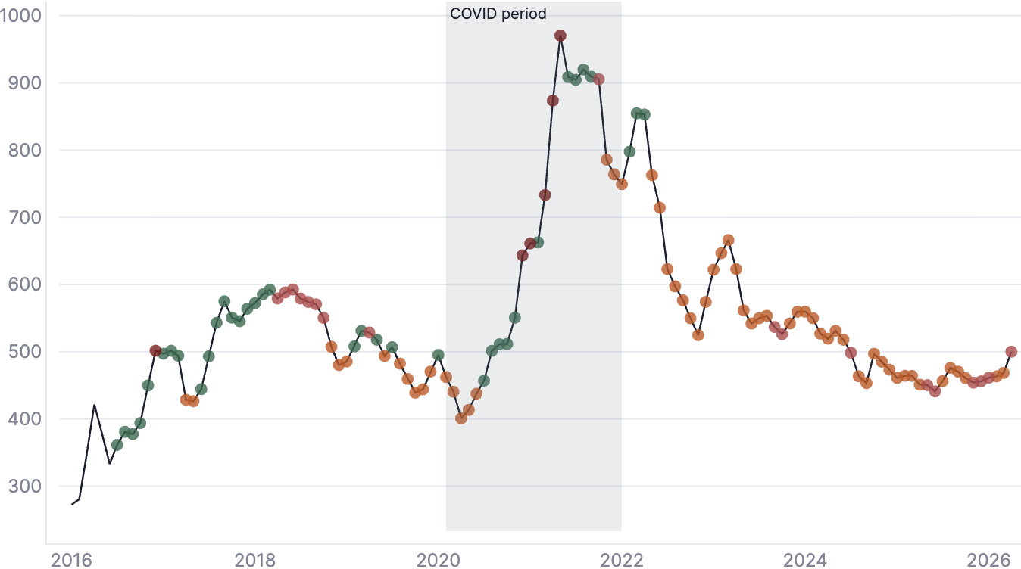
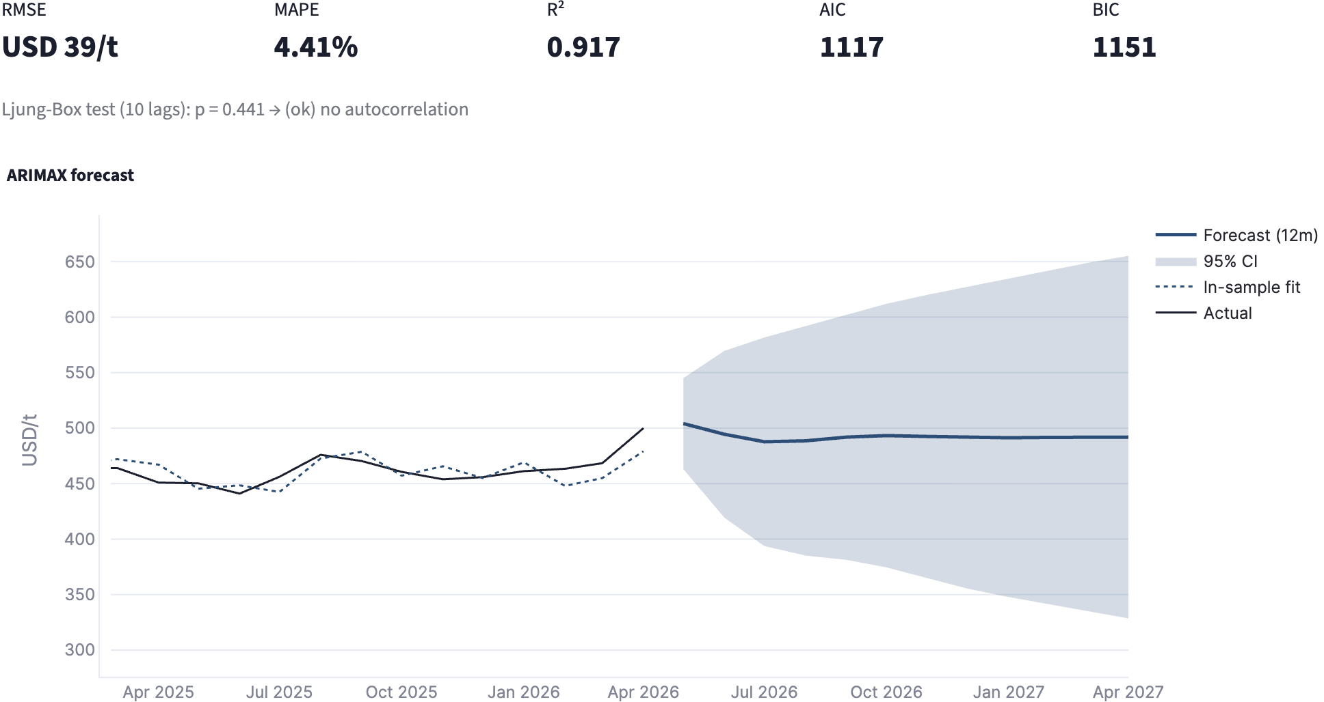
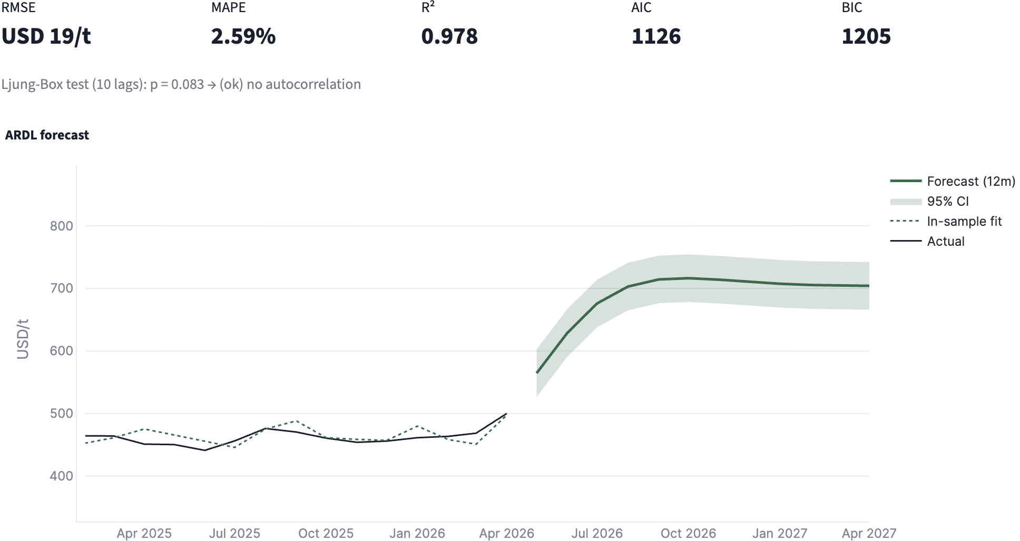
INDUSTRY
HRC & SUPPLY CHAIN
COMPANY & RIVALS
PRICING
THE PROBLEM
DASHBOARD
RECOMMENDATIONS
Regimes, Cycles & Looking Forward — Honestly
The market has data discovered moods; forecasts are directional inputs with wide bands.
Data-discovered regimes (COVID period shaded)
ARIMAX forecast
MAPE 4.41%
RMSE $39/t
R² 0.917
ARDL forecast
MAPE 2.59%
RMSE $19/t
R² 0.978
Source: HRC dashboard — regimes & forecasting tabs. In-sample fit shown; forecasts carry wide bands and are decision inputs, not targets.

Slide 12



INDUSTRY
HRC & SUPPLY CHAIN
COMPANY & RIVALS
PRICING
THE PROBLEM
DASHBOARD
RECOMMENDATIONS
Recommendations — What the Evidence Says to Do
Decision mapped to the calls SPA : posture, timing, and the one thing to watch.
1
The market is flattening, not falling
2
Hold the line — do not cut
3
Margins are strong — room to hold
After a +27% climb, the forecast says prices hold. Holding is not falling.
Cutting now gives back hard-won gains for no real reason.
Profit/tonne is in the healthiest quartile of its history; no need to buy sales with price.
4
China points slightly up
5
Watch our own costs
Bottom line
Hold price. Defend margin.
Watch iron ore & coking coal as the early warning signal — and pass cost through if it rises.
China rose last month and tends to lead India ~1 m — a gentle upward pull, if anything.
Raw-material costs are creeping up. If they keep rising, raise price — don't absorb it quietly.
Source: synthesis of HRC dashboard outputs (forecast, spread percentile, lead-lag, attribution). Recommendations are evidence-based inputs; pricing decisions rest with the Pricing Committee.

Slide 13

TATA STEEL
What This Gives Tata Steel
Five things we now know with evidence instead of instinct — and a capability that keeps learning.
1
Raw materials dominate the price
Cost leads; demand & macro come second
2
Some drivers move first — a watch-list
Lead time is warning time; track monthly
3
The spread shows where margin sits
A decade of context for today's reading
4
China gives India a ~1-month head start
Moderate but real cross-region signal
5
Recognisable moods — we explain the turns
Ukraine deep-dive validated the engine
A living capability, not a one-off study. The dashboard refreshes every month — same validated engine, ten interactive tabs. hrcpipeline-tata-bharat.streamlit.app

Slide 14
THANK YOU

