Slide 1

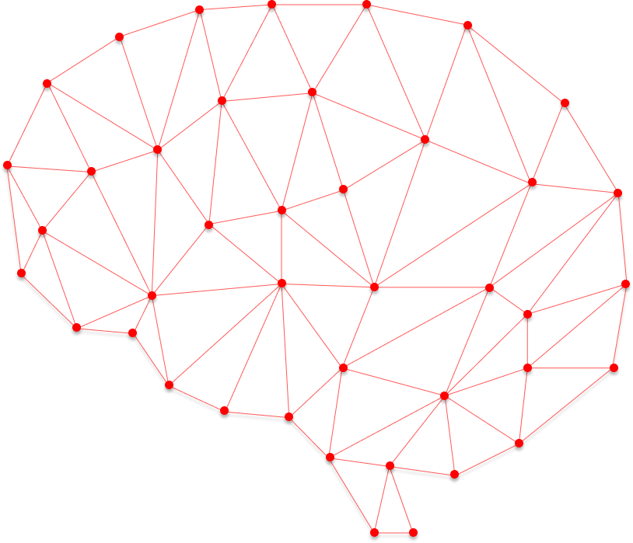

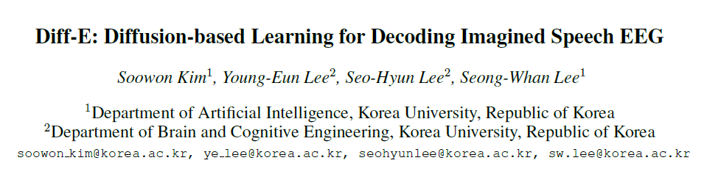
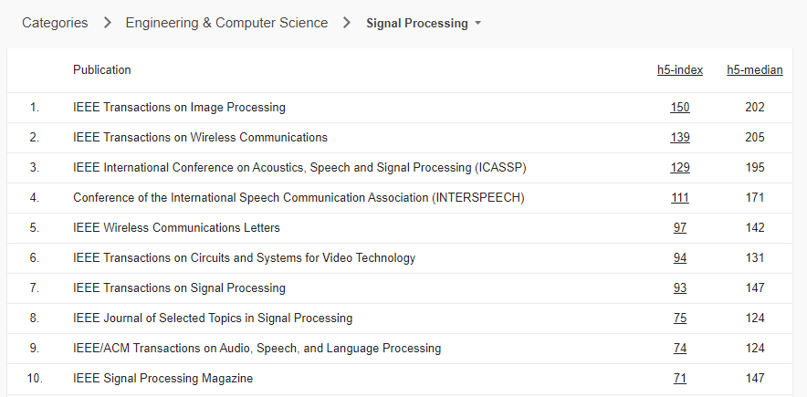
BMIS Study Paper Review #1
Presenter : Saehyung Cheong

Slide 2
Introduction
Denoising diffusion probabilistic models (DDPMs) have become a powerful tool for identifying sophisticated patterns within complex data, especially when dealing with high-dimensional data.
The CAE aids in learning meaningful features potentially lost during the forward process in DDPMs.
In this study, a novel approach to decode EEG signals using DDPMs and a Conditional Autoencoder (CAE) was presented.
This proposed approach represents the first attempt to utilize diffusion models to decode EEG signals associated with imagined speech.

Slide 3
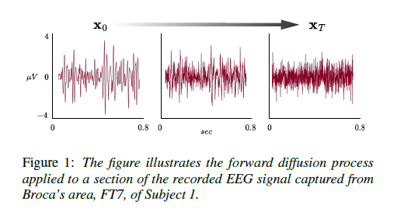
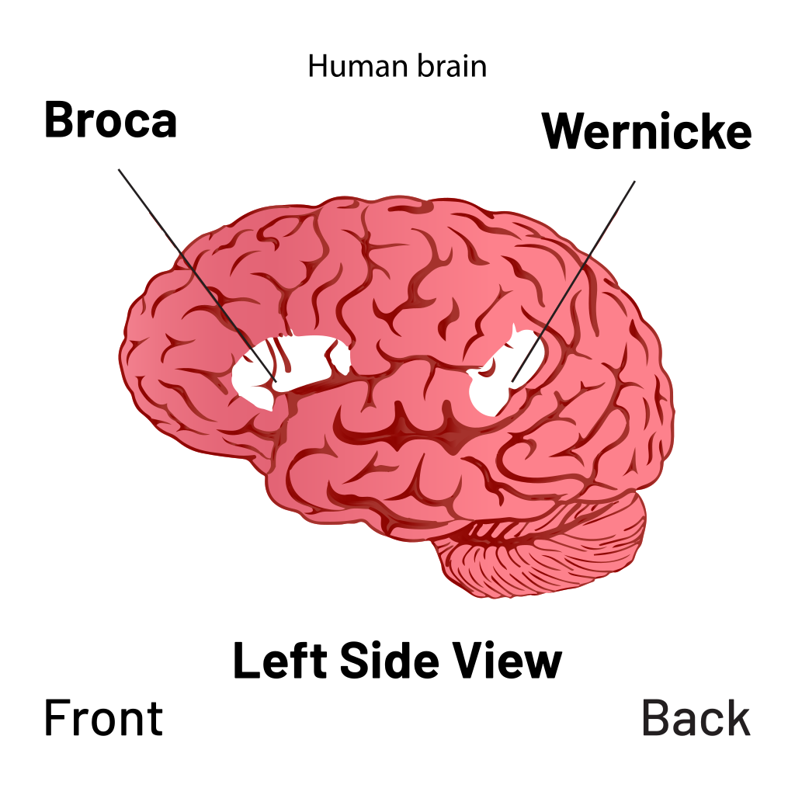
Introduction

Slide 4
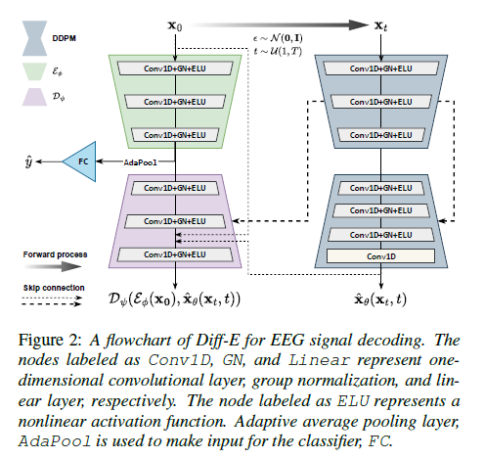




Materials and Methods
Denoising Diffusion Models

Slide 5
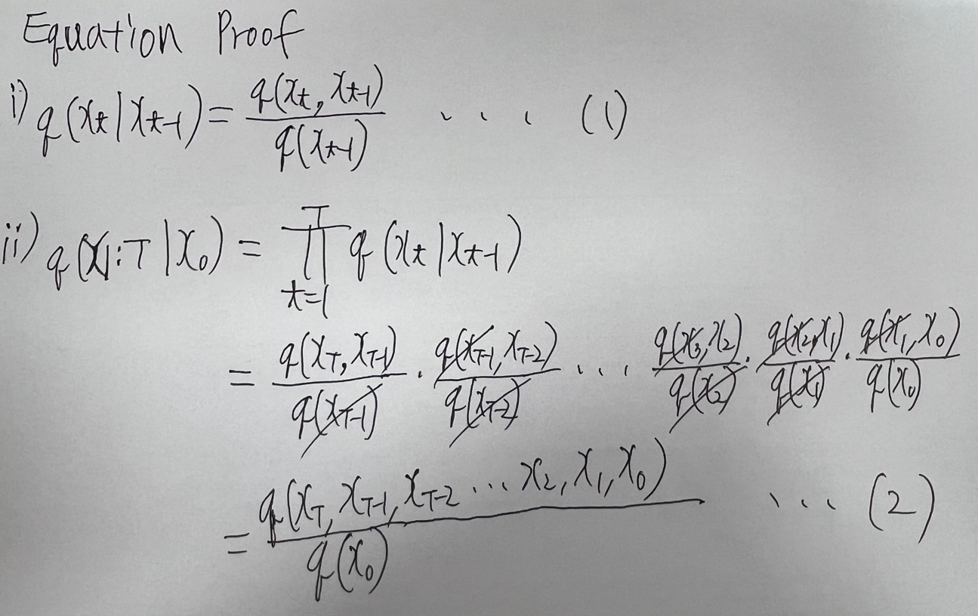
Materials and Methods
Denoising Diffusion Models

Slide 6

Materials and Methods
Conditional Autoencoder
Classifier
Model Implementation Details
∙ Model Code → https://github.com/yorgoon/DiffE/

Slide 7
Materials and Methods
Data Description
The study involved recruiting twenty-two healthy participants, of whom fifteen were male, with a mean age of 24.68 ± 2.15.
They were instructed to imagine saying twelve different words or sentences, such as “ambulance,” “clock,” “hello,” “help me,” “light,” “pain,” “stop,” “thank you,” “toilet,” “TV,” “water,” and “yes”.
The researchers randomly presented twenty-two blocks of twelve words and a rest class.
Each participants contributed one thousand three hundred samples, consisting of one hundred samples per category.

Slide 8
Materials and Methods
Preprocessing
The first step was to apply band-pass filtering to the signals between 0.5 and 125Hz, with additional notch filtering at 60 and 120Hz to eliminate power line interference.
They used automatic electrooculography and electromyography removal methods to eliminate ocular and muscular artifacts.
After removing the artifacts, the EEG signals were selected in the high-gamma frequency band for training the model and data analysis.
The dataset was then epoched into 2-second segments, with baseline correction applied 500ms before the task.

Slide 9
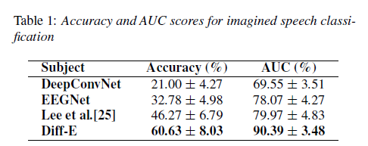
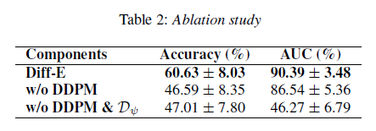
Results and Discussion
Performance Comparison
Ablation Study

Slide 10
Results and Discussion
Future Works
The method was tested on a non-public dataset, as it had larger and more diverse classes than other public datasets, which usually have only a few classes.
Although the EEG dataset was relatively large, it may still be inadequate for large deep-learning models to optimize effectively.
They plan to collect larger datasets with more subjects and apply their method to various EEG paradigms, including motor imagery and event-related potentials.
They also plan to investigate methods for end-to-end learning directly from raw EEG signals, potentially reducing the need for extensive pre-processing and enhancing the efficiency of their method.

Slide 11
Conclusion
The use of DDPMs provides an innovative solution that has demonstrated superior performance compared to traditional methods such as DeepConvNet and EEGNet.
Selecting appropriate model architectures is also important as DeepConvNet and EEGNet showed poor performance in our study.
Overall, this study provides a promising approach to accurately decoding EEG signals related to imagined speech.
This work also contributes to advancing the understanding and utilization of deep learning-based approaches in EEG signal processing and decoding.
Notes:
감마파에서 음성 관련된 뇌파가 많이 나온다.

