Slide 1

University of Regina
Faculty of Engineering and applied Science
ENIN-833 (Winter 2020)
Presentation Title
Developing a PID Controller to Control the Output Speed of a DC Motor
Using Ziegler–Nichols Method
Behnam Moradi
M.Sc. in Industrial Systems Engineering
Supervisor
Professor Mehran Mehrandezh

Slide 2
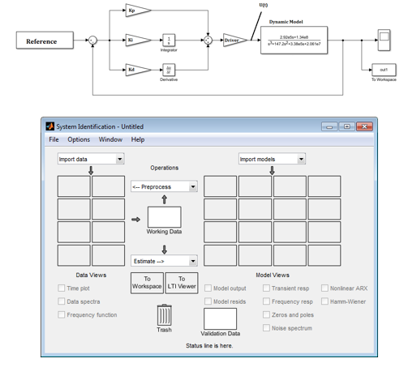
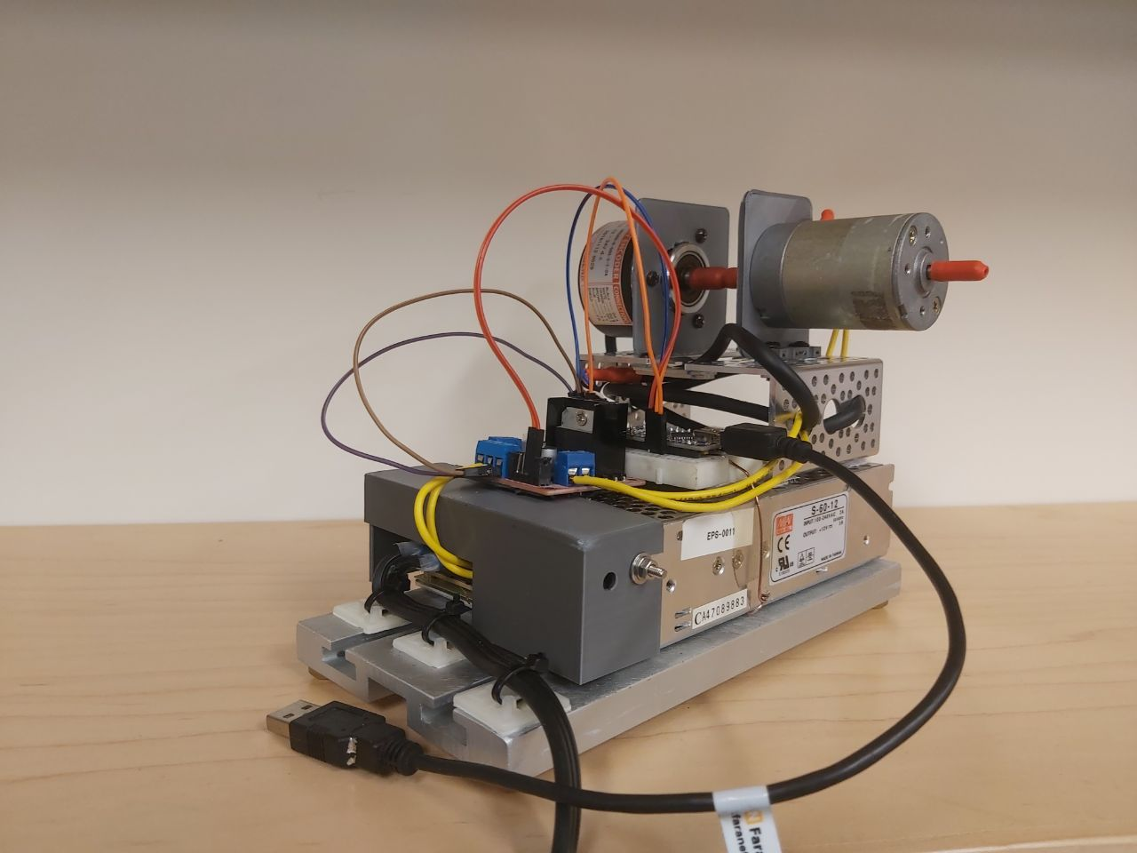

Developing a PID Controller to Control the Output Speed of a DC Motor Using Ziegler–Nichols Method
Simulated System
Actual System

Slide 3
Developing a PID Controller to Control the Output Speed of a DC Motor Using Ziegler–Nichols Method
Presentation Outline
0.000
How to Extract the Dynamic Model of the Actual System?
1
What is Ziegler–Nichols (ZN) Method?
2
What is the procedure to Implement ZN Method?
3
How to Validate ZN Method Using the Actual System?

Slide 4
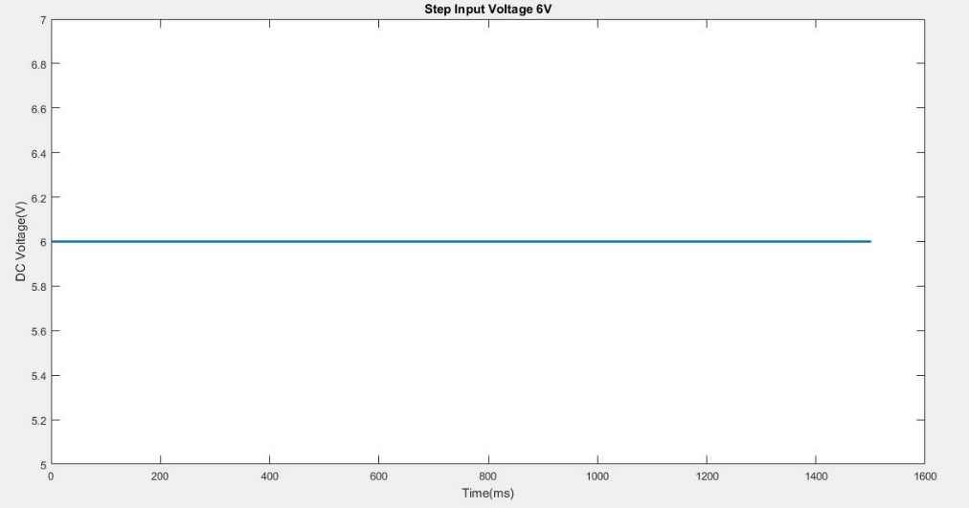
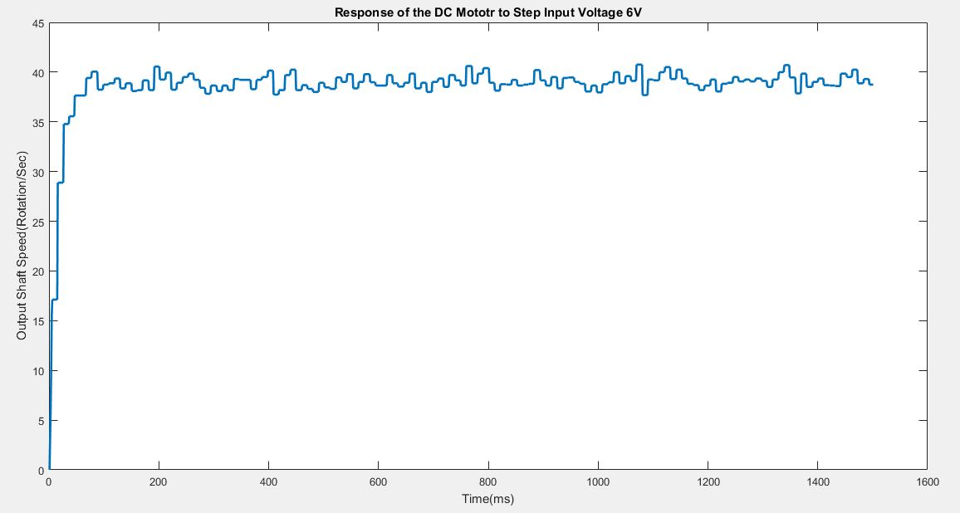
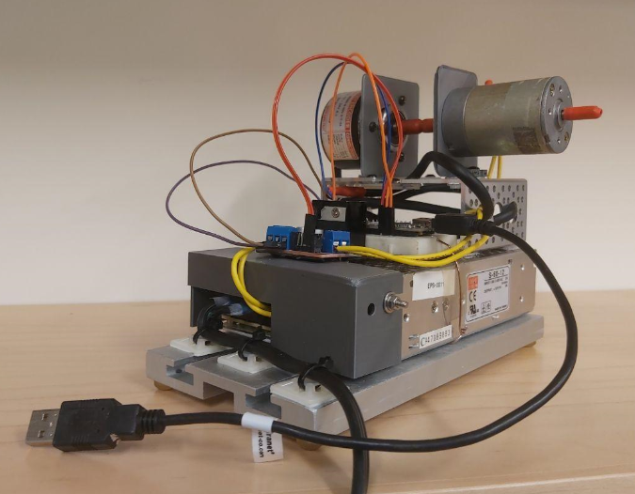
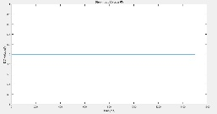
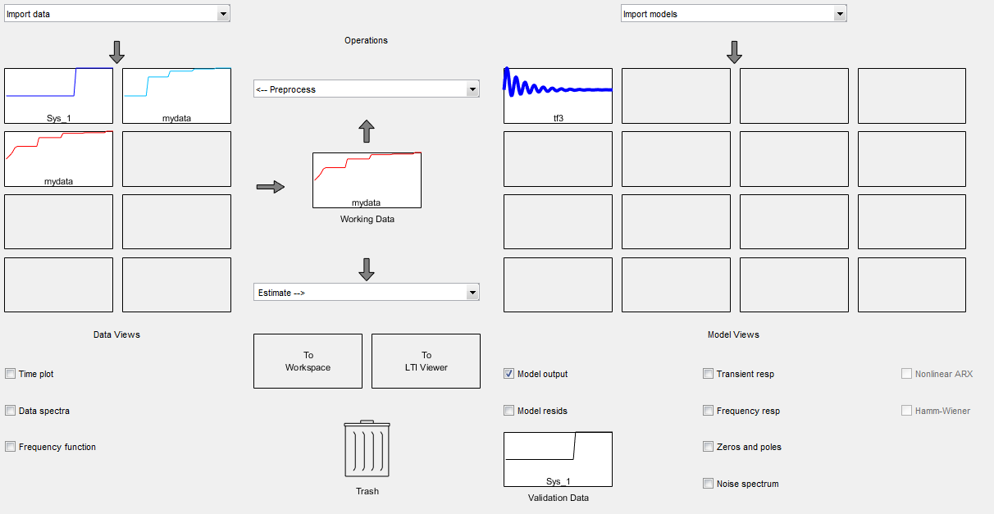
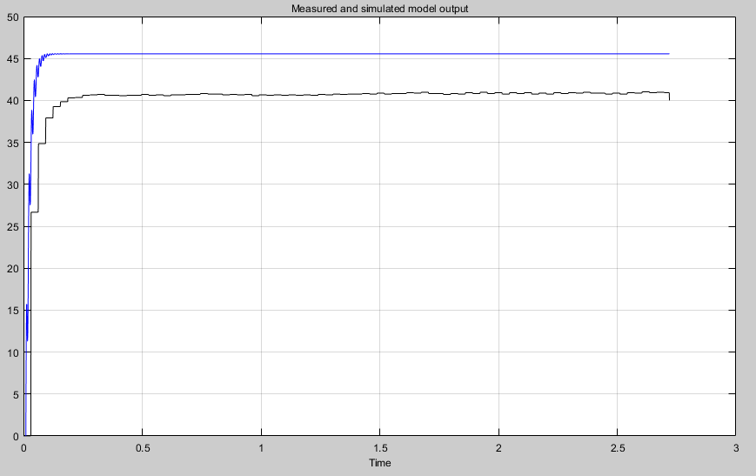
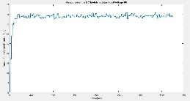

Developing a PID Controller to Control the Output Speed of a DC Motor Using Ziegler–Nichols Method
0.001
How to Extract the Dynamic Model of the Actual System?
DC Motor Set-Up
Input
Output
Input
$$G(s)=\frac{2.92×{\left(10\right)}^{5}s+1.341{\left(10\right)}^{8}}{s^{3}+147.2s^{2}+3.38{\left(10\right)}^{5}s+2.061{\left(10\right)}^{7}}$$
Output
74%
MATLAB Sys Identification

Slide 5
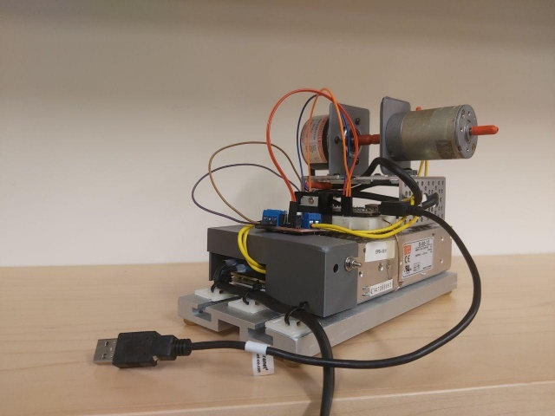
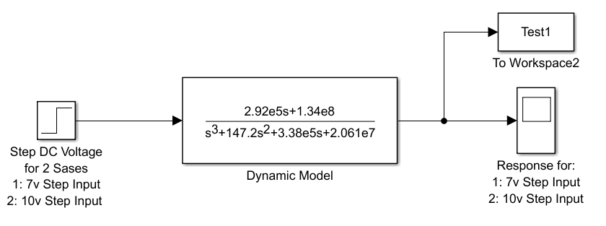
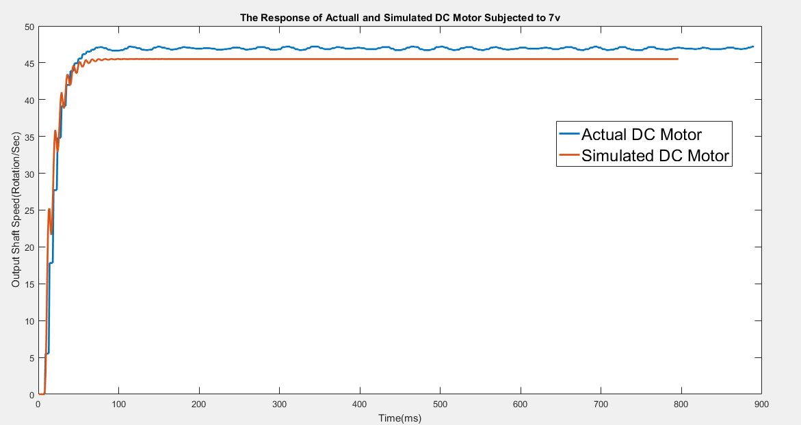
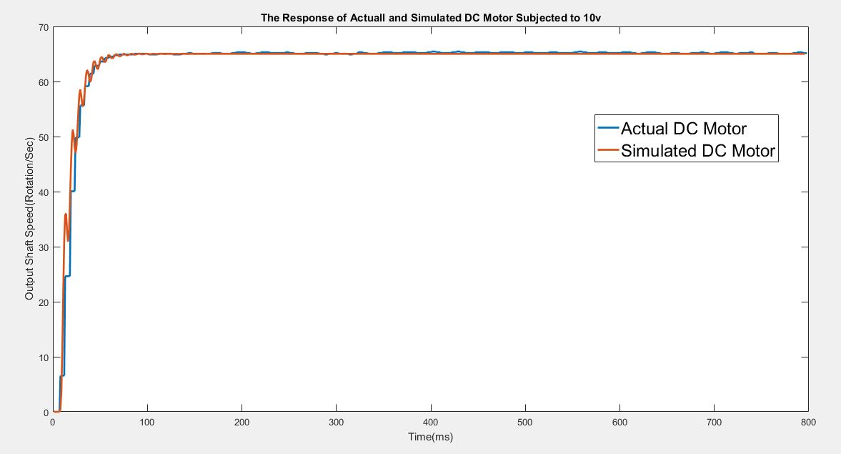
Developing a PID Controller to Control the Output Speed of a DC Motor Using Ziegler–Nichols Method
0.000
How to Validate The Model?

Slide 6
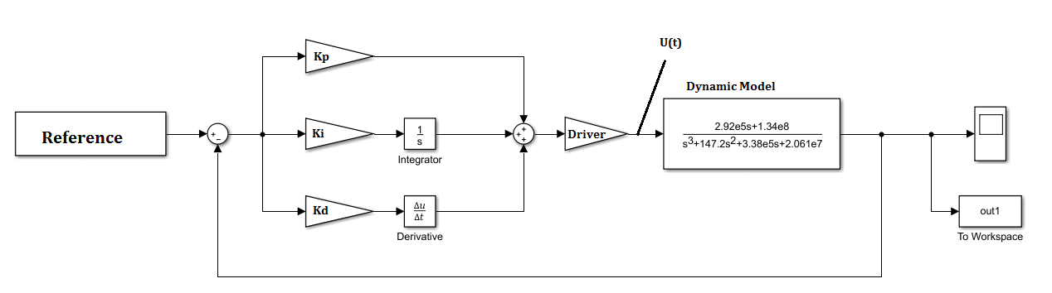
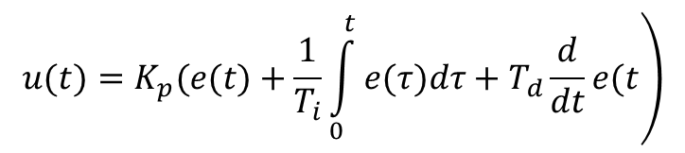
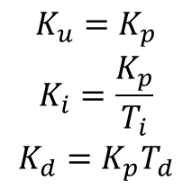
Developing a PID Controller to Control the Output Speed of a DC Motor Using Ziegler–Nichols Method
1
What is Ziegler-Nichols (ZN) Method?
$$\left.u(t)=K_{p}(e(t)+\frac{1}{T_{i}}\int_{0}^{t}{e(τ)dτ}+T_{d}\frac{d}{dt}e(t\right)$$
Kp = ?
Ziegler-Nichols Method is:
An iterative online method to choose Kp, Ki, and Kd in order to tune a PID Controller.
PID
Ki = ?
$$\begin{matrix}K_{u}=K_{p} \\ K_{i}=\frac{K_{p}}{T_{i}} \\ K_{d}=K_{p}T_{d}\end{matrix}$$
Kd = ?

Slide 7
Developing a PID Controller to Control the Output Speed of a DC Motor Using Ziegler–Nichols Method
1
Tell me More about ZN Method!
It does not require expert knowledge! Just do the formulation!
It requires a stable system!
It requires a system that can be driven unstable with increasing proportional gain!
It can be implemented on the actual systems without doing any simulation! But some times it can be very expensive to do so.

Slide 8
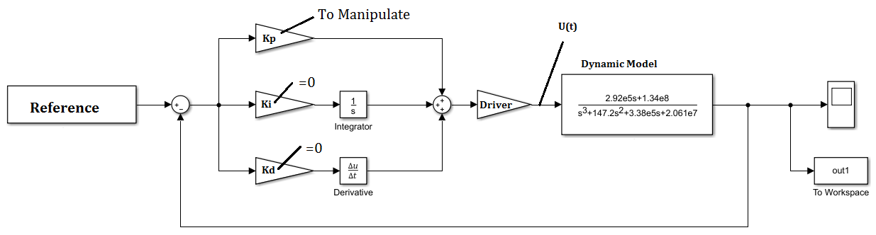
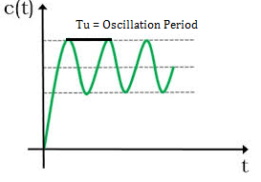
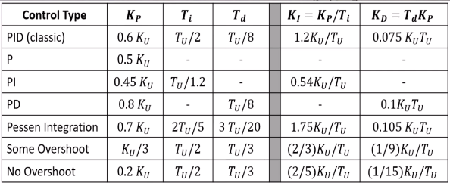
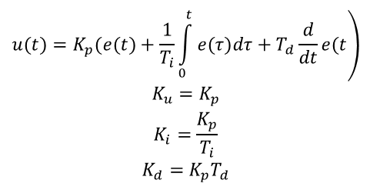
Developing a PID Controller to Control the Output Speed of a DC Motor Using Ziegler–Nichols Method
2
What is the procedure to Implement ZN Method?
1: Start manipulate Kp from a small value to the bigger values.
Marginally Stable System
2: Continue manipulation of Kp until getting Natural/Marginal Stability.
3: Record the value of Kp (Proportional Gain) and Tu (Oscillation Period) and calculate Ki and Kd using Ziegler-Nichols Table.
$$\begin{matrix}\left.u(t)=K_{p}(e(t)+\frac{1}{T_{i}}\int_{0}^{t}{e(τ)dτ}+T_{d}\frac{d}{dt}e(t\right) \\ K_{u}=K_{p} \\ K_{i}=\frac{K_{p}}{T_{i}} \\ K_{d}=K_{p}T_{d}\end{matrix}$$

Slide 9
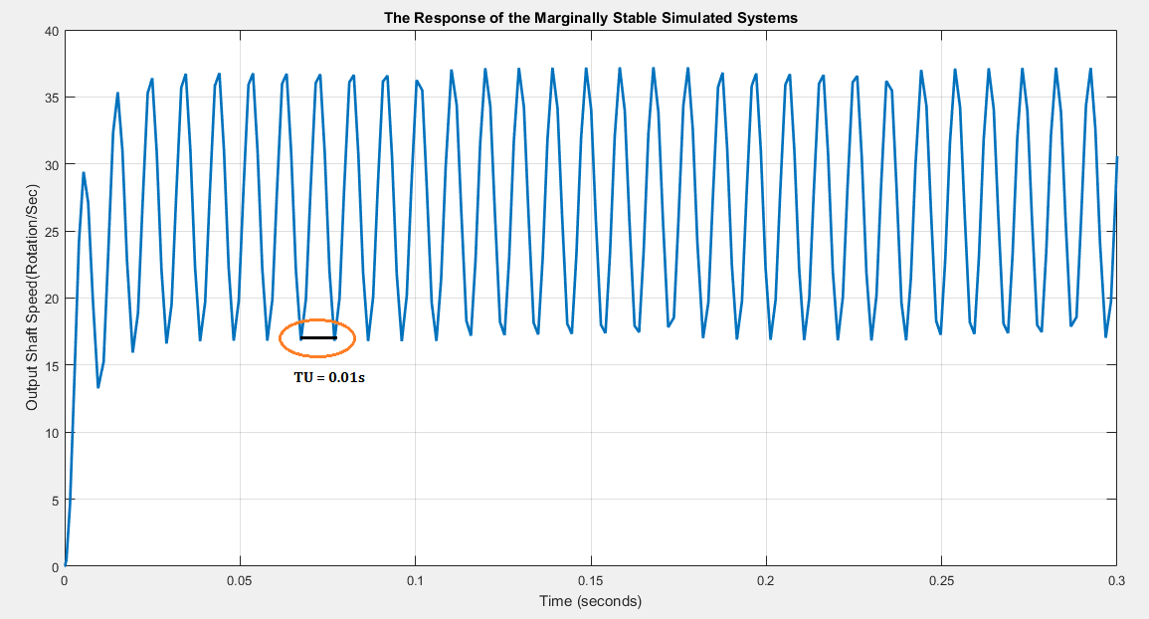
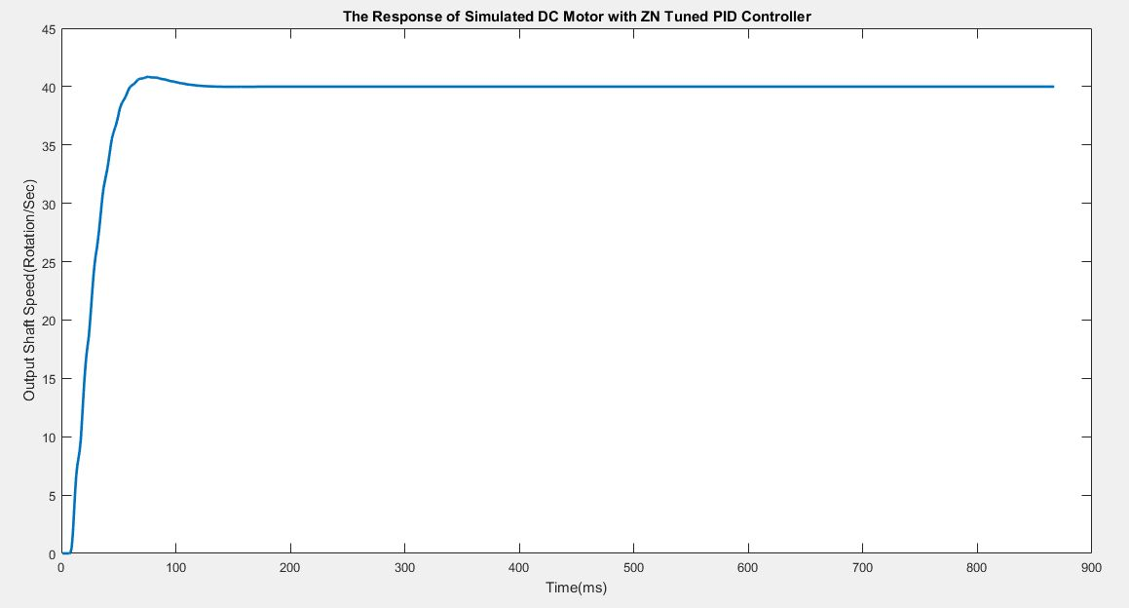
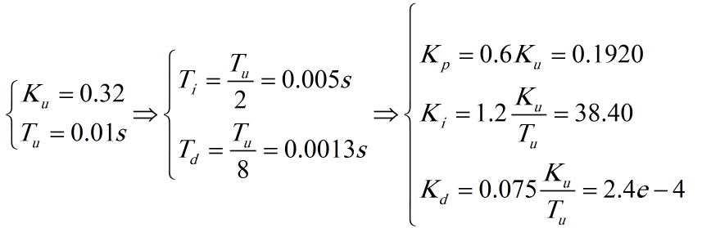

Developing a PID Controller to Control the Output Speed of a DC Motor Using Ziegler–Nichols Method
3
What is the procedure to Implement ZN Method?
$$\left\{\begin{matrix}K_{u}=0.32 \\ T_{u}=0.01s\end{matrix}\right.$$
Set Point/Reference = 40 Rot/sec

Slide 10
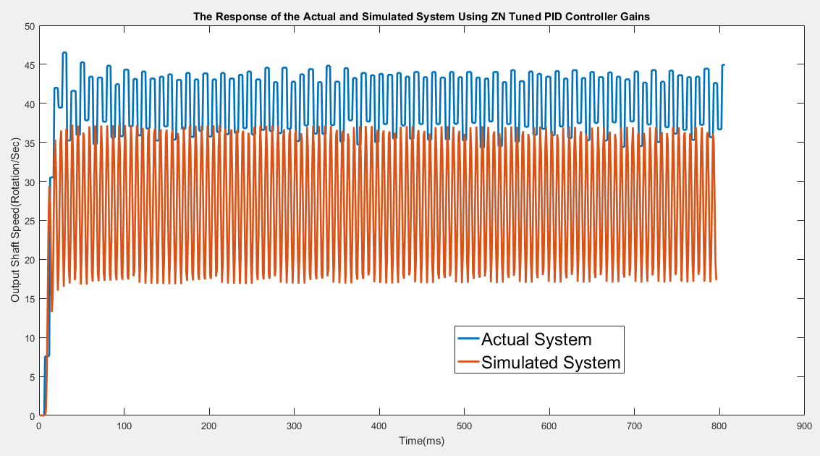
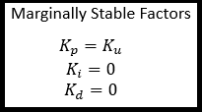
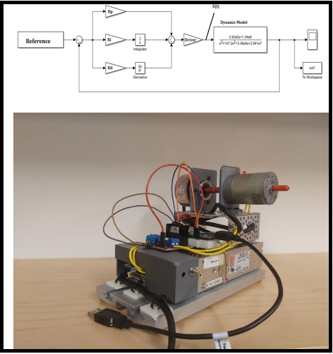
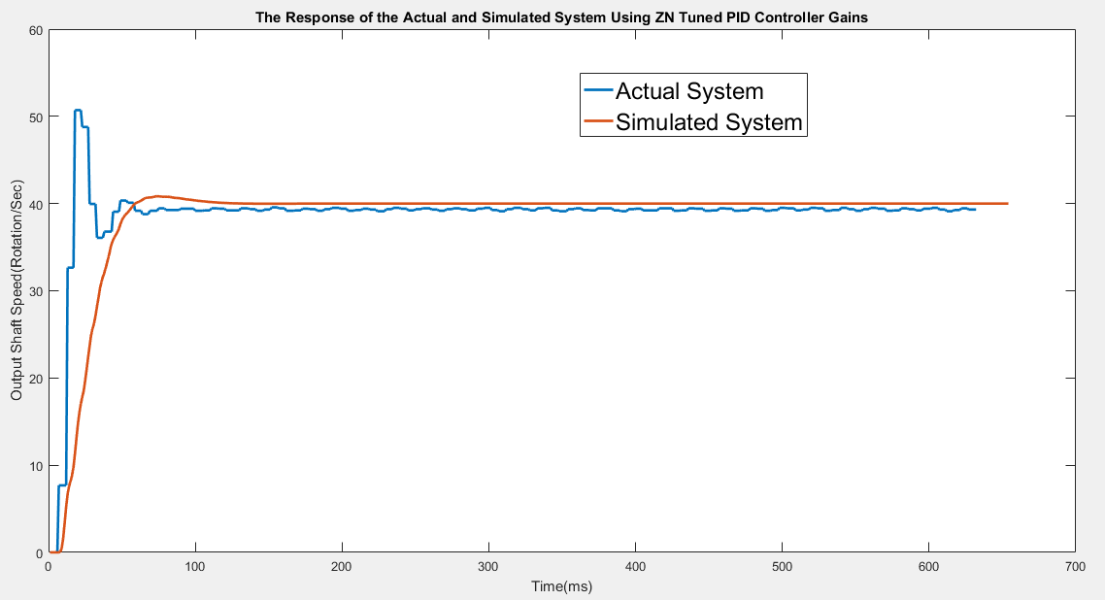
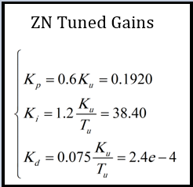
Developing a PID Controller to Control the Output Speed of a DC Motor Using Ziegler–Nichols Method
3
How to Validate ZN Method Using the Actual System?

Slide 11
Thank you!

