Slide 1
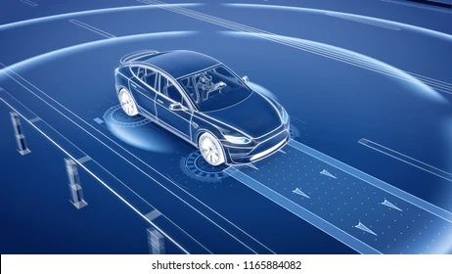
Analyzing the Impact of Car Features on Price & Profitability

Slide 2

Project Description
The automotive industry has been rapidly evolving over the past few decades that results in increasing competition among manufactures and a changing consumer landscape.
It become more important to understand the factors that drive consumer demand for cars.
So by using, Regression analysis and market segmentation to understand the factors that drive consumer demand for cars and help the manufacturer develop a pricing strategy that balances consumer demand with profitability, and identify which product features to focus on in future product development efforts.
It will help the stakeholder to improve their competitiveness in the market and increase its profitability over time.

Slide 3
Tech Stack Used
Ms Excel office 2016
A spreadsheet software where data can be stored in tabular format, cleaned and analysed to obtain meaningful insights for data-driven decisions.
For EXCEL FILE CLICK HERE
Tableau Public 2023.3
Tableau Public is a free platform to explore, create and publicly share data visualizations online. With the largest repository of data visualizations in the world, Tableau Public makes developing data skills easy.
For Tableau Dashboard CLICK HERE
Ms PowerPoint 2016
A powerful presentation maker used to create slideshow of valuable information through charts, and images.

Slide 4
Approach
The client has asked How can a car manufacturer optimize pricing and product development decisions to maximize profitability while meeting consumer demand?
Using Regression analysis, Trend lines, Correlation Coefficients to analyze the relationship between a car's features, market category, and pricing, and identifying which features and categories are most popular among consumers and most profitable for the manufacturer.
Client have also asked to create a interactive dashboard for the following:
How Distribution of prices vary by brand and body style?
Which car have highest and average MSRPs and how does it vary by body style?
How do the different feature such as transmission type affect the MSRP, and how does this vary by body style?
How does the fuel efficiency of cars vary across different body styles and model years?
How does the car's horsepower, MPG, and price vary across different Brands?
Using Tableau, I will create a interactive dashboard for the client to take data-driven decisions on car features, pricing on their future productions.

Slide 5
The dataset contains information on various car models and their specifications, and is titled "Car Features and MSRP". It was collected and made available on Kaggle by Cooper Union, a private college located in New York City.
It contains 16 columns and 11,914 observations.
Data Cleaning:
All the duplicate rows are deleted from the data based on all columns. 11,199 columns will remain.
There are some null values and incorrect data in the dataset for the following columns:
Engine fuel Type: Only 3 values missing and it can be easily filled by searching on the internet.
Engine HP: About 69 missing values, their can also filled be wed searching.
Engine Cylinders: 30 missing values, wed scrapping is used.
Number of Doors: 6 values are missing filled them by searching on the internet.
Transmission type: There are 12 columns filled with “Unknown”, here by wed scraping we can correct them.
Market category: There are 3376 columns filled with “N/A”, using Pivot table the most frequently occurring market categories are calculated and fill the incorrect rows.

Slide 6
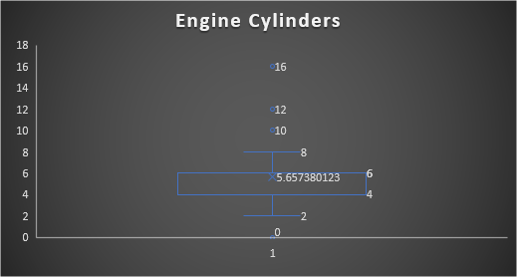
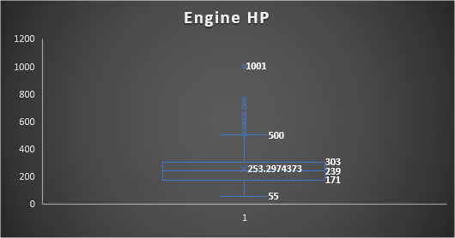
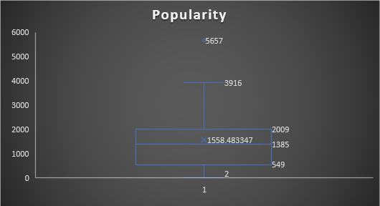
These 3 columns have outliers:
Above 500 horsepower, above 8 engine cylinders, and above 3916 ranking is a outlier.
But all the outliers are checked and left them as it is.

Slide 7
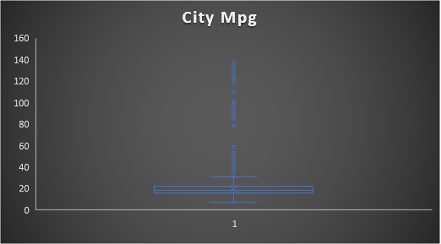
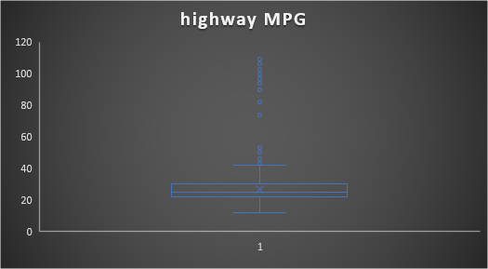
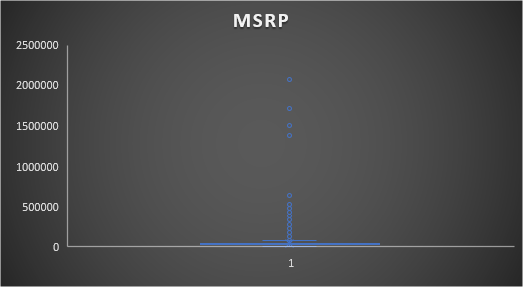
Highway MPG have a extreme data point 354 miles per gallon which is wrong. So, it is corrected.
Other Columns doesn’t have any wrong with the outliers.

Slide 8
Data analytics tasks:
Popularity of a car model varying across different market categories:
Task 1.A: Pivot Table: Pivot tables are among the most useful and powerful features in Excel. We use them in summarizing the data stored in a table.
Create a pivot table that shows the number of car models in each market category and their corresponding popularity scores.
Task 1.B: Combo Chart: A combination chart is a chart that combines two or more chart types in a single chart. Creating a combo chart that visualizes the relationship between market category and popularity.

Slide 10
Task 1.B: Combo chart that visualizes the relationship between market category and popularity.
Insights:
The table shows market categories and the count if cars in that category.
Majority of the cars manufactured are in “Flex Fuel” Category with 2022 cars.
Most popular cars in the market belongs to Crossover, Flex Fuel, Performance and Flex Fuel, Diesel categories.
This combo chart shows the count of cars in each market category in a line chart and its popularity in bar chart.

Slide 11
2. Relationship between a car's engine power and its price: Create a scatter chart that plots engine power on the x-axis and price on the y-axis.
Insights:
Scatter Plot to show the relationship between the horsepower of the car to its Price.
The relation between engine horsepower and MSRP is Positive Correlation.
Trendline have positive slope, that means the variables have positive association between them.
If horsepower increases, the price of the car also increases. The car will be expensive if it have high horsepower engine.

Slide 12
3. Which car features are most important in determining a car's price? :
Regression Analysis: Regression analysis is a set of statistical methods used for the estimation of relationships between a dependent variable and one or more independent variables.
Here we are going to use regression in data analysis add-in available in Excel to perform regression analysis to identify the variables that have the strongest relationship with a car's price. Then create a bar chart that shows the coefficient values for each variable to visualize their relative importance.

Slide 14
Insights:
Regression Analysis helps individuals and businesses determine how changes in one variable are associated with changes in another.
R-Squared is the coefficient of determination. It is a statistical measure of how well the regression line approximates the actual data. Here R-squared value is 0.4606 which is a low measure as it is less than 0.5.
The P-Value helps to determine if the relationships you observe also present in the larger population. Except city MPG all the other features are statistically significant.
Notes:
So it is better to remove cityMpg from our model

Slide 15
Insights:
Coefficients describe whether there is a positive or negative mathematical Relationship between the independent(Car Features) and dependent(Price) variables.
Positive sign shows that if independent variables increases and the price also increases.
Negative sign indicates if the car features variables increases, the price decreases.
These coefficient values indicates the mean change in the price given a one-unit change in car features.
So here, we have a high value for engine cylinders it means if there is a increase in number of cylinders, the price of the car increases by 8206 mean change.
Notes:
So it is better to remove cityMpg from our model

Slide 16
Row Labels | Average of MSRP
Acura | 35087
Alfa Romeo | 61600
Aston Martin | 198123
Audi | 54574
Bentley | 247169
BMW | 62163
Bugatti | 1757224
Buick | 29034
Cadillac | 56368
Chevrolet | 29075
Chrysler | 26723
Dodge | 24857
Ferrari | 238219
FIAT | 22670
Ford | 28511
Genesis | 46617
GMC | 32444
Honda | 26655
HUMMER | 36464
Hyundai | 24926
Infiniti | 42640
Kia | 25514
Lamborghini | 331567
Land Rover | 68067
Lexus | 47549
Lincoln | 43861
Lotus | 68377
Maserati | 113684
Maybach | 546222
Mazda | 20417
McLaren | 239805
Mercedes-Benz | 72070
Mitsubishi | 21341
Nissan | 28921
Oldsmobile | 12844
Plymouth | 3297
Pontiac | 19800
Porsche | 101622
Rolls-Royce | 351131
Saab | 27880
Scion | 19933
Spyker | 214990
Subaru | 24241
Suzuki | 18026
Tesla | 85256
Toyota | 28847
Volkswagen | 28979
Volvo | 29725
4. How does the average price of a car vary across different manufacturers?
Task 4.A: Creating a pivot table that shows the average price of cars for each manufacturer.
Task 4.B: A bar chart or a horizontal stacked bar chart that visualizes the relationship between manufacturer and average price.

Slide 17
Insights:
In this task, shows the relationship between manufactures and their respective average prices.
“Bugatti” model car have the highest average price while a model car called “Plymouth” have lowest average price.
Bugatti have only 3 car models, all of these are in Coupe style, Exotic, High-Performance market Category, with 16 engine cylinders and 1001 Horsepower. But it gives only 14 highway MPG and 8 city MPG.
While Plymouth, with only 4/6 cylinders have higher fuel efficiency but low horsepower than Bugatti but unfortunately it is discounted in 2000.
Next lowest average price car belongs to Oldsmobile, high fuel efficiency, have 4/6 cylinders and 140-150 Engine HP, but the popularity of this model is very low.

Slide 18
5. What is the relationship between fuel efficiency and the number of cylinders in a car's engine?
Task 5.A: Create a scatter plot with the number of cylinders on the x-axis and highway MPG on the y-axis.
Trend lines are straight lines that connect two or more points on a chart to identify and confirm trends.
A trendline is created on the scatter plot to visually estimate the slope of the relationship and assess its significance.
Task 5.B:
Correlation: It is a statistical measure that expresses the extent to which two variables are linearly related.
Positive Linear Correlation
Negative Linear Correlation
Non-linear Correlation
No Correlation.
Correlation coefficient is used in to measure how strong a connection between two variables and is denoted by r.
Calculate the correlation coefficient between the number of cylinders and highway MPG to quantify the strength and direction of the relationship.

Slide 20
Insights:
Relation between fuel Efficiency and Engine Horsepower is shown in scatter plot, with a trendline.
Here trendline have negative slope, which shows the negative association between them.
The correlation of these two variables is negative linear correlation, which means as one variable increases, the other decreases.
Correlation Coefficient (r) is -0.654.
Less Engine cylinders more fuel efficiency and vice versa. While, less cylinders means less Horsepower.

Slide 21
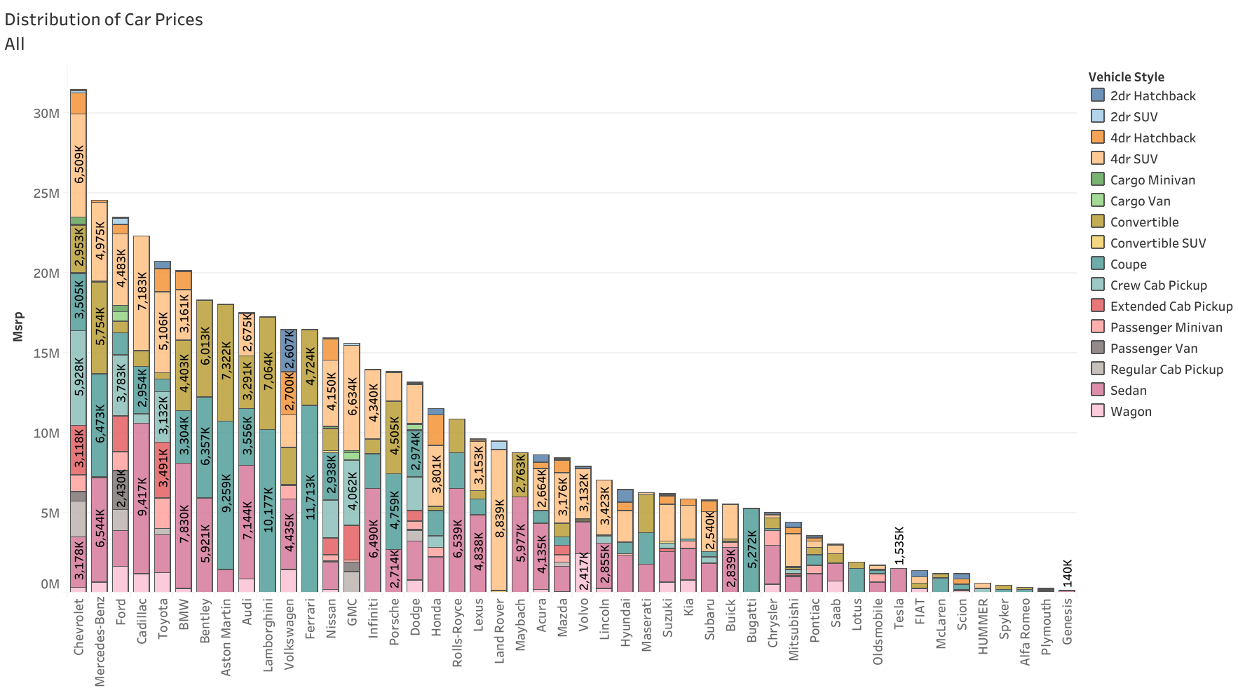
Creating interactive dashboard in Tableau:
CLICK HERE For Tableau public Dashboard
1. How does the distribution of car prices vary by brand and body style?
So this is a confusing chat, here each colour represents each body type.
So, added a filter for make and vehicle style to make it more readable.

Slide 22
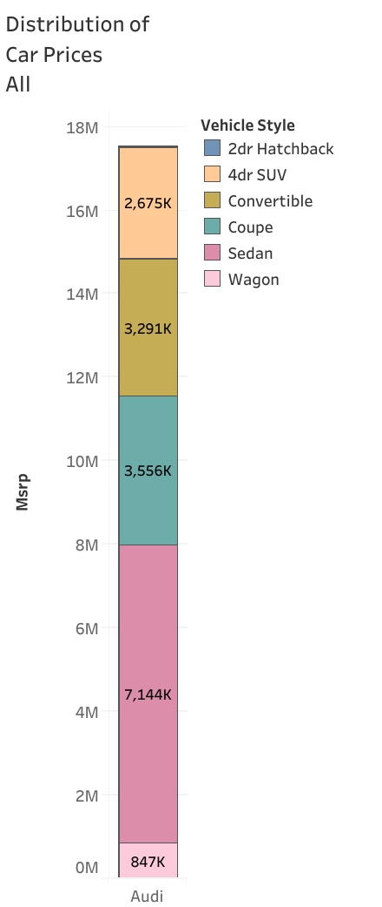
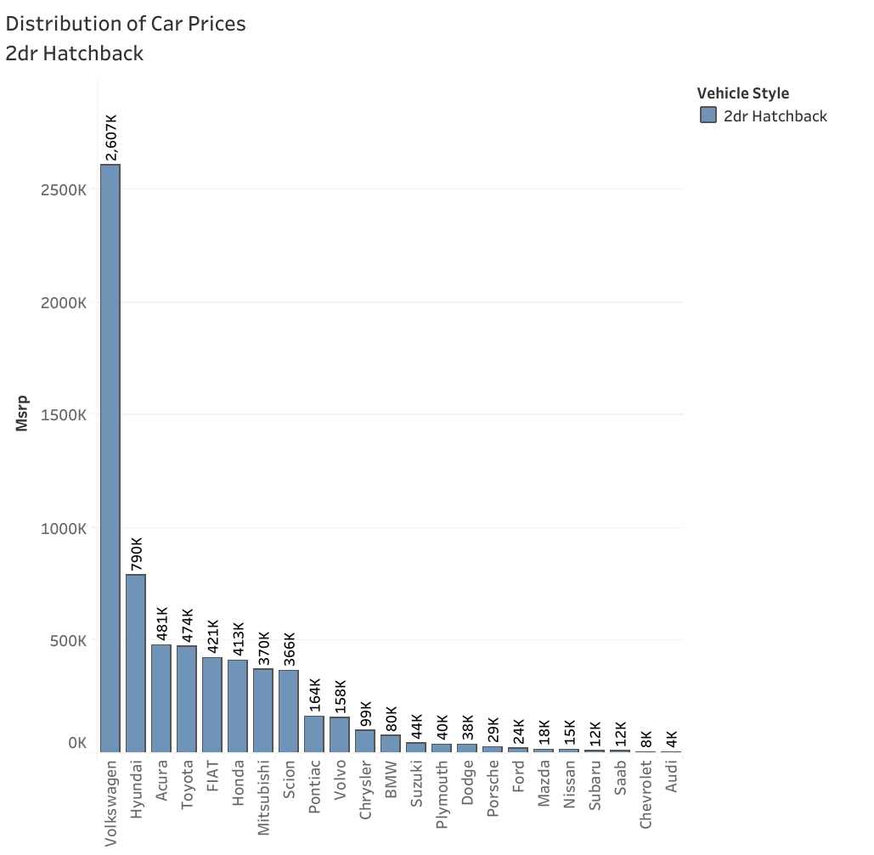
For 1st Picture, I have applied filter for car make. So here I am showing distribution of Prices for “Audi” for all the vehicle style.
For 2nd picture, I have applied filter for Vehicle style i.e., “ 2dr Hatchback” for all Car models.

Slide 23
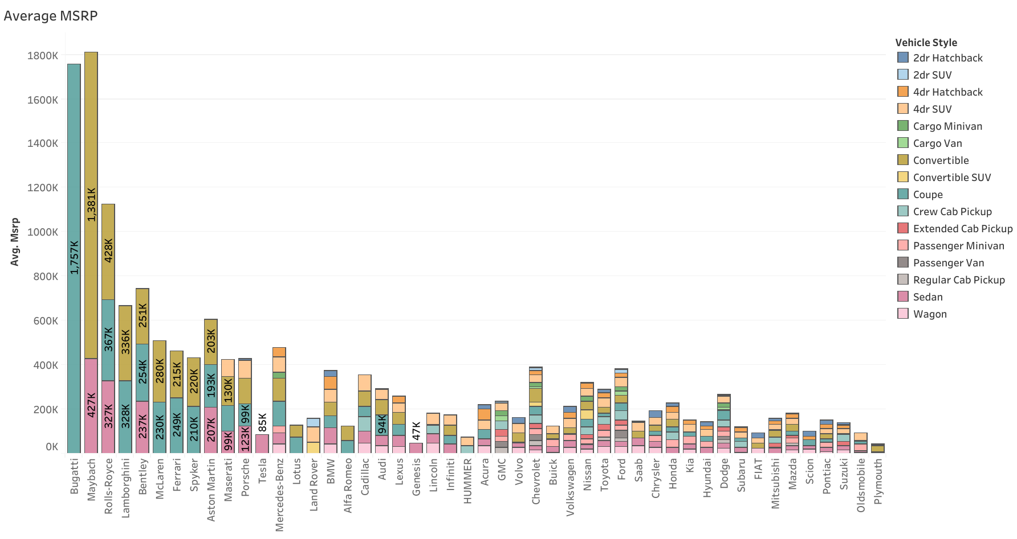
2. Which car brands have the highest and lowest average MSRPs, and how does this vary by body style?
Again this is a clustered chart so, I am Going to use “Make and Vehicle Style” filters.
Highest Average belongs to “Bugatti” with 1,757,224 dollars. It comes under luxury Car Brand.
Lowest Average Belongs To “Plymouth” with only 3,297 dollars. This is the most affordable car brand.

Slide 24
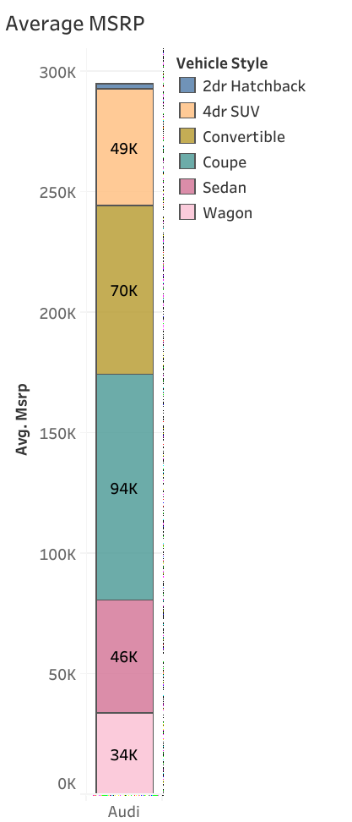
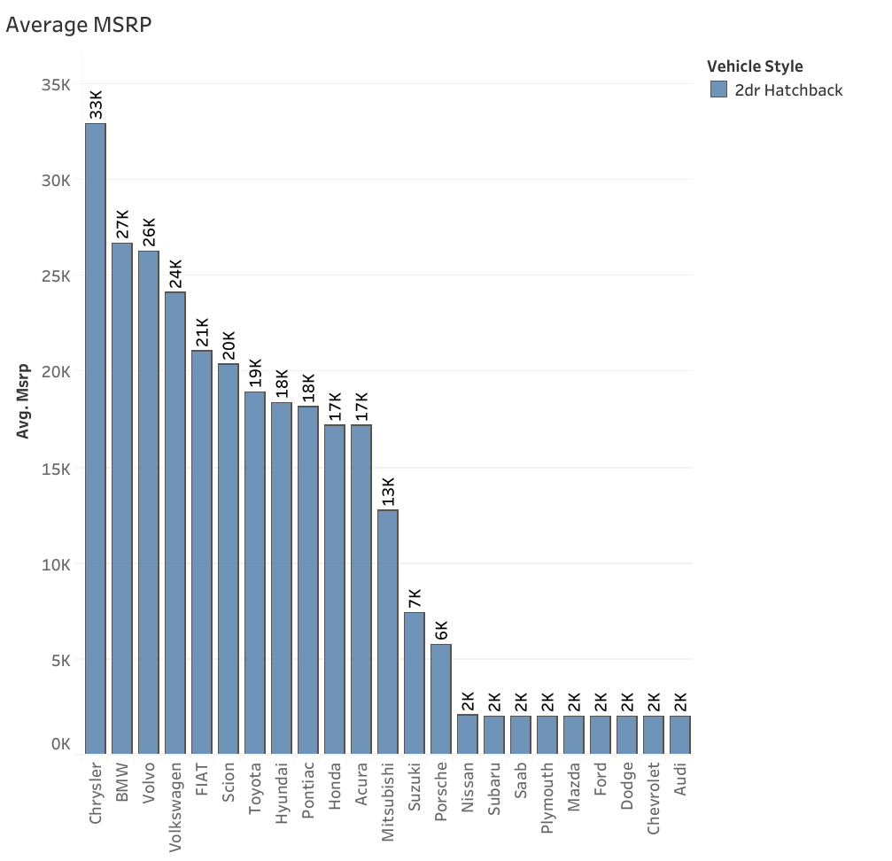
Here too we have applied the same filter as before. But instead of distribution of prices, this chart shows the average price of car by its Brand/make and Vehicle Style.

Slide 25
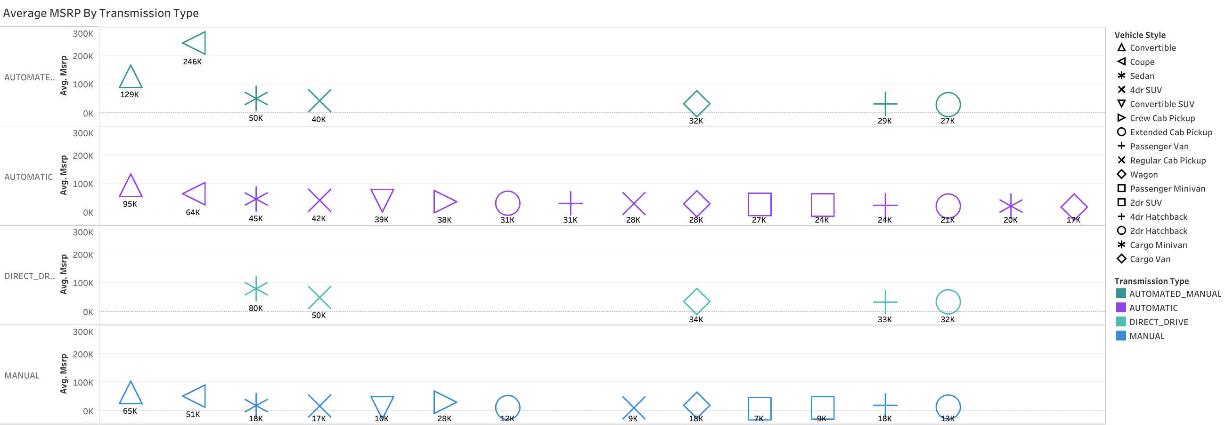
3.How do the different feature such as transmission type affect the MSRP, and how does this vary by body style?
Here each shape represents a Vehicle style while each colour represents a transmission type. Here too we can apply filters based on “Make” and “Vehicle Style”.

Slide 26
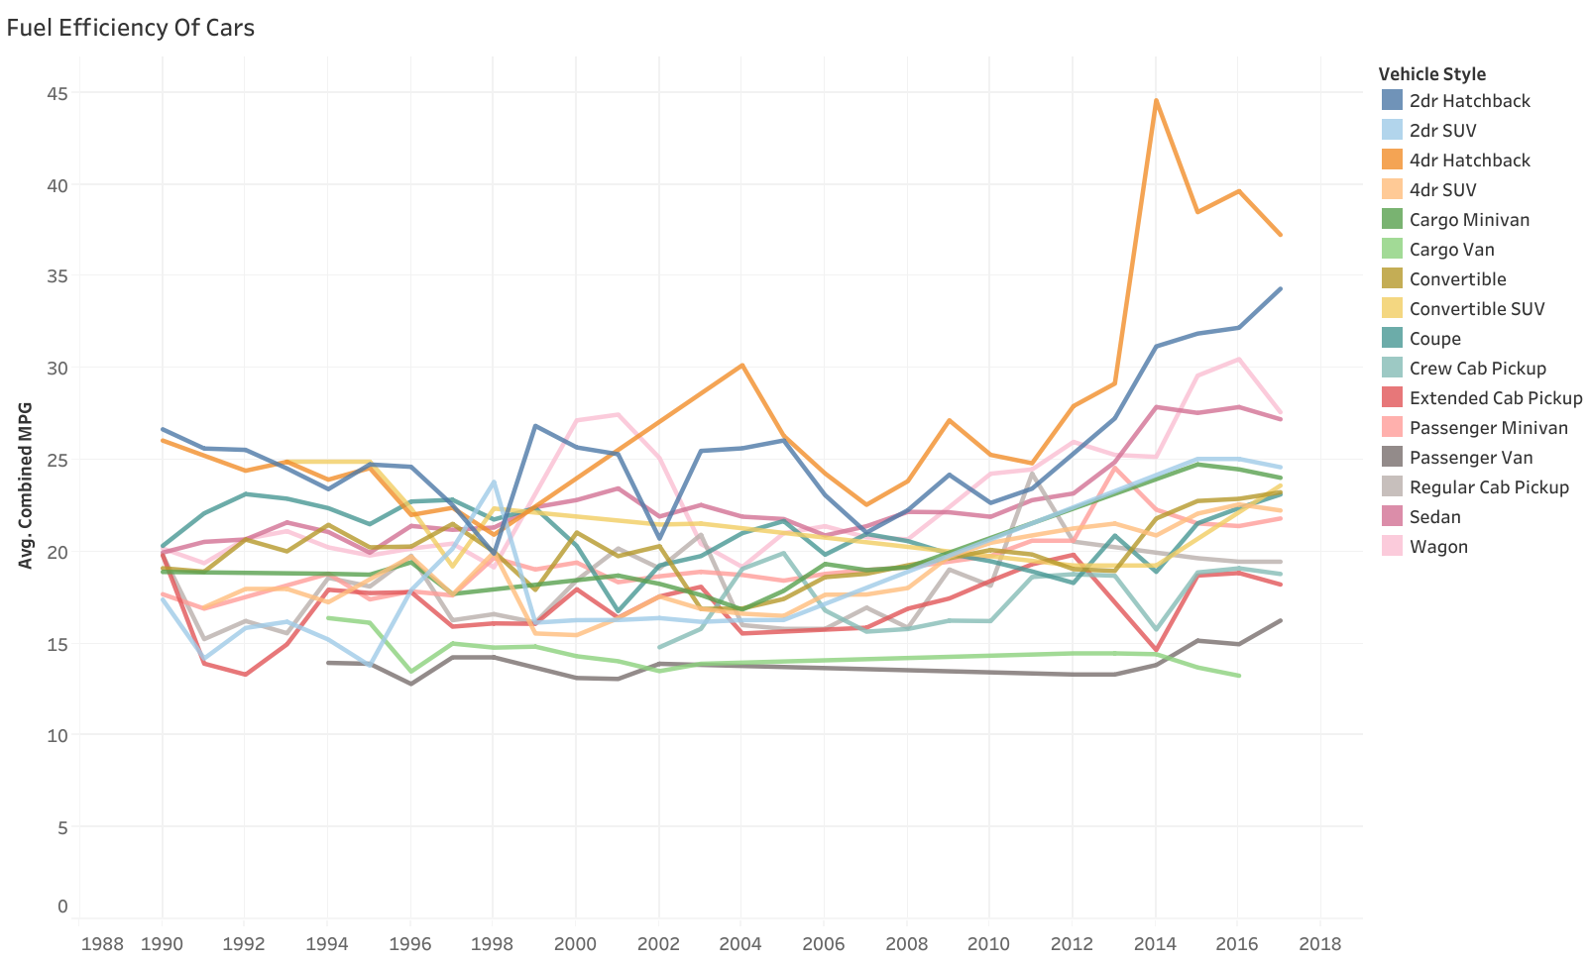
4. How does the fuel efficiency of cars vary across different body styles and model years?
Here I have used Line Chart to visualize the MPG over years. As the data is collected in US, I have used the US EPA measure to calculate the Combined MPG. i.e., 55% of city MPG and 45% of Highway MPG.
Each colour represents Vehicle style and can filter the chart by Make and Vehicle Style.

Slide 27
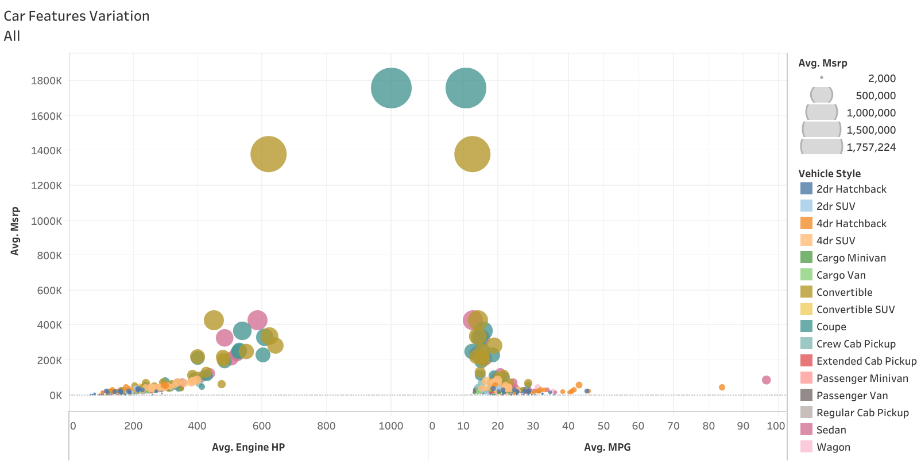
5. How does the car's horsepower, MPG, and price vary across different Brands?
The size of the buddle is represented by Average MSRP and each Colour represents the vehicle style. This chart shows how Average horsepower and Average MPG will affect the Price of the car and their variation by make and Vehicle type.

Slide 28
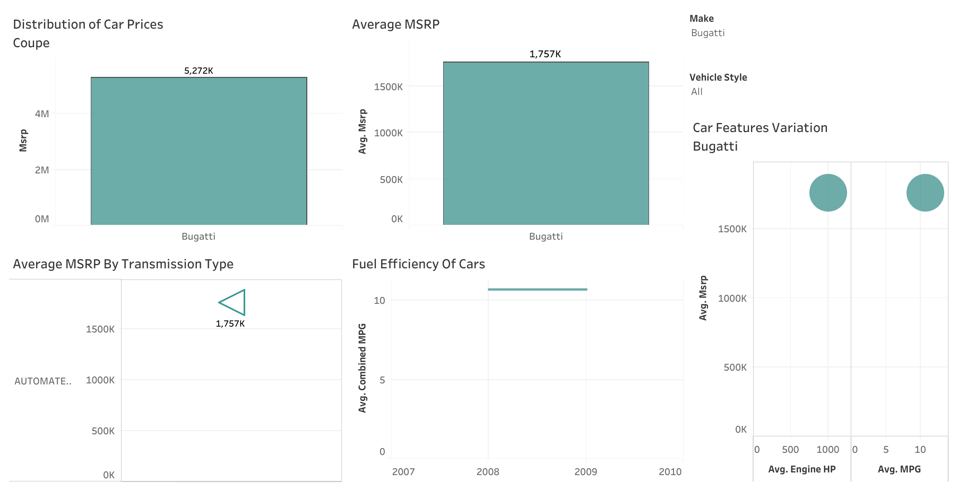

Slide 29
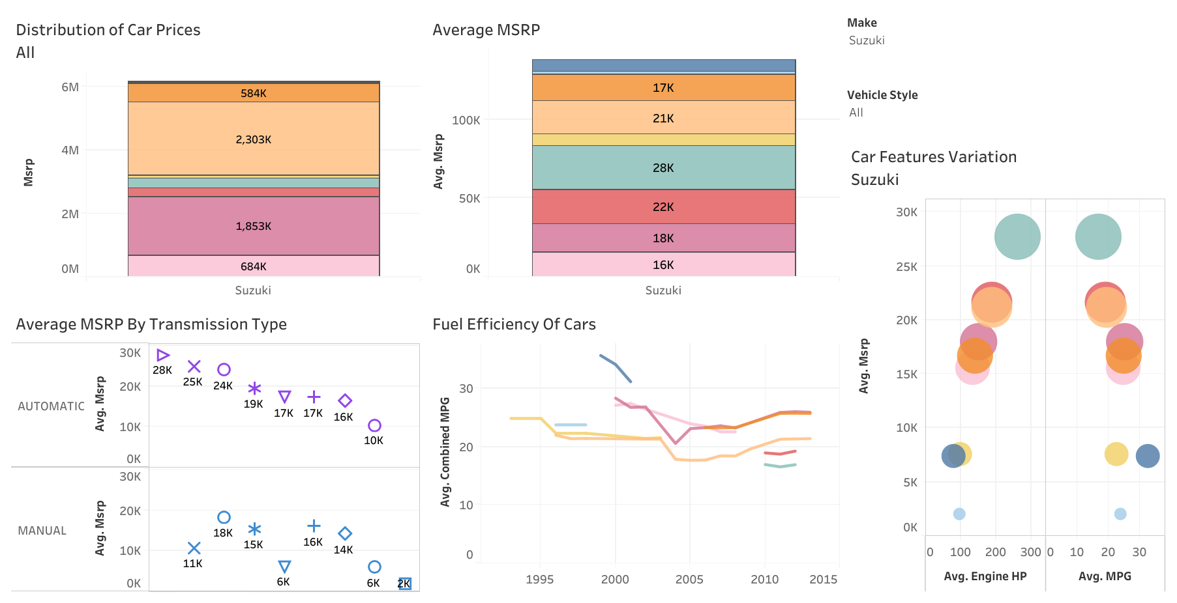

Slide 30
Insights About Suzuki:
In 2nd Dashboard, we have car features plotted against Price of the Suzuki model car. They have 8 Vehicle styles and these are represented by various colours.
This model also 3rd lowest average price car model.
These cars are made in automatic and manual transmission Types.
Some of the vehicle styles have continued for only 2-3 years. 4dr SUV have continued for all the years.
This 4d SUV have high fuel Efficiency in 1995 but it continuously decreases in the following years.
Horsepower and fuel efficiency are negatively correlated. It is plotted with MSRP.
If Horsepower increases, the price of the car increases.
If fuel efficiency increases, the price of the car will be low.
Insights About Bugatti:
Bugatti have the highest average price in all the models, it have only one vehicle style “coupe”.
Transmission type of this car is Automated_Manual.
Fuel Efficiency of this car is 10.70 MPG, while it has 1001 hp.
It comes under Exotic, High-Performance market Category.

Slide 31
Results:
In this project, we learnt that in order to optimize the price of the car, it is important for have less number of engine cylinders, low engine Horsepower and high fuel efficiency.
For Affordable car Less engine cylinders, less horsepower and more fuel efficiency.
So the factors which affects the pricing are:
Car Make and its Model.
More engine cylinders, high Price for the car
High Engine Horsepower leads to high price in the car.
High Fuel Efficiency, low price.
Higher the popularity score lower the price.
Most cars belongs to Crossover, Flex fuel, Performance and Diesel.
Automatic and Manual transmission type cars are more with a different range of prices.
Price also changes according to vehicle style too.

