Slide 1
How the Project Works
Purpose of the Project
This project is a web-based encryption and decryption tool called CryptX.
It allows users to encrypt plaintext into ciphertext and decrypt ciphertext back into plaintext using cryptographic algorithms.
CryptX
Encryption Process
The user enters plaintext in the input field.
For Encrypting/Decrypting Texts
They select a key generation method: LCG (Linear Congruential Generator), RSA, or a Custom Key.
The backend generates a key (if necessary) and encrypts the plaintext using the CTR Mode (Counter Mode) algorithm.
The encrypted text (ciphertext) and the encryption key are displayed to the user.

Slide 2
How the Project Works
Decryption Process
Purpose of the Project
This project is a web-based encryption and decryption tool called CryptX.
The user enters the ciphertext and the decryption key.
The backend decrypts the ciphertext using the provided key.
It allows users to encrypt plaintext into ciphertext and decrypt ciphertext back into plaintext using cryptographic algorithms.
The original plaintext is displayed to the user.
CryptX
Encryption Process
Key Generation Methods
The user enters plaintext in the input field.
For Encrypting/Decrypting Texts
They select a key generation method: LCG (Linear Congruential Generator), RSA, or a Custom Key.
LCG: Generates pseudo-random keys using a mathematical formula.
RSA: Uses the RSA algorithm to generate secure encryption keys.
The backend generates a key (if necessary) and encrypts the plaintext using the CTR Mode (Counter Mode) algorithm.
Custom Key: Allows users to input their own encryption key.
Language Support
The encrypted text (ciphertext) and the encryption key are displayed to the user.
The tool supports multiple languages, including Arabic, using UTF-8 encoding.

Slide 3
Tools and Technologies Used
How the Project Works
Decryption Process
Purpose of the Project
This project is a web-based encryption and decryption tool called CryptX.
Backend Development
The user enters the ciphertext and the decryption key.
The backend decrypts the ciphertext using the provided key.
Python: The main programming language used for backend logic
It allows users to encrypt plaintext into ciphertext and decrypt ciphertext back into plaintext using cryptographic algorithms.
The original plaintext is displayed to the user.
Flask: A lightweight web framework to handle HTTP requests and serve the application.
Encryption Process
Key Generation Methods
The user enters plaintext in the input field.
They select a key generation method: LCG (Linear Congruential Generator), RSA, or a Custom Key.
LCG: Generates pseudo-random keys using a mathematical formula.
RSA: Uses the RSA algorithm to generate secure encryption keys.
Frontend Development
Custom Key: Allows users to input their own encryption key.
The backend generates a key (if necessary) and encrypts the plaintext using the CTR Mode (Counter Mode) algorithm.
HTML: For structuring the web pages.
Language Support
CSS: For styling the user interface.
The encrypted text (ciphertext) and the encryption key are displayed to the user.
JavaScript: For adding interactivity to the frontend.
The tool supports multiple languages, including Arabic, using UTF-8 encoding.

Slide 4
How the Project Works
Tools and Technologies Used
Decryption Process
Backend Development
The user enters the ciphertext and the decryption key.
The backend decrypts the ciphertext using the provided key.
Python: The main programming language used for backend logic
The original plaintext is displayed to the user.
Flask: A lightweight web framework to handle HTTP requests and serve the application.
Key Generation Methods
LCG: Generates pseudo-random keys using a mathematical formula.
RSA: Uses the RSA algorithm to generate secure encryption keys.
Frontend Development
Custom Key: Allows users to input their own encryption key.
HTML: For structuring the web pages.
Language Support
CSS: For styling the user interface.
JavaScript: For adding interactivity to the frontend.
The tool supports multiple languages, including Arabic, using UTF-8 encoding.

Slide 5
How to Run the Project
Tools and Technologies Used
Decryption Process
Install Python
Encryption Algorithms
The user enters the ciphertext and the decryption key.
Download and install Python from the official website: Python Download.
The backend decrypts the ciphertext using the provided key.
CTR Mode: A block cipher mode of operation used for encryption and decryption
Ensure you have Python 3.10 or higher installed.
The original plaintext is displayed to the user.
LCG: A simple random number generator for key generation.
Set Up the Project
Key Generation Methods
RSA: A widely used public-key cryptosystem for secure key generation.
Clone or download the project files to your computer.
LCG: Generates pseudo-random keys using a mathematical formula.
RSA: Uses the RSA algorithm to generate secure encryption keys.
Other Tools
Install Dependencies
Custom Key: Allows users to input their own encryption key.
Open a terminal and navigate to the project folder.
UTF-8 Encoding: Ensures compatibility with multilingual text, including Arabic.
Language Support
PyInstaller: Used to convert the Python project into a standalone executable file.
Install the required libraries using:
The tool supports multiple languages, including Arabic, using UTF-8 encoding.
pip install flask

Slide 6
Tools and Technologies Used
How to Run the Project
Run the Application:
Install Python
Encryption Algorithms
Download and install Python from the official website: Python Download.
Start the Flask server by running:
python app.py
Ensure you have Python 3.10 or higher installed.
CTR Mode: A block cipher mode of operation used for encryption and decryption
LCG: A simple random number generator for key generation.
Set Up the Project
Open a web browser and go to http://127.0.0.1:5000 to access the application.
RSA: A widely used public-key cryptosystem for secure key generation.
Clone or download the project files to your computer.
Use the Application
Other Tools
Install Dependencies
Use the encryption panel to encrypt text.
Open a terminal and navigate to the project folder.
UTF-8 Encoding: Ensures compatibility with multilingual text, including Arabic.
PyInstaller: Used to convert the Python project into a standalone executable file.
Use the decryption panel to decrypt text.
Install the required libraries using:
pip install flask

Slide 7
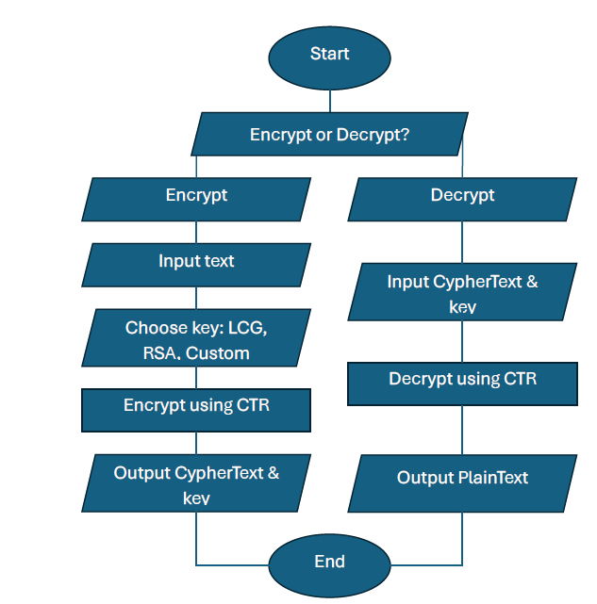
Tools and Technologies Used
How to Run the Project
Install Python
Run the Application:
Start the Flask server by running:
Download and install Python from the official website: Python Download.
Ensure you have Python 3.10 or higher installed.
python app.py
Open a web browser and go to http://127.0.0.1:5000 to access the application.
Set Up the Project
Clone or download the project files to your computer.
Use the Application
Install Dependencies
Use the encryption panel to encrypt text.
Open a terminal and navigate to the project folder.
Use the decryption panel to decrypt text.
Install the required libraries using:
pip install flask

Slide 8
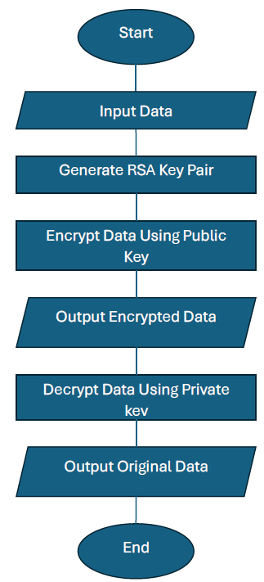
How to Run the Project
Flowcharts
Encryption Algorithm in code
Run the Application:
Start the Flask server by running:
python app.py
Open a web browser and go to http://127.0.0.1:5000 to access the application.
Use the Application
Use the encryption panel to encrypt text.
Use the decryption panel to decrypt text.

Slide 9
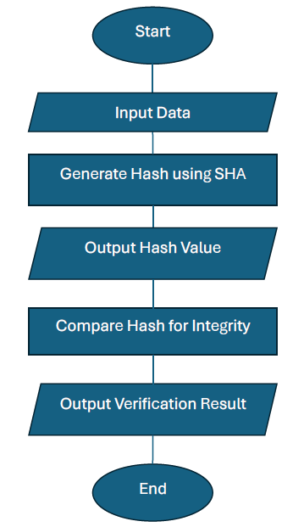
How to Run the Project
Flowcharts
RSA Encryption Algorithm
Run the Application:
Start the Flask server by running:
python app.py
Open a web browser and go to http://127.0.0.1:5000 to access the application.
Use the Application
Use the encryption panel to encrypt text.
Use the decryption panel to decrypt text.

Slide 10
How to Run the Project
Flowcharts
SHA Encryption Algorithm
Run the Application:
Start the Flask server by running:
python app.py
Open a web browser and go to http://127.0.0.1:5000 to access the application.
Use the Application
Use the encryption panel to encrypt text.
Use the decryption panel to decrypt text.

Slide 11

Algorithm
LCG Encryption Algorithm

Slide 12
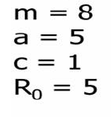
Algorithm
LCG Encryption Algorithm

Slide 13
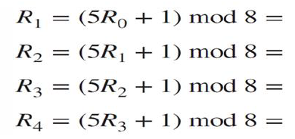
Algorithm
LCG Encryption Algorithm

Slide 14
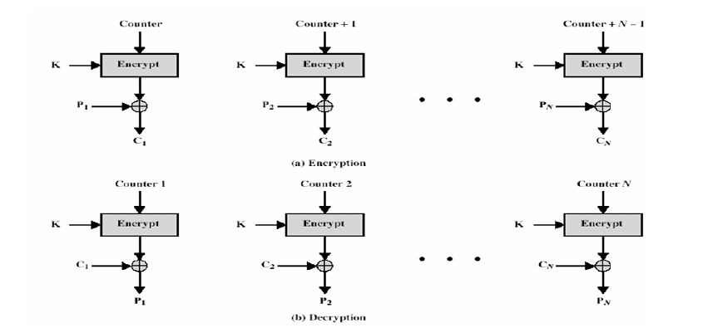
Algorithm
Counter Encryption Algorithm

Slide 15
Algorithm
Counter Encryption Algorithm

Slide 16
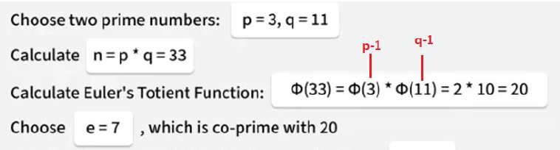
Algorithm
RSA Encryption Algorithm

Slide 17
Algorithm
RSA Encryption Algorithm

Slide 18
Algorithm
RSA Encryption Algorithm

Slide 19
Algorithm
RSA Encryption Algorithm

Slide 20
Algorithm
SHA-1
Converting text into ASCII code
Convert ASCII code into binary
Add all binary bits with each other
Add “1” then zeros until it matches 448 Bit
Add the main message length which is 64 Bit
To form 512 Bit divided into 16 words for each one is 32 Bit
Make the basic Logical 4 operators onto the words (20 Words each)
The final Hash result it will be 160 Bit length

