Slide 1



DATA
FileGdb-API
Shape
Geopackage
File-GDB
DataAccessor
SQL, Metadata
Logging
DataSource
DataSource & Info
LayerAccessor
Layer (Vector)
Layer
LayerProcessor
One Layer: Filter, GeoValidation, Dissolve, CRUD - Attributes
GeoProcessor
( > 1 Layer)
Feature
FeatureProcessor
CRUD – Attribute Content
Field
Geometry
GeometryProcessor

Slide 2
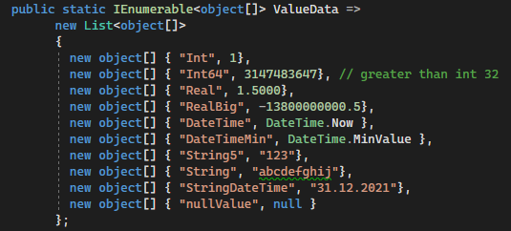
Target - Datasource
 | SHP | GPKG | FGDB
SHP | CreateDatasource CopyLayer | CreateDatasource CopyLayer | CreateDatasource CopyLayer
GPKG | CreateDatasource CopyLayer | Internal / External CopyLayer | CreateDatasource CopyLayer
FGDB | CreateDatasource CopyLayer | CopyLayer | Internal / External CopyLayer
Source –
Datasource

Slide 3
Values to store
Feldname |  | Typ | W | N | Int 1 | Int64 3’147’483’647 | Real 1.5 | RealBig -13’800’000’000.5 | DateTime DateTime.Now |  | String5 «123» | String «abcdefghij» | StringDateTime «31.12.2021» | nullValue null
Id |  | ObjID | - | N | r | r | r | r | r |  | r | r | r | r
Geom |  | Geometry | - | N | r | r | r | r | r |  | r | r | r | r
ObjktId |  | Long |  |  |  | c | c | c | c |  |  | c | c | n
TextFeld3 |  | Text |  |  |  | l |  | l | l |  |  | l | l
Textfeld60 |  | Text
IntFeld |  | Long |  | N |  | (c) c | c | c | c |  |  | c | c | n
Int64Feld |  | Long |  | N |  | c | c | c | c |  |  | c | c | n
RealFeld |  | Double |  | N |  |  |  |  | c |  |  | c | c | n
DateFeld |  | Date |  |  | c | c | c | c |  |  | c | c |  | n
DateTimeFeld |  | Date |  |  | c | c | c | c |  |  | c | c |  | n
BoolFeld |  | Short |  | N |  | c | c | c | c |  |  | c | c | n
BlobFeld |  | Blob |  |  | (c) | (c) | (c) | (c) | (c) |  | (c) | (c) | (c)
Shape_Length |  | Double | - |  | (r) | (r) | (r) | (r) | c |  | (r) | (r) | c | c
Shape_Area |  | Double | - |  | (r) | (r) | (r) | (r) | c |  | (r) | (r) | c | c
Text300NotNullFeld |  | Text |  | N |  |  |  |  |  |  |  |  |  | (n)
DateNotNullFeld |  | Date |  | N | c | c | c | c |  |  | c | c |  | N
Errors expected |  |  |  |  | 7, 3, 4 | 10, 5, 9 | 11, 6, 8 | 12, 7, 9 | 11, 7, 9 |  | 7, 3, 4 | 13, 10, 12 | 10, 7, 9 | 11, 12, 14
Valids expected |  |  |  |  | 8, 9, 10 | 5, 7, 5 | 4, 6, 6 | 3, 5, 5 | 4, 5, 5 |  | 8, 9, 10 | 2, 2, 2 | 5, 5, 5 | 4, 0, 0
15 Fields in Datasource
SHP: 12 fields
Not available
r = read-only
c = cast-error
l = length-limit
n = not nullable
GPKG: 14 fields
Not available
FGDB: 13 fields
Not available

Slide 4
