Slide 1
Analysis of Job Postings and Employment Levels in Swing States of the 2020 Election
Barrett Nibling
October 2, 2020

Slide 2
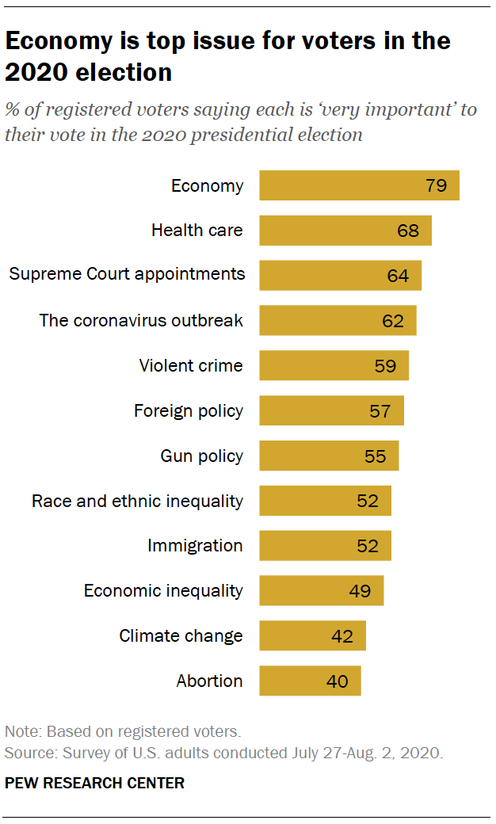
OVerview
2020 has been a tumultuous election year
The country in the midst of a recession
Eight-in-ten voters say economy is the top issue
A big factor of the economy is job strength
Courtesy of Pew Research Center: https://www.pewresearch.org/politics/2020/08/13/important-issues-in-the-2020-election/

Slide 3
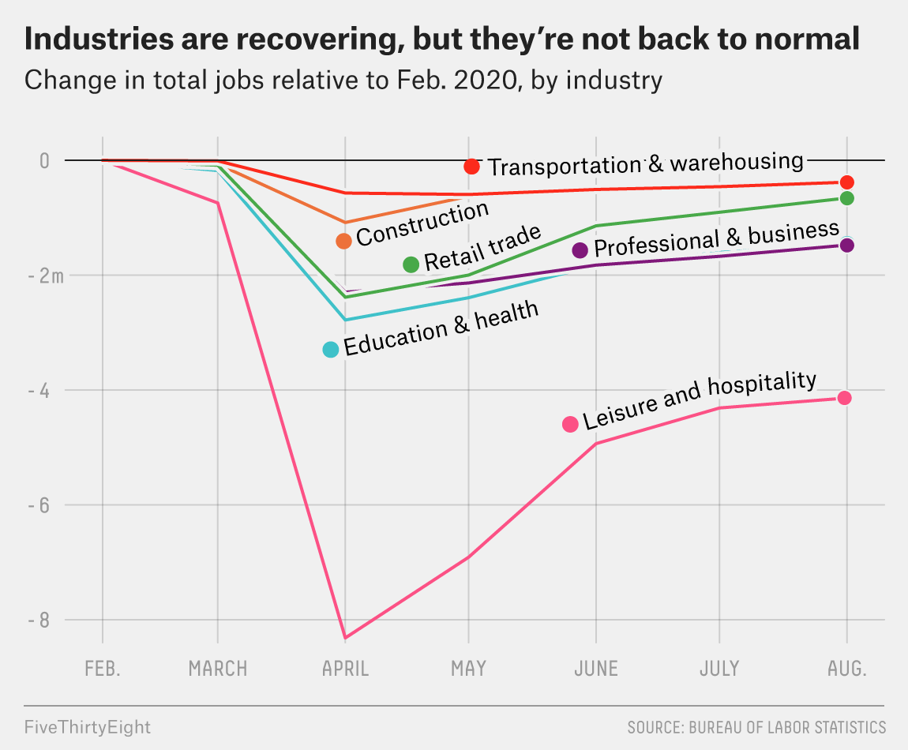
OVerview
Millions of Americans were laid off and forced into unemployment due to COVID
The national unemployment rate reached 14.7% in April*
Numbers are slowly trending back
But it is enough to convince voters?
Courtesy of FiveThirtyFive.com
*Source: U.S. Bureau of Labor Statistics

Slide 4
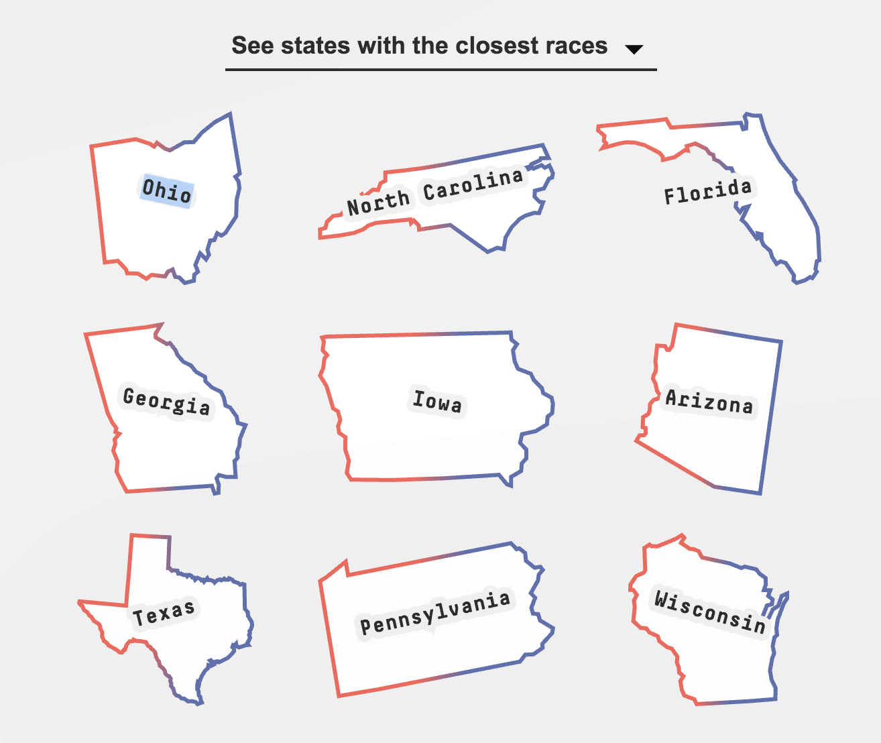
Overview
Nine swing states:
Arizona, Florida, Georgia, Iowa, North Carolina, Ohio, Pennsylvania, Texas, and Wisconsin.
Insight is vital to get an edge
Two key indicators of job strength:
Job Postings
Employment Levels
Courtesy of FiveThirtyFive.com

Slide 5



data
Opportunity Insights Economic Tracker:
State-level Job Postings Data:
Weekly count of new job postings provided by Burning Glass Technologies
Relative to the January 2020 index period (i.e. percentage values)
Breakdown- Industry, Educational requirement, and Combined
State-level Employment Levels Data:
Daily number of active employees provided by Paychex, Earnin, and Intuit
Relative to the January 2020 index period (i.e. percentage values)
Breakdown- Wage, Industry, and Combined

Slide 6
Questions
When compared to non-swing states, do swing states show a significant difference in job postings and employment levels?
(i.e. Is there a correlation between being a swing state and these variables?)
When compared to each other, do these swings states differ from each other in job postings and employment levels?
(i.e. Which swing states are most affected by these variables?)

Slide 7
Method
Check normality to determine testing method
Question 1- Swing vs Non-Swing (A/B test)
If normal, Standard t-test and Welch’s t-test
If not, non-parametric tests such as Kruskal-Wallis or Mann-Whitney U
Question 2- Swing vs Swing (A/B/C/… test)
If normal, One-way ANOVA and Tukey's Honest Significant Differences (HSD) tests
If not, Kruskal-Wallis test

Slide 8
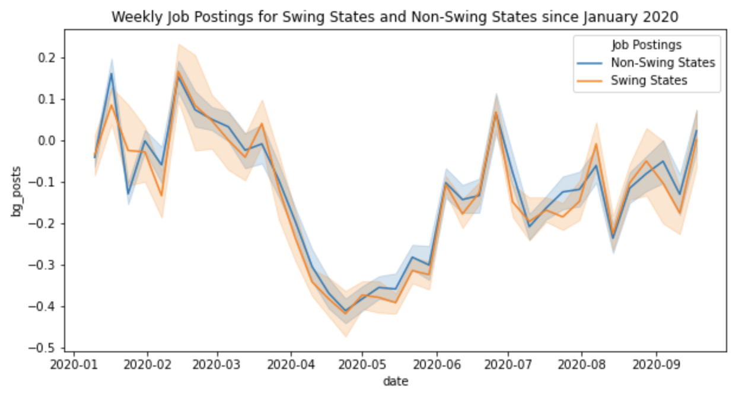
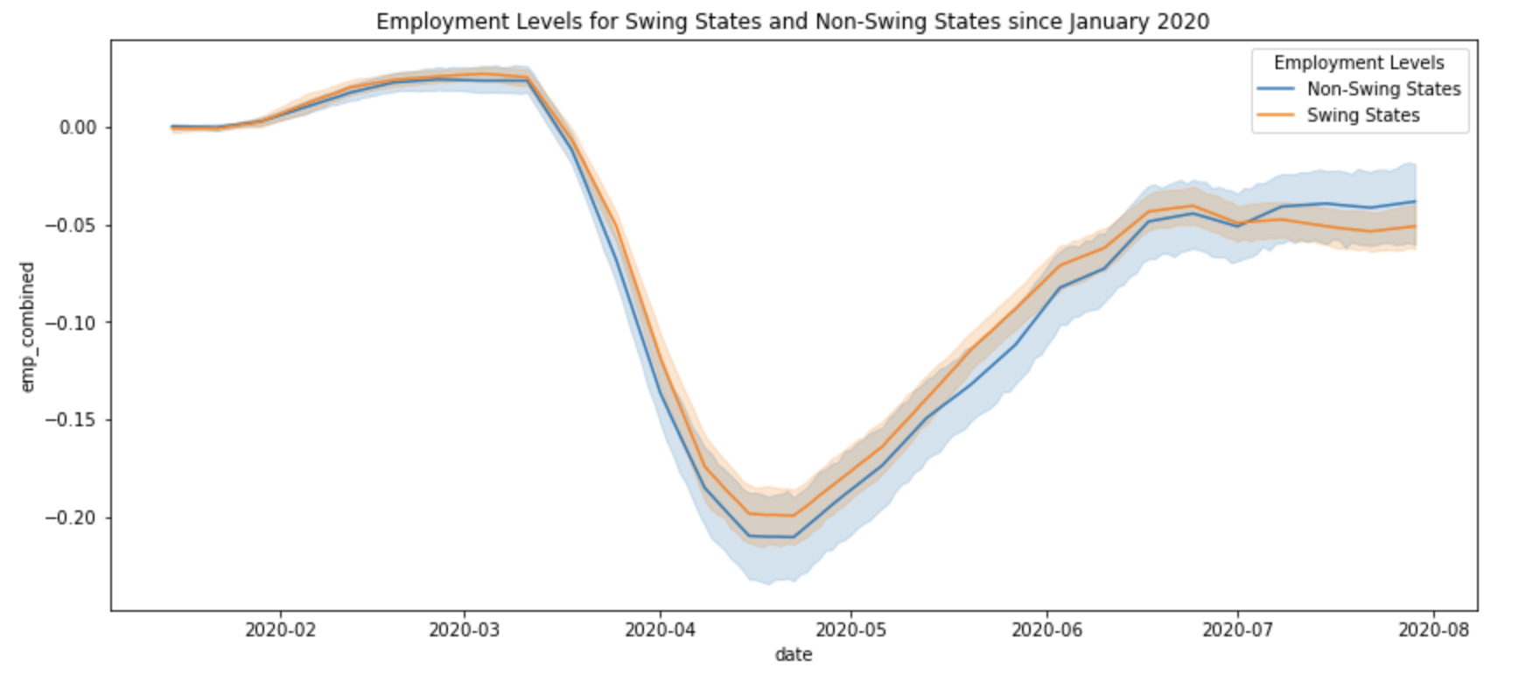
Swing vs non-swing
Job Postings Data:
Normally distributed (parametric testing)
P-values: 0.277 with Standard t-test, 0.249 with Welch's t-test
No significant difference
Employment Levels Data:
Not normally distributed (non-parametric testing)
P-values: 0.367 with Mann-Whitney U test, 0.734 with Kruskal test
No significant difference

Slide 9
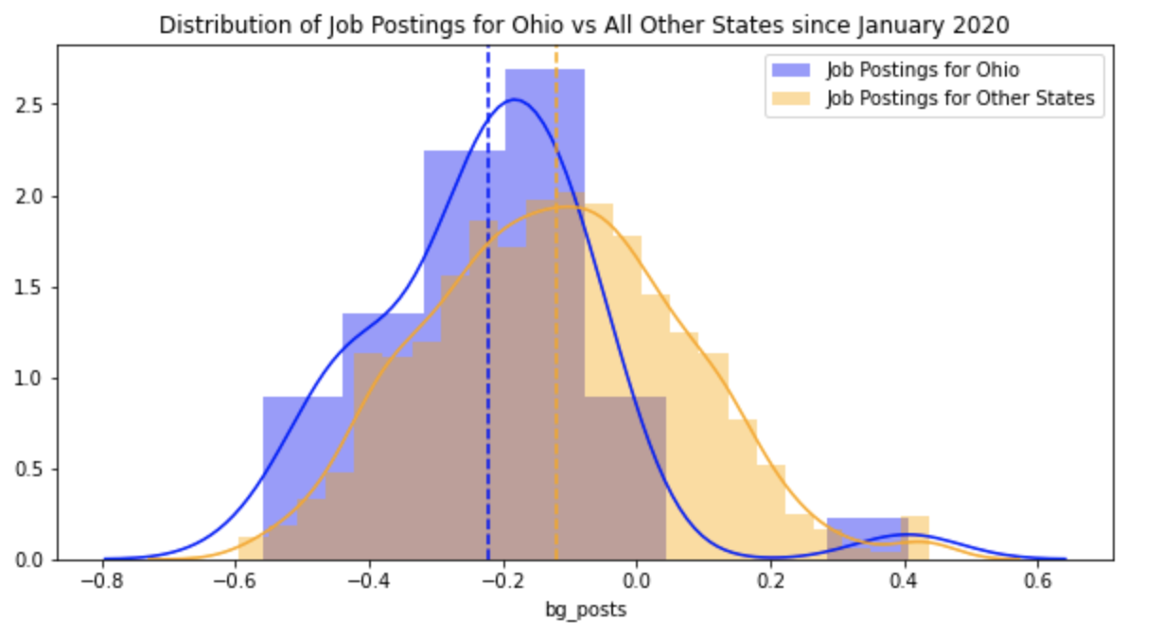
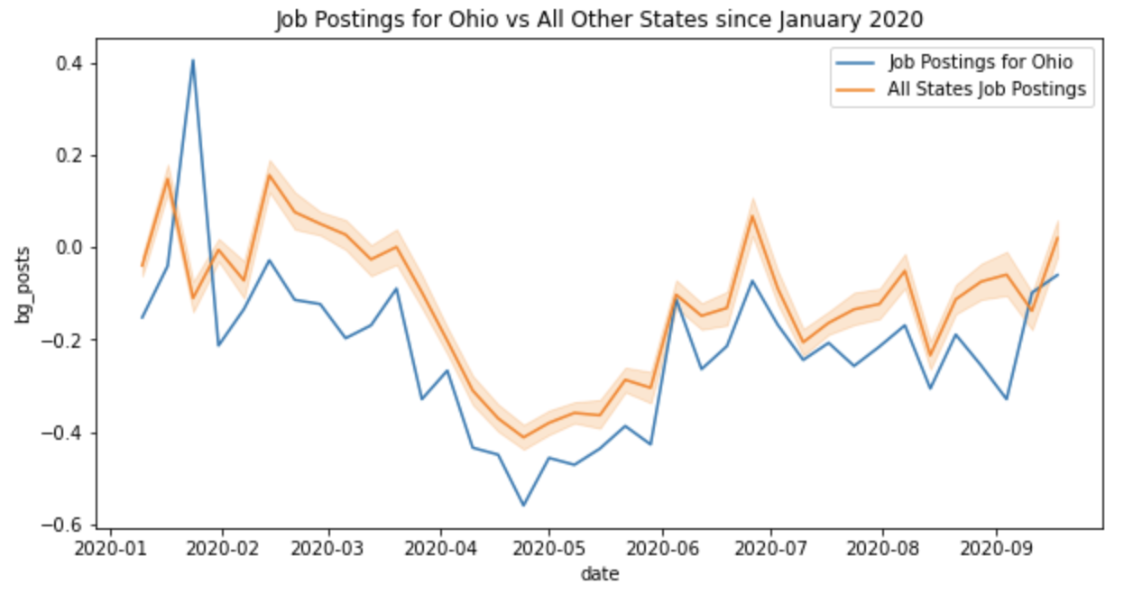
Swing vs swing: Job Postings Data
Normally distributed (parametric testing)
P-value with One-way ANOVA = 0.0166
At least one significant difference
P-values with Tukey’s HSD
Most values greater than 0.05
Ohio-Georgia = 0.0091
Ohio-Iowa = 0.0145
Only Ohio showed significant difference with two other swing states
Ohio is 4th worst in terms of job postings in the entire US

Slide 10
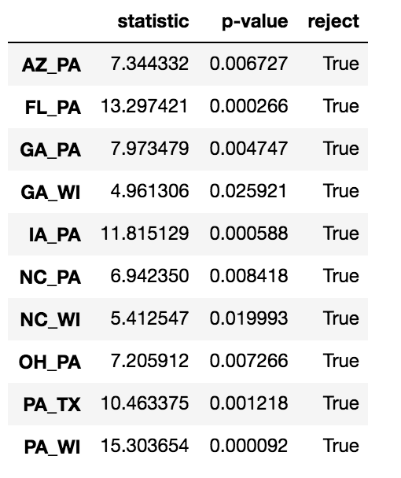
Swing vs swing: Employment Levels Data
Not normally distributed (non-parametric testing)
P-values with Kruskal test (see chart)
Most values greater than 0.05
Wisconsin-Georgia & Wisconsin-N. Carolina ≈ 0.02
Pennsylvania-All other swing states < 0.01
Pennsylvania is a clear outlier among swing states
Suffered a more severe drop in employment levels than other swing states

Slide 11
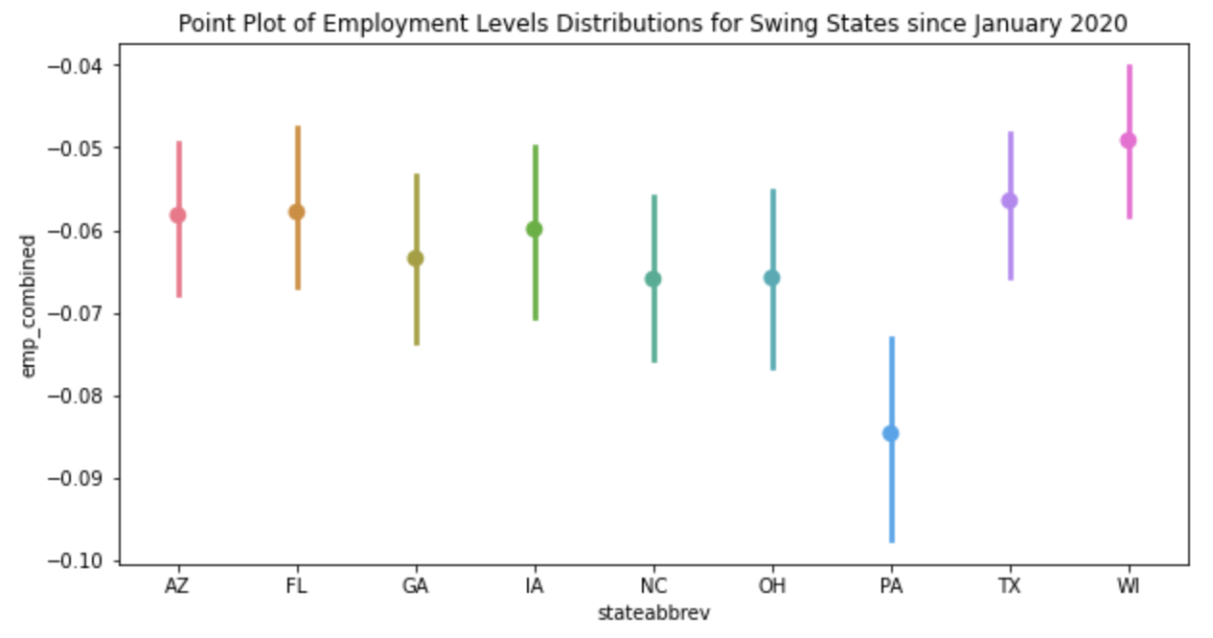
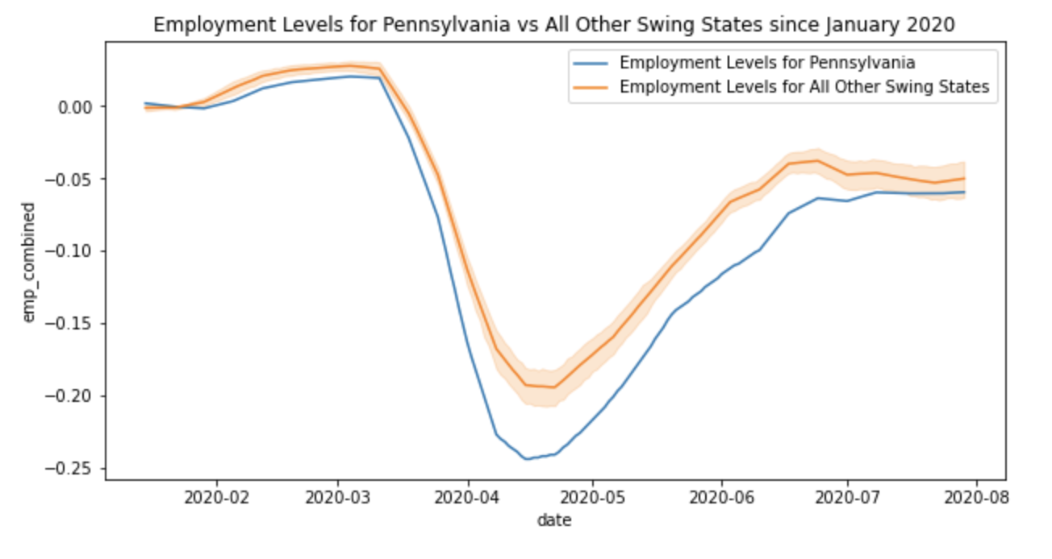
Swing vs swing: Employment Levels Data
Employment Levels in Pennsylvania are on average lower than the other swing states in terms of overall distribution and in terms of yearly trends.

Slide 12
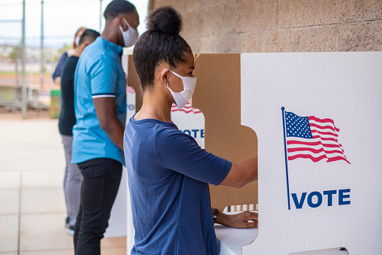
Conclusion
As Political Party Operative, inference is necessary to target potential voters
Resources are thin, so concise and tactful campaigning is critical to win swing states
Knowing the concerns of voters and how the data matches those concerns is key

Slide 13

Conclusion
Ohio low job postings:
Advertisements displaying promises to increase the number jobs
Pennsylvania low employment levels:
Campaign strategies that illustrate clear plans to retain jobs in industries most affected by COVID

Slide 14

Future Considerations
Explore different aspects of both job postings and employment levels
Demographics, Industries, Wages, etc.
Explore the relationship between job postings and employment levels
Both followed similar trends
Look outside of 2020 for perspective

