Slide 1
IA316 Project
OuiCar Bike
Benoît Durand - Coralie Betbeder-Déchelette

Slide 2
Introduction
Git repository : https://github.com/Bnoyt/ia316-renting
Python classes
Environnement
Person
Bike
Policies
Tester

Slide 3
I - Environnement
Person
price_appetence
day_appetence
user_embedding
Bike
renting_planning
bike_embedding

Slide 4
I - Environnement
Price
User
Bike
Price appetence of the user
|nb days wanted - nb days proposed|

Slide 5
I - Environnement
History build with the following components :
user_id
days_wanted
bike_proposed
price_proposed
days_proposed
answer
reward
best_reward
probas

Slide 6
II- Implementation and agent performance
Random policy
Select a bike randomly among the available ones
Smarter Random policy
Select the bike with the longest availability among the available ones
Thompson Sampling
We use an a priori beta distribution to start bike attribution
Each time a bike is chosen, we update the distribution given the reward previously obtained

Slide 7
II- Implementation and agent performance
ε-greedy
ε is given a priori
with probability ε : we apply the Smarter Random policy
with probability 1-ε : we choose the the bike with highest average reward
UCB
We build confidence intervals of the expectation of the reward of each couple (bike,person)
We propose a bike based on the highest lower confidence bound

Slide 8
II- Implementation and agent performance
Deep learning policy
user embedding
bike embedding
Final layer = scalar product
1 epoch at each update
Deep learning with memory
concept of memory (size m)
At each update, random sample of m balanced samples
2 epochs

Slide 9
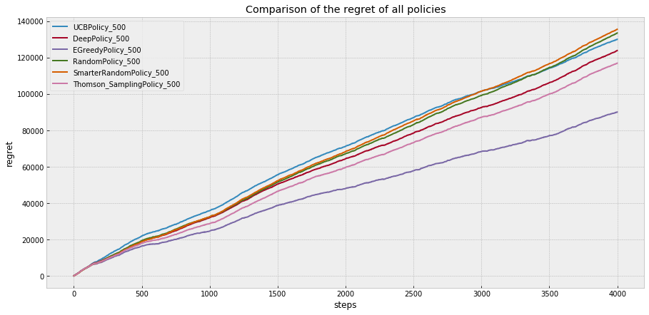
II- Implementation and agent performance

Slide 10
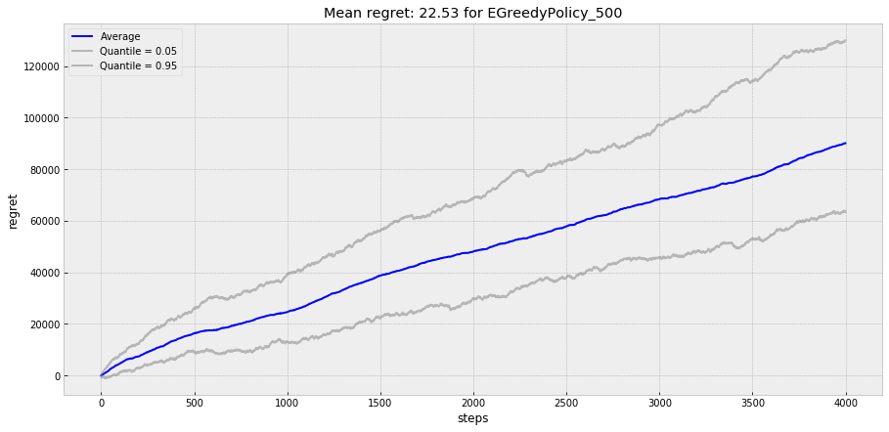
II- Implementation and agent performance

